Slide 1

Status of In-Kind Contributions to Accelerator
Lund, 5 March 2015
Håkan Danared
Mats Lindroos

Slide 2

In-Kind to Accelerator
Since the launch of Expressions of Interest in spring 2013, discussions on in-kind are going on with 26 organizations.
Possible partners to Accelerator have been identified in Denmark, Estonia, France, Germany, Hungary, Italy, Norway, Poland, Spain, Sweden, Switzerland, UK.
Value of items discussed with these partners represents 50.3% of the accelerator budget, excluding cash contributions and paid contracts.
Next step with many partners is to agree on technical details and write specifications.
At the same time, issues need to be solved concerning cash flow, VAT, etc.
The ESS aim is to have In-Kind Agreements signed after the ERIC transition, i.e. Technical Appendices should be ready in June.
Not IKC, 22%
Potential IKC, 25%
Planned IKC, 50%
Cash, 3%

Slide 3
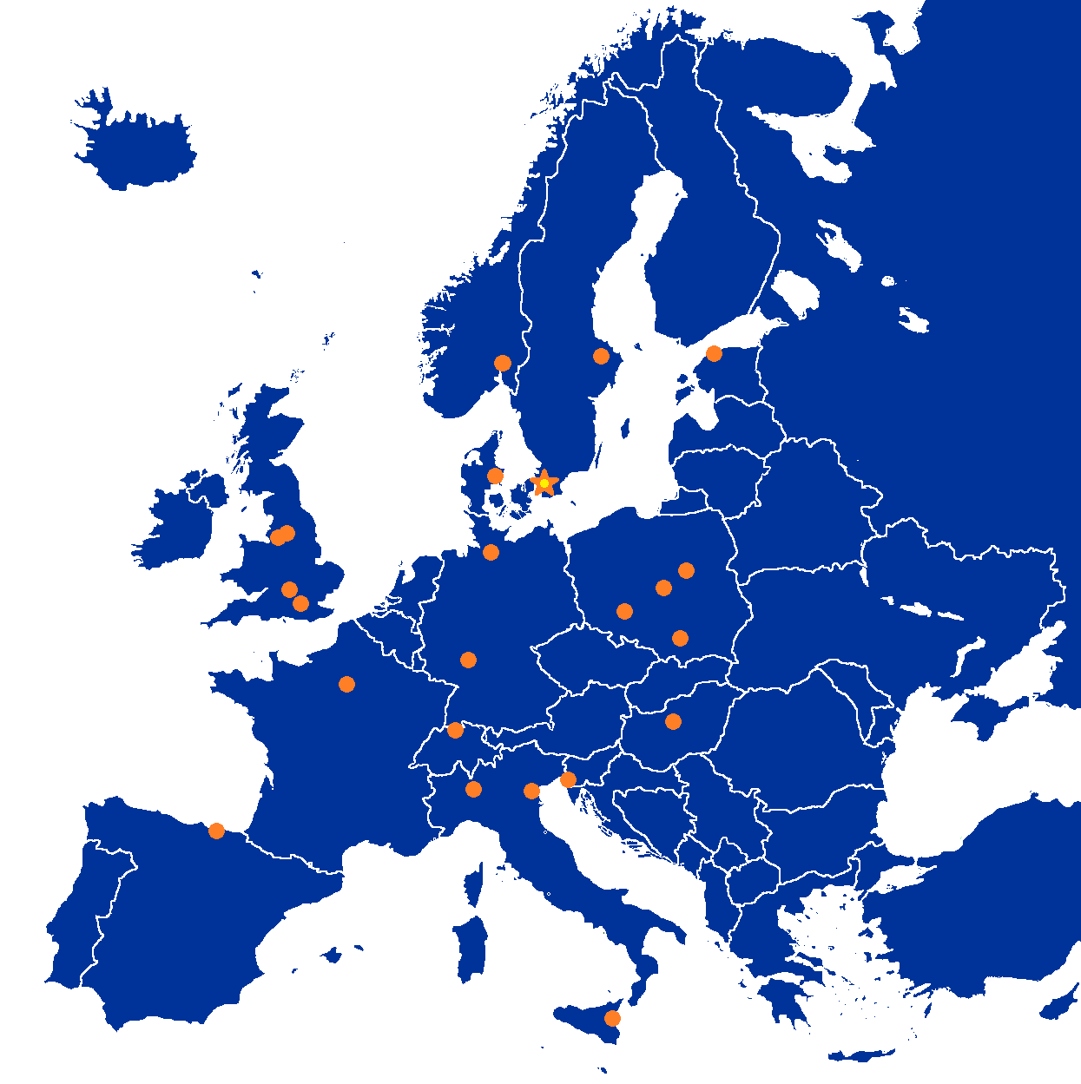
Partner Institutions
In-kind
CEA
CNRS
Cockcroft Inst
Daresbury Lab
Elettra
ESS-Bilbao
GSI
Huddersfield Univ
IFJ PAN
INFN Catania
INFN Legnaro
INFN Milan
NCBJ
RAL
RHUL
Tallinn UT
TU Lodz
Univ Oslo
Warsaw UT
Wigner Inst
Wroclaw UT
Paid contracts
Aarhus Univ
DESY
Lund Univ
PSI
Uppsala Univ

Slide 4
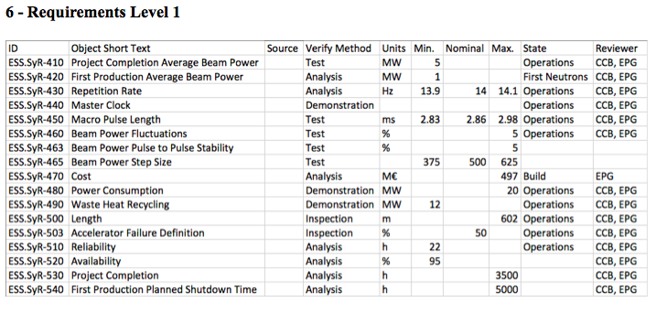
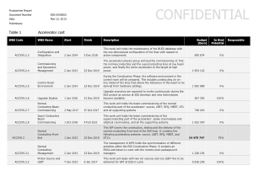
Cost, Scope, Schedule
ACCSYS Requirements Level 1
Deliverables within a technical appendix are defined, as usual, by cost, scope and schedule.
ESS Cost Book
ACCSYS High Level Master Schedule

Slide 5
Cost, Cost Book, Packages, Risk
Total budget for the accelerator fixed at 510 M€.
Cost book defined at WP/WU level or sometimes at one level below WUs, rarely two levels below WUs.
Packages with responsibility for complete systems preferred. Can span several WPs/WUs or parts of these.
But also small IK contributions welcome, interesting for small partners, often for items below the resolution of the cost book.
Cost of IK contributions are functions of scope (e.g. requirements). IK agreements with costs are negotiated for fixed scope and schedule, with risk delegated to partners.
But risk is with ESS if scope needs to change. Can lead to revised cost and schedule. Changes approved by CCB (Control Change Board).

Slide 6
HoA: ESS-Bilbao, RF
The "RF systems for warm linac" work package will consist of the design, prototyping, procurement, assembly/integration, factory acceptance testing, transportation at the ESS site of the RF equipment for the RFQ, 3 MEBT bunchers and 5 DTL tanks. The components delivered by ESS Bilbao shall comply with the requirements from ESS Lund.
In addition, LLRF systems for the superconducting spoke linac (26 cavities) are included in the contribution. This is because the RF frequency is the same as for the normal conducting linac.
Each RF system of the contribution basically includes:
LLRF controls
Controls and interlocks
High power amplifiers (i.e. klystron based)
High power voltage converters (modulators)
RF distribution

Slide 7
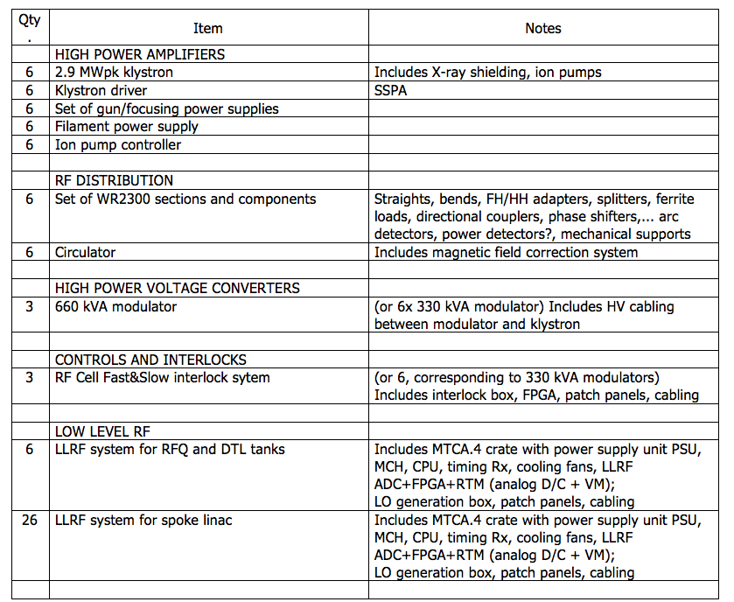
Scope

Slide 8
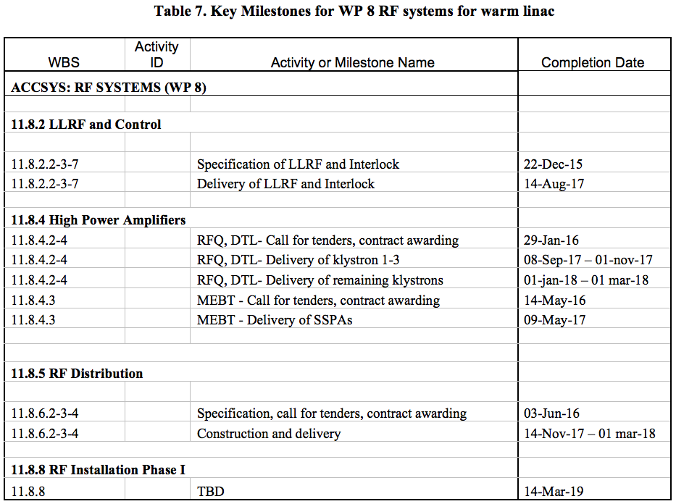
Schedule, WP8

Slide 9
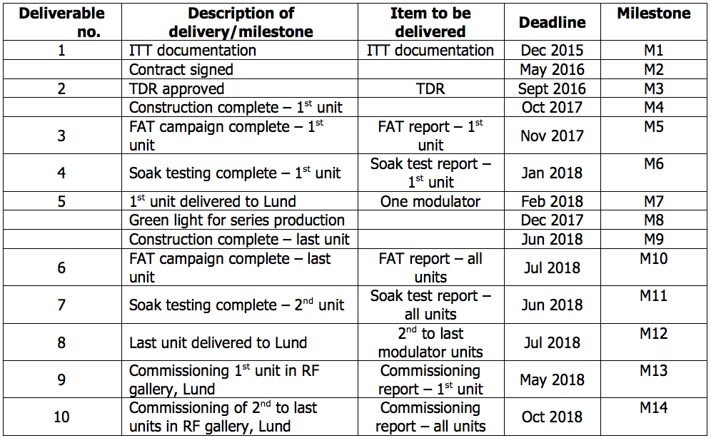
Schedule, WP17
Deliverables/milestones, WBS 11.17.3.1-2

Slide 10
Cost

Slide 11
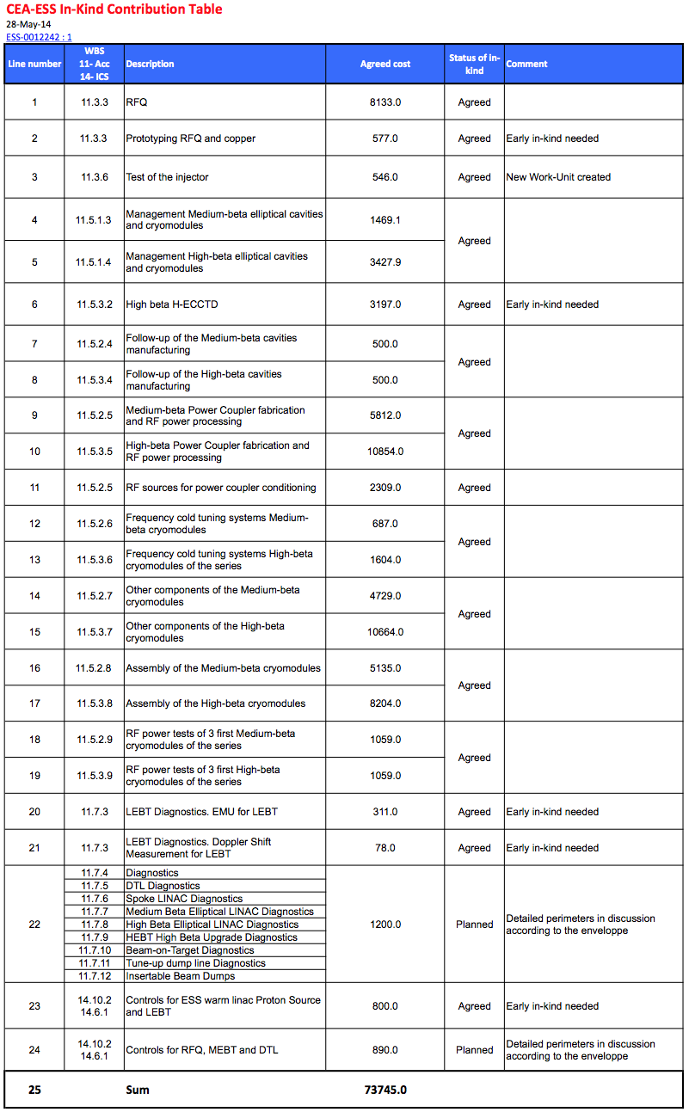
CEA Agreement (1)

Slide 12
CEA Agreement (2)

Slide 13
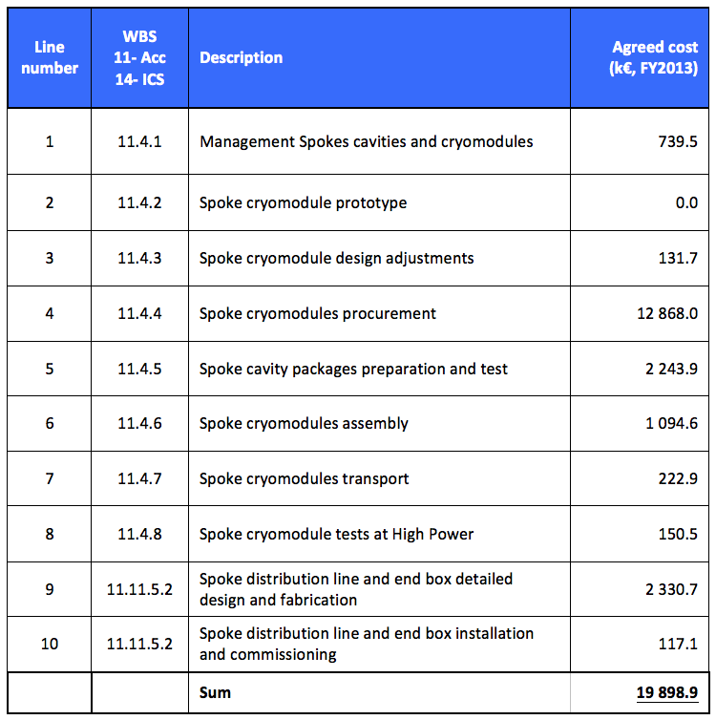
CNRS Agreement

Slide 14
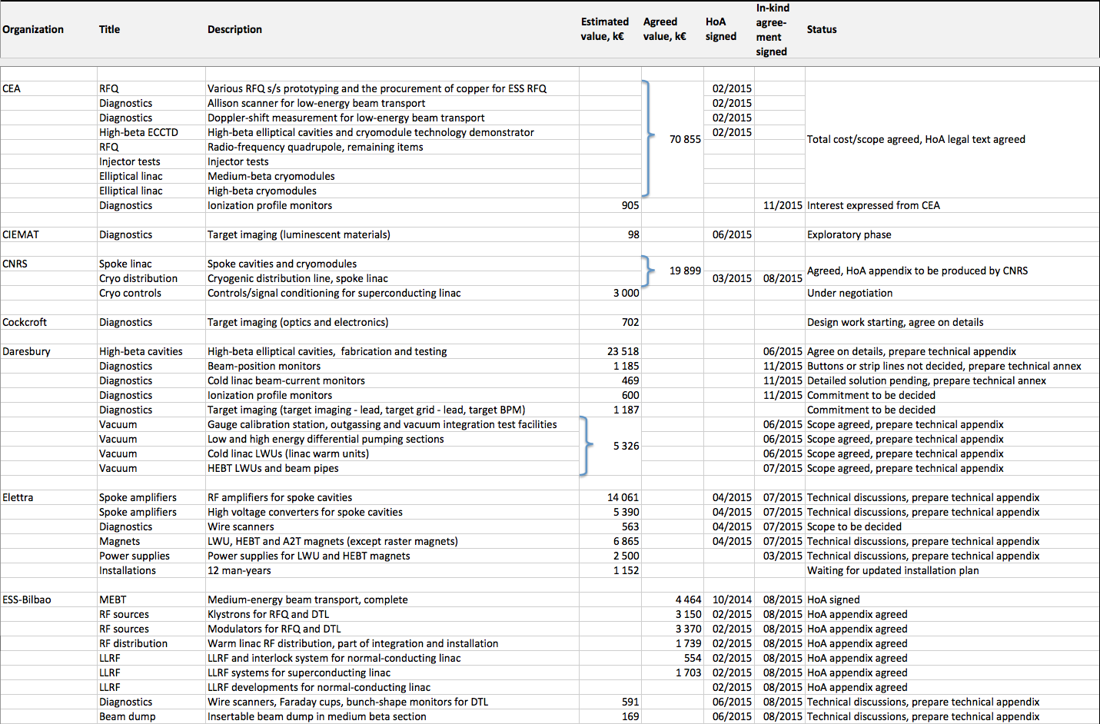
Planned/Agreed In-Kind Contributions (1)

Slide 15
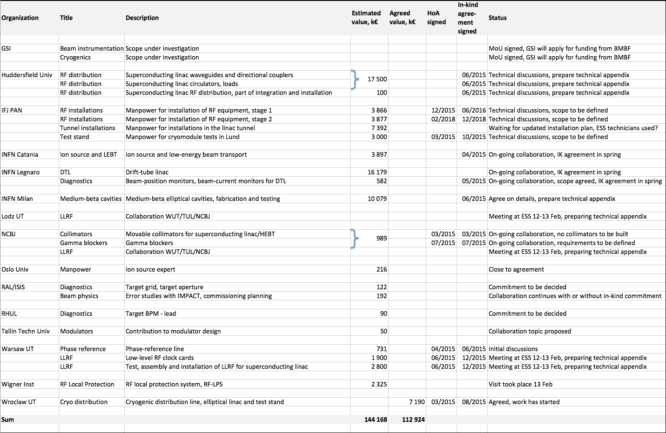
Planned/Agreed In-Kind Contributions (2)

Slide 16
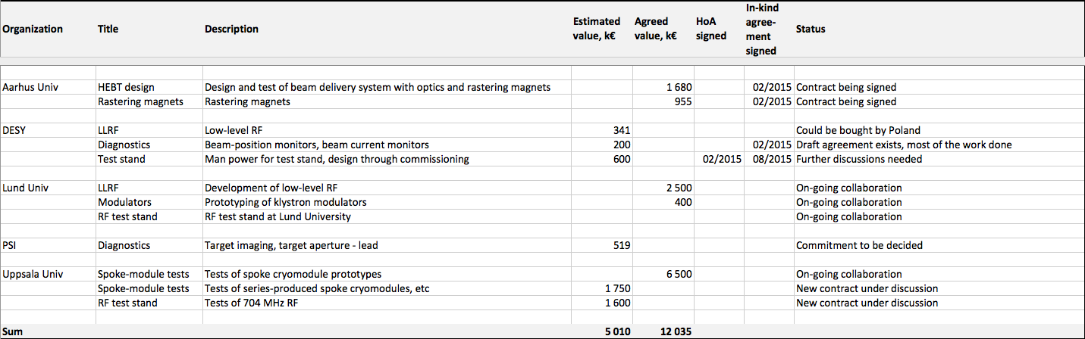
Planned/Agreed In-Kind Contributions (3)

Slide 17
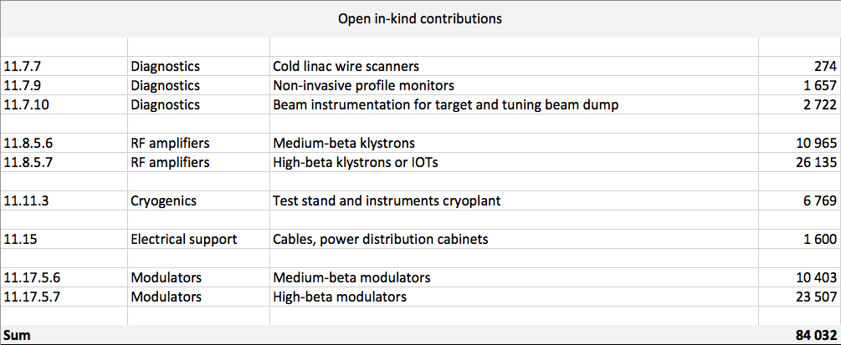
Open In-Kind Contributions

Slide 18
END

