Slide 2
DMSC Risk Management Workshop
IDS
PRESENTED BY Petra aulin

Slide 3
Agenda
Introduction
2 Brainstorming risks and define them
3 Quantify risks and decide on Risk Owner
4 Mitigation suggestions for relevant risks
5 Workshop (2, 3, 4)
6 Concluding remarks

Slide 4
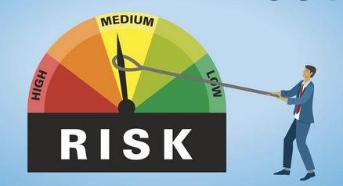
1
“To consider what could go wrong, one needs to begin with what must go right"
Introduction

Slide 5
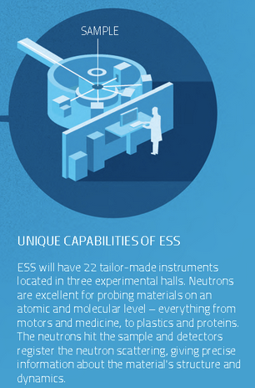
Introduction
Why do we need to have a risk management workshop?
In the phase of Initial Operations, the ESS Strategy to First Science is driven by:
the ultimate goal to deliver neutron source
the expectations of Sponsoring Countries, and
interests of the In-Kind Partners.
The ESS Divisions (sub-projects) are there to deliver the ESS Strategy.

Slide 6
Introduction
Why do we need to have a risk management workshop?
What is the mission for this particular group at DMSC?
- Provide world leading scientific software and Scientific computing sevices(?) for neutron scattering
- By collaborating with stakeholders, deliver integrated software & hardware services to the ESS neutron instrument and user programme
DMSC Vision and Mission
The groups’ visions and missions
IDS
Ensure the delivery of an integrated data pipeline for each instrument, a smooth user journey and good user experience.
Support the development of a world leading user program. Stay at the forefront of their respective fields.

Slide 7
Introduction
Why do we need to have a risk management workshop?
If the risks are not identified, avoided, or resolved the project may end up with a bigger budget, be delayed or even end up completely stalled.

Slide 8
Introduction
Why do we need to have a risk management workshop?
Helmut – Staff meeting 24 May 2022:
”We have a new plan and we have to make sure that we deliver this project on schedule and on budget.
If we see ESS as a car driving on a road – we are on the very right side now. If we encounter some obstacles we go into the ditch. Therefore we need to try hard to get a bit more to the centre of the road. So if there is something unforseen happening we have the ability to react and control”
Recommendation from DMSC STAP report
May 2022:
” There are major challenges for the DMSC ahead:
In light of the heavy strictures on the staff profile that is now in place following the rebaselining process, it will be a challenge for the DMSC to deliver the scope required of it. The task of mitigating risk and close monitoring of progress for the earliest sign of problems has the highest priority.”

Slide 9
Introduction
Why do we need to have a risk management workshop?
ESS
Helmut
DG
Project Directorate
Andrew Kimber
Project Director
Project Directorate
Rafal Rudnicki
Risk Manager
Project Support and Admin
Science Directorate
Andreas
Technical
Strategy
Inkind
ES&H

Slide 10
Introduction
Workshops
Register IRIS
Communication
Follow up
Review
Identify
Classify
Control
Treat
Monitor
What is the plan to keep track and handle the risks?
DRAM x 2
DST
SWAP
IDS
ECDC?

Slide 11
Introduction
Identify
What is the goal?
Accept
Avoid
choose not to undertake certain business activities to avoid any exposure to the threat they might pose.
Transfer/share
…the impact to another party to cover the potential loss from an uncertain event.
Reduce
… the severity of the loss or the likelihood of the loss from occurring.
4 ”Mitigation suggestion” types: planning for disasters and having a way to lessen negative impacts.

Slide 12
Introduction
What is a risk?
A risk IS NOT
Known & continuing condition,
Existing organisat. weakness
Frequent, re-occurring problem,
Certain event.
A risk IS
Possible change of condition,
Probable event,
Uncertainty as to (when, where, how much …)
a risk is an event due to which a project is affected negatively. This means that risk factors are to be taken care of so that the project can run successfully.
Notes:
Obvious – something that we know will happen = org. Weakness
Risks need to have lack of controll
Risk is something that MAY or not MAY NOT happen.
If you know it will happen – then it is not longer a risk then it is a crisis happening that you need to control

Slide 13
Introduction
What is a risk?
Proper, 3-element risk definition is describing a specific scenario:
Event of … happening (or change of condition), ... Caused by (direct causal relationship), ... Resulting in (direct impact)
EXAMPLE:
Leakage of water pipes in the DMSC server room, - EVENT caused by defected welding of the pipes, - CAUSE resulting in shutdown of servers in Copenhagen- CONSEQUENCE
Cause
Event
Consequence
Notes:
Critical phase: will take more time and it is worth it. The better you define the cause and concequence ”shit in shit out”. then you can quickly come up with mitigations correct Bring up Rafal s slide 7 if many causes and many concequences

Slide 14
Introduction
What boundary conditions do we have for this workshop?
the schedule delay will be major
there is a failing risk mitigation
the € impact will be high
the core performance will not work
ESS deliberately takes high risks
There is a leading change (tech/partners)
Focus on risks related to DMSC where either (/and)…
Notes:
Prioritize… Rebaselie is deliberate… (Zoom in to find meaningful risks) – what happens if….

Slide 15
2
Brainstorming risks

Slide 16
Brainstorm risks
Brainstorm ideas
Delete duplicates
3 element definition together
Risk is about something we had no/limited control of, that is happening to our (more less) surprise

Slide 17
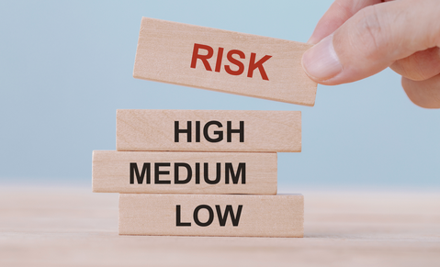
3
Quantify risks & decide on risk owner

Slide 18
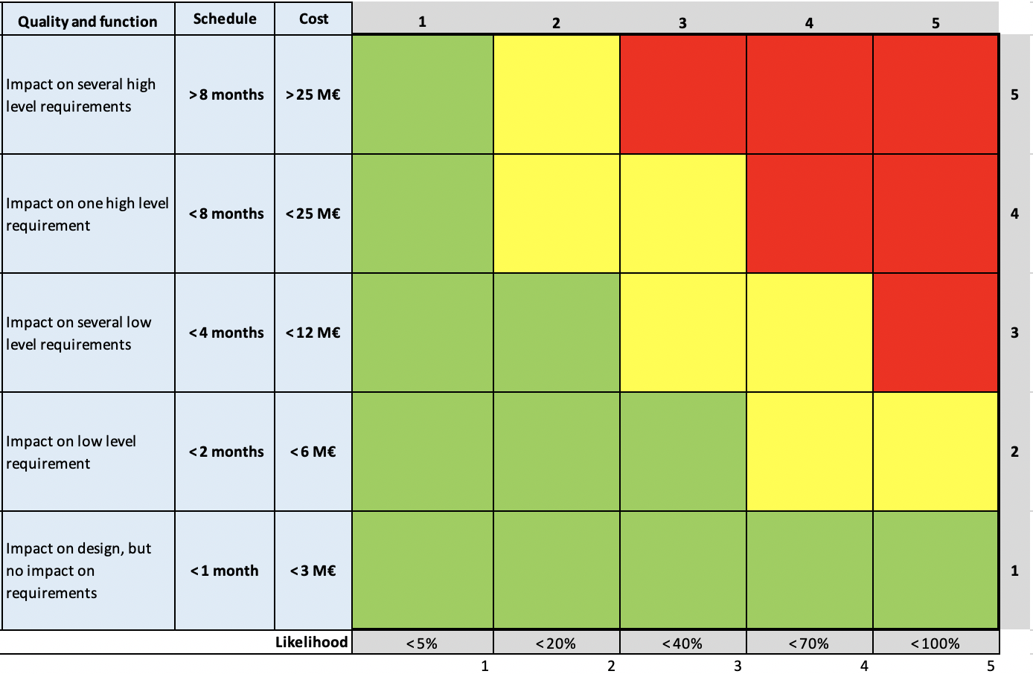
Quantify risks
Severity & Likelihood – Risk Criteria for Initial Operations
Risk matrix values and risk ownership levels are decided by ESS management
Identify the risk ownership
(default risk ownership):
red risks: Director
yellow risk: sub-project / Division manager
green risk: WP manager or delegated person,
but …

Slide 19
Risk Owner
Central function
What makes a proper risk owner ?
The lowest possible management level with:
competency to handle the risk
management power to action risk treatment
access to budget to finance risk treatment

Slide 20
4
Mitigation suggestions

Slide 21
Mitigation suggestions
The core, mission and main purpose of risk management
Workshops
Register in IRIS
Communication
Follow up
Review
In this workshop we come with mitigation suggestions for the risk owner to approve in the ”Review workshop”
It is the duty of the risk owner to drive the risk down to an acceptable level
Before deciding or acting on risk mitigation, risk owner may need to:
consult stakeholders
obtain approvals if required

Slide 22
Mitigation suggestions
4T concept
Very High |  |  |  |  |  | not acceptable: - higher management - most resources and diligence when treating these risks
High
Medium |  |  |  |  |  | to be considered: - mid management - deliberate decisions to mitigate or accept
Low
Very Low |  |  |  |  |  | acceptable: - don’t waste your time for them
 | Very Low | Low | Medium | High | Very High
tolerate – do not take action (acceptable: low probability and low impact risks);
terminate – remove the risk or stop activity generating the risk (not acceptable: high probability and high impact risks);
treat – prevent from happening to decrease frequency / probability (high probability and medium to low impact);
transfer – limit the impact and / or transfer the impact to another party (low probability and medium to high impact).
Transfer
Terminate
Tolerate
Treat

Slide 23
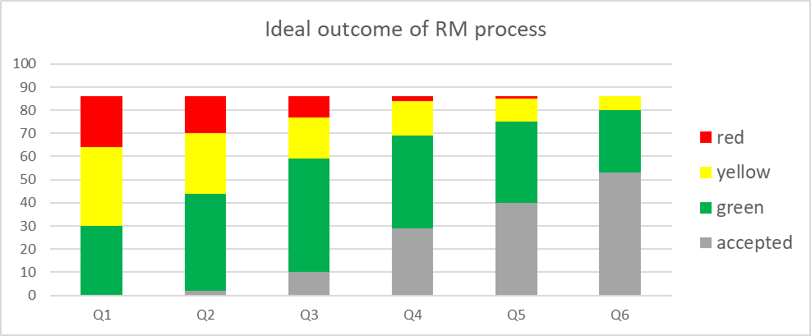
Mitigation suggestions
The core, mission and main purpose of risk management
We will focus on the yellow and red risks
Describe risk mitigation (project, task /action, change)

Slide 24
5
What will happen next?

Slide 25
Review and forward process
The risk owners to take action
Workshops
Review
Register IRIS
Communication
Follow up
There will be a ”Review-workshop” with the appointed risk owners. The owner will
evaluate what the expected impact mitigation will have on decreasing the risk magnitude (when applied/completed)
do comparison with alternative mitigation plans in terms of cost vs benefit and demonstrate the best choice
The risks will be uploaded in the risk register ”IRIS”
The risk owners will then communicate what is in Iris with ever
yone involved in the workshops and all stakeholders and arrange for risk tracking to recurring meetings
Then there will be a new risk workshop (aim is to review risks quarterly with main focus on red and yellow risks)

Slide 26
Finish presentation

Slide 27
Workshop time
First thing first:
“To consider what could go wrong, one needs to begin with what must go right"
WHAT MUST GO RIGHT FOR THIS GROUP TO DELIVER
the ESS Strategy to First Science:
the ultimate goal to deliver neutron source
the expectations of Sponsoring Countries, and
interests of the In-Kind Partners.

Slide 28
A. Brainstorm ideas write short quick ideas on post its “Risk is about something we had no/limited control of, that is happeining to our (more less) surprise”

Slide 29
B. Get rid of duplicates

Slide 30
C. Make a three step definition together

Slide 31
Brainstorm risks
the schedule delay will be major
there is a failing risk mitigation
the € impact will be high
the core performance will not work
ESS deliberately takes high risks
There is a leading change (tech/partners)
Focus on risks related to DMSC where either (/oand)
Proper, 3-element risk definition is describing a specific scenario:
Event of … happening (or change of condition), ... Caused by (direct causal relationship), ... Resulting in (direct impact)
EXAMPLE:
Leakage of water pipes in the DMSC server room, - EVENT caused by defected welding of the pipes, - CAUSE resulting in shutdown of servers in Copenhagen- CONSEQUENCE
Write and explain the risk
Cause
Event
Consequence

Slide 32
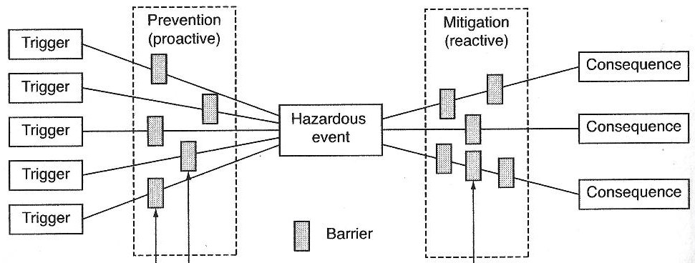
Cause and Concequence
(back up slide)How to deal with multiple causes and / or consequences of an event

Slide 33
D. Quantifying the risks 2 groups – move 2 people Challenge - Defend

Slide 34
Quantify risks
Severity & Likelihood – Risk Criteria for Intial Operations

Slide 35
E. Who is the risk owner?
2 groups – move 2 people Challenge - Defend

Slide 36
F. Mitigation suggestions 2 groups – move 2 people Challenge - Defend

Slide 37
Mitigation suggestion
Severity & Likelihood – where will the risk move?
Very High | 5 | 10 | 15 | 20 | 25 | not acceptable: - higher management - most resources and diligence when treating these risks
High | 4 | 8 | 12 | 16 | 20
Medium | 3 | 6 | 9 | 12 | 15 | to be considered: - mid management - deliberate decisions to mitigate or accept
Low | 2 | 4 | 6 | 8 | 10
Very Low | 1 | 2 | 3 | 4 | 5 | acceptable: - don’t waste your time for them
 | Very Low | Low | Medium | High | Very High

Slide 38
Mitigation suggestions outcome
Are our suggestions moving the risks?

Slide 39
G. Presentation of major risks for everyone - likelihood, severity, risk owner, mitigation suggestion – where will that move the risk?

Slide 40
Additional slides

Slide 41
Feedback from pilot
To make the workshop as good as possible for the others
What to keep?
What to shorten?
What to emphasise?
What to make clearer?
What to delete?
What to add?

Slide 42
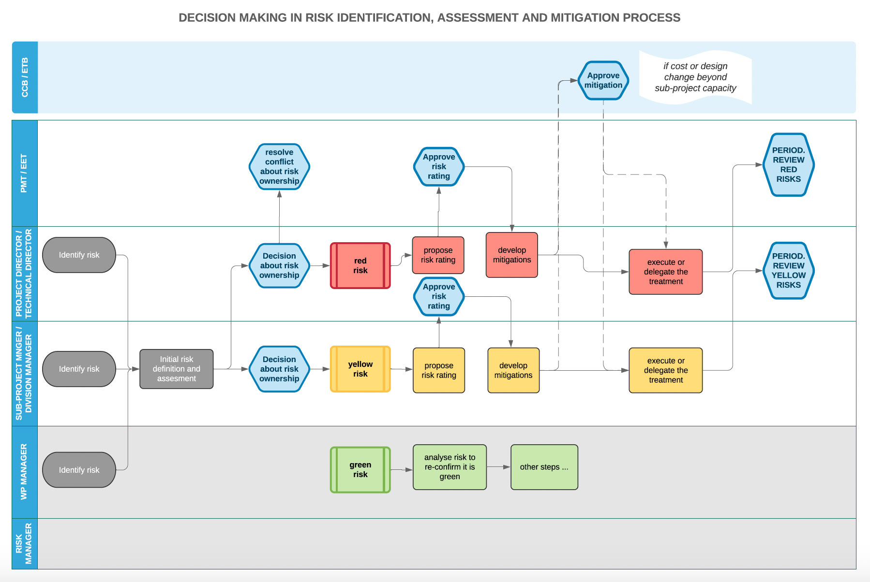
Identify Risk Owner
Notes:
PMT has stopped existing. Not the approved process after rebaseline (awaiting or project director) but this is how we worked before rebaseline

Slide 43
Identify stakeholders
Focus on risks related to DMSC where either (/oand)
Who is impacted by the risk?
Who is the risk generator?

