Slide 1



Build on Lessons Learnt on IK Contributions
5th Work Package 3 Workshop
Christine Darve
ESS – In-Kind Management Division
14.06.2022 - Lund, ESS Campus
This project has received funding from the European Union’s Horizon 2020 research and innovation programme under grant agreement No 823867

Slide 2
Summary of Lessons Learnt
Lesson Learnt | Follow-up
Optimize lesson-learnt based on other experiments and RIs, e.g. SNS cryomodules layout, E-XFEL at CEA enable ll on Quality & Risk Management, PQP, transportation. Transfer of technology and knowledge: SRF Cavities | Communication and TA to match both party’s interests. Survey and implement other project expertise at ESS without re-inventing the wheel. Povide references to other projects and RI for expert use.
Limit TA dependencies and interfaces, e.g. ACCSYS WP05 used ESS/CEA, ESS/STFC, ESS/INFN to build elliptical cryomodules. The MEBT is the responsibility of ESS Bilbao and the LWU (STFC) but composed of sub-components from several laboratories. | Limit interfaces and encourage collaborative work, (individual institute and collective) meetings. ESS to enforce that IK partner comply with ESS rules including Quality and component acceptance. ESS to have a central role in the coordination of component integration.
The TAs were signed as the ESS was maturing from a ”green field” status (unclear SoW, Quality and Safety Rules, Management system), which has impacted greatly the project schedule and cost. | Select skilled WP leader. Follow-up on TA with the subprojects and write amendment with WP leader to reflect cost and schedule changes. Propose clear and relevant milestones to monitor the activities. Improving communication from Quality division to IK.

Slide 3
Summary of Lessons Learnt
Lesson Learnt | Follow-up
More focus on Equipment Compliance (EC) requirements for the non-radiological should be enforced. Lack of focus on non-radiological/conventional safety and quality, e.g Ion Source & ATEX. Electrical cabinet for target Tom’ room. NB: ESS licensing team focuses on radiological issues (SSM requirement); ESS has very limited rules applied to the Quality of equipment, i.e. Mechanical (pressure, weld, etc), Electrical, Chemistry. | Prepare and implemente ”ESS-2972919 - ESS Rule for Equipment Compliance”; Standardize WoW to be implemented via ESH_Q to sub-Projects. Licensing should be considered as early as possible in the process. Integrate/check safety disciplines involving legal authorities (e.g. SSM, Work Environment Authority, fire brigade, etc..). Action items identified during review process should be tracked and reported.
Harmonize process and hardware to prevent misleading activities and installation challenges. Enforce transversal communication w/ proper stakeholder: Technical Directorate, Project Directorate and "Support Directorates", e.g. IKM, ESH&Q, Admin needs to be coordinated. | Clear communication channels (e.g. Technical Office) and communication tools (e.g. Manual/Handbook, task force meetings, training, check list, benchmarking with other institutions) should be implemented for a timely respond to specific and global issues.

Slide 4
Summary of Lessons Learnt
Lesson Learnt | Follow-up
Unclear roles and responsibilities distributed between in-house and In-Kind leads to misunderstandings (Technical Annexes should account for IK responsibility for integration) | Critical analysis by central (engineering) team. Assign strong mandate to integration team. Skilled personnel to apply agreed process on equipment to be integrated.
How to handle unrealistic delivery schedules. Over ambitious plans will lead to delays and cost overruns | Rebaseline ESS.2 has partially answered this part. Project management culture, transparency, accuracy to be enforced.
A global risk register (technical and project) is essential to support the equipment quality to be delivered | Partily solved with IRIS. Develop a coordinated risk register (systematic perspective and risk assessment). Field Coordinator meetings to exchange WoW

Slide 5
Earlier BrightnESS Best Practice workshops
➔ 14-15 Nov. 2016: 1st BrightnESS Best Practice Workshop: Engineering aspects of large-scale In-Kind projects (bilbao) , Info and Recommendations
➔ 13-14 June 2017: 2nd BrightnESS Best Practice Workshop: Installation aspects of large-scale In-Kind projects (catania) and Recommendations
➔ 19-20 June 2018: 3rd BrightnESS Best Practice Workshop: Detailing the ESS In-Kind Installations: Organization, Plans and Support (lund), Summary - Best Practices Recommendations
Installation Organization, Schedule and Lessons learnt | Installation Binder | Installation Services
Safety and Working on_Site | Technical Documentation | Acceptance, Handover and Systems Testing
➔ 5 July, 2018: Topical - BrightnESS Best Practice Workshop: ”VAT Exposure related to Installation in Sweden”

Slide 6
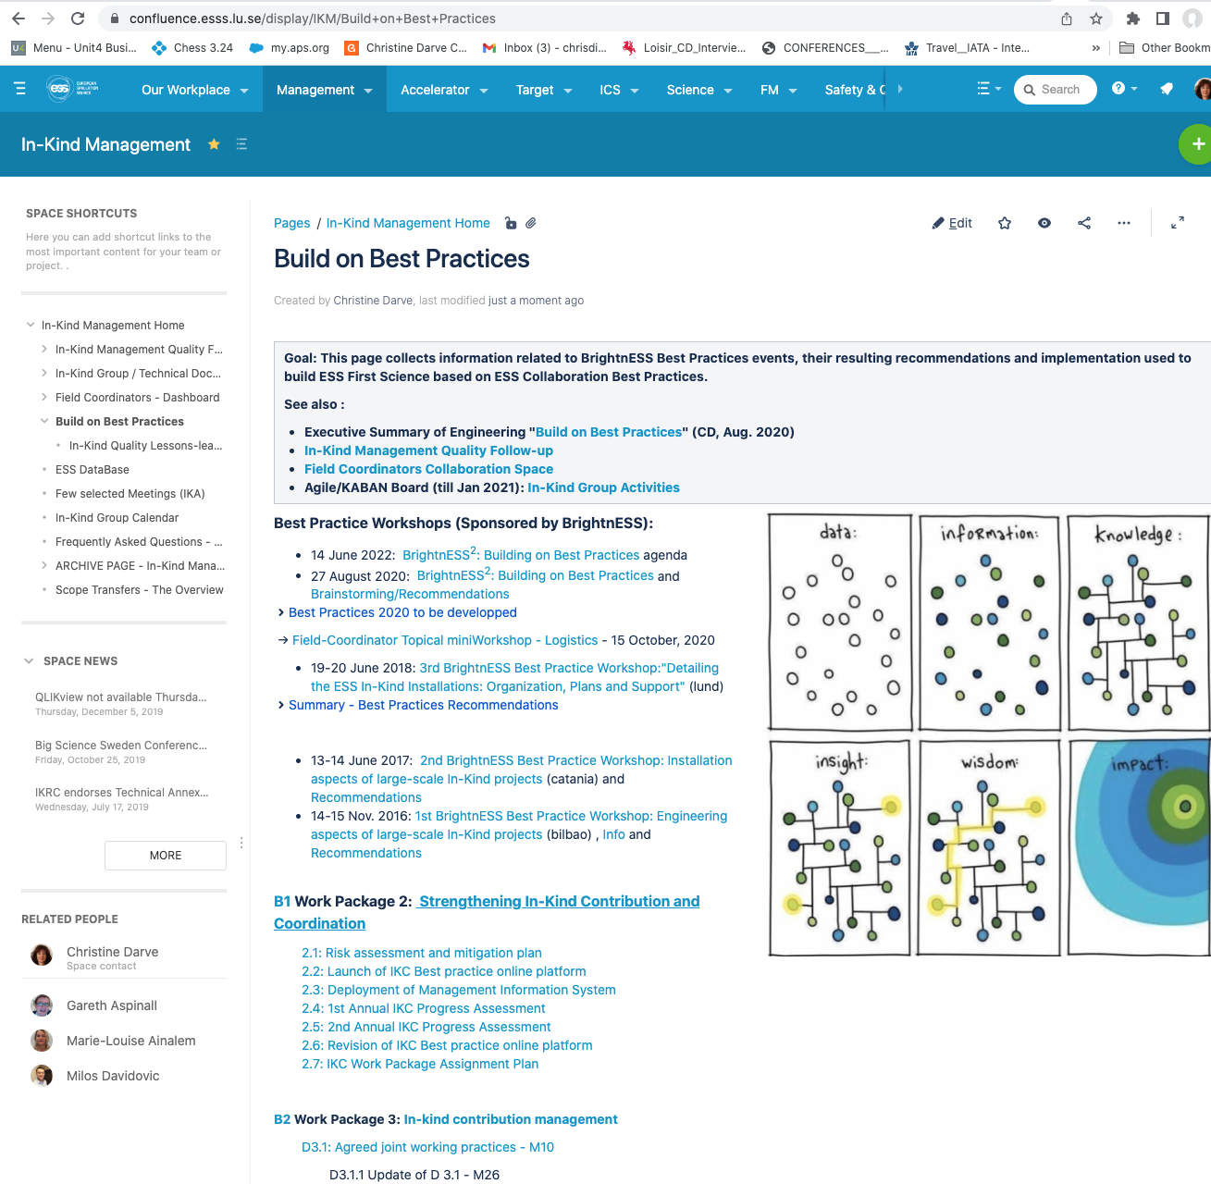
Useful Links
➔ August 27, 2020: 4th Field Coordinator “Building on Best Practices Workshop”, a thorough discussion and analysis of Lessons Learnt and Best Practice: BrightnESS²: Building on Best Practices
➔ 15 October, 2020: Topical - Field-Coordinator Topical miniWorkshop – Logistics
ESS Confluence page:
Build on Best Practices

Slide 7
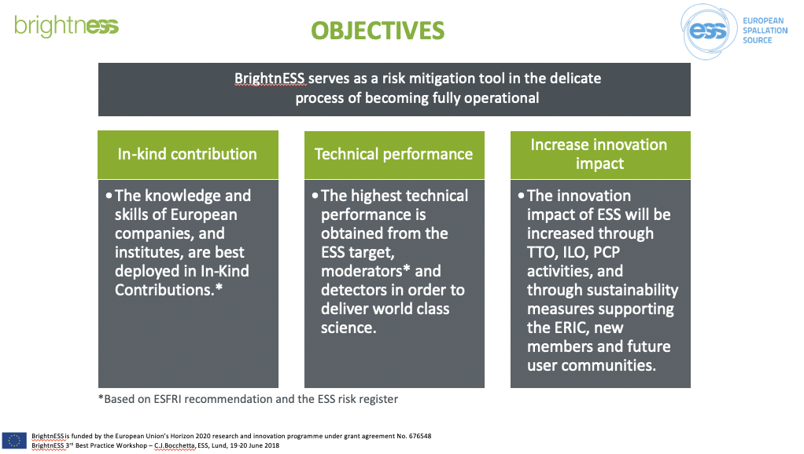
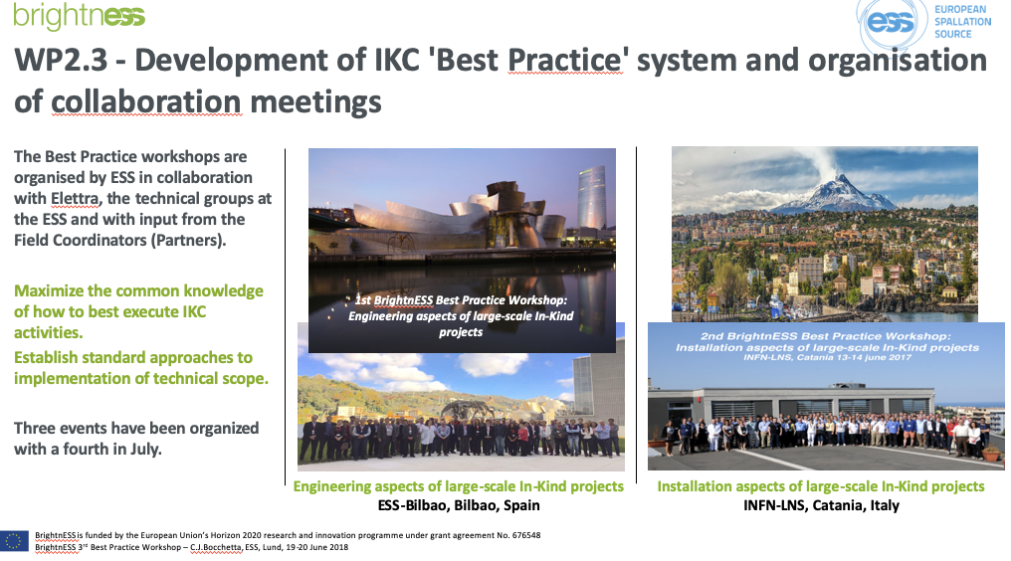
Details - Build on Best Practices BrightnESS
August 27, 2020: 4th Field Coordinator “Building on Best Practices Workshop
Root cause analysis : delay or non-conformity
Follow-up on lessons-learned

Slide 8
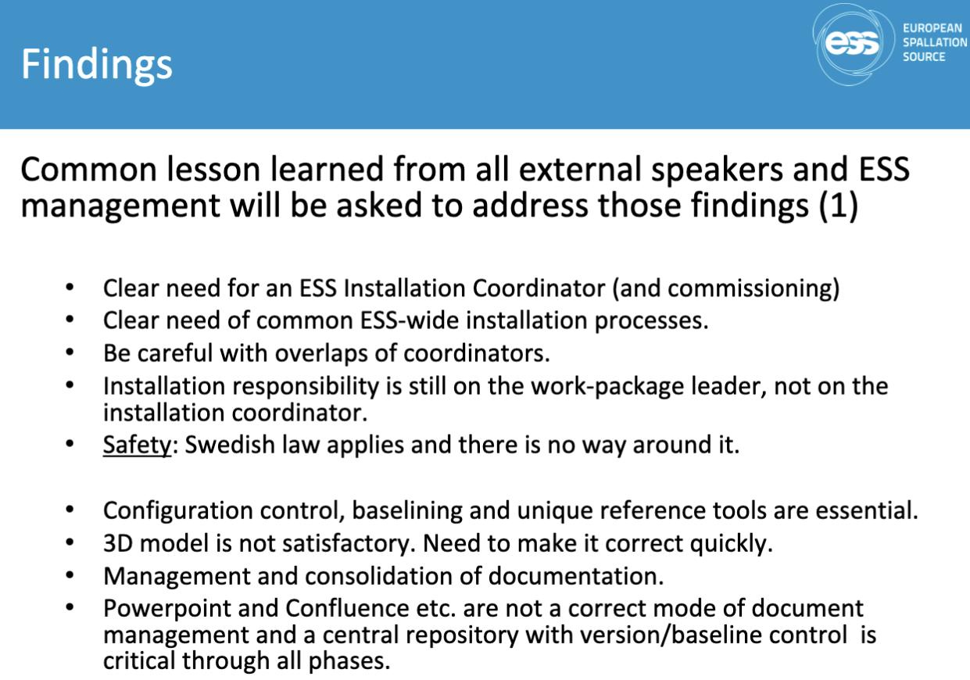
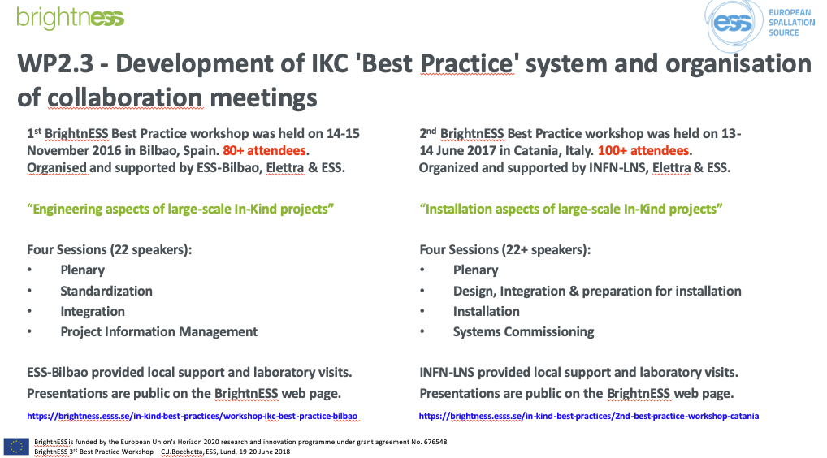
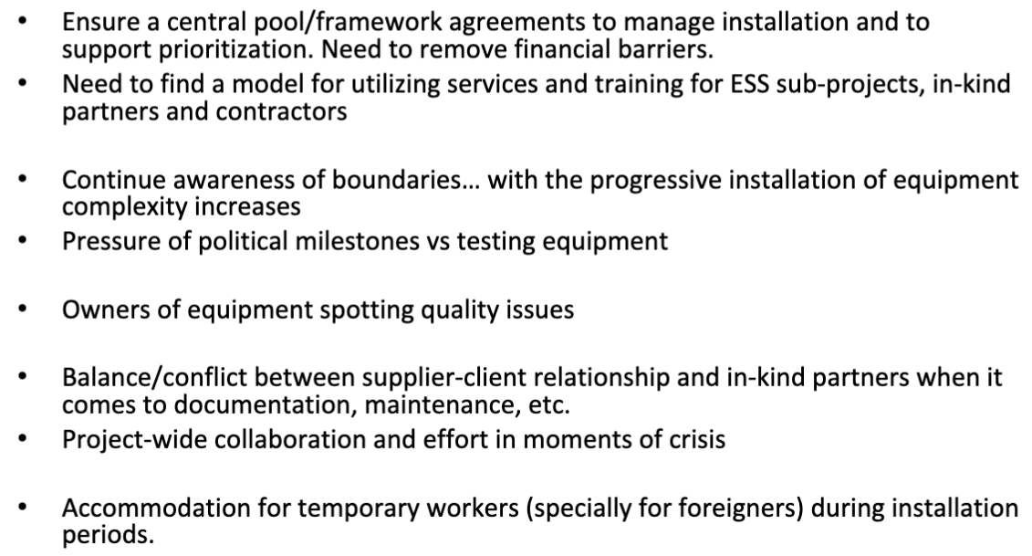
Details - Build on Best Practices BrightnESS
Installation aspects
Installation
CHESS / CIDL
August 27, 2020: 4th Field Coordinator “Building on Best Practices Workshop
Framework and QA
See Fabien Rey 5 ‘ Presentation of his section → 3D modelling Integration

Slide 9
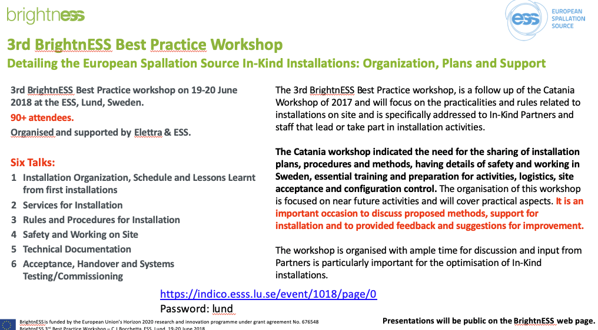
Details - Build on Best Practices BrightnESS
CIDL: Configuration Item Documentation List
  See details later
EAM: Entreprise Asset Management (see EAM site & EAM Training)
  Ultimate link ! (incl. NCR from Jira; ESS-0008702 + ESS-0008823)
ESS Installation Binder Library
  For IRR
Exonaut Risk Register and training
  For discussion?
FBS: Factory Breakdown Structure
  See details later
Quality Inspection Status
  RIR: ESS-0118174; file
  Procedure: ESS-0102301; file
  QC Inspection Report: ESS-0372680; file
  IKP can pre-register item on JIRA before delivery
XRM+
  For discussion ?
Lessons Learned (QA) and procedure
Introduction to the ESS Learning Lounge
August 27, 2020: 4th Field Coordinator “Building on Best Practices Workshop

Slide 10
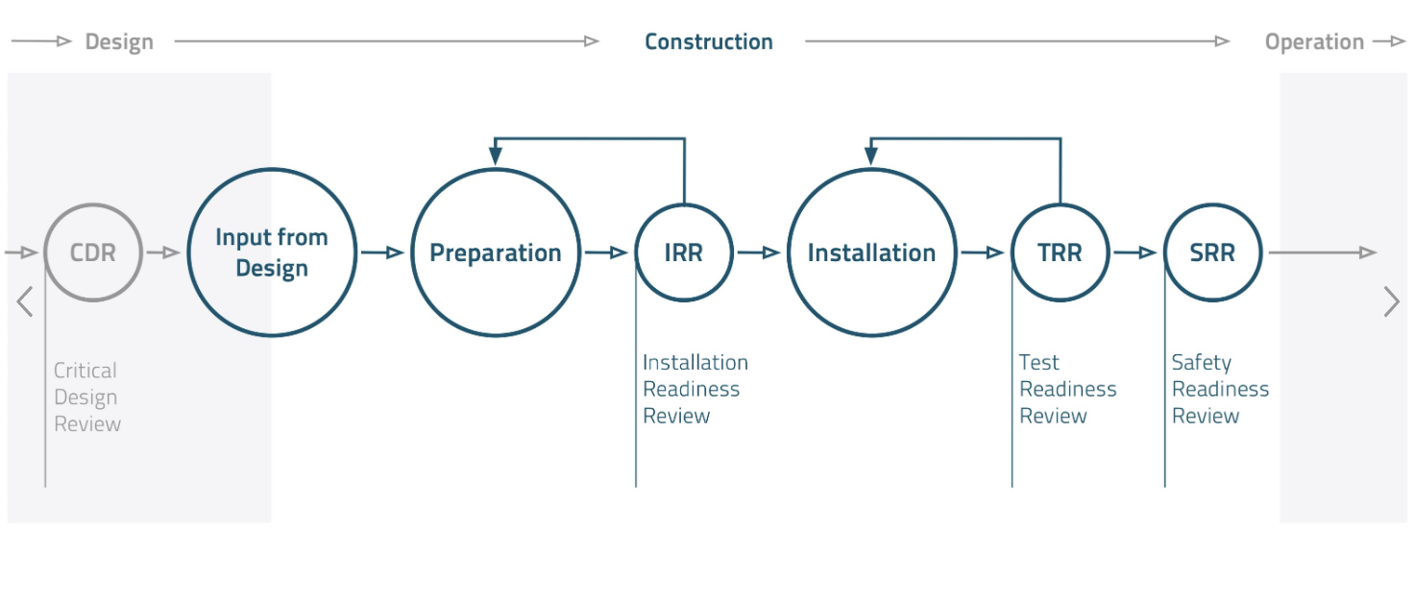
ESS Installation
ESS-0092276 Engineering HandBook
ESS-0051706: Process for Neutron Instrument Design and Construction
How we work
Tollgate 6
NI Operations
Readiness Review
PDR=Tollgate 2
Tollgate 4
Tollgate 5
Safety Systems Acceptance Review
Tollgate 3
August 27, 2020: 4th Field Coordinator “Building on Best Practices Workshop
- Drawings
- Installation & Test Docs
- List of Components & Material
- Reference Documents
- P&ID
- Commissioning Plans
- Description of Work
- Responsibility Matrix Organisation
- Installation Time Schedule
- Temporary Service
- Installation Procedures
- Certificates and Permits
- Work Instructions and Work Risk Assessment
- Work Order
- Installation Binders
- Signed Readyness Review
- Check List/Report
- Approved Installation Plan
- Check List/Protocol Form
- PJB Meeting
- Daily Notes
- Progress Reports
- BIA
- List of NCRs
- Status Follow-Up
- Inspection Plans
Protocols
- Signed Test Readiness Review
- List of Outstanding
- Activities and NCRs
- Red Lines Drawings and other Documents
- Installation Binders
- Certificate of Compliance
- Preliminary As-Built Documents
Safety Readiness Review complements the TRR with a thorough assessment of every conventional and radiation safety aspects linked to the operation of this part of the facility.

Slide 11
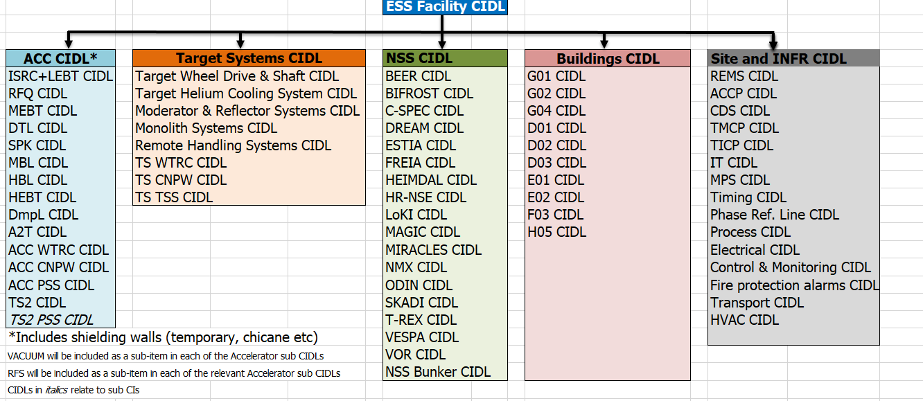
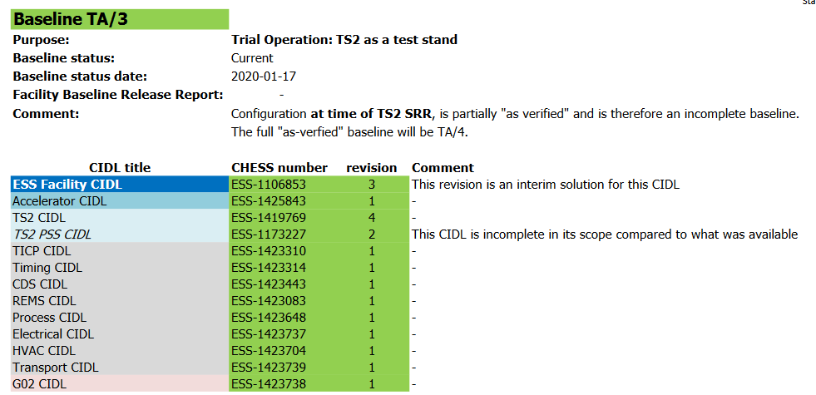
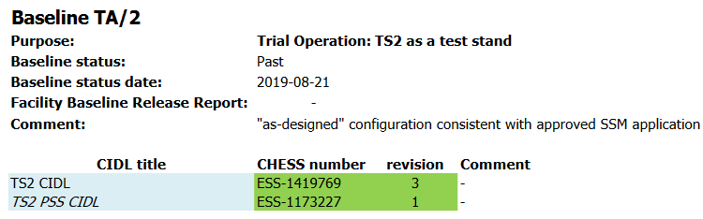
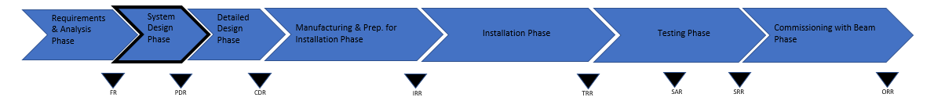
Facility baseline plan – Test Stand 2 as an example
  The Facility baseline plan (ESS-0482562) describes the combination of the CIDL’s defining the status of each CI for example at the time of the TS2
  TA/2: Approved SSM application
  TA/3: SRR review
  A change to the facility baseline requires approval by affected CI owners(s)
  A change to the engineering baseline requires approval by the system owner unless the CI is affected which requires approval by CI owner
Baseline TA/2
August 27, 2020: 4th Field Coordinator “Building on Best Practices Workshop
Engineering Baseline
Facility Baseline
As designed
As verified

Slide 12
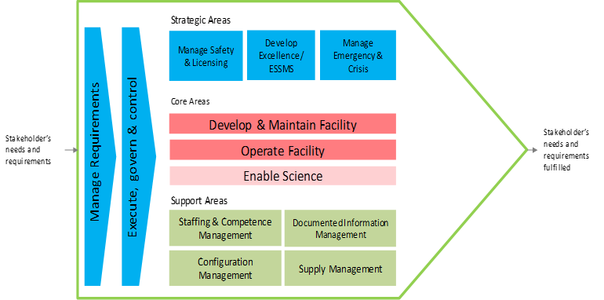
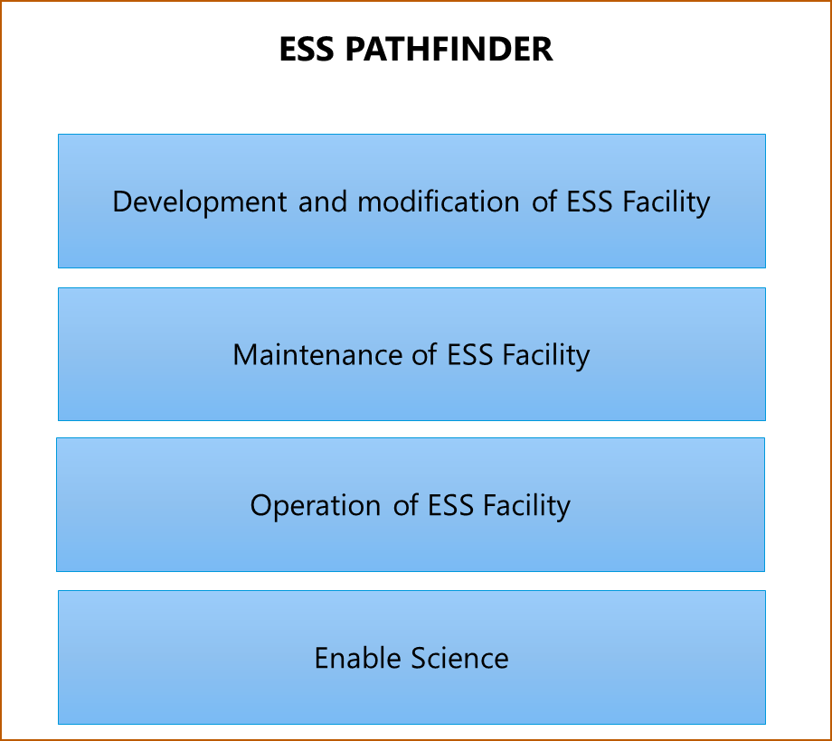
Mock-up - To build upon ?
Background
Courtesy: Peter Rådahl
Core areas
The ESS organization find it challenging to
    How to perform work (applicable rules, guidelines or roles (and we have a lot!)
    To know whom to consult or involve when performing work
    Get specific guidance on a certain system
    Find technical documentation in CHESS
A mock-up have been produced to see if we can answer to those challenges
    Is built around the ESS core WoW Areas
We have asked a number of ESS staff to give feedback on the mock-up
    Management
    Central functions, EXB and EEB
    NCL team (about 30 staff)
August 27, 2020: 4th Field Coordinator “Building on Best Practices Workshop

Slide 13
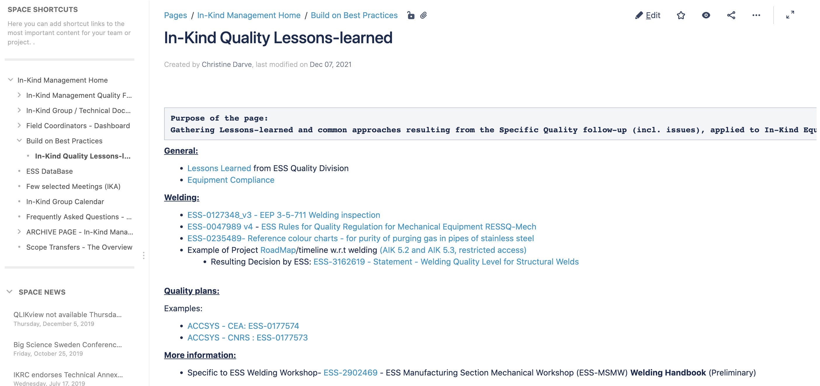
Example of Lessons-learned follow-up

Slide 14
Focusing on In-Kind Quality – see IKRC25
In-Kind Management to enable / support In-Kind Collaboration
As briefed in Agenda Item 8, the In-Kind Management Directorate is continuing (see IKRC24), in close collaboration with the central engineering management team, Quality & Safety, and Technical Directorate, to:
Develop guidelines and rules to aid In-Kind partners with Swedish law, EU regulations, Quality, Safety Compliance and Site Acceptance Test.
Support integration of In-Kind Equipment on the ESS site.
Further develop internal tools to facilitate rules implementation (e.g. training and check-lists).
Support inspection / controls to check that requirements are met (e.g. review processes, CDR, FAT, SAT and follow-up meetings and actions)

Slide 15
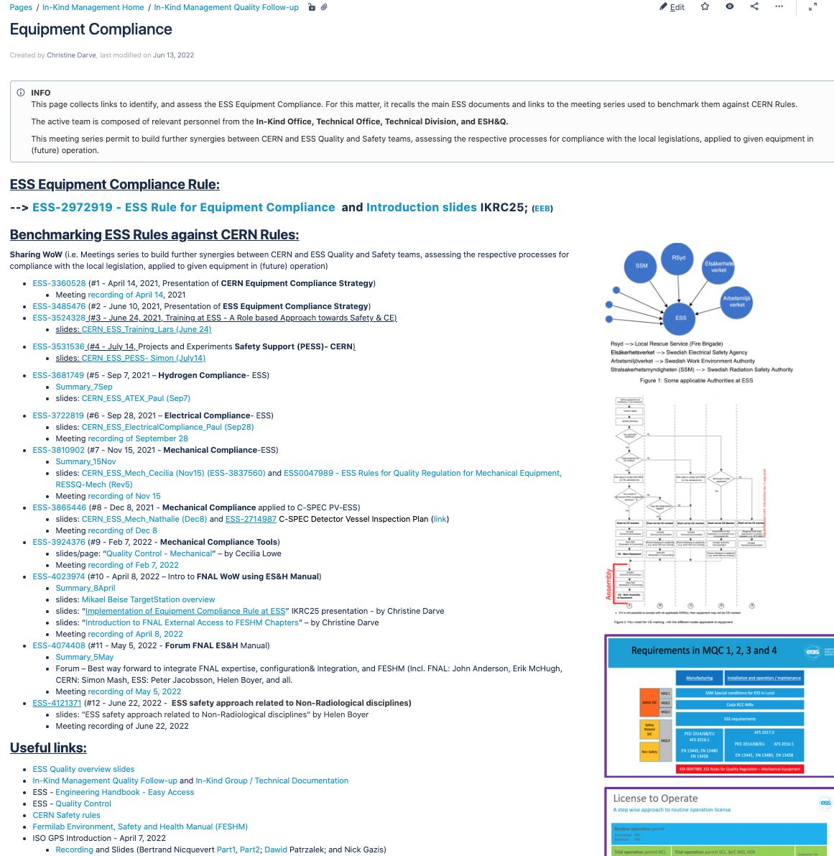
Focusing on In-Kind Quality
General application of “ESS-2972919 - ESS Rule for Equipment Compliance” (see IKRC24)
Generic : Bridge In-Kind Collaboration and Contribution with other RI
Project deliverables relies on the Safe Integration of Equipment
IK delivered Equipment shall comply with European Directives in order to obtain the permit to be operated at ESS
Involve ESS Quality Control in Sub-projects
Focus on Essential Safety Requirements and Applications of WoW benchmarked with operating RI
  Lessons-Learned from: CERN, FNAL
  Project collaborations: Myrrha/BE, - Elettra/ storage ring, INFN / SPES
➔ Strengthen Bridges between IK Management, Sub-Projects and ESH_Q, and Central Engineering
Notes:
WoW exchanged with CERN to create synergies based on lessons learned

Slide 16
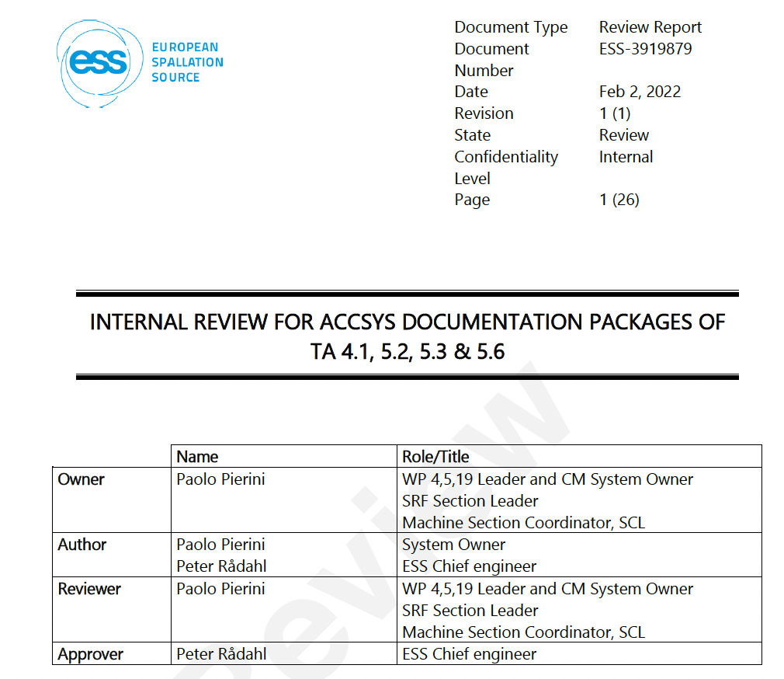
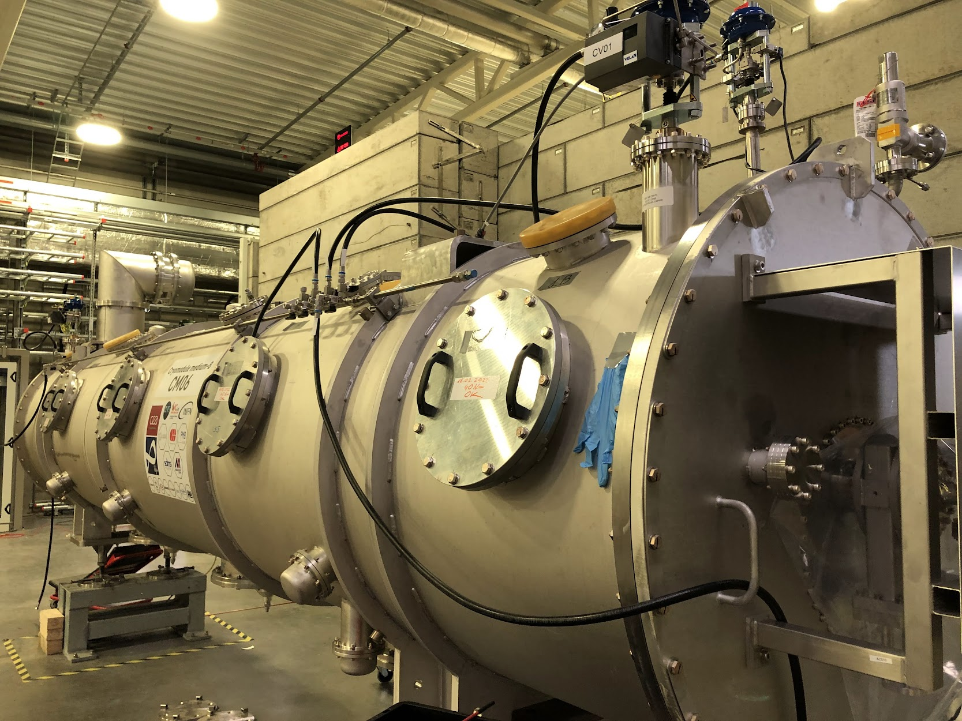
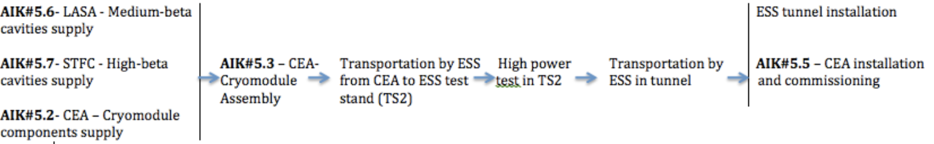
Pilot cases for Equipment Compliance
Accelerator
Bridge In-Kind Collaboration with Central Engineering
AIK 4.1 and AIK 5.x: CryoModules
Acceptance Review
  Coordinated with ESS Chief Engineer and System Owner
  The scope of the spoke and elliptical cryomodule delivery is articulated within several Technical Annexes, each of which made provisions for several “SAR stages”, first at the IK partner and then on reception at ESS.
Acceptance = Inspection

Slide 17
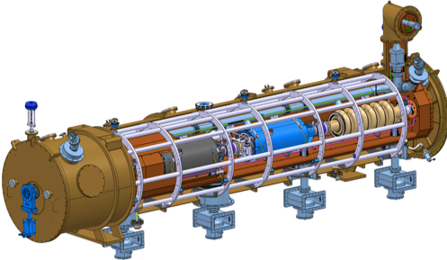
Pilot cases for Equipment Compliance
Accelerator
Bridge In-Kind Collaboration with Central Engineering
This Acceptance Review (AR) is not strickly a review according to the ESS engineering process but combine a review and the Technical Annex.
If delivery is a design package, then the AR is based on the CDR and the Technical Annex
If delivery is a site delivery, then AR is based on the SAT result and IK Technical Annex
The internal review has two purposes, to identify and assess:
  How we have received, prepared and integrated the IK delivery into ESS ”infrastructure” to support future activities, e.g. operations, maintenance
  The IK delivery

Slide 18
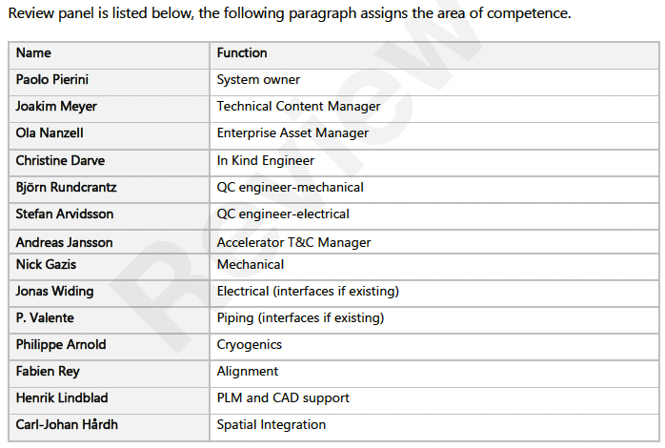
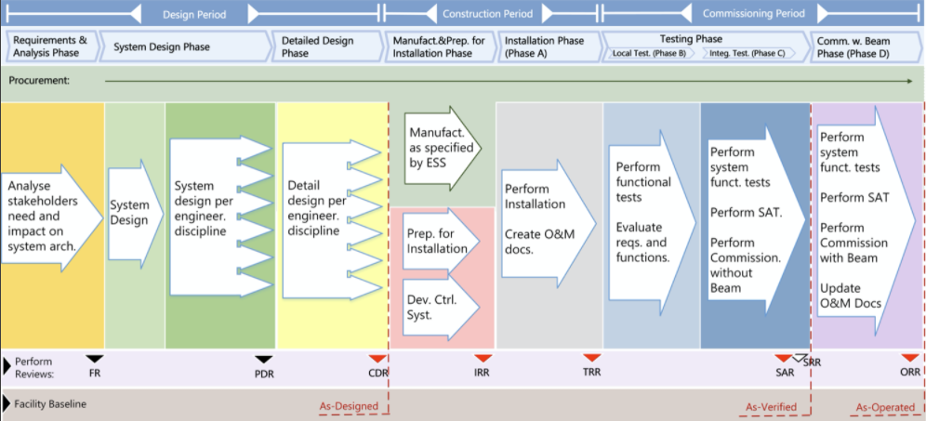
Pilot cases for Equipment Compliance
Accelerator
Bridge In-Kind Collaboration with Central Engineering

Slide 19
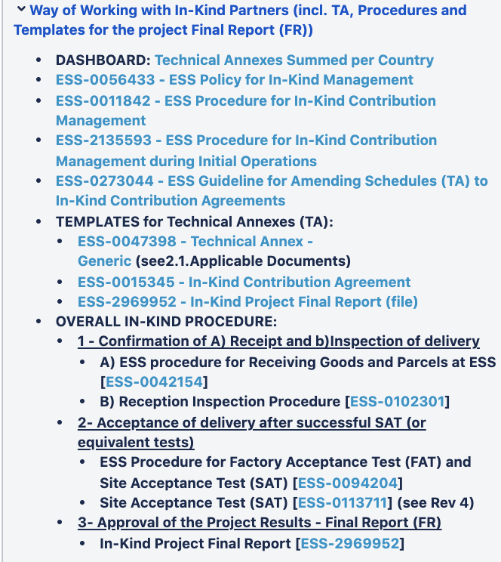
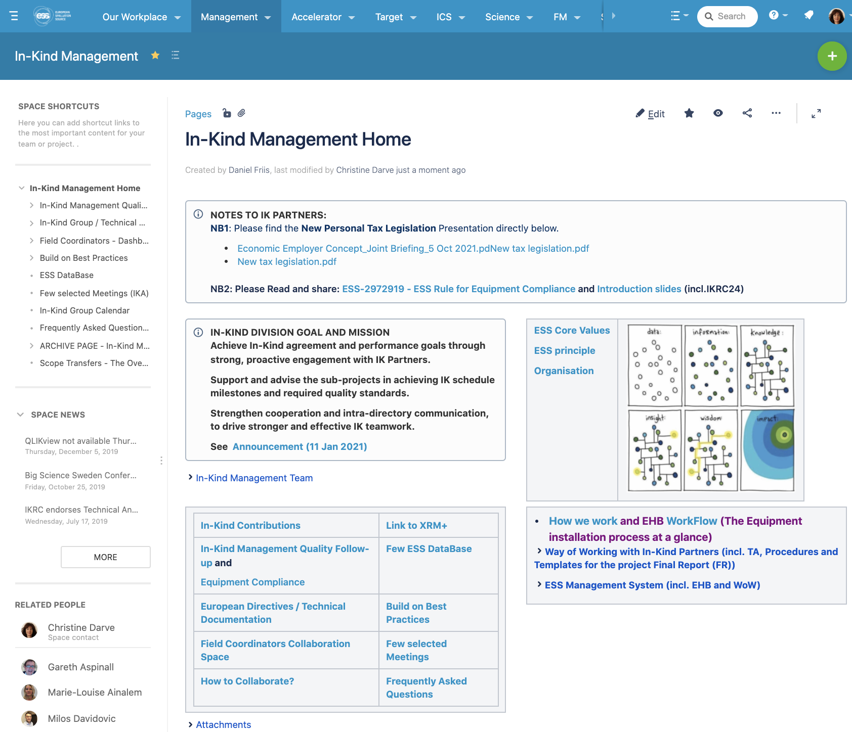
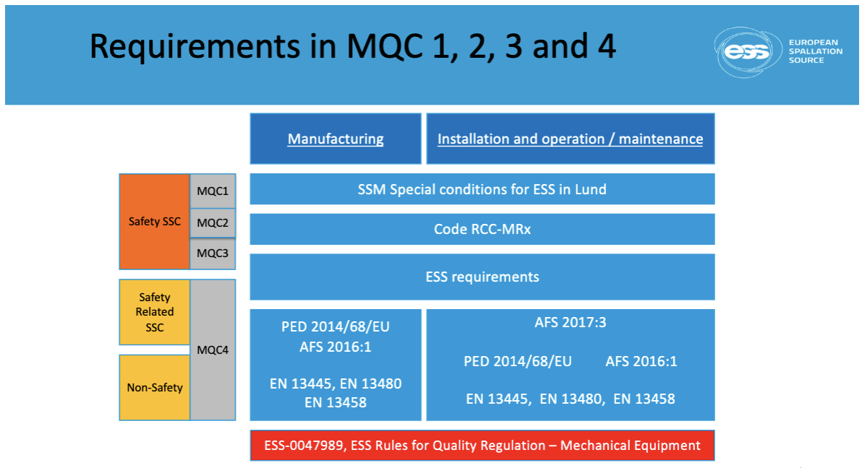
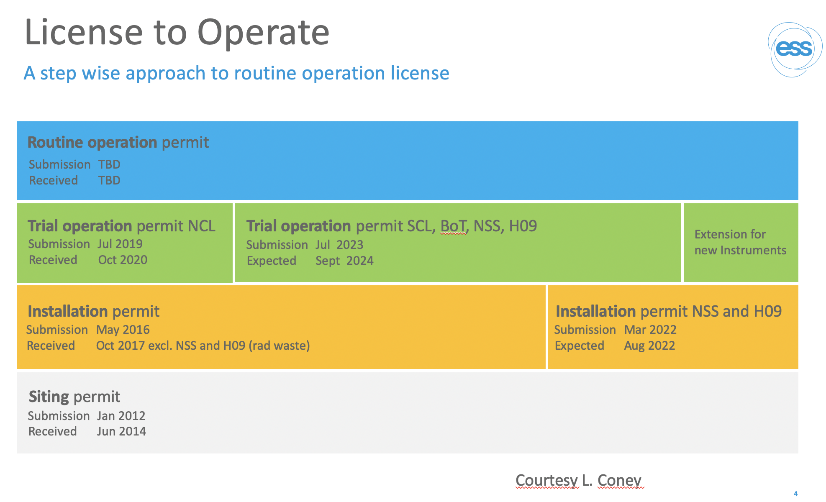
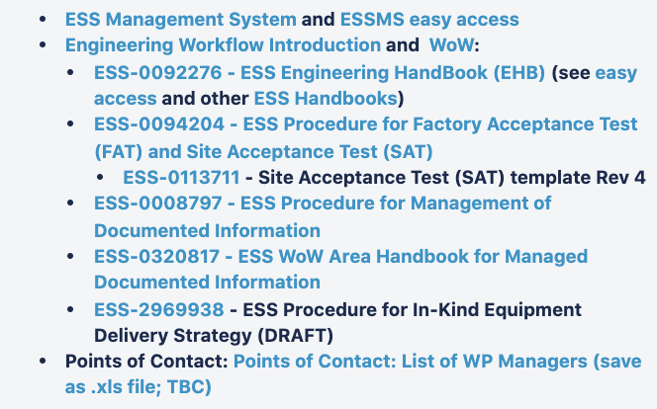
In-Kind Division and Engineering
Notes:
For Robust Rebaseline → implementation of robust Maintenance plan (ESS organization)
In the light of Survey findings, and on-going risk analysis to compile the best fitted contingency, Quality Factor
i.e. to Pay attention to the Management of Quality

Slide 20
Summary
- Strengthen bridges between:
      In-Kind Partners (supplier),
      Technical Directorate (owner) and
      ESS Central Functions (enabler/facilitator/mediate)
- Implement ESS Requirements & Rules to operate safely delivered IK Equipment (MUDA)
- SMART communication to properly Identify, Assess and Mitigate
- Root-cause-analysis to apply to deviations (scope (NC), time, cost) on In-Kind Equipment
Questions ?
Notes:
-> Engineering Integrated Management Plan

Slide 21
Thank you!
Christine Darve, ESS
christine.darve@ess.eu
This project has received funding from the European Union’s Horizon 2020 research and innovation programme under grant agreement No 823867

