Slide 1
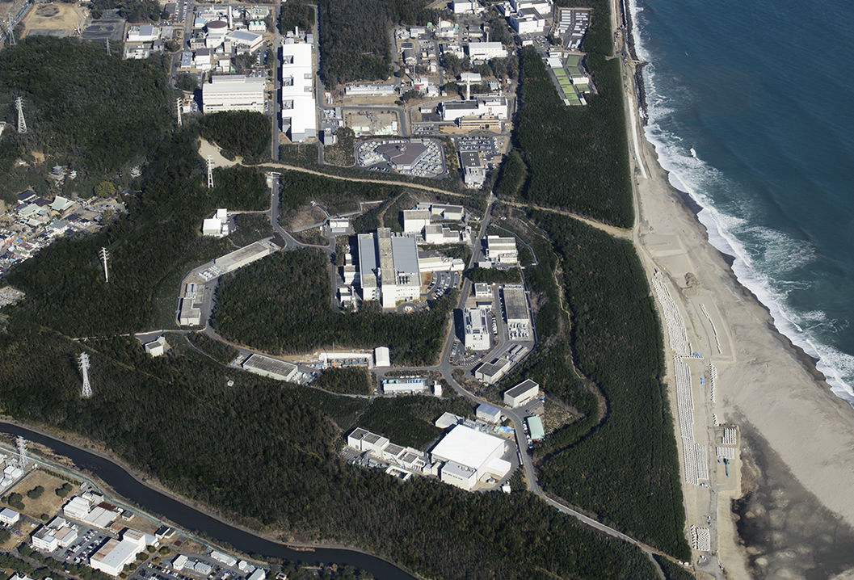
1) J-PARC’s Safety Strategy
Radiation safety, Licensing and
General safety
The Commissioning Workshop of ESS-J-PARC Collaboration
October 11 (Tue), 2022
III. Safety during Commissioning and Operation（9：00~10：30）
Yoshimi Kasugai
J-PARC
Safety Division

Slide 2
Contents
Radiation matters
  Outline of the “Licensing” and “Approval”
  “Licensing & “Approval” requirement
  Flow of the “Licensing” and “Approval” process
  Strategy for radiation safety
  Short answers for your questions
General safety matters
  Work manager license system

Slide 3
“Licensing” and “Approval”
“License” and “Approval” are needed for J-PARC operation.
  The “License” is issued by the Nuclear Regulation Authority (NRA) of Japan, based on the national low: “Act on the Regulation of Radioisotopes, etc.”
  The “Approval” is given by the local governments, based on “The local agreement on safety of nuclear power reactors etc.”
The “License” requirements shows the general and minimum regulation for preventing radiation hazard.
The “Approval” requirement was determined base on “the local agreement”:
  asking us to take best efforts to minimize radiation doses at the site boundary and radioactive wastes, including gas and water release.
Needs to be renewed step-by-step for facility upgrade

Slide 4
“Licensing” Requirements on External Dose
Site Boundary : 0.25 mSv / 3 months
Buffer Area Boundary : 20 μSv / 1 week
(0.5 μSv/h)
Controlled Area Boundary : 1.3 mSv / 3 months
(2.6 μSv/h)
3 months => 500 hours
Region of Regular Access: < 1 mSv / week
(25 μSv/h)
1 week => 40 hours
Restricted & Forbidden Area

Slide 5
Requirement of the Controlled Area of the J-PARC Accelerator
Cross sectional view of the J-PARC LINAC accelerator
< 25 μSv/h
Controlled Area
*Regular Access
< 0.5 μSv/h
Intermediate Tunnel
Negative pressure control by regular exhaust
Access prohibited during the beam operation.
Accelerator Tunnel
Holding air during beam operation

Slide 6
Requirement of the Controlled Area of MLF
Controlled Area
< 0.5 μSv/h
< 25 μSv/h
Experimental Hall
Proton Beam
Muon Target
Neutron Target
Experimental Hall

Slide 7
Legal Limits of radioactivity release
Radioactive wastewater drain
  The radioactivity concentration in drain water need to be less than the legal limits.
  Corresponding to 1 mSv dose for 1-year drinking.
Radioactive gas exhaust
  The radioactivity concentration in the gas needs to be less than the legal limits at the site boundary.
  Corresponding to 1 mSv dose for 1-year inhalation.
Nuclide | Chemical Form | Concentration Limit (Bq/cm³)
Tritium (T) | HTO | 60
Nuclide | Chemical Form | Concentration Limit (Bq/cm³)
Tritium (T) | HTO | 5×10⁻³
⁴¹Ar | Gas | 5×10⁻⁴

Slide 8
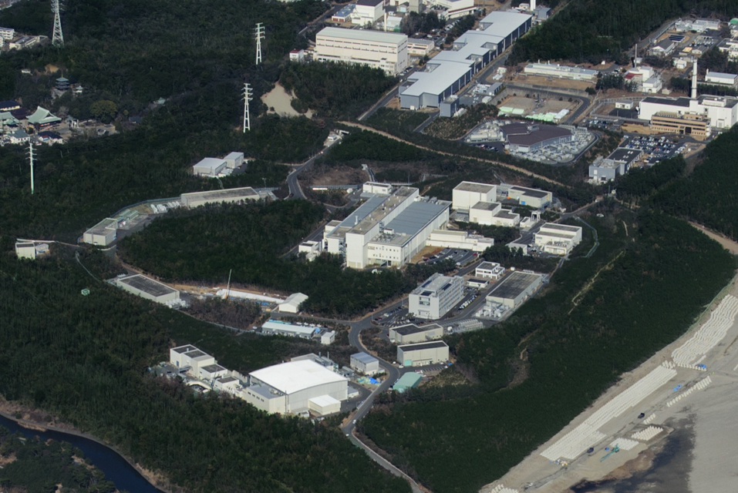
Radioactive Gas Release
Radioactive gases from the controlled areas are exhausted to the stacks after filtering process.
  There exist 17 stacks in J-PARC.
Radioactivity concentrations in the exhaust gases are always monitored.
1
2
3
4
15
13
8
14
6
5
16
17
10
7
9
12
11

Slide 9
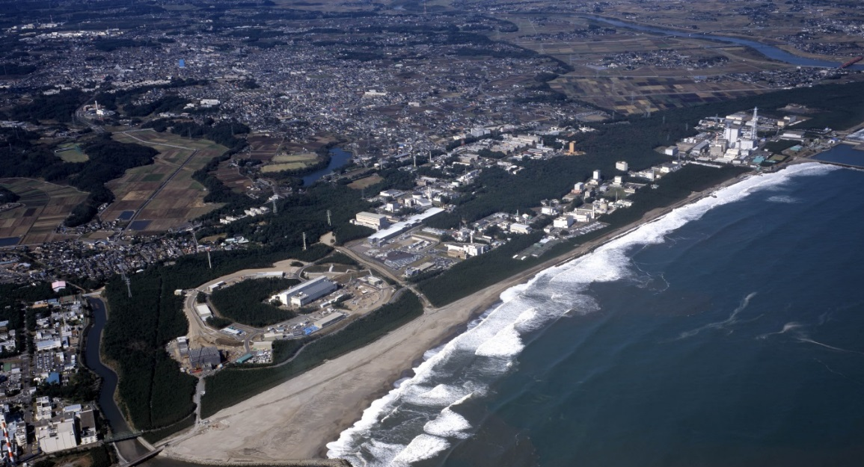
Radioactive Water Drain
The waters used in controlled areas are drained from the common outlet of JAEA Tokai site to the Pacific Ocean.
We check and certify that the radioactivity concentration is less than the legal limits every time before the drain.

Slide 10
“Approval” Requirement (1)
There exist nuclear power plants, the relevant facilities and the research laboratories in and around Tokai village in Ibaraki prefecture.
The nuclear plants etc. and the local governments have made agreements for keeping their safety and environmental protection.
An prior approval on the basis of the agreement is required for building a new facility or the modification.
  For the approval, we need to make documents which mentions the followings:
    New building / modification plan
    Safety measures
    Annual amounts of radioactive wastes (including radioactive gas and water release)
    Annual dose at the site boundary.

Slide 11
“Approval” Requirement (2)
The construction of J-PARC was approved in 2002, before the construction began, under the conditions as follows:
  Annual dose at the site boundary: < 50 mSv
    Corresponding 1/20 of the legal limit: 1 mSv/year
  Annual amounts of radioactive wastes (estimated)
    Radioactive gas release: 1.3 TBq (³H and others)
    Radioactive water release: 1.3 TBq (mainly ³H)
    =>The national lows restricted their concentrations only.
The application of the approval was made many times for upgrading the J-PARC facilities.

Slide 12
“Licensing” and “Approval” processes
【Typical flow of the processes】
Two flows are proceeded in parallel!
“Licensing”
“Approval”
Document Preparation
J-PARC Review Committee
Document Preparation
Pre-negotiation
Pre-negotiation
Document submission
License application
Assent of the “License” application
Reviewing in the NRA
Review Committee of the local government
License issuance
Test-operation Start
Approval
Facility Inspection by NRA
Full operation

Slide 13
Strategy for Radiation Safety
Focusing on radiation shielding
Keep sufficient margin for radiation shielding design
  For example, shielding thicknesses had been determined so that the calculated doses were kept to be less than 1/4 of the design targets.
Inspection of the properties related to shielding performance of the shielding blocks etc.
  Requested to makers and vendors that the densities and thicknesses must be larger than their design values
  “We” inspected them before the installation.
    The inspection records was shown on the NRA inspection as evidence of the shielding performance.
Step-by-step increase of the beam intensity
  Gradually increased beam intensity with confirmation of the feasibility of safety requirement: such as beam loss of accelerators etc.

Slide 14
Your questions and concerns (1)
Q: Which are the safety criteria for the commissioning / operation phase at J-PARC?
Satisfaction of the “License” and “Approval” requirement is the minimum requirement.
In addition, validation of the dose estimation for the shielding design is indispensable.
  For proceeding to next upgrade of beam intensity, measured doses must be less than the estimated values corresponding to those for low power operation.

Slide 15
Your questions and concerns (2)
Q: What actions are required when there is a deviation ?
The NRA Inspection must be passed.
  Otherwise, beam operation can not be continued!
If there are some deviations between measurement and design estimation, we should find the reason and make improvement in order to proceed to next upgrade of beam intensity.

Slide 16
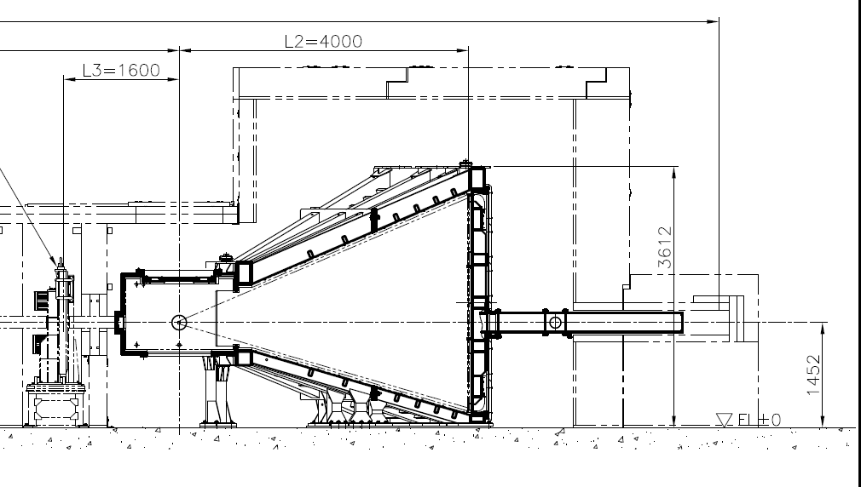
Example of dose deviation
Beam Stop
（Concrete）
（Steel）
Neutrons
（Borate resin）
Sample
Distance from the neutron source: 30 m
Stainless Steel (3~4 mm thickness)

Slide 17
Your questions and concerns (3)
Q: If there is a safety deviation during commissioning / operation, what are the actions to follow when reporting internally within the J-PARC organization and how is it reported to the Japanese authority?
The things were reported to the top managements, and the investigation was carried out and the counter measures was discussed in J-PARC wide.
  In the case mentioned in the previous slide, the beam stop was covered with additional shield.
Japanese regulation system does not have the function to report these kinds of things to the authorities, except radiological incidents etc.

Slide 18
Your questions and concerns (4)
Q: Are there any safety criteria for when to follow a "change control /configuration management" procedure when/if modifications or repairs are made during the commissioning or operation phase?
If major modification needs to be done, the modification plan are executed on the approval of the top management including the director.
  The modification plan is often discussed in a special committee consulted by the J-PARC radiation safety review committee.

Slide 19
General safety matters
Work Manager License System
Many kinds of works are being done in many places in J-PARC facilities.
  Potential Hazard: High-place work, Cryogenic, High pressure, Heavy object, Electrical shock, Oxygen deficiency, Fire, Radioactivity etc.
We experienced many kinds of incidents, trouble, near-miss events since the operation begun.
In order to minimize accidents and to manage such kinds of works more safely, Work Manager License System was introduced in 2019.
The purpose is, for the staffs who become a work manager, to raise their awareness of their roles and responsibilities.

Slide 20
What is the “Work Manager.”
“Work Manager”: Manages through a whole work process as a representative of J-PARC staff members.
Typical management structure for work safety in J-PARC
Section Leader
Section Safety Leader
Work Manager
J-PARC staff member
Site manager
J-PARC staff member or contractor
Worker

Slide 21
License Requirement
Completion of the following education.
Experience-Based Safety Training
Lecture Course
Encourage the staff to recognize their roles and responsibilities clearly as a work manager.

Slide 22
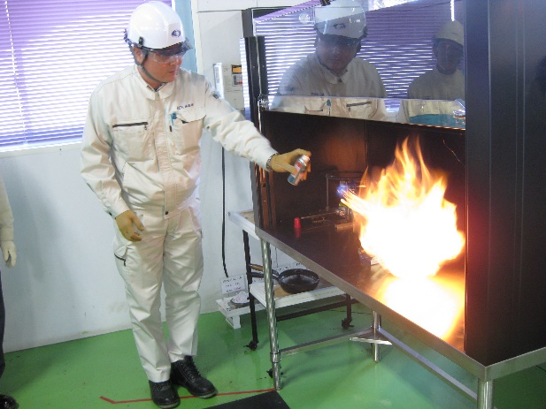
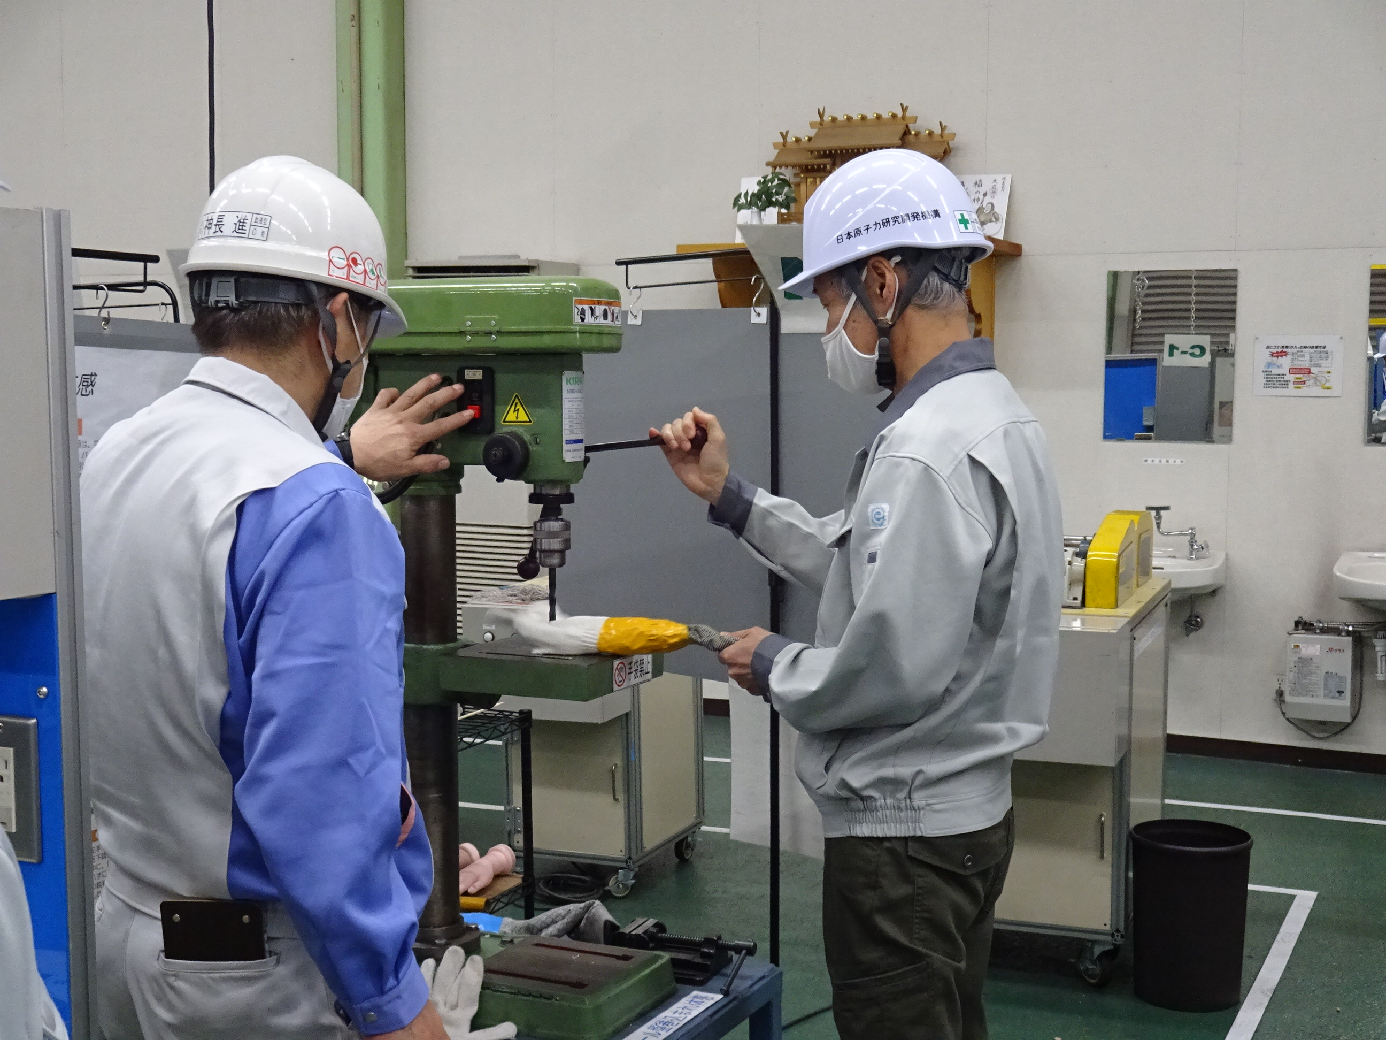
Experience-Based Safety Training
In the training, they experience many kinds of hazards and accidents simulated safely.
The trainings are outsourced to professional companies.

Slide 23
Lecture Course
Case Study to focus on Accidents and Troubles
Role of a Work Manager
What we emphasize in the lecture is briefly given.

Slide 24
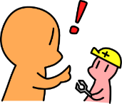
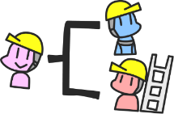
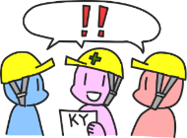
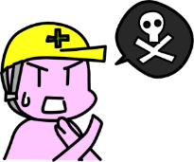
Backside of the License Card
What to Do as a Work Manager
□ Follow through with the “Stop Work” policy.
□ Confirm that every task is properly assigned for each worker.
□ Inform potential risks in the work.
□ Share awareness on safety and unsafe situations in daily briefing.

Slide 25
License acquisition in J-PARC
More than 400 staffs have already acquired the license.
The lecture course and the experience-based safety training are held several times a year for new commers.
Refresher course of the lecture will be held every four year.
  The next one will be held in 2024. All licensed staff members need to take it.

