Slide 1
Experience with controls tools at ESS
Top level control room experience.
Arek Gorzawski

Slide 2

Scope
Daily scope from the control room
Controls middleware
Deployment system (CCCE)
Controls Configurations/ Persistence
Controls configuration
Controls Software
OPIs (widgets, not actual panels)
Operational settings
CS Studio Tools:
Logbook
Monitoring/Control for EPICS IOCs
Data Browser
Role Based/Location Based Access?
Archiver (data storage)
Save Restore
Python Tools
OPIs (OP / SO developed)
OXAL

Slide 3
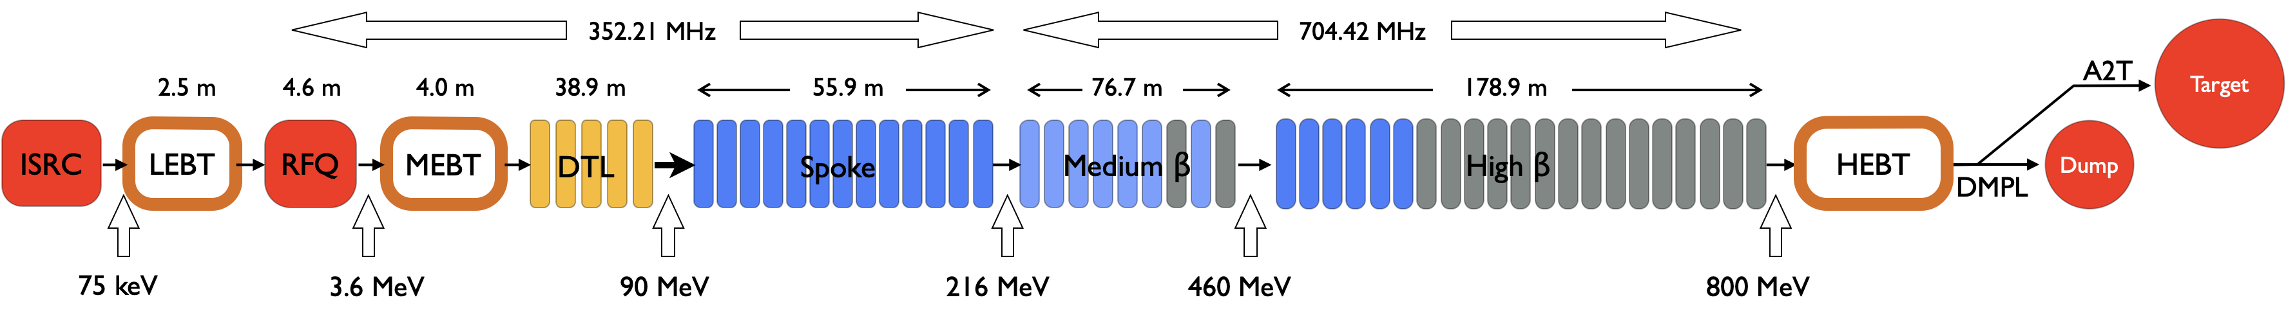
Global overview wrt the scope
Just to stay on the same page
OPIs
Applications
OXAL
Applications
Python Applications
CCCE
CCDB
CS Studio Phoebus
Archiver
EPICS

Slide 4
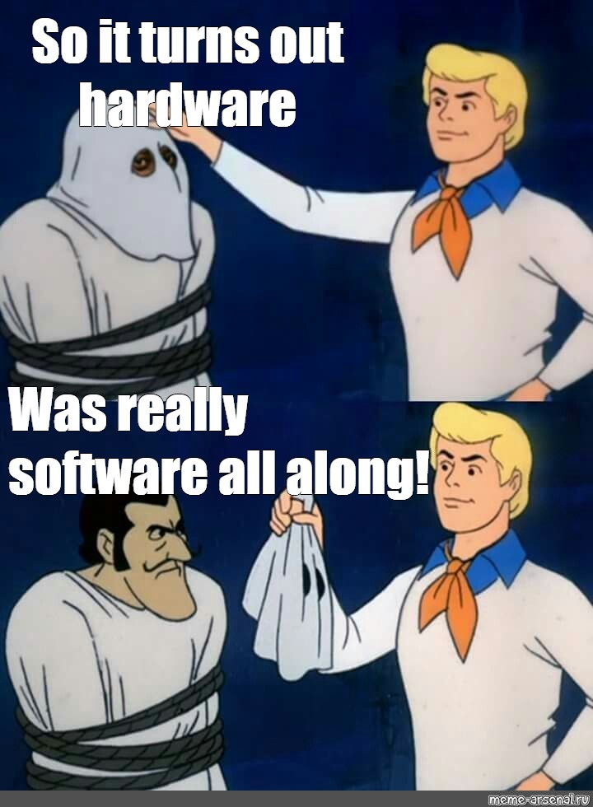
Software

Slide 5
What do we interact with?
Software pt1: OPIs
  Most panels for now (NCL commissioning) run inside the CSStudio Phoebus
  We chose to provide three layers of screens (Engineering, SystemExp, Operator)
    First runs revealed a real split
 | Desired (but abandoned) | Working
Engineering | Expert view very detailed and specific, often prepared to work also with non-operational systems
System Expert | Expert view on the operational system | Expert and Operations Team view on the operational system
Operator | Expert view on how/what operator should see (but not act on!) | Operations Team view on how/what is used to run a system

Slide 6
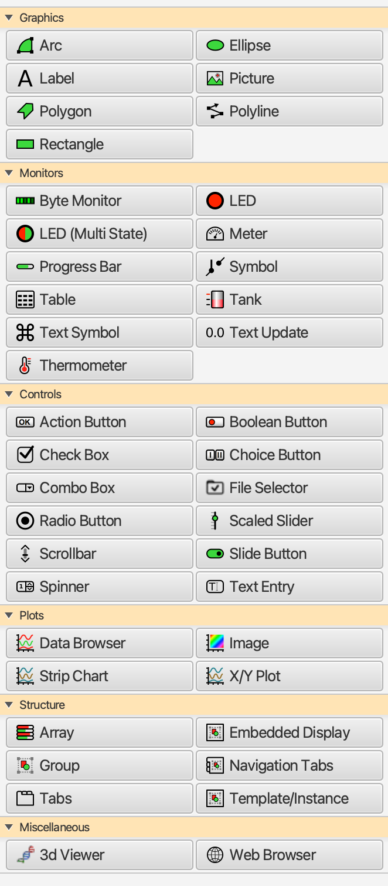
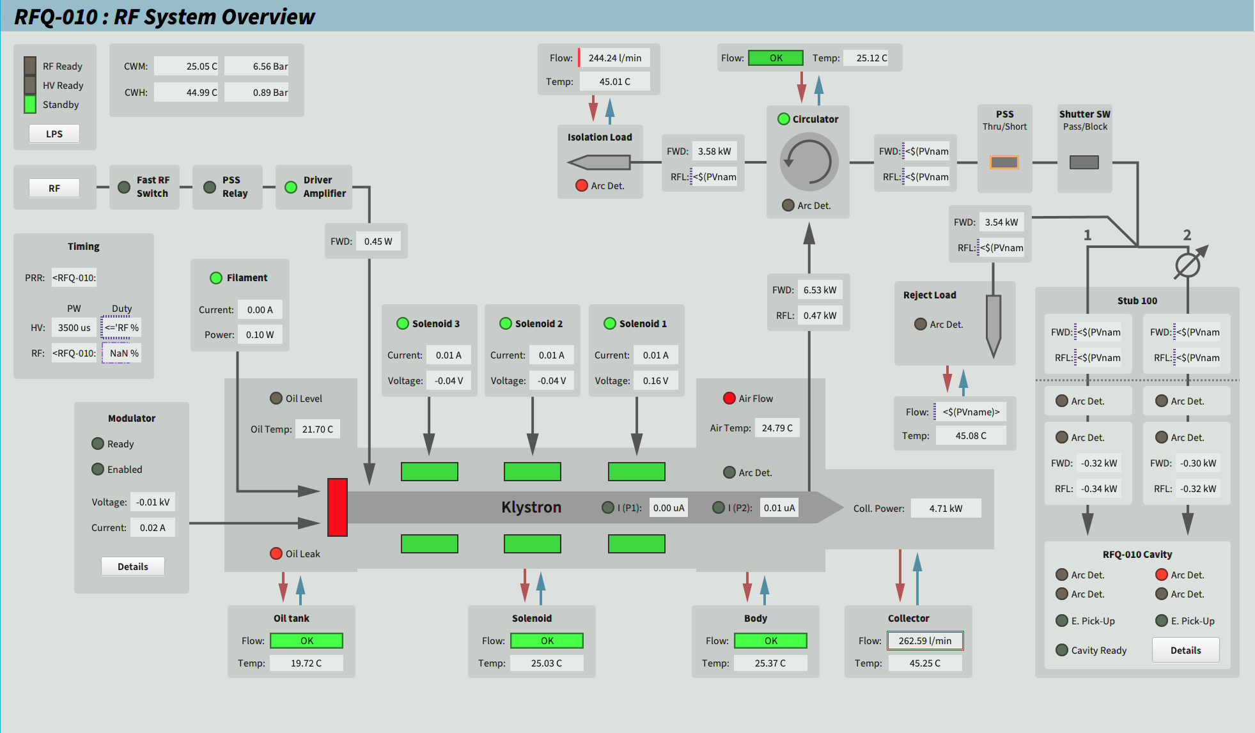
What can we interact with?
Software pt2: OPIs widgets
Many available widgets, covering most of the processes’ graphical representation
  Few more requested, pending community/developers availability
Courtesy B. Bolling

Slide 7
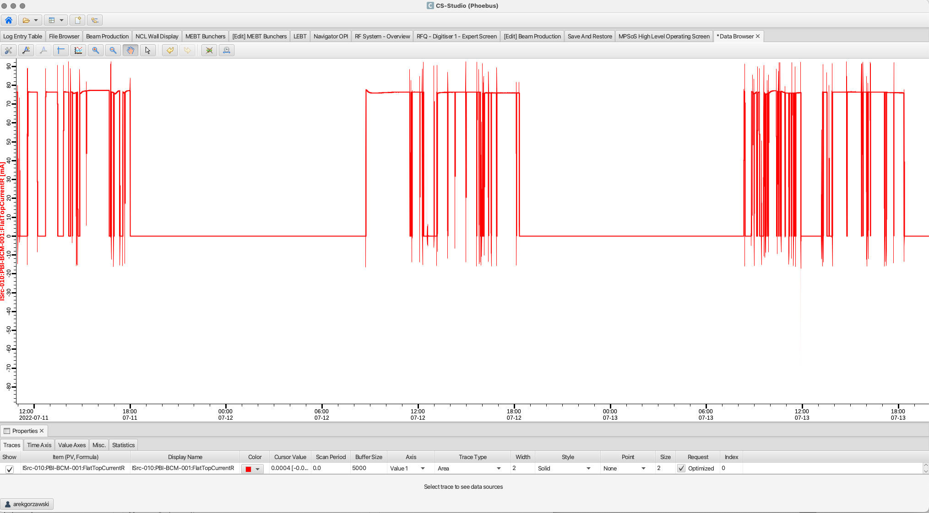
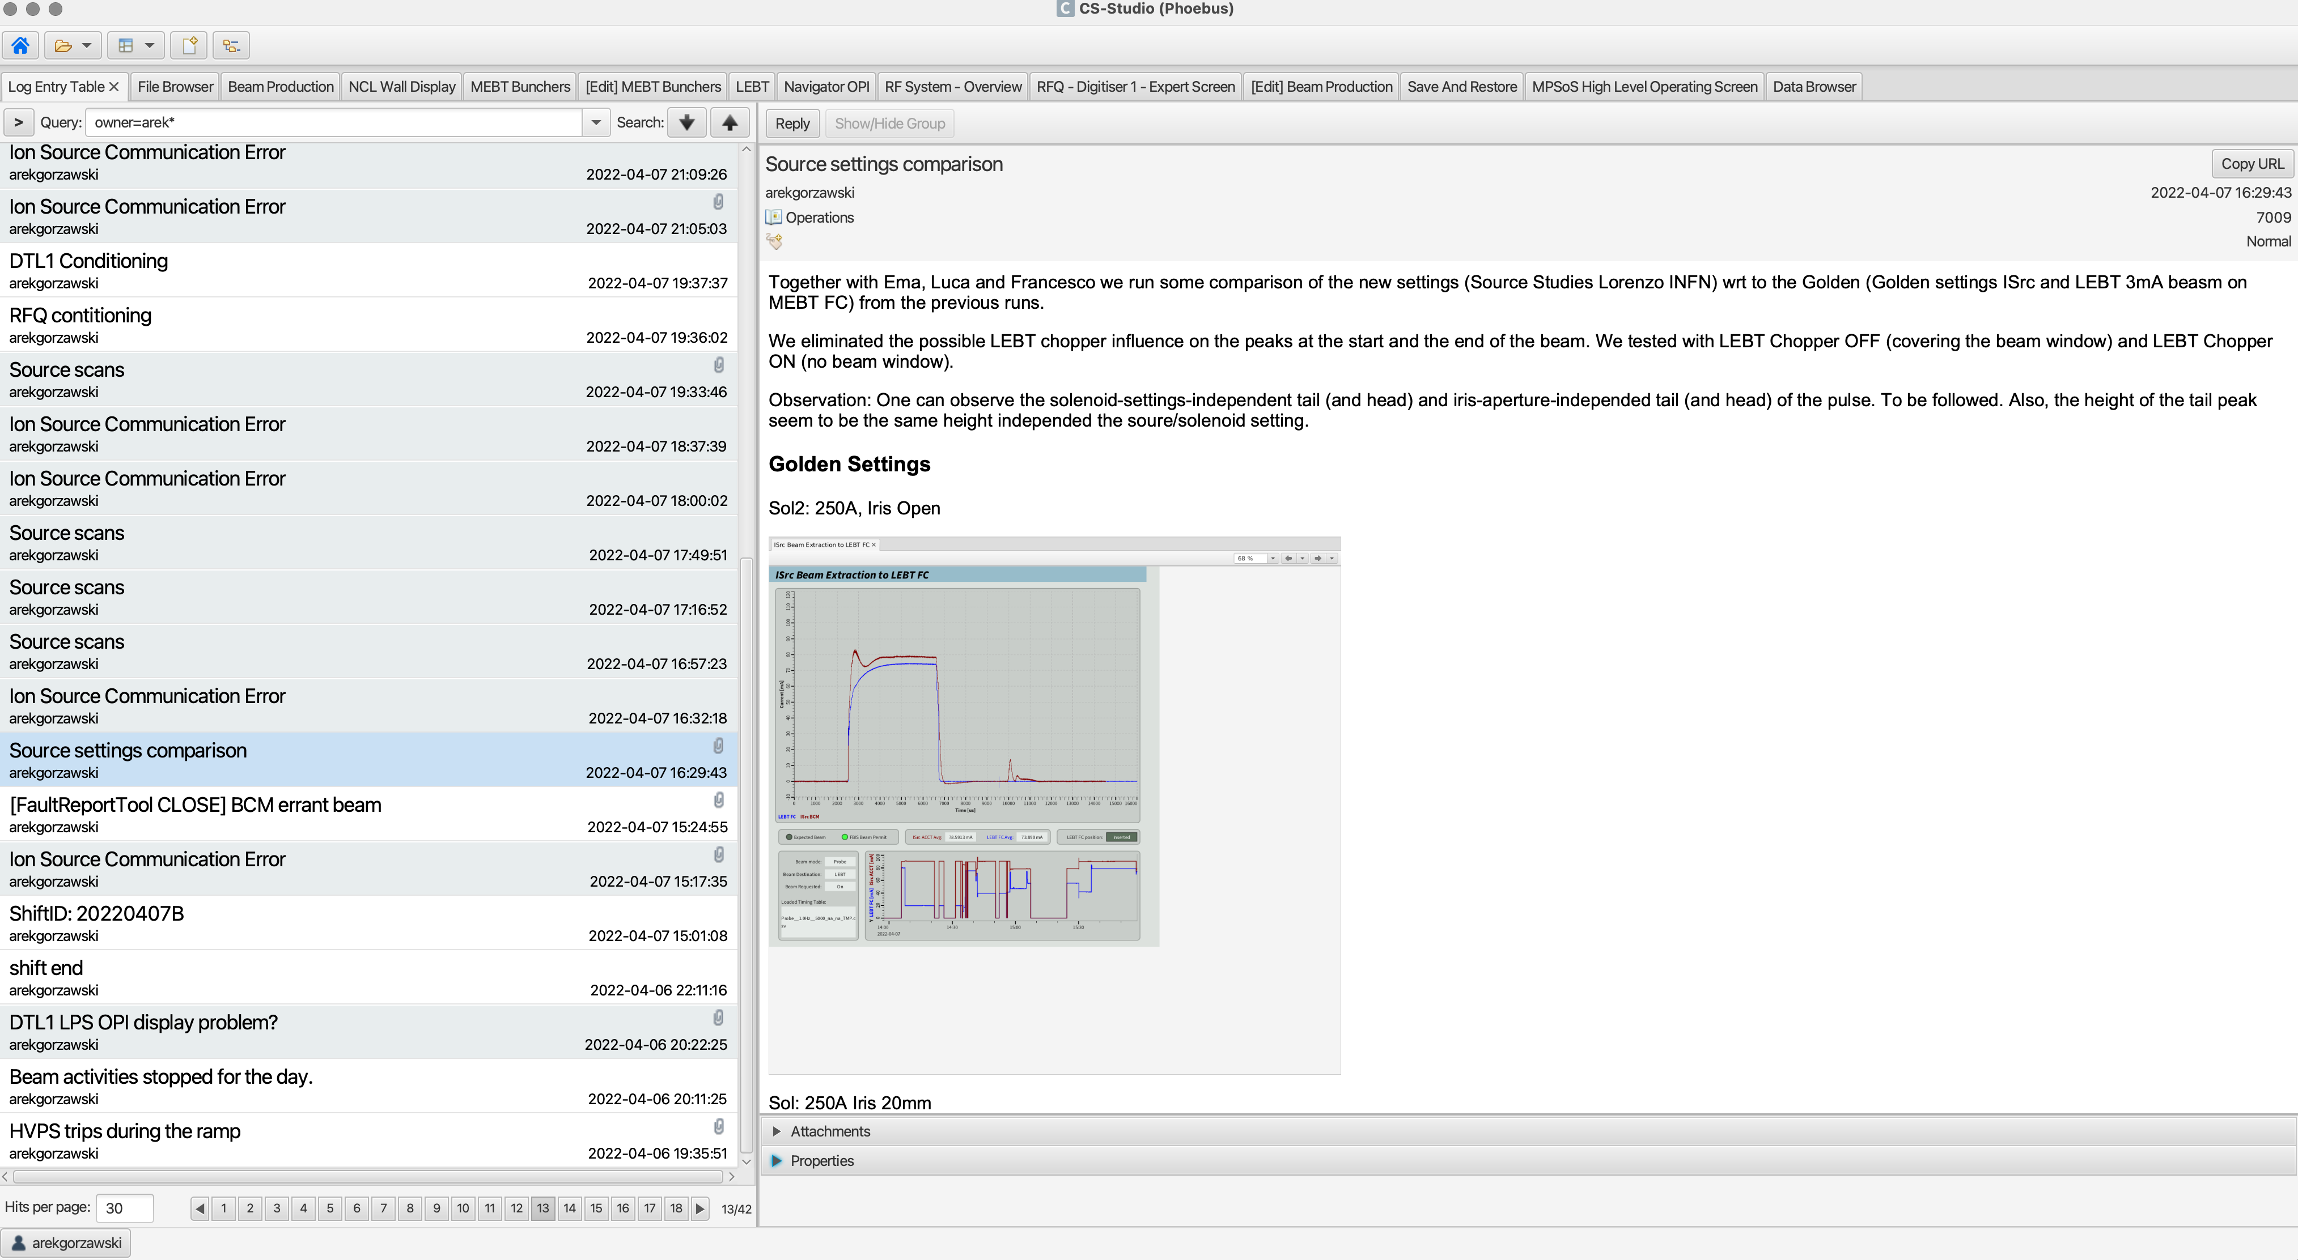
What do we interact with?
Software pt3: Logbook/ Data Browser
  Great integration with the other part of operating screens
    Easy swap from screen displayed value towards values’ trend etc.
    Easy logging (Logbook) actions, well integrated inside the CS Studio.
  New features often requires community support/approval.
    Not a trivial thing to manage…

Slide 8
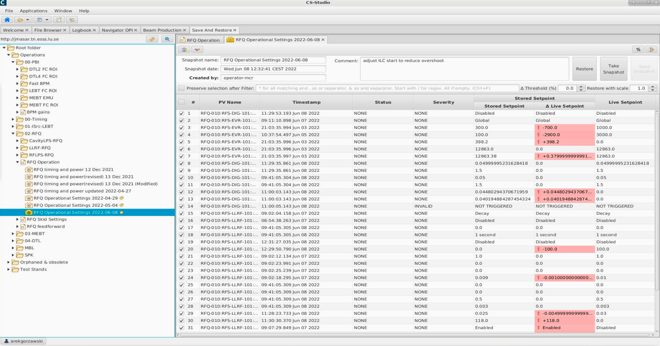
What do we interact with?
Software pt4: Save Restore (GUI)
  Good integration with the Controls Suite
    Tool used at the daily base to control machine set points
    Easy way to find the working point difference
  Missing features for dynamic control (see later part about persisting layer)

Slide 9
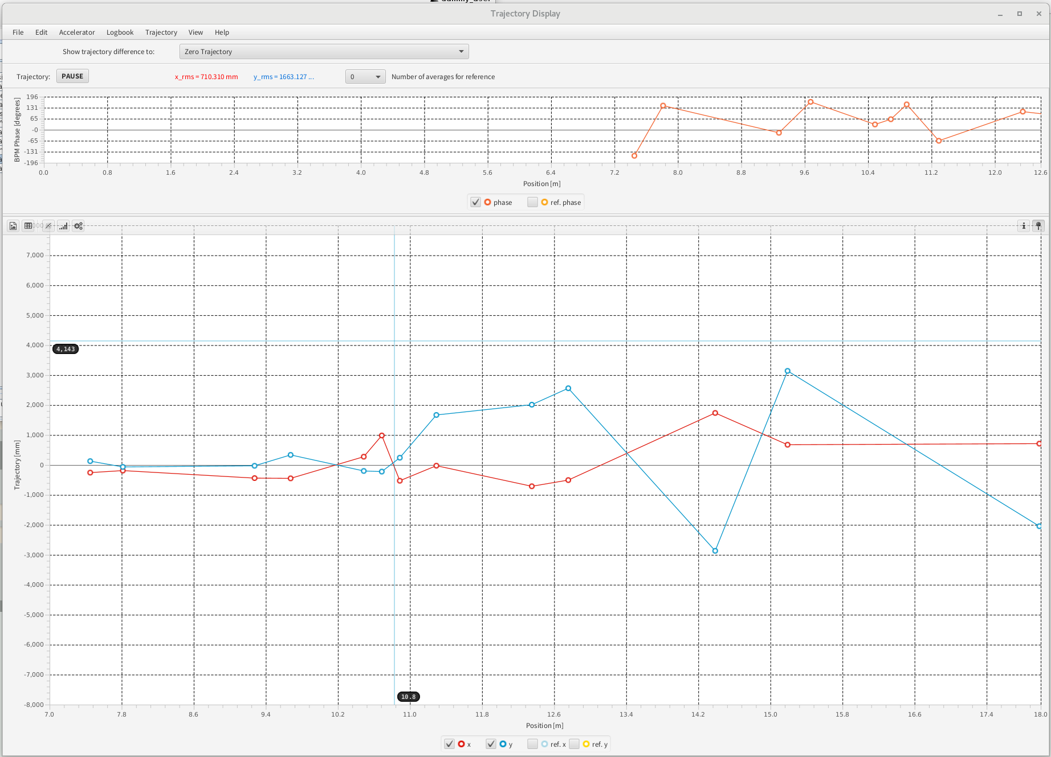
What do we interact with?
Software pt4: OXAL
  Integration with EPICS on Java level
  Primarily trajectory correction and display,
  Mainly issues with PVNames that are being changed

Slide 10
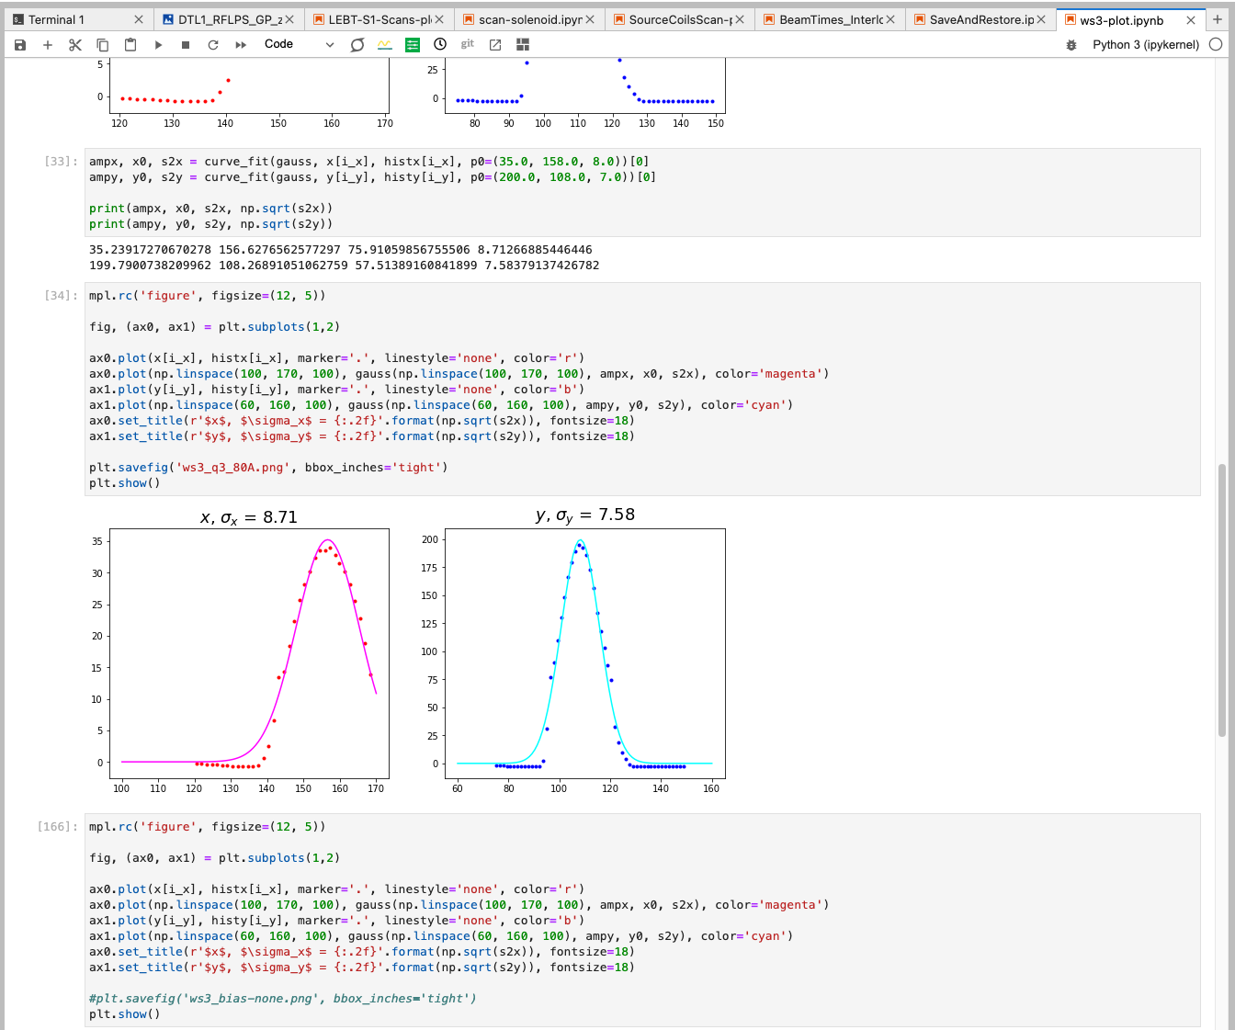
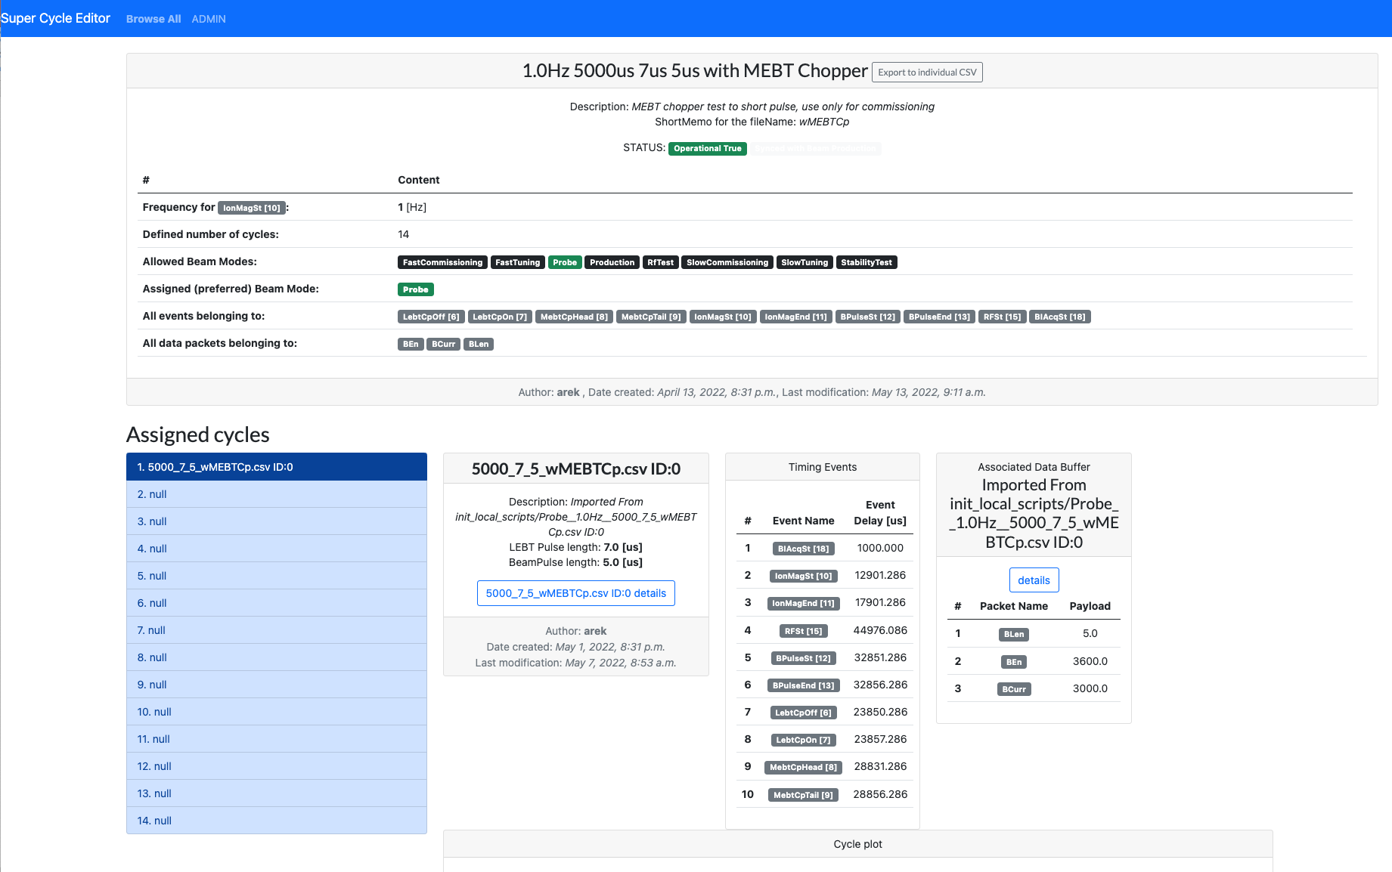
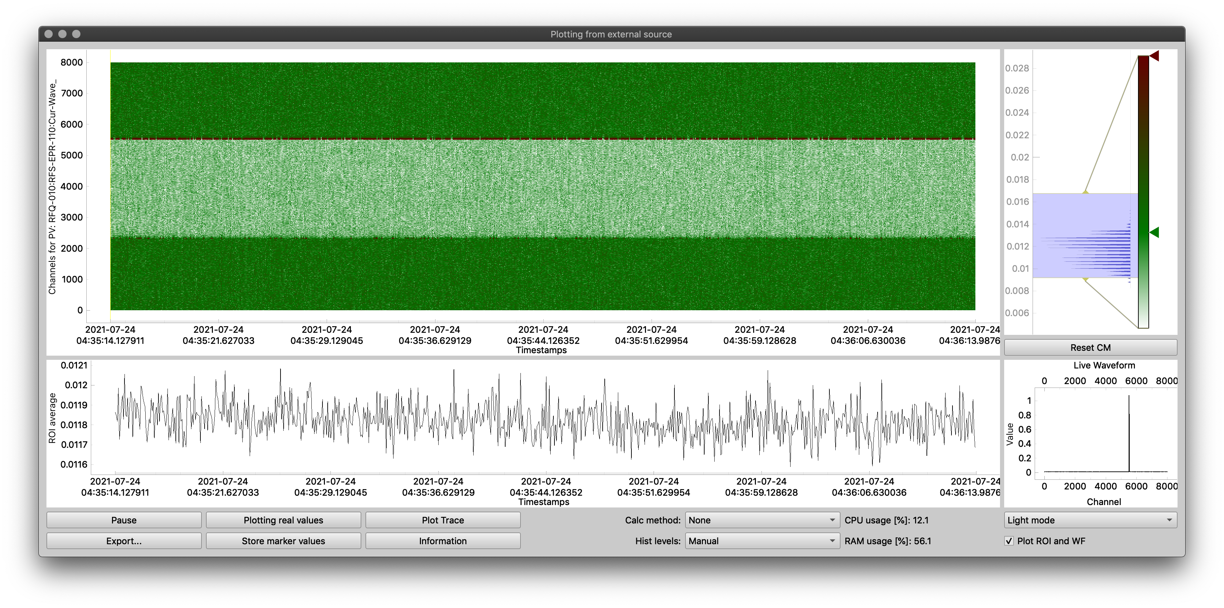
What do we interact with?
Software pt6: Python tools
  Wide use of python notebooks (jupyter) well equipped with libraries and interfaces for channel and pv access (pyepics & p4p)
  Dedicated standalone application (pyQT) to support advanced plotting/monitoring mechanisms (quite common but not supported in CS Studio).
  Tailored ESS Machine operation applications that are not yet part of the CS Studio,
    Fault Reporting Tool,
    Super Cycle Editor,

Slide 11
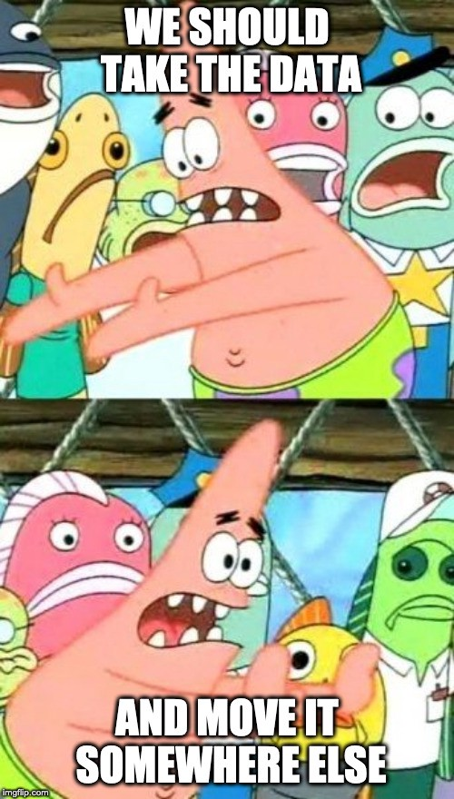
Configurations/ Persistence

Slide 12
Controls Configuration
Pt1. Configurations
  EPICS allows (and is based!) on the decentralized configuration.
    Access to the device configuration mainly through the OPIs (if exposed there)
  We lack of the central point of the configuration (PLC/IOCs) exposed for the operations
    ‘No operationally running and trustworthy’ Controls Configuration DB,
      Sparse device spectrum
      Limited configurations saved,
    Instead we have distributed IOCs DB definitions,
  We miss the programmatic revision flow for changes in the operational system,
    In order to control the process we have external procedures
  Both issues are being addressed by the Integration Team, hoping that next commissioning round will have a prototype version.

Slide 13
Operational settings
Pt2. Configurations in Save Restore (service side)
  Great tool to provide static sets of settings.
    Allows to compare saved snapshots between each other and current state of the machine
    Pretty easy to statically filter/navigate between the saved configurations
  Quite early in the commissioning we realised dynamic filters (based on the state of the machine) are needed!
    E.g. Settings for given Beam Modes/Beam Destination,
  More flexible approach on building the snapshot sets,
  Easier way to find out the machine state at times,
All improvements are being assessed, hopefully we can have them for the next round.

Slide 14
Data Persistence
EPICS Archiver Applience & hdf5
  We use two parallel nodes for scalar and light (<10k points) waveforms
  For large waveforms we have a separate node,
    about 2605 connected PVs with ~2.2 TB/day
  Archiver solution is quite often cumbersome when it comes to the saving and extraction of big amount of data,
Completely new approach on storing the high speed/high volume PVs is under the development! We hope to have a prototype early next year!
Node | Connected PV | Event rate | Data Rate (GB/day)
Archiver-01 | 172463 | 20,364.59 | 36.23
Archiver-02 | 57273 | 13,603.16 | 22.31

Slide 15
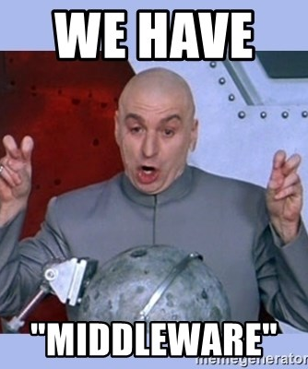
Middleware

Slide 16
What do we have to face?
Middleware pt1
  Process Variable naming changes
    Overhead of name changes. Commissioned systems (and their PV names) shall not be just fixed at any convenience moment!
    hard to make script based OPIs/applications (more exceptions than rules),
    Not too many encountered, but few very critical.
  IOC Deployment tool
    Centralized infrastructure for what/when and by who was deployed and running! Working well !
    Lacks for features for sanity checks after restart (wrt Configuration DB)
  Monitoring IOCs
    Deployment tool allows basic monitoring (ioc shell)
    No information what operational configuration the IOC was started/deployed with (see later Configuration DB)

Slide 17
How do we access it?
Middleware pt2: EPICS’ flat access
  All PVs in the technical network are accessible,
  PV Access
    Implemented in few locations (on the IOC level)
    Remote control still available and needed for the hardware/pre beam test purpose
    No flexible access (user/location not ROLE based access) for time of the intervention.
      Users have all access all the time
Is this sustainable in the commissioning/installation phase? Would that need to be changed

Slide 18
Summary
  Very nice top level experience (Control room software),
    Few minor issues, mainly driven by lack of coordination with the operations.
  Once we go deeper in the controls architecture, we notice that some part of the tools are missing,
    Critical controls configuration data base,
    Long term high resolution data storage solutions
  We aim (with the major contributions from Controls Group) to improve in the next round of commissioning

Slide 19
Thank you!

