Slide 2
Klystron RF Station Test and Operation
(in just 15 mins so –
Fasten your seat belts and hold on to your hats and glasses)
PRESENTED BY Morten Jensen on behalf of the RF Group
RF Group Leader and Work package manager

Slide 3
Accelerator Overview (47 mA)
Key parameters:
Average Beam Power: 5 MW
Peak Beam Power: 125 MW
Beam pulse width: 2.86 ms
Beam energy: 2 GeV
Final Beam current: 62.5 mA peak
Repetition rate: 14 Hz
3
30 kW Solid State Amplifiers
Early Beam commissioning
User mode (2 MW) (Blue plus Purple)
User mode (2 MW) (Blue plus Purple)
Target
ISrc
LEBT
RFQ
MEBT
DTL
SPK
MBL
HBL
HEBT
Dump
2.4 m
4.6 m
3.8 m
39 m
56 m
77 m
179 m
75 keV
3.6 MeV
90 MeV
216 MeV
571 MeV
3 MW Klystrons
1.5 MW Klystrons
47 mA, 2 MW, 1.15 GeV
200 kW Tetrodes
352 MHz
704 MHz

Slide 4
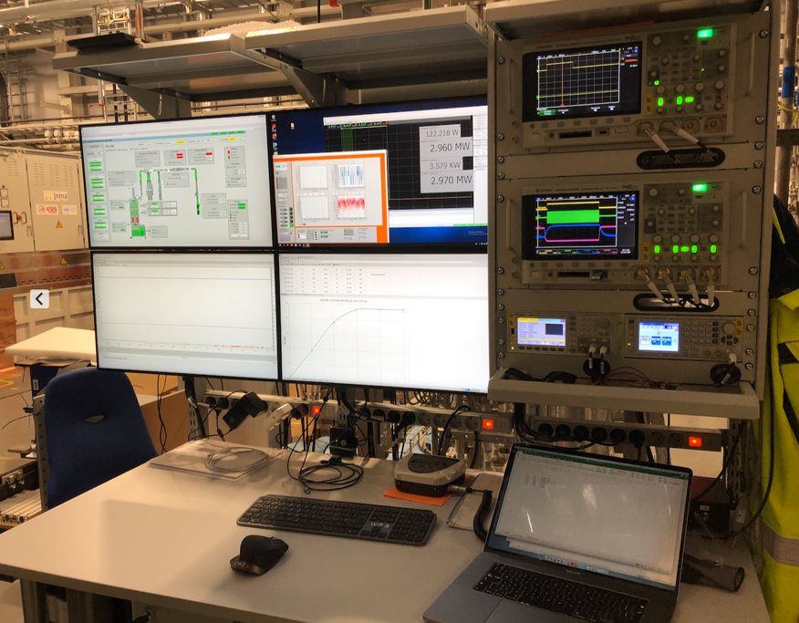
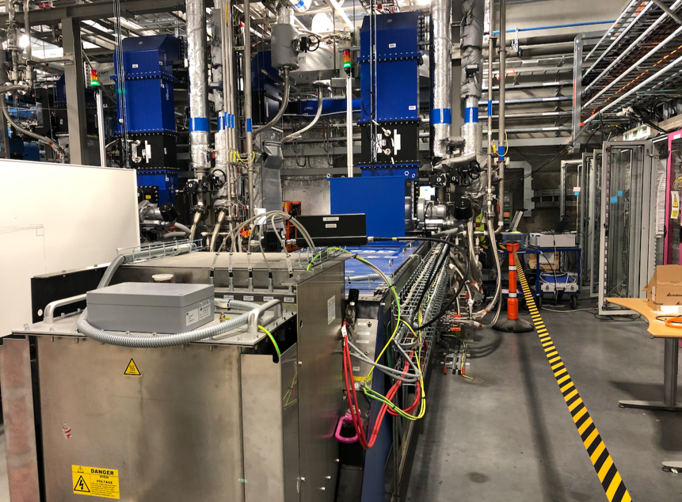
Overview of RF Testing (DTL3 example)
Klystron Incoming Inspection
ESS-3475614
Interlock Checklist
ESS-3475780
High Power Test Protocol
ESS-3428454
Low Power Test Protocol
ESS-2025267
SAT Results
ESS-3683321
LLRF Test and Verification
ESS-3122750
RFDS
Certification Protocol
ESS-3224826
System
Handover

Slide 5
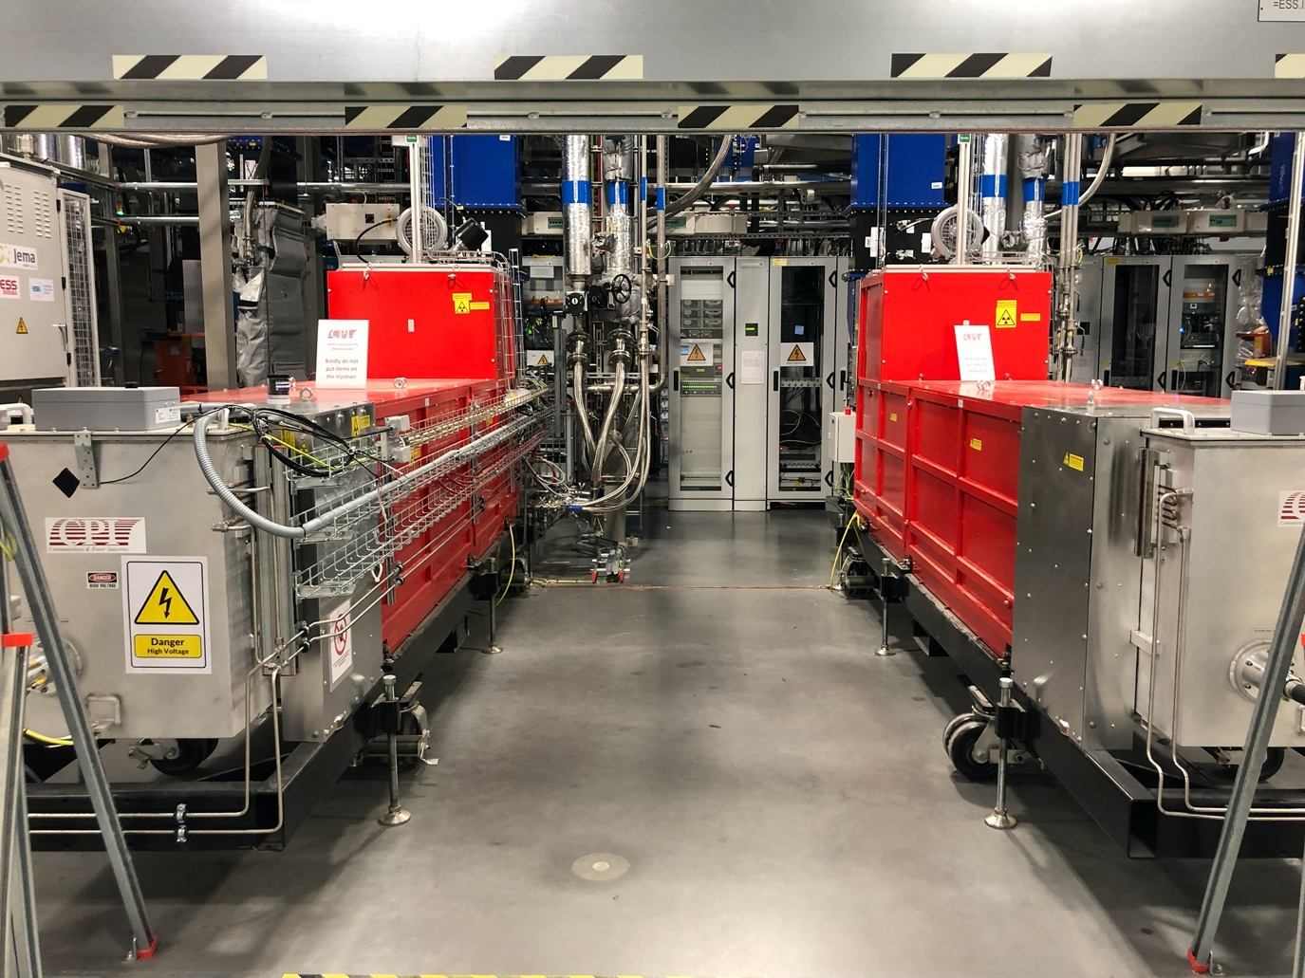
RFQ and DTLs
352 MHz 3 MW

Slide 6
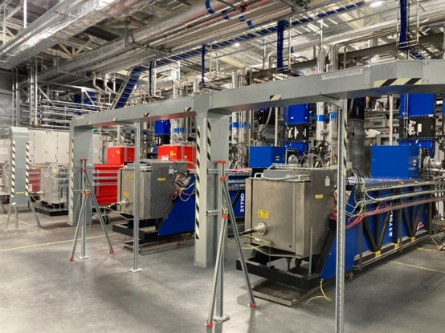
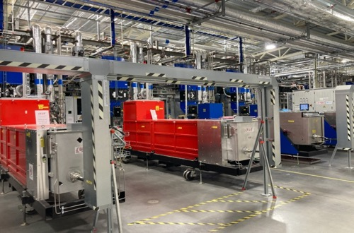
NCL Linac: klystron based power stations
Status
2 Systems in Operation
RFQ: CPI klystron – Bilbao In-kind. In operation since May 2021
DTL1: CPI klystron – Bilbao In-kind. In operation since May 2021
No major issues until now:
Additional shielding had to be implemented to be compliant to ESS limit of 1 𝜇Sv/hr
Additional cooling added around the oil tank
- Some trips due to a faulty air pressure sensor which has been replaced for a different design
Occasional DC arcs on RFQ klystron
4 Systems fully tested
DTL2: Thales klystron (ESS) installed and tested
DTL 3/4/5: Thales klystrons (Bilbao In-kind) installed and tested
Occasional DC arcs during conditioning
Additional shielding had to be implemented to be compliant to ESS limitation of 1 𝜇Sv/hr
DTL 3 and 5 klystrons had to be retuned due to the presence of sidebands: see next slides

Slide 7
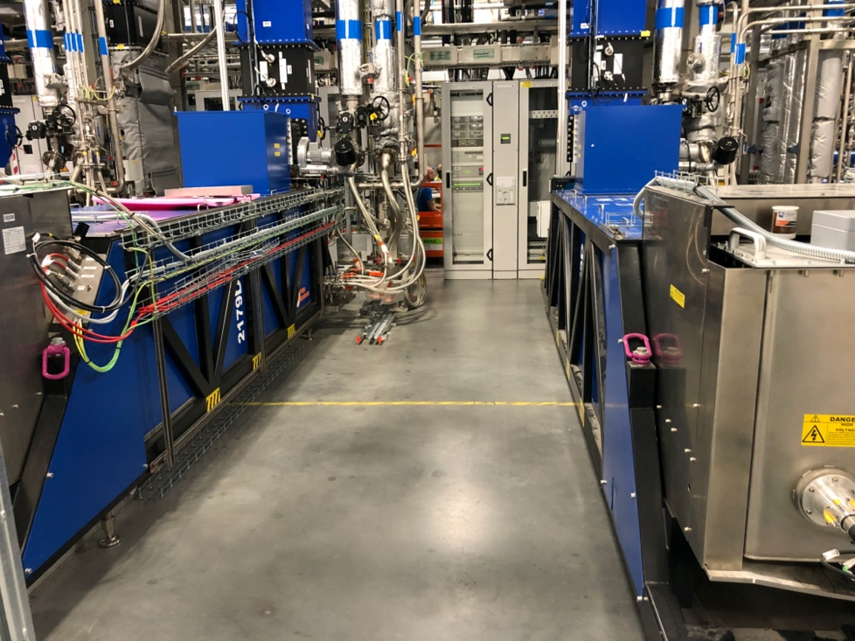
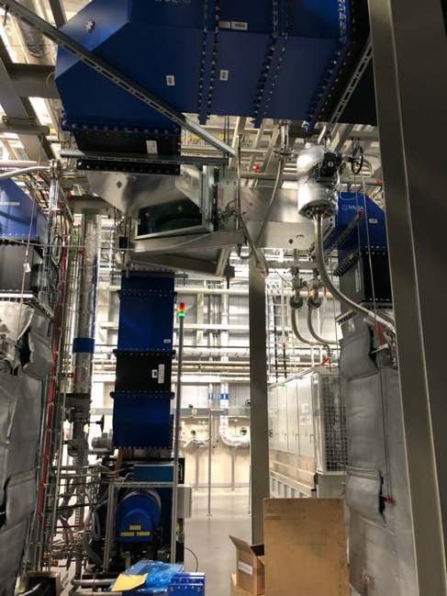
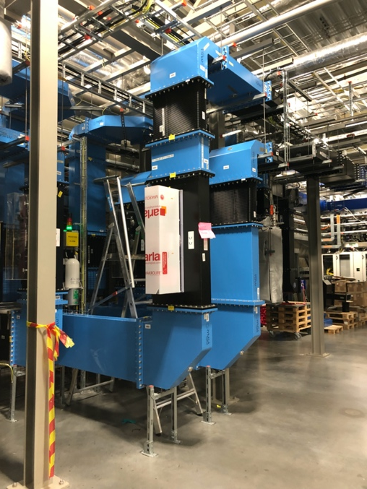
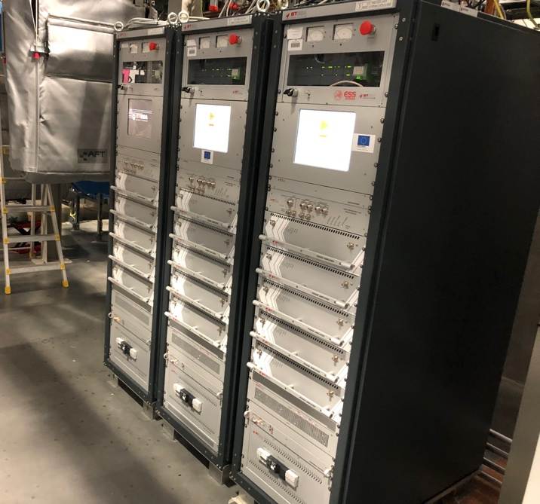
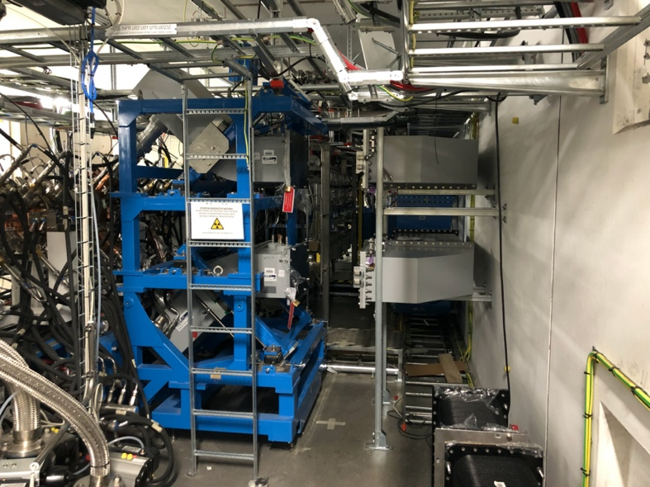
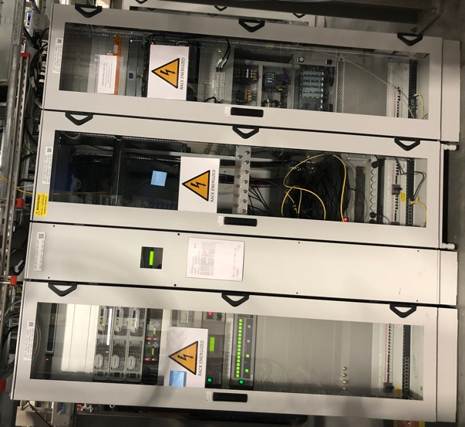
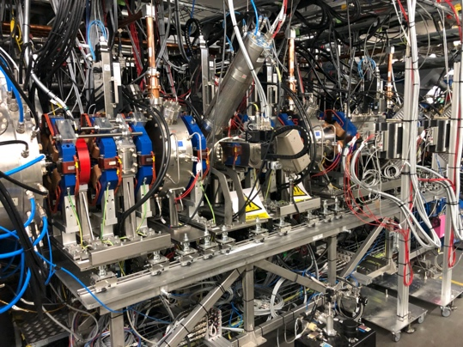
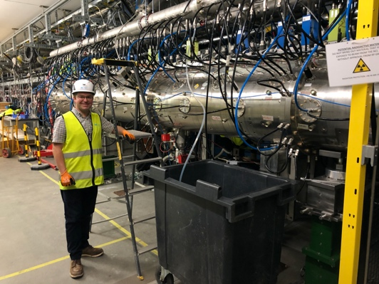
NCL RF system – RFQ, and DTLs tested and available
SSPAs
DTL 3-4 klystrons
RFDS
MEBT
DTL 1
Tunnel connection to RFQ

Slide 8
NCL Linac: klystron based power stations
TH2179D sidebands
Origin of the issue (DTL3 klystron – TH2179D S/N 179-015):
Reflected power pulse shows a strange ”step” for some levels of klystron output power.
Modulation is visible on the klystron FW waveform; analysis with spectrum analyzer reveals presence of sidebands at +/- 24 MHz from the carrier

Slide 9
NCL Linac: klystron based power stations
TH2179D sidebands
Similar issue observed on DTL5 klystron (TH2179D S/N 179-017)
but this time only in a small power region below saturation (@ Pkly=2.45 MW); No ion pump current increase observed
DTL4 klystron (TH2179D S/N 179-016) does NOT show any sign of sidebands or instabilities.
Several tests performed on the two klystrons showing the sidebands (change of HV, solenoid current, output VSWR…). Sidebands also detected when connecting the spectrum analyzer at port 3 of the INPUT circulator. Reflected electrons??
After talking to Thales, possible cause is identified in a peak of gain at about 352.21+24 MHz due to cavities 4 and 5 tuned too close to each other.
Proposed solution: retuning cavity 4
Thales found a factory note that DTL 4 klystron had to be retuned in the factory

Slide 10
NCL Linac: klystron based power stations
TH2179D sidebands: white noise measurement
DTL3 (179-015) - 100 kV
To confirm the diagnose, we measured the cavity frequency by checking the klystron output in presence of white noise only (from DC beam).
Waveguide to coax adapter connected to the klystron output
Klystron RF drive disconnected. Klystron input terminated on circulator-loads.
Spectrum analyzer connected to the adapter through a 10 dB attenuator.
2 MHz between cavity 4 and 5
DTL4 (179-016) - 105 kV
DTL5 (179-017) - 109 kV
Cavity 4 seems to be tuned about 2 MHz higher compared to DTL3/5 klystrons.
Cavity 4 and 5 are 4.5 MHz apart
2 MHz between cavity 4 and 5

Slide 11
NCL Linac: klystron based power stations
TH2179D retuning
Thales visit to retune cavity 4 on DTL3 and DTL5 klystrons
Cavity 4 retuned in few iterations by changing the length of the gap (distance between noses)
Several spectrum measurements taken at each step
After 2/3 iterations the sidebands are lower but the problem is not completely solved. Cavity 4 tuner reached its limit.
Solenoid current is then changed to find a sideband-free combination
The klystrons have been re-tested to full power and for several settings of the output match. Sidebands not detected.
New white noise measurement of cavity frequency tuning is carried out after the tuning: cavity 4 frequency is now 2 MHz higher than before.
DTL3 klystron (TH2179D S/N 179-015) - 100 kV
DTL5 klystron (TH2179D S/N 179-017) - 109 kV

Slide 12
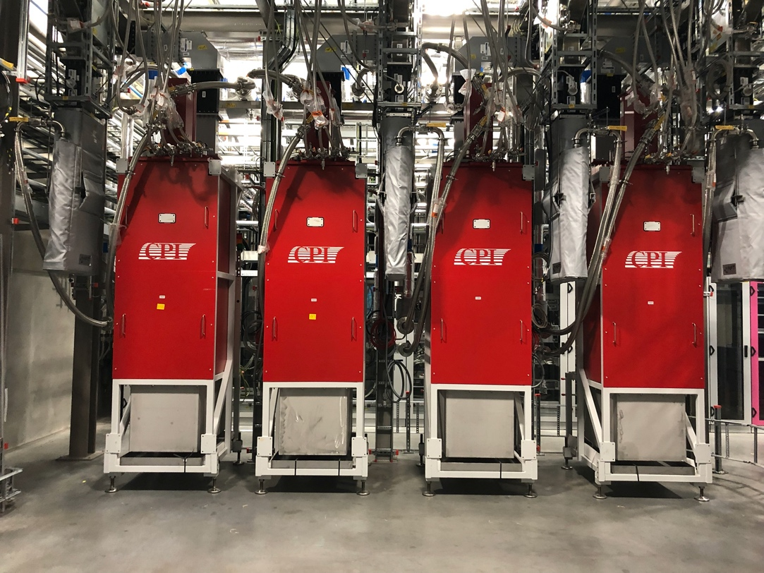
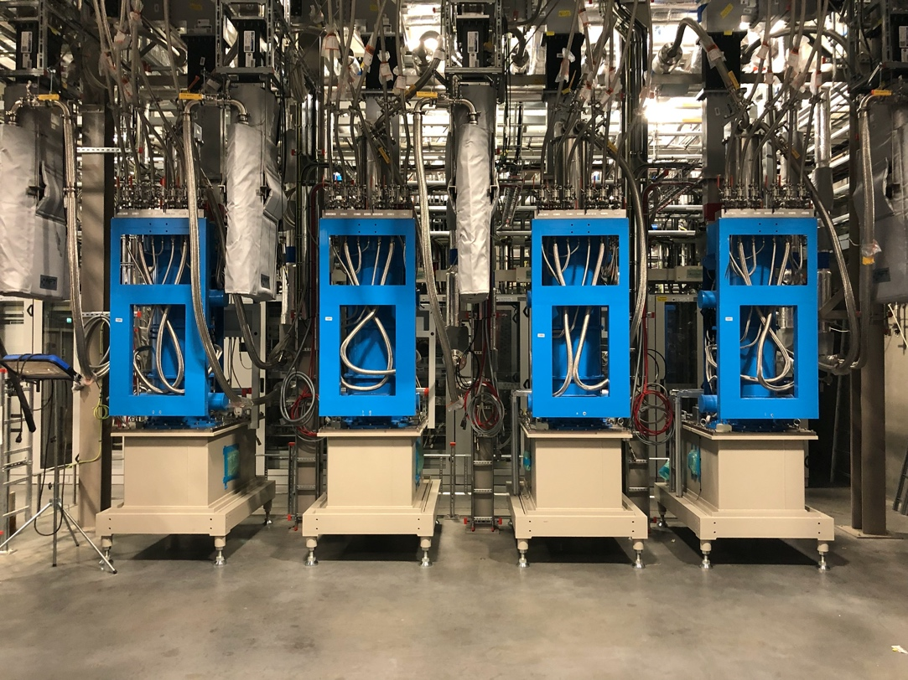
MB and HB
704 MHz 1.5 MW

Slide 13
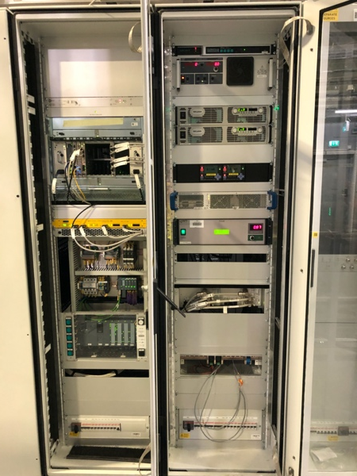
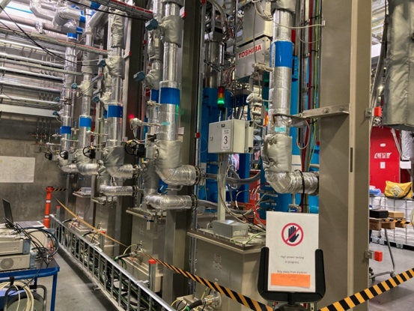
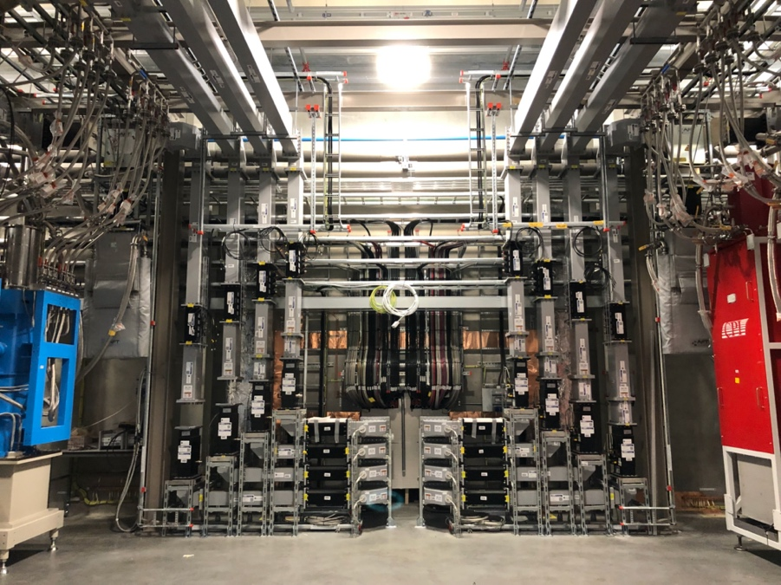
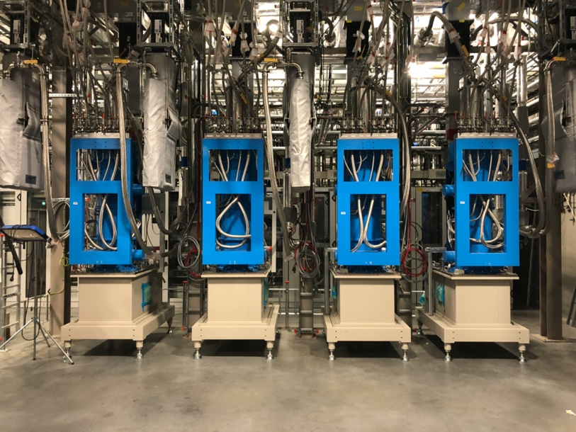

MB and HB (and Test Stand 2)
MB RF system installation practically complete with only a little LLRF cabling and cavity tuner control outstanding.
All RFDS is installed tuned and aligned.
The first 14/36 MB RF stations have completed High Power testing including LLRF
7 more systems have completed low power testing awaiting high power test.
TS2:
Two RF systems incl power dividers have been in operation for several years
Used for integration, improvement and concept testing

Slide 14
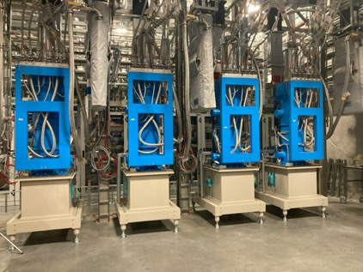
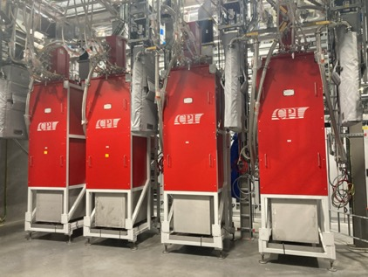
Medium and High Beta Linac
Status
Medium Beta (36 systems)
All medium beta klystrons (18 Canon + 18 CPI) have been installed in the final locations; last cell installation ongoing.
Site testing of the first 14 klystrons (8 Canon + 7 CPI) completed with no issues
DC conditioning of the next 3 klystrons (CPI) started but several issues have been met (see next slides).
Photo credits: S. Calic
High Beta (84 systems)
15 high Beta klystrons delivered from Canon; 3 more shipped from the factory.
4 High Beta klystrons delivered from Thales; 14 more to come.
Some quality issues found (pipes, frame..) and currently being addressed.
Currently installing one high beta Thales klystrons in one of the medium beta cells.

Slide 15
Medium and High Beta Linac
Early experience on the medium beta klystrons
Canon E37504
Some additional shielding (provided by Canon) had to be implemented around the collector after measurements on site
Very smooth DC and RF conditioning: DC conditioning 4 klystrons at the time.
BW measurement somehow ”delicate”: high body dissipation and cathode poisoning on one klystron when running off frequency (recovered)
White noise measurement carried out on 2 klystrons
Test with mismatch for high efficiency carried out on 2 klystrons and demostrated results comparable with FAT (see following slides)
Beam current
Ion pump current
Beam voltage
Filament current
S/N 18G005 60 kV (fundamental)
S/N 18G005 80 kV (second harmonic)

Slide 16
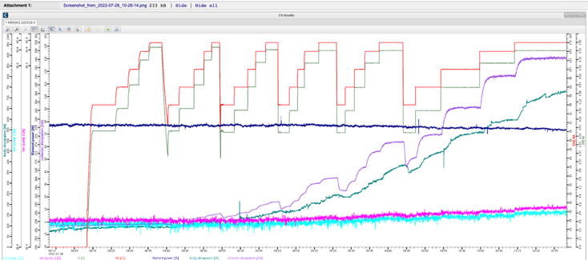
Medium and High Beta Linac
Early experience on the medium beta klystrons
SN 106:
Conditioning and Site test successful!
CPI VKP-8292A
First 4 klystrons conditioned and tested without problems
Next RF cell somehow ”problematic”:
One klystron (SN 106) conditioned and tested smoothly
The other three klystrons (SN 105/107/108) showed DC arcing (internal/external), cathode poisoning and high body dissipation
None of these issues was observed at the factory

Slide 17
Medium and High Beta Linac
Early experience on the medium beta klystrons: CPI VKP-8292A
SN 105:
DC conditioning not possible due to consistent DC arcing.
All arcs appeared to be internal and followed by ion pump current increase.
Original focusing currents resulted in cathode poisoning observed in the range 107-110 kV for long pulses (over 2 ms)
Rapid increase in body dissipation at higher voltages.
Changing settings for the bucking coil reduced slightly the body dissipation and solved the emission issue (but not the DC arcing).
SN 107:
Audible arcs in the oil tank during DC conditioning (no gas).
HV cables found too close to the bottom of the oil tank. Cables shortened and audible DC arcing disappeared.
Cathode poisoning between 107-112 kV and high body dissipation also observed.
Beam voltage
Beam current
PRESENTATION TITLE/FOOTER

Slide 18
Medium and High Beta Linac
Early experience on the medium beta klystrons: CPI VKP-8292A
NOTE:
Most of the klystrons delivered after S/N 104 were tested on a ”golden” frame/solenoid at the factory (delivered with the last tube), and assembled at ESS in the final frame, provided by Scanditronix (contracted by CPI).
SN 108:
DC arcing (internal).
Pretty active ion pump current compared to the other tubes.
Rapid increase in body dissipation at higher voltage (0ver 1.2 kW DC at less than half duty). Conditioning stopped.

Slide 19
Medium and High Beta Linac
Early experience on the medium beta klystrons: CPI VKP-8292A
Magnet swapped between tube 105 and 117 (117 frame was the one used for testing at factory) to find out if the problem is with the magnet or with the tube.
After the swap, SN105 conditioned and reached full power in one morning!
CPI suggested that the polarity of the magnetic field could have been reversed.
The polarity of the magnet power supply was then swapped on SN 107

Slide 20
G02 – Status of RF Systems wk 2241
Ready for Beam on Target (RBOT) Baseline
#
Installation on-going
CELL 100/110
CELL 120
CELL 130
CELL 140
CELL 150A
RACKS
RACKS
B1
B2
B3
RACKS
RACKS
PS1
PS2
PS5
PS6
RACKS
RACKS
PS9
PS10
PS13
PS14
RACKS
RACKS
PS17
PS18
PS21
PS22
RACKS
RACKS
PS25
RACKS
#
Installation complete ready for test
NCG + SPK
352.21 MHz
#
Low Power Tested
K1
K2
K3
K4
K5
K6
PS3
PS4
PS7
PS8
PS11
PS12
PS15
PS16
PS19
PS20
PS23
PS24
PS26
#
High Power Tested
M1
M2
M3
NCL: Klystron@3 MW
Bunchers: SSPA@30 kW
SPK: Tetrodes@400 kW
MB: Klystron@1.5 MW
HB: Klystron@1.5 MW
CELL 150B
CELL 160
CELL 170
CELL 180
CELL 190
K1
RACKS
RACKS
K5
K9
RACKS
RACKS
K13
K17
RACKS
RACKS
K21
K25
RACKS
RACKS
K29
K33
RACKS
MB
K2
K6
K10
K14
K18
K22
K26
K30
K34
K3
K7
K11
K15
K19
K23
K27
K31
704.42 MHz
K35
K4
K8
K12
K16
K20
K24
K28
K32
K36
M1
M2
M3
M4
M5
M6
M7
M8
M9
CELL 200
CELL 210
CELL 220
CELL 230
CELL 240
RACKS
K1
K5
RACKS
RACKS
K9
K13
RACKS
RACKS
K17
K21
RACKS
RACKS
K25
K29
RACKS
RACKS
K33
RACKS
K2
K6
K10
K14
K18
K22
K26
K30
K34
HB
704.42 MHz
K3
K7
K11
K15
K19
K23
K27
K31
K35
K4
K8
K12
K16
K20
K24
K28
K32
K36
M1
M2
M3
M4
M5
M6
M7
M8
M9
Post RBOT Scope
2023
TBC

Slide 21
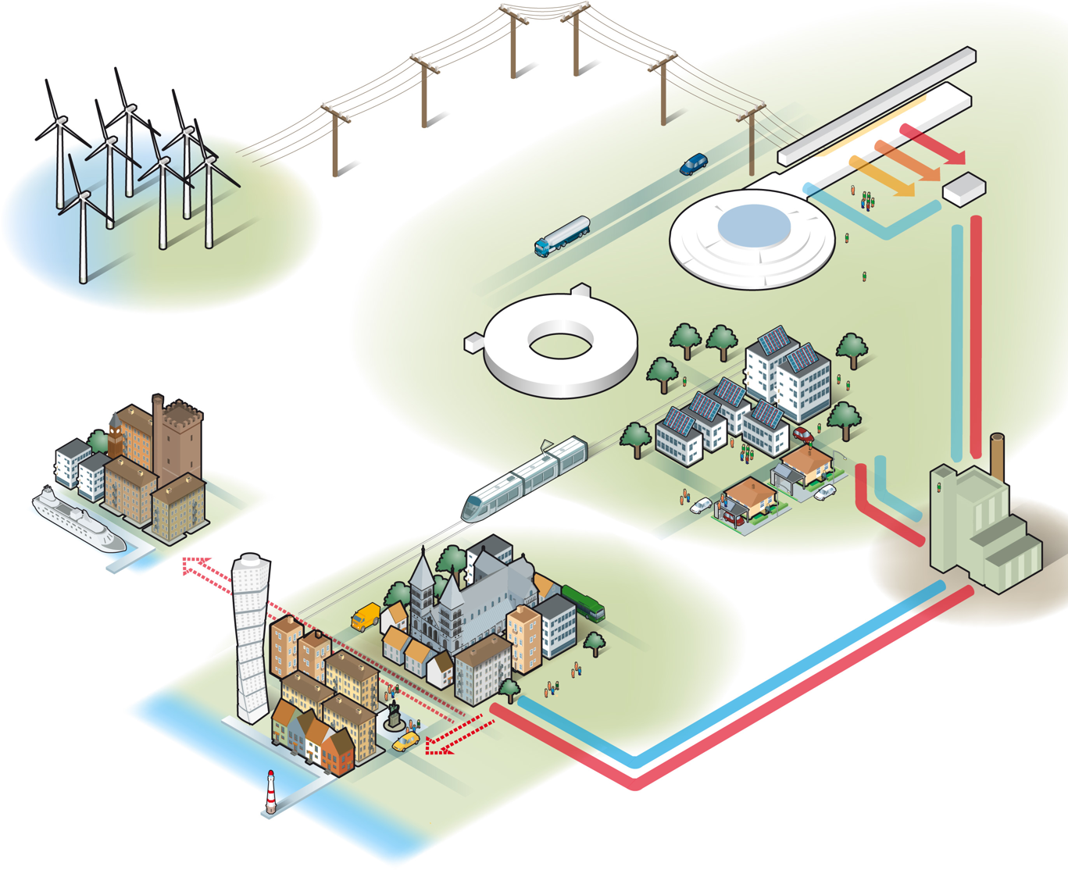
Energy Efficiency

Slide 22
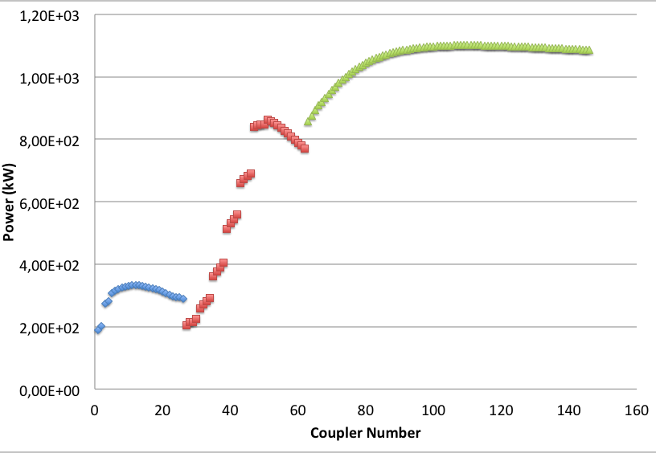
Medium and High Beta Linac
Energy efficiency optimization
CPI Klystrons: efficiency at saturation ≈ 61-65% (from FAT results)
Canon Klystrons: efficiency at saturation ≈ 63/69% (from FAT results)
Thales Klystrons: efficiency at saturation ≈ 63/66% (from FAT results; only 4 delivered)
Due to the ESS power profile along the medium beta Linac, if we operate all klystrons at nominal HV (the HV needed to have 1.5 MW power at saturation), and considering only steady state (no transients):
Superconducting Linac (97%):
84 High β cavities: 704 MHz, input power from 835 kW to 1.1 MW (plus 30% overhead)
26 spoke cavities: 352 MHz, maximum power at coupler 332 kW
36 Medium β cavities: , input power from 200 kW to 866 kW (plus 30% overhead)
Low efficiency at operation point
Considerable amount of power to heat that has to be removed
Klystron lifetime is reduced

Slide 23
Medium and High Beta Linac
Energy efficiency optimization
Step 1: lowering klystron HV as much as possible – considering overhead for regulation+losses (25%) and the limit on filling time of superconducting cavities.
Step 2: when lowering the HV the klystron efficiency at saturation is usually lower
When reducing the beam voltage and current the space charge forces between the electrons vary and the cavity position is not optimum anymore
The impedance of the beam increases -> the external Q of the output gap is also not optimal anymore
Possible solutions:
The plasma wavelength can be slightly changed by acting on beam radius -> changing magnetic focusing field
The external Q of the output cavity can be adjusted by varying the matching of the output cavity (output VSWR)

Slide 24
Medium and High Beta linac
Test of Canon E37504 at lower HV
Results from Canon E37504 S/N 18G005 testing at ESS site
Nominal HV: 106.8 kV (21.74 A)
Saturated Output Power at nominal HV: 1.55 MW
Saturated Efficiency at nominal HV: 66.7%
Saturated efficiency at 73.6 kV with output iris installed and solenoids adjusted: 69%
No instabilities, spurious or abnormal phase behavior
Output mismatch for operation at reduced HV was also implemented on the CPI and Thales prototypes and successfully tested during the FAT
13% increase in efficiency!

Slide 25
Medium and High Beta Linac
More advantages….
Filament power could be reduced at lower HV, potentially increasing klystron lifetime
20% increase in klystron lifetime will mean 7 k€/year/klystron (if we assume 400 k€ for klystron cost and klystron lifetime 10 years) -> 350 k€/year for 50 klystrons
Reducing HV means less stress on the equipment (klystron cathode, collector, modulator components…)
The heat load is reduced -> less power required for cooling

Slide 26
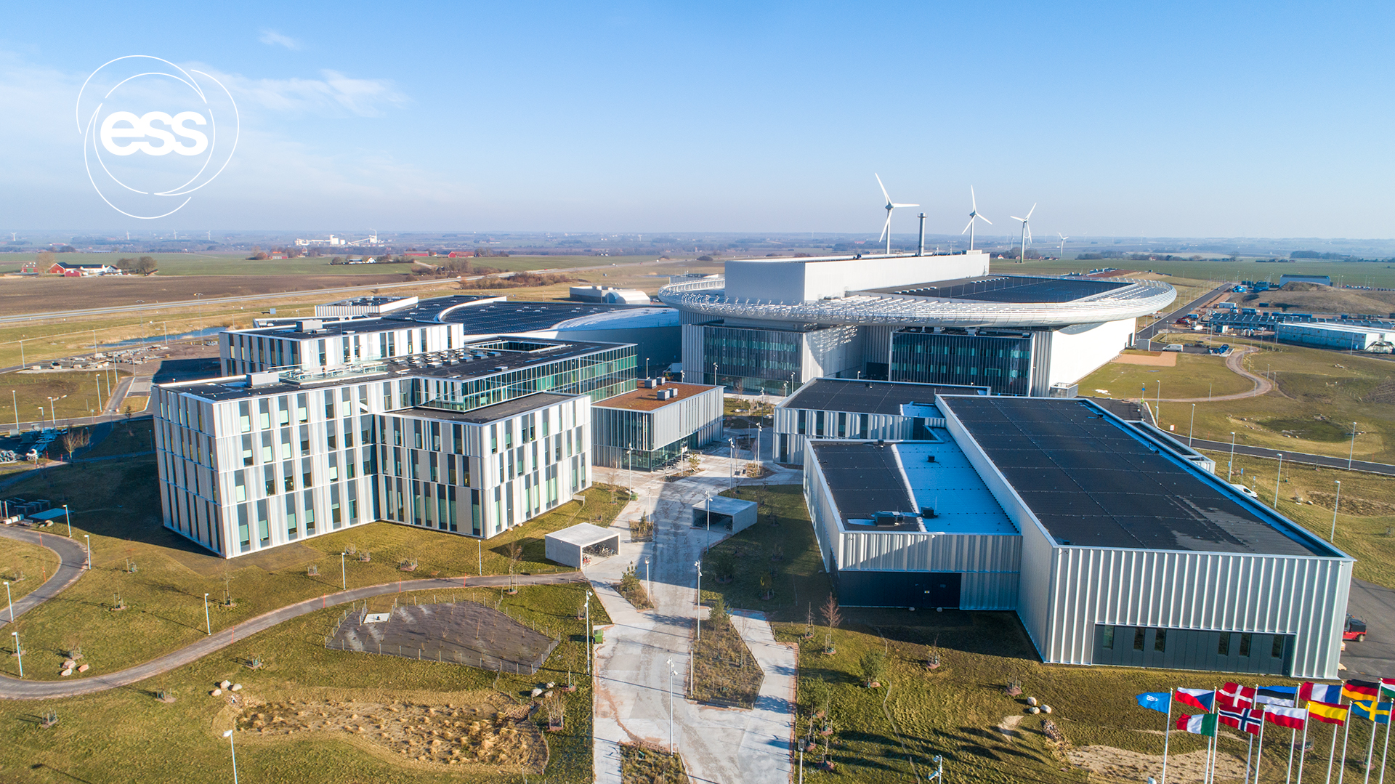
Thanks to the RF Group and in particularly Chiara Marrelli for the slides (Full Klystron talk is available here CWRF 2022 https://indico.cern.ch/event/1116404/
Any Questions or Comments?

Slide 27
Medium and High Beta Linac
Efficiency at operating point: step 2
Use of output mismatch AND solenoid adjustment to improve efficiency at lower beam voltages
Assuming we are able to keep the same efficiency at low voltages as at nominal (demonstrated on Canon klystrons, will require some more work for the others)
Superconducting Linac Power profile:
84 High β cavities
spoke
36 Medium β cavities

Slide 28
Medium and High Beta Linac
Electricity Savings when optimizing klystron operation
Savings using mismatch in all cells
Assumptions:
- Modulator efficiency: 90%
- Price of electricity: 0.09 €/kWh
- Klystrons operating 5500 h/year
Savings/year lowering HV: 1627 k€/year (18.1 GWhr/year)
Savings/year lowering HV + Optimization with mismatch≈ 1881 k€/year (20.9 GWhr/year)
Savings/year just due to Optimization with mismatch: 253 k€/year (2.8 GWhr/year)
High efficiency klystron upgrade would increase the savings even more (up to 28 GWhr/year, 594 k€/year more compared to current klystron optimized for low power)
…probably more if the price of electricity goes up
And that’s not it….

Slide 29
Medium and High Beta Linac
…and more possible savings
Delay between HV and RF can be reduced to zero to increase the operational efficiency.
This way cavity filling can start before and the initial »power step» can be slightly reduced.
Tested so far in open loop only (work ongoing)

