Slide 2
Updates on the High Level Requirements and Technical Description for ESS ODHDS
PRESENTED BY Donya daryadel

Slide 3
Agenda
ODH Monitors Redundancy
ESS Gas Alarm Strategy
ODH Confirmed Alarm
Interface with fire alarm/off-site alarm service
Emergency Response OPI
Mute the Audible Alarm function
Reset the ODH alarm remotely
Alarm circuit fault monitoring
ODHDS UPS backup time
CTLG confined space
ODHDS Zone States

Slide 4
ODH Monitors Redundancy
ODHDS fault tolerance
Linked to the evacuation time criteria, based on PDR committee recommendations and experiences at CERN and SNS.
ODH_HLREQ2: The ODHDS shall have a fault tolerance of “X” ODH monitors if the placement of other monitors in the area is such that the evacuation time criteria can be met without considering the “X” number of faulty monitors.
  This tolerance shall be zero in areas for which the evacuation time criteria is unavailable.

Slide 5
ODH Monitors Redundancy
Evacuation time criteria
Based on fire and egress analysis for the accelerator tunnel and gallery [1], there are two concepts for safe evacuation time as below:
  ASET (Available Safe Egress Time): The time until critical conditions
  RSET (Required Safe Egress Time): The total time to evacuate from the acceleration building to a safe place
Critical condition criteria for ODH needs to include:
  The critical O2 level
  The critical height of oxygen deficiency
  The critical temperature
Calculating ASET requires critical condition criteria definition for ODH and simulating ODH propagation inside the tunnel and emergency exits.

Slide 6
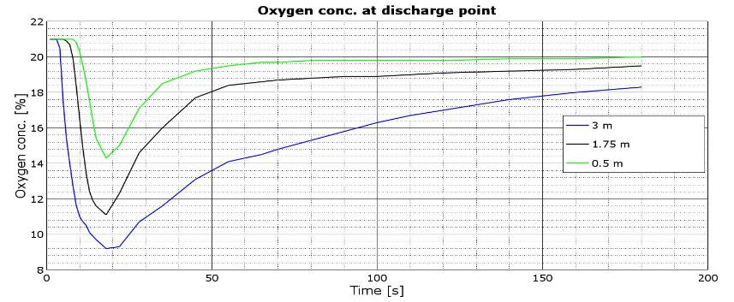
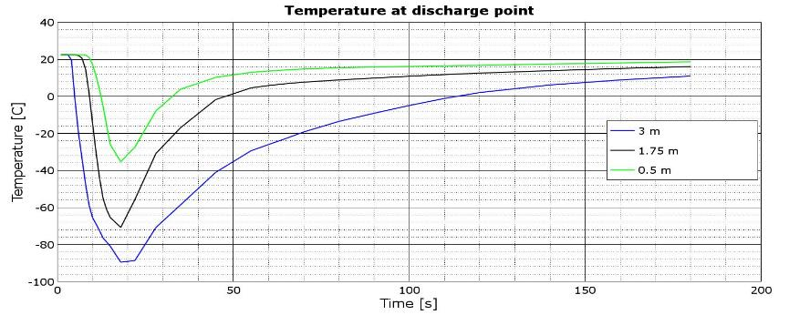
ODH Monitors Redundancy
Accelerator ODHDS, ASET
For accelerator ODHDS, ASET calculation is not available.
The O2 level can reach below 15% at discharge point quite soon, in around 10s.
The temperature can reach below -40˚C in around 11s.
Based on the below diagrams, ASET could not be more than 20s.

Slide 7
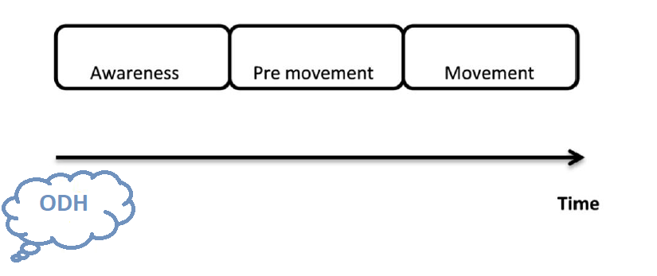
ODH Monitors Redundancy
RSET definition
RSET=Awareness time+ Pre-movement time+ Movement time
Awareness time: The time from when an ODH starts until the occupants in a building becomes aware of an ODH
Pre-movement time: The time from when people become aware of the ODH until they start to evacuate.
Movement time: The time it takes to get to an open place or another safe place after the occupants have started to evacuate.

Slide 8
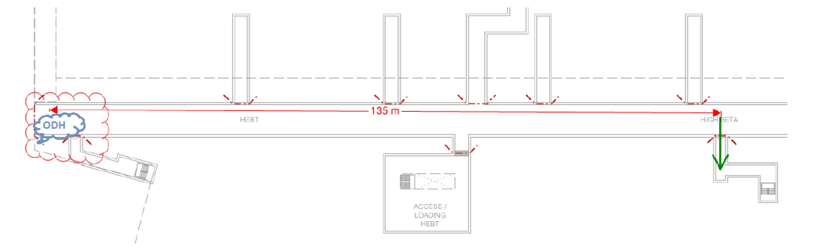
ODH Monitors Redundancy
Accelerator ODHDS, RSET
Awareness time: Propagation time+ detection time+ alarm triggering time
A rough estimation of ACC ODHDS Awareness time ~ 10+7+1= 18s
Acc. to [1], the pre-movement time has been considered around 60s, but since it depends on the level of personnel training and human reaction, it can be reduced.
Acc. To [1], movement time will be around 90s, assuming 1.5 m/s evacuation speed and 135m worst case evacuation distance
Based on the above estimations, the RSET for ACC ODHDS will be around 168s.

Slide 9
ODH Monitors Redundancy
Accelerator ODHDS, fault tolerance
“X” fault tolerance for the ODH monitor, means that the ASET will be larger than RSET even with losing “X” monitors of ODHDS.
Losing “X” monitors increases the detection time and awareness time consequently which leads to longer RSET.
The estimated RSET (168s) with fully operational ACC ODHDS is much greater than ASET (<20s) for ACC ODH.
So the fault tolerance for ACC ODHDS can not be more than “0”.

Slide 10
ODH Monitors Redundancy
Accelerator ODHDS, ODH monitor faulty or in lost communication state
ODH_TD22: If a fault or lost connection is detected in at least one ODH monitor in the accelerator tunnel:
  The gas alarm light and sounder inside and outside the accelerator tunnel are triggered and remain ON until all ODH monitors in the tunnel come back to normal or the sounders are muted from the ODHDS main OPI or HMI by the operator.
  The ODH evacuation alarm is transmitted to the fire alarm system to be repeated in the relevant evacuation zones including G01 and G02 areas except for the areas covered by gas alarm devices as long as the ODH evacuation alarm is active.

Slide 11
ODH Monitors Redundancy
Accelerator ODHDS, ODH monitor in maintenance mode
ODH_TD23: Putting an ODH monitor into maintenance mode will ignore any alarms from that monitor.
ODH_TD24: ODH Evacuation Alarm won’t be triggered in case one or several ODH monitors in one zone are put in maintenance mode with the other ODH monitors in a normal state.
The necessary compensation measures shall be taken in case of the ODH monitor is in maintenance mode.
The compensatory measures for putting ODH monitors in maintenance mode shall be as per the risk assessment.
Putting an ODH monitor in maintenance mode shall decrease the fault tolerance level of the ODHDS, but since the ACC ODHDS fault tolerance is “0”, it has no impact on it.

Slide 12
ODH Monitors Redundancy
CryoB ODHDS updates
For CryoB ODHDS, RSET, and ASET evacuation time analysis is not available.
Taking into account that required data is not available for specifying the fault tolerance level of CryoB ODHDS, the most reasonable approach is to consider zero fault tolerance for this ODHDS the same as ACC ODHDS.
In this case, ODH evacuation alarm will be triggered while one monitor is faulty or in a lost communication state.
Requirements for putting ODH monitor in maintenance mode will be the same as accelerator ODHDS.
Question to the committee:
  Does it make sense to consider fault tolerance zero for all the CryoB ODHDS zones?

Slide 13
ESS Gas Alarm Strategy
Merging ODH, H2 and toxic gas alarm
As mentioned in the previous presentation, ODHDS is expanded to cover ODH, H2, and toxic gas alarms where applicable, based on PDR committee recommendations.
ODH_HLREQ8: ODH alarming, H2 alarming, and toxic gas alarms shall be part of the same alarm called the ESS gas alarm.
ODH_HLREQ11: All gas alarm devices across ESS shall stream the same tone.

Slide 14
ESS Gas Alarm Strategy
Gas alarm device installation areas
ODH_HLREQ12: The gas alarm devices shall be installed in the following areas:
  ODH class 1 areas, where ODH source exists or ODH can propagate into.
  ODH areas specified by the ESS safety committee to be treated as class 1, where ODH source exists or ODH can propagate into.
  ATEX areas, including H2 source.
  Areas where H2 can propagate into, but there is no source of H2 inside it.
  Areas including toxic gas sources .
  Areas where toxic gas can propagate into, but there is no source of toxic gas inside it1.
  Areas that need to be evacuated by passing through the types of areas mentioned above.

Slide 15
ESS Gas Alarm Strategy
Gas alarm activation criteria
ODH_HLREQ14: The ODHDS shall trigger a gas alarm in an area according to the alarm activation matrix if any of the following is true and applicable:
  O2 level is detected as less or equal to 18% by any ODH monitor in the area.
  Number of faulty ODH monitors is higher than allowed by the ODH monitor fault tolerance for the area. (see ‎ODH_HLREQ2).
  H2 level is detected as more than 10% LEL by any H2 detector in the area.
  Toxic gas level is detected more than TBD by any toxic gas detector in the area.
  The mains power is disconnected, and the capacity of the backup power is reduced to the level that can sustain less than 30 minutes of operation in the alarm state.

Slide 16
ESS Gas Alarm Strategy
Repeating gas alarm through fire alarm system
ERT requires evacuating a full evacuation zone where an ODH happens, to get an overview and enable a safe state for occupants e.g. both G01 and G02 have to be evacuated in case of ODH in G01 (ACC tunnel).
So it is decided to repeat the gas alarms through the fire alarm system in areas that belongs to the same evacuation zone but don’t include gas alarms.
ODH_HLREQ15: The gas alarm shall be repeated in designated areas (other than the ones mentioned in ‎ODH_HLREQ12) via a fire alarm system for evacuation. The designated areas will be determined through risk assessment.
In accelerator ODHDS, the ODH evacuation alarm is transmitted to the fire alarm system to be repeated in the relevant evacuation zones, including G01 and G02 areas, except for the areas covered by gas alarm devices as long as the ODH evacuation alarm is active.
Currently, there is no such interface between CryoB and TS2 ODHDS with a fire alarm system to repeat the ODH evacuation alarm, this will be added in the future system update.

Slide 17
ESS Gas Alarm Strategy
CryoB and the accelerator ODHDS status
  Currently there are no H2, toxic gas sources in TS2 and Cryo buildings areas.
  The ISrc H2 gas detection system is independent of the accelerator ODHDS. It will be further assessed in future whether these two systems should merge.
  So gas alarm devices in the ACC ODHDS and CryoB ODHDS, only represent ODH alarm.

Slide 18
ODH Confirmed Alarm
Background
  As mentioned in the previous presentation, as of today ERT considers “confirmed accident” to be one fixed monitor accident alarm + PPE monitor alarm OR one fixed monitor accident alarm with a trend data.
  When ESS soon arrange for transmission to SOS, there will still be a call back to gate guard. But in case of confirmed accident, the accident alarm transfer then may be defined as a rescue operation, where the municipality cover their own costs.
  Currently the trend of O2 level for each oxygen monitor and also the status of oxygen monitors are available on ODH OPI, so the trained operator can understand the severity of an ODH accident by checking these data.
  But to make the situation easier for any operator to consider an ODH accident as a confirmed accident, we have been asked to code this in ODHDS, such that it automatically find out if it is a trend data accident alarm and triggers “confirmed accident”.

Slide 19
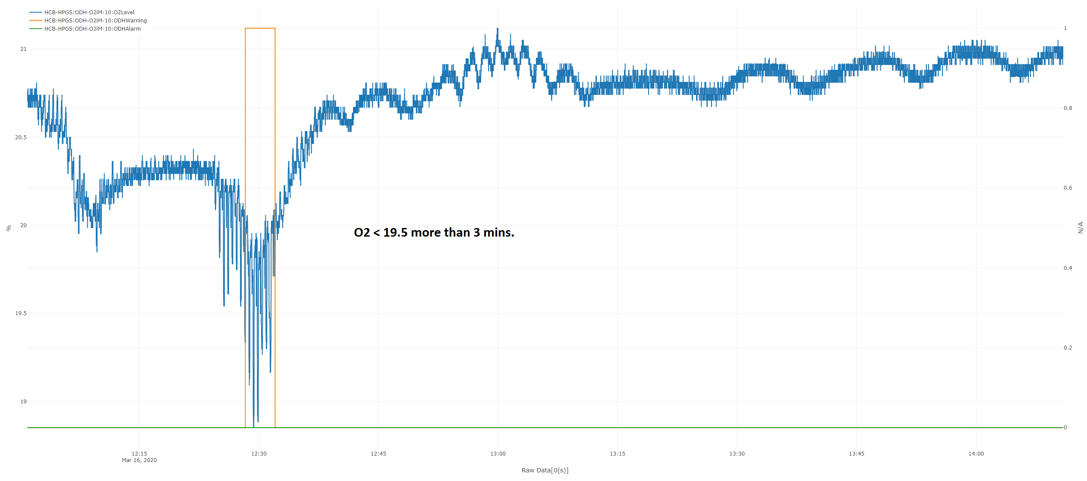
ODH Confirmed Alarm
Investigating the ODH incident on 2020.03.16

Slide 20
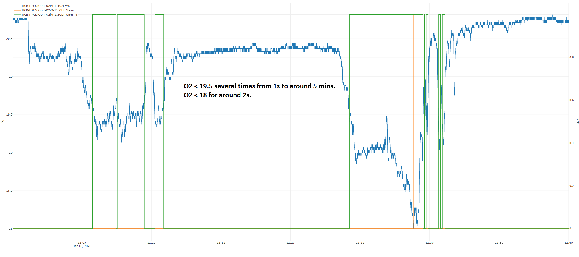
ODH Confirmed Alarm
Investigating the ODH incident on 2020.03.16

Slide 21
ODH Confirmed Alarm
  Unfortunately, we don’t have enough real ODH incidents archived in our database, to enable a proper analysis of the “ODH Confirmed Alarm” situation.
  It is proposed to consider an alarm a confirmed ODH alarm when A-alarm is triggered by the ODH monitor for more than one minute or if we have at least 2 ODH monitors at the A-Alarm status simultaneously.
  Question to the committee:
    Do you have any experience in defining confirmed alarms in ODHDS?
    Is the definition provided for ODH confirmed alarm makes sense?
    Is it reasonable to consider the same delay period for ODH confirmed alarm in the accelerator tunnel and HCB?

Slide 22
Interface with fire alarm/off-site alarm service
  Based on the ODHDS PDR committee recommendation, we removed the fault and warning signals from the list of signals sent to the off-site alarm service.
  Also, it is decided to send “ODH confirmed alarm” to SOS, instead of “ODH alarm” to avoid sending false/minor alarms to SOS.
  ODH_HLREQ15: The gas alarm shall be repeated in designated areas (other than the ones mentioned in ‎ODH_HLREQ12) via a fire alarm system for evacuation. The designated areas will be determined through risk assessment.
  ODH_HLREQ21: The “ODH confirmed alarm” signal will be sent to the off-site alarm receiving center and shall be configured so that it will be triggered in case of a wire break.
  The off-site alarm and security center informs the gate guard at SMR “Confirmed ODH alarm” status of the ODHDS.

Slide 23
Interface with fire alarm/off-site alarm service
CryoB and the accelerator ODHDS status
  Accelerator ODHDS will send two alarms, including ODH evacuation alarm for repeating the alarm through the fire alarm system, and ODH confirmed alarm for sending to the off-site alarm service to the fire alarm stand in the communication room.
  The list of fire alarm devices that will be activated in case of “ODH evacuation alarm” triggering shall be compliant with the approved ESS alarm strategy.
  In case “ODH confirmed alarm” triggers, off-site alarm center will call the gate guard to inform about the situation.
  These signals will be configured as fail-safe, it means that in case of the ACC ODHDS power loss or the interconnecting cable cut, they will be triggered.
  CryoB ODHDS will also be changed to send the same type of signals to fire alarm system in its future software update.

Slide 24
Emergency Response OPI
  The ER OPI is an operator-level OPI developed to be used by Operations in the event of any emergency to assist ESS First Responders.
  Emergency Response (ER) OPI, is normally viewed from the shift leader workstation in the MCR.
  It includes a section related to ODH that contains a link to the main ODHDS OPI, and it shall be updated to show a summarized state of the ODH monitors as below:
    O2 Alarm (<18%) → If any ODH monitor detects an O2 level (<18%), the indicator turns red with the text “O2 Alarm (<18%)”.
    O2 Warning (<19.5%) → If no ODH monitor detects an O2 level (<18%) but at least one ODH is in warning, the indicator turns yellow with the text “O2 Warning (<19.5%)”.
    ODH monitor fault → If the number of faulty/lost monitors is more than the fault tolerance number of the area, the indicator turns red with the text “ODH monitor fault.”
    If there is non of the above statuses, the indicator turns green with the text “O2 OK”.

Slide 25
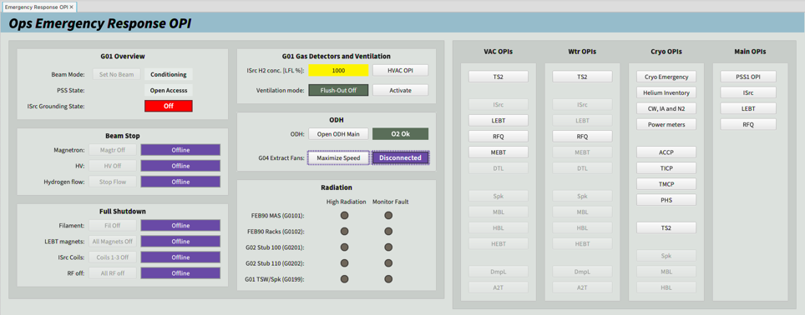
Emergency Response OPI
Screenshot

Slide 26
Mute the Audible Alarm function
  Based on ODHDS PDR committee recommendation and ESS ERT request, the mute function from designated stations connected to EPICS has been added to the system.
  As soon as FR lead gives clearance to shorten safety distance, FR team can not apply it, because of extremely high noise that makes it impossible to run any emergency communication close to the building. Therefore it is of importance that on immediate request from FR-lead, when building is evacuated, the noise from building alarm can be silenced.
  ODH_HLREQ24: The ODHDS shall include a function to temporarily mute the audible alarms through ODH HMI and OPIs in MCR and SMR in a controlled way to facilitate communication between emergency response team members during rescue service in the ODH.
  ODH_TD34: The gas audible alarm can be muted temporarily for 60 minutes from ODH OPIs on the shift leader’s workstation at MCR, gate guard workstations at SMR and with an admin account of the relevant ODHDS HMI.
  ODH_TD35: The gas audible alarm can not be muted in the first 5 minutes of alarm triggering.

Slide 27
Mute the Audible Alarm function
  ODH_TD36: The alarm can be muted zone-wide.
  ODH_TD38: While the alarm is muted, the count-down timer starts and will be displayed on the HMI and every OPI.
  ODH_TD39: The gas audible alarm mute function can be reset during the mute period from ODH OPIs on the shift leader’s workstation at MCR, gate guard workstations at SMR and with an admin account of the relevant ODHDS HMI.
  ODH_TD40: The gas audible alarm will be re-activated in case of new monitor turns into alarm, faulty or lost connection states during the alarm muting period.
  ODH_TD41: It will be possible to cancel the alarm muting from ODH OPIs on the shift leader’s workstation at MCR, gate guard workstations at SMR, and with an admin account of the relevant ODHDS HMI.
  ODH_TD42: Resetting will also cancel the alarm muting and restarts the relevant timer.
  ACC ODHDS will have this function, and it will be added to the CryoB ODHDS in the future system update.

Slide 28
Reset the ODH alarm remotely
  Based on ODHDS PDR committee recommendation and ESS ERT request, the rest function from designated stations connected to EPICS has been added to the system.
  ODH_HLREQ23: The ODHDS shall provide means to reset the ODH alarms through ODH HMI and OPIs in MCR, and SMR.
  ODH_TD43: The system will not allow resetting if all monitors are not above 19.5%.
  ODH_TD44: ODH alarm due to O2 level less than 18%, can be reset manually from ODH OPIs on the workstations at MCR, gate guard workstations at SMR and with an admin account of the relevant ODHDS HMI.
  ODH_TD45: ODH alarm due to ODH monitor fault or lost communication will be reset automatically after the condition for generating this alarm has been removed.
  ACC ODHDS will have this function and it will be added to the CryoB ODHDS in the future system update.

Slide 29
Alarm circuit fault monitoring
  ODH_TD32: The circuits of gas alarm devices connected to ODHDS are monitored for wire breaks and short circuits.
  ODH_TD33: Alarm notification is triggered in case a wire break or short circuit happens in any gas alarm circuits.
  This function and the way of its implementation in the hardware will be presented later in the “ACC ODHDS electrical and mechanical design” slides.

Slide 30
ODHDS UPS backup time
  ODH_HLREQ28: The ODHDS battery capacity shall allow 5 hours of operation of the system in a normal state and thereafter 30 minutes of operation in alarm state for the areas where the input power is backed up by a diesel generator and 8 hours of operation plus 30 minutes of operation in alarm state where the input power is not backed up by a diesel generator.

Slide 31
CTLG confined space
  The Cryo Transfer Line Gallery (CTLG) is considered a confined space due to only one access point and the absence of mechanical ventilation in the CTLG.
  Since considering ODHDS in this area requires periodic maintenance of the monitors and their relevant filters, which can cause further risks for the maintenance personnel, the accelerator ODHDS PDR committee recommended not to have fixed ODH monitoring there and instead to treat this space with rigorous procedures required for confined space entry
  Current fixed ODH monitors and alarm devices in CTLG will be removed as soon as its entrance to the tunnel is closed and it turns into a confined space

Slide 32
ODHDS zone states
Normal
Maintenance
Zone Error
Start-up
ODH Alarm
ODH Warning

Slide 33
ODHDS zone states
Start-up state (ODH_TD50)
Only active upon PLC start-up/restart for a defined period of time.
Evacuation alarms are not triggered.

Slide 34
ODHDS zone states
Normal state (ODH_TD51)
All monitors in the zone are healthy, or the number of faulty/lost communication monitors is less than the ODHDS monitor fault tolerance number, and O2 levels from all of them are above 19.5%.
Evacuation alarms are not triggered.

Slide 35
ODHDS zone states
ODH Warning state (ODH_TD52)
O2 level from any ODH monitor in the zone drops below 19.5% whilst other monitors are reading above 18%, and all monitors in the zone are healthy, or the number of faulty/lost communication monitors is less than the ODHDS monitor fault tolerance number.
Evacuation alarms are not triggered.

Slide 36
ODHDS zone states
ODH Alarm state (ODH_TD53)
O2 level from any ODH monitor in the zone drops below 18%.
Triggered and latched until reset.

Slide 37
ODHDS zone states
Zone Error state (ODH_TD54)
To have more than “X” monitors in faulty or lost communication state for zones with “X” ODH monitors fault tolerance.
Disconnected mains power and the capacity of the backup power is reduced to the level that can sustain less than 30 minutes of operation in the alarm state.
Whilst other monitors are reading >18%.
Triggered but not latched.

Slide 38
ODHDS zone states
Maintenance state (ODH_TD55)
Any monitor in the zone is in a maintenance state whilst other monitors are reading >19.5%, and, the number of faulty/lost communication monitors is less than the ODHDS monitor fault tolerance number.
Evacuation alarms are not triggered.

Slide 39
THANK YOU

Slide 40
References
[1] Fire and Egress Analysis of Accelerator Buildings (ESS-0101695 )
[2] Results from CFD simulations - Helium spill in the tunnel compressed (ESS-0061985)
[3] High Level Requirement Specification for ODH Detection Systems (ESS-3236032)
[4] Technical Description of ESS ODH Detection Systems (ESS-3137044)

