Slide 2
H2 detection and safety interlock system
ACC ODHDS CDR (2022-09-15)
PRESENTED BY Morteza Mansouri

Slide 3
Agenda
1 CMS
2 Methodology for H2 risk assessment
3 H2 monitoring and safety interlock system
4

Slide 4
1
CMS

Slide 5
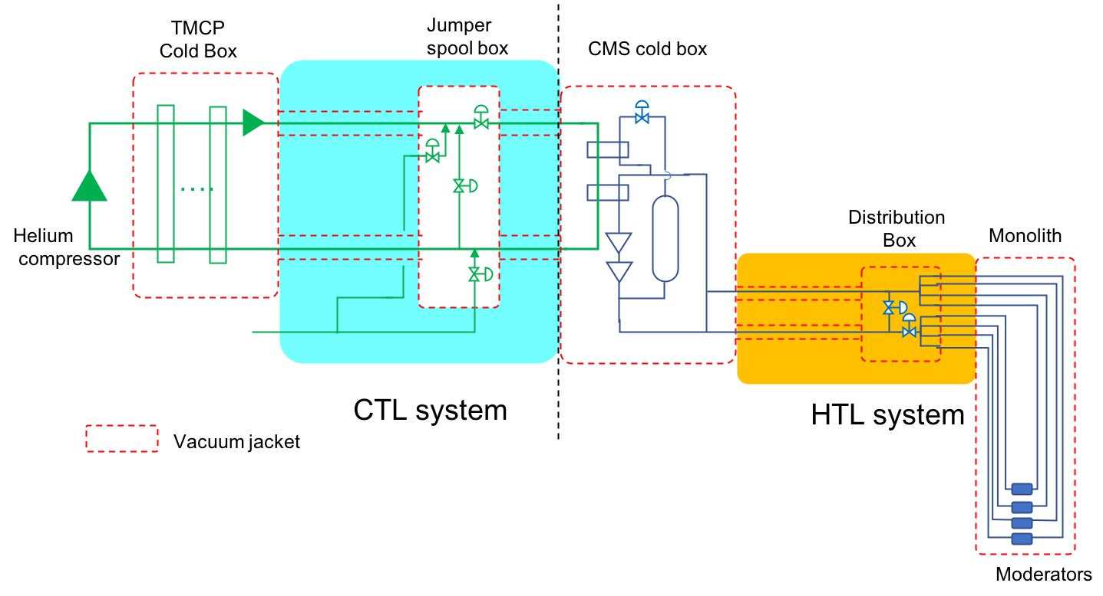
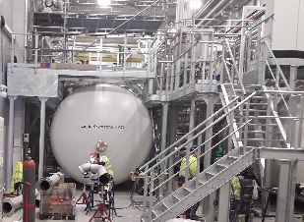
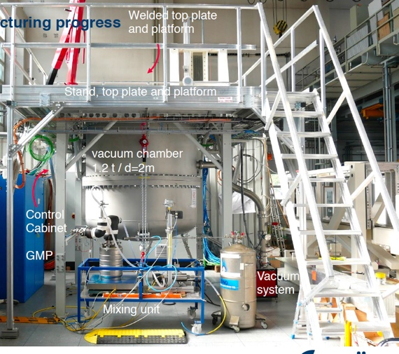
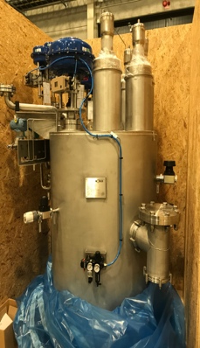
CMS System Overview
Contractors / In-kind partners
Slide courtesy of Marc Kickulies

Slide 6
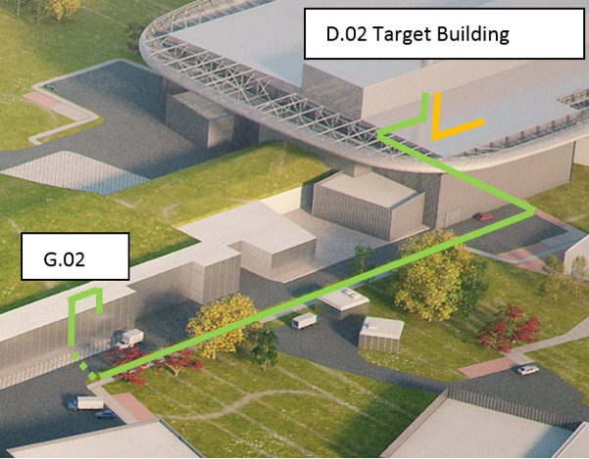
System Site Layout
Introduction to the individual Agenda Items
CMS
HTLs
CTL - Section 2
TMCP
CTL - Section 1
Slide courtesy of Marc Kickulies

Slide 7
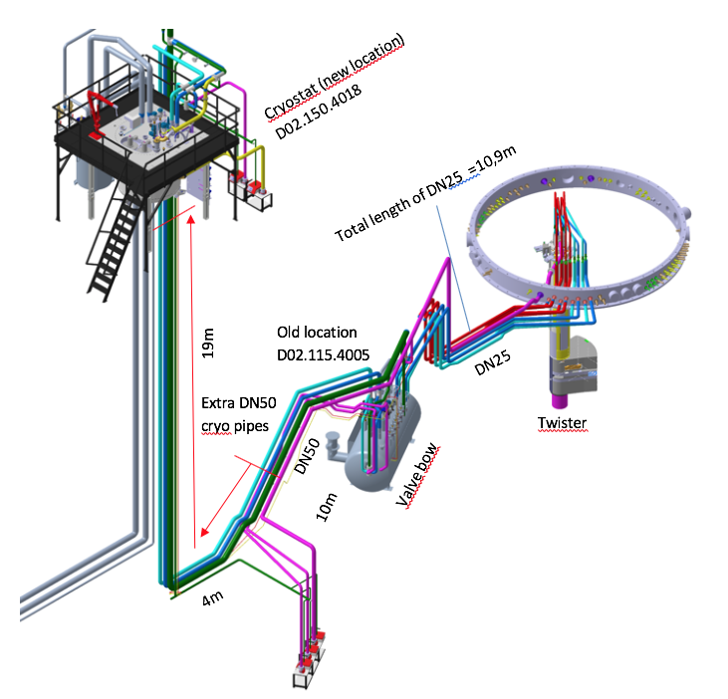
Hydrogen in Target
CMS
MRP
Distribution box
HTL
Vent line
Filling station
Slide courtesy of Marc Kickulies

Slide 8
Location of GH2 filling station
Slide courtesy of Marc Kickulies

Slide 9
2
Methodology for H2 risk assessment

Slide 10
Methodology
Setting the ATEX zones has followed the Swedish legislation SRVFS 2004:7 (The Swedish Civil Contingencies Agency regulations in regards to ex-plosive atmospheres when handling flammable gases and liquids)
Bowtie analysis method (ESS-0056199, appendix 5) is used to illustrate the initiating events and hazardous scenarios and also to set the required safeguards and barriers. This is a purely qualitative analysis, and is performed as a typically accepted method in industry and also for the Swedish rescue service (as the authority to permit the operation of systems with H2 hazards).
BPCS for CMS + H2 monitoring and safety interlock system
Information courtesy: Björn Yndemark

Slide 11
3
H2 monitoring and safety interlock system

Slide 12
H2SIS functions
Three H2 detectors will be installed in each H2 and A2T rooms. The H2 detectors will be connected to the hydrogen safety interlock system. The system shall contain two separate functions:
Monitoring function
The purpose of the monitoring function is to provide MCR with information of H2 release in the room. It will also give the first responder and rescue services a better understanding of the release before taking further action.
Gas alarms will be triggered as soon as any of the H2 detectors measure 10% of LFL (0,4% volume of hydrogen in air). Fire alarms (= evacuation alarms) can repeat the gas alarm in adjacent areas for evacuation of building.
Automatic vent function
If a release of 25% or higher of LFL (1% volume of hydrogen in air) is detected by one or more of the three detectors in the room, control valves CV-82095 and CV-62001 will direct the gaseous and liquid hydrogen to the vent system and empty the loop reaching atmospheric pressure within 50 seconds.
Source of information: ESS-4073346

Slide 13
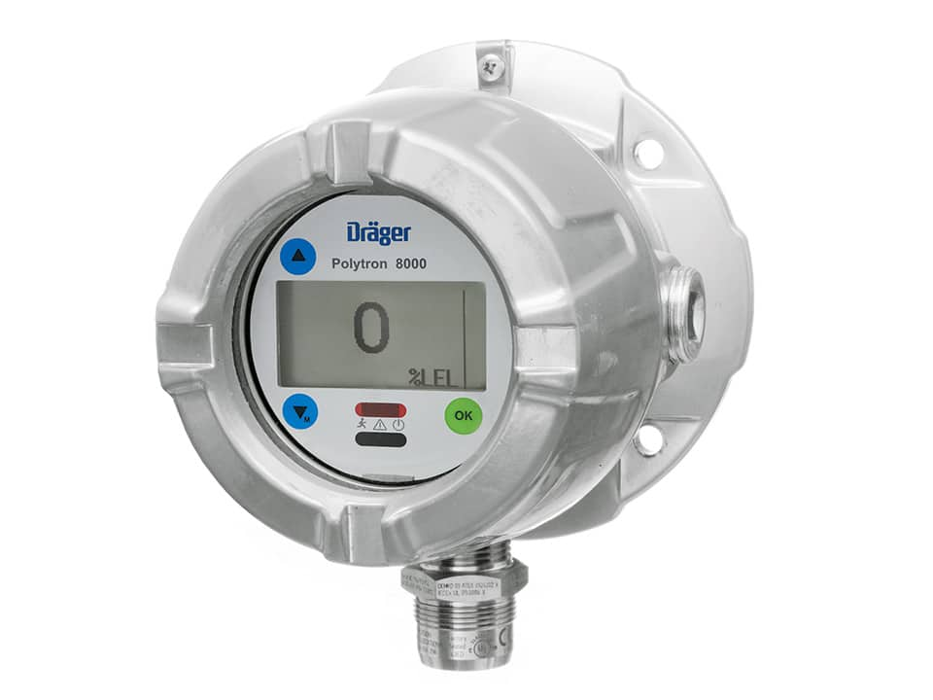
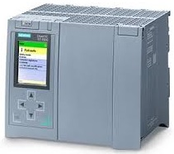
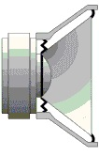
basic architecture for H2SIS
EPICS (gas alarm OPI, data archiving)
H2 Level = 100% of LFL
H2 level < 10% of LFL
H2 Level ≥ 10% of LFL
H2 Level ≥ 25% of LFL
H2 detectors status is constantly displayed at MCR
Confirmed H2 alarm
Off-site alarm service
Fire alarm system
H2 detector
Logic Solver
Gas alarms
Solenoid valve disabled
Solenoid valve enabled
Control valve
Control valve open
BPCS for CMS
Positioner
Instrument air

Slide 14
Comments/questions
Is the methodology to assess the H2 risk and identify the safety functions appropriate?
How to determine the reliability requirement for the safety functions assigned to H2SIS?
In a hazardous scenario, when the H2 concentration at the location of H2 detector(s) is 25% (the threshold that the automatic vent function should be triggered), estimate the amount of H2 concentration at the potential leak point. This would enable us to identify the severity of the hazardous scenario. Using the ESS conventional hazards risk matrix and considering the frequency of the initiating event (leak from valves, failure of pipes, etc.), we should be able to quantify the gap between IE frequency and Target risk, and hence determine the SIL (while taking other barriers such as BPCS, passive safety valves, etc. into account)
How to realize H2SIS and other gas alarm systems such as ODHDS and Toxic gas detection system?

Slide 15
How to realize the gas alarm system(s)
 | Option 1: H2SIS, ODHDS and Toxic Gas Detection (each system includes its own sensors, logic solvers and alarm devices) | Option 2: Gas detection and interlock system (ODHDS and TGDS as one system and H2SIS as one with shared alarm devices) | Option 3: Gas detection and interlock system (ODHDS, H2SIS and TGDS in one system, only independent sensors)
Applicable standards, reliability requirements, documentation | EN 60079-29-3 applies to each system. Functional Safety standard (e.g. IEC 61511) and specific reliability requirements (e.g. SIL) only applies to H2SIS. No specific reliability requirements to ODHDS or TGDS (e.g. standard application program, standard PLC I/O modules, etc.) More documentation | EN 60079-29-3 applies to each system. Functional Safety standard (e.g. IEC 61511) and specific reliability requirements (e.g. SIL) only applies to H2SIS. No specific reliability requirements to ODHDS or TGDS (e.g. standard application program, standard PLC I/O modules, etc.) More documentation | EN 60079-29-3 applies to each system. Functional Safety standard (e.g. IEC 61511) and specific reliability requirements (e.g. SIL) only applies to H2SIS. No specific reliability requirements to ODHDS or TGDS (e.g. standard application program, standard PLC I/O modules, etc.) Less documentation.
Implementing the ESS alarm strategy | Each system should install its own alarm devices (it would be an issue in areas where 2 or more of these systems exist) | One set of alarm devices to be used for all three systems. Dependency between ODHDS/TGD and H2SIS for alarming. | One set of alarm devices to be used for all three systems.
Commissioning and Maintenance | Commissioning of one system does not impact the operation of the other ones. Each system can be maintained or be switched off with no impact on the other ones. Higher maintenance effort due to independent infrastructure and HW for each system. | Commissioning new parts of one system (e.g. TS ODHDS) may impact the already commissioned parts (e.g. H2SIS) due to alarm dependency. Overall maintenance effort is less than option 1 but higher than option 3. Maintenance and proof testing of one system (e.g. H2SIS) can impact the alarming function of the other ones (e.g. TS ODHDS). | In order to commission new parts of one system (e.g. TS ODHDS), the already commissioned parts (e.g. H2SIS) cannot be operational. Overall maintenance effort on the gas alarm system is less than option 1 and 2. Maintenance and proof testing of one system (e.g. H2SIS) can impact the operation of the other two systems, since the frequency for testing H2SIS may not necessarily match the frequency for ODHDS and TGDS tests.
Development cost (infrastructure, HW, SW) | Higher development cost than option 2 and 3, as independent cabinet, alarm devices, network and electrical infrastructure should be provided. developing, debugging, testing and maintaining multiple application programs. | The development cost is lower than option 1 and higher than option 3 (e.g. two cabinets in Target H2 room, one for H2SIS and one for ODHDS, two application programs). | The development cost is lower than option 1 and 2 (shared infrastructure, shared PLC modules, cabinets, etc.) Developing, debugging, testing and maintaining one application program.
If we can implement compensatory measures (e.g. ODH/TG portable monitors, etc.) when ODHDS and TGDS are not operational, option 3 seems to be the most viable solution.

Slide 16
Thank you

Slide 17
Back-up slides

Slide 18
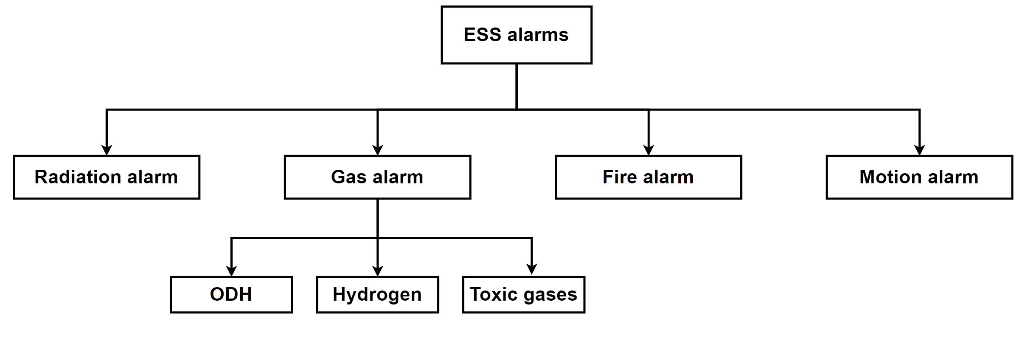
ESS gas alarm strategy
Fire alarms are already installed across ESS buildings. Fire alarm can be used as general evacuation alarm.
Gas alarm will be repeated by fire alarm system in areas adjacent to areas with hazardous gas.
For gas hazards that typically cannot be sensed by human, and immediate evacuation is required, dedicated gas alarm (light and sounder) will be installed in hazardous areas.
See further details in “High-level requirements and ODHDS technical description” presentations.

Slide 19
Finish presentation

