Slide 1
LLRF Experience at the Spallation Neutron Source
Mark Crofford
EuCARD2 Mini Workshop on LLRF and Beam Dynamics Mutual Needs
June 2 & 3, 2015

Slide 2
RF Systems – Outline
Spallation Neutron Source (SNS) Overview
SNS RF Systems
  High Power Systems
  Low-Level Systems
  Reference System
LLRF Performance and Challenges
Cavity Regulation
Errant Beam Issues
Adaptive Feed-Forward and Beam Loss
Downtime Statistics
Summary

Slide 3
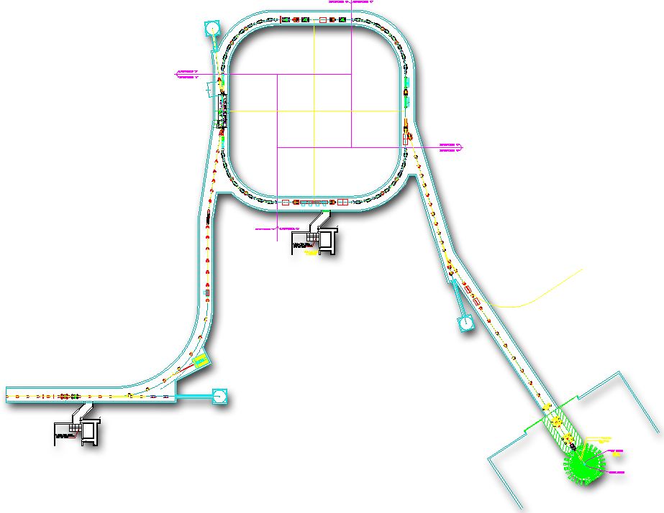
Spallation Neutron Source
Neutron scattering facility to research properties of materials
1 GeV Protons create neutrons through spallation process
H⁺
Current
Ring
Power on Target | 1.4 MW at 1.0 GeV (1.2 MW now)
Pulse on Target | 1.5 E14 protons (24µC)
Macro-pulse in Linac | ~1000 mini pulses of ~24mA avg over 1ms at 60Hz
1ms
H⁺
1 ms beam into 700 ns
Current
H⁺
2.5 MeV
87 MeV
186 MeV
387 MeV
1000 MeV
670ns
H⁻
RFQ
DTL
CCL
SCL, β=0.61
SCL, β=0.81
Linac
Target
Source
MEBT
945 ns
N
Mini pulse
Flux
Current
1 ms macro-pulse
~20–100x ILL
Credit: W. Blokland – IBIC 2013

Slide 4
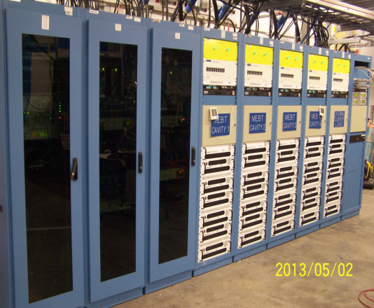
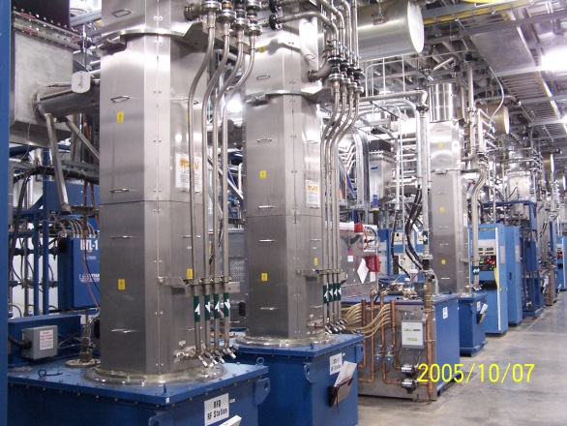
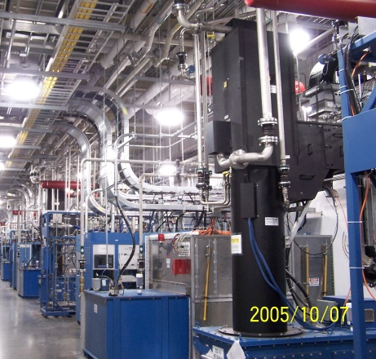
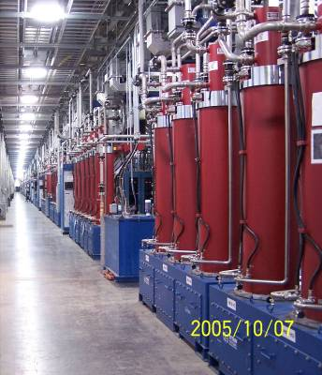
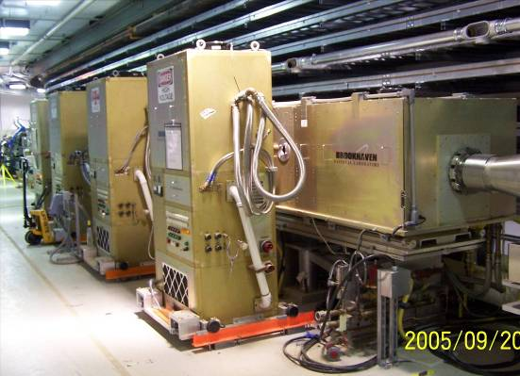
SNS High Power RF Systems
MEBT
RFQ & DTL
CCL
101 RF systems are installed and operational
Type | Application | Frequency | Peak Power | Vendor | Installed
Tetrode | Ion Source | 2 MHz | 80 kW | Thales | 1
Solid-State | MEBT Rebunchers | 402.5 MHz | 25 kW | Tomco | 4
Klystron | RFQ, DTL | 402.5 MHz | 2.5 MW | E2V & Thales | 7
Klystron | CCL | 805 MHz | 5 MW | Thales | 4
Klystron | SCL | 805 MHz | 550-700 kW | CPI & Thales | 81
Tetrode | Accumulator Ring | 1 & 2 MHz | 500 kW | Thales & CPI | 4
SCL
Ring

Slide 5
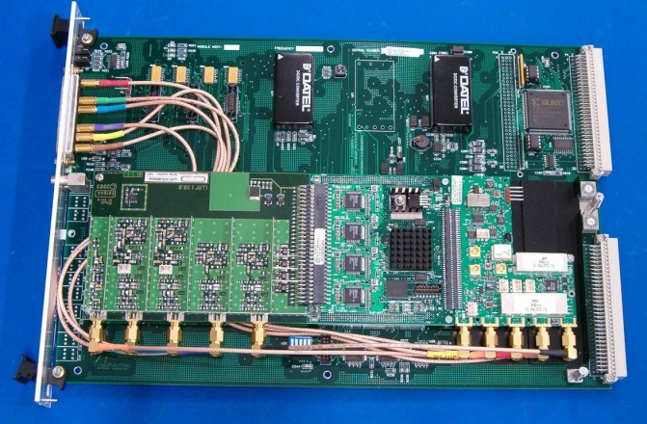
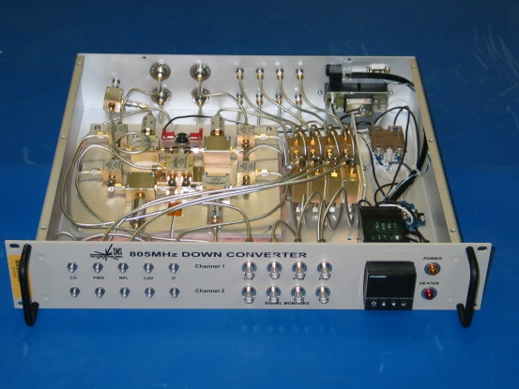
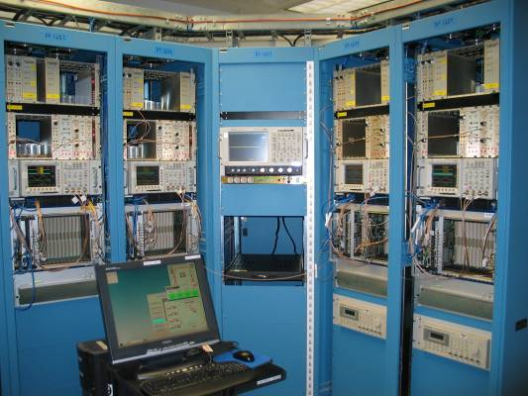
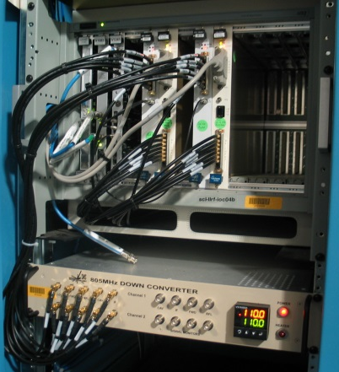
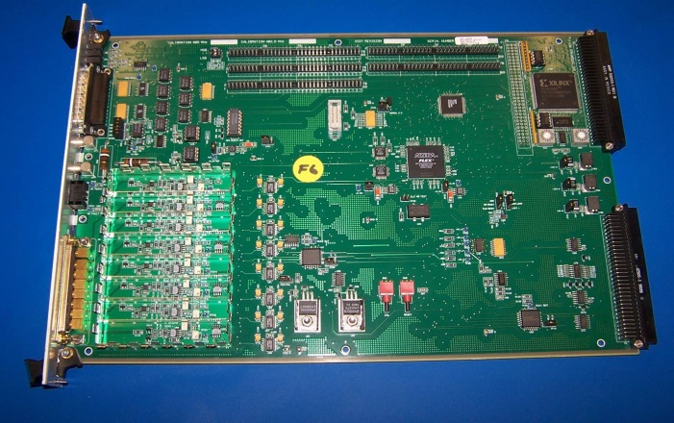
SNS Low-Level RF Systems
Linac LLRF – 402.5 & 805 MHz
  Field Control Module (FCM)
  High-power Protection Module (HPM)
  Down Converter
Ring LLRF – 1.05 & 2.10 MHz
  DSP based (BittWare quad DSP module)
  4 channel ADC module
  4 channel DAC module
FCM
Down converter
Linac
LLRF
Ring
LLRF
HPM

Slide 6
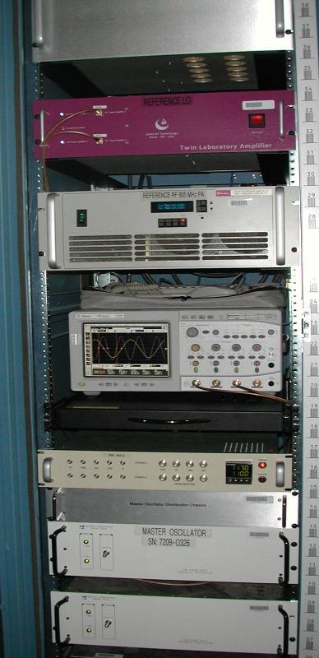
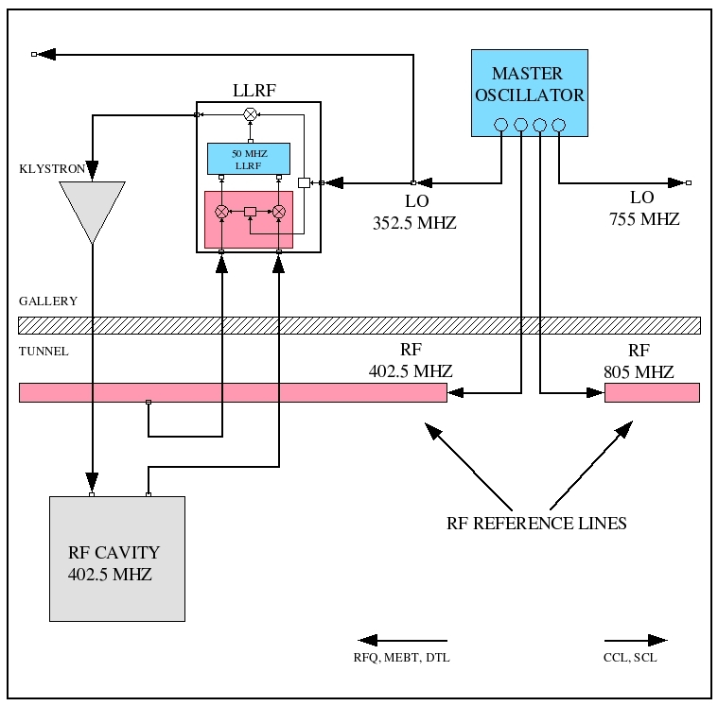
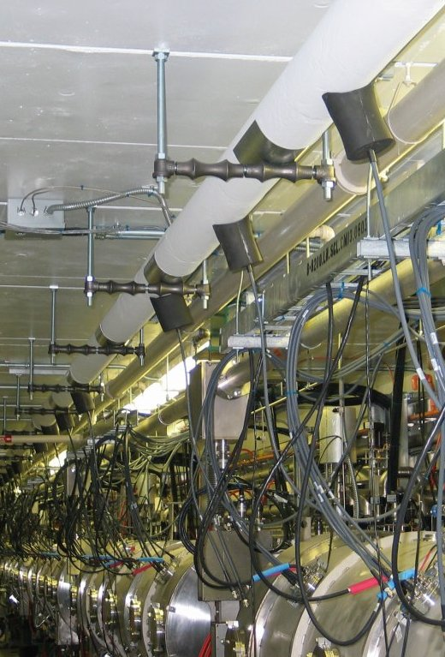
SNS Linac RF Reference System
402.5 MHz section serves 11 systems: RFQ, MEBT Rebunchers, and DTL
805 MHz section serves 85 systems: CCL and SCL
805 MHz section extends to the end of the Linac tunnel and is ready to support additional RF systems to be installed for the Second Target Station
Reference line is temperature and pressure regulated to improve stability
Reference
System

Slide 7
LLRF Performance
The LLRF system continues to operate within specification
Automation has simplified operator interaction and improved cavity recovery
  One button cavity startup eliminates operator error
Improvements and features added over time to overcome operational issues
  Voltage droop – droop compensation added
  Multipacting during cavity fill – slow ramp added to minimize reflected power
  RFQ temperature stability - pulse width modulation added to improve temperature stability of the RFQ
  Inadequate CPU speed – replaced IOCs with faster models to support full pulse operation

Slide 8
LLRF Issues
10 years of successful operation but some failures are starting to manifest
The output amplifier IC for the RF output circuit has shown step variations in the output level
  Multiple failures in the past year
  Traced the problem to bond wire failures
  All amplifier ICs are being replaced during the calibration cycle of the system
System has several obsolete components including the FPGAs
  Adequate spares are available
  Redesign in consideration

Slide 9
Cavity Regulation
Specification from the initial SNS Parameters document:
  Static RF error: +/- 1 degree, +/- 1 percent
  Dynamic RF error: +/- 0.5 degree, +/- 0.5 percent
  RMS or peak-to-peak error specifications would have been more useful
Beam Conditions
850 kW on target
26.3 mA avg.
37.8 mA peak
Data taken 3/25/2015

Slide 10
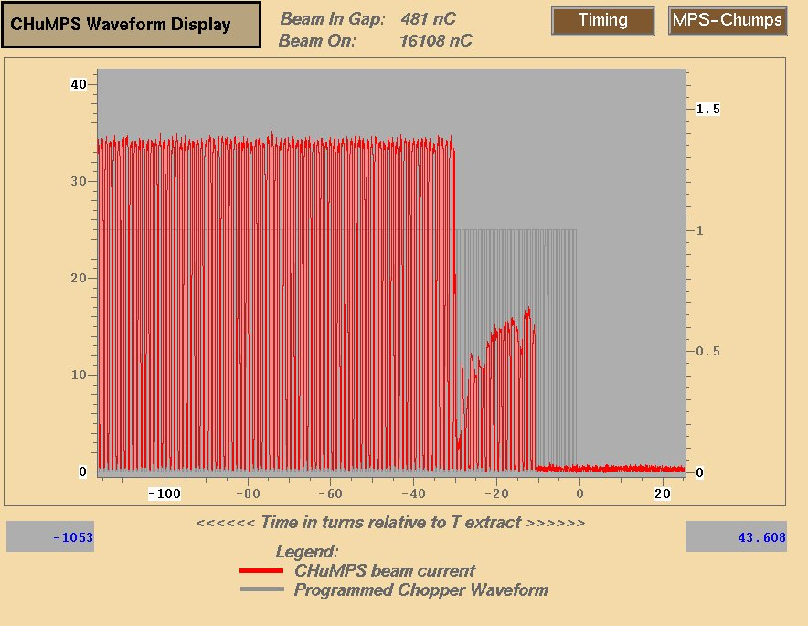
Errant Beam Definition
Abrupt beam loss caused by:
  Low current or partial beam pulses
  Beam pulses with incorrect energy
  Abrupt beam losses
SCL Beam Loss Monitors (BLM) are the primary indication of errant beam
Fast beam current monitor in MEBT
Credit: C. Peters – AAC, 2013

Slide 11
Why is Errant Beam Important?
Errant beam mechanism
  Beam hitting cavity surface desorbs gas or particulates creating an environment for arcing
Super Conducting Linac (SCL) cavity performance degrades over time
  SCL cavities do not trip with every errant beam pulse, but the probability for a trip increases with the frequency of bad pulses
  Cavity fields have been decreased and cavities have been turned off resulting in lower beam energy
SCL cavity performance degradation from errant beam can be restored
  Requires cavity warm up during a long shutdown and then RF conditioning before resuming beam operation
  Cryomodules have been removed from the tunnel for cavity RF coupler repairs but this takes months
C. Peters – AAC, 2013

Slide 12
The Majority of Errant Beam Faults Originate in the Warm Linac
<10% of BLM trips were due to the ion source/LEBT
  Most ion source induced BLM trips occur during the first week of a new source installation
    High voltage arcing
>90% of BLM trips were due to warm linac RF faults
  RF faults occur at different times during the pulse
    The majority of faults during the RF fill have reproducible times
    Faults during the RF flattop are random
  RF fill faults can be reduced
    Adjust the RF field
    Adjust the RF fill time
    Change the cavity resonant frequency
    Vacuum maintenance
Credit: C. Peters – AAC, 2013

Slide 13
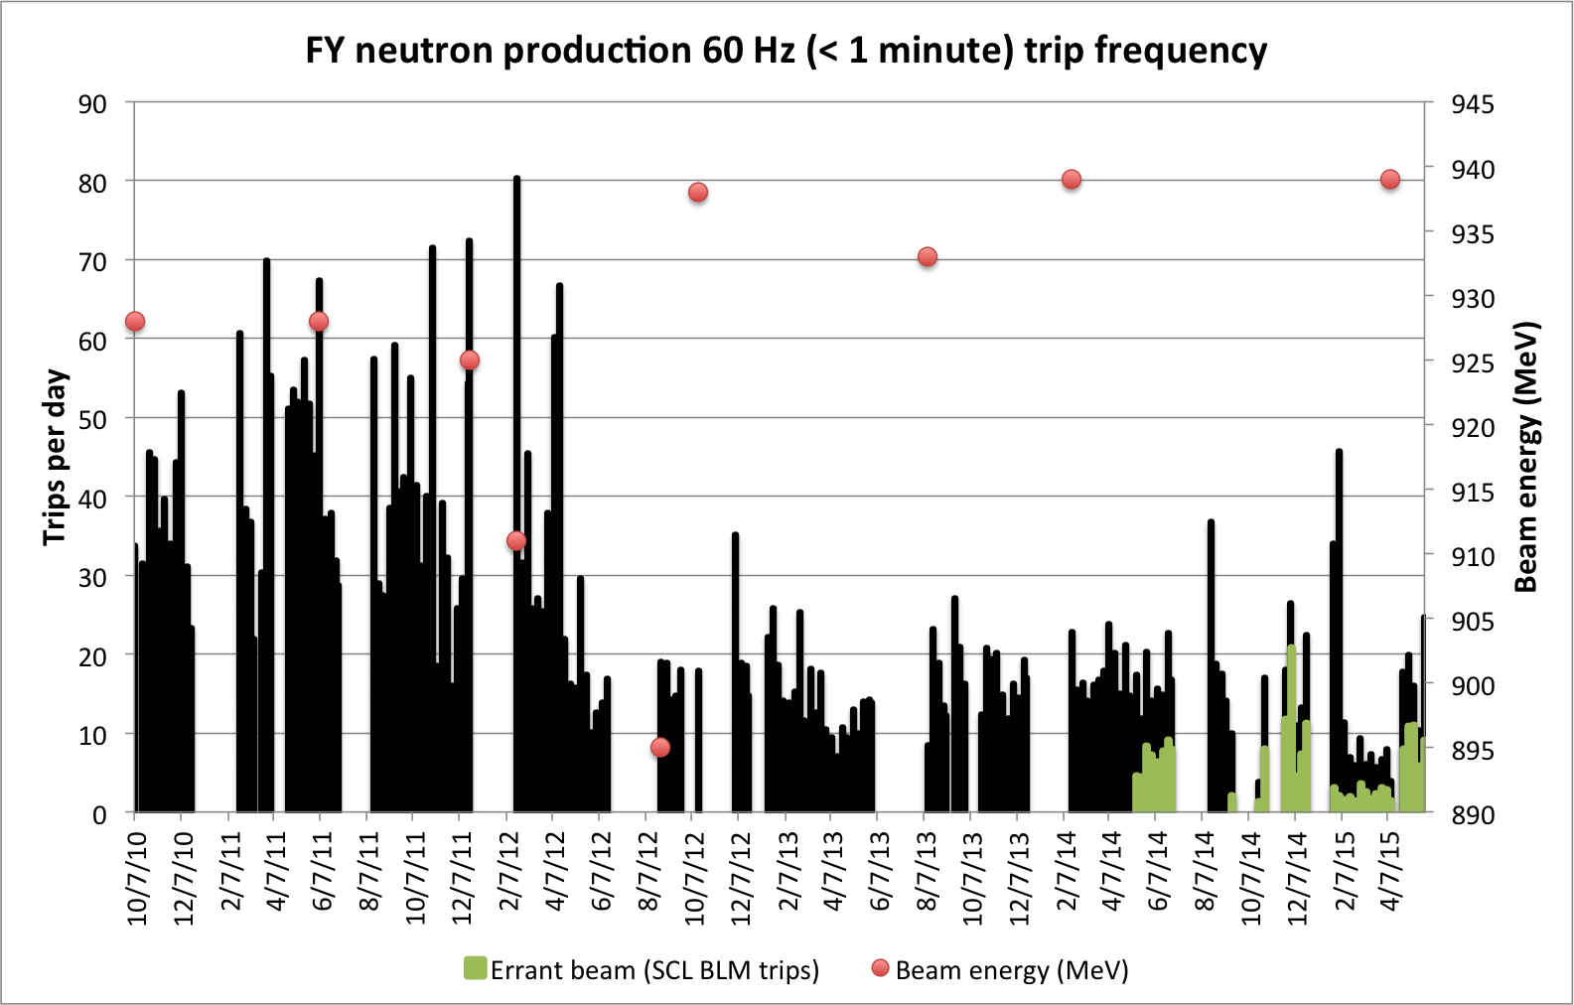
Errant Beam Trips Reduced
Initially, ~75% (30 per day) of short trips were caused by errant beam
Errant beam trips have been reduced from 30 to 10 events a day
Green bars are actual errant beam trips.
SNS started specifically recording them in FY14
FY15 reduction was during 850 kW run
FY11
FY12
FY13
FY14
FY15
Credit: C. Peters – IPAC, 2015
Notes:
This plot shows the beam energy decrease over time, and then the stability since the trip reduction.
The green are actual errant beam trips. We started specifically recording them in FY14.
The latest reduction in FY15 was during the 850 kW run. Reduced RF pulse width. We also conditioned each structure about 10-15% higher average power than we ran.

Slide 14
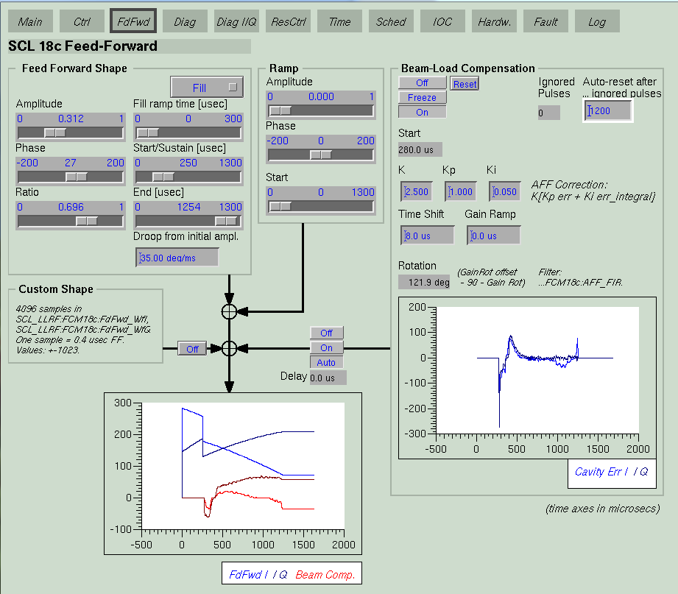
Adaptive Feed-forward
Simple approximation method
  Correction = K[Kp*error + Ki*error_integral]
Utilized for cavity filling and pulse-to-pulse feedback
  Dual AFF buffers
  Cavity filling AFF provides additional RF power to speed cavity filling
    Ramp shape
    Droop correction
  Pulse-to-pulse provides correction for repetitive errors cause by beam loading, modulator ripple, and Lorentz force detuning

Slide 15
Adaptive Feed-forward & Beam Loss
The adaptive feed-forward is sufficient but the learning speed of the algorithm could be improved
Most noticeable during Physics shifts
  1 Hz operation
  Beam setup variations
Learning is iterative, beam is lost during learning
  AFF calculations occur at the IOC – limited to 20 Hz
  Does not compensate for non-repetitive errors
  Some guaranteed beam loss!
Improvements to the algorithm are being investigated

Slide 16
RF Downtime – May2013 to April 2015
Total Downtime 265 hours out of 10303 scheduled Accelerator Physics/Neutron Production hours (2.57%)
Warm Linac accounts for the majority of downtime

Slide 17
RF Downtime (cont.)
Occasional major event quickly adds to the system downtime but this is only ~20% of the total downtime
  DTL 6 circulator failure – 17 hours (June 2014)
  CCL2 klystron failure – 14 hours (May 2014)
  CCL3 klystron failure – 16 hours (Oct 2014)
Majority of warm linac trips are ~ 20 – 30 minutes in duration
  Cavity and window arcing
  Vacuum excursions/bursts
SC linac trips are ~5 – 10 minutes in duration
  Errant beam
Overall reliability of the RF systems is very good
  Continue to seek ways to improve the systems

Slide 18
Summary
RF systems reliability is sufficient to achieve neutron production availability >90%
Improvements in the LLRF and automation have simplified operation
Better understanding of errant beam causes has resulted in the reduction of downtime
Adaptive feed-forward was instrumental in achieving regulation requirements but there is room for improvement

