Slide 1

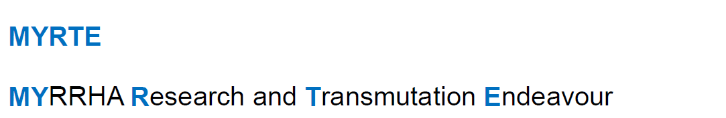



Effect of transients on beam dynamics
Mini Workshop on LLRF and Beam Dynamics mutual needs in Hadron Linacs
Jean-Luc BIARROTTE
CNRS-IN2P3 / IPN Orsay, France

Slide 2
The longitudinal weakness
Origin of longitudinal losses
The TraceWin transient toolbox

Slide 3
The LONGITUDINAL weakness of hadron linacs
Hadron linacs are very sensitive to longitudinal imperfections (i.e. RF phase & field errors)
Because we have a huge number of RF cavities to tune (& therefore a high probability to have a bad tuning somewhere!)
Because the beam velocity is not constant (β<1), so that any acceleration error induces a phase error at the next cavity and so on…
Because we need high gradients to optimize capital cost, and therefore we tend to choose synchronous phases as close as possible to 0° => reduced acceptance & buckets
Because the beam emittance is often quite large compared to the cavities buckets => halo particles can easily experience high non-linearities in the outer part of the bucket (and can even be completely lost after crossing separatrix)
Compromise is necessary to ensure safe operation at a reasonable cost!
Advanced simulation tools can be helpful to improve our understanding of this weakness and assess its consequences on beam losses

Slide 4
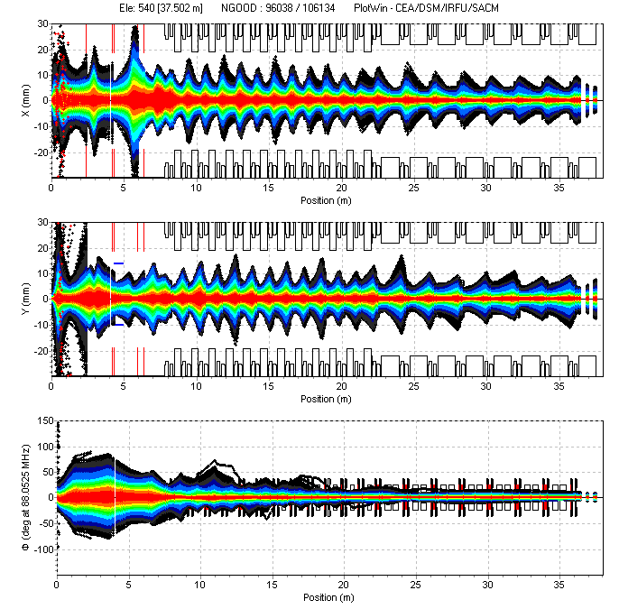
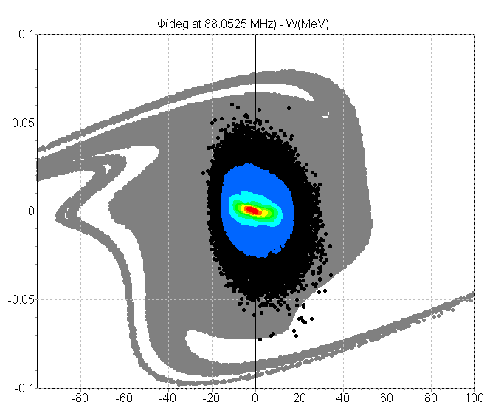
Example of SPIRAL-2 (1/3)
SPIRAL-2 linac nominal optics
deuterons 5mA, 1.5 -> 40 MeV
Longitudinal acceptance is quite narrow…
10⁵ particles

Slide 5
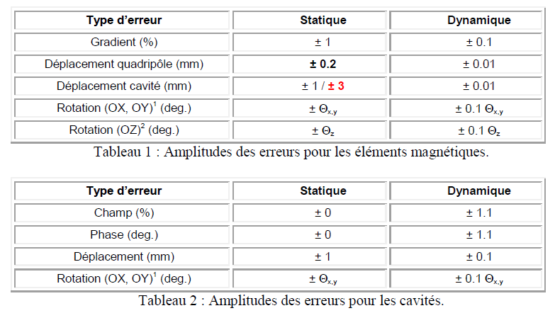
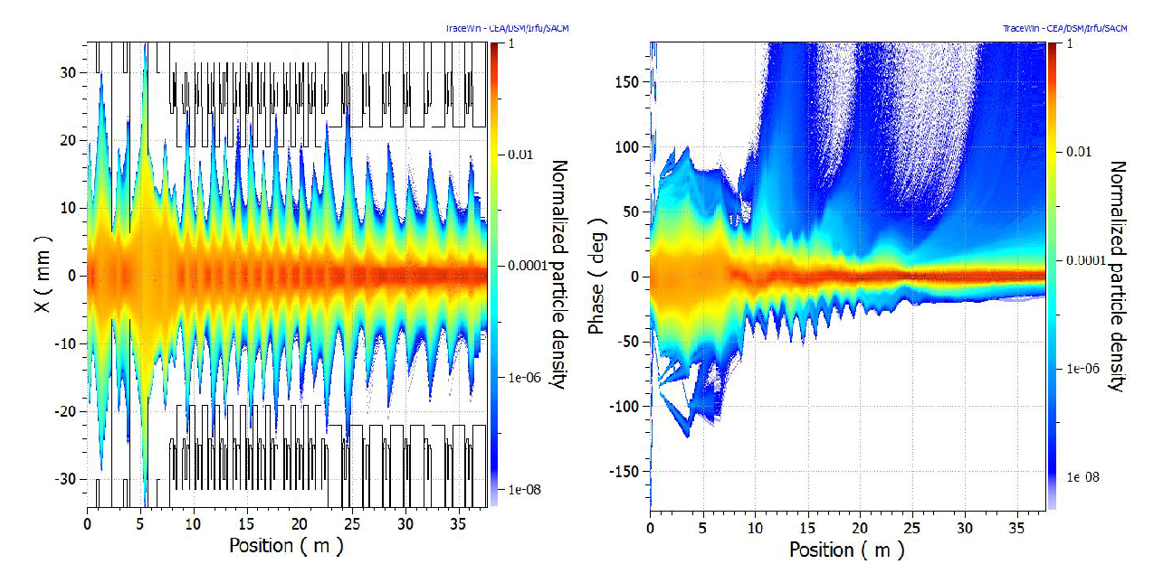
Example of SPIRAL-2 (2/3)
SPIRAL-2 linac error studies
500 linacs * 10⁶ particles
1% & 1° longitudinal errors
Losses clearly come from particles leaving longitudinal acceptance
5.10⁸ particles
Courtesy D. Uriot

Slide 6
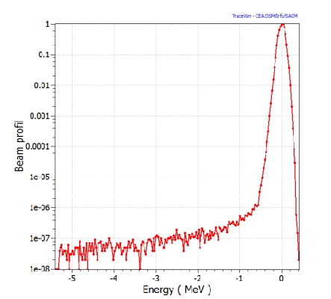
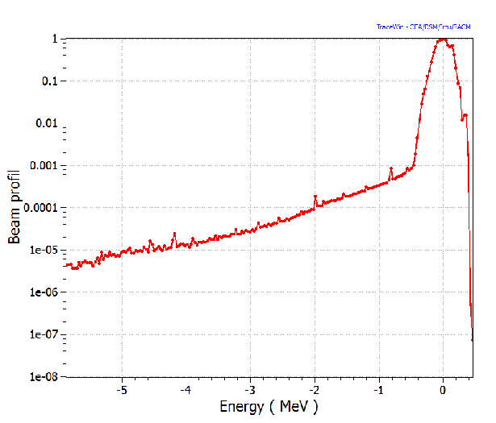
Example of SPIRAL-2 (3/3)
SPIRAL-2 linac error studies
Increasing longitudinal errors to 2% & 2°
Losses are expected to be 2 to 3 orders of magnitude higher due to the long tail created in the longitudinal phase space
1%, 1°
2%, 2°
Beam energy distribution at the linac output

Slide 7
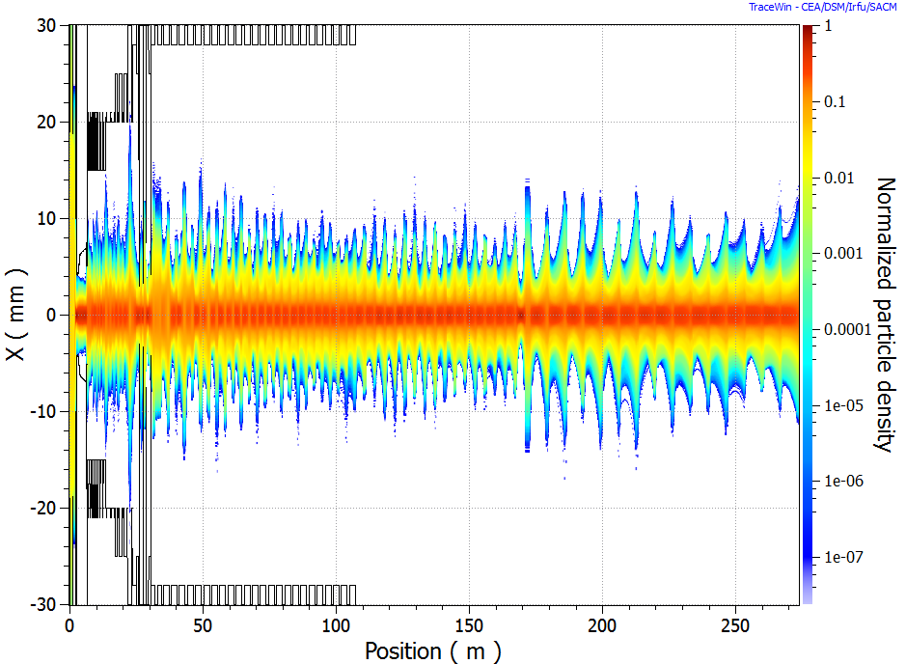
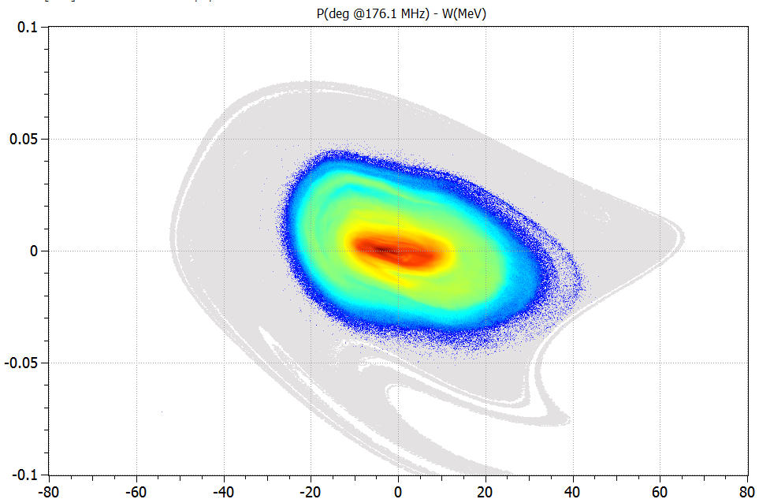
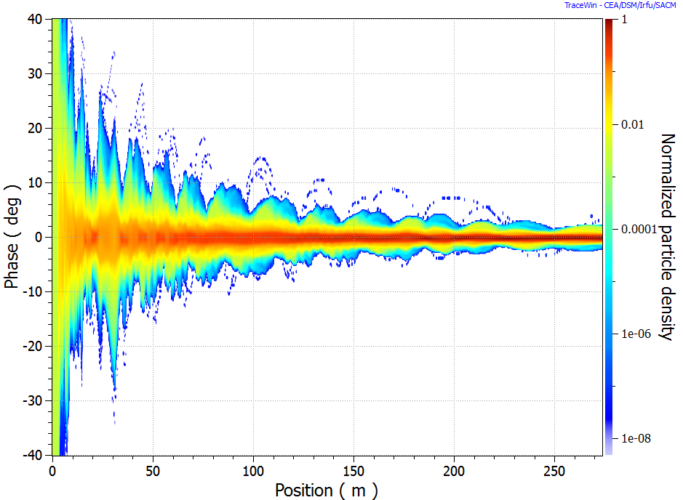
Example of MYRRHA (1/3)
MYRRHA linac nominal optics
protons 4mA, 30keV -> 600 MeV
Longitudinal acceptance is a bit larger due to the margins taken for fault-tolerance…
10⁸ particles

Slide 8
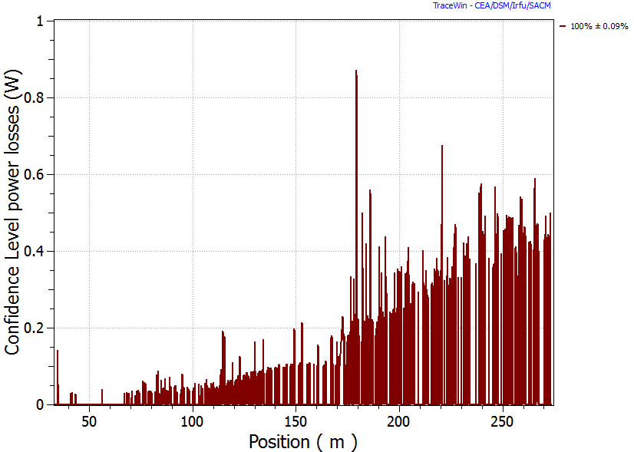
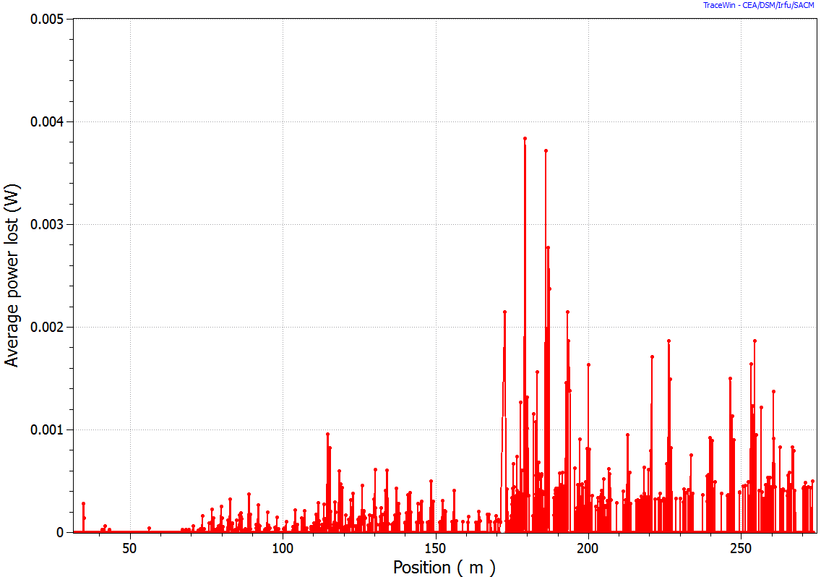
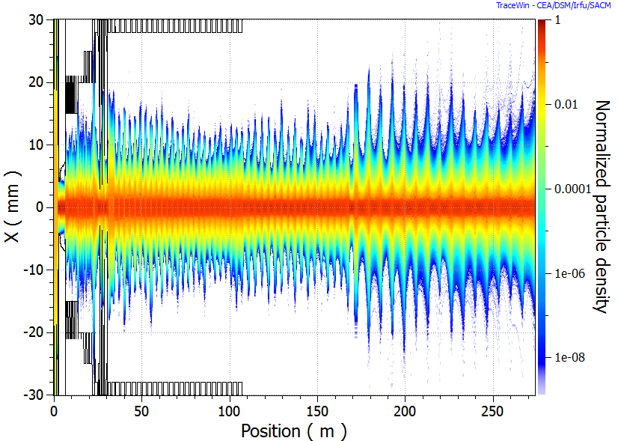
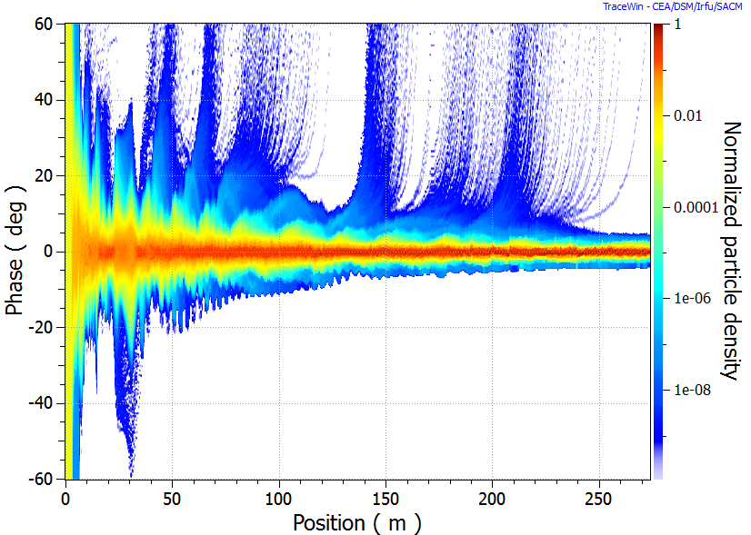
Example of MYRRHA (2/3)
MYRRHA linac error studies
1000 linacs * 3.10⁶ particles
1% & 1° longitudinal errors
Losses are very low, but still coming from particles leaving longitudinal acceptance
Worst losses for 100% of the 1000 linacs
Mean losses
3.10⁹ particles (17 beam bunches)
Courtesy D. Uriot

Slide 9
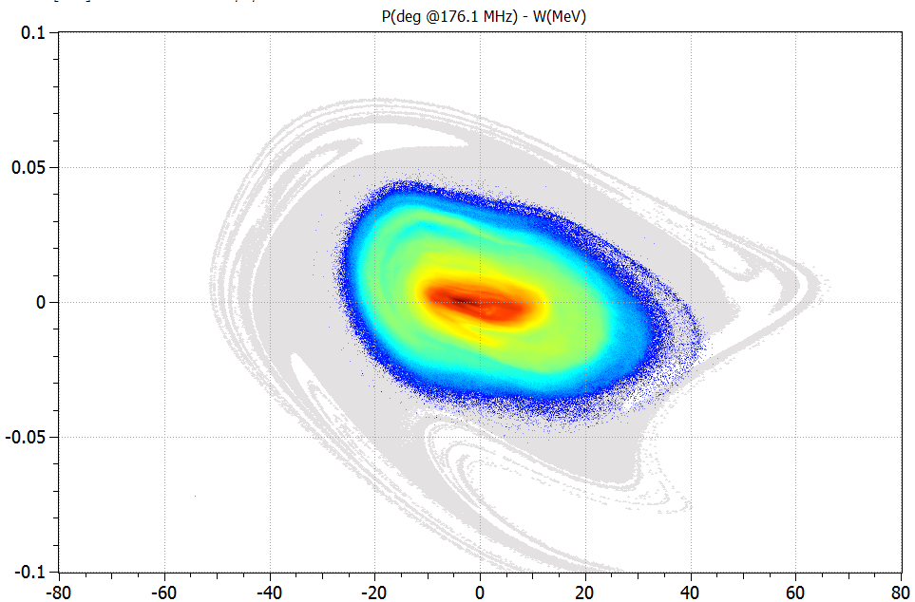
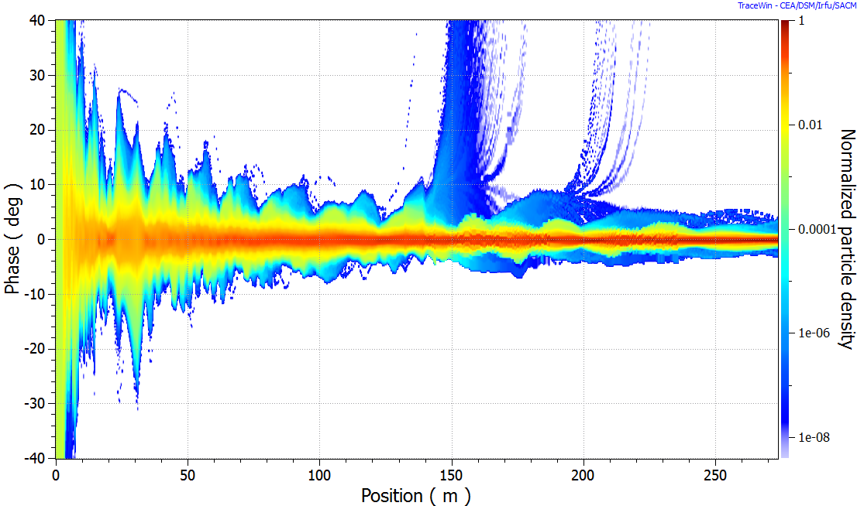
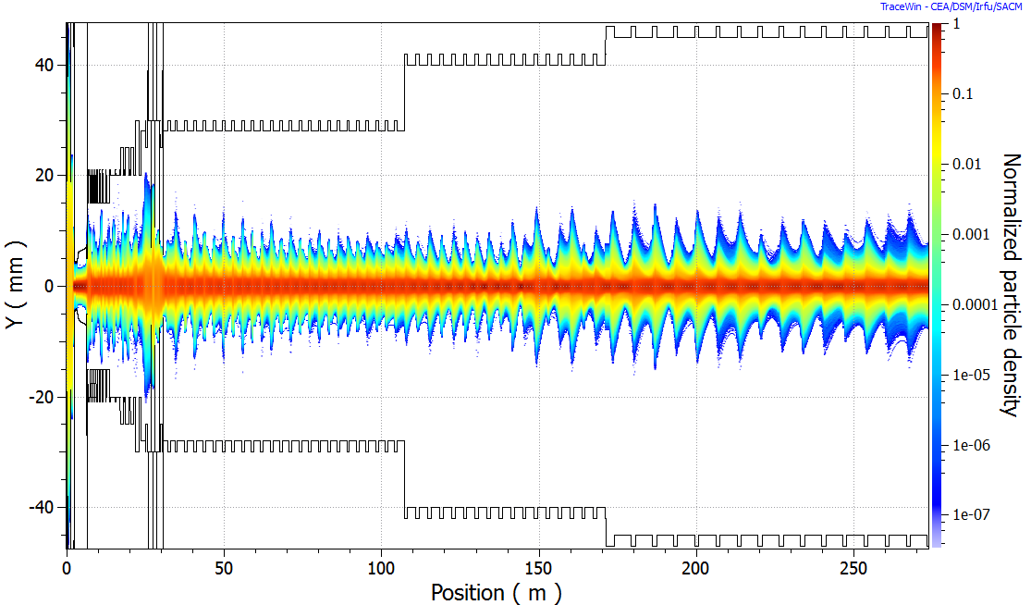
Example of MYRRHA (3/3)
MYRRHA linac fault tolerance study
4 cavities OFF simultaneously, 16 cavities used for compensation
Losses are still acceptable and comes from particles leaving longitudinal acceptance
Adding errors, the situation is not acceptable anymore for 10% of the simulated linacs
Acceptance w/ nominal tuning
Acceptance w/ fault-recovery tuning
10⁸ particles
Courtesy D. Uriot

Slide 10
The longitudinal weakness
Origin of longitudinal losses
The TraceWin transient toolbox

Slide 11
Origin of longitudinal losses: STRUCTURES TUNING
Beam losses due to weak longitudinal design and/or tuning
Wrong RF cavity field/phase tunings (due to bad TOF measurements for example)
Small acceptance and/or large RFQ emittance
Parametric resonances & instabilities (-> halo)
HOM excitation and Beam break up
…
A priori more or less under control during the design phase…

Slide 12
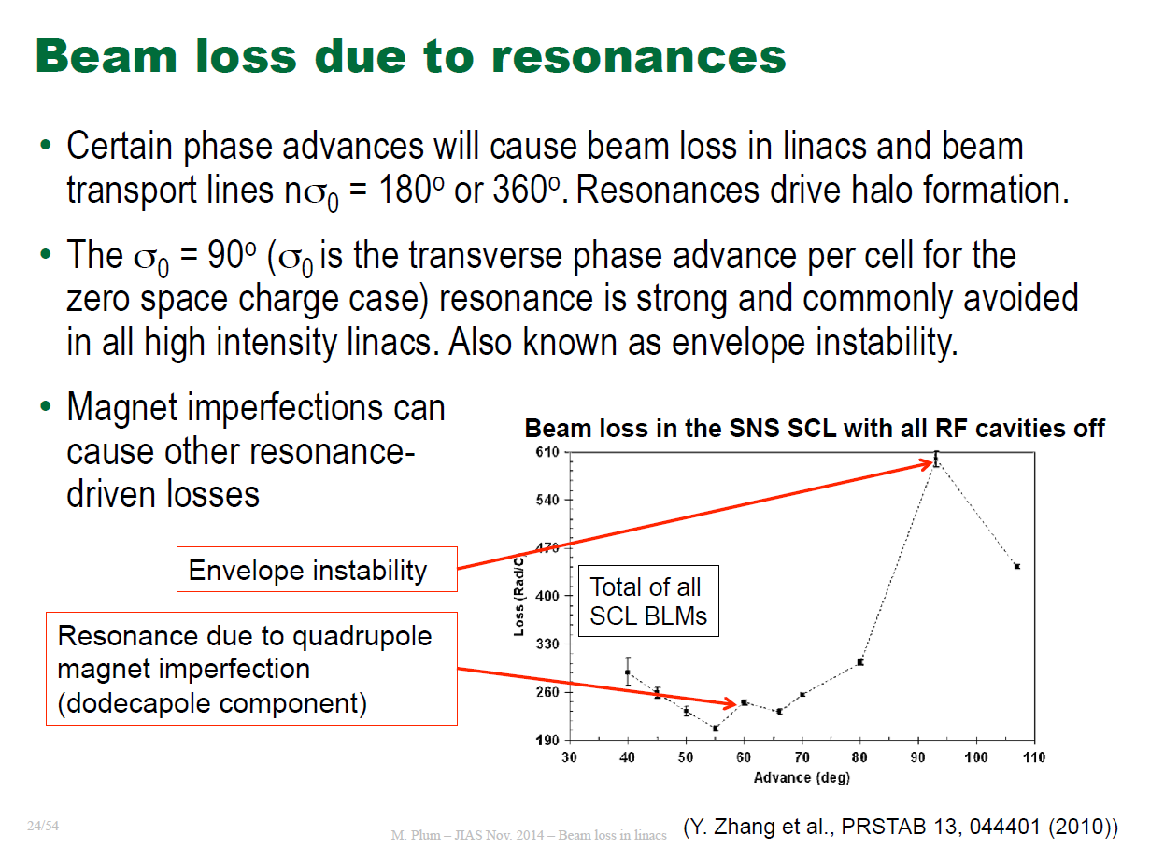
EX #1 -> Resonances (SNS)
Courtesy M. Plum

Slide 13
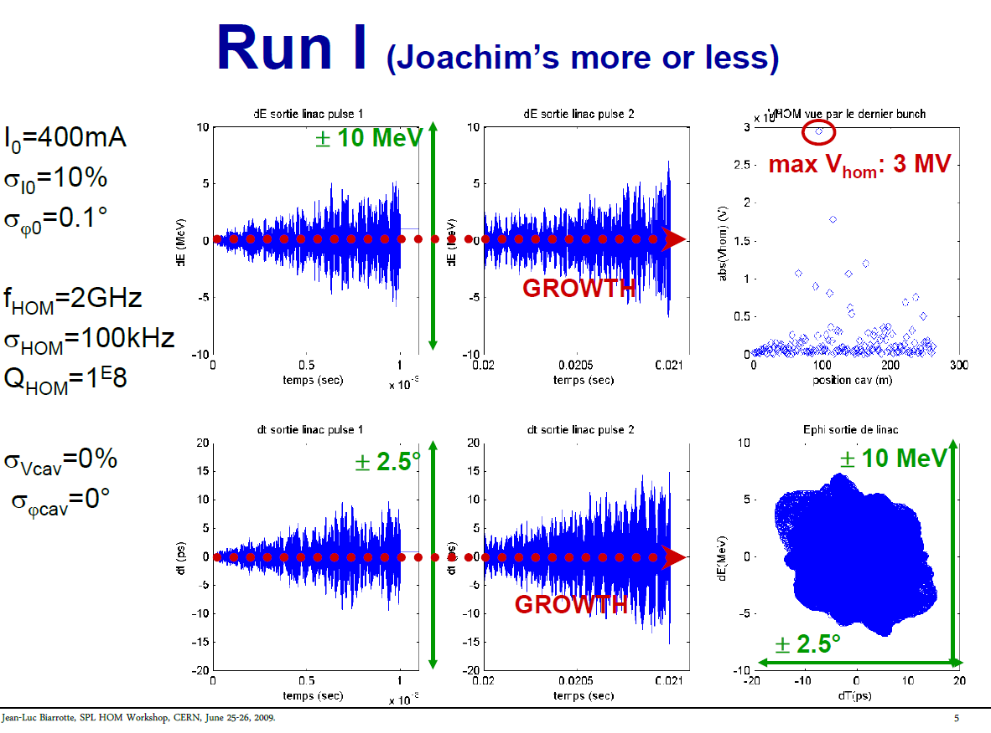
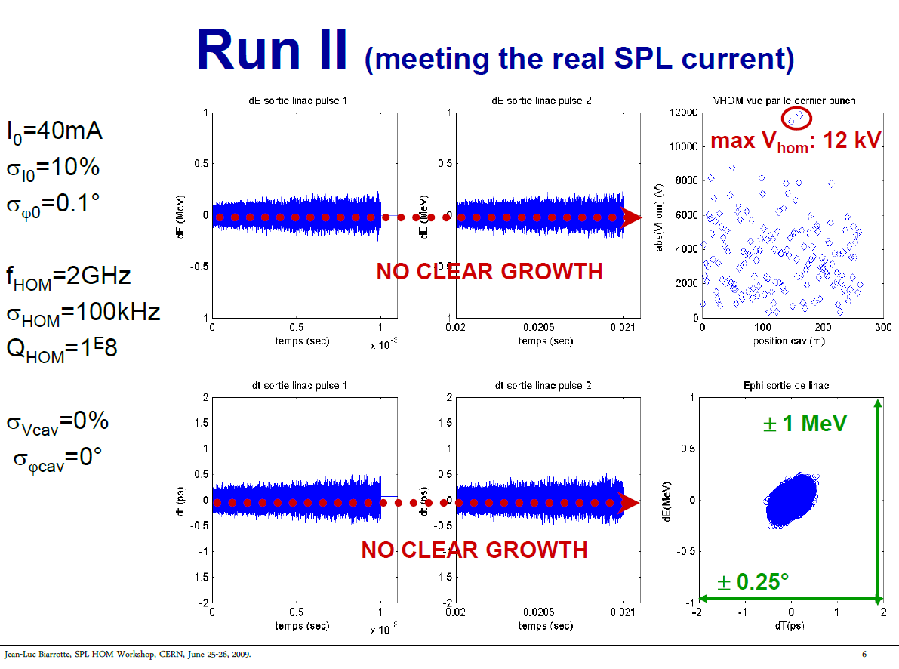
EX #2 -> HOM excitation (SPL test-case)

Slide 14
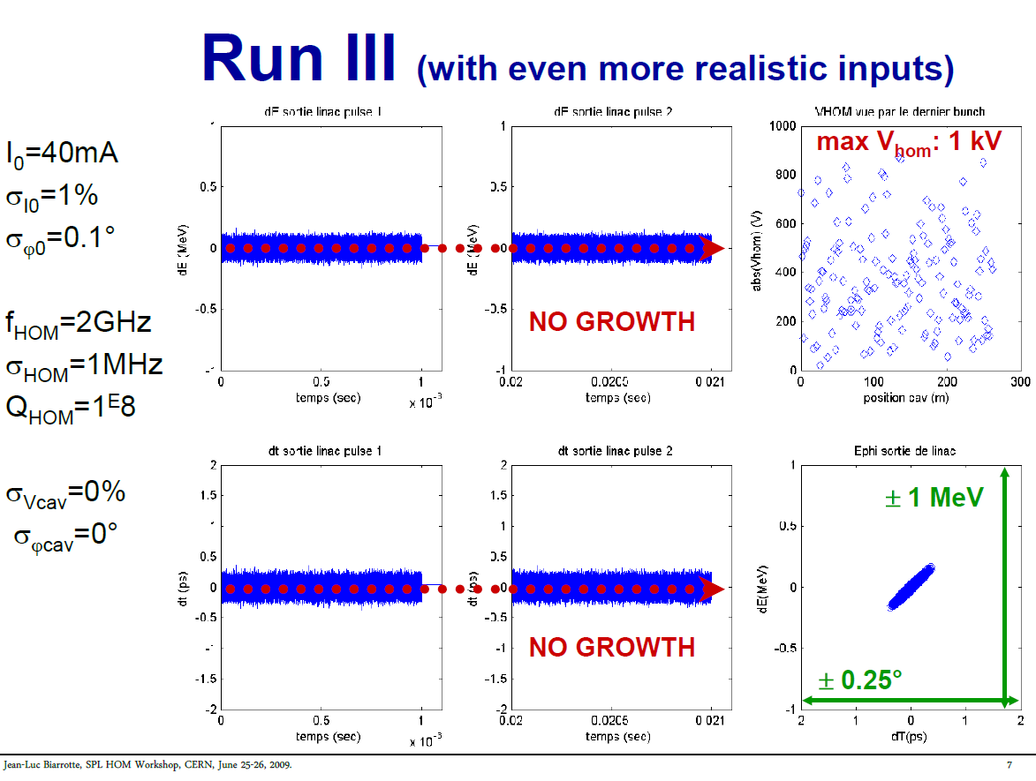
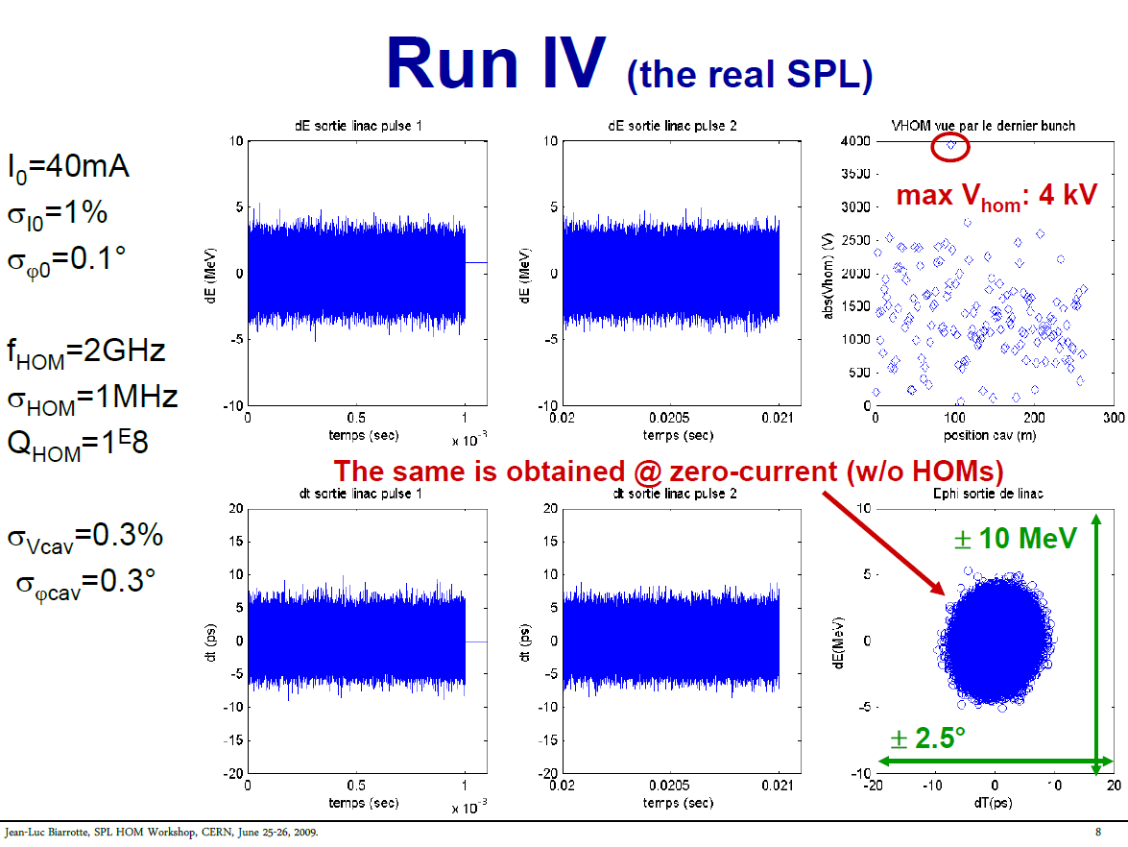
EX #2 -> HOM excitation (SPL test-case)
V ϕ errors from LLRF is the main contributor to longitudinal instabilities Vs BBU

Slide 15
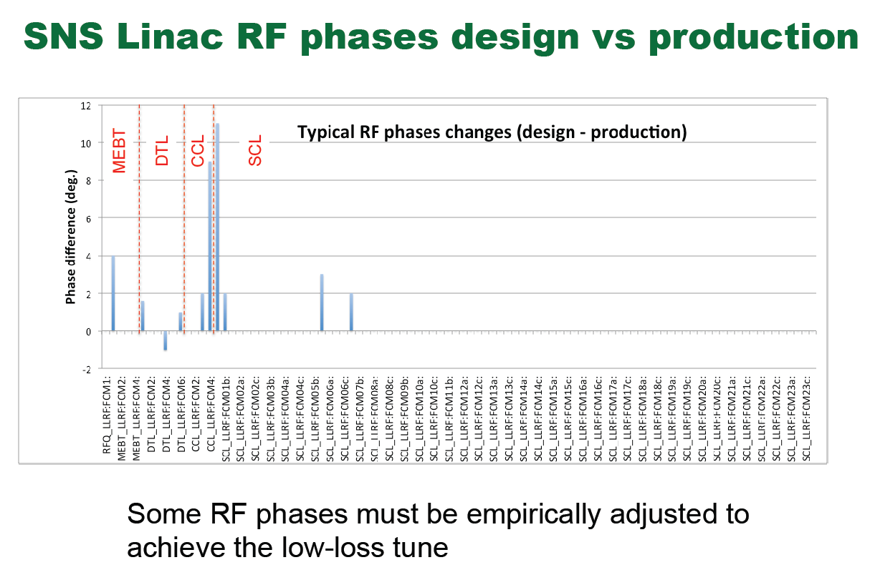
EX #3 -> RF phase tuning (SNS)
Courtesy M. Plum

Slide 16
Origin of longitudinal losses: TRANSIENTS
Beam losses due to unexpected transients
Fluctuations of the ion source (unstable plasma, arcing)
Chopper-induced transients (incl. space-charge compensation transients)
NC RF cavities instabilities due to poor vacuum (arcing, field collapse)
SC RF cavity instabilities (multipacting, Q-switch…)
RF feed-back & feed-forward performance and response time
Response to beam loading transients
Management of microphonics and Lorentz force detuning
Control algorithm performance (PID, residual error, adaptative feedforward…)
RF system trips off (due to a failure, to an interlock…)
RF reference stability (drifts due to temperature in RF galleries…)
…
Enhanced risk of harmful transients in pulsed RF machines

Slide 17
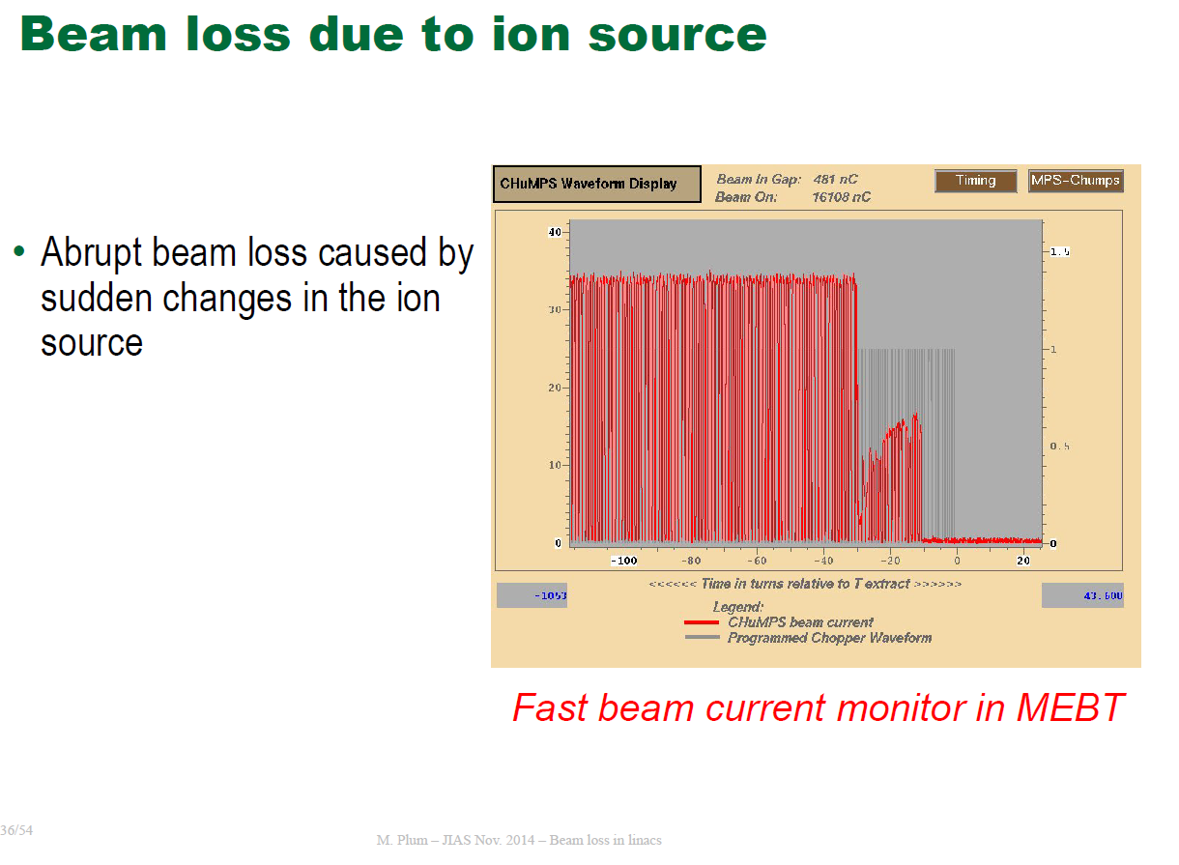
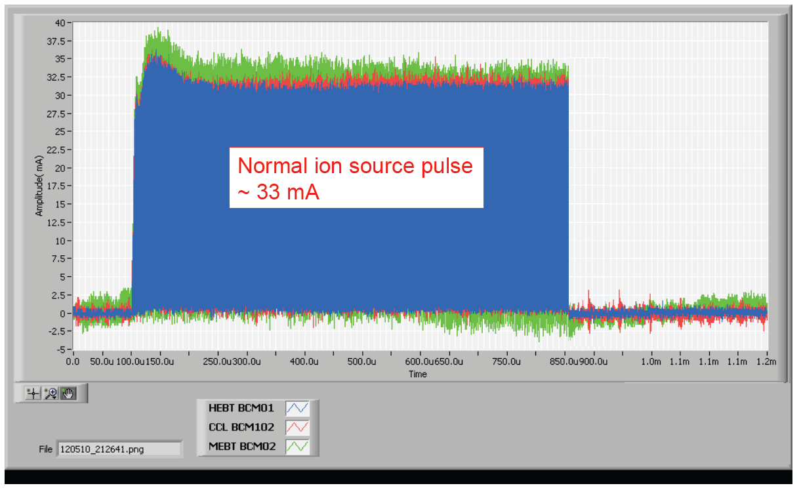
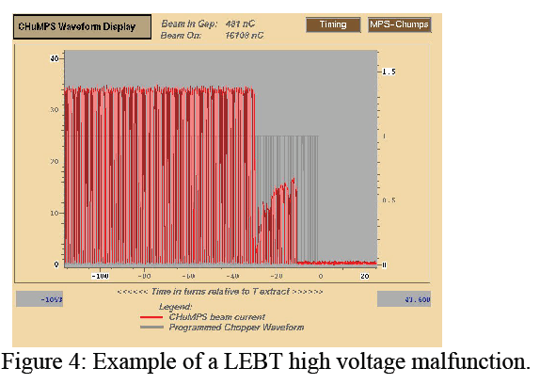
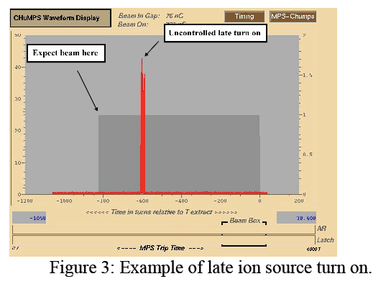
EX #1 -> Ion source fluctuations (SNS)
=10% of errant beam trips in SNS
Courtesy M. Plum

Slide 18
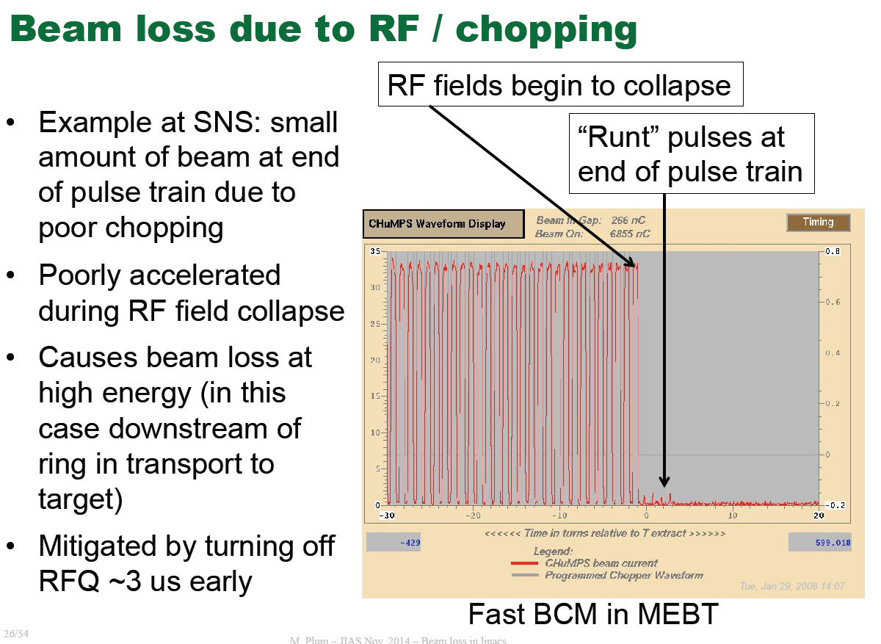
EX #2 -> Chopping issues (SNS)
Courtesy M. Plum

Slide 19
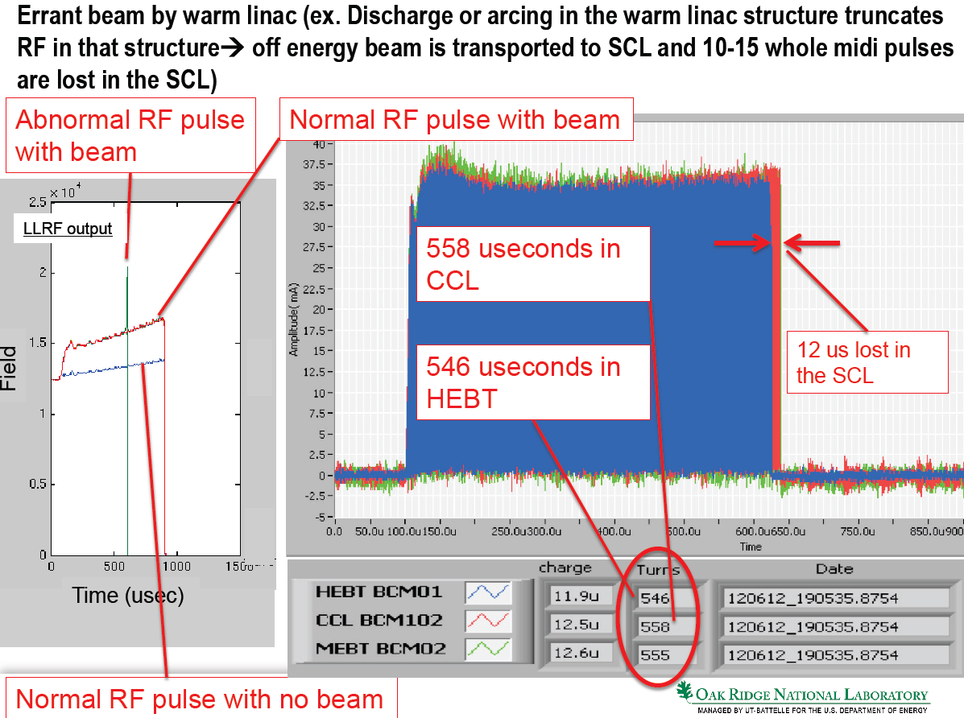
EX #3 -> NC cavities instabilities (SNS)
=90% of errant beam trips in SNS !!!
Courtesy S-H. Kim

Slide 20
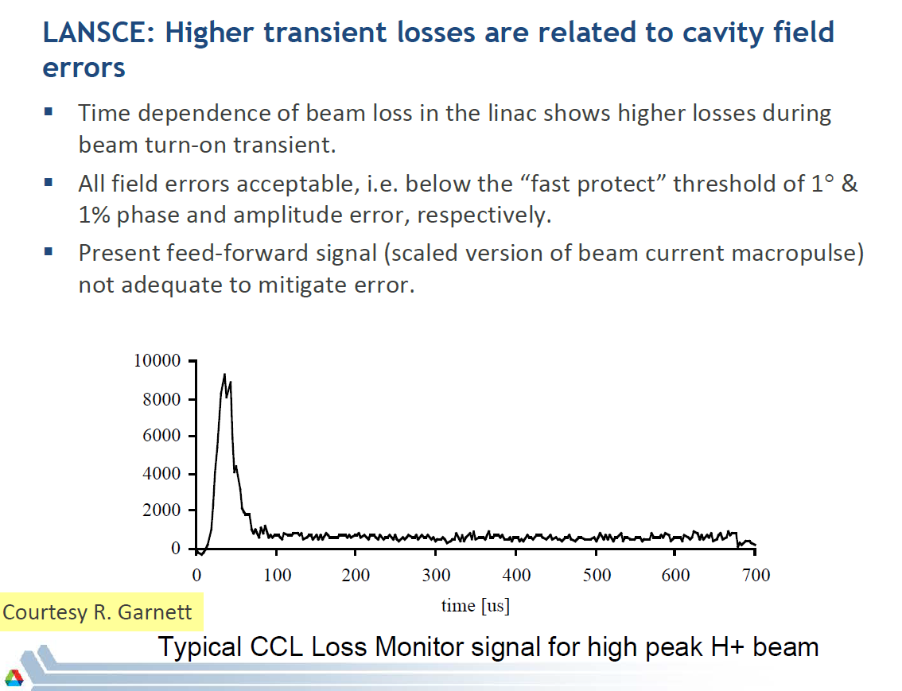
EX #4 -> LLRF performance (LANSCE)
Courtesy P. Ostroumov

Slide 21
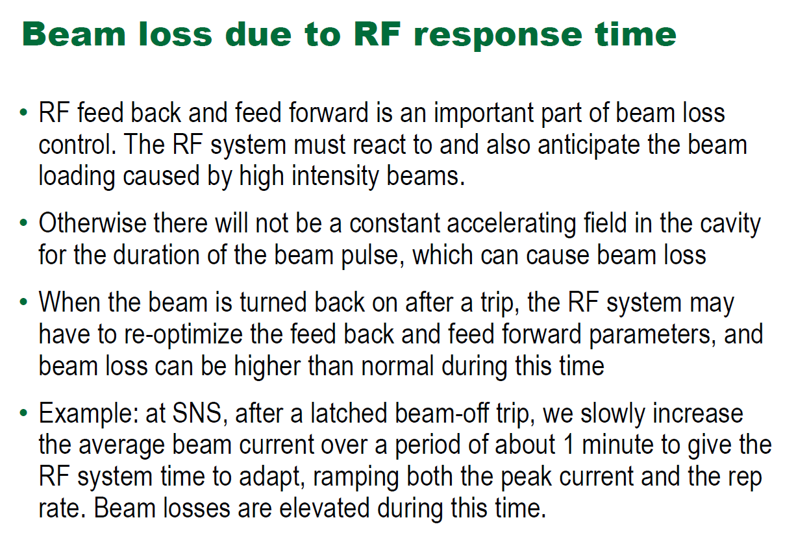
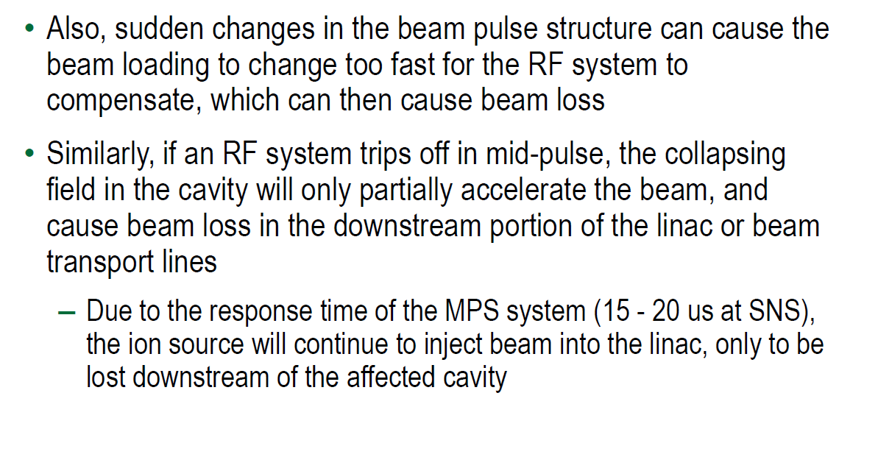
EX #5 -> LLRF performance (SNS)
Beam loading issues
RF trip issues
Courtesy M. Plum

Slide 22
TRANSIENT effects (especially longitudinal) can generate quite large and harmful beam losses…
All these transients are usually not simulated by beam dynamics codes, because present codes rely on the Monte-Carlo error studies to assess these « dynamic errors »
Such a method is quite poor to describe the situation, because these transients are NOT randomly distributed events !!!
-> Specific tools would be useful ☺

Slide 23
The longitudinal weakness
Origin of longitudinal losses
The TraceWin transient toolbox

Slide 24
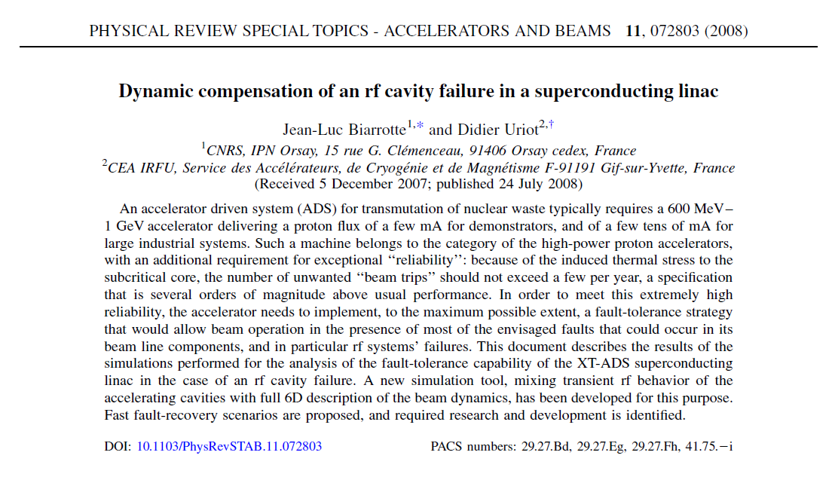
Simulation tool development

Slide 25
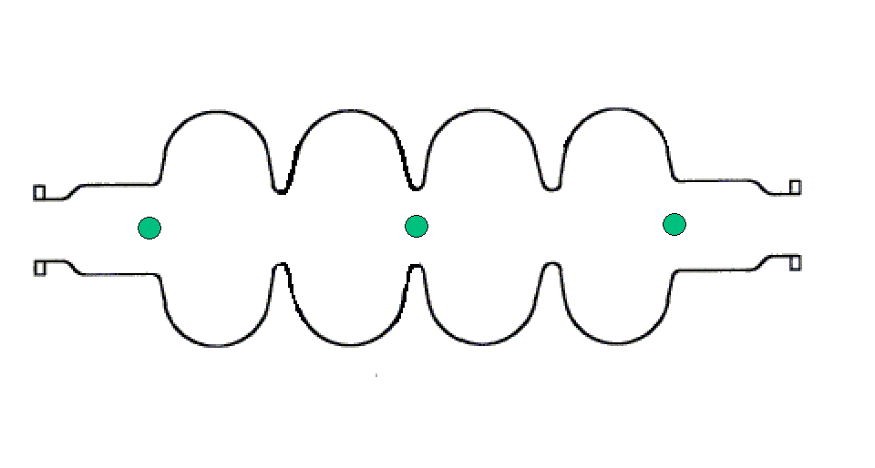
Simulation tool development
MODELING RF CAVITY + BEAM
First order model
Includes RF control loop
V_{C} fi_{C}
Set-points
P I D
delay LP filter
RF amplifier with saturation
Beam

Slide 26
Simulation tool development
IMPLEMENTATION IN THE TRACEWIN / PARTRAN CEA CODE
Implementation of cavity model with RF control loop in the whole linac
Crosscheck with Simulink simulations
- Implementation of the option “transient calculation”: Enveloppes/MP are simulated every dt
Can be very consuming depending on the choice of the time steps
Example:
Simulation of a 10 ms linac behaviour simulation, with δt0=1 ns, δt1=1 µs, δt2=10 µs and δt3=10 µs. With 10,000 macro-particle, about 1 Gigabytes are needed to save the results and the simulation spends about 22 hours.

Slide 27
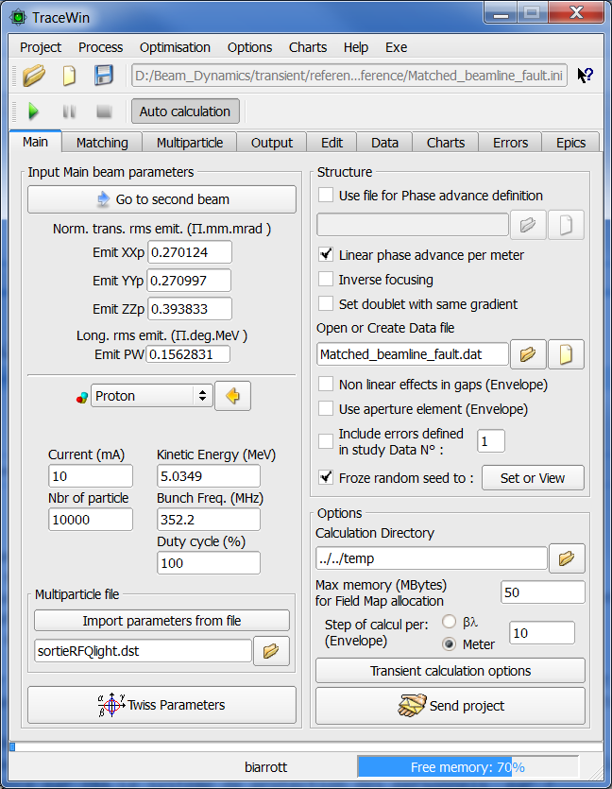
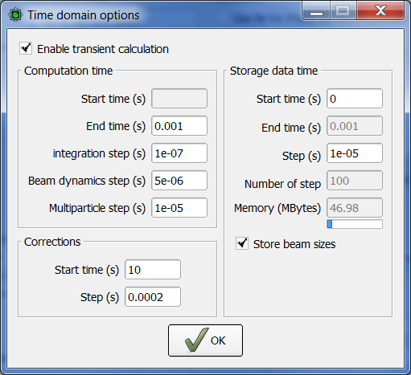
Simulation tool development
A VERY POWERFUL & UNIQUE TOOL
Able to analyse the effect of time-dependent perturbations
While simulating the whole beam behavior (longitudinal + transverse planes)
EXAMPLE : EFFECT OF MICROPHONICS
Microphonics (100, 600, 1000 Hz) of given amplitudes and phases randomly ditributed
=> Energy jitter induced at the end of the linac

Slide 28
Ex1: Consequence of a RF cavity failure
Failure of the last Spoke cavity: P_{inc} = 0 kW @ t=0, nothing is done
Eacc = f(t), Fisynch = f(t)
The failed cavity becomes decelerating (beam loading effect)

Slide 29
Ex1: Consequence of a RF cavity failure
Failure of the last Spoke cavity: P_{inc} = 0 kW @ t=0, nothing is done
Output energy = f(t), Beam losses = f(t)
First beam losses at t + 160 us

Slide 30
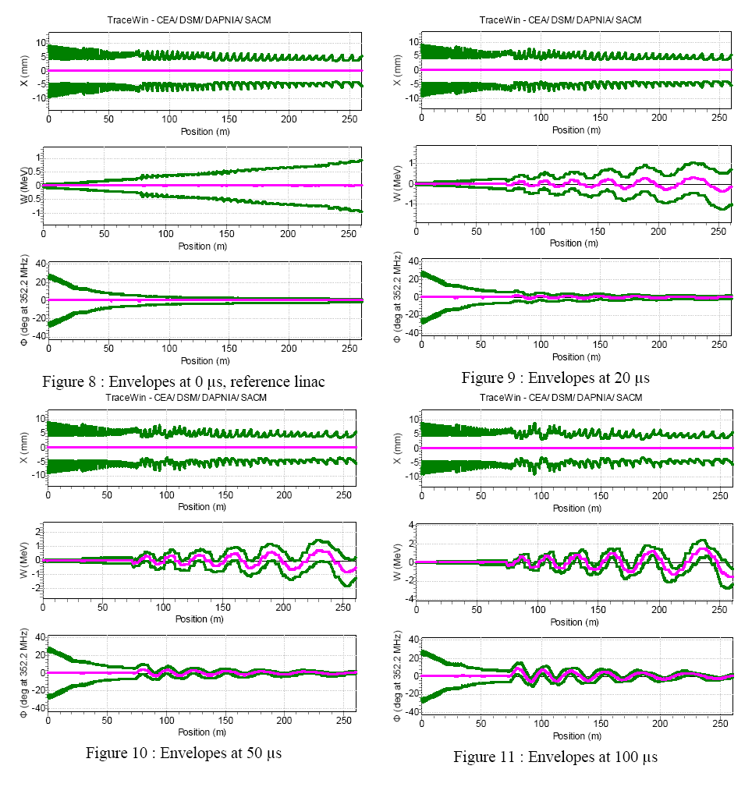
Ex1: Consequence of a RF cavity failure
Beam enveloppes at different t
Failed cavity position

Slide 31
Ex1: Consequence of a RF cavity failure
Phase space at different t
t=0
t=100us
t=150us
t=200us

Slide 32
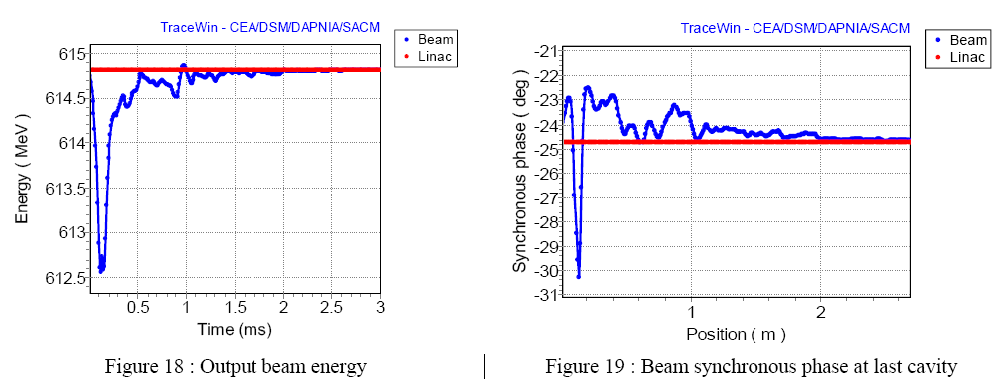
Ex2: Online compensation of a cavity failure
EXAMPLE : @ t=0, the last spoke cavity fails
t1 = 75 us (detection time), t2 = 75 us (correction step)
40 correction steps are performed before stabilization
0.5%

Slide 33
Ex2: Online compensation of a cavity failure
EXAMPLE : @ t=0, the last spoke cavity fails
t1 = 75 us (detection time), t2 = 75 us (correction step)
Good emittance behaviour, no beam losses during the procedure
Worse situation at 140us

Slide 34
Ex2: Online compensation of a cavity failure
EXAMPLE : @ t=0, the last spoke cavity fails
t1 = 75 us (detection time), t2 = 75 us (correction step)
6 cavities used with 50% Eacc margin available (with 8 cavities : 40%)

Slide 35
Ex2: Online compensation of a cavity failure
SPECIFICATIONS FOR DETECTION TIME & CORRECTION STEP
t1 < 150 us (detection time), t2 < 150 us (correction step)
If longer, beam losses starts to appear during the retuning

Slide 36
This tool was specifically developped to look at transient aspects of the local compensation method (MYRRHA project)
Beyond that , it can be used to look at some specific transient cases (see after)
In any case, it is an excellent basis for further developments if one wants to assess transient beam losses

Slide 37
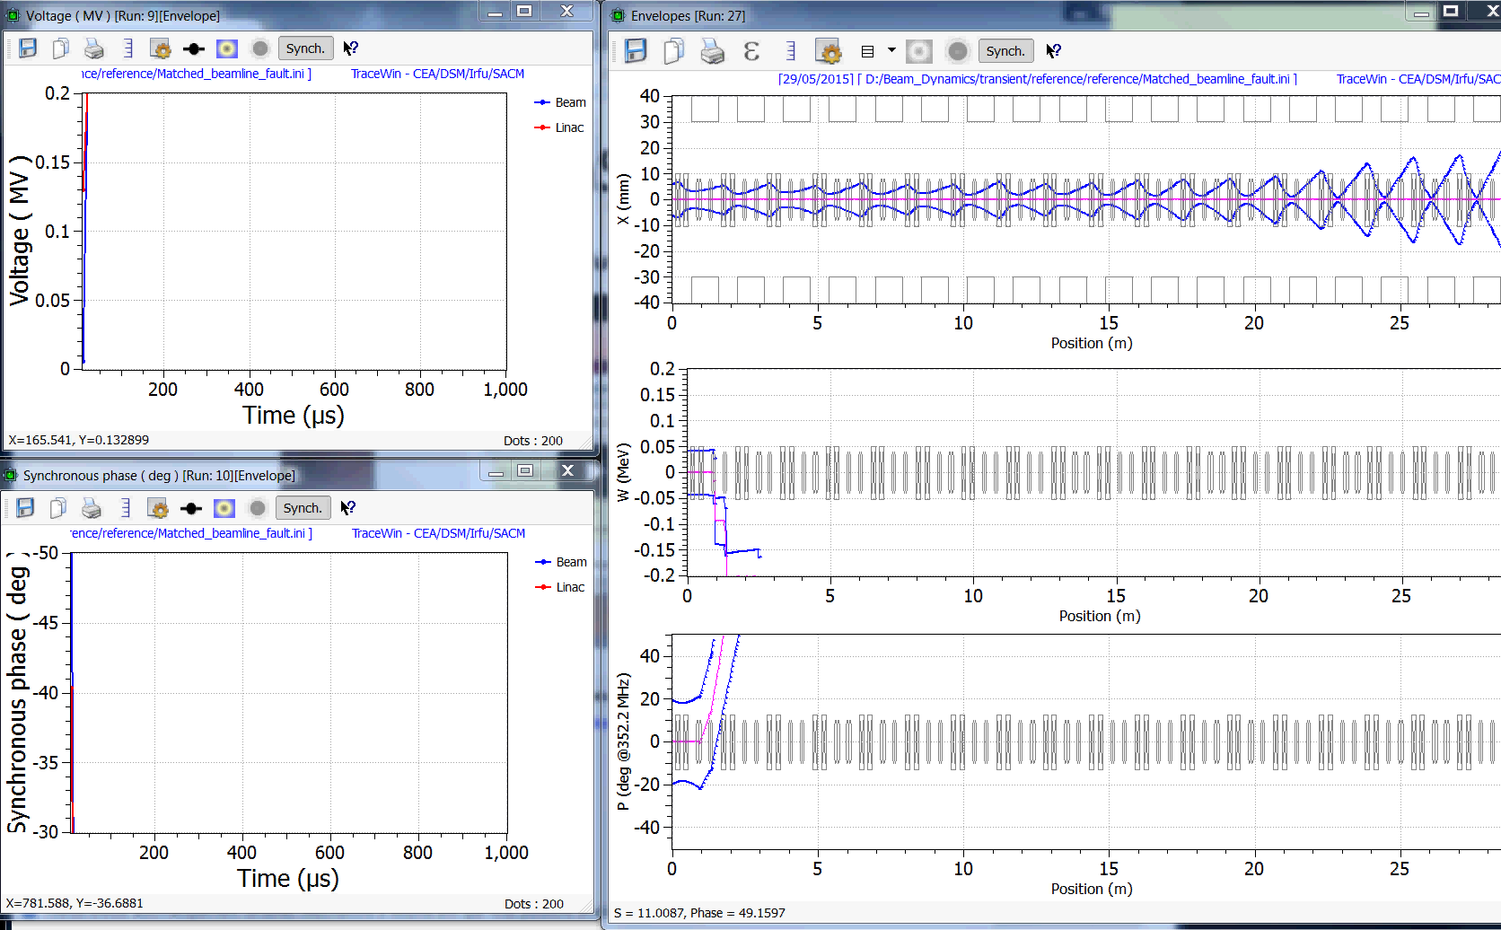
Ex: RF switch ON (t=0) with beam (V,ϕ at 1st cavity)

Slide 38
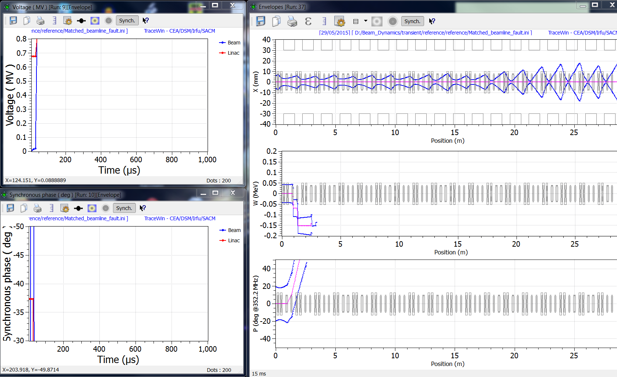
Ex: RF switch ON (t=0) with beam (V,ϕ at last cavity)

Slide 39
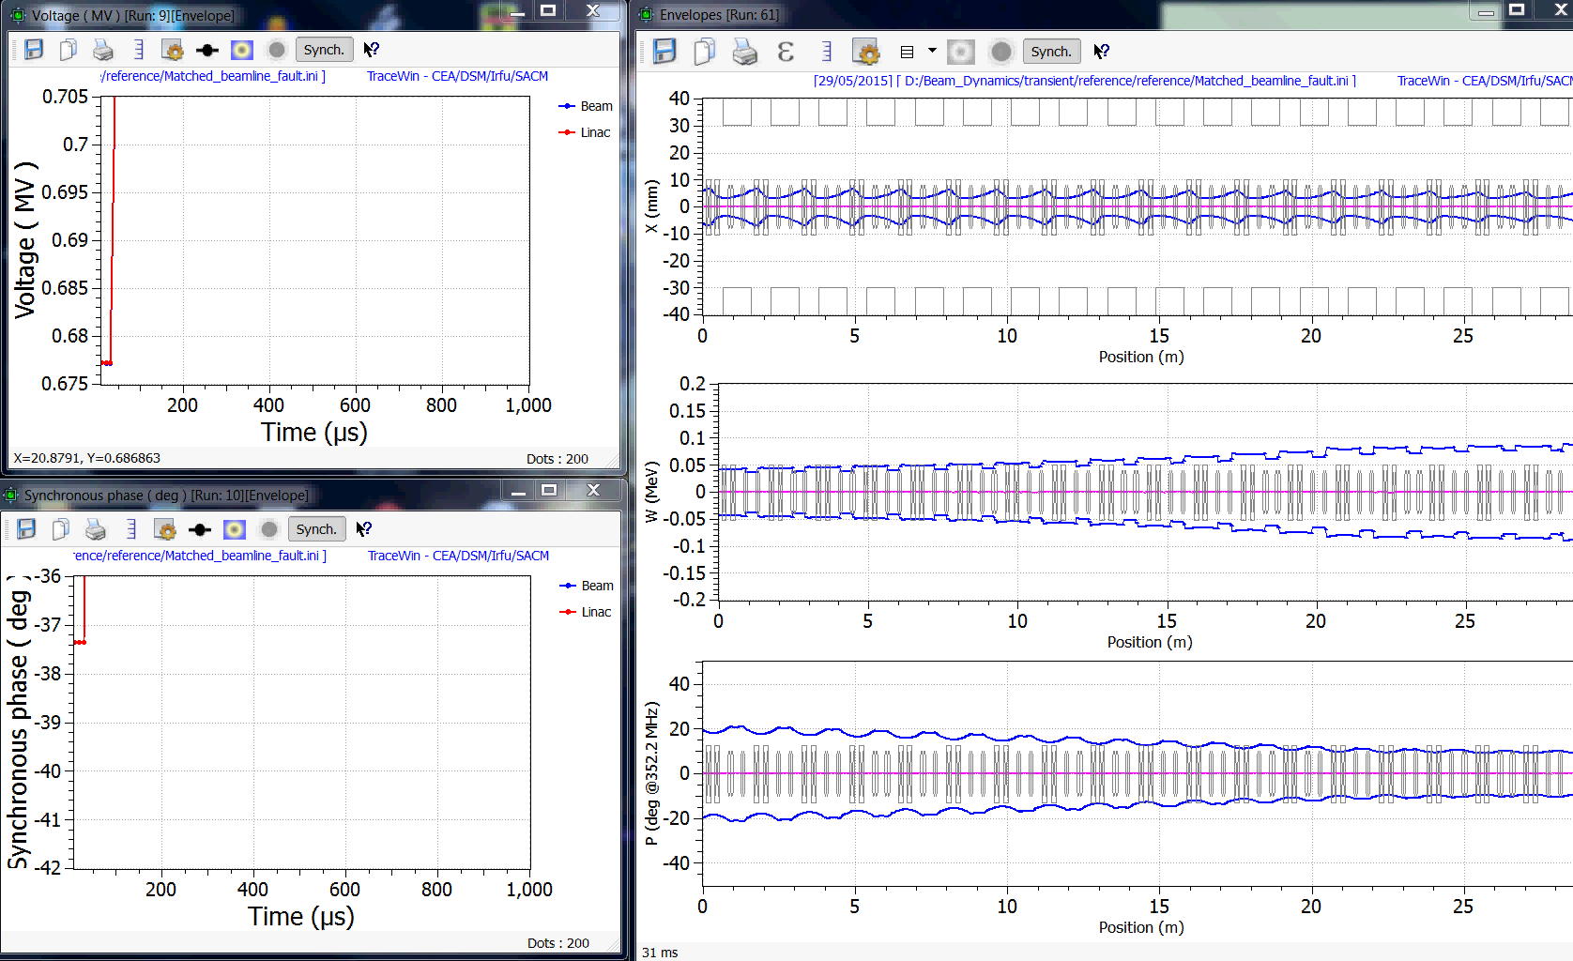
Ex: I drop (t=0.5ms) from 10mA to ∼0mA (V,ϕ at last cavity)

Slide 40
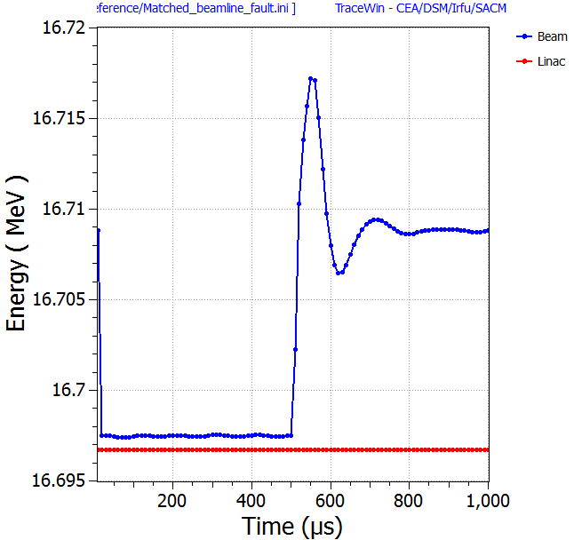
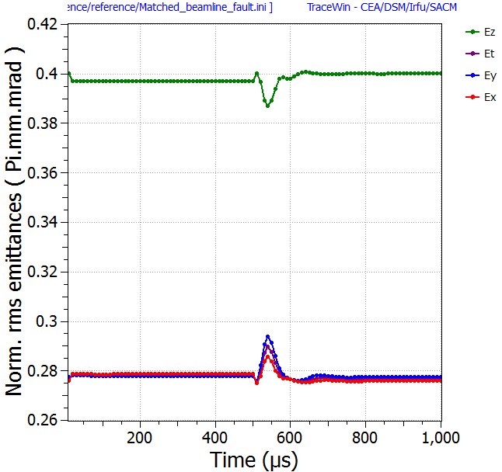
Ex: I drop (t=0.5ms) from 10mA to ∼0mA (W,ε at last cavity)
10mA
0mA
10mA
0mA

Slide 41
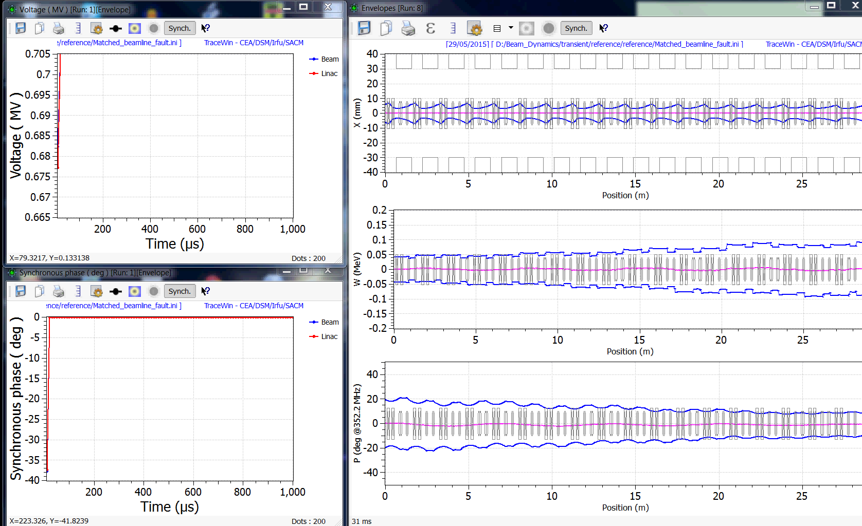
Ex: 10mA beam loading effect (t=0.5ms) (V,ϕ at last cavity)

Slide 42
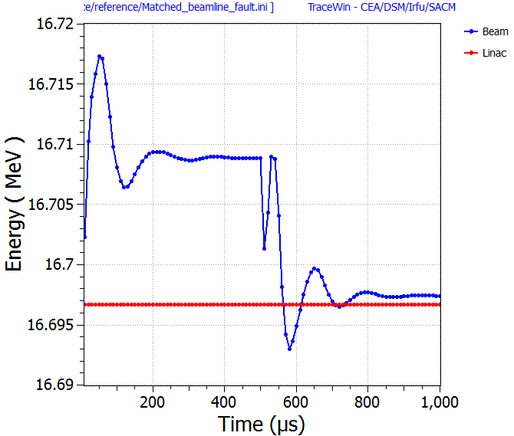
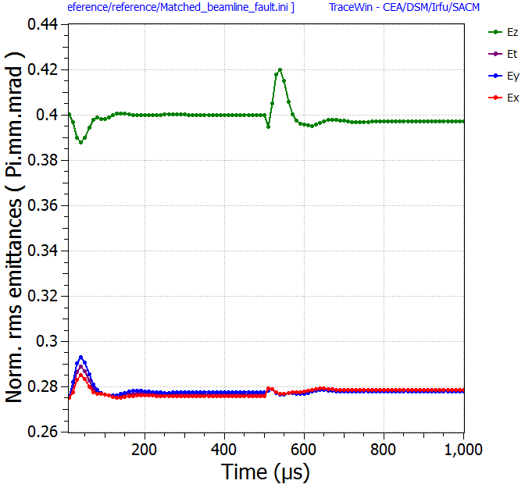
Ex: 10mA beam loading effect (t=0.5ms) (W,ε at last cavity)
No beam
Beam
No beam
Beam

Slide 43
Thank You for your attention!

