Slide 1



Superconducting Cavity Control
&
Fault-Compensation Strategy for MYRRHA
F. Bouly (LPSC / CNRS), J.-L. Biarrotte (IPNO / CNRS)
LLRF-Beam Dynamics Workshop
1 and 2 June 2015
Lund, Sweeden

Slide 2
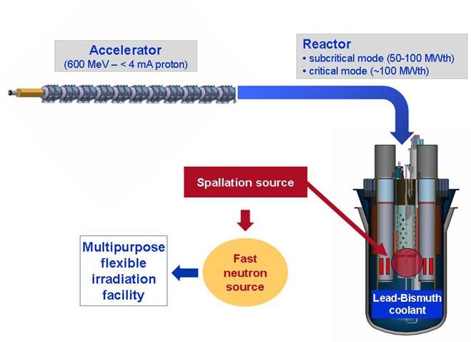
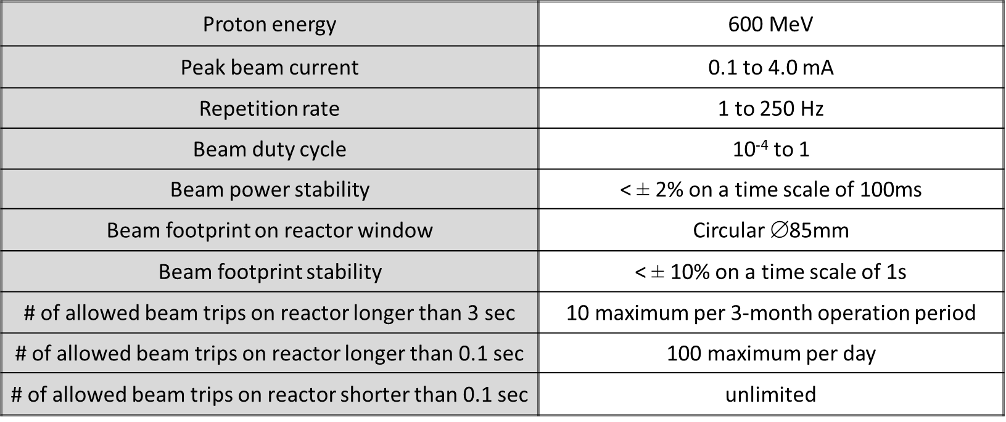

The MYRRHA Project (Reminder)
 Demonstrate the ADS Concept & Transmutation
➲ Coupling : Accelerator + spallation source + subcritical reactor
High power proton beam (up to 2.4 MW)
 Extreme reliability
➲ Avoid beam trips longer than 3 seconds to minimise thermal stresses and fatigue on target, reactor & fuel assemblies and to ensure 80 % availability (reactor re-start procedures).
➲ Actual Specification : Less than 10 trips per 3-month operation cycle.

Slide 3
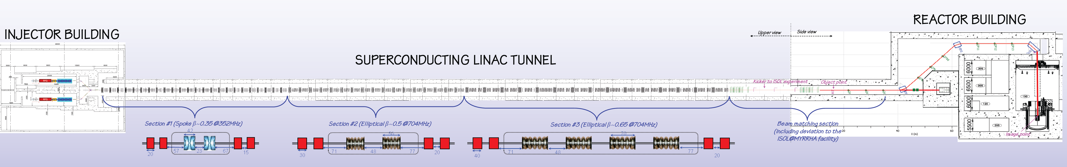
Reliability guideline & Linac layout
 In any case, reliability guidelines are needed for the ADS accelerator design:
➲ Robust design i.e. robust optics, simplicity, low thermal stress, operation margins…
➲ Redundancy (serial where possible, or parallel) to be able to tolerate/mitigate failures
➲ Repairability (on-line where possible) and efficient maintenance schemes
 Layout of the MYRRRHA linac
Parallel redundancy
Serial redundancy

Slide 4
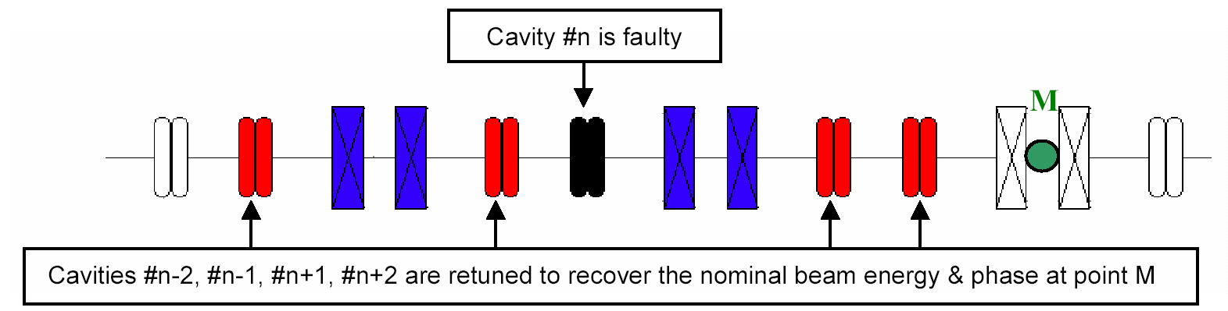
Fault compensation in the main linac: Serial Redundancy
❶ A failure is detected anywhere
→ Beam is stopped by the MPS in injector at t₀
❷ The fault is localised in a SC cavity RF loop
→ Need for an efficient fault diagnostic system
❸ New V/φ set-points are updated in cavities (cryomodule) adjacent to the failed one
→ Set-points determined in advance: via virtual accelerator application and/or during the commissioning phase
❹ The failed cavity is detuned (to avoid the beam loading effect)
→ Using the Cold Tuning System
❺ Once steady state is reached,
beam is resumed at t₁ < t₀ + 3sec
→ Failed RF cavity system to be repaired on-line if possible

Slide 5
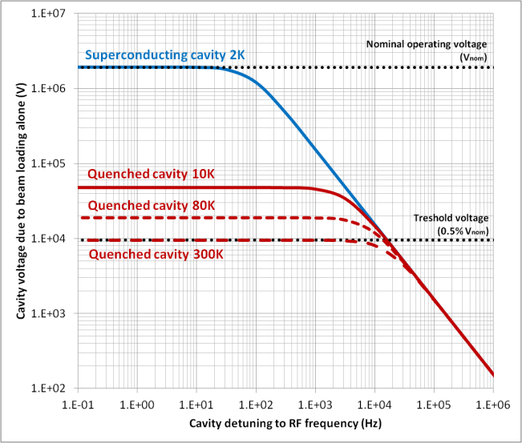


Cavity control Systems Requirements
 Beam power stability ± 2% (over 100 ms integration time)
 Energy output accuracy 600 MeV ± 0.5 MeV, to ensure a good beam transport (low losses)
➲ Results in a required precision, for the individual control system of SC cavities, of:
$$\frac{ΔV_{cav}}{V_{cav}}<0.5 \%$$
$$Δϕ_{S}<0.5°$$
 The control system must enable the retuning procedures with a limited amount of CW Power
➲ Retune a compensation cavity in less than 3 sec.
➲ Detune the failed cavity in less than 3 sec. :
_ if still superconducting → limit the induced decelerating voltage < 0.5 % of the nominal voltage.
_ if quenched → limit the dissipated power
J-L. Biarrotte et al. Proc. SRF2013

Slide 6
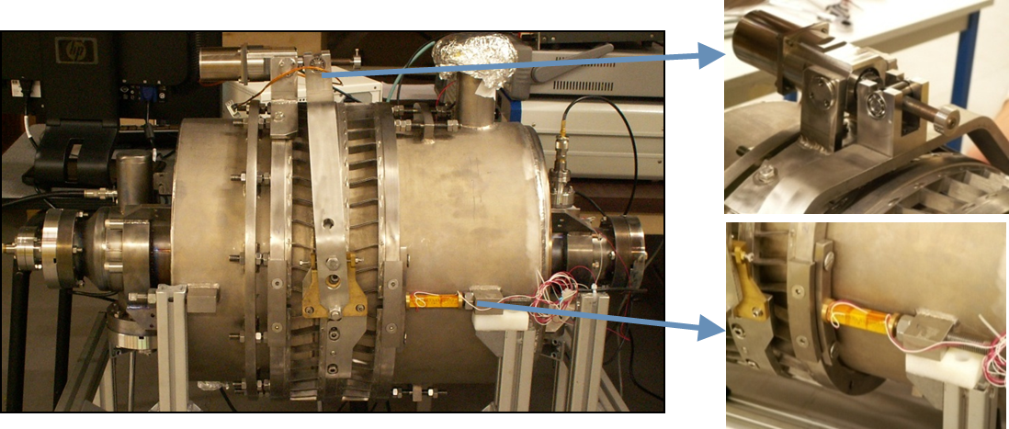
Modelling & retuning procedure assessment
 Development of Matlab Simulink Model with Laplace Transfer Functions
➲ To assess the feasibility of the fault compensation procedure
➲ To evaluate the technological requirements (RF power, tuning system, LLRF, …)
Model based on an existing superconducting cavity prototype and its associated systems
➲ 5-cell elliptical cavity (β_{opt} = 0.51 medium energy section of the MYRRHA linac)
➲ Cold tuning sytem : a blade tuner controlled by a motor (‘slow’ & large scale) and piezo actuators (‘fast’)

Slide 7
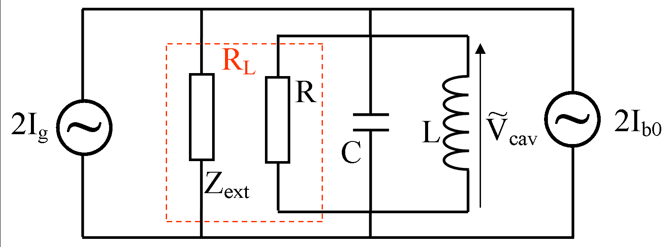
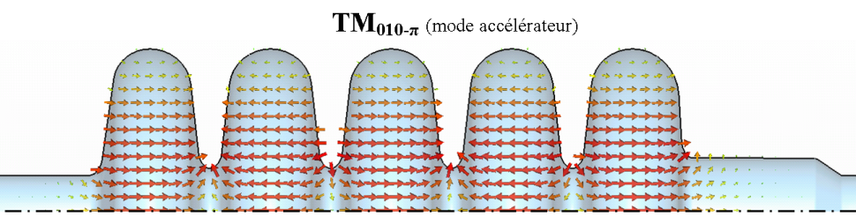
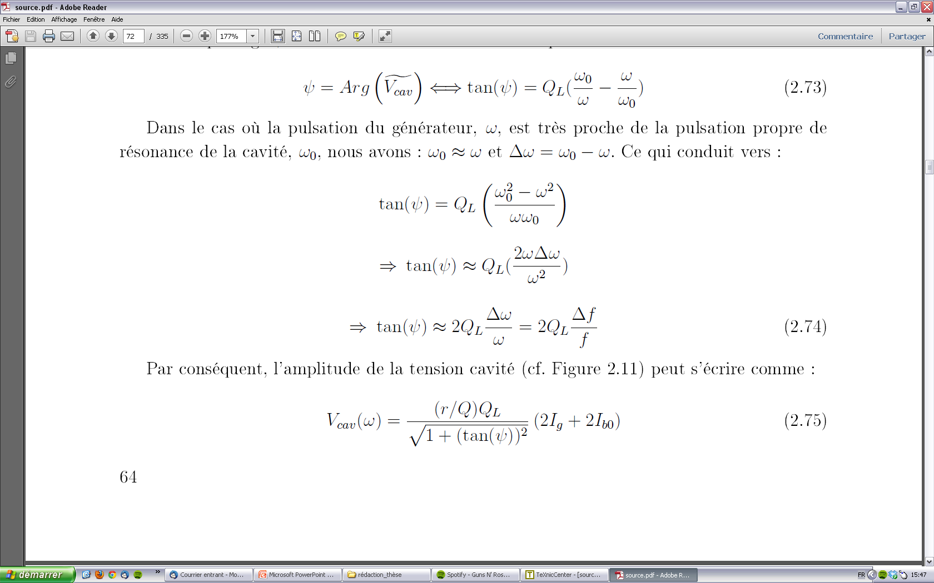
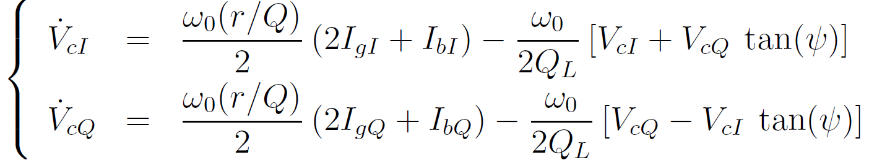
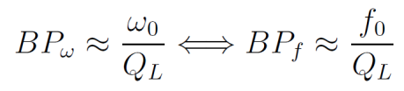
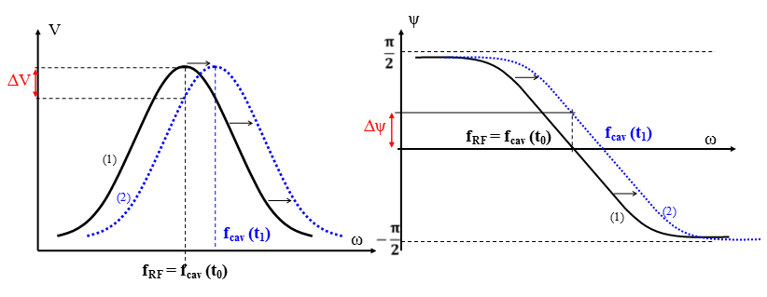
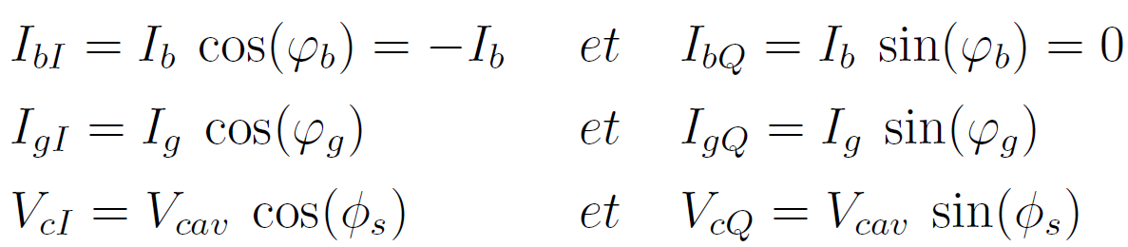
Cavity model & main characteristics
   Band pass resonator ↔ RLC parallel circuit.
   RF amplifier & beam seen as current generator for the cavity.
   One can link the cavity parameters ((r/Q), Q₀ ,Q_{L} ) to R_{L} (or R), L et C.
Stationary
Transient

Slide 8
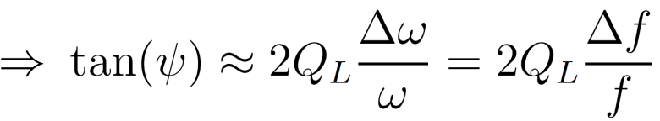
Cavity control principle (1/3)
Im
  Complex plane representation : cavity non optimised frequency tuning
V_{g}
V_{b}
φ_{g}
V_{cav}
V_{b}(at ω₀ = ω)
I_{b}
O
ϕ_{s}
Re
ψ
ψ
V_{ref}
I_{g}
φ_{g}
V_{inc}
V_{b}
V_{g} (at ω₀ = ω)
   Accelerating Field :V_{acc} = V_{cav} cos(ϕ_{s}) = V_{cI}
   ψ depends on the cavity frequency tuning :

Slide 9
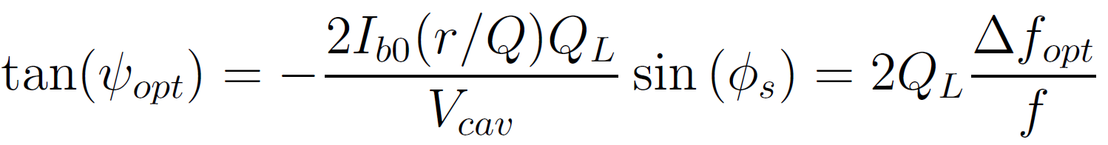
Cavity control principle (2/3)
Im
  We want to reach the optimal cavity frequency
  Optimal tuning is achieved to minimise the reflected power at the cavity input.
V_{cav}
V_{ref}
I_{g}
V_{inc}
V_{b}(at ω₀ = ω)
I_{b}
O
ϕ_{s}
Re
V_{ref}
I_{g}
V_{inc}
  Optimal frequency (de)tuning :

Slide 10
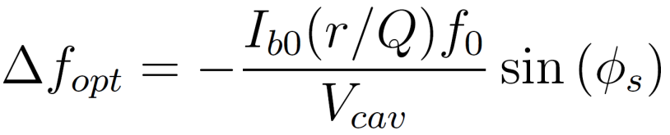
Cavity control principle (2/3)
Im
V_{g} (at ω₀ = ω)
V_{b}
V_{cav}
V_{ref}
I_{g}
V_{inc}
φ_{g}
V_{b}(at ω₀ = ω)
ψ
O
ϕ_{s}
Re
ψ
I_{b}
φ_{g}
V_{b}
V_{g}
  Optimal frequency detuning :
When the optimal detuning is achieved : φ_{g}= ϕ_{s}

Slide 11
Global Control Strategy
φ_{g}
V_{cI}^{set-p},V_{cQ}^{set-p}
Low Level RF
+
_
Amp.
V_{cI} V_{cQ}
Beam
CAVITY
Perturbations :
Lorentz detuning
Microphonics
He bath pressure …
Δf_{L}, Δf_{mic}
LLRF Loop
+
+
Δf_{He}
Δf_{SAF}
φ_{g}
Cold Tuning System
CTS Loop
ϕ_{S}^{set-p}
-
=0
Controller
+
Amp.

Slide 12
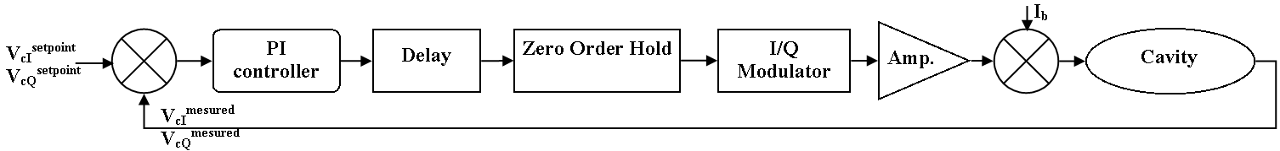
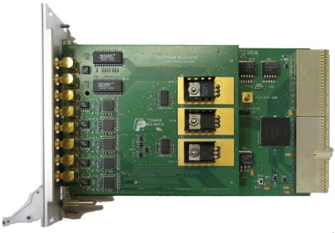
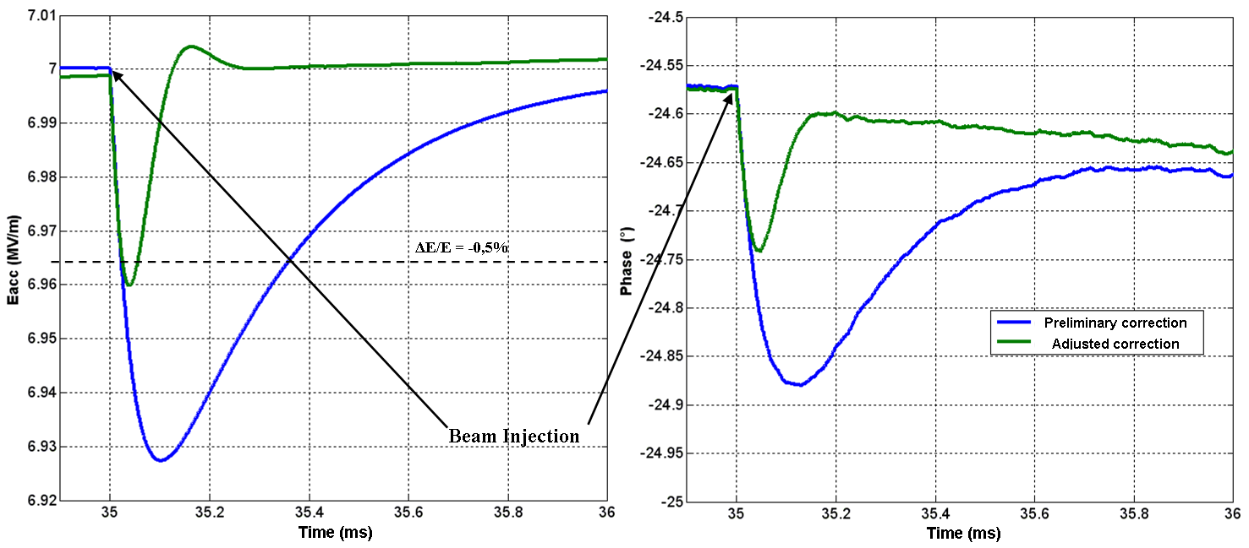
LLRF feedback loop Model
 Based on an existing LLRF prototype
C. Joly : EUCARD/MAX workshop, Mars 2014
   Modelled in I/Q formalism - Transfer function in Laplace domain:
Complete board with analogue mezzanine
    ➲ Maximum RF power available 30 kW.
    ➲ Numerical system effects : Delay + ZOH + modulator.
    ➲ PI correctors adjusted to minimise beam loading effect

Slide 13
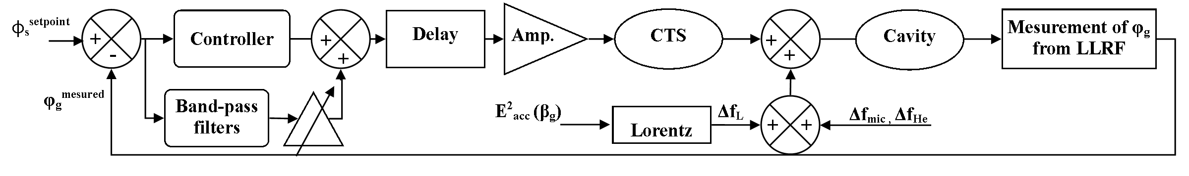
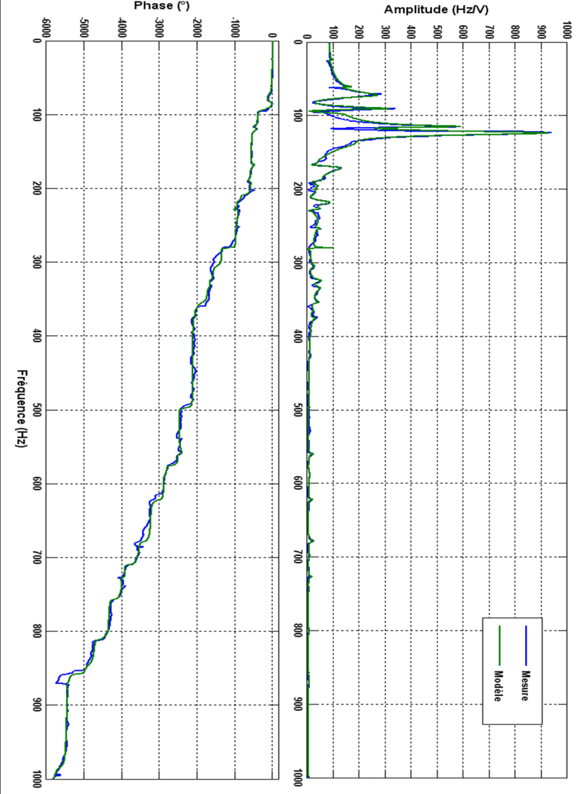
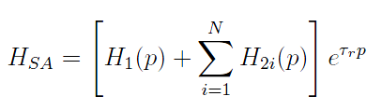
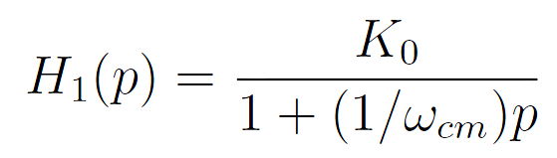
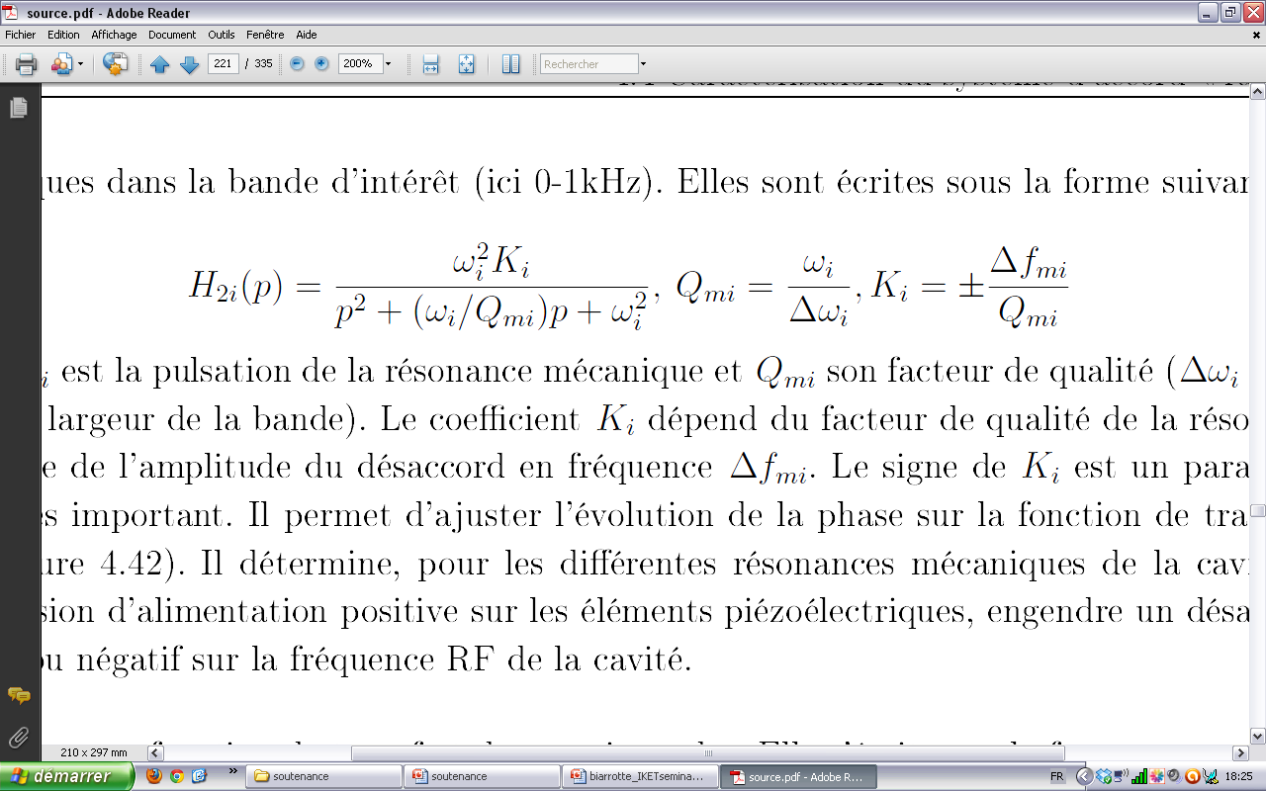
Fast Cold Tuning System Control Loop
   Transfer function of the cold tuning system modelled from measurements

Slide 14
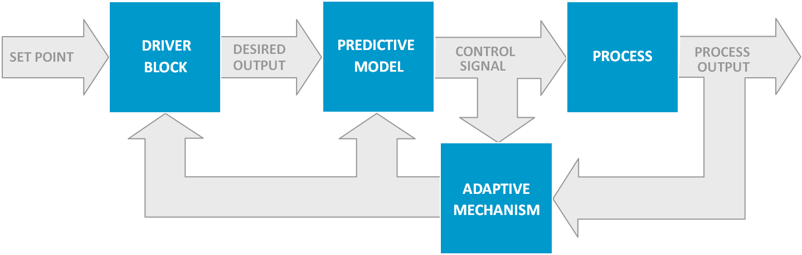

Adaptive & Predictive Control System
   Different solutions for the Tuning system controller have been studied :
    ➲ A PI corrector - An adaptive and predictive system (from ADEX)
  Predictive : instead of reacting to the error already produced, like PIDs, it predicts the process variable's evolution and thus anticipating to the predicted drifts from their set points.
   Adaptive : it learns in real time from the changing process dynamics in order to have a permanent precise prediction. The adaptive mechanism informs the driver block about the current process status and of the process output deviation from the desired trajectory.

Slide 15
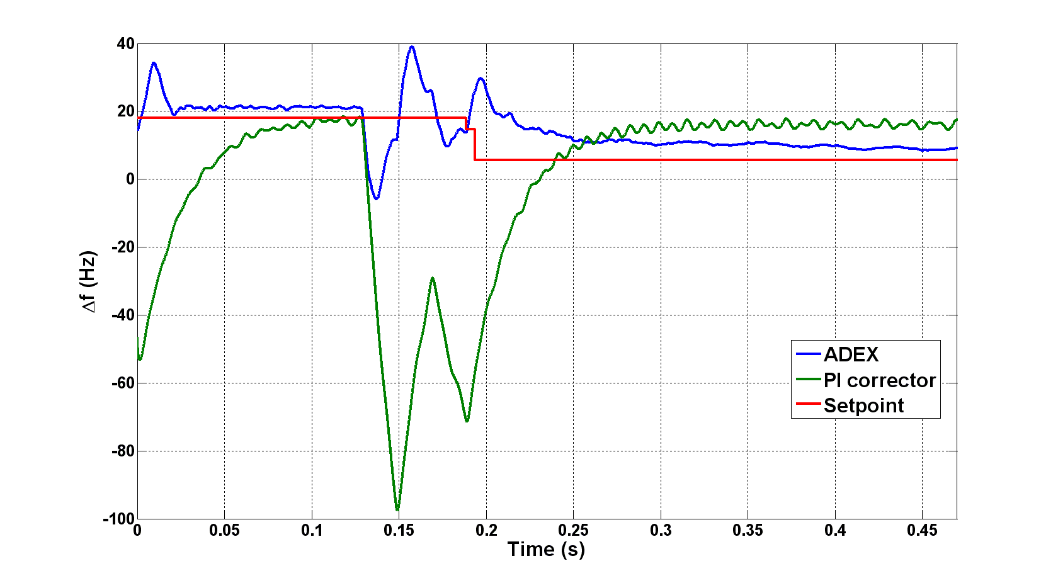
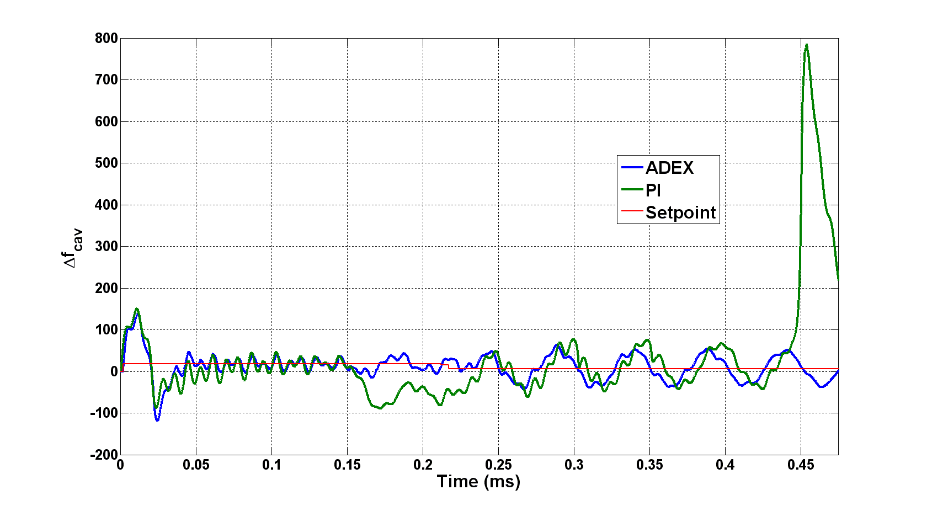
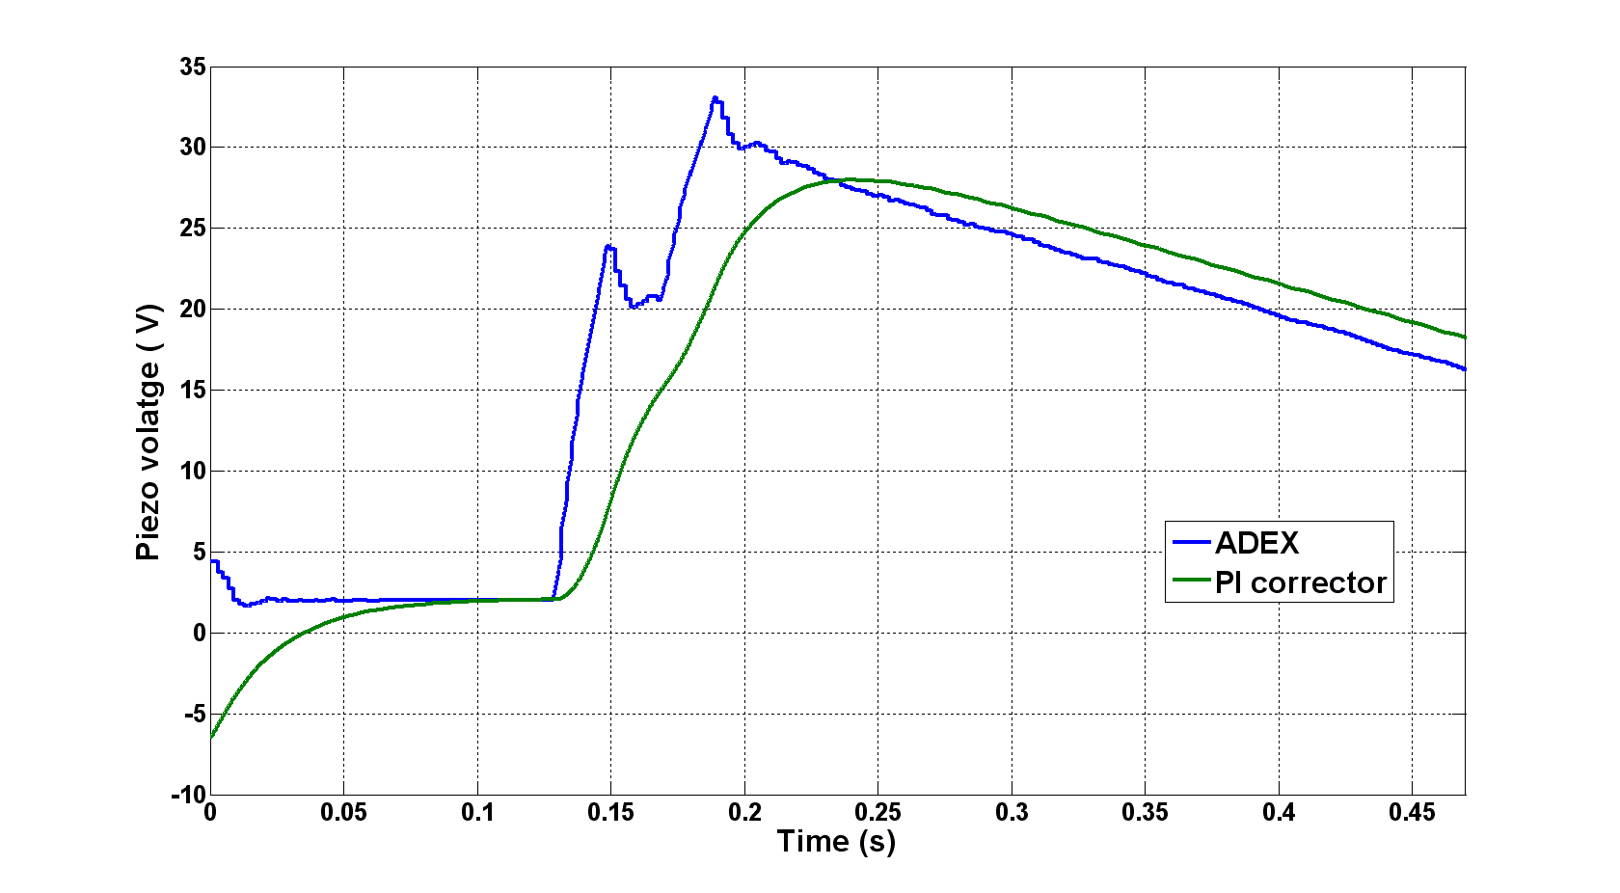
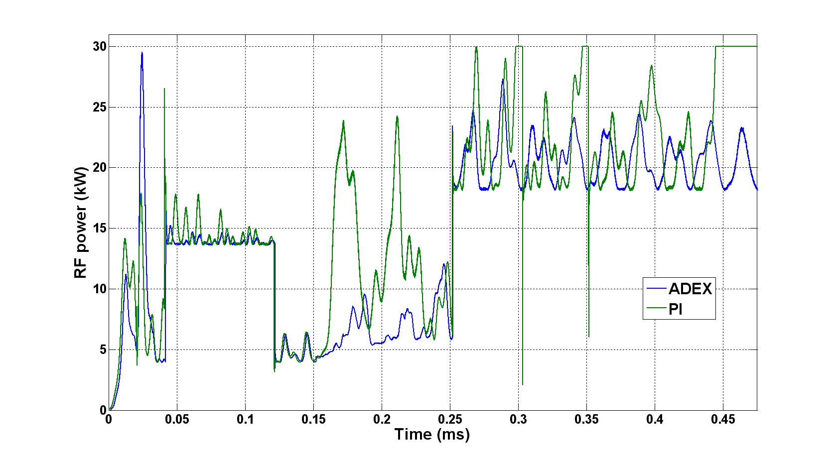
PI Corrector vs. Adaptive System
     Simulations showed that the ADEX system can help to increase the response time of the system and maybe the microphonics compensation.
Example: Simple frequency control
Example: strong microphonics perturbations

Slide 16
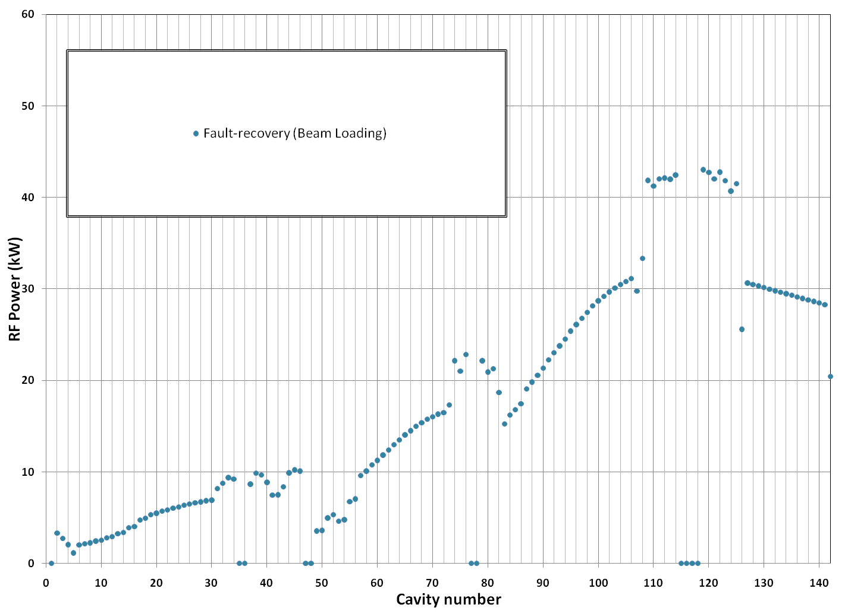
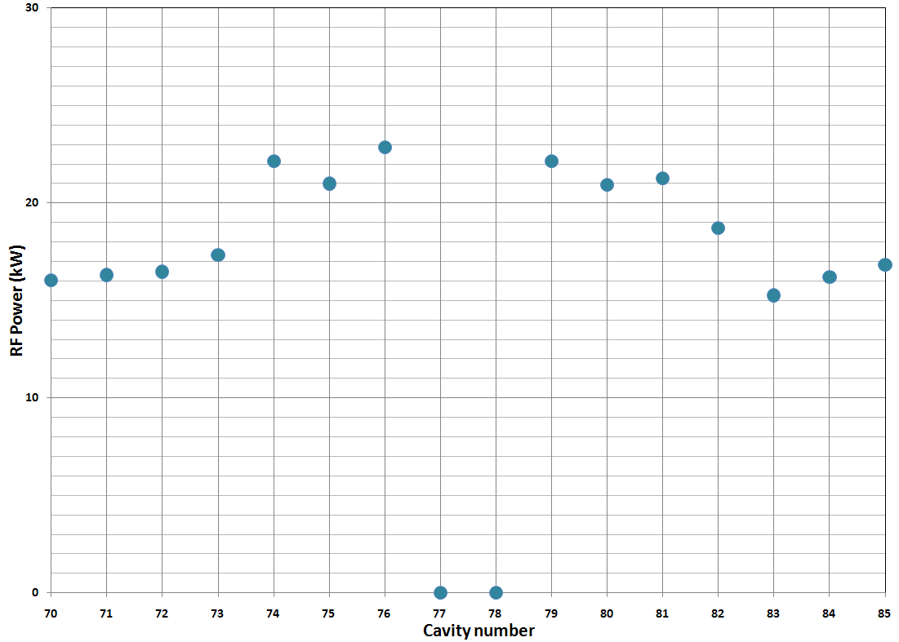
Simulation of fast-fault recovery scenario
Cavity n°76
One of the compensation cavities
Recovery from the failure of a β 0.47 cryomodule
Cavity n°77
One cavity of the failed module

Slide 17
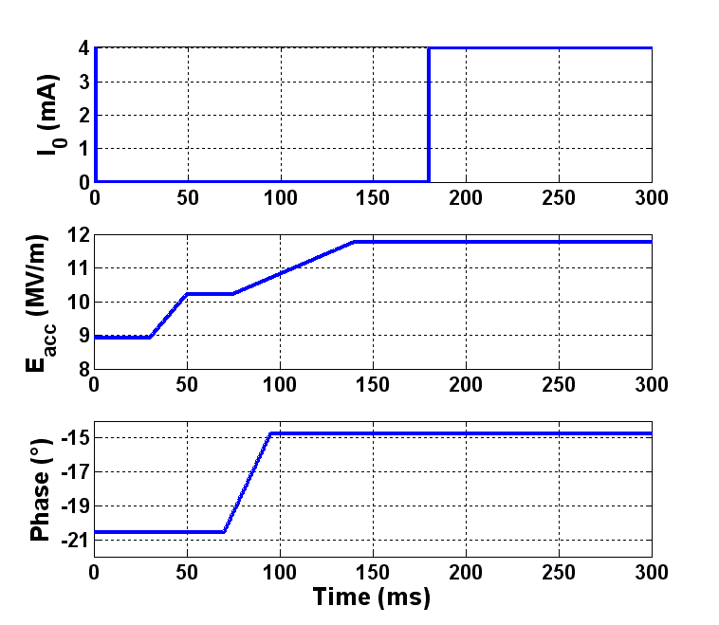
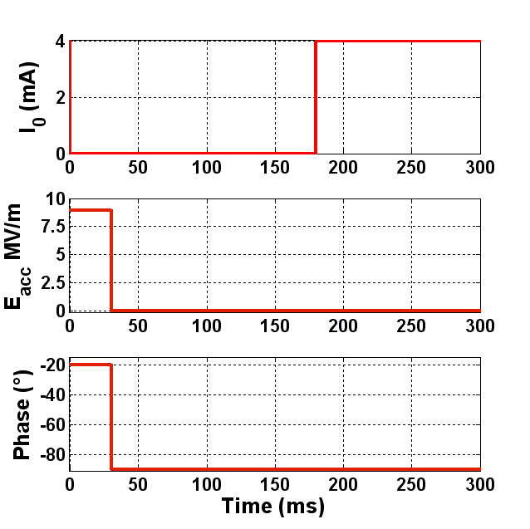
Scenario description
Compensation cavity
Cavity n°76
Failed cavity
Cavity n°77

Slide 18
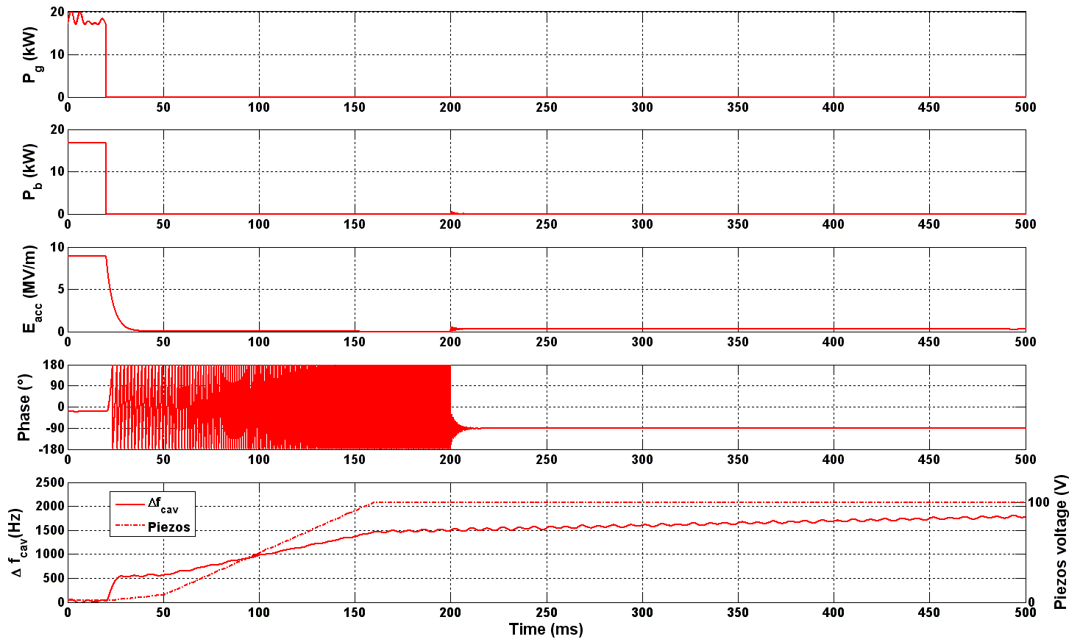
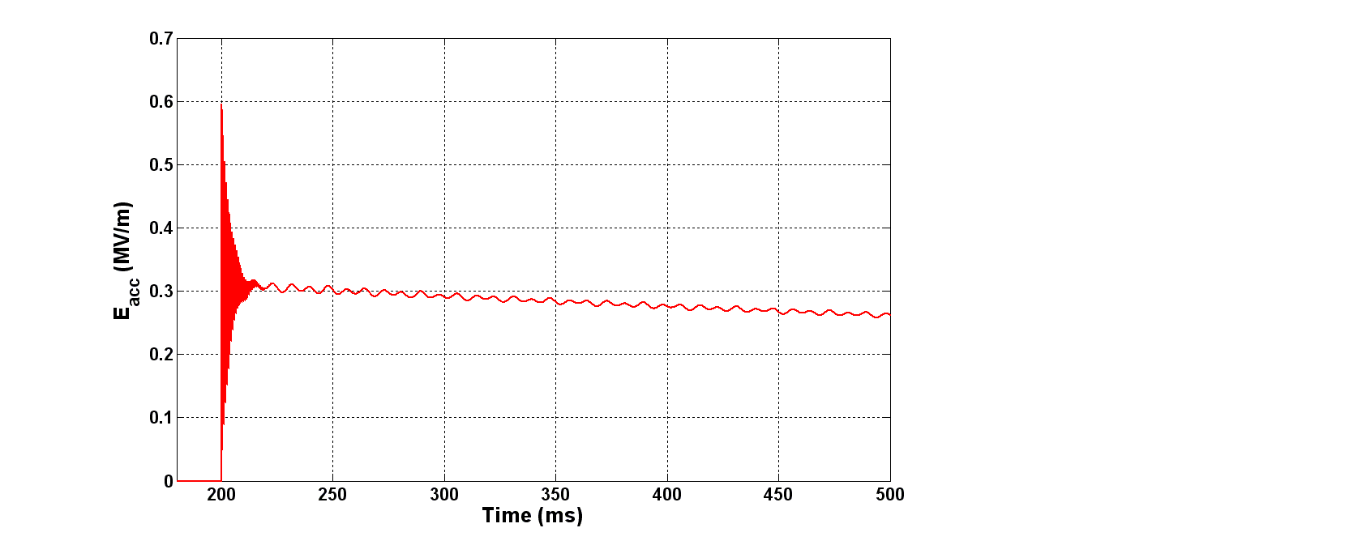
Failed cavity (N°77)
Beam deceleration
150 keV >> 22.25 keV (higher than acceptable limit from the 0.5 % error tolerance)
 Motor must detune the cavity at a speed higher than 5 kHz/sec.
Motor detuning action at 1 kHz/sec

Slide 19
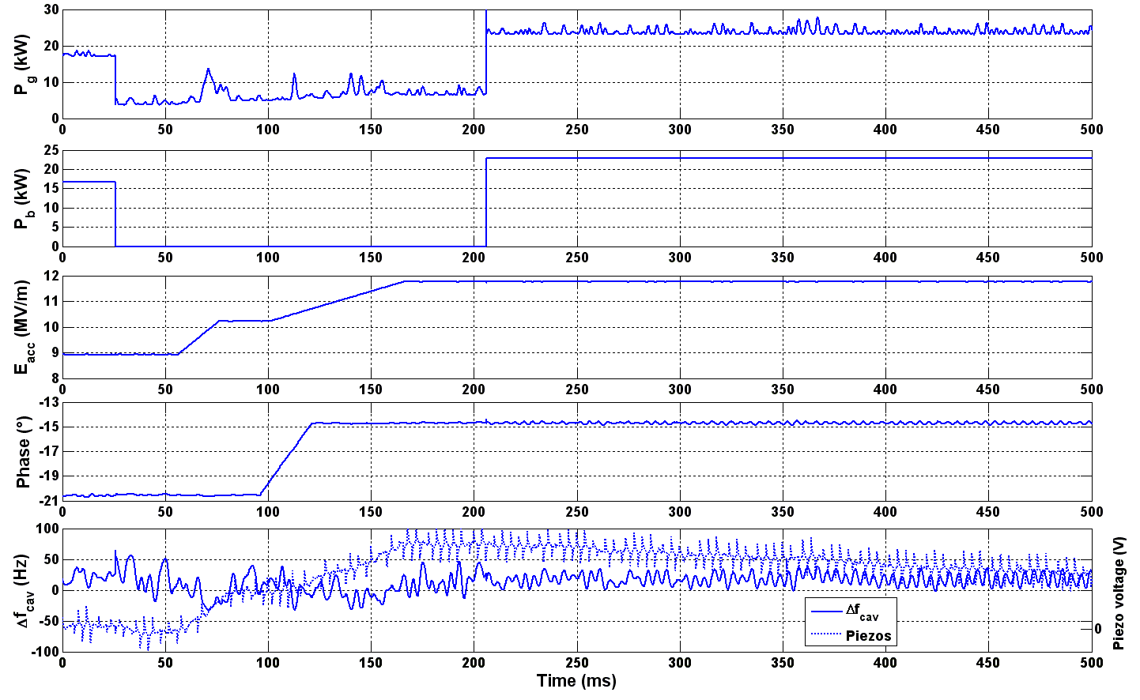
Compensation cavity (N°76)
-45

Slide 20
CONCLUSIONS
   Based on existing systems a model of the cavity and its feedback loops have been developed : cavity + cold tuning system + LLRF.
   Results from simulations showed that it is possible to retune the cavities in less than 3 seconds.
   Still, procedure feasibility depends on the failure detection speed : here 30 ms are assumed (should be achievable…) .
   It is therefore highly recommended to dispose of a “fast” tuning system (response time : ~ 1 ms) :
    ➲ Otherwise, in certain cases, RF power margin may not be sufficient
   The unused cavity can disturb the beam :
    ➲ Beam deceleration must be lower than 0,5% Δw_{nominal} (~ 20 keV )
    ➲ In worst case, the minimum required detuning Δf ≈ 12 kHz (> 140 * bandpass) has to be achieved in less than 3 seconds.
   So we need a tuning system which :
    ➲ Acts on a broad frequency band  a minimum of 20/30 kHz around f₀
    ➲ is quite fast to detune the failed cavity  V_{mini} ≈ 5 kHz/sec
    ➲ is fast and precise for Lorentz detuning and microphionics compensation
   On this basis a modular electronic board (prototype) have been developed to implement an adaptive & predictive controller of the CTS. Tested on room temperature & superconducting cavity.

