Slide 1
Polarisation Project
SANS STAP 2022
Wai Tung (Hal) Lee

Slide 2
Overview
Science cases well-established (ESS Polarisation Workshop Report, 21-22 September 2020).
12 of the 15 approved ESS instruments will be capable of providing polarised neutrons.
Supported by in-kind contributions, external grants and ESS Polarisation project.
Polarisation project has been incorporated into the ESS plan for 2022-2027 period.
Grant acknowledgement:
(A) W.-T. Lee, E. Blackburn, T. Nylander, D. Orlov, et. al., Tillväxtverket European Regional Development Fund project SREss3 (2020-2023).
(B) M. Feygenson, E. Babcock, W. Schweika et. al, Röntgen Ångström Cluster: nPDFSAS (grant no 2019-06117_VR)
(C) E. Blackburn, M. Månsson, W.-T Lee, G. Nilsen, P. Deen, R. Toft-Petersen, M. Pascal, Swedish Research Council (VR) “Cooperation with ISIS: instrumentation and methods for ESS” Grant # 2021-06157.

Slide 3
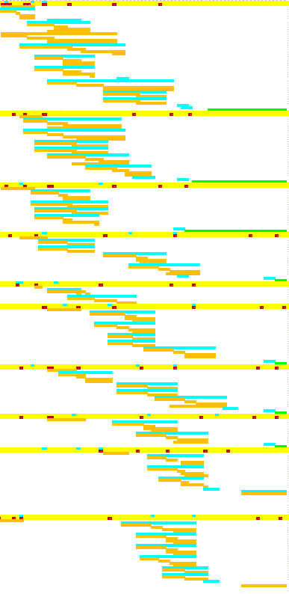
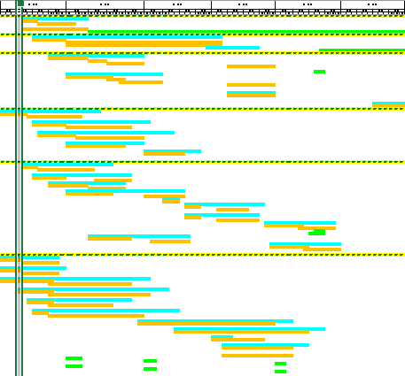
Overview
2022
2023
2024
2025
2026
2027
How we carry out the project:
Has its own resource, budget and operation, i.e. not affecting instrument scope
Where they overlap, instrument scope has higher priority.
Effective communication with instrument team provides oversight.
BIFROST
2022
2023
2024
2025
2026
2027
ODIN
SEOP
MEOP
DREAM
Gas
Transport
SKADI
Field device
LoKI
FREIA
N.S.F. setup
HEIMDAL
T-REX
3He cells
CSPEC
MIRACLES
Shared equipment tasks
Instrument specific tasks

Slide 4
Polarised SANS development
SANS polarisation analyser development focuses on SKADI. Equipment can first be tested on LoKI. A subset of equipment can be used on both instruments without further modification.
SKADI
LoKI
Shared polarisation equipment

Slide 5
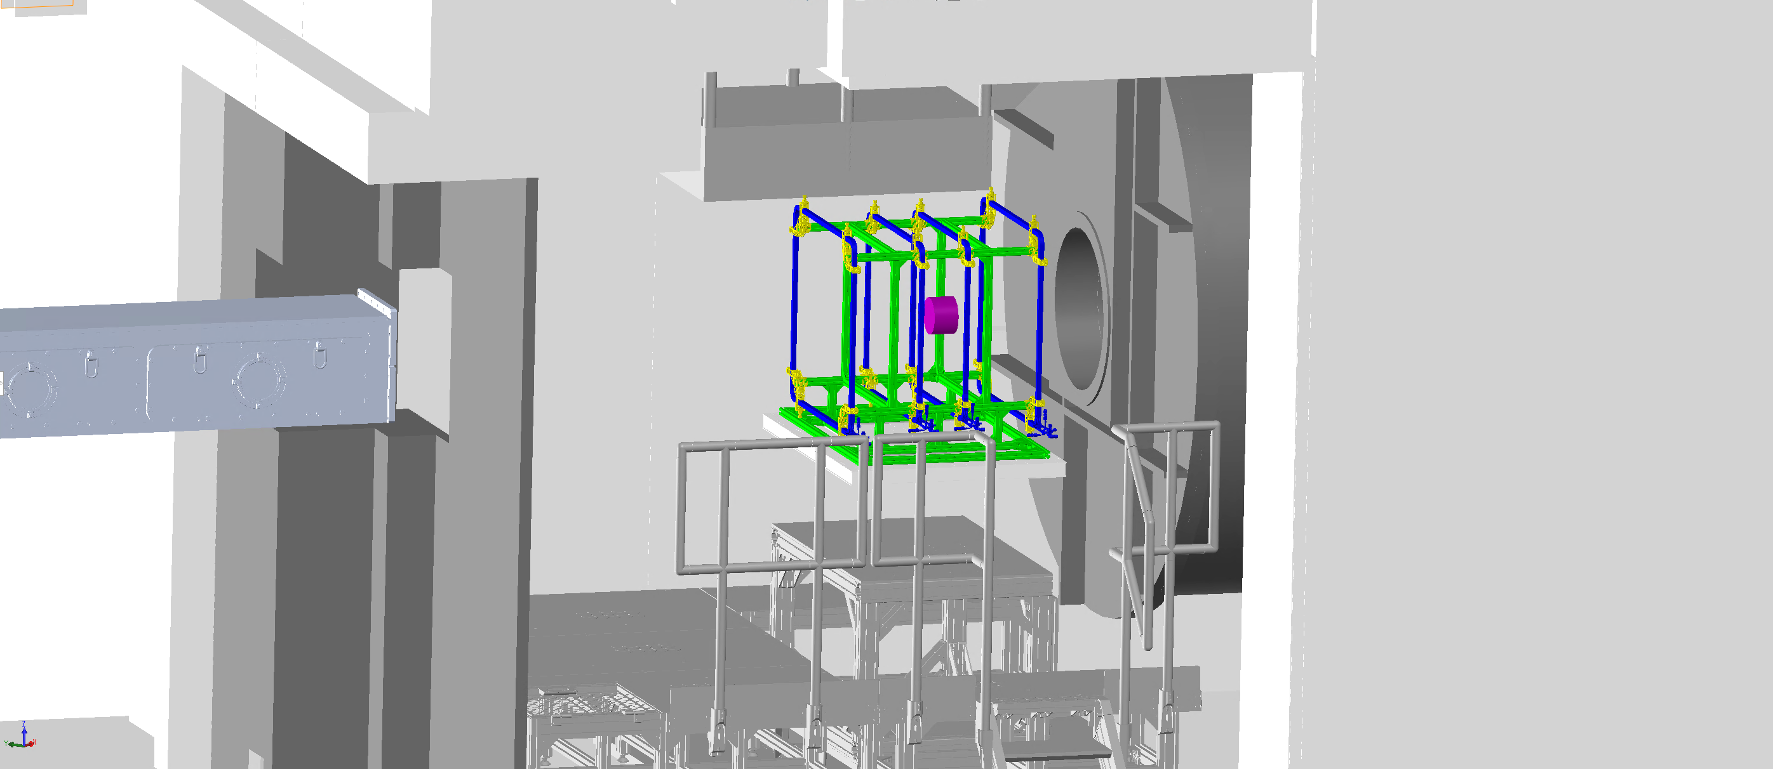
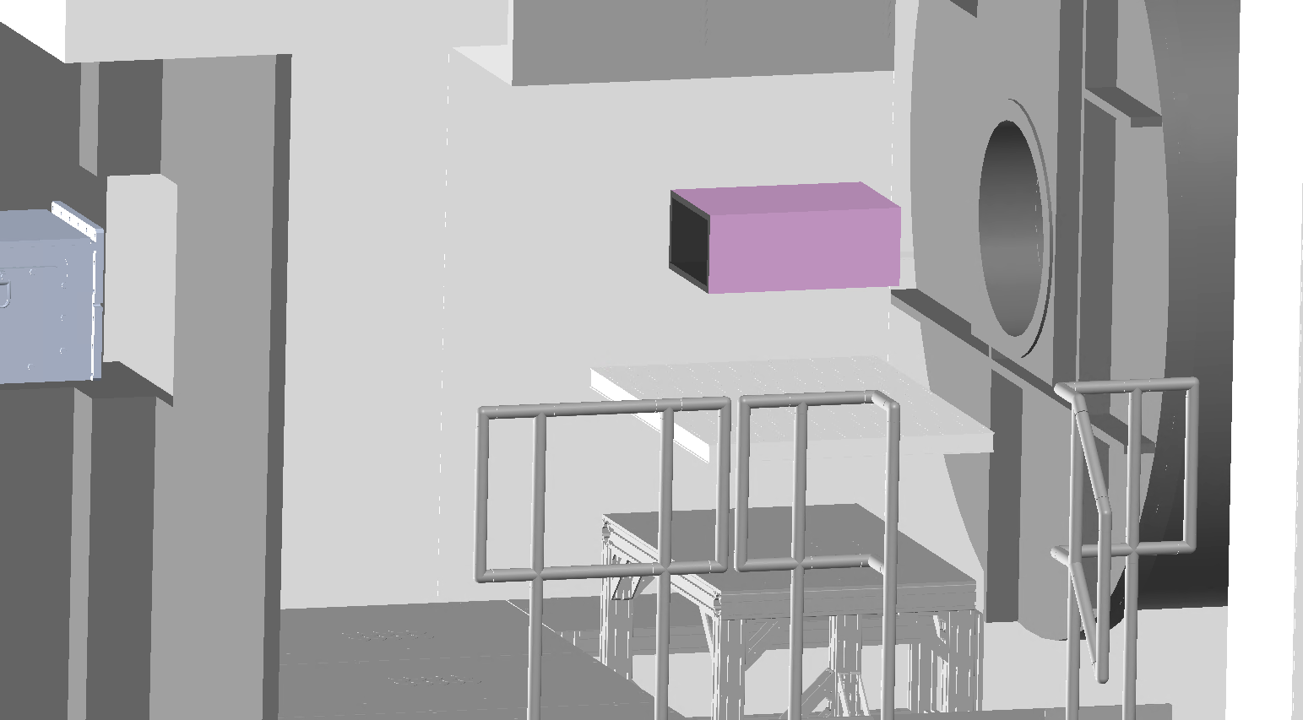
Analyser options
Uniform field coils
Pro: Sample and sample environment that doesn’t produce a magnetic field can be mounted close to analyser cell – increase Q-range.
Con: Susceptible to magnetic interference.
Magnetostatic cavity (“Magic Box”, solenoid)
Pro: Can work with high-field magnets that doesn’t produce a large fringing field.
Con: Sample and sample environment keeps a distance from the analyser - reduce Q-range.
Additional option: in-situ polarisation to keep the analysing efficiency stable.
All options above will be provided.

Slide 6
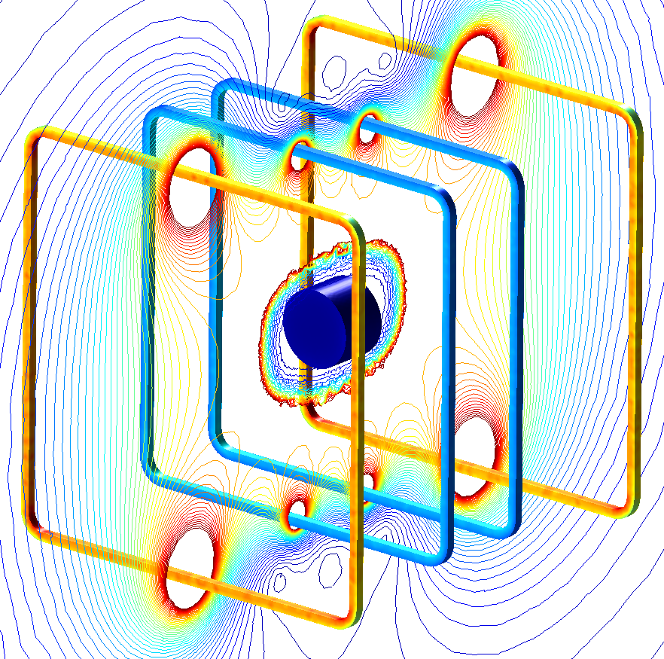
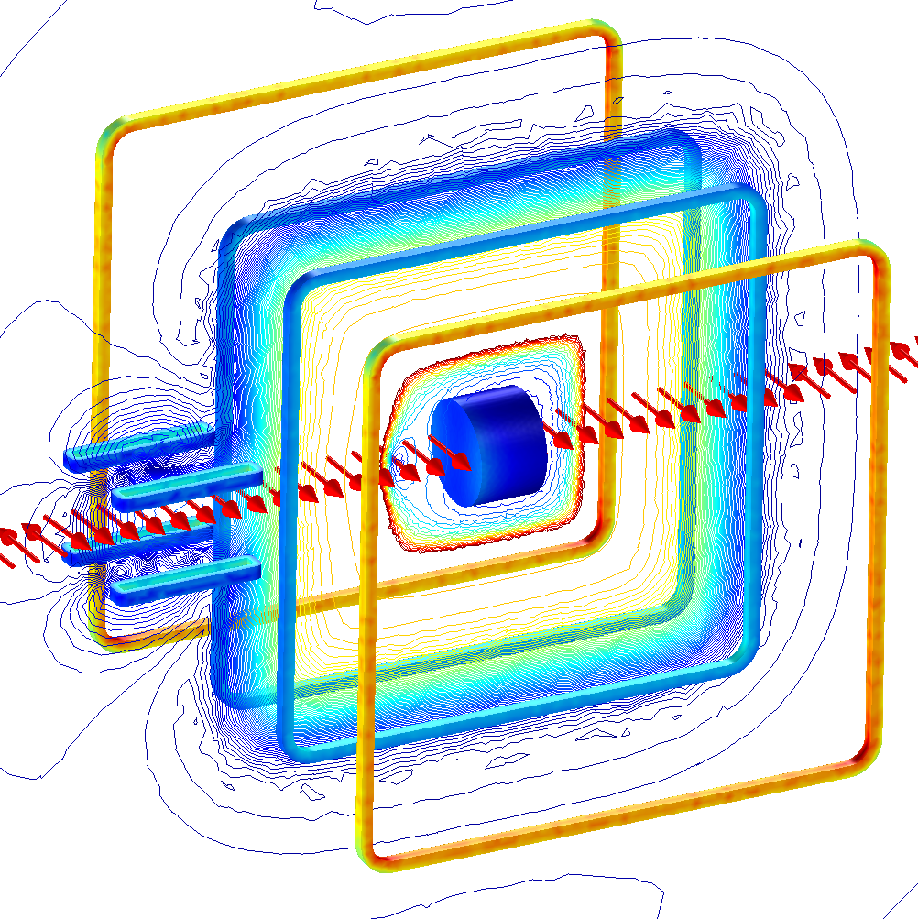
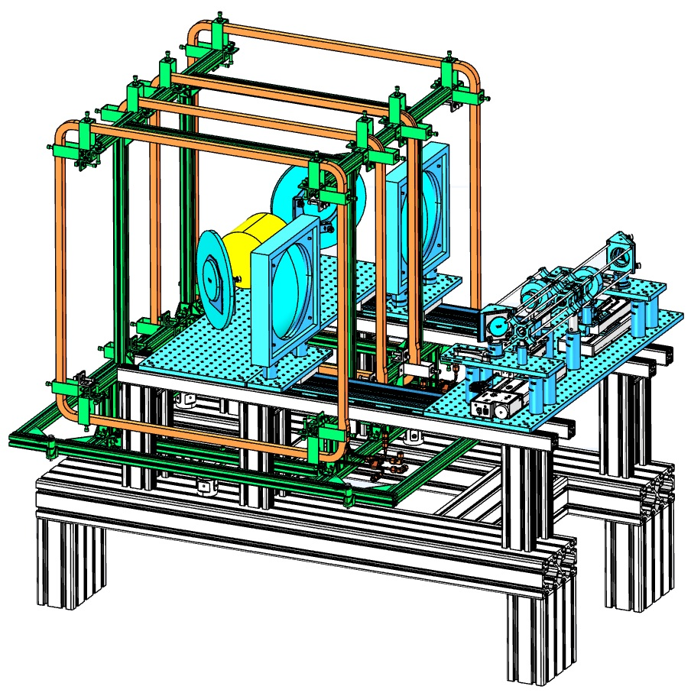
First development: Uniform field coil
Use for lab-based polariser, SKADI, LoKI, and may find application in DREAM, HEIMDAL, ODIN.
Satisfies required uniformity (< 2x10⁻⁴/cm gradient) for polarised ³He cell. 4mT at centre.
Coils and coil mount are being built.
³He cell
Transverse field
with 1mT guide field.
Horizontal ±15° from centre, 19cm
Lab-based polariser
Longitudinal field

Slide 7
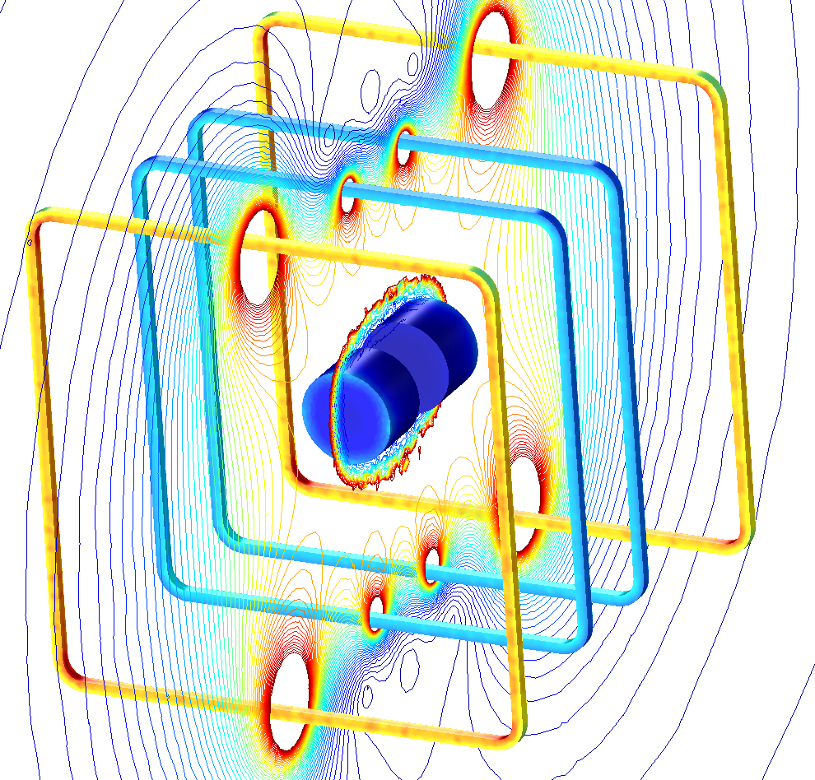
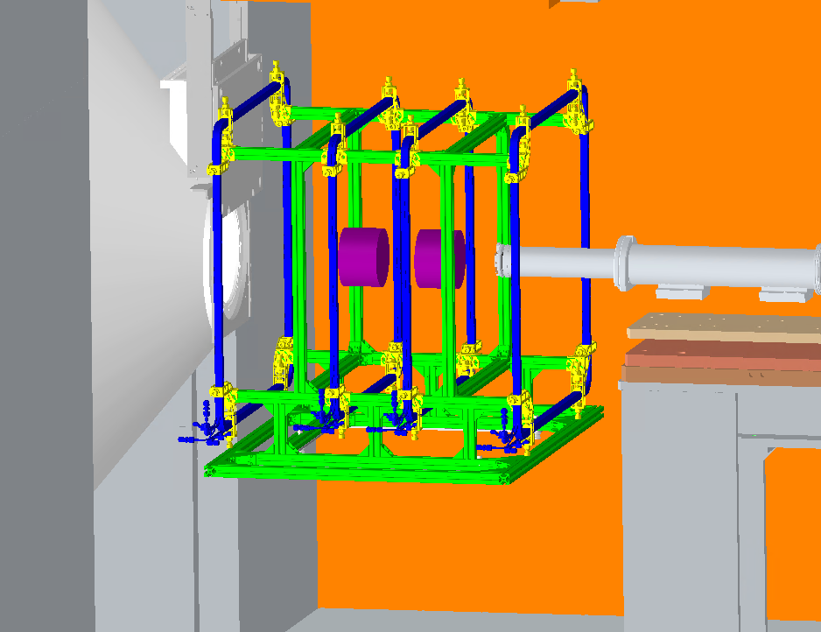
First development: Uniform field coil
The coil support incorporates the standard “L3” sample environment interface.
It can be placed on the sample table on either SKADI or LoKI.
On LoKI, two ³He cells are used (polariser-analyser), with 60mm gap for sample environment equipment.
Analyser for SKADI
Polariser & analyser for LoKI
Two ³He cells in uniform field

Slide 8
Collaborations:
Tillväxtverket SREss3 grant: 0.5 FTE of 2 post-docs and 1 engineer.
  Polarised SANS postdoc Annika Stellhorn (advisor: Elizabeth Blackburn, Lund University)
    To address the need for polarised SANS data analysis software tools, organised Workshop “Magnetic SANS – Data Analysis and Software Prospects” for incorporating polarisation in the SANS data analysis software SasView, in cooperation with LINXS & the SasView development team
    Carry out well-planned polarised SANS experiments.
    Experience in instrumentation work for polarised experiment -> instrumentation for instruments
  Engineer Joel Hagman (advisor: Tommy Nylander, Lund University)
    Polarised instrumentation work with focus on SKADI, LoKI, ODIN.
    Carried out calculation with Hal to determine field coil parameters. Designed coil mounting frame and coil alignment setup.
In the works: Polarisation in-kind project
  Partners from Lund University, KTH Royal Institute of Technology, Uppsala University.
  Contributes a wide range of polarisation equipment defined in the Polarisation Project.
  Carry out instrument specific tasks, including some of the tasks for SKADI polarisation.

Slide 9
Next steps:
For polarised SANS
Design magnetostatic cavity based analyser.
Design guide field from beam entrance in instrument cave to sample position for SKADI.
Develop in-situ polarisation setup – no more ³He polarisation decay.
Specify infrastructure support – electricity, cooling water, interface to control electronics, safety (laser safety if using in-situ polarisation setup).
Develop software: equipment control, data reduction, data analysis.
To support polarised neutron development and operations
Build up a suite of equipment – polarised ³He cells and cell-making, ³He gas transporter and transfer station, etc.
Set up Polarisation and Optics Lab. Hire technician dedicated to polarisation work.

