Slide 1
Cryostats & Magnets for SANS
SANS STAP 24 Oct 2022
PRESENTED BY Alex Holmes

Slide 2



Planning
Magnets
P80 BOT
P80 SOUP
 | 2022 | 2023 | 2024 | 2025 | 2026 | 2027 | Instr.
2.5 T WBM |  |  | X |  |  |  | ESTIA HC
8 T magnet |  |  |  | X |  |  | MAGIC HC
5 T WBM(reflecto) |  |  |  |  |  |  | Reflect.
17 T Horizontal |  |  |  |  |  |  | ESTIA SOUP
2.5 T WBM |  |  |  |  |  |  | Pool
15 T magnet |  | X |  | X |  |  | BIFROST HC
15 T magnet |  | X |  | X |  |  | Pool
6.5 T magnet |  |  | X |  |  |  | ESTIA FS
Spectro magnet |  |  |  | X |  |  | CSPEC HC
Preparation CFT
Design
CFT
Construction
Procurement
Tests
Control and mechanical
integration
X
Tests on the
instrument
Specifications

Slide 3
Planning
Cryo provided by instruments and IK
P 80 BOT
P 80 SOUP
 | Budget | 2022 | 2023 | 2024 | 2025 | 2026 | 2027 | Instr.
Cryofurnace 20 ch | DREAM |  |  |  | X |  |  | DREAM HC
Flow cryostat | ESTIA |  | X |  |  |  |  | ESTIA HC
Wet cryostat | BIFROST |  | X |  |  |  |  | BIFROST HC
Cryofurnace | CSPEC |  |  | X |  |  |  | CSPEC HC
Sample changer 6 | CSPEC |  |  | X |  |  |  | CSPEC HC
He3 insert | CSPEC |  |  | X |  |  |  | CSPEC HC
Wet cryostat | MAGIC |  | subtg3 X |  |  |  |  | MAGIC HC
Dilution fridge with 8Tmagnet | IK |  |  |  | X |  |  | MAGIC FS
HP cryostat | IK |  |  |  |  |  |  | BIFROST FS
Dry Cryo VESPA | VESPA |  |  |  |  |  |  | VESPA ?
Preparation CFT
Design
CFT
Construction
Procurement
Tests
Control and mechanical
integration
X
Tests on the
instrument
Specifications
Notes:
ESTIA flow later. Can also be used for SANS – sapphire windows
HP cryostat – no assigned instrument.
T-REX OC in budget, could be same as CSPEC
ODIN, BEER, MIRACLES, no cryostats in budget. Relying on pool

Slide 4
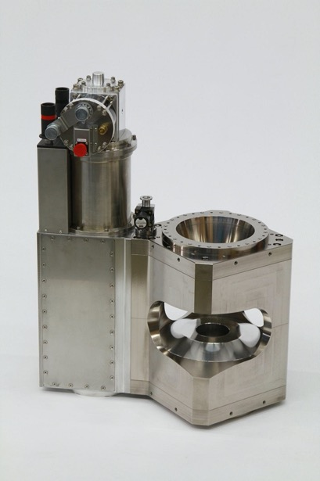
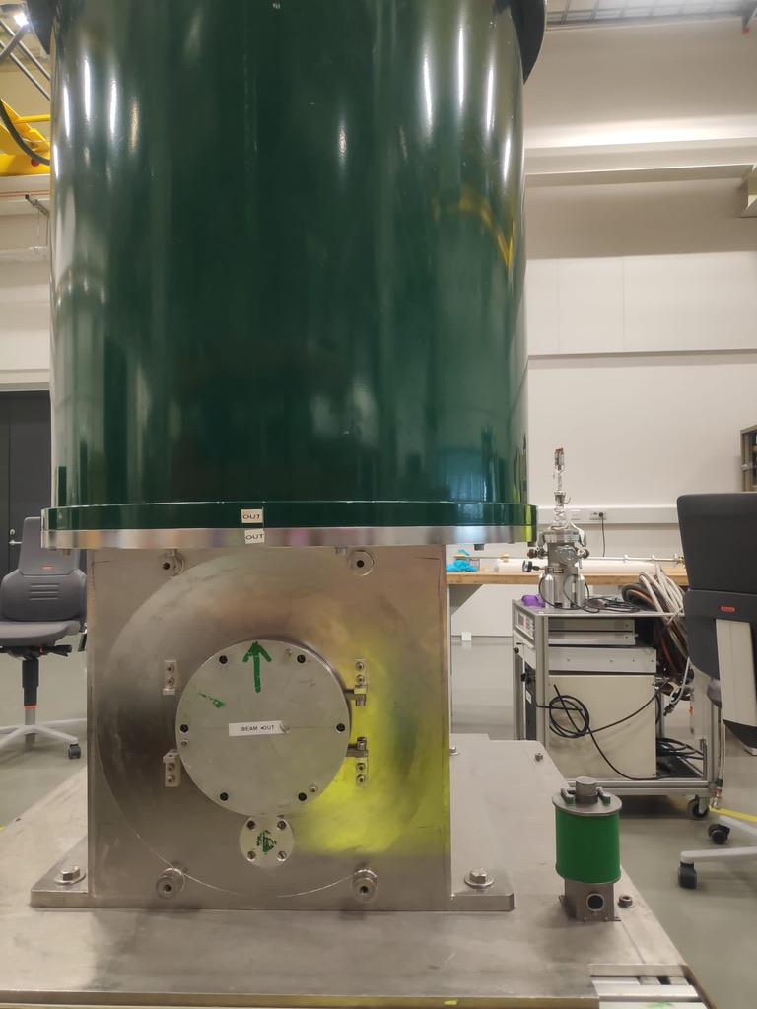
Magnets for SANS
2.x T Warm Bore magnet
Based on TOFTOF design
Design tweaked to allow for polarised neutron transport.
To be used for 70% ESTIA experiments Available for LOKI, SKADI otherwise
Design study launched, main procurement in preparation
17T Magnet
External, will be supported on SKADI
Horizontal field B//beam +/- 10°
Not currently in day 1 scope: electromagnet (though possible synergy with MCA; split coil horizontal magnet

Slide 5
Planning
Pool cryo
P 80 BOT
P 80 SOUP
 | 2022 | 2023 | 2024 | 2025 | 2026 | 2027 | Inst
Wet cryo HEIMDAL |  |  |  |  |  |  | HEIMDAL ?
Cryofurnace DIFF 2nd hand |  |  | X |  |  |  | DREAM HC
Sample stick rot x6 |  |  |  |  |  |  | POOL
Dil. fridge (2nd hand) |  |  |  |  |  |  | POOL
Wet cryo SANS |  |  |  |  |  | X | LOKI SOUP
Dilution fridge |  |  |  | X |  |  | BIFROST FS
He3 sorption insert |  |  |  |  |  |  | POOL
Wet cryo BIFROST (spare) |  |  |  |  |  |  | BIFROST SOUP
Wet cryo MAGIC (spare - OC#1) |  |  |  |  |  |  | MAGIC SOUP
Dry cryo HEIMDAL |  |  |  |  |  |  | HEIMDAL ?
Wet cryo MIRACLES |  |  |  |  |  |  | MIRACLES ?
Wet Cryo TREX |  |  |  |  |  |  | TREX ?
Dry Cryo SANS |  |  |  |  | X |  | LOKI SOUP
Dry Cryo SPECTRO |  |  |  |  |  |  | CSPEC HC
Dry Cryofurnace DIFF EC |  |  | X |  |  |  | DREAM SOUP
Cryofurnace HEIMDAL |  |  |  |  |  |  | HEIMDAL ?
Cryofurnace TREX |  |  |  |  |  |  | TREX ?
2xflow cryo for ESTIA
Notes:
+Flow cryostats x2 for ESTIA
Dry cryo for Spectro not necessarily just for CSPEC.
Standardising sample space sizes?

Slide 7
Cryofurnaces for SANS
Mini-pool with LSS instruments (LOKI, SKADI, ESTIA)
Day 1 provision
1 dry (top loading CCR)
1 wet (orange type)
ESTIA flow cryos will also be compatible (additional integration needed)
Start first with dry system. Wet will be needed as beam power increases.
Key requirements (some tension within these - may require multiple tails):
Sapphire/silicon windows
Tail to fit in 80mm 2.xT magnet bore
Sample space to fit 2” standard samples. (could be cut)
Rotation of entire cryostat preferred over sample stick - currently not in scope

