Slide 1
SKADI
Current Status
STAP October 2022
Sebastian Jaksch, Romuald Hanslik, Tadeusz Kozielewski, Henrich Frielinghaus,
Alexis Chennevière, Sylvain Désert et al.
Notes:
----- Meeting Notes (28.02.17 13:13) -----
Welcome
First Presentation of TG2 for SKADI
Science Case, Top Level Requirements, Cursory Overview
Construction Schedule and Risk Analysis

Slide 2
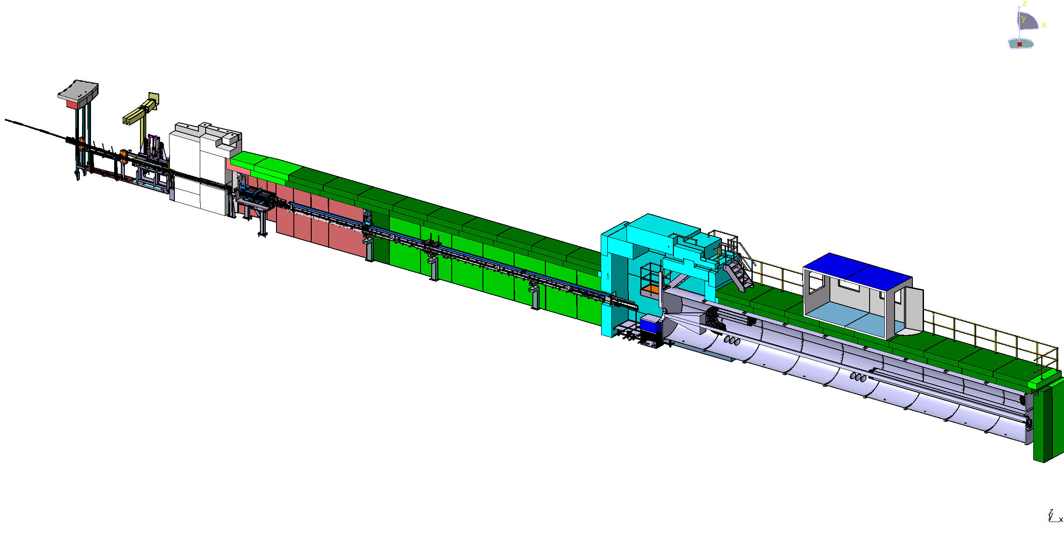
SKADI layout
13.6.7.1.1 Beam extraction System-
NBOA, BBG, Reflector
FZJ
13.6.7.1.4 Beam geometry conditioning-
Collimation and apertures +shielding
LLB
13.6.7.1.7 Flight tube
Feed Through bunker wall
FZJ
13.6.7.1.8.2 Heavy shutter
FZJ
13.6.7.1.5 Beam filtering system-
Polarizer, Spin Flipper
FZJ
13.6.7.1.3
Chopper System
FZJ
13.6.7.2 Sample Exposure System-
Sample area, shielding
FZJ
13.6.7.3.2 Neutron detector system Detectortube, detector vessel, shielding
LLB

Slide 3
Major Steps since last STAP
NBEX manufactured and NBOA installation imminent
In-bunker manufacturing …
Bunker feedthrough manufacturing …
And heavy shutter installation in progress
Ready for installation in January 2023, installation early next year
Load spreading slab for sample cave currently being installed
Detector testing in progress, agreement for firmware programming under discussion with new detector group head (Kevin Fissum)
IDR for collimation and detector tanks have been passed
TG3 for sample cave is passed
Chopper TG3 passed, manufacturing started
Layout for sample hutches being refined (on top of sample cave)

Slide 4
Major Steps since last STAP
Polarization planning presented by Hal
CUP/CEP progressing, in discussion with ESS groups
Polarization and GISANS setup being refined in the framework of a RAC grant

Slide 5
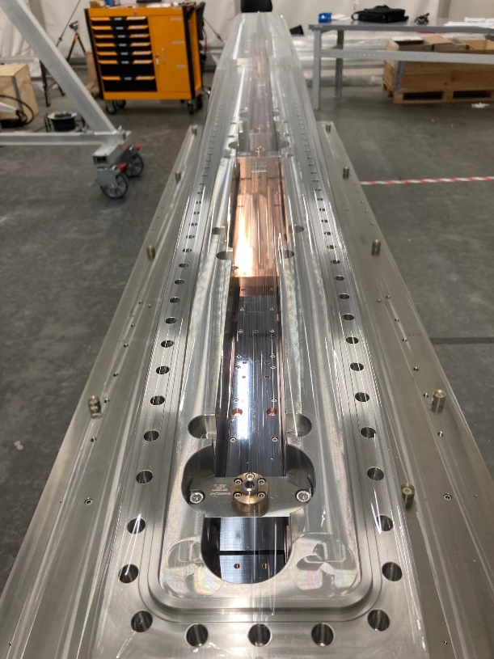
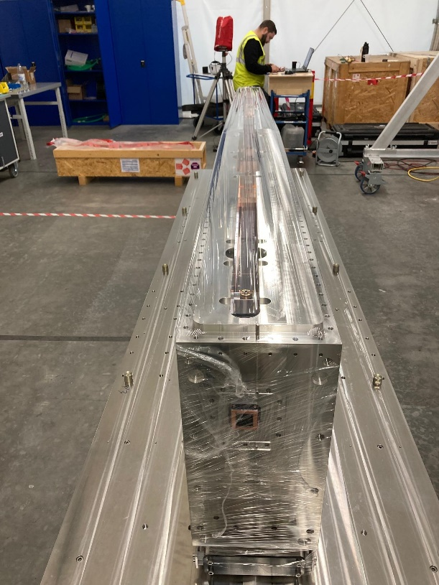
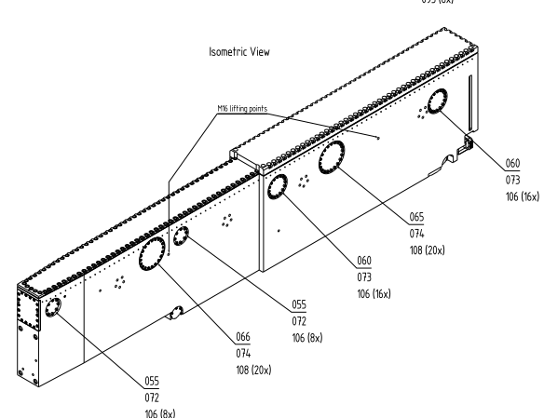
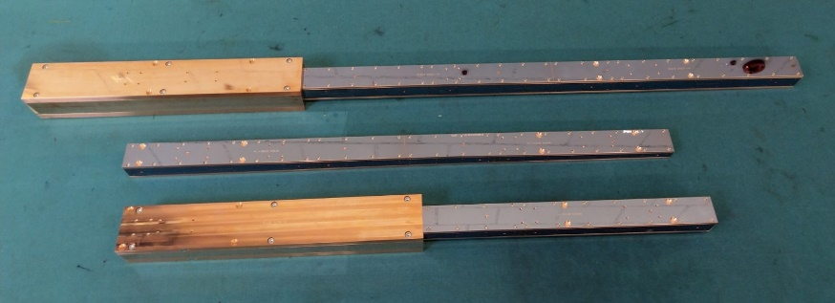
Integration of NBEX with NBOA
The NBOA has been delivered and is in storage at ESS, awaiting installation. NBEX ins now also aligned and awaiting installation
This is in line with the overall installation scheme (end 2022). At the moment there are no expected issues concerning manufactuing or installation specific to SKADI.

Slide 6
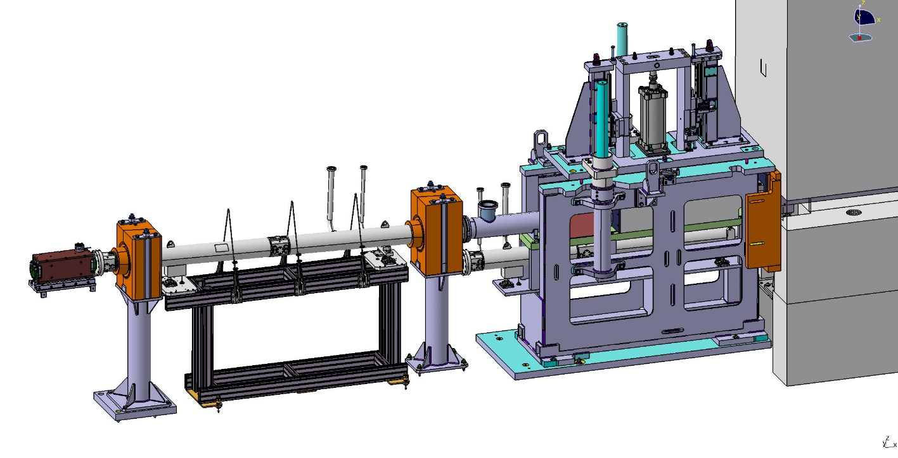
In-Bunker Beam Extraction
Delivery and installation contracted for late 2022
Production of all components in line with installation for early 2023
Bunker opening window is early 2023
The in-bunker installation comprises the guide segment in the light shutter, the reflector setup to offset the beam out of line of sight, the heavy shutter as well as the bunker wall feed through. All components except for the heavy shutter will be supplied by Swiss Neutronics.
Manufacturing process has started. Delivery to ESS expected in Dec 2022/ Jan 2023. Installation windows starts in March 23.

Slide 7
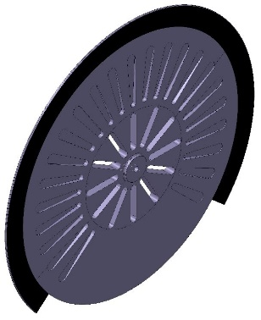
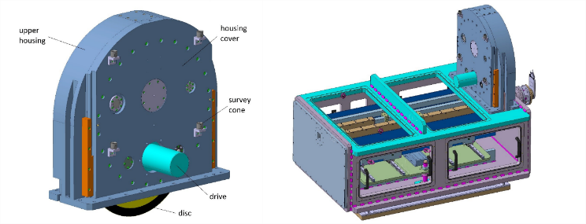
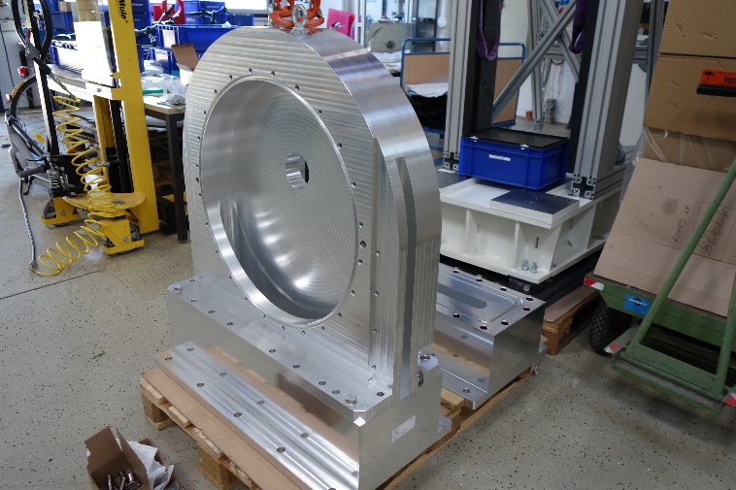
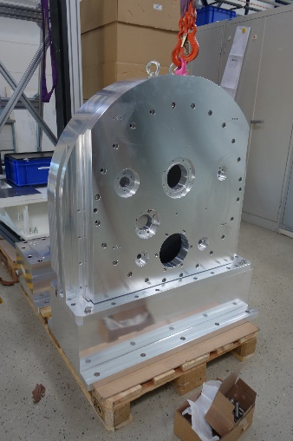
Chopper
Manufacturing in progress
Slight changes (no neutronic impact) to accomodate collimation manufacturer
Issue with different coordinate systems (mcstas vs. TCS) discovered and resolved
Materials have been ordered or are already on stock. Housings, spindles (not SKADI specific components) will be ready early 2023. Disks will be manufactured during 2023. Installation foreseen in 2024.
Currently interfacing the choppers with the collimation tank is the priority.

Slide 8
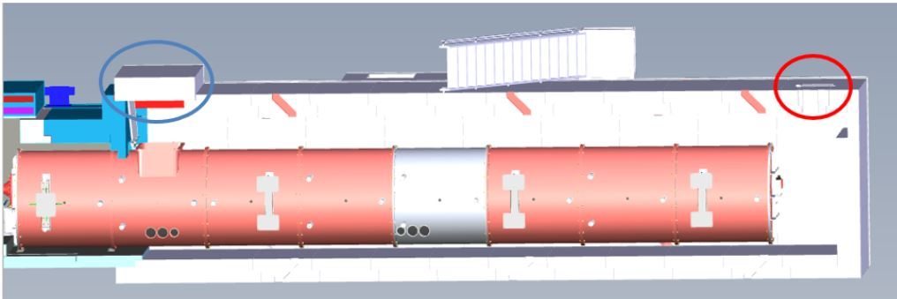
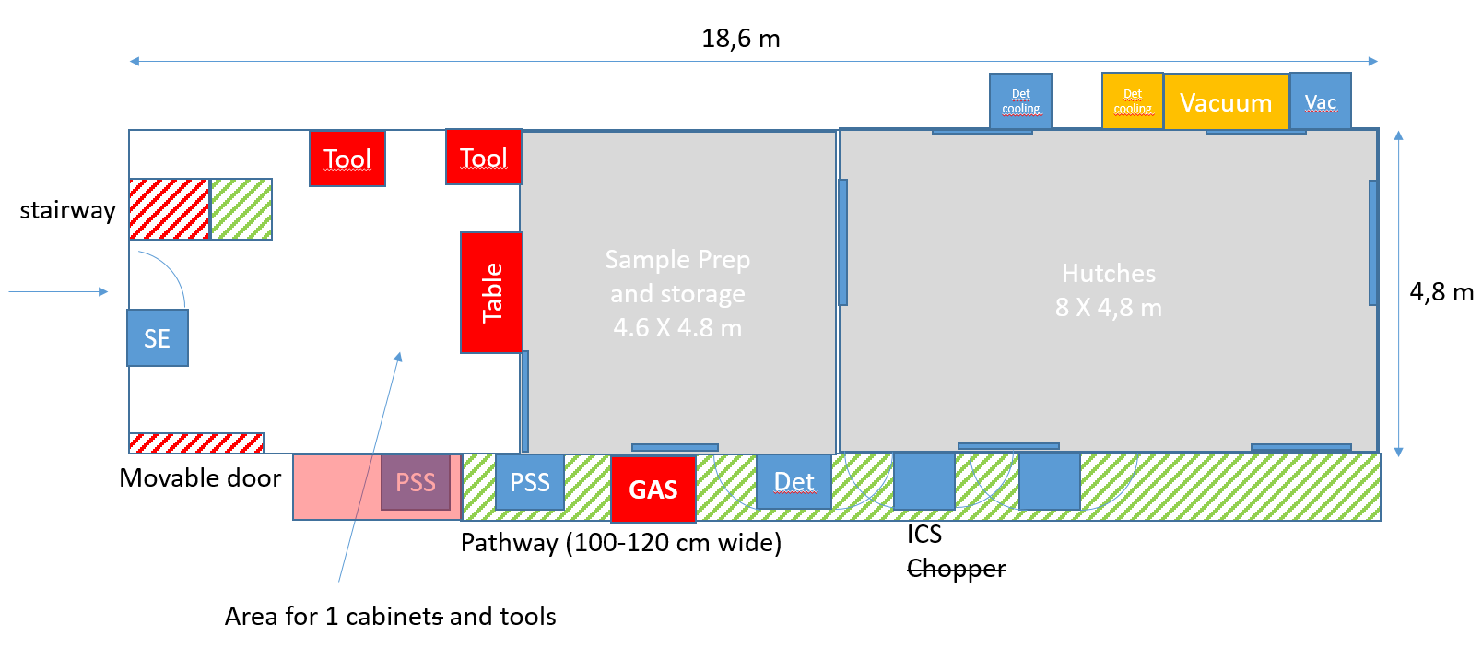
Shielding
Foreseen start of tender in Sept 2022 → contract early 2023
Tender has been delayed in order to include/consider measurement hutch
Trying to get as much information from/for CEP/CUP
Has short lead times

Slide 9
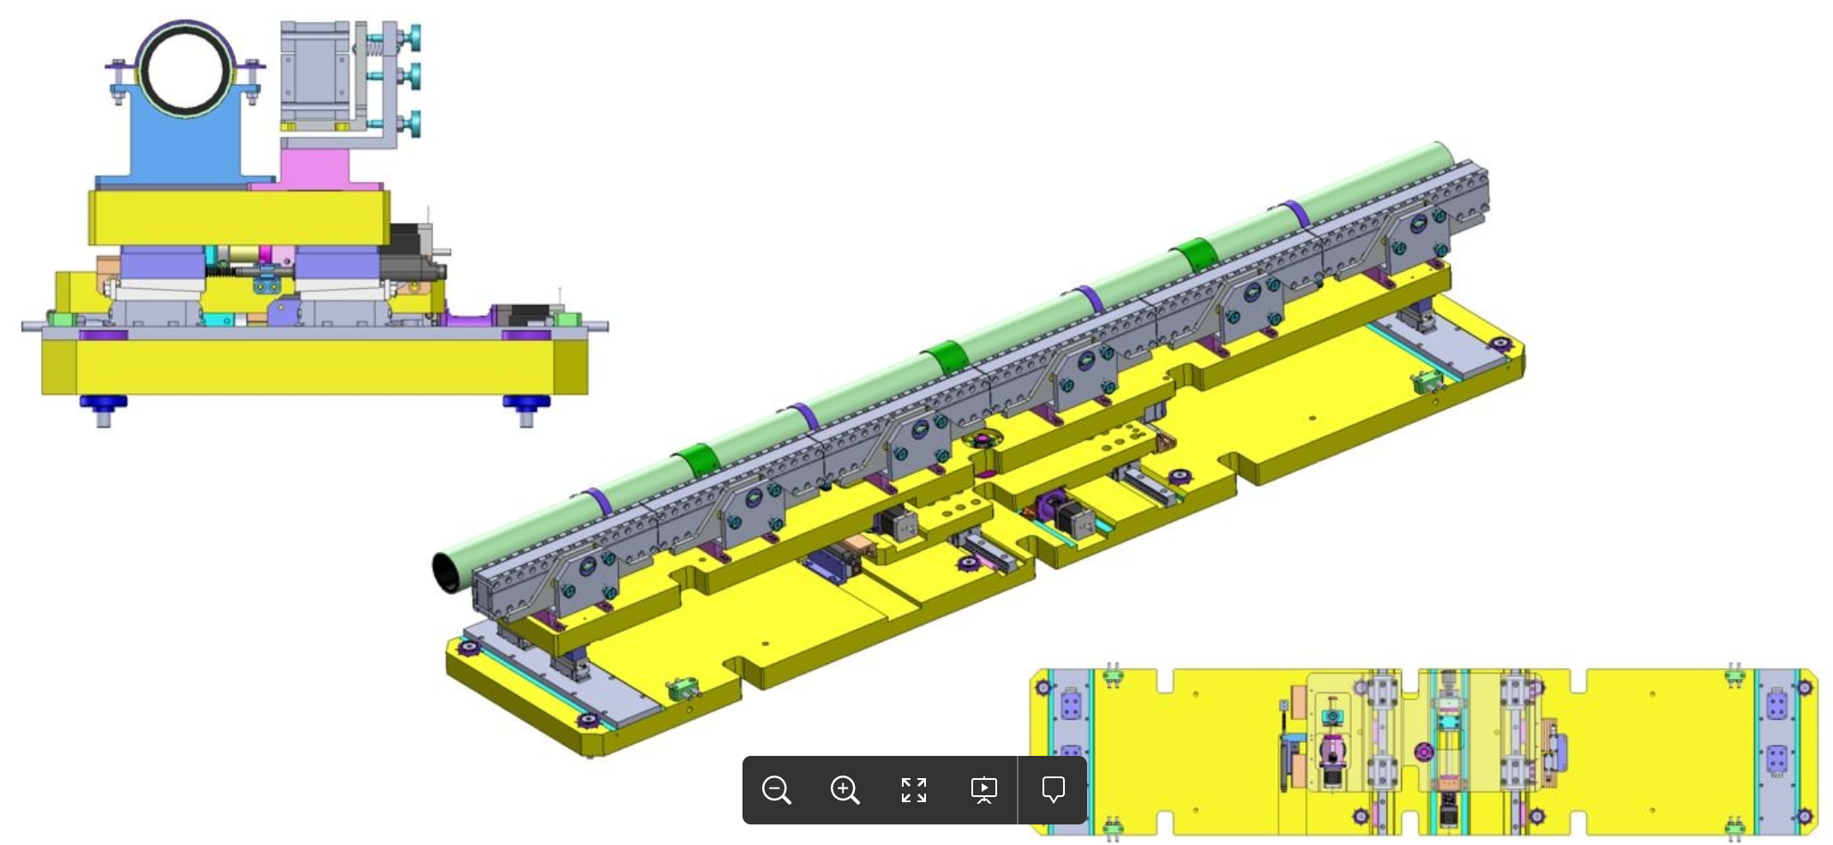
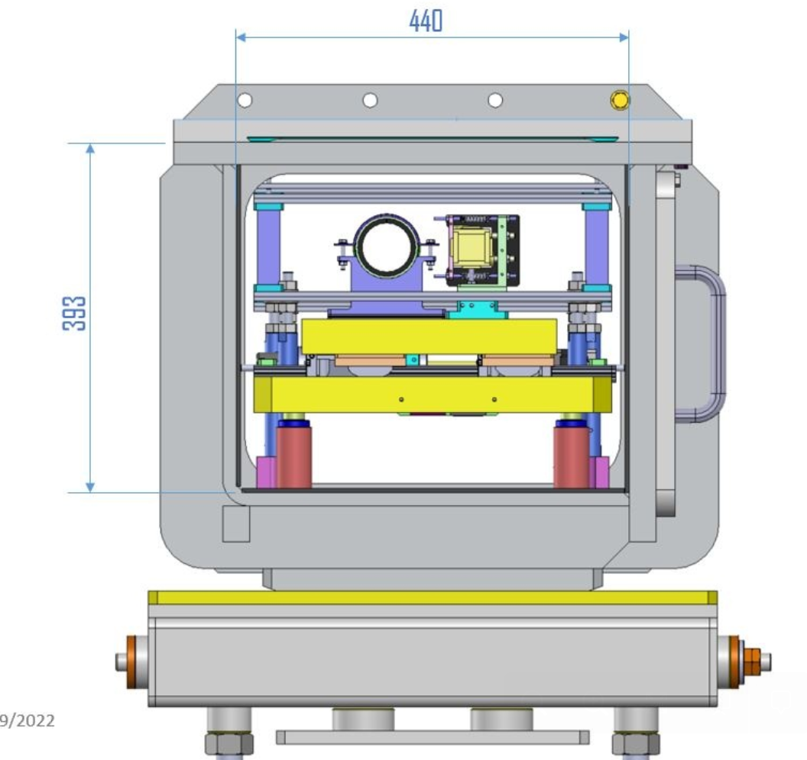
Collimator
Contract signed with AVS
IDR passed
Expected delivery time 10 month after contract
Installation planned to start mid 2023. Interfacing with the sample cave as well as the chopper is ongoing.
Since the neutron guides as limiting components are all m=1 with 3 cm x 3 cm cross section there is little risk in production of those.
For this section we therefore do not foresee any problems with schedule or production.
VSANS testing still hampered by lack of neutrons throughout Europe, however installation procedure is progressing nicely
9

Slide 10
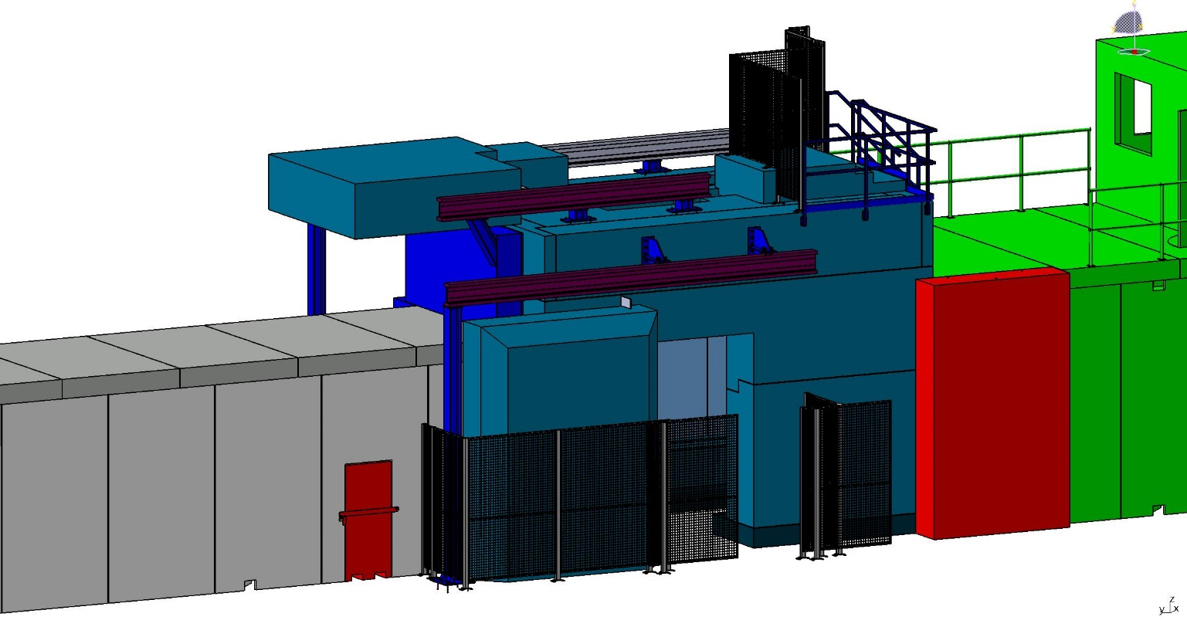
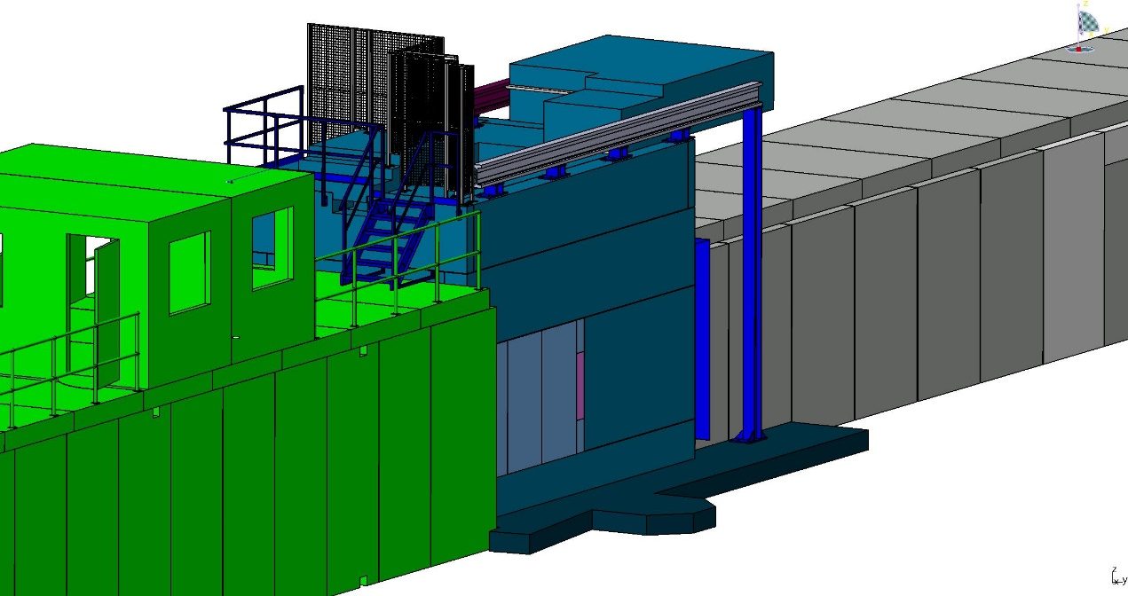
Sample Cave
Full installation contracted in 2023
Load spreading slab currently being installed

Slide 11
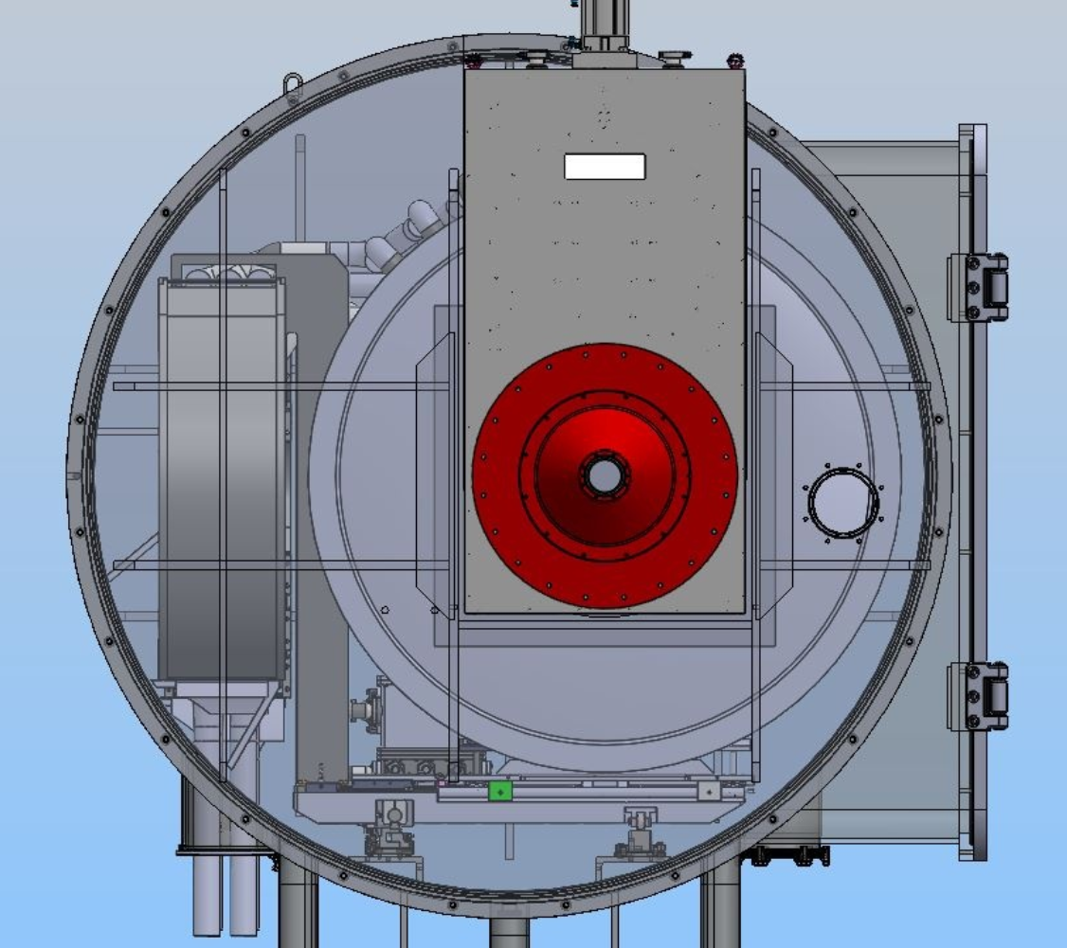
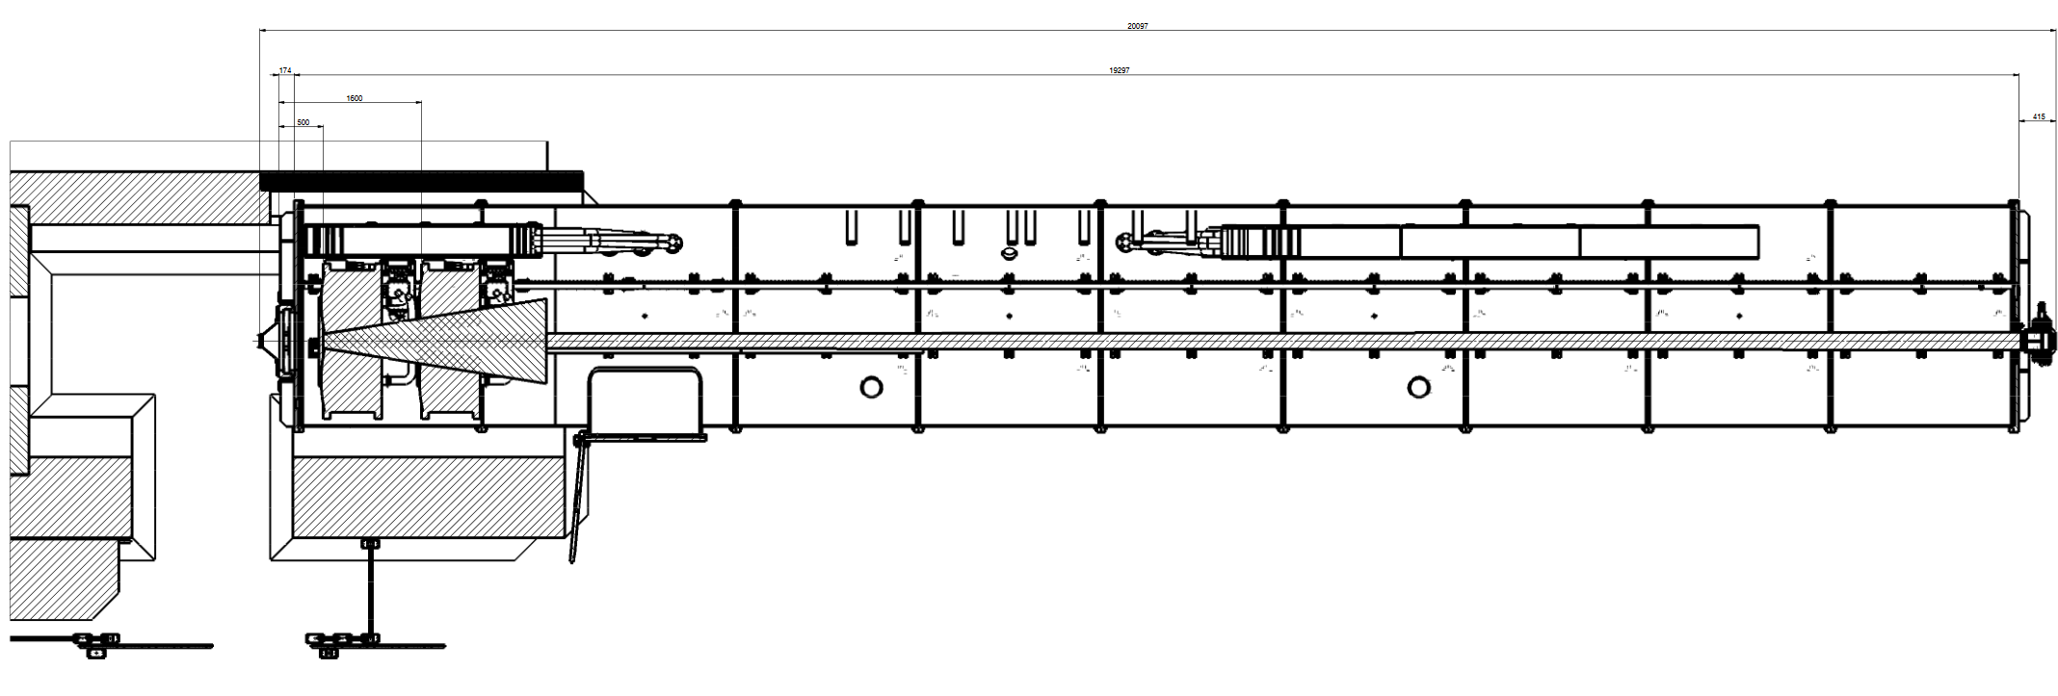
Detector and detector tube
Manufacturing contracted with SDMS for detector tube
Currently issues with increased prices
Delayed due to price increase, but still not on critical path
Several beamtimes (ANSTO (DINGO) & ORNL (Imaging Beamline)) have been secured in order to perform proper testing of the final DAQ system.
Cooling system will be designed alongside detector tube.
For ESS integration adaption of the firmware together with the master box is necessary. Discussions to put out the conctract are currently ongoing, but should be finalized soon with the new detector group head.

Slide 12
Polarization and RAC
RAC grant together with ESS, Uppsala U (Max Wolff), LMU Munich (Bert Nickel)
Development of polarized GISANS
Allows for the development of PA
Will deliver additional sample table
Project just started, so not much information yet: Dedicated presentation by Hal

Slide 13
Schedule Overview
Component | Delivery and Installation last STAP | Delivery and Installation current
NBOA | Delivered | Delivered
In-Bunker | Q4-22 | Q2-23 (bunker opening)
Collimator+Detector vessel+shield. | Q2-24 | Q2-24
Polarizer, Fast Shutter | Q2-24 | Q2-24
Choppers | Q3-24 | Q2-24
SCS | Q3-24 | Q3-24
Monitors | Q1-23 | Q1-23 (unclear due to personnel change at ESS)
Sample Area | Q4-23 | Q4-23
Hutch Area | Q4-24 | Q3-24
TG3-Full | Q4-21 | Q3-23 (rolling TG, most TGs done a lot earlier)
TG4-Full | Q2-24 | Q2-24
TG5-Full | Q3-25 | Q3-25
Schedule risks:
Covid delays
Manufacturer overload
Material shortages
Not under instrument team control, but we are monitoring the situation

Slide 14
General Comments
No fundamental issues precluding TG5 mid 2025
Increased risk of material shortage now with nearly all manufacturers
Funding for the sample environment has been secured through a Röntgen-Anström-Cluster proposal (portGISANS). Project has now started: dedicated presentation by HAL

Slide 15
Take Home
All external components have been subcontracted, apart from the shielding
Manufacturing of dedicated components is already running
Installation of first components currently being done (load spreading slab)
In bunker opening window early 2023 will be reached
Increased prices and availability are an increasing concern
Complete installation until 2025 is completely feasible

