Slide 1
Artur Glavic & Sven Schütz :: ESTIA Core Team :: Paul Scherrer Institut
Estia – Project Update
STAP meeting 25/10/2022

Slide 2


Estia Team
Alessandra Luchini left ESS for position at university of Perugia
Sven Schütz taking over as project leader for Estia
Artur Glavic assist with scientific/technical expertise as needed
New instrument scientist position at ESS to be published soom

Slide 3
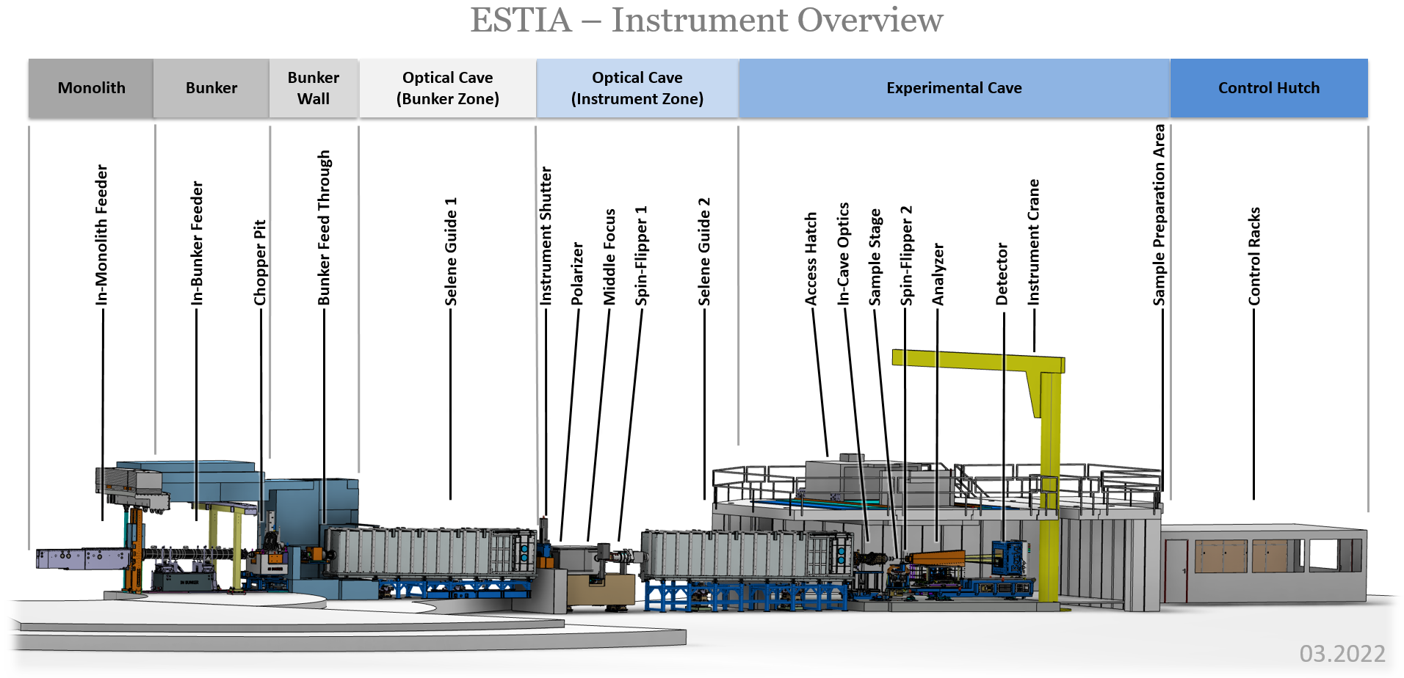
ESTIA instrument overview

Slide 4
ESTIA instrument overview
All components at ESS, NBOA integrated to monolith insert

Slide 5
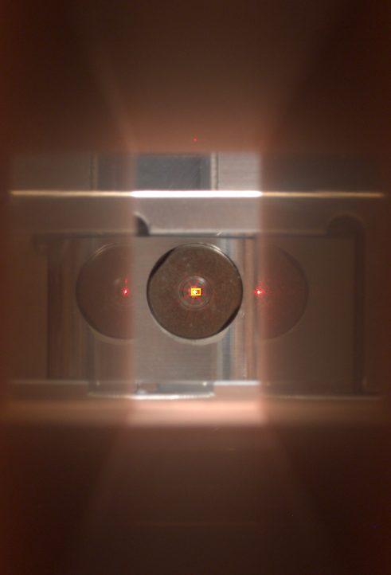
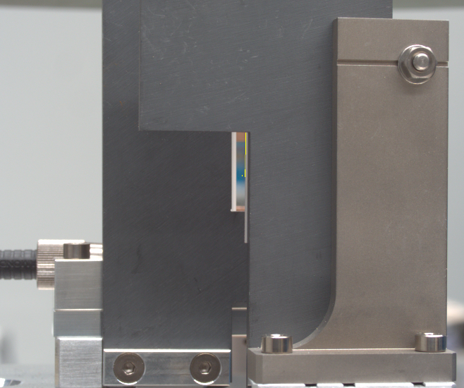
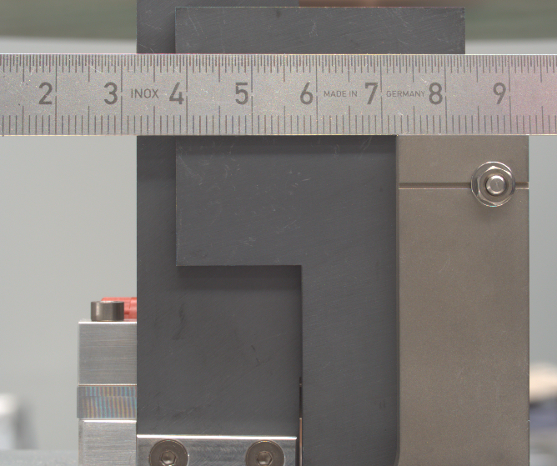
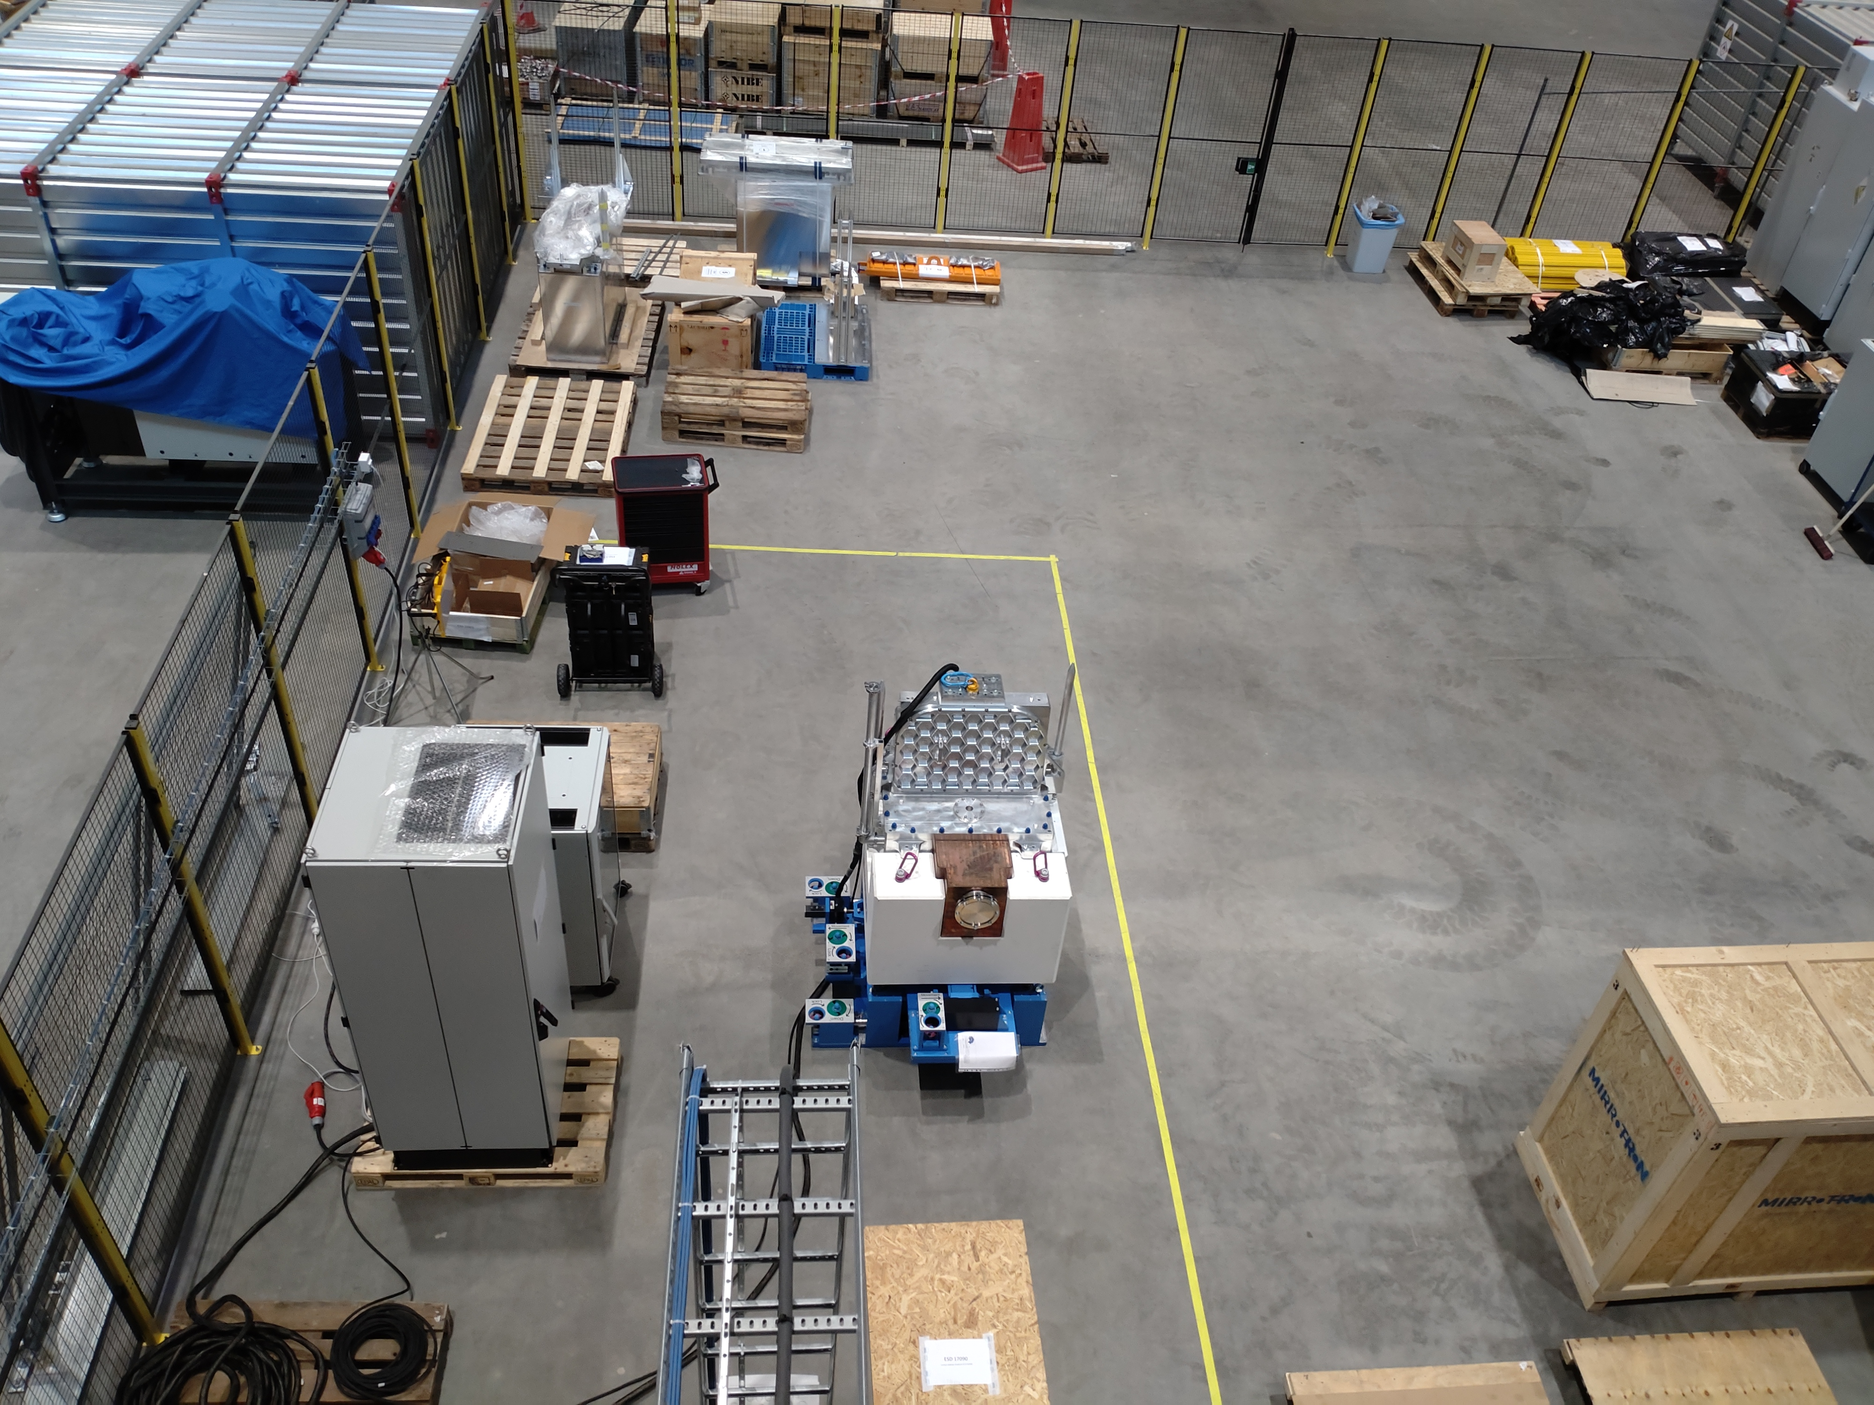
ESTIA- In-bunker Components
B₄C
@ PSI
Testing of VS
Improvement of Virtual-Source blade kinematic mounts to allow better alignment
@ ESS
Chopper FAT at ESS
Preparing integration of in-bunker feeder optics into support/vacuum vessel.
Final installation of in-bunker component Autumn 2022- beginning 2023
GGG
VS motion tests
VS reference light test
Chopper
FAT area

Slide 6
ESTIA instrument overview
Selene 1 and Selene 2 are at ESS, installation and commissioning ongoing

Slide 7
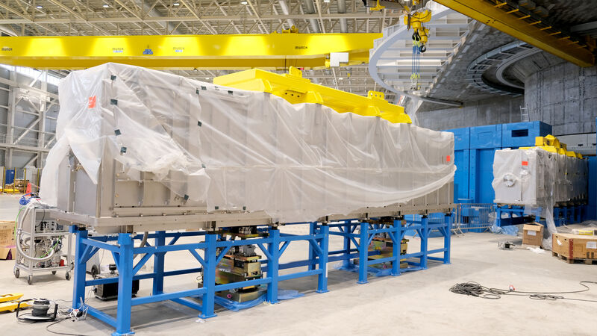
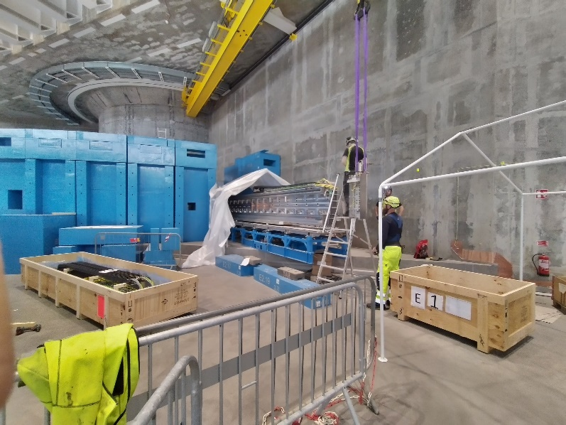
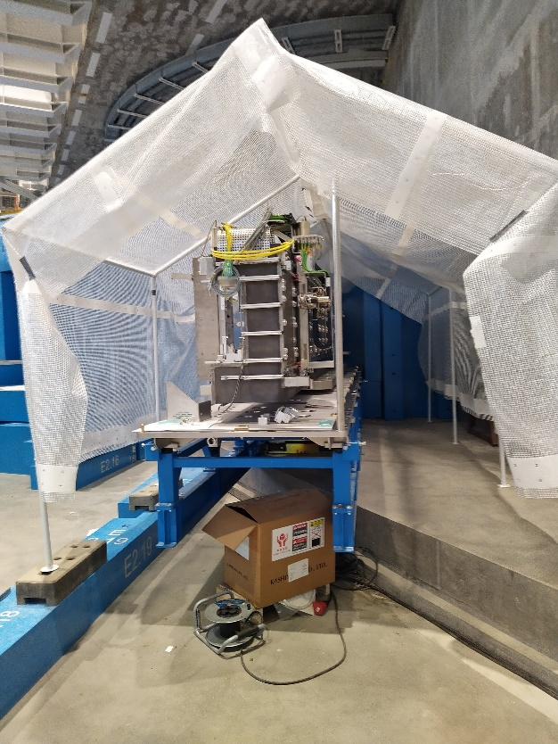
ESTIA – Selene 2
Selene guide 2 carrier and vacuum vessel are installed at ESS
Alignment robot and metrology cart
57 of the 60 mirrors for Selene 1 and 2 were produced and accepted.
We expact that the next batch will arrive soon and complete production.
➔ Installation of the mirrors and robots at ESS in early 2023

Slide 8
ESTIA - Middle Focus
Design of the Middle Focus in detailing phase, some items being procured

Slide 9
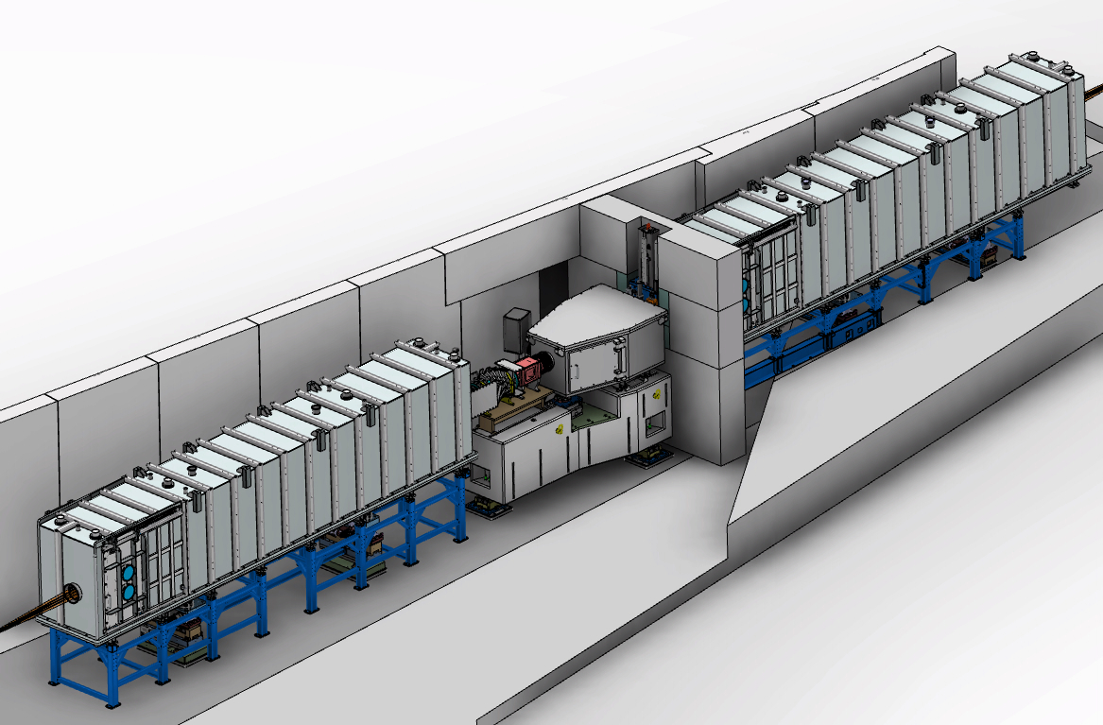
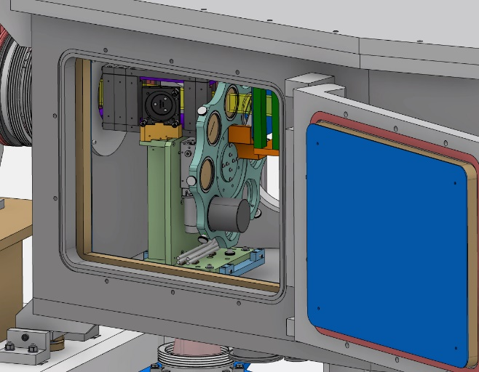
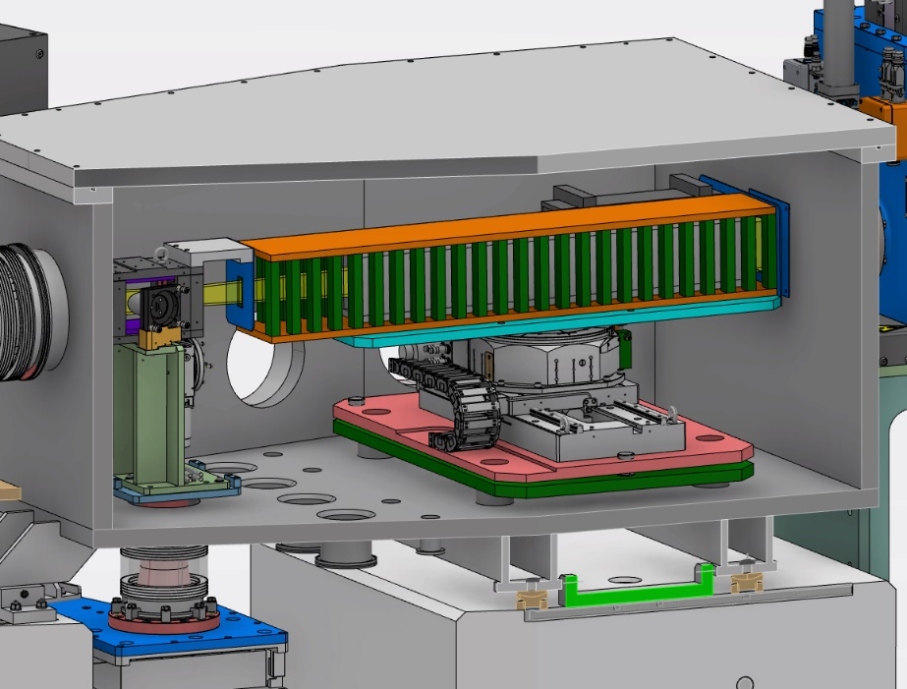
ESTIA-Middle Focus
Overview of the design
Instrument shutter
Mask Changer
Selene 1
Polarisers, FOM
Selene 2
Spin-flipper

Slide 10
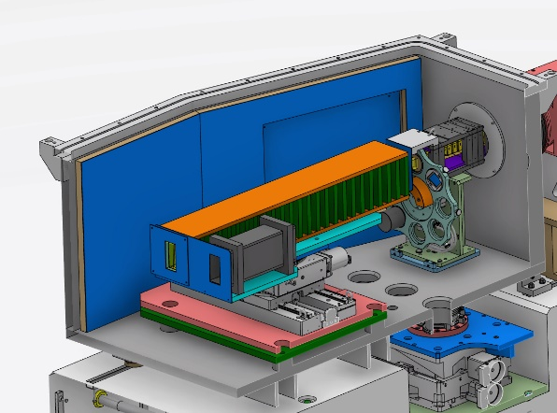
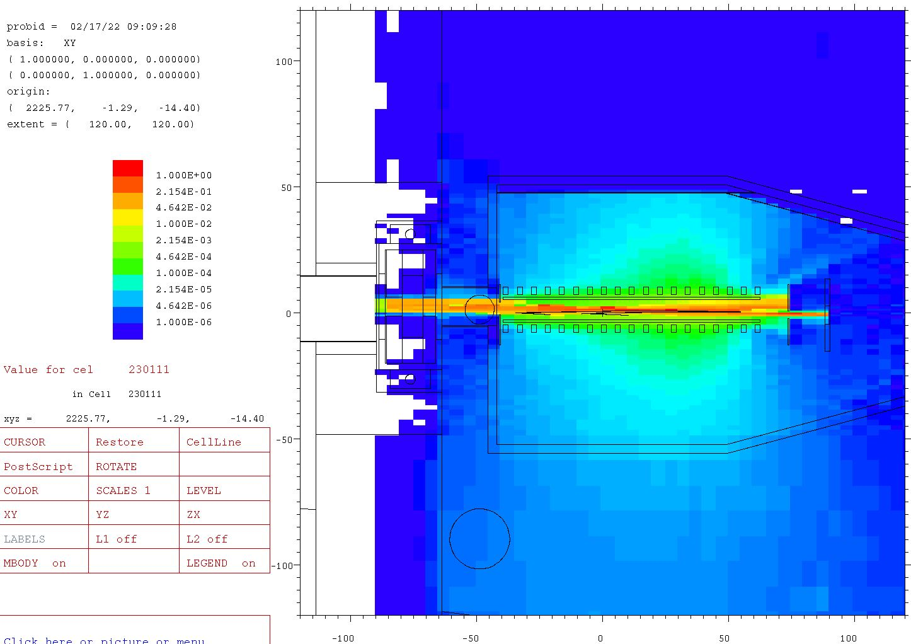
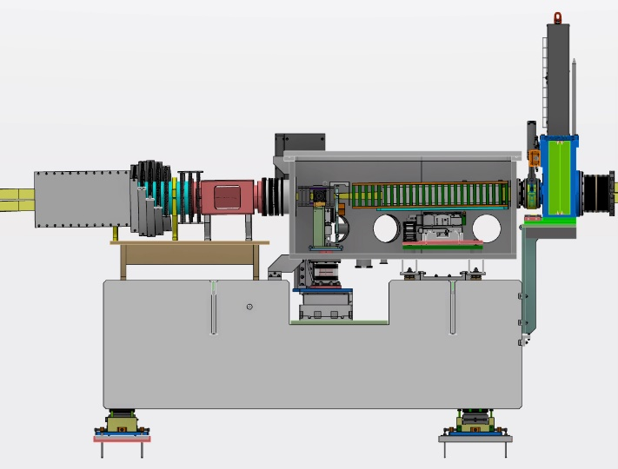
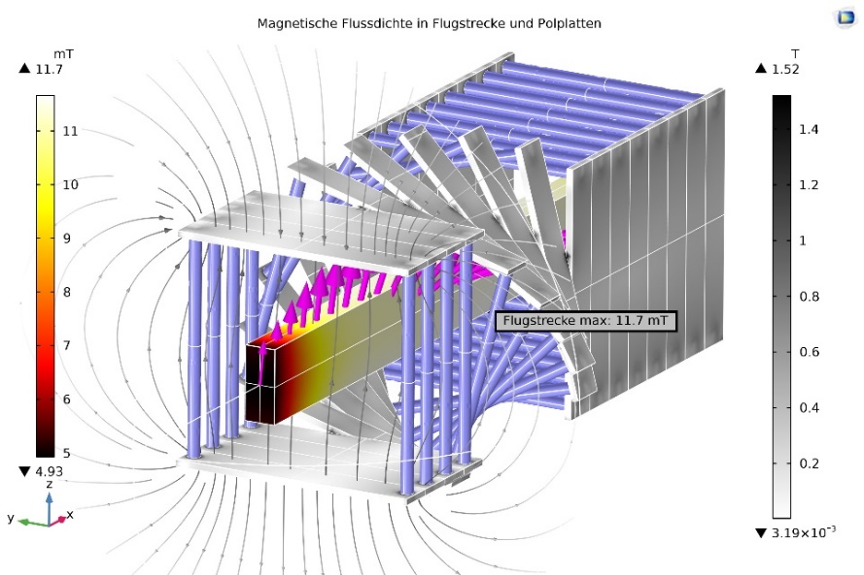
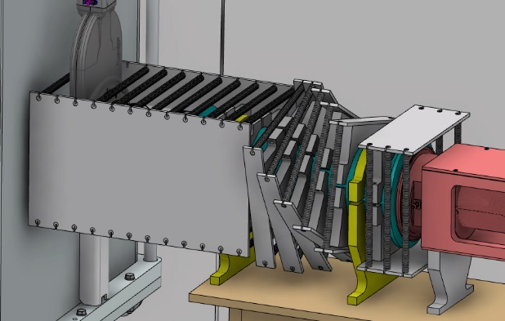
ESTIA-Middle Focus
Overview of the design
Procurement of the polarisers, FOM and spin flipper: contract signed with SNAG and kick-off soon
Polarisers/FOM motorised support/mask changer: stages ordered
Vacuum vessel: procurement started
in-vaccum B-Al + lead (3cm)
shielding calculations
Sv/h
rotating guide field (>10mT)

Slide 11
ESTIA instrument overview
Experimental cave contract signed and kick-off held

Slide 12
ESTIA instrument overview
Sample stage and detector arm design is progressing

Slide 13
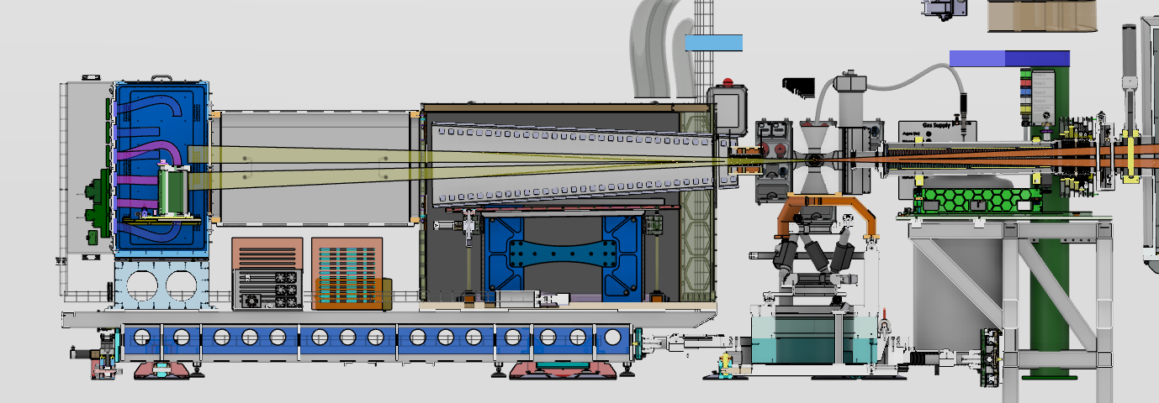
ESTIA – Sample Stage & Detector Arm
Overview of the current design
Detector
Flight tube
Analysers + Guide field
Spin-flipper
Detector elctronics
Sample stage

Slide 14
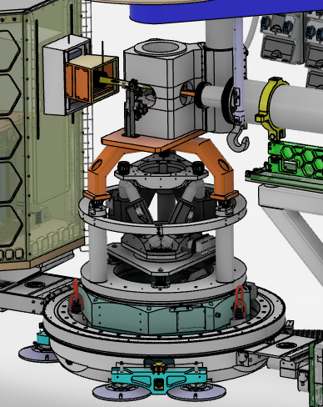
ESTIA – Sample Stage & Detector Arm
Warm Bore magnet (2.5T vertical): contract signed and kick-off held
Overall sample stage design is ongoing
Sample holder for solid/air and small flow cryostat: design will start in early 2023. The sample holder will be mounted directly on the hexapod
Hexapod (L2 interface):
Procurement started
L1 interface: directly connected to the omega stage. Potential adapters for the magnet
Omega stage

Slide 15
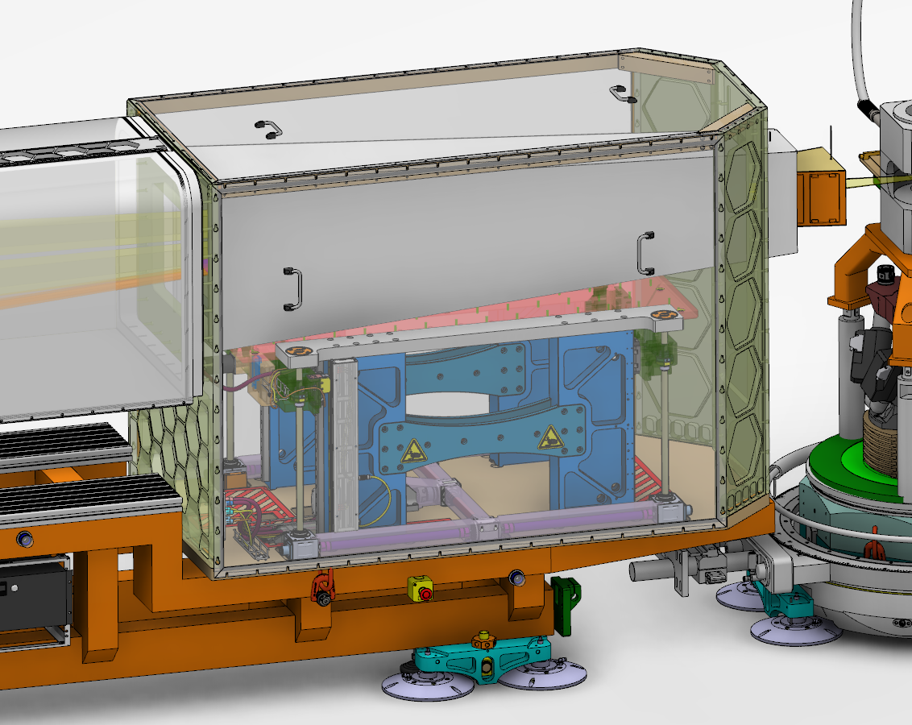
ESTIA – Sample Stage & Detector Arm
Analysers+guide field: mechanical design on hold while guide field for spin-flipper is not complete
Motorised support for the analysers: concept finished, design on hold until final analyzer defined

Slide 16
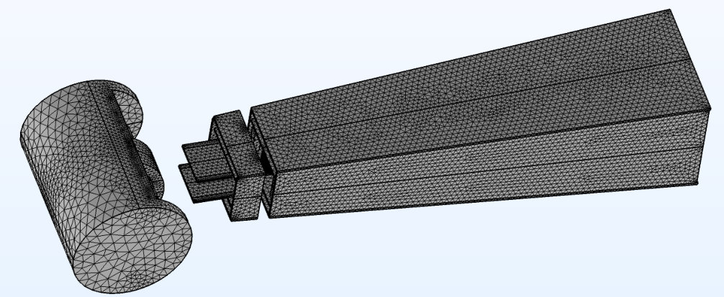
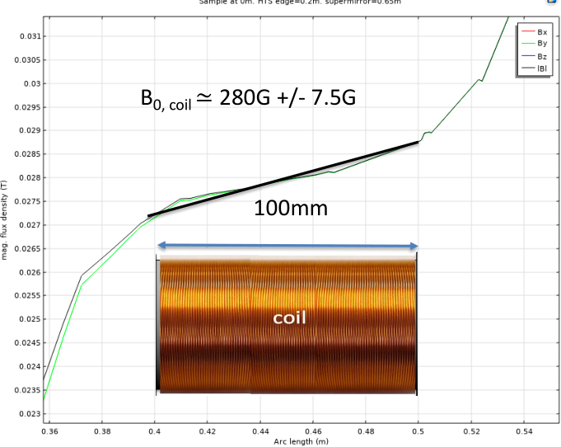
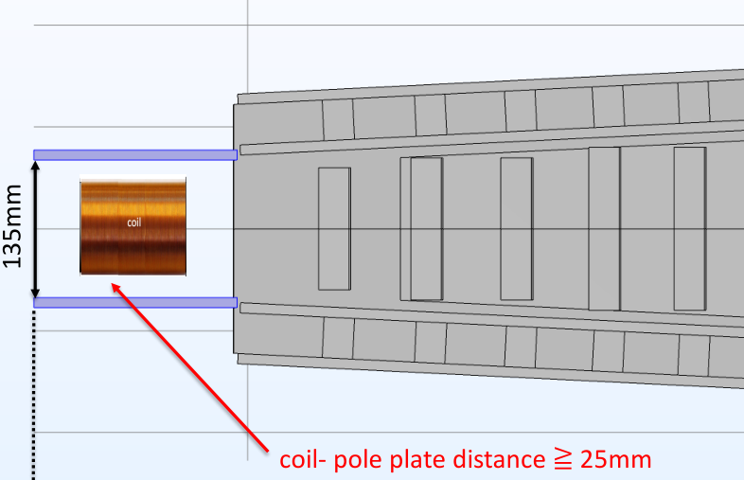
ESTIA – Sample Stage & Detector Arm
Analysers+guide field: mechanical design on hold while guide field for spin-flipper is not complete
Motorised support for the analysers: concept finished, design on hold until final analyzer defined
Spin-flipper: different variants for passive gradient field developed and feasibility of high-frequency coils tested, finalizing concept before procuring system

Slide 17
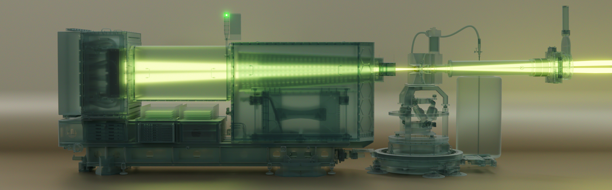
ESTIA – Sample Stage & Detector Arm
ESS input/support required for design:
Specification of possible safety components (laser fence etc.) w/ instrument
Full safety concept of entire system (together with PSI)
Dimension of detector electronics
Cable/pipe specification to detector
Some details about the detector vessel/front-end electronics

Slide 18
Thank you for your attention!
Any questions?
Page 18
Notes:
18

Slide 19
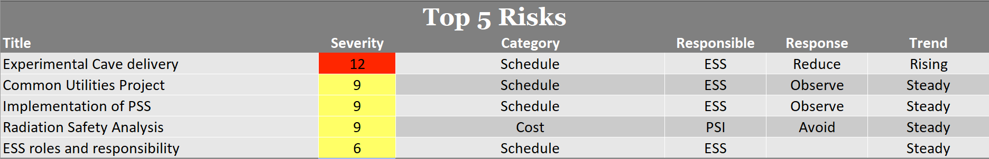
Risk Report
Current Risk Register
Risk Register from previous STAP meeting

Slide 20
Financial Report
2023

