Slide 1
Multi-Blade detector status Oct 2022 Francesco Piscitelli

Slide 2
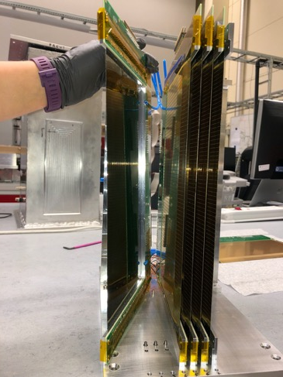
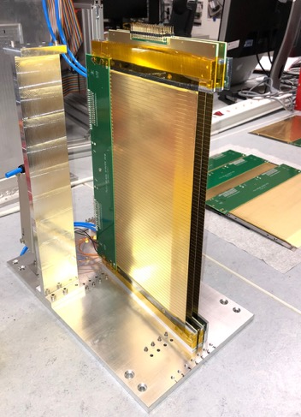
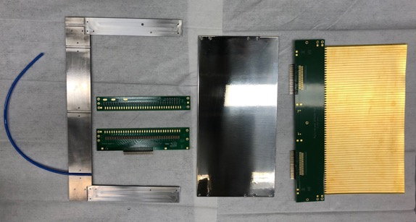
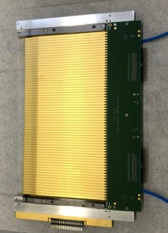
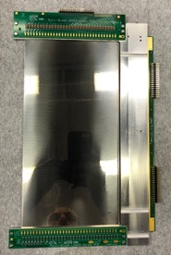
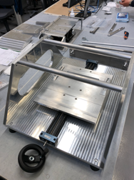
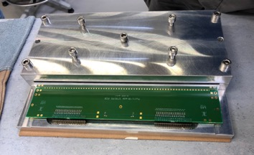
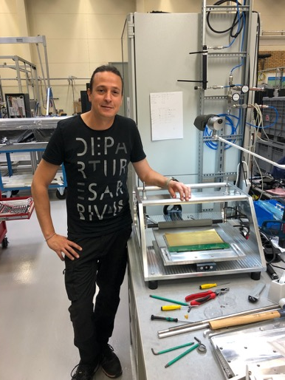
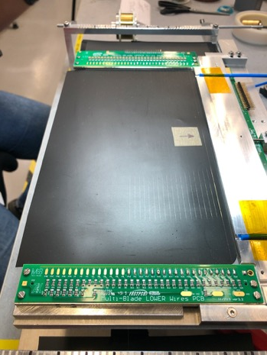
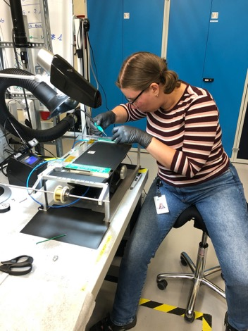
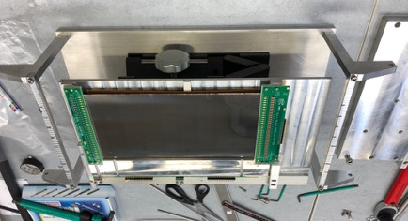
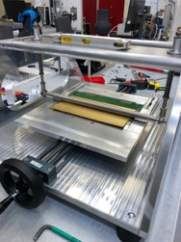
Multi-Blade: TOOLING is complete and tested on MB300L
parts
A unit
cathode strips
Gluing machine KV-1
Oven clamp
6-unit detector
Wiring machine K-7

Slide 3
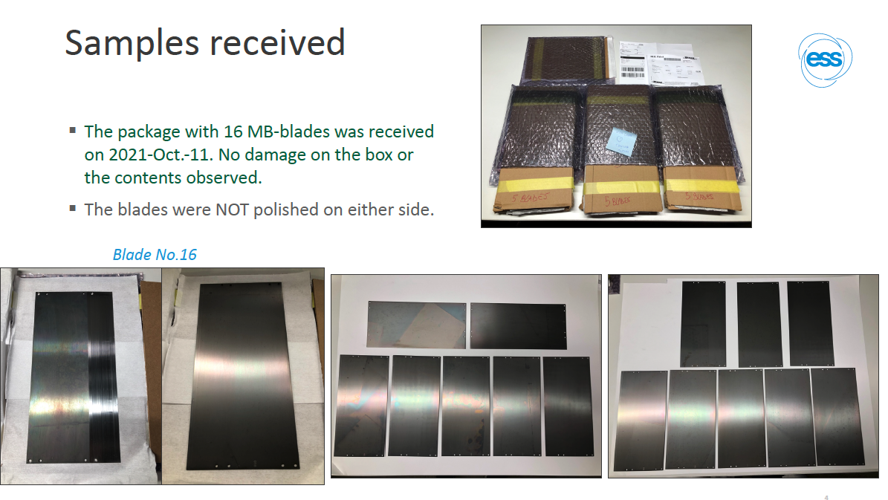
Previously used dental Titanium, always worked, last year dental Ti not available, switched to Gr2 Ti.
OCTOBER 2021
Titanium

Slide 4
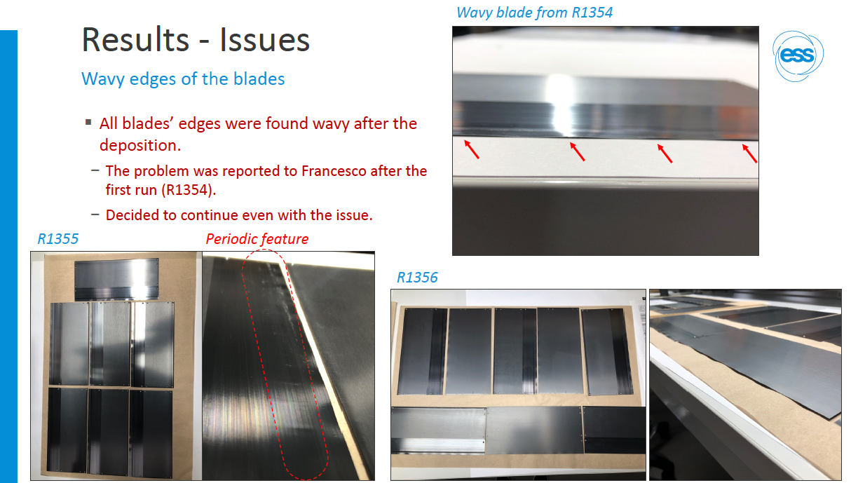
OCTOBER 2021
Titanium

Slide 5
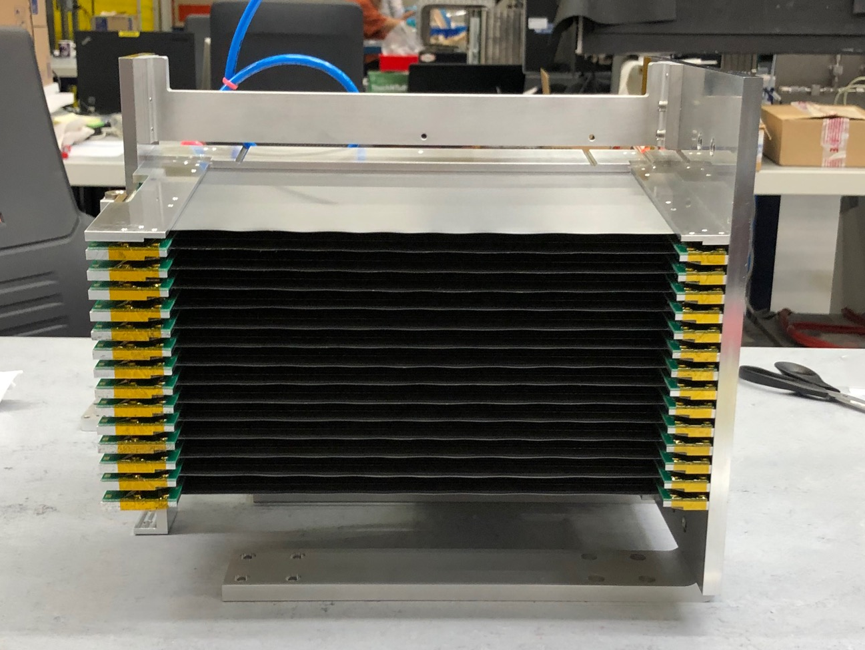
OCTOBER 2021
Titanium
Either miss delivery or have
A wavy blade detector
We decided to continue and blades
can be replacved later at any time
14 UNIT DETECTOR FOR AMOR

Slide 6
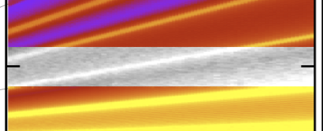
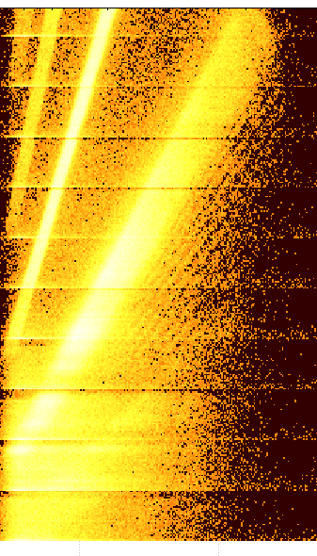
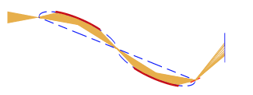
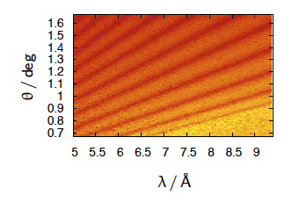
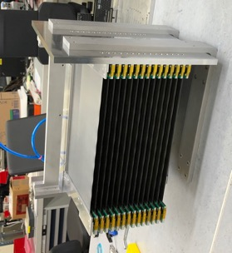
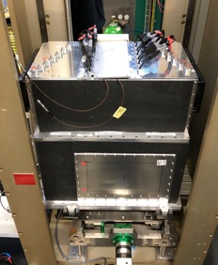
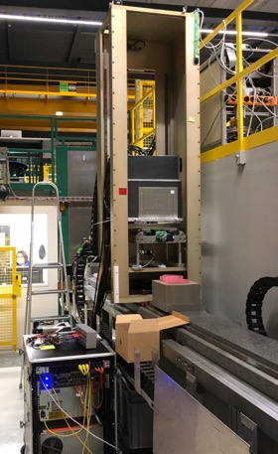
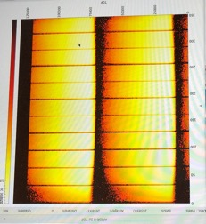
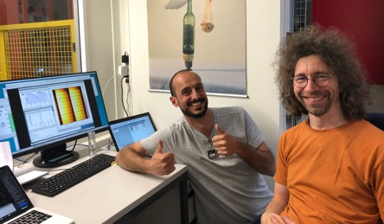
Multi-Blade for ESTIA, FREIA installed permanently at AMOR (PSI)
Selene guides
focusing reflectometry
(ESTIA ~ AMOR)
5
Y-ToF
4
5
4
3
detector
3
EFU produced real time image
from ESTIA Instrument Proposal
(θ,λ)
2
0.065Å⁻¹
0.065Å⁻¹
sample
2
Generally not
visible on
raw data!
Proof of the good
spatial res.
MB18 prototype operational on AMOR during entire 2021 for operations and commissioning.
AMOR (conceptually identical to ESTIA) decided to have a permanent Multi-Blade detector for serving the instrument.
1
1
SIMULATED
MEASURED with Multi-Blade NiTi sample
MB AMOR is operational on AMOR (PSI) from 9th May 2022 using the previously developed CAEN electronics -> any solution about the blades (solved!) and the electronics will be fitted at a later stage once ready.
Thanks to Jochen Stahn (AMOR instrument scientist)
and DG, ICS, and EC/DC groups for the support.
14-unit detector for AMOR
(active area 260x140mm²)
Same units as ESTIA (48 units) and FREIA (32 units)
Direct beam 1.7MHz (saturation of CAEN
electronics), no problem up to ~1MHz over
10x10cm² area

Slide 7
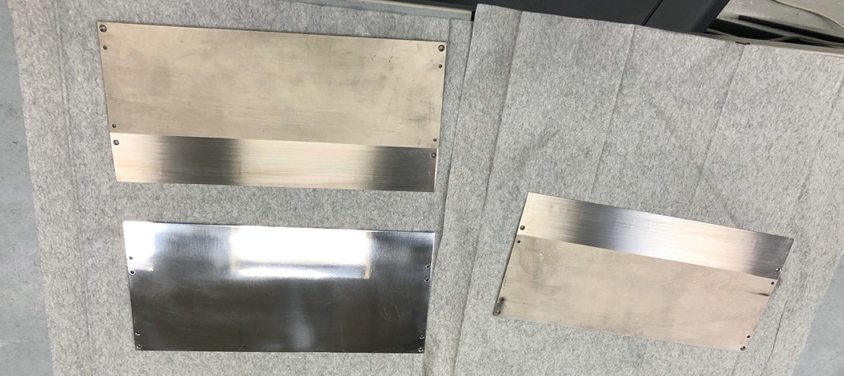
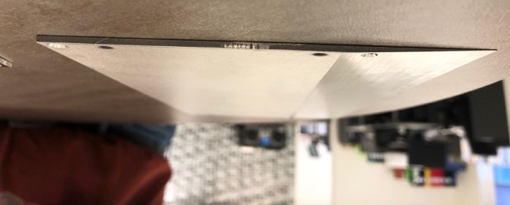
One option is to change from Titanium to Stainless Steel, it has been tested and no issues on neutronic side, NO ACTIVATION ISSUE

Slide 8
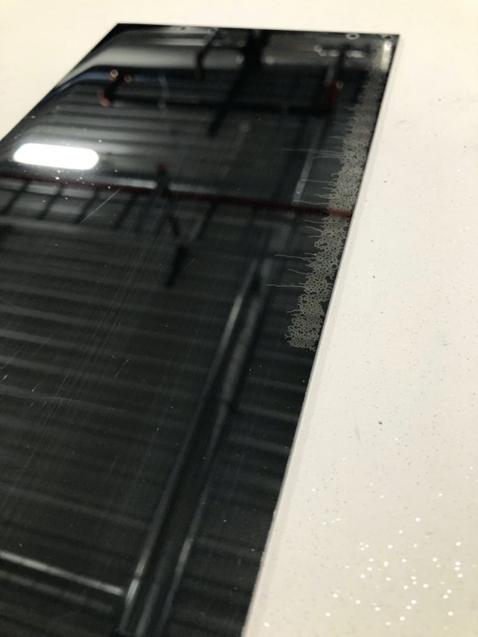
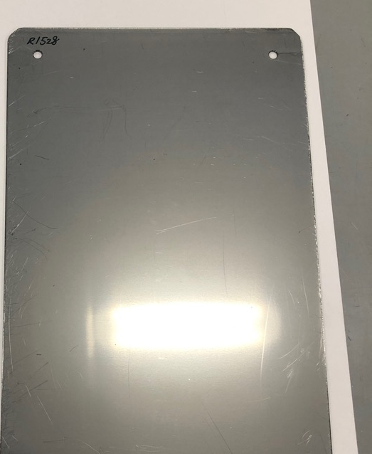
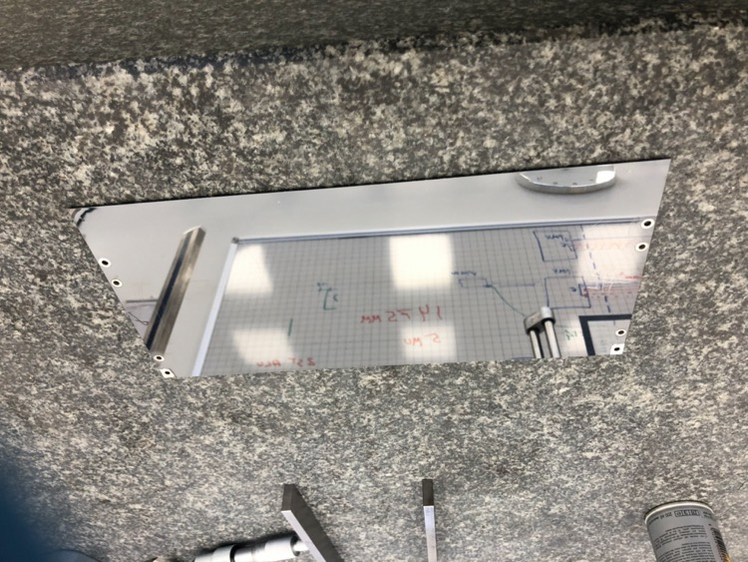
Also tested in detector with neutrons
We will have 2 batches of Stainless steel
316 2B finish
Adhesion issue
solved
304L mirror

Slide 9
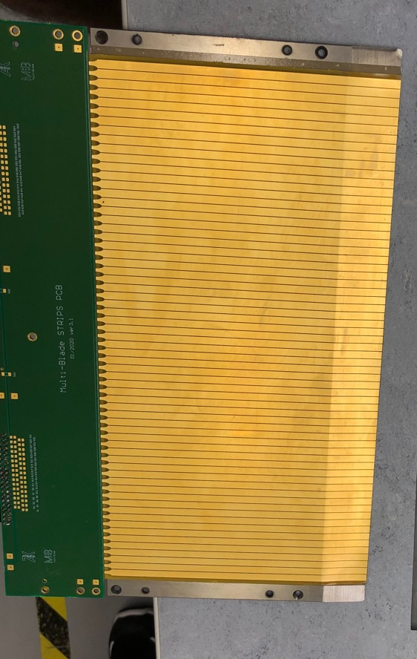
Yet another issue: Epoxy tape OUT OF PRODUCTION
Epoxy tape glue
Ti blade
Epoxy tape glue
PCB
PCB
26.5 cm
20 cm rolling direction
Ti blade
FOUND 2 ALTERNATIVES FROM 3M UNDER TESTING

Slide 10
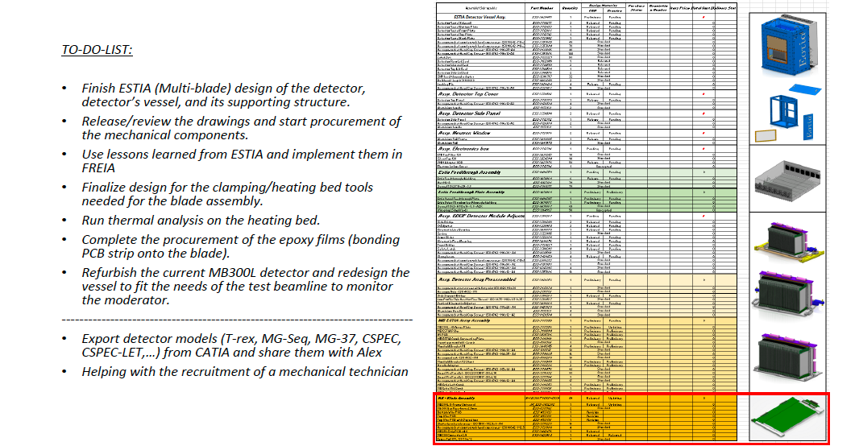
MECHANICAL ENGINEERING work to finalize MB detector:

Slide 11
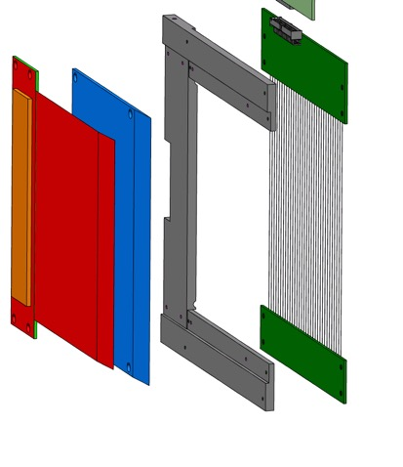
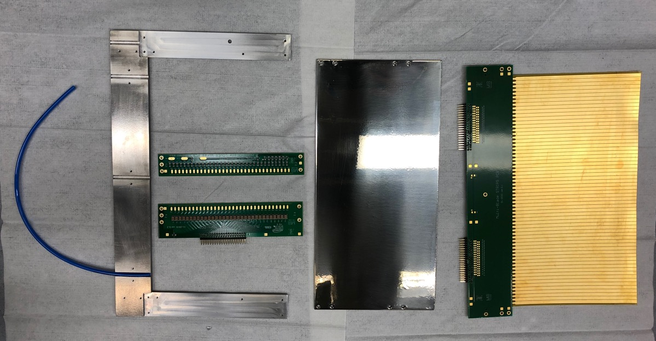
Schedule:
Strip PCB received 140pcs
Wire PCBs ordered, in production
Blades 140 pcs by end of year
Coating on 140pcs completed by Feb 2023
Wiring of first units can start by end of year, then store units
(same for all instruments)
ESTIA vessel manufacture next spring
Quantities:
48 units for ESTIA,
32 for FREIA,
10 TBL,
14 AMOR (replacement)
¹⁰B₄C substrate
holding frame
cathode strips
anode wires
Strip PCB
Ti-blade
U-frame
4mm gas pipe
Top wire PCB
Bottom wire PCB

Slide 12
Work on VMM electronics has restarted,
New EMC …
Filters…

Slide 13
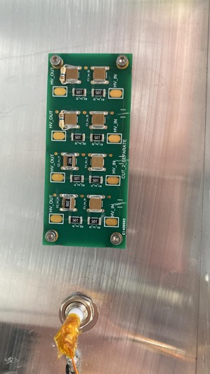
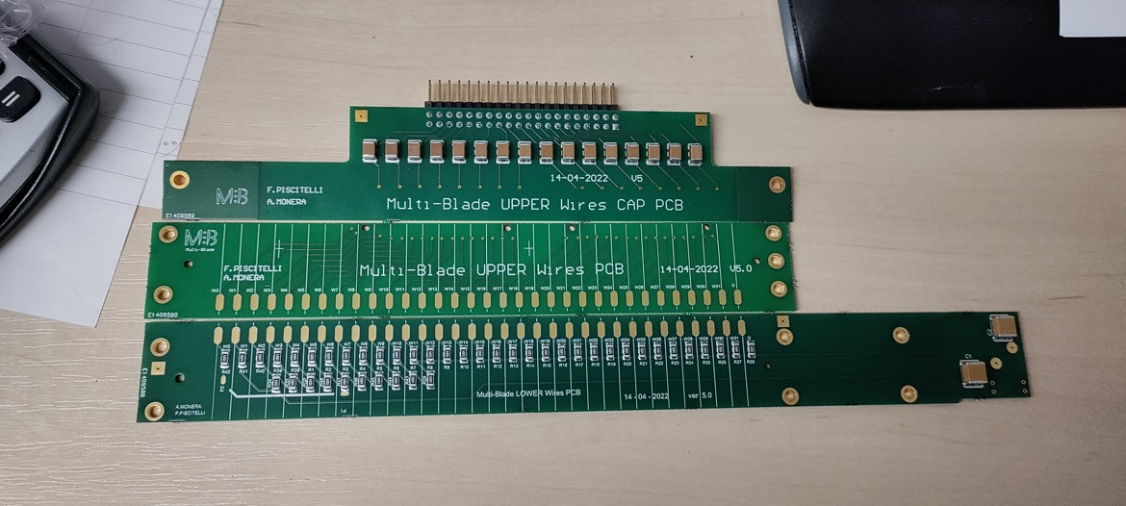
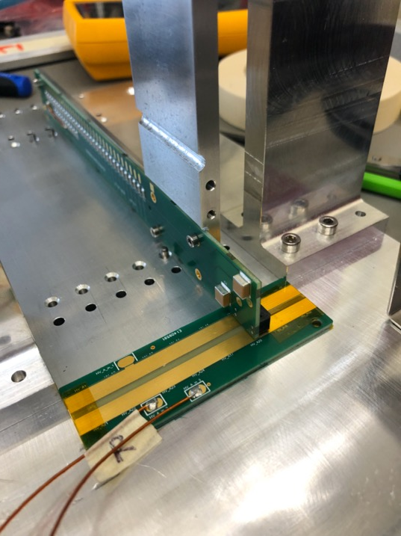
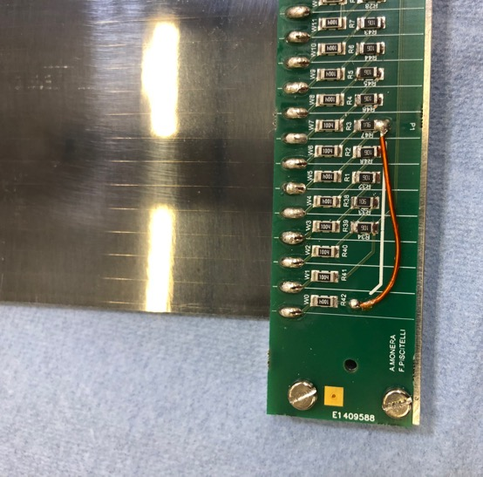
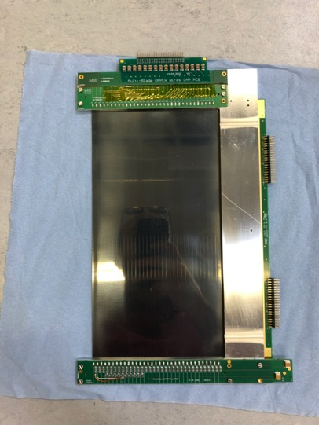
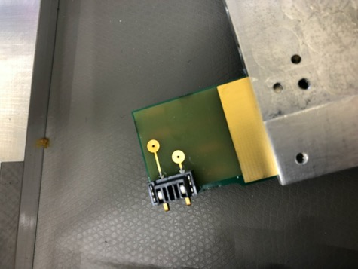
circuits modified according to VMM review recommendations

Slide 14
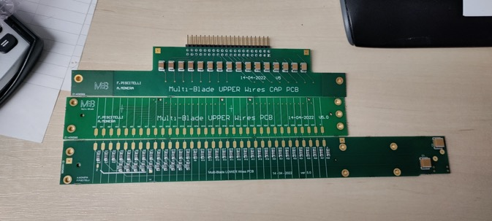
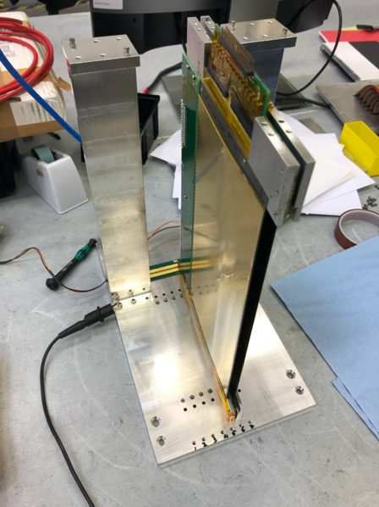
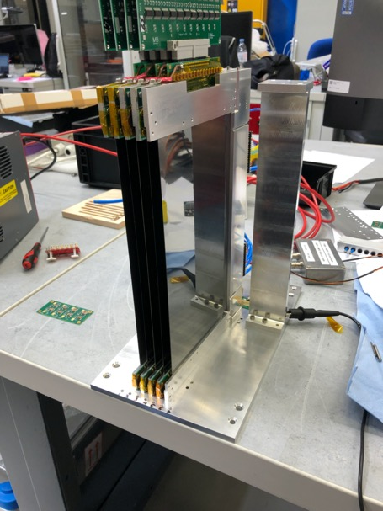
1 blade circuit modified according to VMM review recommendations
And tested in a refurbished MB300L at STF

