Slide 2
DST capital investment projects
Science Directorate Projects Meeting
PRESENTED BY Jesper rude selknæs

Slide 3
Introduction
DMSC capital investment activities
Objectives – what we wish to accomplish
The goal of the DMSC capital investments projects are to ensure that the hardware, hosting and licensing capacities are in place to ensure:
Data acquisition, data reduction, data analysis and data storage of experimental data can be achieved in accordance with the requirements set by instrument teams and end user expectations.
Scientific computing activities required by ESS to support the construction, development and operation of the facility can be executed.
That scientific computing capacities required by external funded projects (PaNOSC and HighNESS) can be delivered.

Slide 4
Capital investment plan
2022 overview – 973KEUR in total investments

Slide 5
Tracking and planning
Methods and tools used
P6 is used on a per-year level – one activity for all investments in a given year
JIRA is used for tracking and planning in a given year:
One epic for all procurements in a given year
One story for each tender or batch of small procurements
Epics and stories are annotated with P6 activities providing a link between P6 and JIRA
BigPicture is used to monitor the progress of the investment activities – allowing for accurate reporting to planners and management.
An extended Excel spreadsheet is used to keep track of spendings.

Slide 6
Tracking and planning
P6 activities overview
P6 activities
In the period 2022 to 2027 these activities are planned in P6:
2022: NSS-A2146967170 Budget value: 973KEUR
2023: NSS-A2146967230 Budget value: 1842KEUR
2024: NSS-A2146967240 Budget value: 1970KEUR
2025: NSS-A2146967250 Budget value: 590KEUR
2026: NSS-A2146967260 Budget value: 1625KEUR
2027: NSS-A2146967280 Budget value: 1410KEUR

Slide 7
2022 investment plan
Status on activities
Investment project | Procurement method | BOM | Publ | Quotes evaluated | Goods recv. | Invoice recv.
HPC replacement nodes | Tender | Done | OCT-384 | Yes | Yes | Yes
InfiniBand switches | Tender | Done | OCT-387 | Yes
Ethernet equip. | Tender | Done | OCT-402
Beamline equipment | (Tender) | On-going
Licenses | Ad-hoc | On going | Partially | Partially | Partially | Partially
Services | Existing agreements | N/A | N/A | N/A | Yes | Partially
Misc. equipment | RFQs and FWA | On going | On going | Partially | Partially | Partially

Slide 8
2022 investment plan
Status on spendings
Investment project | Budgeted costs | Actual accrued costs | Completed
HPC replacement nodes | 130KEUR | 170KEUR | Yes
InfiniBand switches | 250KEUR | 133,3KEUR | No
Ethernet equip. | 275KEUR | - | No
Beamline equipment | 100KEUR | - | No
Licenses | 70KEUR | 8,6KEUR | No
Services | 68KEUR | 41,86KEUR | No
Misc. equipment | 80KEUR | 21 KEUR | No
Total 2022 costs | 973KEUR | 374,76 KEUR | -

Slide 9
2022 investment plan
Status on spendings

Slide 10
Known issues
Inflation, supply chain and schedule
Vendors reports expected price increases between 90% and 100%
Major supply chain issues for all relevant components – specifically on InfiniBand parts and customized workstations.
Implemented mitigation:
We are working with vendors to find ways of avoiding the most severe supply-chain issues.
We are initiating procurements as soon as we are confident that we need a given piece of equipment.
We are adjusting and refining our procurements to limit the budget impact of cost increases.
DST is an active part in talks on adjustments to existing framework agreements on selected parts.
Participation in relevant big-science events and vendor meeting – most recently BSBF2022.

Slide 11
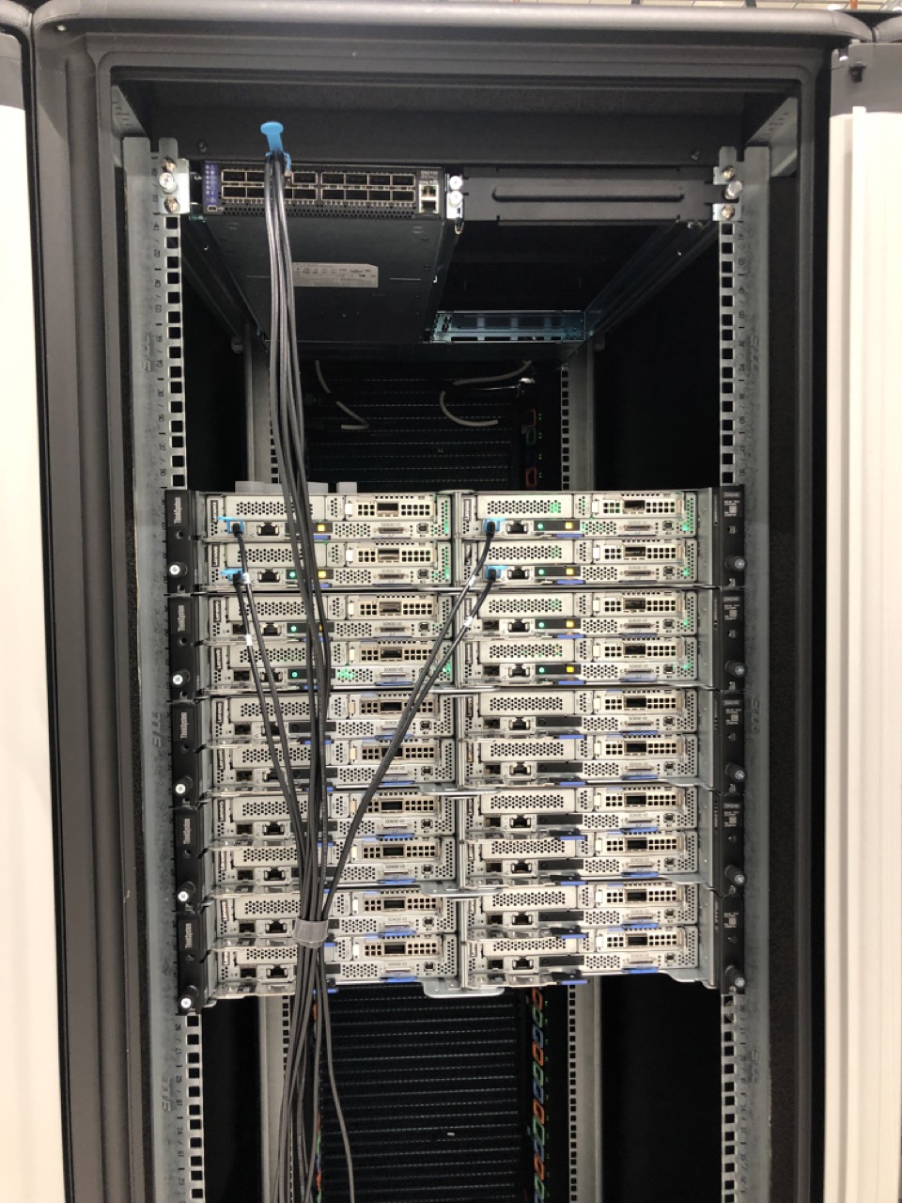
Actual and tangible progress
New HPC nodes in COBIS server room
20 pcs. 32 cores 512GB memory
4 more underway – delivery late October

Slide 12
Finish presentation

