Slide 2
Data Systems and Technologies (DST)
STAP presentation October 2022
PRESENTED BY Jesper Rude selknæs

Slide 3
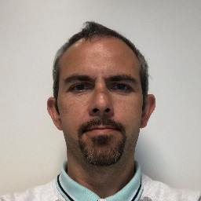
The DST team
Jesper Rude Selknæs
Alexandre Stefanov
Brian Lindgren Jensen
1 vacant position since August 2020
1 vacant position since August 2021
1 vacant position since March 2022
2 positions approved by the recruitment committee but no viable candidates has been identified.
1 Position pending approval from the committee – scheduled for Q1 2023.
Kareem Galal

Slide 4
Data systems and Technologies
Scope
The scope of the DST group is to provide the IT infrastructure for scientific computing at ESS. This includes:
Storage systems for scientific data
Compute capacities for data reduction, analysis, modeling and simulations.
Front-end systems for users to access compute resources (JHUB and VISA)
Systems for running the experimental control and data acquisition software – developed by the ECDC group.
Systems for supporting software development activities at DMSC and ESS as a whole.
The required networks to support the bullets above.

Slide 5
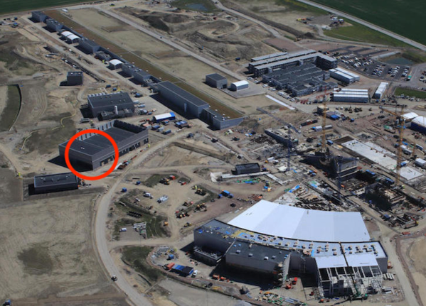
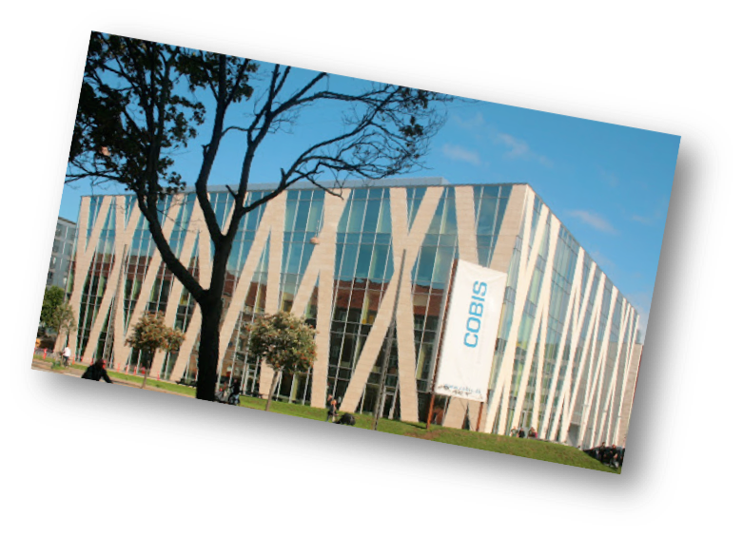
DST areas of responsibility
Site server room
Beamlines
Detector readout and EPICS Bridge
DAQ
Live Data reduction and analysis
LIve storage - raw
Live storage - derived
Service Failover
External Archive
Raw data (read-only)
Derived data (read/write)
Copenhagen server room
Data Portal
Offline environment

Slide 6
Status report
What has been accomplished since the April 2022 STAP:
Deployment of a production OpenStack installation in Copenhagen – Lund pending.
Deployed a proof of concept VISA installation and an interim OpenStack solution in the COBIS data center in order to gain experience and feedback from users in DMSC and from instrument data scientists. So far very good feedback has been received.
SpectrumScale rolled out in full production – site-to-site file transfer is on-going with good results so far.
Continue to further the progress of commissioning YMIR as a real-life instrument. Currently the detector data network is being worked on.
Engaging in collaborations with the other IT infrastructure groups.
Executed most of the DST procurement plan for 2022. Only one large outstanding tender which will close oct. 30th 2022.

Slide 7
Plans for the rest of 2022 + H1 2023
An overview
Given the limitations of the groups resources we will focus on the following activities:
Work closely with the ECDC group on commissioning activities on the YMIR test beamline.
Improving OpenStack to a more cloud-like service.
Getting a production ready VISA installation running against a production ready OpenStack setup.
Deploy instrument controls network as applicable.
Progressing the work on JupyterHubs and Jupyter Notebooks
Operating the two DMSC data centers
Closing the three work packages in PaNOSC we are involved in (wp4, wp6 and wp8).
Work with the other IT groups on a new official ESS Linux distribution of choice when CentOS dies.
Work with the other IT groups one infrastructure architectural subjects.
Execute the capital investment plan for 2022.
Recruit the two positions planned for 2022.

Slide 8
Plans for the rest of 2022
Oct
Nov
Dec
Hardware installations
OpenStack and VISA improvements
Cold commissioning
Hardware installations
Last 2022 purchases
Cold commissioning
Complete evacuation of legacy VM platform
End of year tasks
Cold commisioning
On-barding staff
Timeline

Slide 9
Plans for the rest of 2022
Staff ramp up plans
DST aims to hire 2 positions in 2022:
One position with competencies within virtualization, OpenStack and containerization.
One position with general HPC and scientific computing skills.
To mitigate lost effort from not being able to hire DST will implement the following initiatives:
Check for viable consultants on existing framework agreements.
Seek to get acceptance for hiring students to cover some of the trivial tasks and free up core DST personnel. This would also open an opportunity to fertilize the ground for ESS as a workplace for IT professional's at the universities.

Slide 10
Plans for 2022 - 2027
Staff ramp up plans 2022 to 2027

Slide 11
Plans for the rest of 2022
Capital investment plans
DST will execute a 973KEUR investment plan in 2022:
HPC: 24 nodes replacing legacy hardware.
InfiniBand: Core layer of a scaleable fat-tree
Ethernet: 1GBE, 10GBE and 100GBE for connectivity to the instruments.
Beamline and user HW: Workstations and monitors for the instrument cabins.
Licenses: Software licenses for scientific computing.
Services: NREN, NorduNET and server room contracts.
Misc. equipment: Office equipment an minor various spare parts.

Slide 12
2022 investment plan
Status on activities
Investment project | Procurement method | BOM | Publ | Quotes evaluated | Goods recv. | Invoice recv.
HPC replacement nodes | Tender | Done | OCT-384 | Yes | Yes | Yes
InfiniBand switches | Tender | Done | OCT-387 | Yes
Ethernet equip. | Tender | Done | OCT-402
Beamline equipment | (Tender) | On-going
Licenses | Ad-hoc | On going | Partially | Partially | Partially | Partially
Services | Existing agreements | N/A | N/A | N/A | Yes | Partially
Misc. equipment | RFQs and FWA | On going | On going | Partially | Partially | Partially

Slide 13
2022 investment plan
Status on spendings

Slide 14
Plans for 2022 - 2027
Capital investment plans for 2022 to 2027

Slide 15
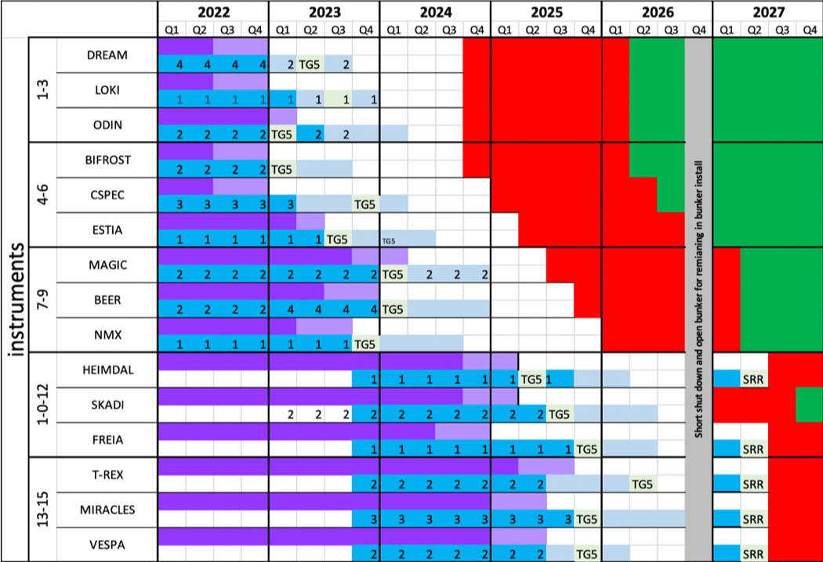
DST milestones for 2022 - 2027
DST ready for CC
DST ready for HC
DST ready for SOUP

Slide 16
Thanks for your attention

