Slide 2
Report from acting Head of DMSC
DMSC STAP Fall 2022
PRESENTED BY Thomas Holm ROd

Slide 3
Project management
Potential in kind contributions
Office situation
Data policy
Prioritization of data analysis software (DRAM presentation)
User Journey (SWAP presentation)
Charge

Slide 4
Agenda
1 Staff updates
2 Risk & project management
3 Some potential collaboration updates
4 Office situation
5 FAIR data
6 Summary

Slide 5
1
Staff

Slide 6
Staff updates
Number of DMSC staff:
22 DK + 1 starting Jan 1 + 1 SE
1/3 of Peter W
8 DK + 3 SE for ECDC
Number of externally funded positions: 2
Number of new finalized recruitments since last STAP: 2 ECDC, 1 externally funded
Number of resignments since last STAP: 1 ECDC, 1 externally funded
Number of open positions: 2 DST, 1 SWAP + 1 admin awaiting approval

Slide 7
2
Risk & project management

Slide 8
Why upgrading?
It’s simply the sensible thing to do
What we want to achieve:
Track record and arguments if we need to access contingency
Engage staff in the ESS project
Show we take staff’s concerns seriously
Current risks in ISIS risk register:
We cannot process data when needed
We cannot transfer data between Lund & Cph
We need to balance overhead with benefits

Slide 9
Risk management
Started to run risk workshops with staff
Staff & stakeholder involvements

Slide 10
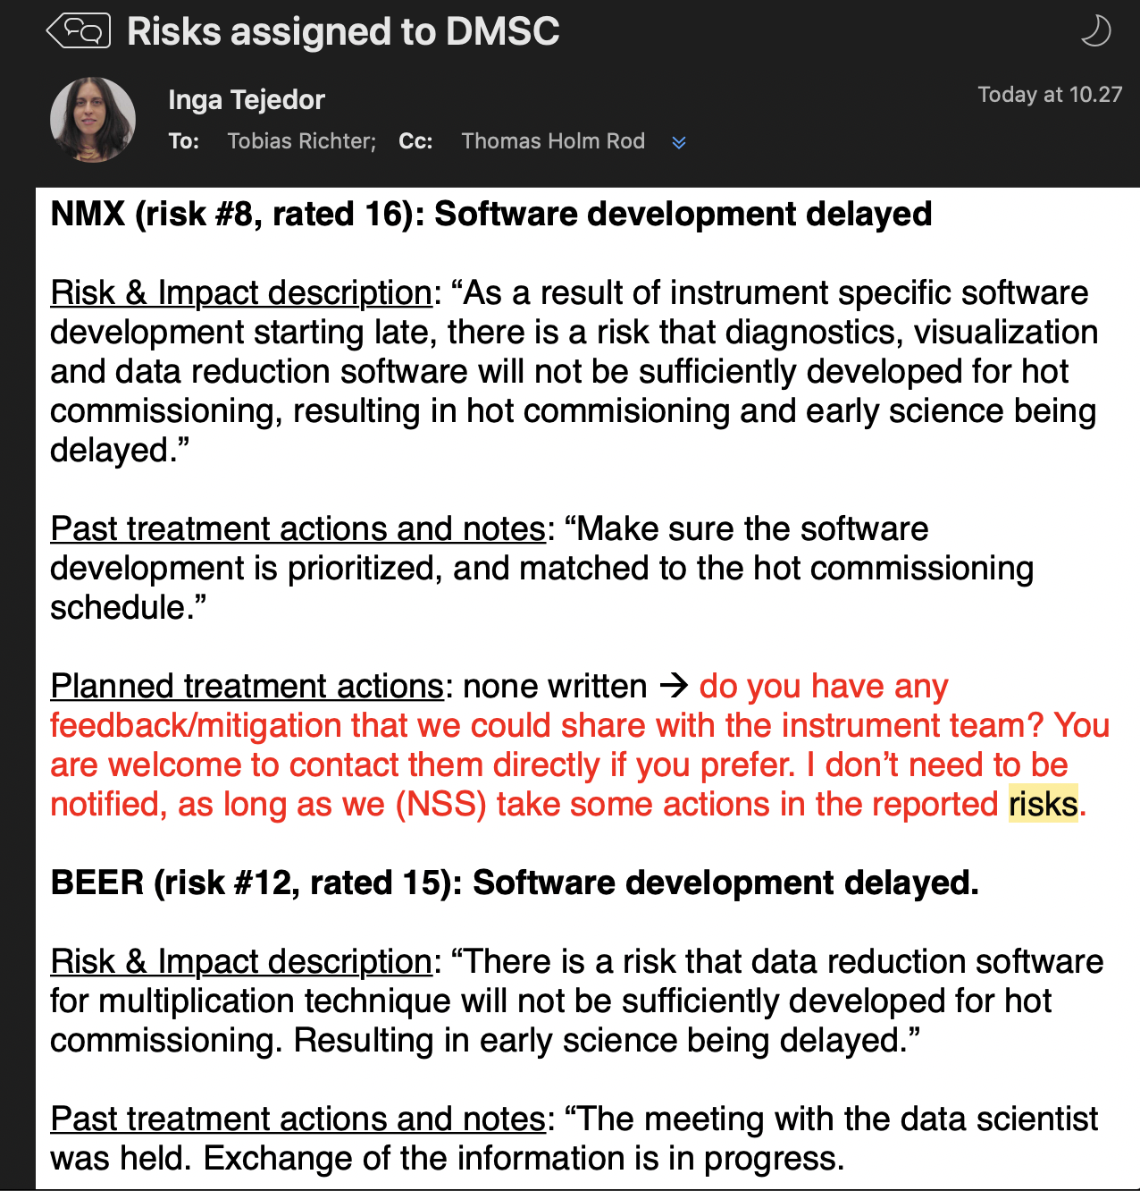
Also ICB
Email from yesterday
Instrument teams have assessed risks as part of the Instrument Collaboration Board (ICB)
Many of them related to DMSC!
Currently discussion between Science and NSS about how to align this

Slide 11
Top risks from IDS workshop
# | Cause | Event | Consequence | Mitigation
1 | Key staff leaving | Failure to deliver full data processing pipeline | Degraded user experience and poor scientific output | Work environment / (avoid SPOF)
8 | Lack of IDS competences | Insufficient support for instrument commissioning | Delay in start of user programme | Training, hiring more people, make competence mapping.
14 | Undefined requirements for remote control. | Inability to control the instruments outside the instrumental hutch. | Failure to meet obligations to regulatory stakeholders. | Have a policy in place and make sure to implement it.
17 | Unmanaged change in an upstream software component | Failure of downstream component | Non working data pipeline and failed user experiments | Improve ways of working. Policies and procedures. Configuration change management. Continuous integration.
18 | Unmanaged change in infrastructure | Non working instrument or associated infrastructure | Unhappy users

Slide 12
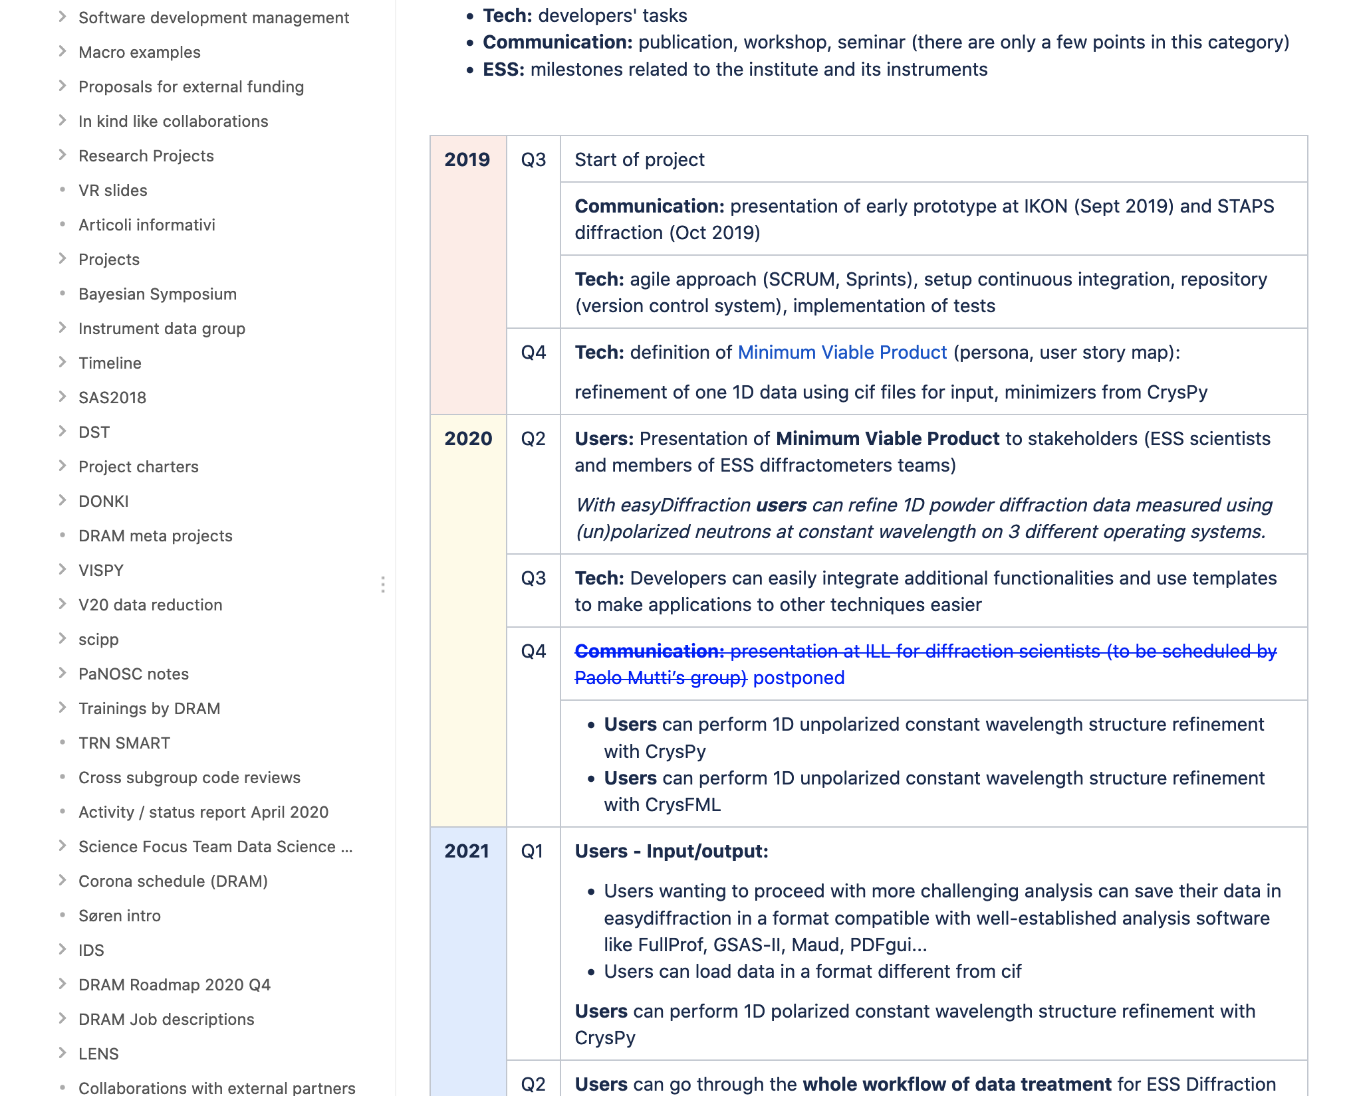
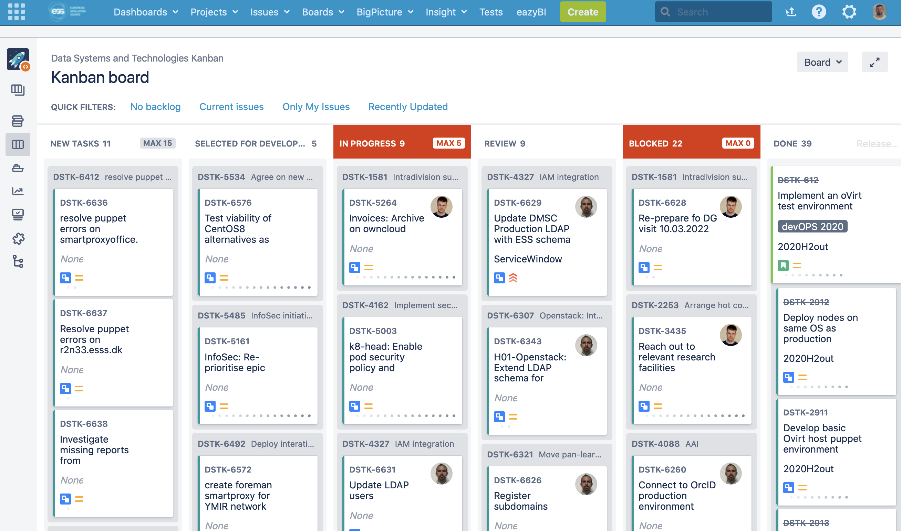
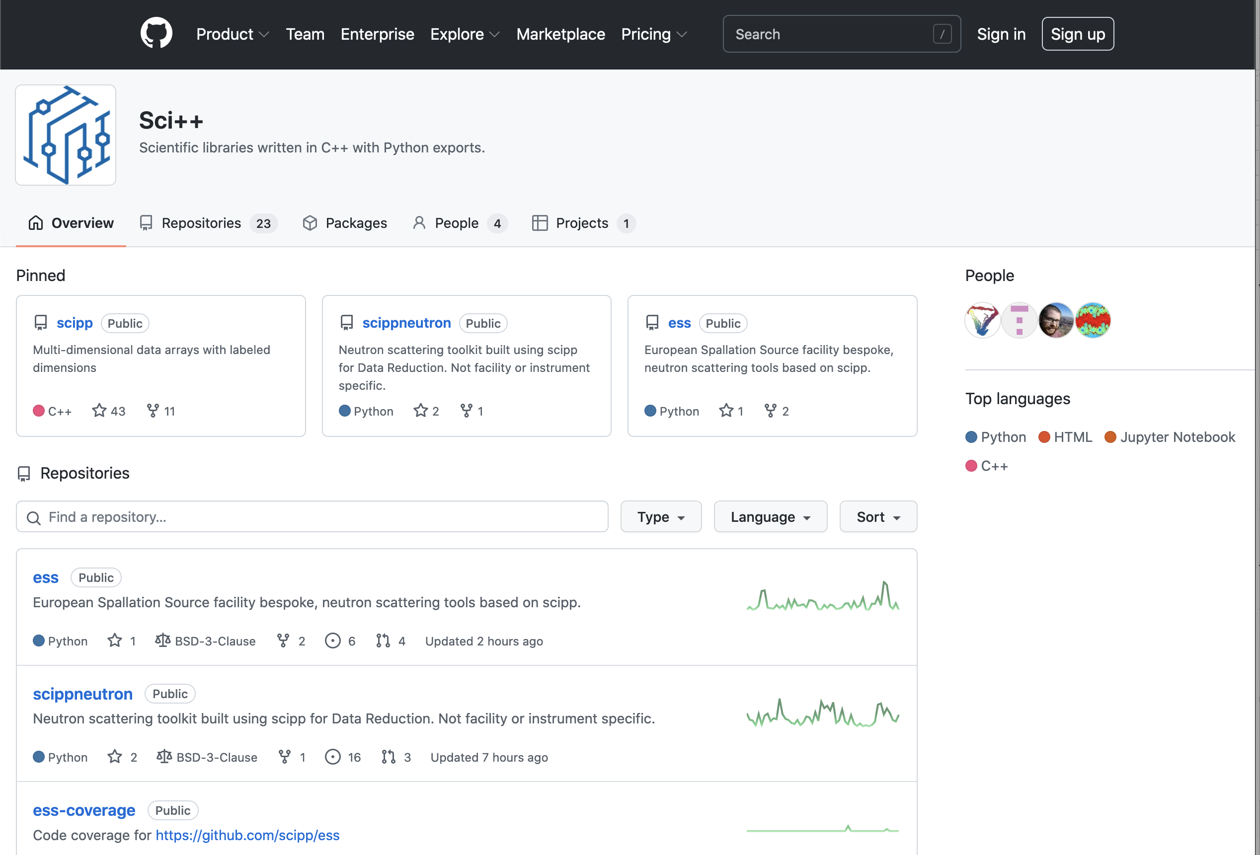
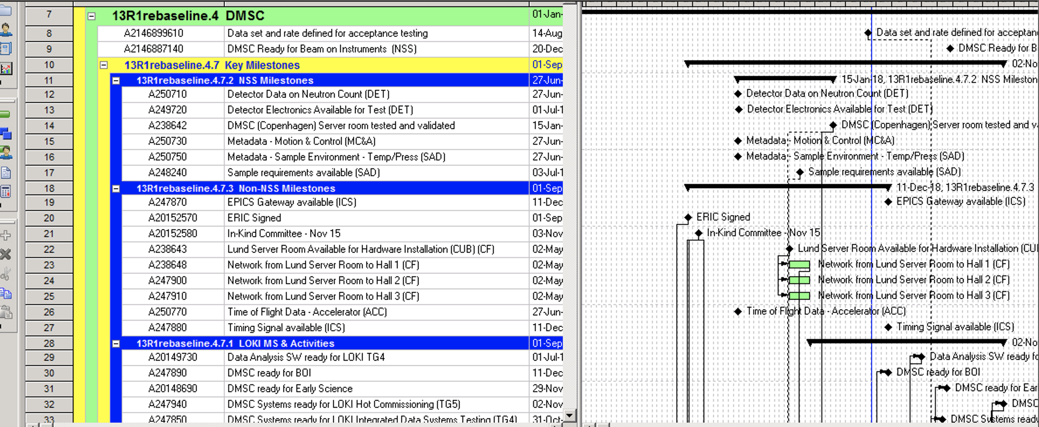
Agile scientific computing house
Use different project management tools than P6

Slide 13
Linking to ESS P6
Work in progress
DST
(JIRA)
SWAP
(GitHub/JIRA)
DRAM (GitHub/JIRA)
ECDC (GitHub/JIRA)
DMSC internal project planning and tracking
DMSC
(JIRA)
ESS/NSS/Science
(P6)
Risk register
Science project planning and tracking

Slide 14
Philosophy applied
… still being developed
Top-down (P6) – empowering the IDS
DMSC delivers a data processing pipeline to each instruments
The Instrument Data Scientist (IDS) for an instrument is the Product Owner of the associated data processing pipeline
The IDS runs a project in JIRA with milestones / user stories that are replicated in P6 and link to development teams
Ideally, the IDS has a test suite running for the data processing pipeline and ‘unit testing’ for the interfaces.
Bottom-up (JIRA/GitHub) – empowering the team
Each development team delivers in principle a component of the data processing pipeline for all instruments
They run an issue tracker / PM tool for their project / deliverable(s)
When informed by an IDS that a milestone is not met, they can create an issue linking to that milestone.

Slide 15
Dashboard for DMSC activities
Eventually we(I) would like to have a nice overview of status
 | UOS | DAQ | DR | DA | DM |  | MS1 | MS2 | MS3 | MS4
LOKI | ☺ | ☺ | ☹ | ☺ | ☺ |  | ☺ | ☺ | ☺ | ☹
DREAM | ☹ | ☺ | ☺ | ☺ | ☺ |  | ☺ | ☹ | ☹ | ☹
ODIN |  |  | ☺ |  |  |  | ☺ | ☺ | ☹ | ☹
BIFROST |  |  |  |  |  |  | ☺ | ☺ | ☺ | ☹
YMIR
UOS
DAQ
DR
DA
DM
Stream events & meta data
Data reduction & visualization
Data analysis
FAIR Data management
Experiment control
User office software
Repeat and update 2019 LOKI milestones with increased complexity (e.g. temperature scan)

Slide 16
Scope for scientific computing
Support users with scientific computing at modern open science facility
Technique
specific
Stream events & meta data
Data reduction & visualization
Data analysis
FAIR Data management
Experiment control
User office software
NSS scope
(Tobias Richter’s presentation)
Including Compute infrastructure Remote access to compute infrastructure & services Live data reduction and visualization Live analysis for some techniques | Plus Support for and with instrument simulations User support for scientific computing (Instrument Data Scientists) Materials and molecular modelling and simulations (not prioritised so far)
Not in scope:
Beam lines control & integration (→ NSS Div.) Business IT (→ IT Division) | Physical networking (→ ICS Division) Integrated controls across ESS (→ ICS Div.)
Notes:
Summary: Scientific computing group that should support
Objectives
Strategy

Slide 17
DMSC-LOKI project on JIRA – 1st take

Slide 18
Big Picture board
User stories

Slide 19
Concluding remarks for project & risks
A process has started for improving our risk and project management
Process is not completed yet. Next steps are:
Consolidate risks and enter major ones into ESS risk register
Get into the habit of regularly assessing risks
Define milestones for all IDS instruments in P6 and JIRA, which will link the ESS wise project with that of the development teams
ESS is generally still adapting to post-rebaseline project management, incl new project directorate
also need to align across Science and NSS

Slide 20
3
Some (potential) collaboration updates

Slide 21
Some updates
Data reduction & analysis
scipp workshop @ ISIS
easyScience workshop @ ISIS
Reaffirmed collaboration on analysis software for diffraction based on CrysFML
Data reduction software based on scipp and easyApp for POWTEX
(Marina Ganeva)

Slide 22
Potential in kind
DTU has reached out with tentative proposal
Proposal
Continued strong engagement in the BIFROST instrument, including commissioning and software/simulation
Engagement in the imaging instruments, including software/simulation
Data management and software activities coupling to our computer science environments
Neutronics simulations (also in relation to moderators).
DMSC comment
There are risks and opportunities.
In kind should strengthen DMSC and not weaken it
Staff must be located at DMSC, managed by DMSC, and fit into our development structure
Affiliations for DMSC employed staff
Fixed term secondments?
Infrastructure?

Slide 23
4
Office situation

Slide 24
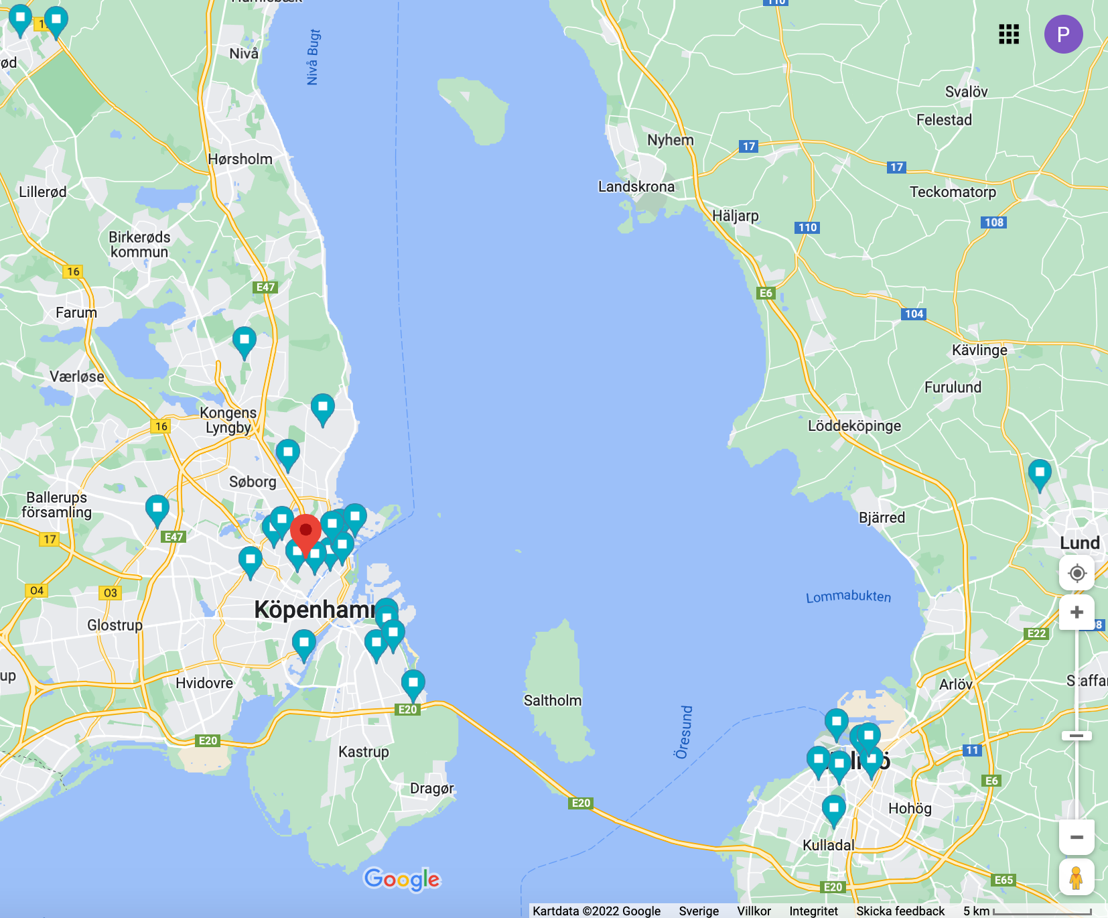
Office situation
Current status
COBIS lease ends Mar 31 2024
BII has taken over lease from COBIS
BII want us out asap
BII will move us to a another area in COBIS building if we stay beyond Spring 2023
Server room can stay incl. workstations for a few people, but still need to see an agreement
In the meantime we are looking for a new office location
Place of living for DMSC staff

Slide 25
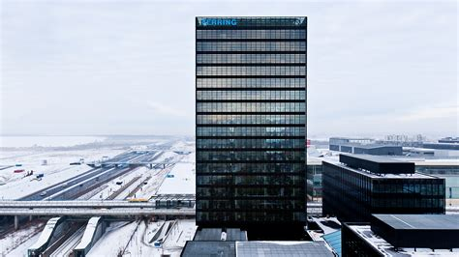
Office situation
Parameters to consider
Interruption and risks to staff retention and project
Accessibility
For visitors (ESS Lund, airport, universities)
To new or existing server room
Attractiveness to staff and new recruits
City environment, (urban Copenhagen is an asset)
Academic environment
Work environment
Guarantees for persistent non-interrupted lease
We have defined some metrics for some of these parameters
We do SWOT analyses for various places

Slide 26
5
FAIR data

Slide 27
Aligned data policy with FAIR guidelines
 | Definition | Updated policy
Findable | to be FINDABLE, any data object should be uniquely and persistently identifiable | Persistent identifiers for any dataset Moreover, metadata catalogue makes data searchable
Accessible | a data object is ACCESSIBLE by machines and humans under the conditions explained in this policy | Data (raw, processed, meta, auxiliary data) openly accessible for ten years after embargo period of three years after end of experiment. Metadata for the lifetime of ESS.
Interoperable | data use a formal, accessible, shared, and broadly applicable language for knowledge representation in order to be INTEROPERABLE | Documented data formats (NeXus)
Reusable | the data object has a plurality of accurate and relevant attributes (usage license, provenance, community standards) to be REUSABLE.” | Raw data now includes all data collected from neutron beamline (incl. data from sample environmet) Metadata + auxiliary data are considered incl. notebooks CC-BY 4.0 license

Slide 28
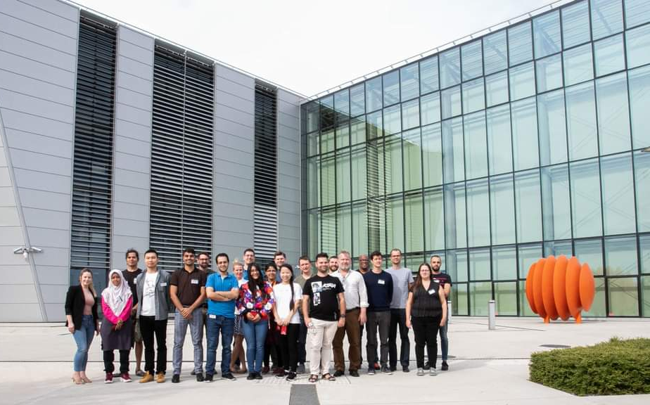
Teaching FAIR data
Involvement from all groups at DMSC
Good feedback on e-learning platform and integration with Jupyter
The idea of a future ESS-DMSC summer school has been discussed and a proposal is being drafted.

Slide 29
Summary
Process started for upgrading our risk and project management to the post-rebaseline situation
Involving all staff
CI for data processing pipeline?
Our office situation is currently a disturbance to admin & management and concern for staff
Can we benefit from in kind?
Recruitment is a challenge
Data policy is in the process of being updated to FAIR
We / I can feel we lack one team assistant

