Slide 2
Staffing for Analysis and Instrument Data Scientists
Instrument Data Scientists (½ IDS instrument)
Data analysis core development
Technique | Instruments | Who or When
Imag. & Eng. | ODIN & BEER | Søren
Reflectometry | ESTIA & FREIA | Andrew M
SANS | LoKI & SKADI | Wojtek
Diffraction | DREAM & MAGIC | Céline
Spectroscopy | BIFROST & CSPEC | Greg
Diffraction | NMX & HEIMDAL | Jan 2024
Spectroscopy | TREX & MIRACLES | Jul 2026
Technique | Who or When
Manager (Atomic sim) | Piotr
Diffraction | Andrew S
Spectroscopy | Simon W
Imaging (& Eng) | Nov 2023
Simulation competences located at DMSC
Who | Position
Mads Bertelsen | Post Doc
Peter K. Willendrup | Part time seconded
Torben R. Nielsen | Acting GL
Thomas Kittelmann | Detector Group

Slide 3
NMX “IDS”
Justin Bergmann recruited as post doc to work on NMX data processing pipeline
funded by Swedish Research Council
Collaboration with Professor Ulf Ryde @ Lund University
Looking into DIALS among other things
Will be invited to future IDS meetings

Slide 4
IDS activities
Detectors tests
Data reduction workflows
Test data
Commissioning plans
Participants in proposals and externally funded research projects
Playing an active role in the YMIR and test beamline projects
Product own / manage data processing pipeline
Collaborating with development teams and instrument scientists on defining data formats
Participating in or submit their own beamline proposals
Contributing to training activities at schools
Co-developing analysis software
Apprising instrument teams and class coordinators DMSC developments
Attending and contributing to instrument STAP meetings

Slide 5
DMSC-LOKI project on JIRA – 1st take

Slide 6
Big Picture board
User stories

Slide 7
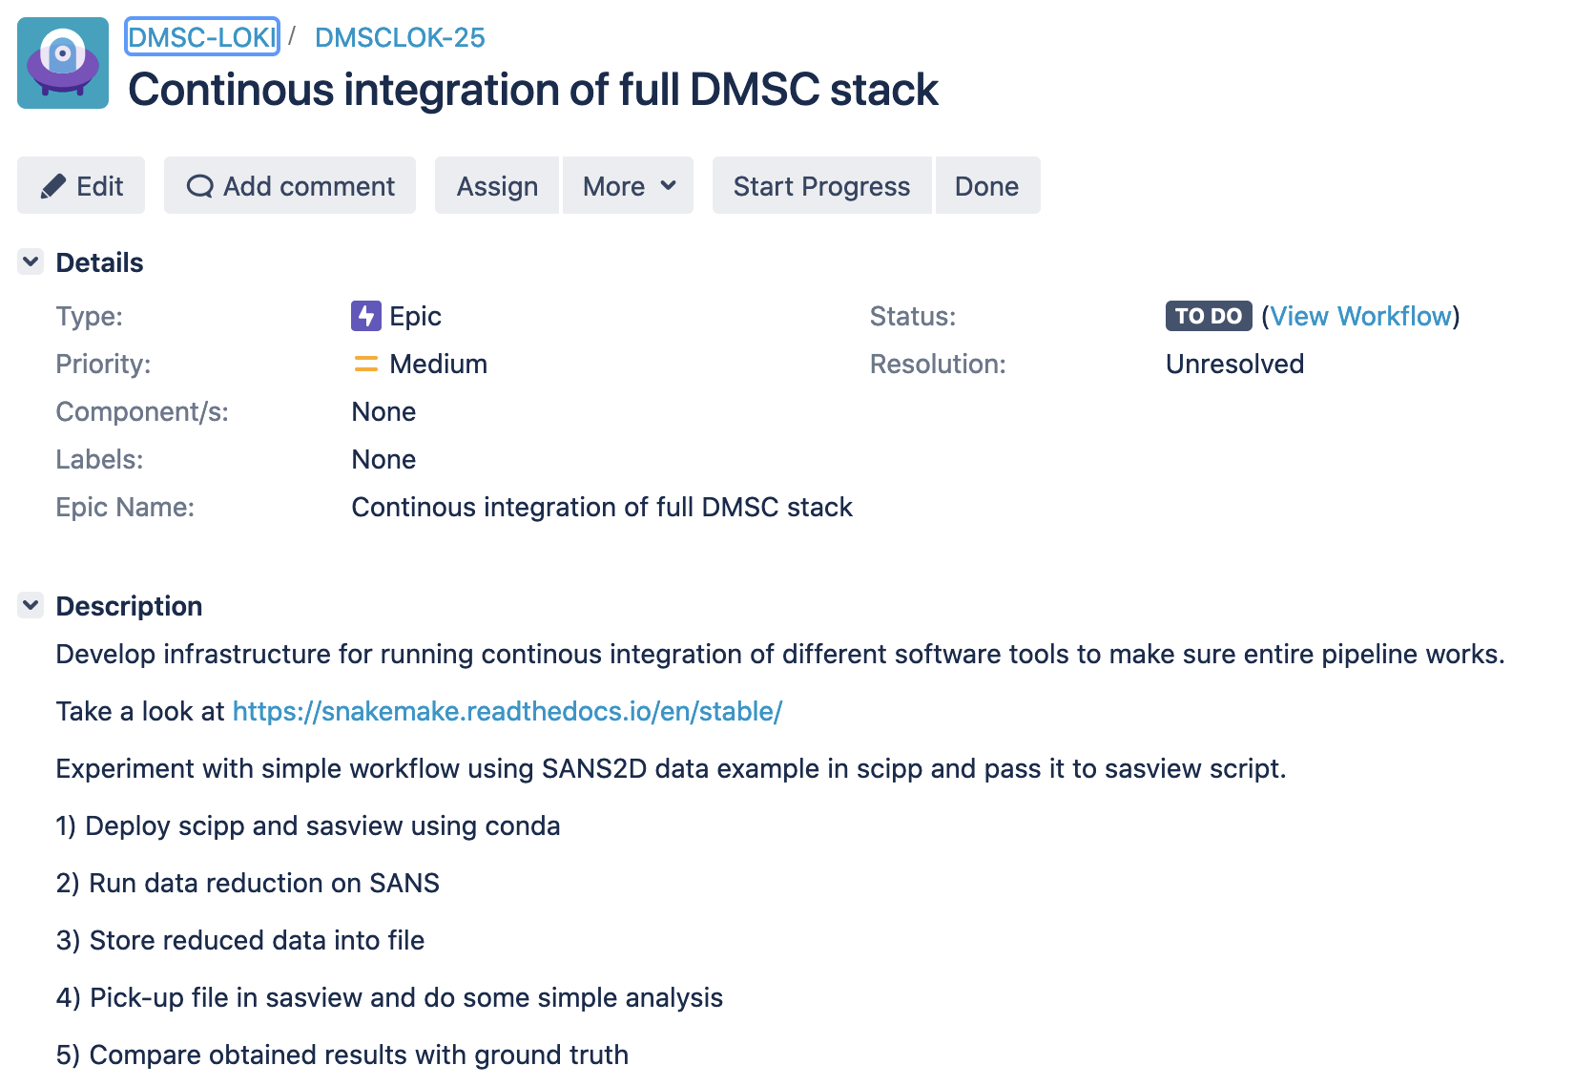
Risk #17 & #18:
Unmanaged change upstream or in infrastructure

Slide 8
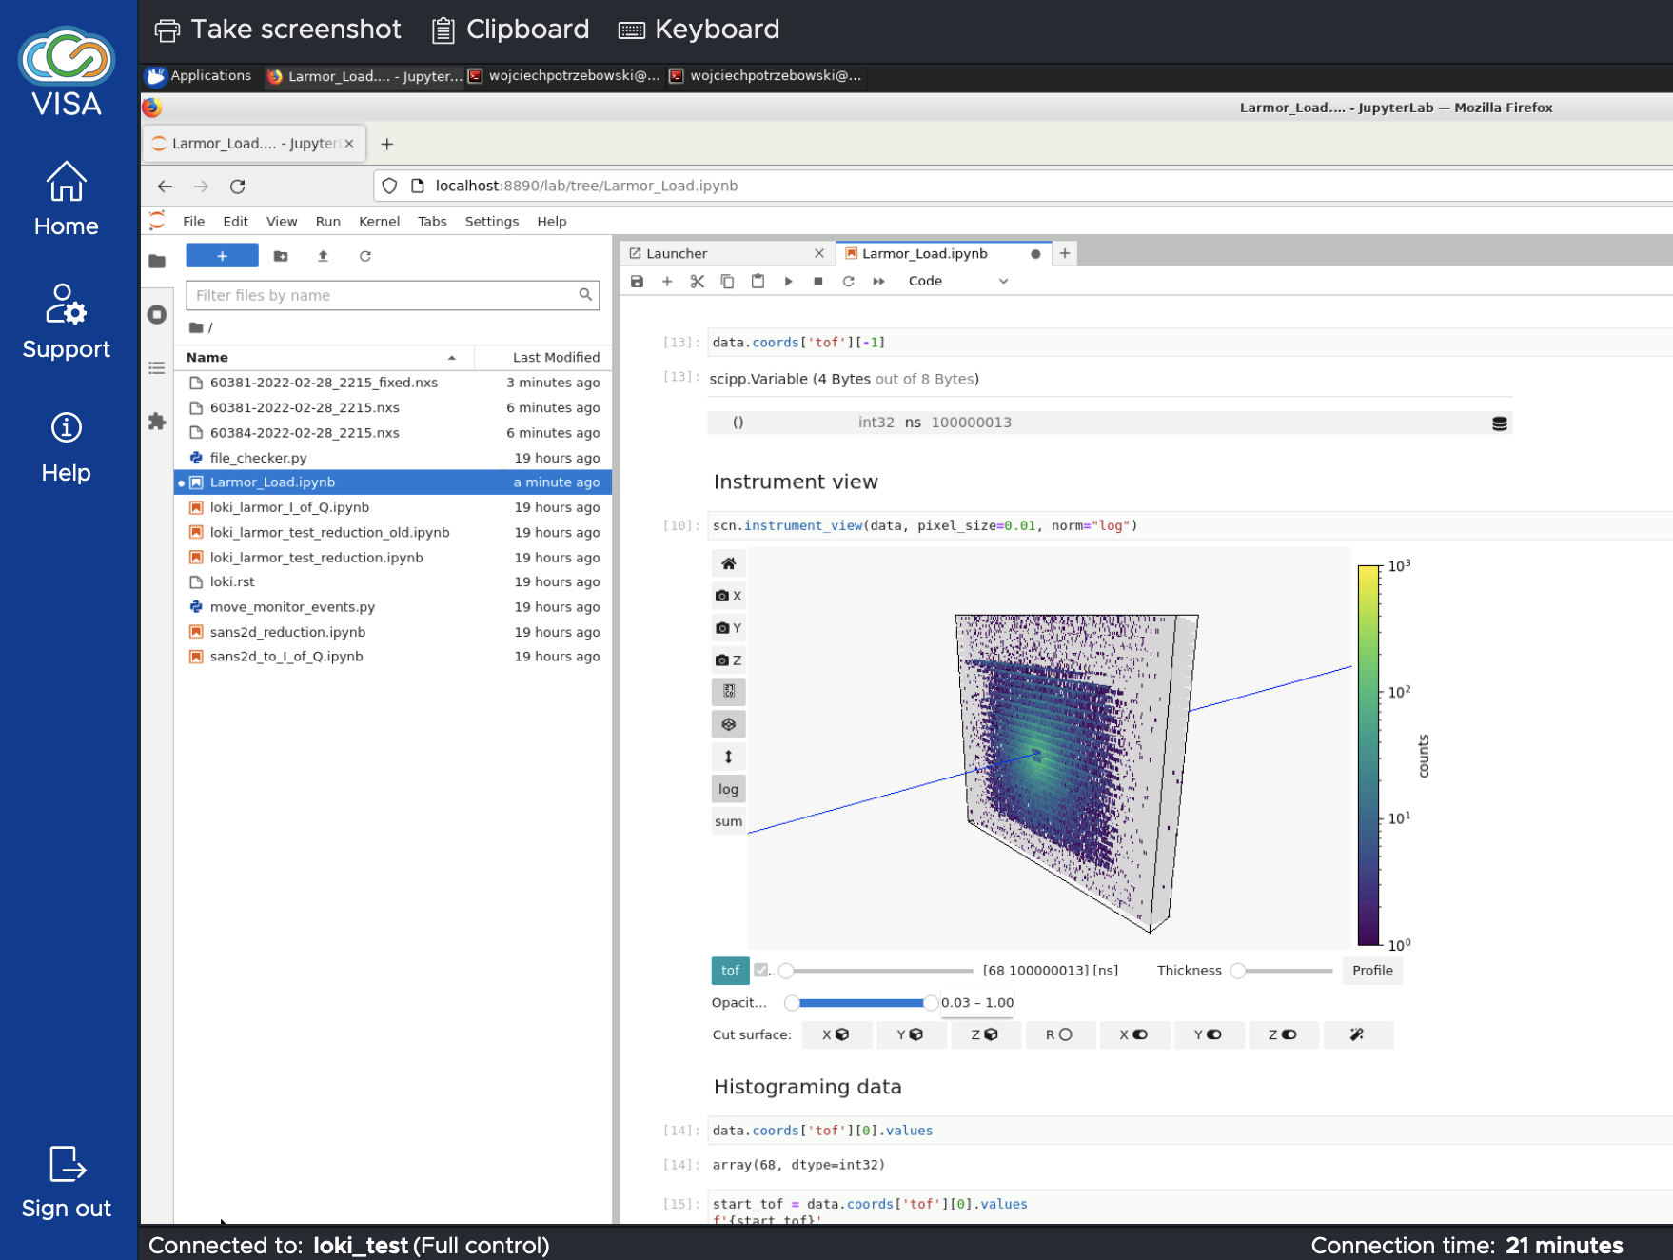
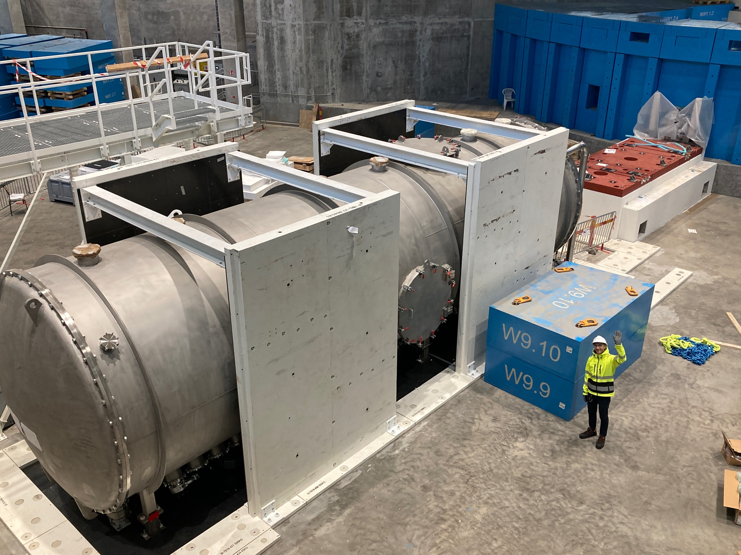
Detector and other equipment tests
IDS are involved
Instrument | Name | Where
LOKI | Wojtek | ISIS
CSPEC | Greg | ISIS
DREAM | Céline | ISIS
ODIN | Søren | LANL & JPARC
ESTIA | Andrew | AMOR@PSI
NMX | Justin | CERN
LoKI detector test at ISIS using VISA

Slide 9
DREAM data reduction
Piece of poster to be presented at Journées de la Diffusion Neutronique
Mantle: #wires=32, #strips=256

Slide 10
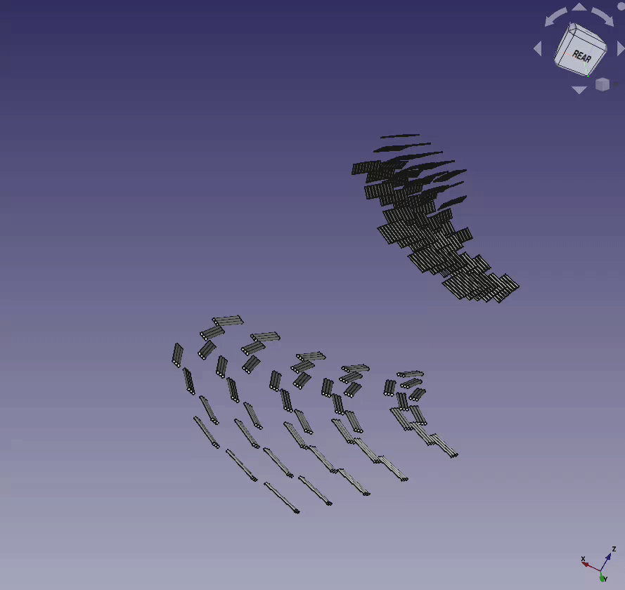
Other Instrument Updates
From: https://confluence.esss.lu.se/display/DMSC/09-2022
ODIN: Established monthly meetings on polarized imaging with Hal (part of weekly ODIN-IDS meetings).
YMIR: Planned next milestones for YMIR/Light-tomography (by ultimo Jan 2023).
ESTIA: Improving and interfacing to NICOS software on Selene guide alignment software with Artur Glavic & ECDC (preparing for CC in Jan)
DREAM: demonstration of VISA for instrument team
BIFROST: secondary flight-path model in STEP format for doing calibration → also developed McStas component for broadcasting simulated events to EFU (digital twin)
Easy science workshop at ISIS (diffraction, reflectometry, spectroscopy)

Slide 11
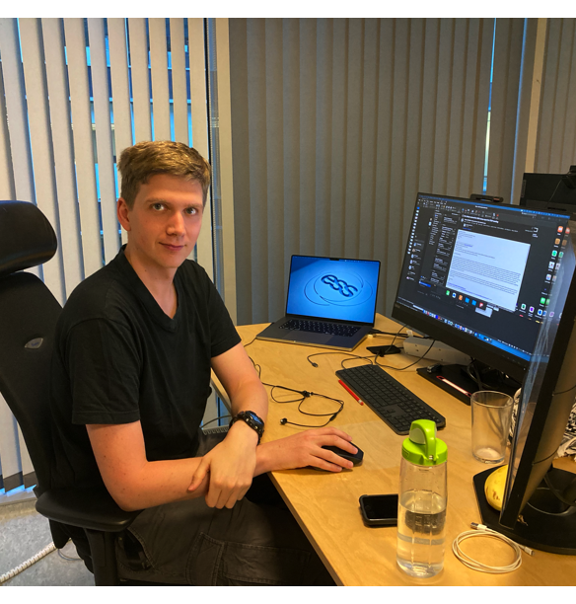
Concluding remarks
All five instrument data scientists play central roles in their instrument team and in DMSC
NMX post doc has sort of IDS role for NMX
Proposal: Do per instrument / IDS presentations at next STAP

