Slide 2
ECDC
Experiment Control and Data Curation Group
PRESENTED BY Tobias Richter

Slide 3
Current Staff and Profile
Who is who in ECDC (NSS)
 | Afonso | Morten | Jenny | Jonas | Matt | Kenan | Daniel | Torsten | Anders | Stefanos
Event Formation |  | ● | ●
Timing |  | ○ |  | ● |  |  |  | ● | ●
Streaming |  |  | ○ | ● | ● | ● | ● |  |  | ○
NICOS |  |  |  | ● | ● | ● | ● |  |  | ○
Device Integration |  |  |  | ● | ● |  |  | ● | ●
Testing | ● | ○ |  | ○ |  |  | ● |  |  | ●
Deployment | ● | ○ |  |  |  |  | ●
Instrument Contact |  |  |  |  | ● | ● |  |  |  | ●
10 Staff (+ Group Leader)
7 at DMSC
3 in Lund associated with Motion, SE and Ymir
1 recruitment open, but not active
NSS + TD staff news
New NSS Project Leader
New Detector Group Leader (since October)
ICS WP12 (EPICS for NSS) went up to 6 staff
ESS Reorg
Experiment control (NICOS)
Data streaming and file writing
ECDC
Event formation
Testing, deployment and Infrastructure
Device integration

Slide 4
Milestones
Checking Schedule Performance
Milestones are good. They provide a reference and calibration opportunity to evaluate our ability to deliver features on a schedule and/or our ability to make reliable plans.
Upcoming/ongoing activties to align
ICS – WP12, maybe CSI & PSS
Instrument installation schedule (including Choppers)
Sample Environment & Motion Control
Discussions started with
Detectors
DMSC
Parts of the organisation already in operational mindset and not committed to project deliveries (deliveries planned as late as possible or on best effort)
Key | Summary | Status | Due Date
ECDC-2774 | EPICS AD basic hamamatsu camera integration | Done | 15-09-2022
ECDC-2654 | user office usable to schedule sessions at Ymir / B02 | Done | 15-09-2022
ECDC-2653 | JSON file writer templates for six instrument created solely by the NeXus Constructor | Done | 16-09-2022
ECDC-2132 | Ymir: Ingest data into a SciCat with SciChat connectivity | Done | 30-09-2022
ECDC-2667 | TBL MB detector pre-BOT commissioning plans | In Progress | 30-09-2022
ECDC-2958 | DGRO backend monitoring and live configuration | Done | 30-09-2022
ECDC-2142 | Ymir: Demonstrate Kafka Authentication and Authorisation | In Progress | 15-10-2022
ECDC-2658 | have staging deployment target in the CUB for rollout testing | In Progress | 31-10-2022
ECDC-2959 | DGRO ring configuration script overhaul | Testing and Review | 31-10-2022
ECDC-2965 | hamamatsu camera integration with timing | In Progress | 15-11-2022
ECDC-2109 | Specific (NICOS UI and) engineering interfaces for ODIN ready | Selected | 30-11-2022
ECDC-2664 | VMM detector running at PSI/AMOR with live EFU processing | To Do | 30-11-2022
ECDC-2131 | Ymir: Use SpectrumScale storage with proposal based directory hierarchy and permissions | In Progress | 15-12-2022
ECDC-2966 | Ymir: Light Tomography - with data processing | To Do | 31-01-2023
ECDC-2745 | Motion control software for standard classes tested end-to-end with NICOS control and data acquisition | To Do | 28-02-2023

Slide 5
Standard Classes for Motion Control
NICOS – EPICS – PLC / Beckhoff
To simplify requirements and implementation common motion types have been classified and MCAG and ECDC have decided which functionality to implement at which level.
ECDC responsibility in the stack is displayed on the right:
Motion hardware is MCAG responsibility, as well as the TwinCat software layer
ECDC (WP12) support the PILS interface layer, including on in the software PLC level
Motion milestone for Ymir delayed to February.
Timing discussions and tests are getting more concrete (e.g. tomography).
PSS integration still theoretical, possibly to be demonstrated at Ymir at some point.
Beckhoff PLC
DAQ
Control System
NICOS
EPICS IOC
TwinCAT
Motors
Encoders
Switches & Sensors
Top Level
Hardware
PILS
PILS
ECDC Responsibility

Slide 6
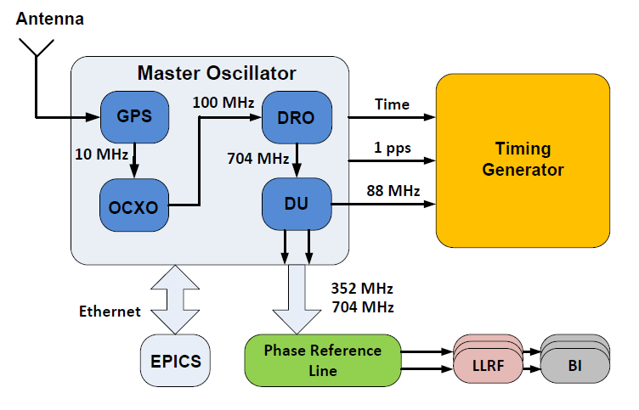
Timing System
GPS
Accuracy
NTP~10ms
PTP~10us
EVR~10ns
One Oscillator
IPC3
NTP server
Master oscillator
NTP IOC
1 Hz PPS System new second
88.0525 MHz
UTC time
IPC2
IPC1
EVG
PTP EVR IOC
EVR IOC
PCIe EVR1
PCIe EVR2
PTP GrandMaster
Sequencer
Optical fiber 14Hz & 88.0525 MHz
EVM Fanout (Repeater Hub)
Optical fiber 14Hz & 88.0525 MHz
TTL Input
TTL Output
Neutron Chopper
Setpoint
TDC
Medium accuracy PTP time stamped motion data
Motion controller
High accuracy EVR time stamped chopper data
EPICS forwarder
Low accuracy NTP time stamped meta data
Kafka cluster+NeXus+DMSC

Slide 7
Detectors
Renaissance
Progress on
Slow control of readout master
Readout master module available at Ymir, full integration (timing, connection to EFUs, etc under way)
To be complemented with some frontend rings in due course
Discussions with Detector Group restarted. In the future more testing and integration is to happen before any external beamtime.
Streaming and processing of simulated data started with McStas/Mats

Slide 8
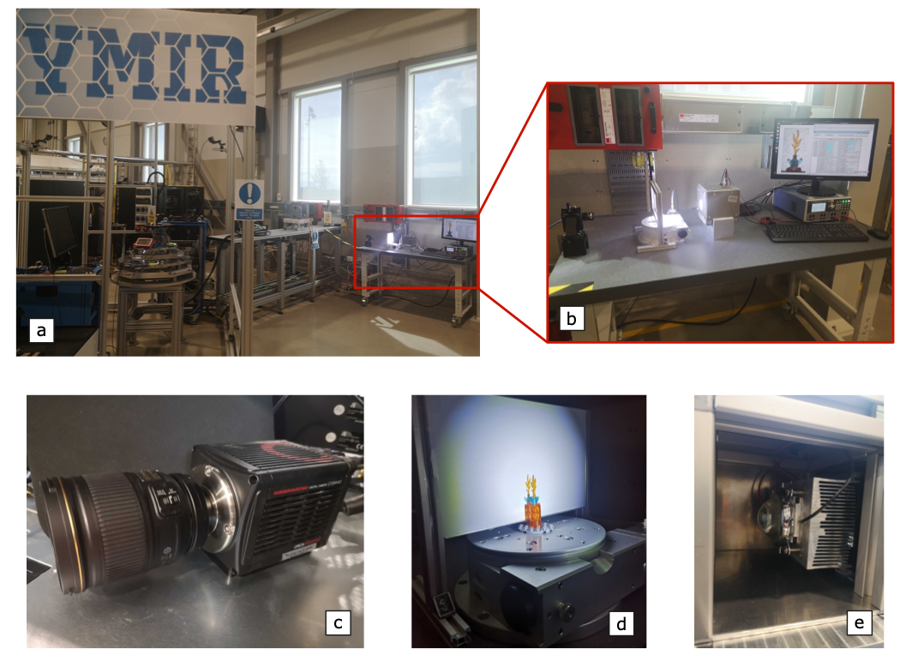
Ymir and Experiment Control
Progress Driver, Verification & Training Opportunity
Ymir Status
Network topology complete in principle, but with work arounds - not operations-grade. First consolidation workshop held.
SciCat integration complete with data appearing in SciCat after running “an experiment” at Ymir (see SWAP)
Hands-on work interaction at Ymir well received by instrument scientists
NICOS
Milestone for ODIN delayed, but progress is being made at Ymir with the light tomography setup (metrology system NeXus/NICOS integration and image visualisation pending)
Some alignment issues with NICOS upstream regarding usability and streaming/event based data acquisition.

Slide 9
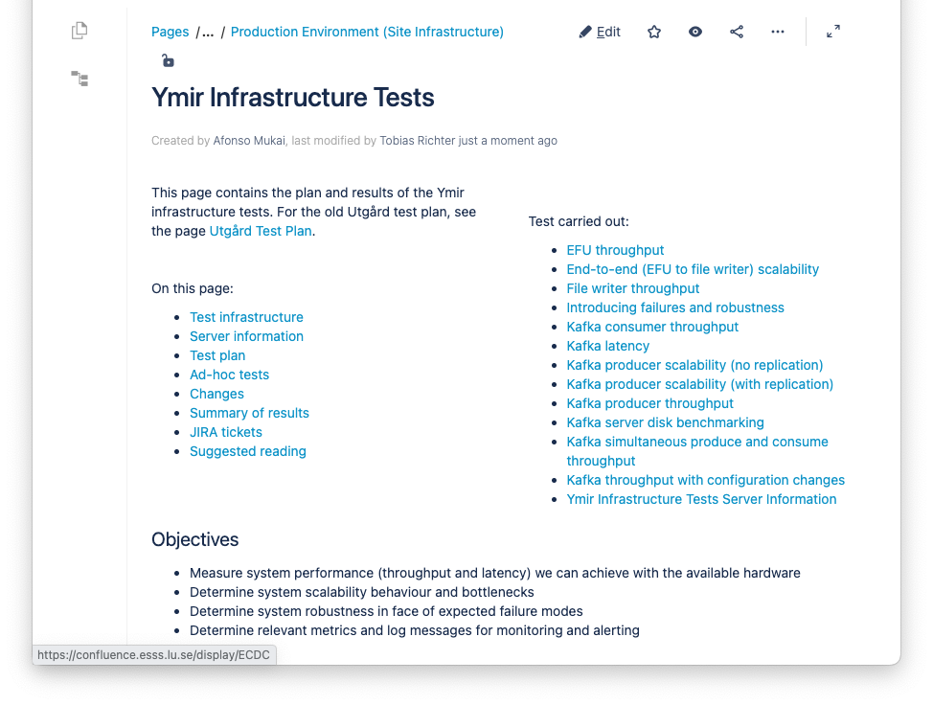
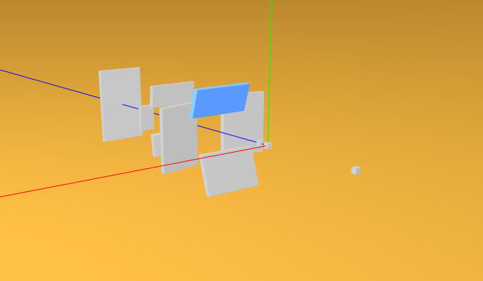
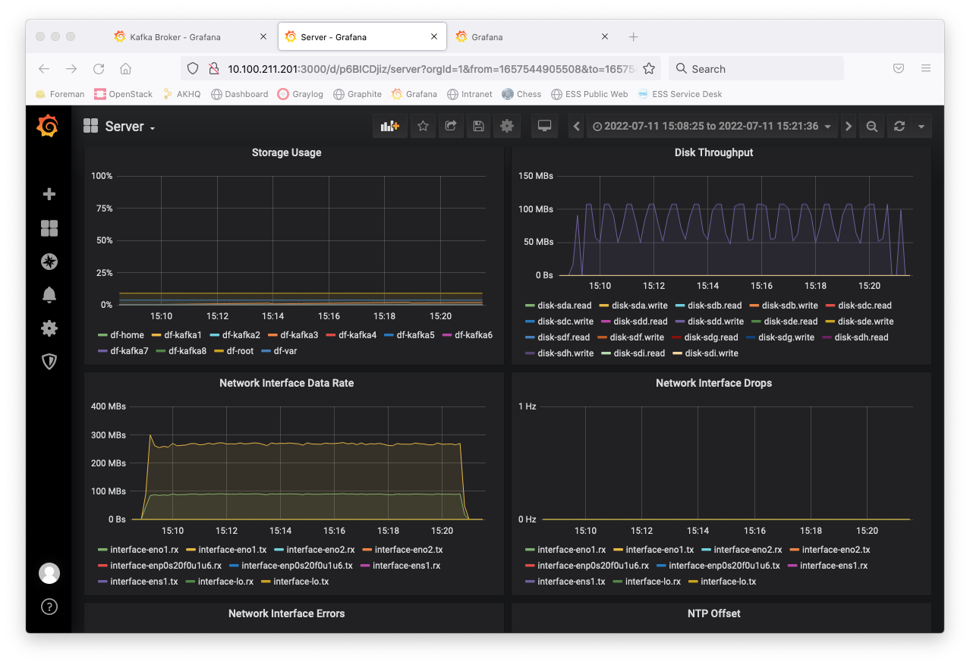
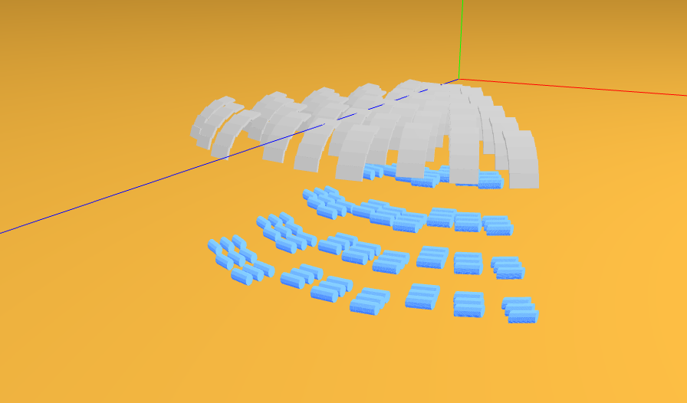
Data Streaming and File Writing
Authentication, Testing and NeXus Templates
The Ymir network allows access restrictions to be implemented and tested, so that users can only live reduce data for “their” experiment.
Hardware/infrastructure performance has been tested in a number of scenarios over summer. Full analysis is ongoing.
NeXus file writer templates have been generated. Discussions with instrument teams (including IDSs & DRAM) have started.

Slide 10
Concluding Remarks
General
NSS focus is set on instrument installations, cold commissioning has started (motion & choppers)
Good approach taken by new detector group leader. But too early to make predictions.
ECDC
Despite our testing and verification efforts no major unexpected issues found in ECDC scope. Will continue the search.

