Slide 1
Requirements Structure and Status for NCFE
Aurelien Ponton
Edgar Sargsyan

Slide 2
Product Breakdown structure (PBS) Levels L1 – L4 for the ESS Accelerator
L1
ESS FACILITY
ICS – INTEGRATED CONTROL SYSTEMS
‘CONTROLS’
SI – SITE INFRASTRUCTURE
‘CONVENTIONAL FACILITIES’
NSS
‘INSTRUMENTS’
RMHF – RADIOACTIVE MATERIALS HANDLING FACILITY
L2
ESS SYSTEMS ‘PROJECTS’
ACC – LINEAR ACCELERATOR (LINAC)
‘ACCSYS’
TS – TARGET STATION
‘TARGET’
ISrc
DTL
(DTL tanks)
SPK
(LWUs, CMs)
MBL
(LWUs, CMs)
HBL
(LWUs, CMs)
Beam to Target
L3
LEBT
RFQ
MEBT
HEBT*
A2T
LINAC SECTIONS
CRYOGENICS DISTRIBUTION
DmpL
(inc. beam dump)
PWRC*
PS*, HV Power Convertors*
ISS*
Ion Source
Specialties
BMD
Beam Magnets &, Deflectors (BM*)
EMR
EM Resonators
(Bunchers, RFQ, DTL tanks,
CMs)
PBI
Proton Beam Instrumentation
L4
SUPPLIED BY WP 6, 17
SUPPLIED BY WP 3
SUPPLIED BY WP 2, 3, 6, 17
SUPPLIED BY WP 3,4,5
SUPPLIED BY WP 7
Safety
DISCIPLINE SYSTEMS (Mapping to WBS Work Packages shown)
RFS
Radio Frequency
Systems
VAC
Vacuum
CRYO
Cryo Plant (ACCP) & Distribution (CDS*)
WTRC
Water Cooling
CNPW*
Conventional Power
SUPPLIED BY WP 8
SUPPLIED BY WP 12
SUPPLIED BY WP 11
SUPPLIED BY WP 16
SUPPLIED BY WP 15
SUPPLIED BY WP 13
To Be Determined or
To Be Agreed Upon
*PBS definition
CM =CryoModule
HEBT=High Energy Beam Transport
LWU=Linac Warm Unit
Date: 27-Feb-2015
Prepared by: E.Tanke, ESS-ACCSYS
CHESS#: ESS-0008904 R4

Slide 3
Product Breakdown structure (PBS) Levels L4 - L5 for the ESS Accelerator
PWRC*
Power Convertors*
ISS*
Ion Source
Specialties
BMD
Beam Magnets &, Deflectors (BM*)
EMR
EM Resonators
(Bunchers, RFQ, DTL tanks,
CMs)
PBI
Proton Beam Instrumentation
L4
DISCIPLINE SYSTEMS (Mapping to WBS Work Packages shown)
SUPPLIED BY WP 6, 17
SUPPLIED BY WP 3
SUPPLIED BY WP 2, 3, 6, 17
SUPPLIED BY WP 3,4,5
SUPPLIED BY WP 7
L5
PS
WP 6, 17
HVPC
WP17
Mechanical Supports
Technical Labs
Mechanical Supports
Technical Labs
Mechanical Supports
Technical Labs
BCM
BLM
‘COMPONENTS’
(includes WP contracted products & services)
EM
BPM
SC Cavities
SPK
SC Cavities
MBL
FC
SC Cavities
HBL
ID
(Insertable Dump)
BSM
PM (invasive)
NPM
(non-invas.)
TD
(Target Diagn.)
Technical Labs
L4
RFS
Radio Frequency Systems
VAC
Vacuum
CRYO
Cryo Plant (ACCP) & Distribution (CDS*)
WTRC
Water Cooling
CNPW*
Conventional Power
DISCIPLINE SYSTEMS (Mapping to WBS Work Packages shown)
SUPPLIED BY WP 8
SUPPLIED BY WP 12
SUPPLIED BY WP 11
SUPPLIED BY WP 16
SUPPLIED BY WP 15
L5
LLRF
WP8
RFRL
WP8
Mechanical Supports
Technical Labs
Technical Labs
Collimators & Gamma Blockers
‘COMPONENTS’
(includes WP contracted products & services)
CIC
WP8
RFMOWP8
Beam
Pipes
SUPPLIED BY WP 6
L5 requirements are specification documents and are not stored in DOORS
AMPL
WP8
AMPH
WP8
FE Collimators
WP3
Linac Dump
WP??
Technical Labs
RFDS
WP8
*PBS definition
CM =CryoModule
HEBT=High Energy Beam Transport
LWU=Linac Warm Unit
Date: 27-Feb-2015
Prepared by: E.Tanke, ESS-ACCSYS
CHESS#: ESS-0008904 R4

Slide 4
Responsibility for Authoring of Requirements
Top-down:
Accelerator Integration Group (AIG)
i.e., the Lead Engineers
Interface:
The interfacing Work Packages
In the case of IKC, this means the contracted institution
Thus:
Top-down requirements will be authored by ESS
For delivery to WP3
Interface requirements will be authored by WP3 and respective WPs
For delivery to ESS AIG

Slide 5
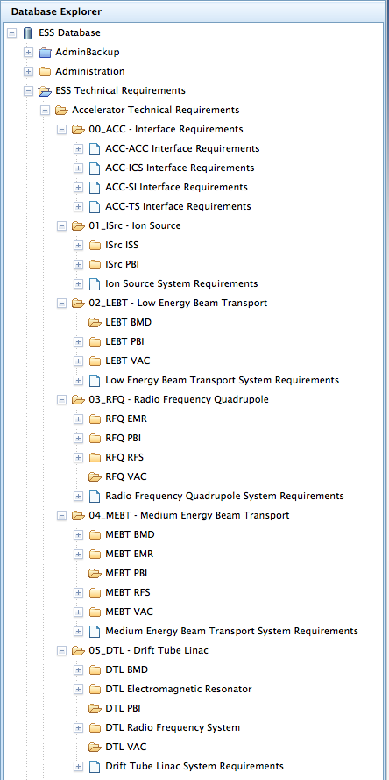
Requirements in DOORS
Interface requirements written by interfacing WPs (Interface A – Interface B) in a common agreement
Examples:
EMR (WP3) – WTRC (WP16)
BMD (WP3) – PWRC (WP17)
Top-down requirements written by Lead Engineers
Linac section | L3-System | L4- ISS | L4- PBI | L4-BMD | L4-EMR | L4-RFS
Ion Source | ✔ | ✔ | ✔ | n/a | n/a | n/a
LEBT | ✔ | n/a | ✔ | to do | n/a | n/a
RFQ | ✔ | n/a | ✔ | n/a | ✔ | ✔
MEBT | ✔ | n/a | to do | ✔ | ✔ | ✔
DTL | ✔ | n/a | to do | ✔ | ✔ | ✔

