Slide 1
Warm Linac interface meeting – Drift Tube Linac
Francesco Grespan – Paolo Mereu

Slide 2
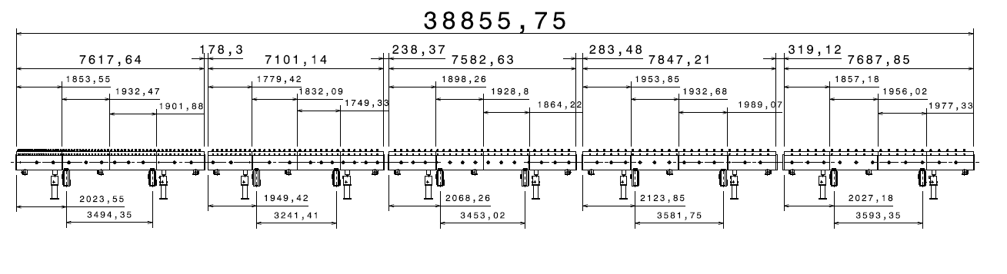
DTL layout

Slide 3
Buildings and Site Infrastructure interfaces
DTL workshop requirements
Transport and installation in the tunnel TO BE DEFINED

Slide 4
Survey & Alignment interfaces
Alignment of
Needs
Drift Tubes inside module (workshop)
Module to Module (workshop)
Tank to Tank (tunnel)
Module support or table and stable laser network in the workshop
Laser network and Alignment support (isostatic fine regulation to couple the modules)
Laser network in the tuner

Slide 5
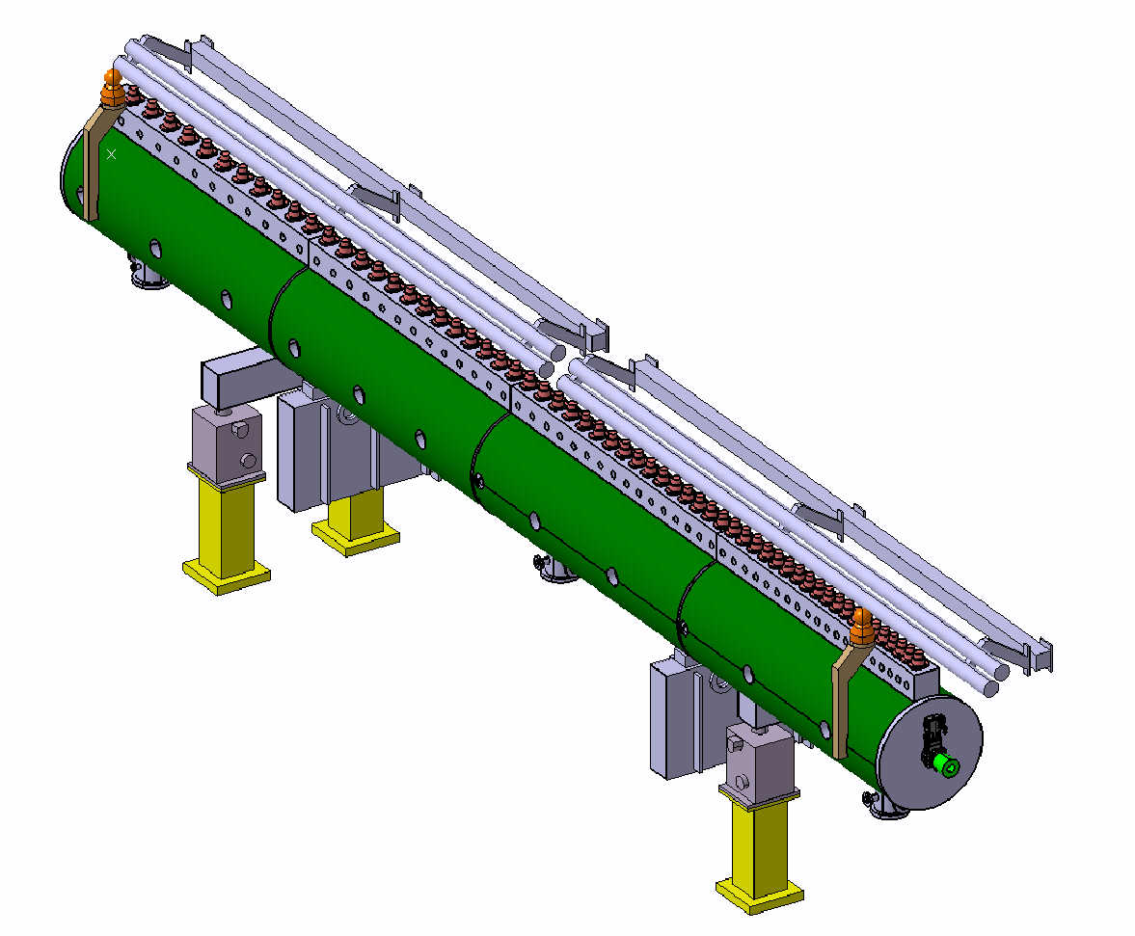
Survey & Alignment interfaces

Slide 6
Conventional Power, Cables, Racks interfaces
Rack for Steerer power supply: 3Hor + 3Vert per tank
Rack for Movable tuners motor controller
Power for water skid: 5 pumps + 1 redundancy

Slide 7
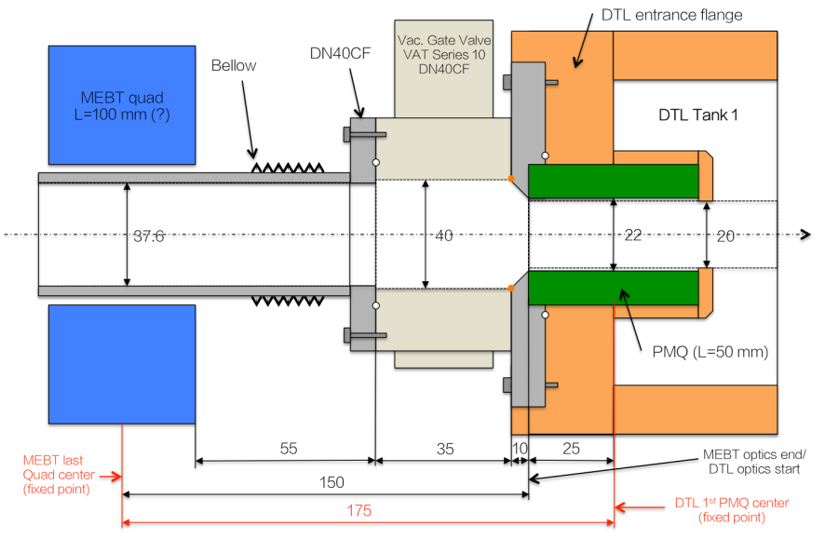
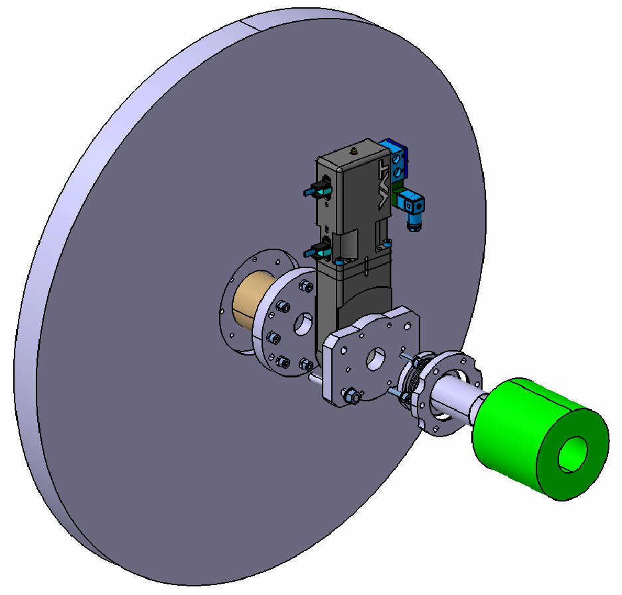
WP2 - Beam Physics interfaces

Slide 8
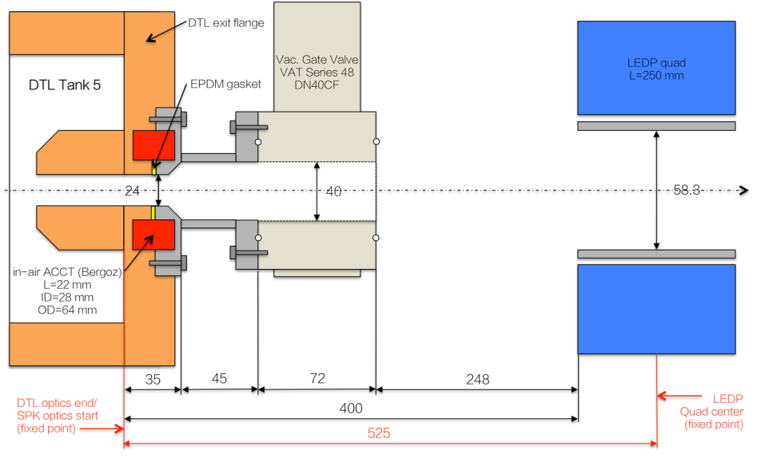
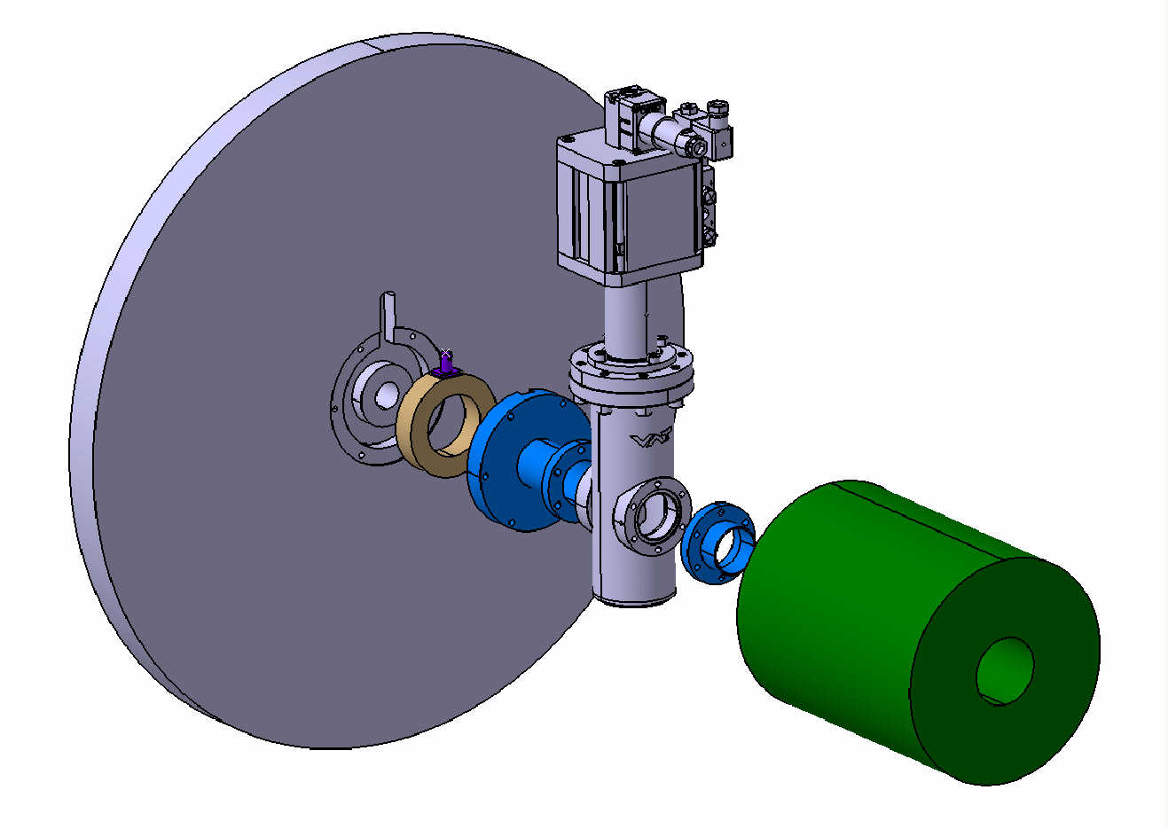
WP2 - Beam Physics interfaces
In-air BERGOZ ACCT 55x91x22

Slide 9
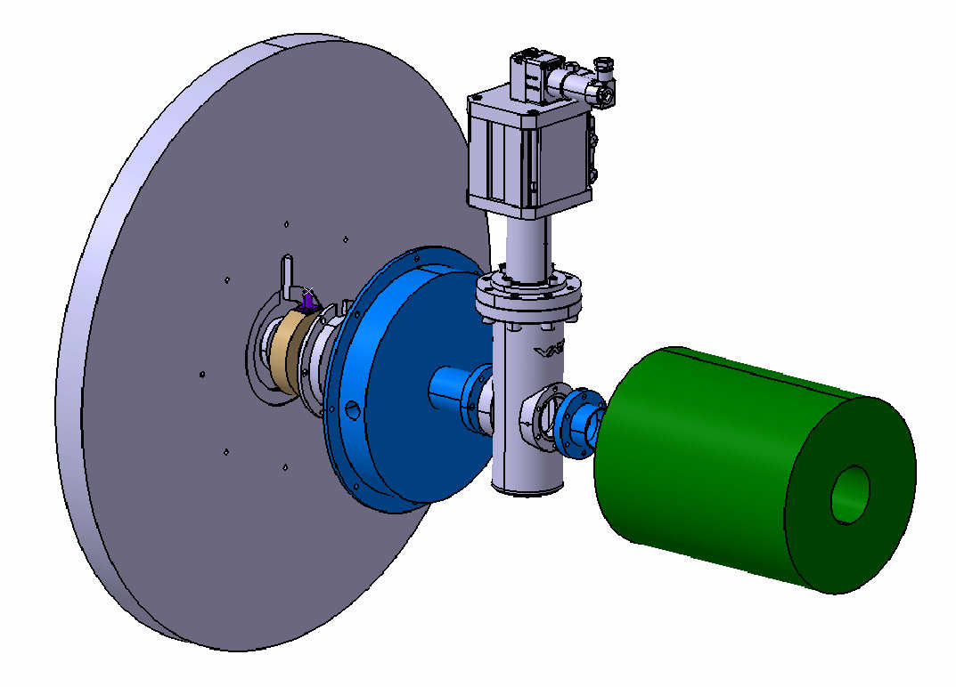
WP2 - Beam Physics interfaces
In-vacuum BERGOZ ACCT 55x91x22

Slide 10
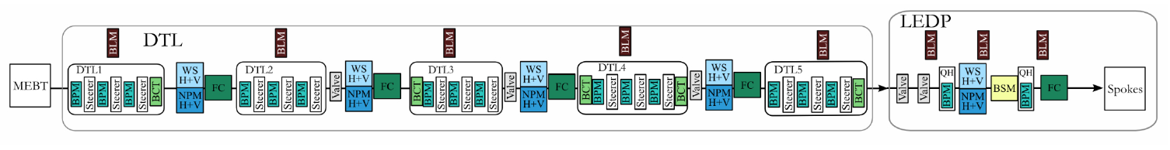
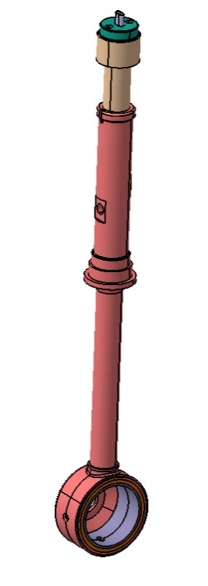
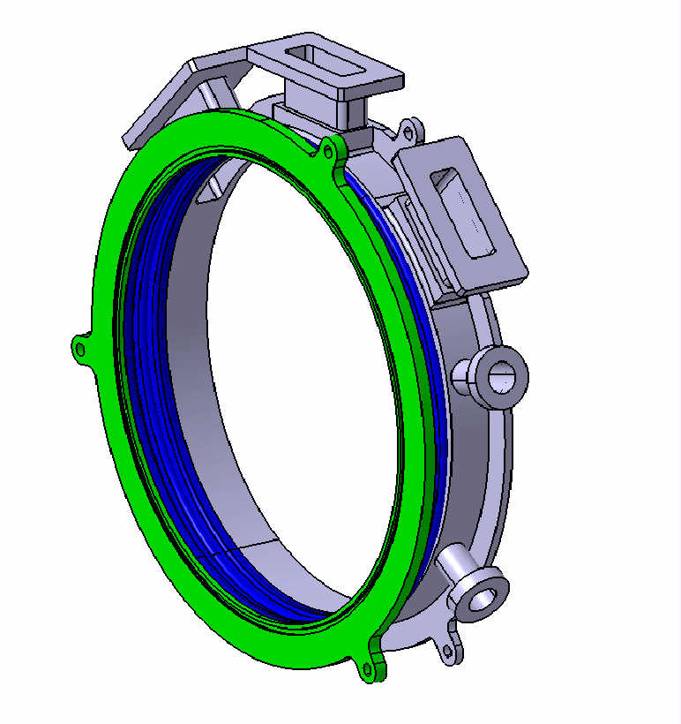
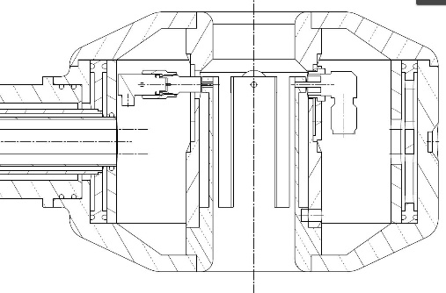
Proton Beam Instrumentation interfaces
Element/Tank | T1 | T1 | T1 | T2 | T2 | T2 | T3 | T3 | T3 | T4 | T4 | T4 | T5 | T5 | T5
Steerer X [DT] | 3 | 21 | 41 | 1 | 11 | 23 | 2 | 12 | 22 | 2 | 10 | 18 | 1 | 7 | 15
Steerer Y [DT] | 5 | 23 | 43 | 3 | 13 | 25 | 5 | 14 | 24 | 4 | 12 | 20 | 3 | 9 | 17
BPM [DT] | 17 | 37 | 59 | 9 | 21 | 33 | 10 | 20 | 28 | 8 | 16 | 24 | 5 | 13 | 21

Slide 11
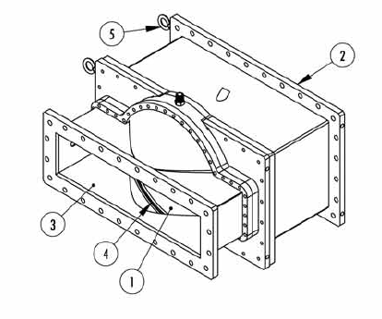
Radio Frequency (RFDS) interfaces
RF windows at ¼ L and ¾ L of each tank (Mega Industries design)

Slide 12
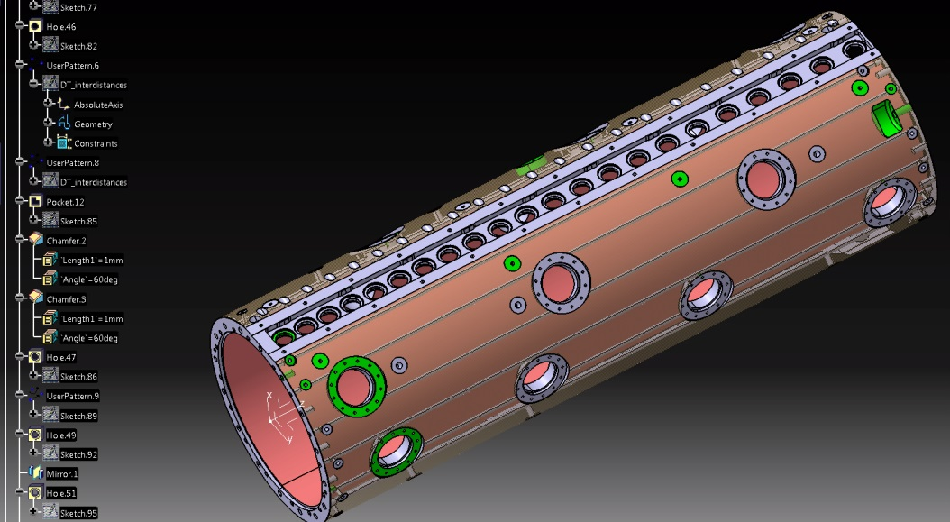
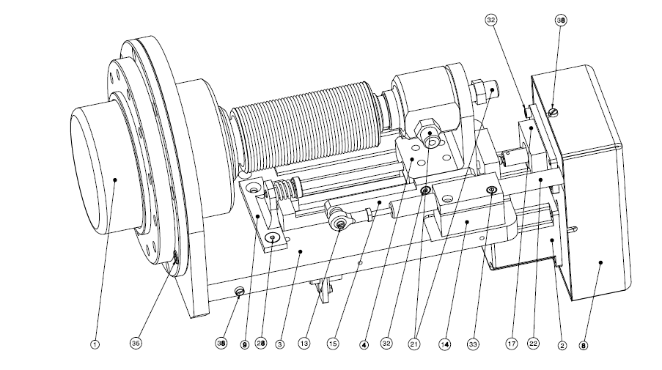
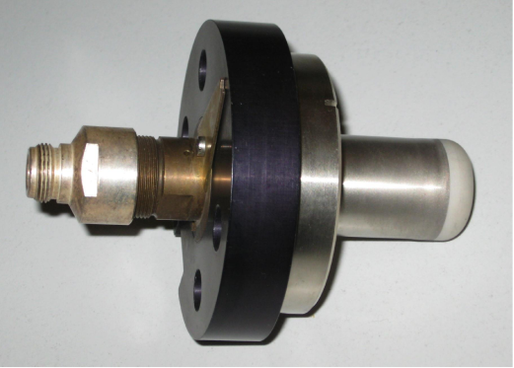
Radio Frequency (LLRF) interfaces
9 RF Pick-ups per tank (N-connector)
3 movable tuners per tank (up to the motor controller)

Slide 13
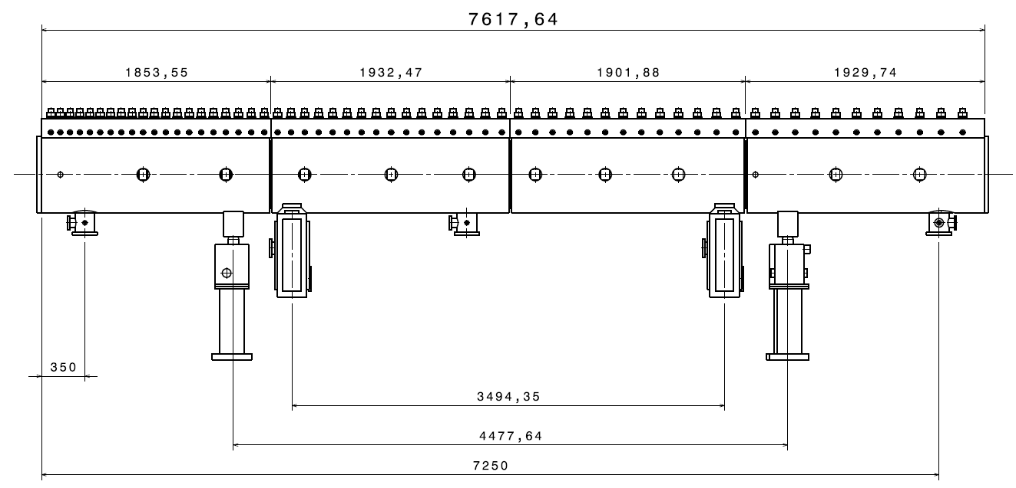
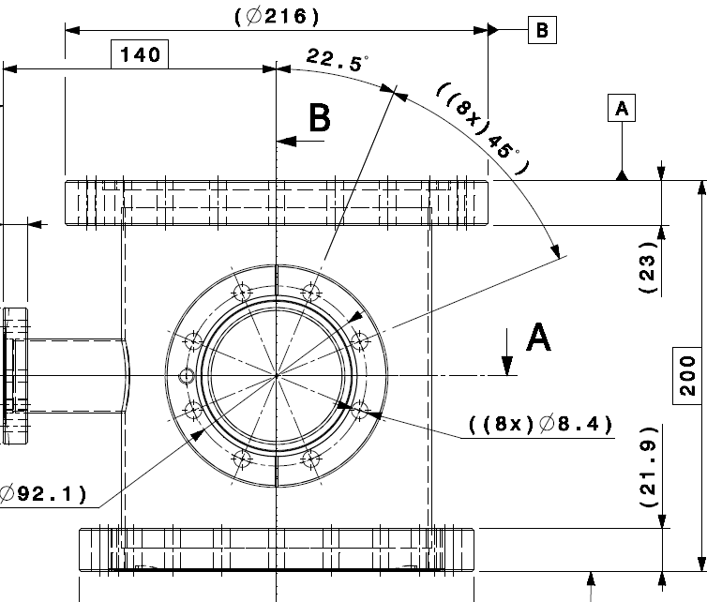
Vacuum interfaces
3 Vacuum manifolds

Slide 14
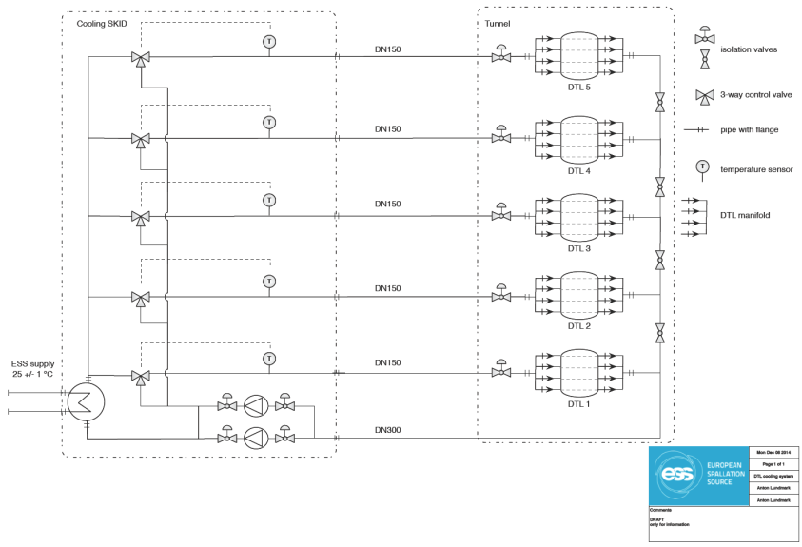
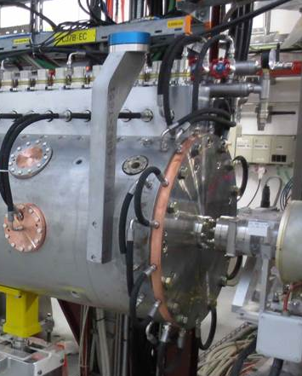
Water Cooling interfaces
Redundancy pump (Valves not represented)
Cooling system data
Power dissipation: 70kW = 950kW × 1.25(margin) × 4ms × 14Hz
Cavity water temperature (inlet: 30°C, dT: 0.5°C)
Water distribution
Water Flow (≈100 mc/h)
1 water skids provided by LNL, with 5 three-way valves, 5 pumps.
2 pipes per tank (DN150)
DTL distribution
Modules: 2 series of 2 modules each
Tuners: 2 groups
Post couplers: 2 groups
DTs: all in parallel (?)
Steerer: all in parallel
End walls: 2
RF couplers: 2

