Slide 1
Interface Workshops for ESS Warm-Linac
Benjamin Cheymol
www.europeanspallationsource.se
24 April 2015

Slide 2
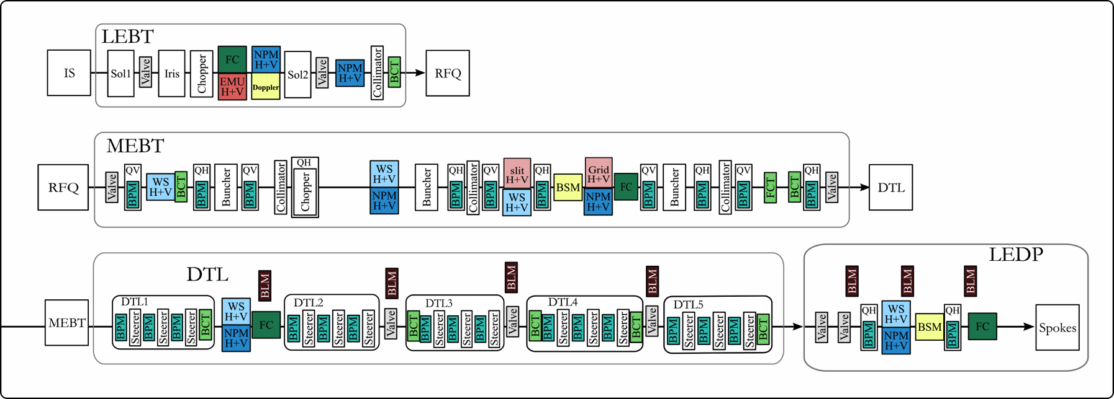
BI layout in warm linac (proposal)
Full suit of diagnostic to measure the 6d phase space of the beam
Mechanical integration of diagnostic is challenging due to lack of space in low energy part of accelerator
Fortunately labs involve in warm linac provide a lot of help

Slide 3
Interfaces WP7-WP3
Difficult to clearly separated the work as WPs are defined
Easier and simpler to separate deliverables from partner labs and from ESS rather than WP3-WP7 deliverables
In this case the interfaces can be defined as
Mechanical interfaces (i.e. flanges)
Signal connector
Note: MEBT not covered in the presentation, Bilbao to deliver a full integrated MEBT

Slide 4
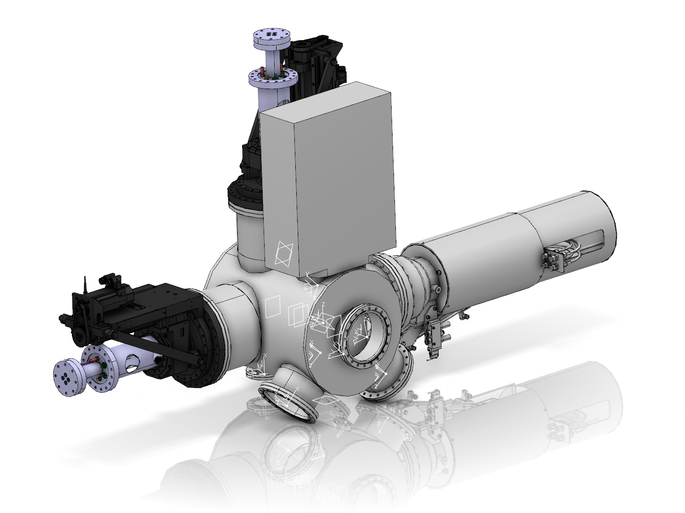
LEBT
Diagnostic (EMU and FC)
Interface tank-chopper
Interface tank-iris
Vacuum pumps (defined by WP12)
Diagnostic box between the 2 solenoids (EMU, FC, NPM, Doppler) including chopper
Design done at ESS with input from INFN Catania
Interfaces: flanges

Slide 5
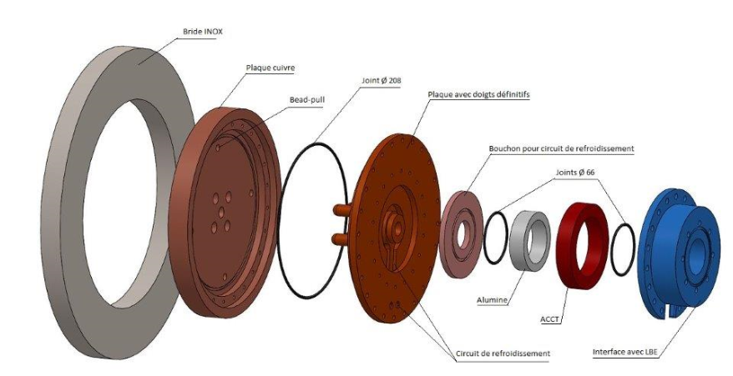
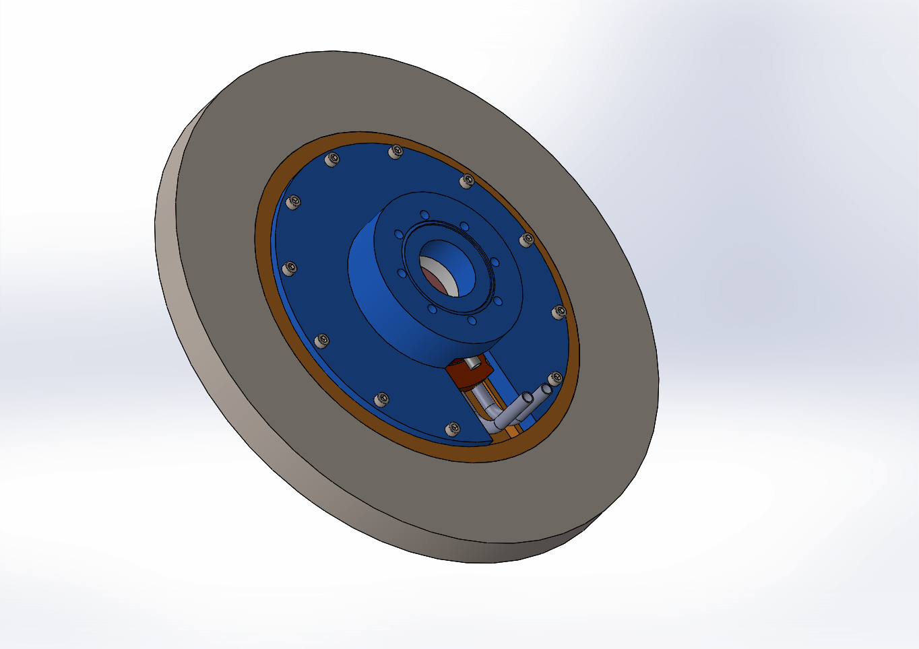
LEBT
Second BCT integrated in RFQ flange, 3 Labs involve:
INFN Catania to design the full flange with accessories based on CEA input
ESS to provide parameter for the BCT
Preliminary design of the RFQ entrance flange (courtesy of CEA Saclay)

Slide 6
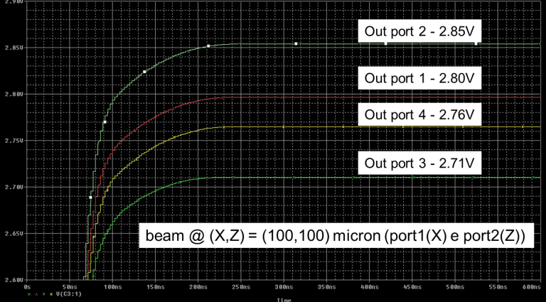
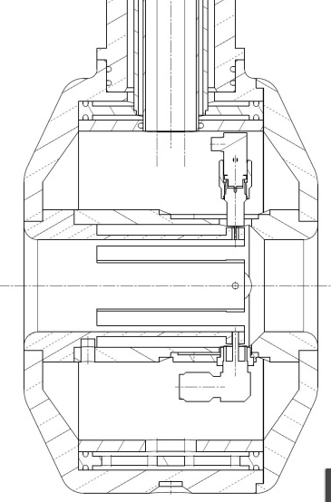
DTL
BPM and BCT:
Integrated in empty drift tube
INFN Legnaro agreed to design and built as IKC the BPMs and integrated the BCT in the drift tube (as well as the cabling outside the DTL tanks)
Electronic provided by ESS based on common design for all accelerator
In these cases interfaces are the connector outside the DTL tanks.
DT & BPM machining@assembly (INFN TO-LNL)
BPM EM simulations
Slides and work from M. Poggi, F. Grespan and P. Mereu

Slide 7
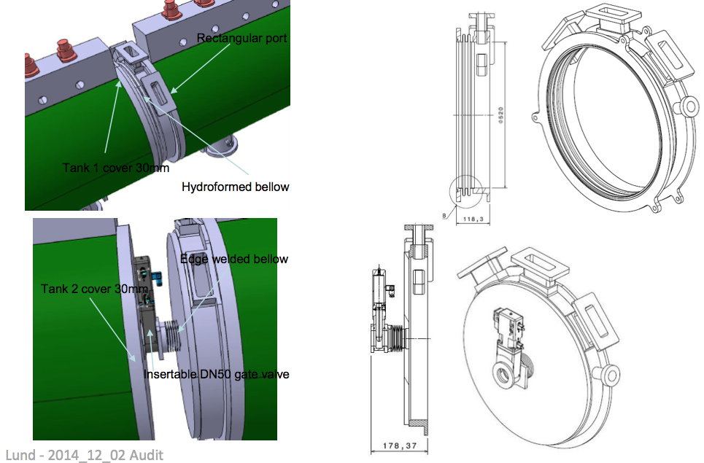
DTL
WS and FC:
To be installed between the DTL tanks
Design of the intertank done by INFN Legnaro
Agreement on flange sizes and position with ESS
Instrument delivered by Bilbao.
ESS intertank design (courtesy of P. Mereu)

Slide 8
Conclusion
For LEBT and DTL, interfaces have been identified
Some need to be documented in more details
For MEBT interfaces has to be defined within the IKC agreement similar solutions as DTL interfaces might be a good option.

