Slide 1
Interface Workshop ESS Warm-Linac
Marcelo Juni Ferreira
Specialized Technical Service - Vacuum
www.europeanspallationsource.se
23 April 2015

Slide 2
Ion Source + LEBT
System A |  |  |  |  | System B
Level | Interface A | Discipline A | Contact A |  | Level | Interface B | Discipline B | Contact B
L3 | ACC.IS | Vacuum | Marcelo/ESS |  | L3 | ACC.LEBT | Vacuum | Marcelo/ESS
L4 | ACC.IS.ISS | Ion Source | Luigi/INFN |  | L4 | ACC.IS.VAC | Vacuum | Marcelo/ESS
L4 | ACC.IS.VAC | Vacuum | Marcelo/ESS |  | L4 | ACC.IS.CNPW | Cables + power | Lea + Frithoff/ESS
L4 | ACC.IS.VAC | Vacuum | Marcelo/ESS |  | L2 | SI | Site Infrastructure | Dave/ESS
Level 3 top-down
User Defined ID | Name | Description | Clarification | Verify Method | Units | Max.
ISRC-VAC-L3-1 | Operating pressure | The maximum operating pressure* measured in the ISrc shall not exceed 1e-3 mbar | *With nominal proton beam current. Operating pressure is the true pressure and not a gas specific equivalent pressure. The gauge used to measure pressure shalll be calibrated . | measurement | mbar | 1,E-03
ISRC-VAC-L3-2 | Mass of Ionising gas | The mass of the ionising gas in the ISrc shall not exceed 28 g/mol. |  | inspection | g/mol | 28
LEBT-VAC-L3-3 | LEBT-ISRC-VAC Vacuum mechanical requirement | A non-magnetic stainless steel hydroformed type bellows shall be provide having a minimum stroke of +/- 5 mm, a minimum annular rotation of +/- 0.5 degree in all directions and a minimum offset of +/-2 mm and a fatigue life of at least 2,000 cycles | Bellows shall be installed after the gated valve at ISRC-LEBT-2 interface requirement | inspection
LEBT-VAC-L3-1 | Operating pressure | The maximum operating pressure* measured in the LEBT shall not exceed 6e-5 mbar | *With nominal proton beam current. Operating pressure is the true pressure and not a gas specific equivalent pressure. The gauge used to measure this pressure shalll be calibrated. | Measurement | mbar | 6,E-05
LEBT-VAC-L3-2 | Mass of Ionising gas | The mass of the ionising gas in the LEBT shall not exceed 28 g/mol. |  | inspection | g/mol | 28
LEBT-VAC-L3-3 | LEBT-RFQ Vacuum mechanical requirement | A non-magnetic stainless steel hydroformed type bellows shall be provide having a minimum stroke of +/- 5 mm, a minimum anular rotation of +/- 0.5 degree in all directions and a minimum offset of +/-2 mm and a fatigue life of at least 2,000 cycles | Bellows shall be installed after the gated valve at LEBT-RFQ-2 interface requirement | inspection

Slide 3
Ion Source + LEBT
Level 3 interface
User Defined ID | Name | Description | Clarification | Verify Method | Units | Max.
ISRC-LEBT-1 | ISRC-LEBT vacuum mechanical interface | The downstream flange set in between the ISRC and LEBT shall not exceed DN160CF with one flange rotatable. | ISO/TS 3669-2 | Inspection | mm | 159
ISRC-LEBT-2 | ISCR-LEBT vacuum interface | A pneumatically operated gate valve DN160CF in the ISCR upstream side shall installed in accordance with the requirements of the Vacuum Handbook. |  | Inspection | mm | 159
LEBT-RFQ-1 | LEBT-RFQ vacuum mechanical interface | The upstream flange of the RFQ shall be the mechancial interface between the LEBT and RFQ. |  | Inspection
LEBT-RFQ-2 | LEBT-RFQ vacuum interface | A pneumatically operated gate valve DN160CF in the LEBT upstream side shall installed in accordance with the requirements of the Vacuum Handbook. | ISO/TS 3669-2 | Inspection | mm | 159
LEBT-RFQ-3 | LEBT-RFQ vacuum gas throughtput interface | The ionisation gas throuhgthput downstream the LEBT shall not exceed 2e-3 mbar.l/s |  | inspection | mbar.l/s | 2,E-03

Slide 4
Ion Source + LEBT
Level 4
From ESS: vacuum diagram, wiring and control signals, list of equipment (following the ESS Vacuum Handbook and standardization model),
Written by the in kind: description and auxiliary documents (manuals , maintenance, procedures and certificates, leak test certificate and vacuum reports),

Slide 5
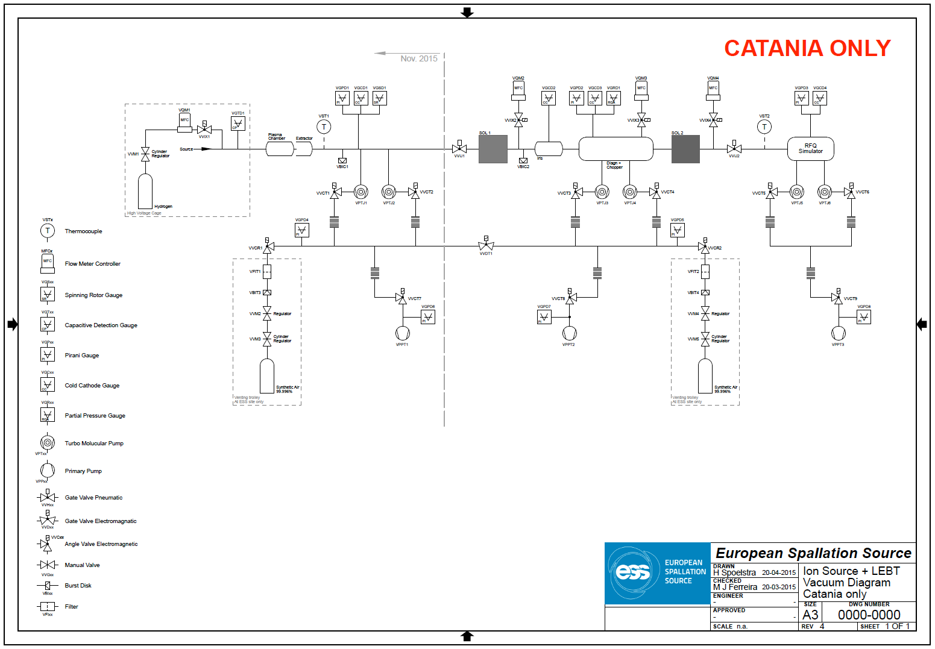
Ion Source + LEBT

Slide 6
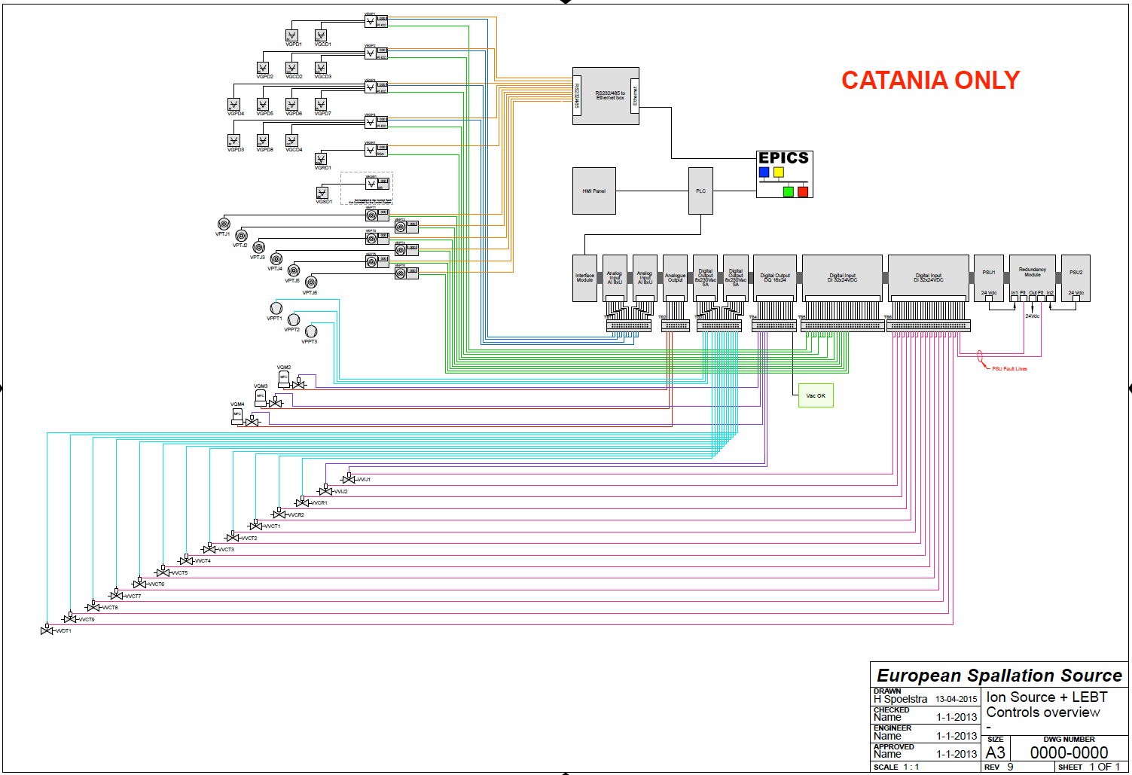
Ion Source + LEBT

Slide 7
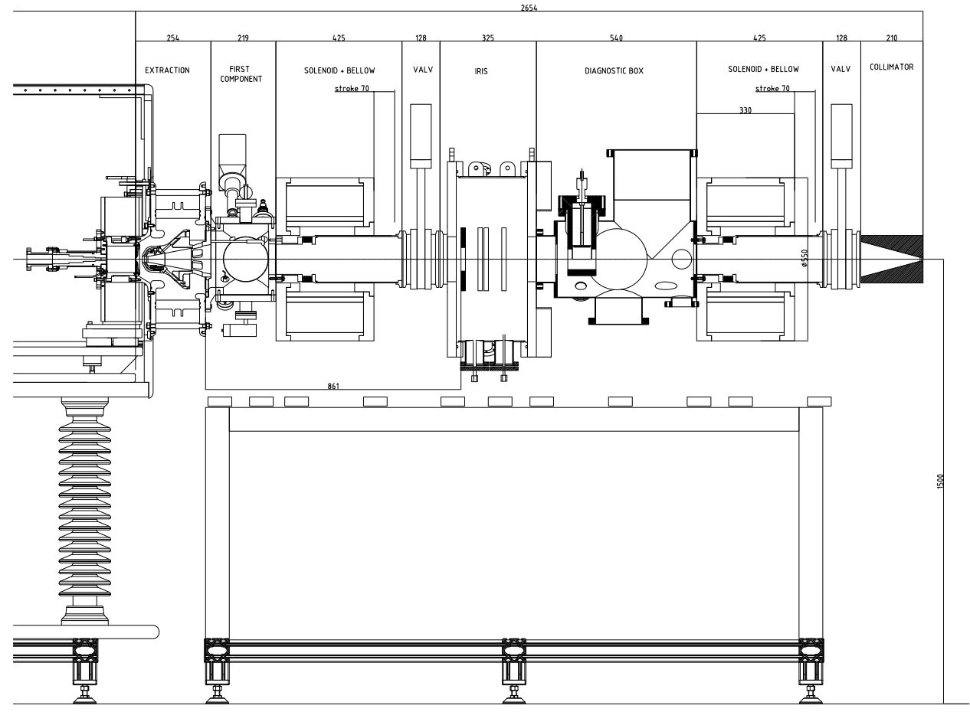
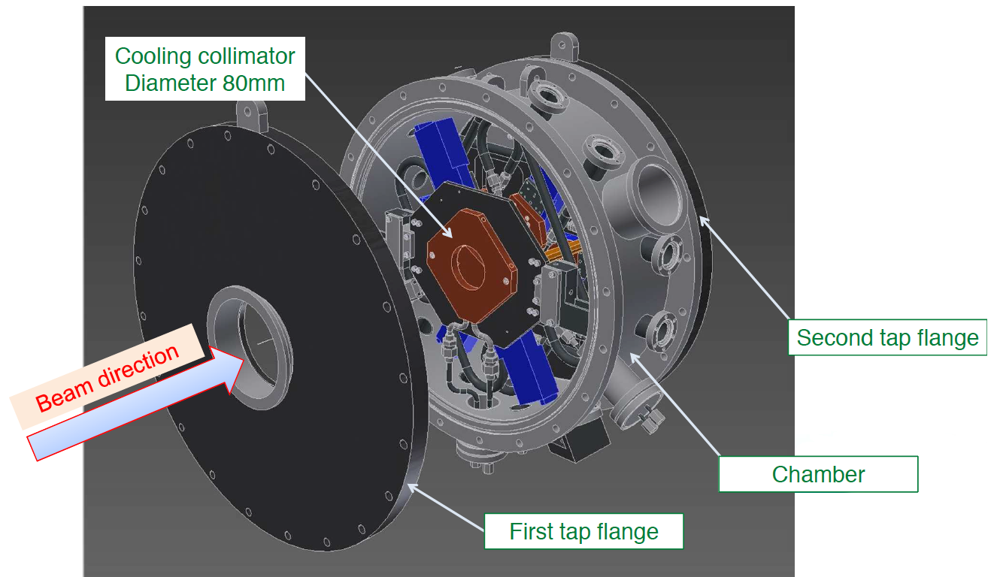
Ion Source + LEBT
Points to be worked:
Mechanical interface MEBT – RFQ,
Iris in vacuum water cooling connections,
Cables length equipment – rack,

Slide 8
RFQ
System A |  |  |  |  | System B
Level | Interface A | Discipline A | Contact A |  | Level | Interface B | Discipline B | Contact B | Interfaces | Representation | Baselines | Requirements
L3 | ACC.RFQ | Vacuum | Marcelo/ESS |  | L3 | ACC.LEBT | Vacuum | Marcelo/ESS | Flow rate | DOORS, ref. doc/spec |  | Vacuum simulations for the integrated Warm Linac
L3 | ACC.RFQ | Vacuum | Marcelo/ESS |  | L3 | ACC.MEBT | Vacuum | Marcelo/ESS | Flow rate | DOORS, ref. doc/spec |  | Vacuum simulations for the integrated Warm Linac
L4 | ACC.RFQ.EMR | RFQ | Bruno/CEA |  | L4 | ACC.RFQ.VAC | Vacuum | Marcelo/ESS | Flanges for vacuum instrumentation, isolation valves | Doc/spec, drawing |  | Number + type of pumps & isolation valves
L4 | ACC.RFQ.VAC | Vacuum | Marcelo/ESS |  | L4 | ACC.RFQ.WTRC | Water Cooling | Anton/ESS | Cooling of pumps? | Doc/spec
L4 | ACC.RFQ.VAC | Vacuum | Marcelo/ESS |  | L4 | ACC.RFQ.CNPW | Cables | Lea/ESS | Connector, cable types + routing | Doc/spec
L4 | ACC.RFQ.VAC | Vacuum | Marcelo/ESS |  | L2 | SI | Site Infrastructure | Dave/ESS | Instrument air for valve actuators | Doc/spec |  | Air pressure
Level 3 top-down
User Defined ID | Name | Description | Clarification | Verify Method | Units | Max. | Development Phase
RFQ-VAC-L3-1 | Operating pressure | The maximum operating pressure over 75% of the length of the RFQ shall not exceed 5e-7 mbar. | Operating pressure is the true pressure and not a gas speciific equivalent pressure. The gauge used to measure this pressure shalll be calibrated. | measurement | mbar | 5,0E-07 | operation

Slide 9
RFQ
Level 3 interface
User Defined ID | Name | Description | Clarification | Verify Method | Units | Max. | Development Phase
LEBT-RFQ-1 | LEBT-RFQ vacuum mechanical interface | The upstream flange of the RFQ shall be the mechancial interface between the LEBT and RFQ. |  | Inspection |  |  | operation
LEBT-RFQ-2 | LEBT-RFQ vacuum interface | A pneumatically operated gate valve DN160CF in the LEBT upstream side shall installed in accordance with the requirements of the Vacuum Handbook. | ISO/TS 3669-2 | Inspection | mm | 159 | operation
LEBT-RFQ-3 | LEBT-RFQ vacuum gas throughtput interface | The ionisation gas throuhgthput downstream the LEBT shall not exceed 2e-3 mbar.l/s |  | inspection | mbar.l/s | 2,00E-03 | operation
RFQ-MEBT-1 | RFQ-MEBT vacuum and mechanical interface | The downstream flange between MEBT and RFQ shall be a DN40CF with a pnumatically operated gate valve in accordance with the requirements of the Vacuum Handbook. This valve is a part of the RFQ. | ISO/TS 3669-2 | Inspection | mm | 40 | operation

Slide 10
RFQ
Level 4
From ESS: vacuum diagram, wiring and control signals, list of equipment (following the ESS Vacuum Handbook and standardization model),
Written by the in kind: description and auxiliary documents (manuals , maintenance, procedures and certificates, leak test certificate and vacuum reports),

Slide 11
RFQ

Slide 12
MEBT
System A |  |  |  |  | System B
Level | Interface A | Discipline A | Contact A |  | Level | Interface B | Discipline B | Contact B |  | Interfaces | Representation | Baselines | Requirements
L3 | ACC.RFQ | Vacuum | Marcelo/ESS |  | L3 | ACC.MEBT | Vacuum | Marcelo/ESS |  | Flow rate | Doc/spec |  | Vacuum simulations for the integrated Warm Linac
L3 | ACC.MEBT | Vacuum | Marcelo/ESS |  | L3 | ACC.DTL | Vacuum | Marcelo/ESS |  | Flow rate | Doc/spec |  | Vacuum simulations for the integrated Warm Linac
L4 | ACC.MEBT.PBI | BPM, BCT, WS (H+V), Scraper, NPM (H+V), Slit, BSM, Grid, FC, FCT | Benjamin/ESS |  | L4 | ACC.MEBT.VAC | Vacuum | Marcelo/ESS |  | Vacuum instrumentation, gate valve position | Doc/spec, drawing
L4 | ACC.MEBT.VAC | Vacuum | Marcelo/ESS |  | L4 | ACC.MEBT.CNPW | Cables + power | Lea + Frithoff/ESS |  | Connector, cable types + routing | Doc/spec
L4 | ACC.MEBT.VAC | Vacuum | Marcelo/ESS |  | L2 | SI | Site Infrastructure | Dave/ESS |  | Instrument air for valve actuators | Doc/spec |  | Air pressure
Level 3 top-down
User Defined ID | Name | Description | Clarification | Verify Method | Units | Max. | Development Phase
MEBT-VAC-L3-1 | RFQ-MEBT Vacuum mechanical | A non-magnetic stainless steel hydroformed type bellows shall be provide (upstream and downstream sides) having a minimum stroke of +/- 5 mm, a minimum anular rotation of +/- 0.5 degree in all directions and a minimum offset of +/-2 mm and a fatigue life of at least 2,000 cycles | Bellows shall be installed after the gated valve at RFQ-MEBT-1 interface requirement | inspection |  |  | operation
MEBT-VAC-L3-200 | Operating pressure | The maximum operating pressure* of the MEBT shall not exceed 5e-7 mbar | *Operating pressure is the true pressure and not a gas specific equivalent pressure. The gauge used to measure this pressure shalll be calibrated. | Measurement | mbar | 5,E-07 | operation

Slide 13
MEBT
Level 3 interface
User Defined ID | Name | Description | Clarification | Verify Method | Units | Max. | Development Phase
RFQ-MEBT-1 | RFQ-MEBT vacuum and mechanical interface | The downstream flange between MEBT and RFQ shall be a DN40CF with a pnumatically operated gate valve in accordance with the requirements of the Vacuum Handbook. This valve is a part of the RFQ. | ISO/TS 3669-2 | Inspection | mm | 40 | operation
MEBT-DTL1 | MEBT-DTL-1 vacuum and mechanical interface | The downstream flange between MEBT and DTL-1 shall be a DN40CF flange with a pnumatically operated gate valve in accordance with the requirements of the Vacuum Handbook. This valve is a part of the MEBT. | ISO/TS 3669-2 | inspection | mm | 40 | Operation

Slide 14
MEBT
Level 4
From ESS: vacuum diagram, wiring and control signals, list of equipment (following the ESS Vacuum Handbook and standardization model),
Written by the in kind: description and auxiliary documents (manuals , maintenance, procedures and certificates, leak test certificate and vacuum reports),

Slide 15
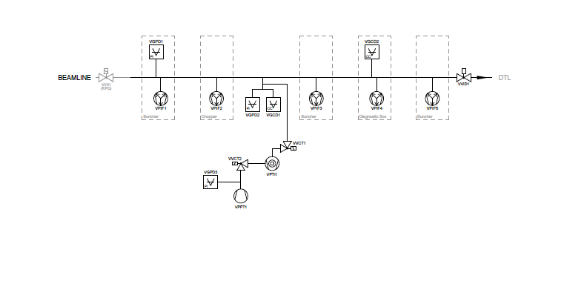
MEBT
RFQ
DTL

Slide 16
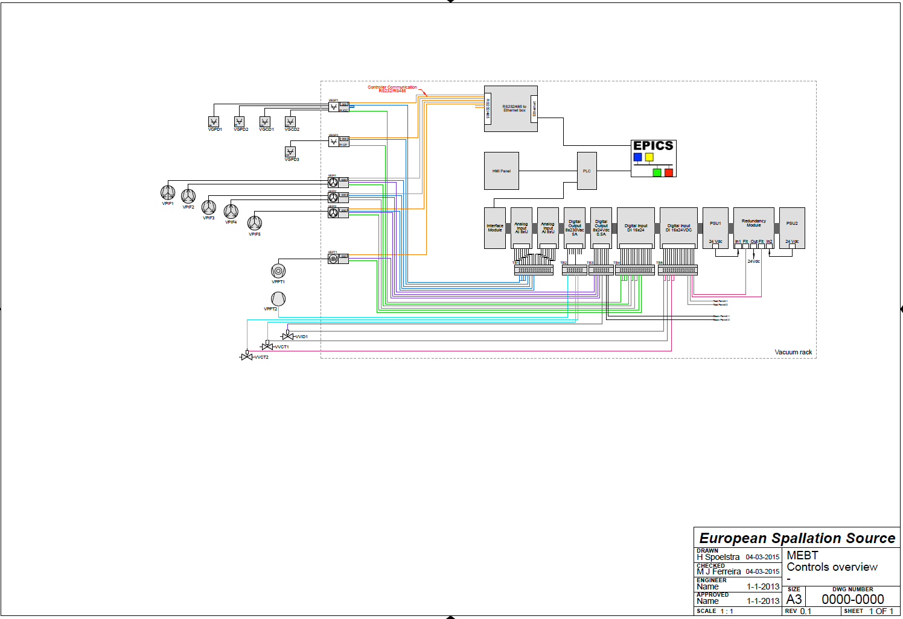
MEBT

Slide 17
DTL
System A |  |  |  |  | System B
Level | Interface A | Discipline A | Contact A |  | Level | Interface B | Discipline B | Contact B |  | Interfaces | Representation | Baselines | Requirements
L3 | ACC.DTL | Vacuum | Marcelo/ESS |  | L3 | ACC.MEBT | Vacuum | Marcelo/ESS |  | Flow rate | DOORS, ref. doc/spec |  | Vacuum simulations for the integrated Warm Linac
L3 | ACC.DTL | Vacuum | Marcelo/ESS |  | L3 | ACC.SPK | Vacuum | Marcelo/ESS |  | Flow rate | DOORS, ref. doc/spec |  | Vacuum simulations for the integrated Warm Linac
L4 | ACC.DTL.EMR | DTL | Andra/INFN LNG |  | L4 | ACC.DTL.VAC | Vacuum | Marcelo/ESS |  | Flanges for vacuum instrumentation | Doc/spec, drawing |  | Number + type of pumps & isolation valves
L4 | ACC.DTL.VAC | Vacuum | Marcelo/ESS |  | L4 | ACC.DTL.WTRC | Water Cooling | Anton/ESS |  | Cooling of pumps? | Doc/spec
L4 | ACC.DTL.VAC | Vacuum | Marcelo/ESS |  | L4 | ACC.DTL.CNPW | Cables | Lea/ESS |  | Connector, cable types + routing | Doc/spec
L4 | ACC.DTL.VAC | Vacuum | Marcelo/ESS |  | L2 | SI | Site Infrastructure | Dave/ESS |  | Instrument air for valve actuators | Doc/spec |  | Air pressure
L4 | ACC.DTL.VAC | Vacuum | Marcelo/ESS |  | L2 | ICS | Integrated control system | Eugene/ESS |  | Control parameters + physical interfaces | Doc/spec
Level 3 top-down
User Defined ID | Name | Description | Clarification | Verify Method | Units | Max. | Development Phase
MEBT-DTL1 | MEBT-DTL-1 vacuum and mechanical interface | The downstream flange between MEBT and DTL-1 shall be a DN40CF flange with a pnumatically operated gate valve in accordance with the requirements of the Vacuum Handbook. This valve is a part of the MEBT. | ISO/TS 3669-2 | inspection | mm | 40 | Operation

Slide 18
DTL
Level 4
From ESS: vacuum diagram, wiring and control signals, list of equipment (following the ESS Vacuum Handbook and standardization model),
Written by the in kind: description and auxiliary documents (manuals , maintenance, procedures and certificates, leak test certificate and vacuum reports),

Slide 19
DTL

Slide 20
ESS Vacuum
Thank you!

