Slide 1
Interface Workshop Warm LINAC
MPS/PSS/TSS Interfaces
24th of April 2015
Annika Nordt
ICS/Protection Systems/Group Leader
www.europeanspallationsource.se
24 April 2015

Slide 2
Overview
Overview on TSS/PSS/MPS
Scope of TSS/PSS/MPS
Interfaces of TSS/PSS with Proton Source/ RFQ
Interface of MPS with Proton Source, LEBT + MEBT chopper
Other interfaces of MPS with warm LINAC systems
Summary

Slide 3
Overview on TSS/PSS/MPS
Notes:
Text according to slide

Slide 4
Scope of TSS/PSS/MPS
The Target Safety System is a safety classified active controls system that is dedicated to the nuclear safety functions of protecting the public and workers from exposure to unsafe levels of radiation and preventing the release of radioactive material beyond permissible limits. In an abnormal event-TSS brings the target station into a safe. TSS is an independent safety-critical system subject to highest reliability demands for ESS safety systems/essential for licensing process for ESS.
The Personnel Safety Systems will prevent personnel from being harmed by exposure to ionizing radiation and other hazards, such as Radio frequency, High voltage and Asphyxiation. All these systems and related interfaces have to be compliant with IEC61508 and are safety classified.
The Machine Protection System will prevent/mitigate damage to the machine’s equipment (accelerator, target, neutron instruments) mainly by stopping beam operation upon the detection of a dangerous condition. It is a mission critical system.
Notes:
Text according to slide

Slide 5
PSS Interfaces with Proton Source and RFQ
Emergency Exit.
Proton Source
RFQ
Safety Contactor
Hardwired Safety Relay
Safety Contactor
Safety PLC
400V 3PH
Notes:
Text according to slide

Slide 6
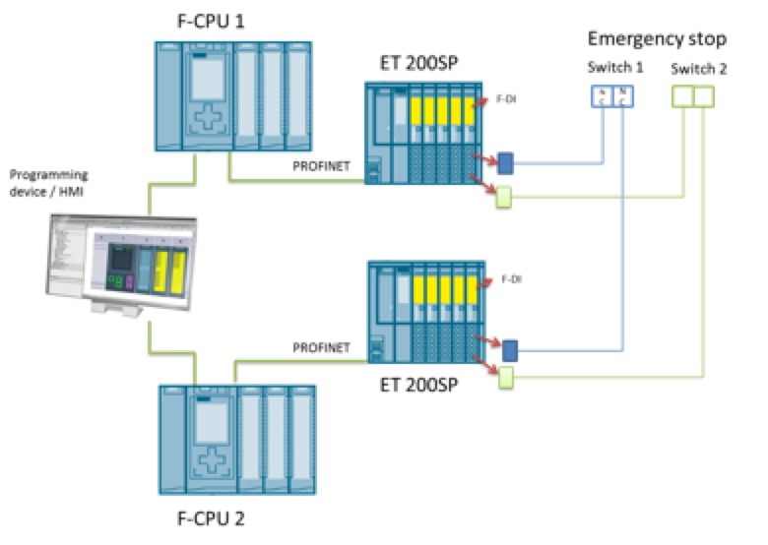
PSS Interfaces with Proton Source and RFQ
Notes:
Text according to slide

Slide 7
TSS Interfaces with Proton Source and RFQ
Proton Source
RFQ
Safety Contactor
Safety PLC or Safety Relay
Sensors for
Target
Safety
System
Safety Contactor
Safety PLC
400V 3PH
Notes:
Text according to slide

Slide 8
TSS/PSS/MPS Interfaces with PS and RFQ
Magnetron for MPS
Sensors for
MPS
Proton Source
RFQ
Safety Contactor
Safety Relay
Sensors for
Personnel
Safety
Systems
Safety Contactor
Safety PLC
Safety Contactor
Safety PLC or Safety Relay
Sensors for
Target
Safety
System
Safety Contactor
Safety PLC
400V 3PH for PSS/TSS
Notes:
Text according to slide

Slide 9
TSS/PSS Interface with Proton Source
At least independent 4 safety contactors are required for stopping beam operation via interrupting the 400 V line which is powering the proton source.
2 out of 4 contactors will have to be compliant with IEC61508/PSS/.
Contact Person: Stuart Birch @ ESS
2 out of 4 contactors will have to be compliant with TSS standards.
Contact Person: Linda Coney @ ESS
Notes:
Text according to slide

Slide 10
MPS Interfaces
Switch now to MPS and its interfaces
Notes:
Text according to slide

Slide 11
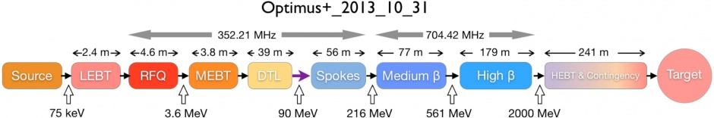
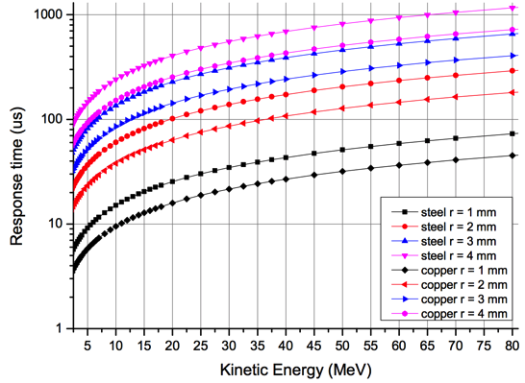
Damage Potential and Timescales for LINAC
After the DTL, the energy of the proton beam is 90 MeV. In case of a beam size of
2 mm radius/and direct impact, melting would start after about 200 μs. Inhibiting beam should be in about 10% of this time.
Examples for required response times to avoid melting of equipment (2mm/10%):
@ 1 MeV: 1 μs
@ 3.6 MeV: 2 μs
@ 90 MeV: 20 μs
@ 216 MeV: 40 μs ….

Slide 12
Machine Protection
Notes:
Text according to slide

Slide 13
Actuators for Machine Protection
Remove RF signal from the magnetron of proton source:
  100 μs until there is no plasma being created anymore
Energize electrodes of LEBT chopper and deflect beam into LEBT absorber:
  300 ns until beam is fully deflected.
  BUT: The absorber can only withstand 2 full pulses before being damaged!!!
Energize electrodes of MEBT chopper and deflect beam into MEBT absorber:
  10 ns until beam is fully deflected
  BUT: The absorber can only withstand 100-200 μs of beam before being damaged!!!
Decrease electrical field of the RFQ:
  20 μs until field is decreased (i.e no beam transmitted & accelerated through the RFQ)
Other options (not investigated yet):
  Remove field from Solenoids in the LEBT
  Cut 400 V line of Proton source using a contactor like TSS and PSS
None of these mitigation techniques can be used by itself, we have to use a combination
→ trigger 1) + 2) + 3) simultaneously
ICS/WP5 is proposing, but MPC will have to approve.
Notes:
Text according to slide

Slide 14
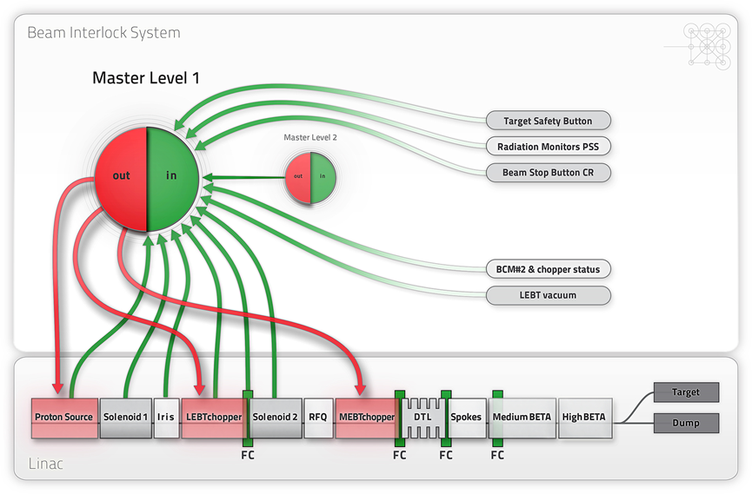
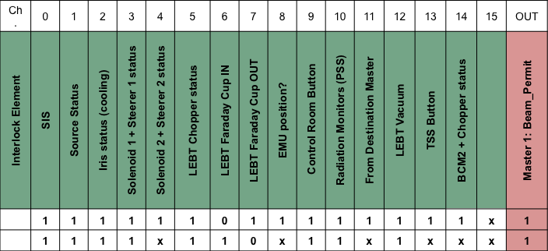
Interfaces MPS/Warm LINAC

Slide 15
Interfaces MPS/Warm LINAC
Proton Source Status: it is expected to have one signal for the internal status of the proton source.
Iris Status: the local control system of the Iris should provide an input to the BIS; e.g. water-cooling will be interlocked. The final logic should be defined as the design proceeds.
Solenoid 1(2) + steering magnets 1(2): interlock for the status of power supplies and water cooling of solenoids and steering magnets.
LEBT chopper status: the LEBT chopper is one of the actuators to stop the beam, and its powering must be verified; in case of a failure, redundancy is guaranteed by switching OFF the RF magnetron of the proton source and applying high voltage to the MEBT chopper.
LEBT Faraday Cup IN/OUT: the position of the cup in the LEBT is interlocked; if the cup is IN, the status of the elements downstream is not relevant to give the beam permit.
EMU (Emittance Measurement Unit) position: it has to be clarified if the position of Allison Scanners has to be interlocked. Note: The LEBT EMU will be designed for a duty cycle at least 2 greater than the nominal. There is little risk to damage them. The position of the 2 EMUs has to be interlocked to avoid insertion at the same time but this could be implemented locally as well in the electronics of the EMU.
LEBT Vacuum: a signal related to the status of the vacuum in the LEBT is needed.
BCM#2 + Chopper status: an interlock signal that relates the status of the LEBT chopper (voltage H/L) and the presence of beam detected by a BCM can be exploited as an option to monitor beam losses in the LEBT: if the HV of the LEBT chopper is OFF and the BCT #2 measures no beam current, the beam must have been lost somewhere in between.
Notes:
Text according to slide

Slide 16
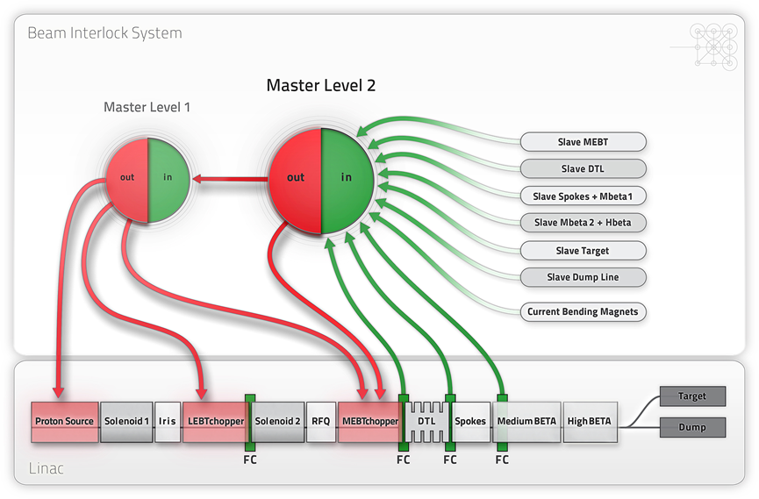
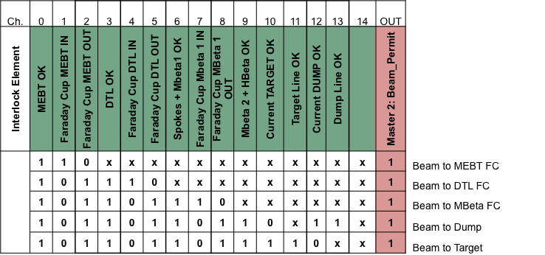
Interfaces MPS/Warm LINAC
MEBT OK: input from the slave MEBT for the status of the MEBT elements (explained later).
Faraday Cup MEBT IN/OUT: the position of the cup in the MEBT is interlocked.
DTL OK: input from the slave DTL for the status of the DTL elements (explained later).
Faraday Cup DTL IN/OUT: the position of the last cup in the DTL is interlocked. We have to know if there are more FCs in the DTL and whether these need interlocking. If there are more FCs in the DTL they can be used only with a pulse length of 5-10 μs pulse length up to 14 Hz (thermal analysis has been done).

Slide 17
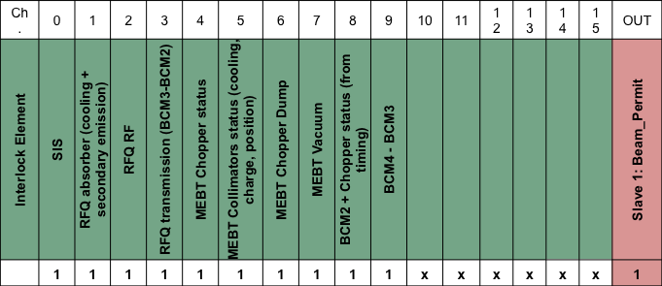
Interfaces MPS/Warm LINAC
MEBT Slave module/inputs:
RFQ Absorber: the status of the RFQ absorber must be interlocked. Temperature, cooling and secondary emission measurements are under discussion (‘secondary emission time window interlock’).
RFQ RF: the status of the RF of the RFQ must be interlocked.
RFQ transmission: the transmission of the RFQ will be measured by using the comparison of the two related BCMs.
Notes:
Text according to slide

Slide 18
Interfaces MPS/Warm LINAC
MEBT Slave module/inputs/cont:
Wire scanners etc. BI equipment okay
MEBT Chopper: The MEBT chopper is one of the actuators of the BIS; therefore, its powering has to be monitored. In case of a failure, redundancy on the BIS action is guaranteed by the triggering of the magnetron RF and of the LEBT chopper.
MEBT collimators: the status of the MEBT collimators has to be interlocked. Temperature, cooling and secondary emission measurements are under discussion (‘secondary emission time window interlock’).
MEBT Chopper Dump: the status of the MEBT chopper dump has to be interlocked (temperature, cooling).
MEBT Vacuum: a signal related to the status of the vacuum in the LEBT is needed.
Differential BCMs: the transmission between BCM#3 and BCM#4 has to be measured and interlocked in case it’s lower than a given threshold.
Notes:
Text according to slide

Slide 19
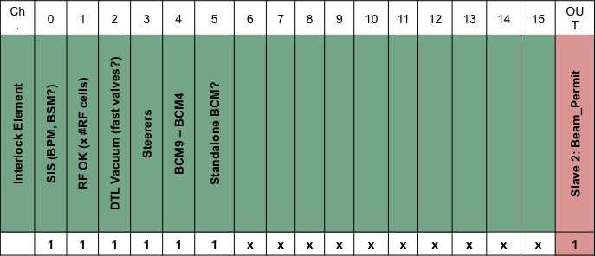
Interfaces MPS/Warm LINAC
DTL Slave module/inputs:
RF OK: the RF systems should provide the status of each RF cell to the BIS.
DTL Vacuum: a signal related to the status of the vacuum in the DTL is needed.
Steering magnets: an interlock monitoring the power supply of the steering magnets should be present.
Diamond BLMs: the possibility of having diamond BLMs in the drift tube of the DTL is under discussion.
Differential BCMs: the transmission between BCM4 and BCM9 has to be measured and interlocked in case it exceeds a given threshold.
Standalone BCM?: the possibility of having an interlock on a standalone measurement of the current from a BCM is under discussion.
Notes:
Text according to slide

Slide 20
More Interfaces MPS/Warm LINAC
Besides the signals presented, we will have to interlock
All insert able devices/positions!
All vacuum valves (in the beam pipe)/positions!
All magnet power supplies/status!
It is important to start thinking about post mortem data (what signals are relevant, how to get data after beam stop, how to understand data/correlate)
It is important to understand that we will have different beam modes (eg short pulses, low beam current, etc) and thus equipment needs to be configurable accordingly!
Remember: we need rich diagnostics for optimization (signal list!)
Notes:
Text according to slide

Slide 21
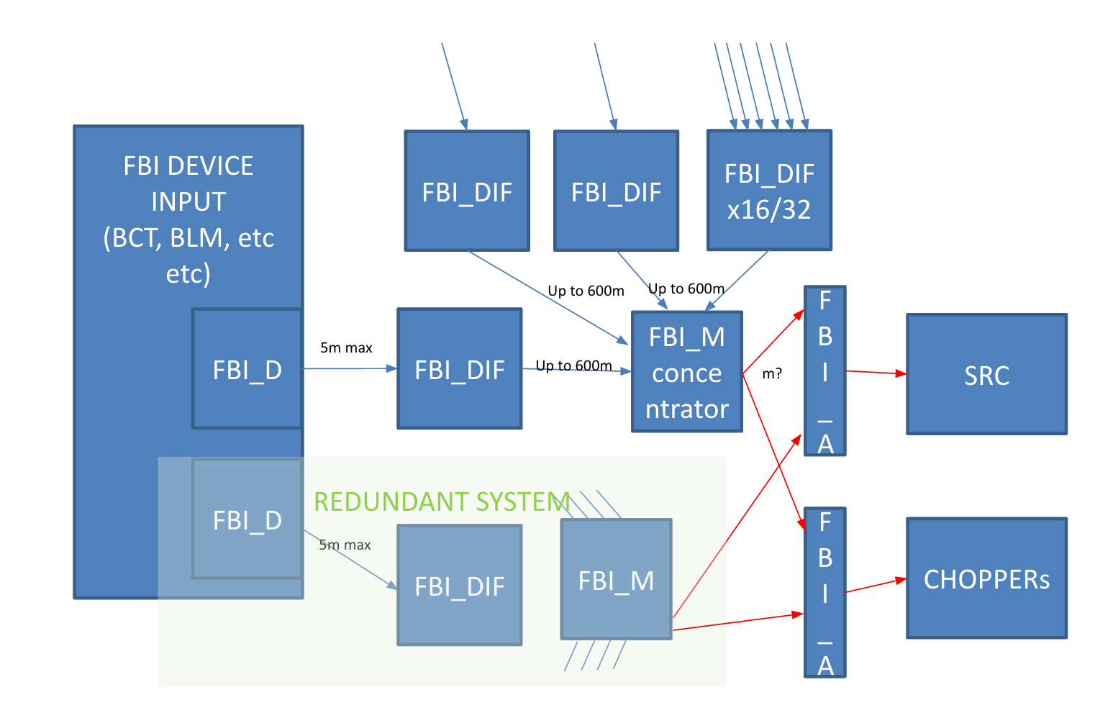
Beam Interlock System (BIS) Hardware
Responsibility of Systems experts
Responsibility of ICS/Protection Group
Responsibility of Systems experts
Only 1 requirement for systems that connect:
implement driver which is defined by MP
It is very easy to implement the driver
Contact Angel Monera @ ESS
He will provide the driver details to you!
FBI: Fast Beam Interlock
FBI_D: Driver
FBI_DIF: Device interface
FBI_M: Master
FBI_A: Interface to actuators

Slide 22
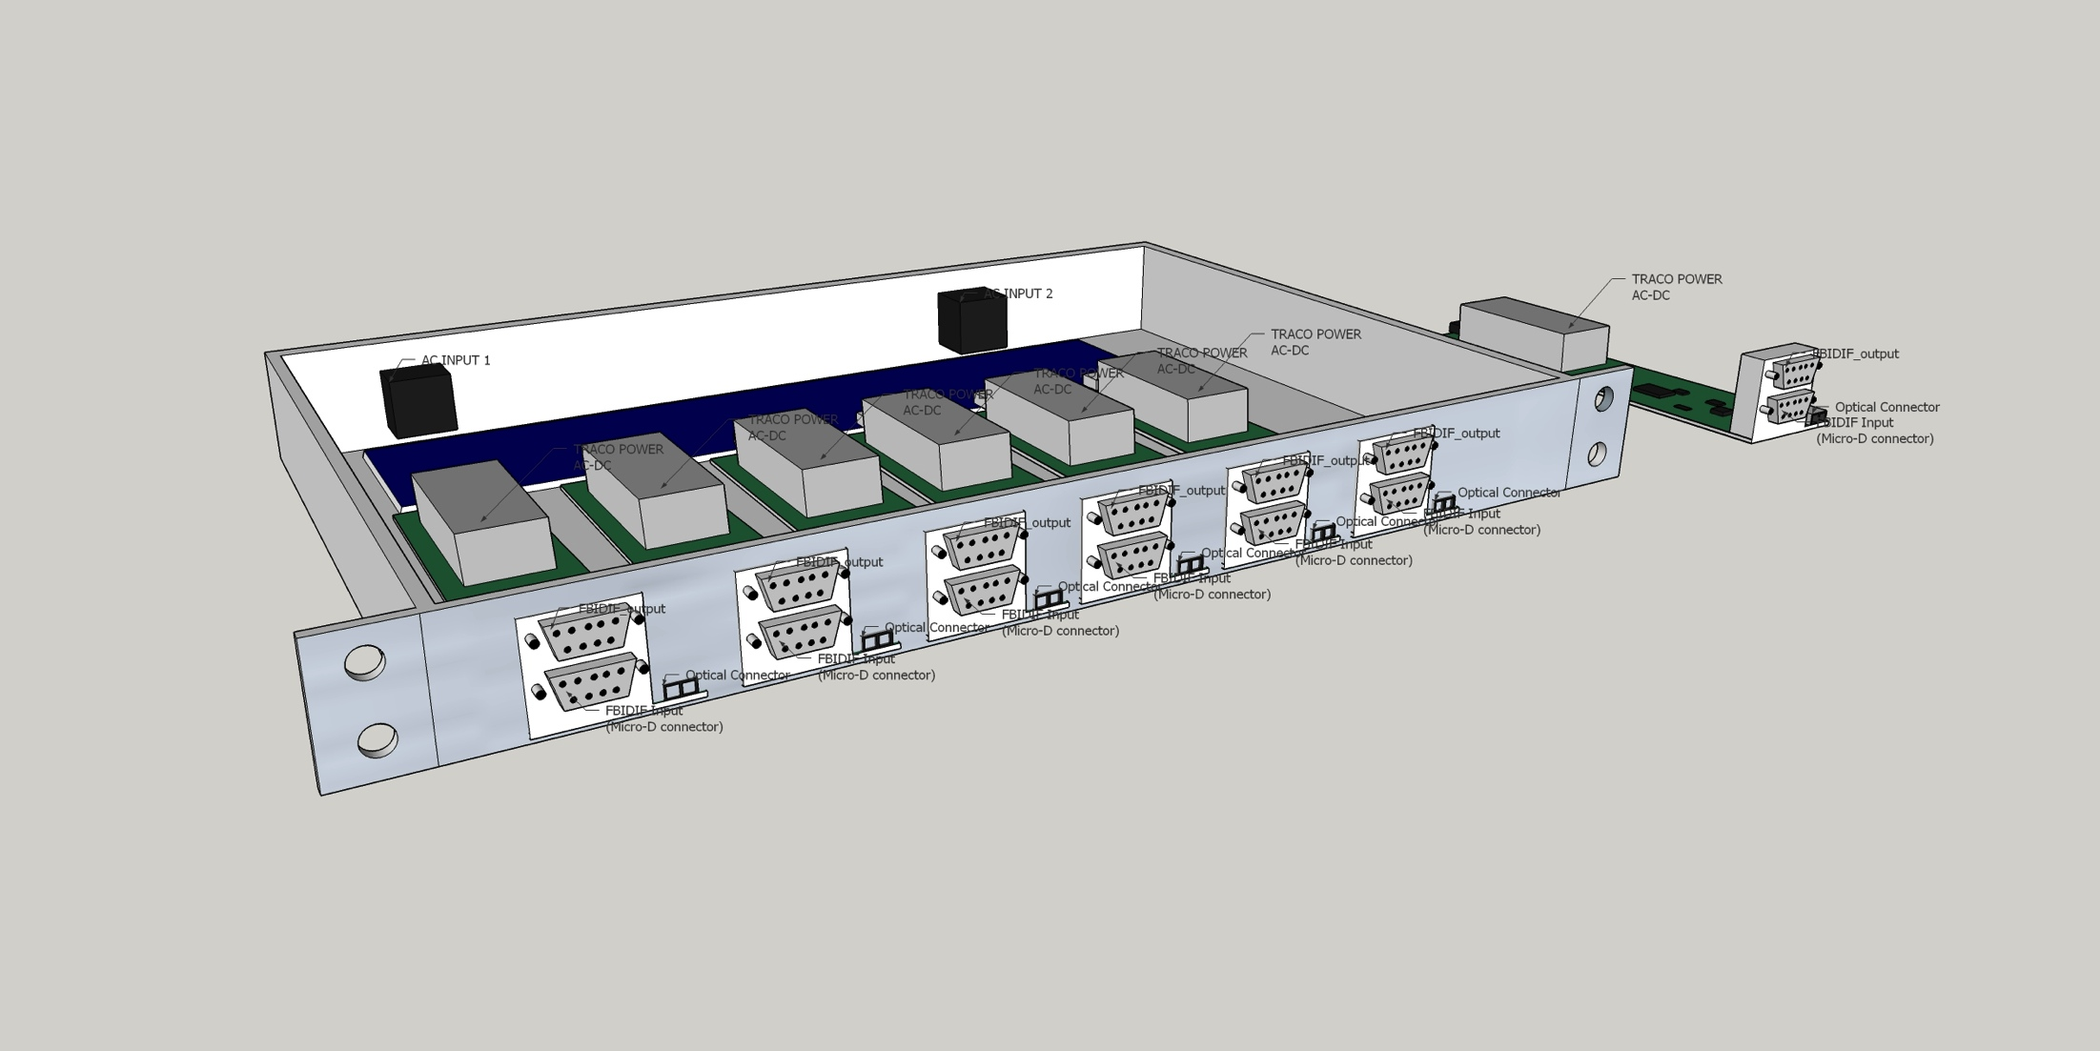
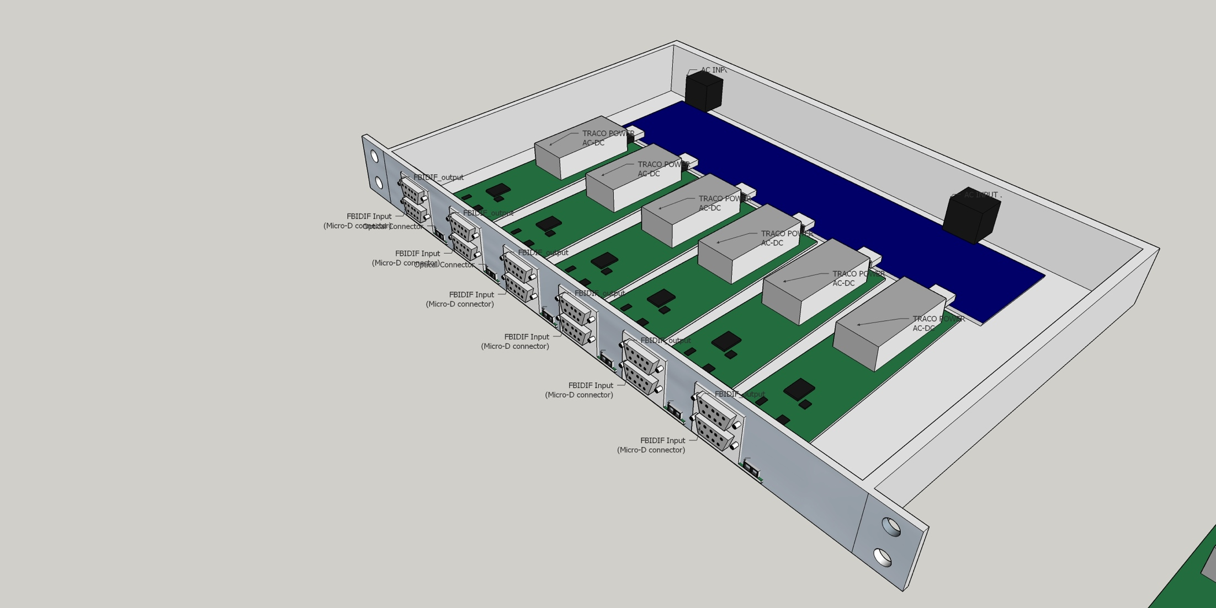
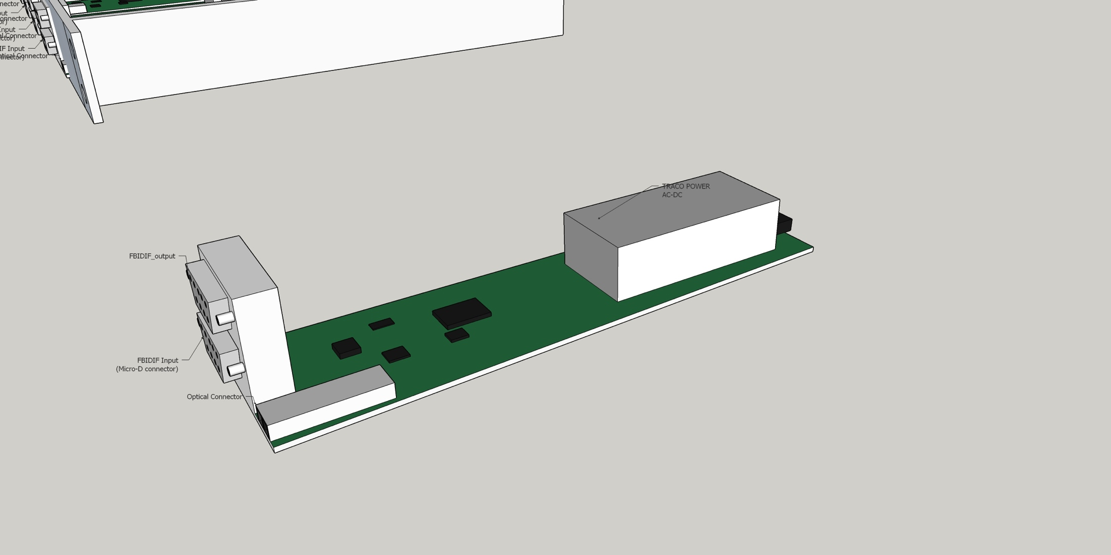
How to connect?
→ Via Interface Module (FBI_DIF) - Box
One module per MP connection
Wide input range allowed: at least 3.3V – 36V (ie almost any type of signal can be connected)
Full link test capabilities: thus redundancy required
Redundant power supply per module
Unique serial number and remote monitoring
Multiple modules per box
Box 19” standard width but low profile (1U)

Slide 23
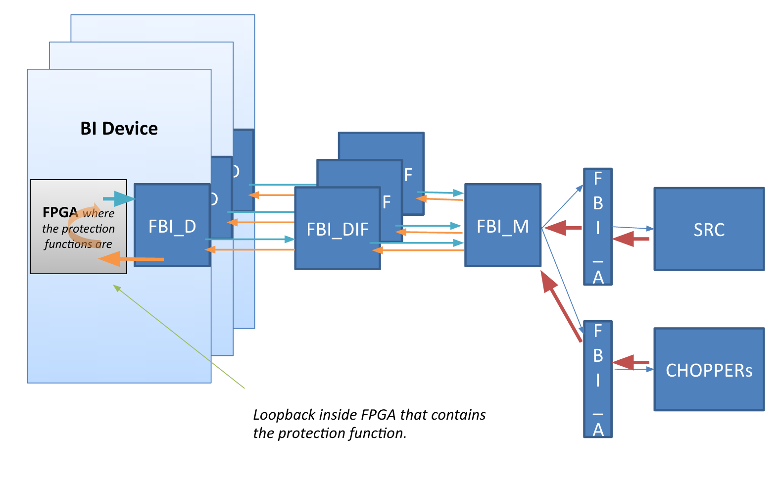
Testing the Links (fast interlocks)
FBI: Fast Beam Interlock System
FBI_D: Driver
FBI_DIF: Device interface module
FBI_M: Master
FBI_A: Interface module to actuators
4% duty cycle machine: use long (68ms) time in between pulses efficiently! Always test links between master and interface module (takes less than 20μs), assuring that everything is up and functioning on BIS level. This increases availability, reliability and the protection integrity level. Links between fast devices (such as from BI) and the related interface module can be tested too in between pulses. Links between slower devices (PLC based) and the interface module cannot be tested in between pulses but will be tested (on different time scales/tbd).

Slide 24
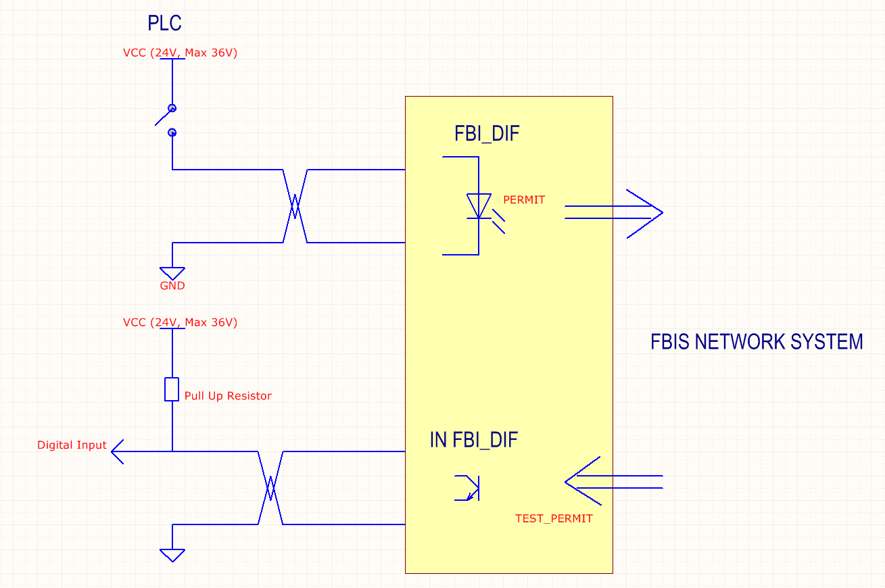
Connections of PLC based systems to BIS
Beam Permit:
Sourcing switch
Ground
Test Permit:
Pull up
Digital Input
Ground
Contact Angel Monera @ ESS

Slide 25
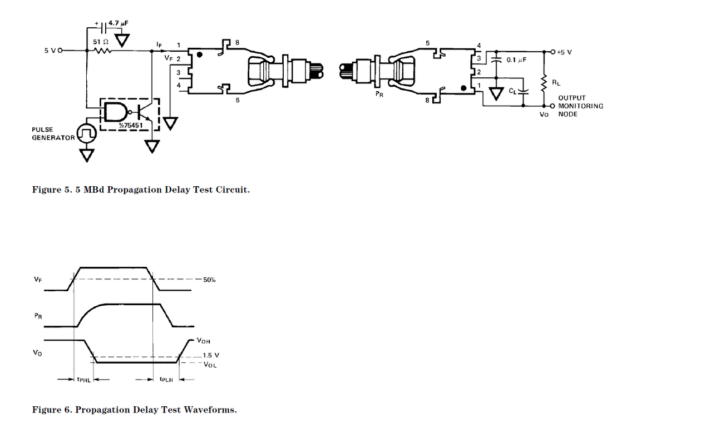
Interface from BIS to Source/magnetron
HFBR-2522 at source
Format: Optical Fiber
Connector type: Simplex
Optical Control Signal to output (0): -24dBm
Optical Control Signal to output(1): -43dBm
Light wavelength: 660nm
Maximum Length: 45m
Note:
Light = Source On,
No light = Source OFF.
Feedback Circuit (source on or off information):
Dry Contacts : => can it be changed by a transistor/optocoupler so we can get this information as fast as possible?? Desired response time: ~10us

Slide 26
Summary
Interfaces between Proton Source/RFQ and TSS/PSS were presented (safety contactors on the 400V line)
Interfaces for machine protection were presented
Contact PSS: Stuart.Birch@esss.se
Contact TSS: Linda.Coney@esss.se
Contact MPS: Annika.Nordt@esss.se
Contact MPS technical details on interfaces: Angel.MoneraMartinez@esss.se

