Slide 1
Survey, Alignment and Metrology
Fabien Rey
Pawel Garsztka
ESS Survey, Alignment and Metrology Group
Interface Workshops for ESS Warm-Linac: ISrc - LEBT - RFQ - MEBT – DTL
April 23rd , 2015
ESS- LUND

Slide 2
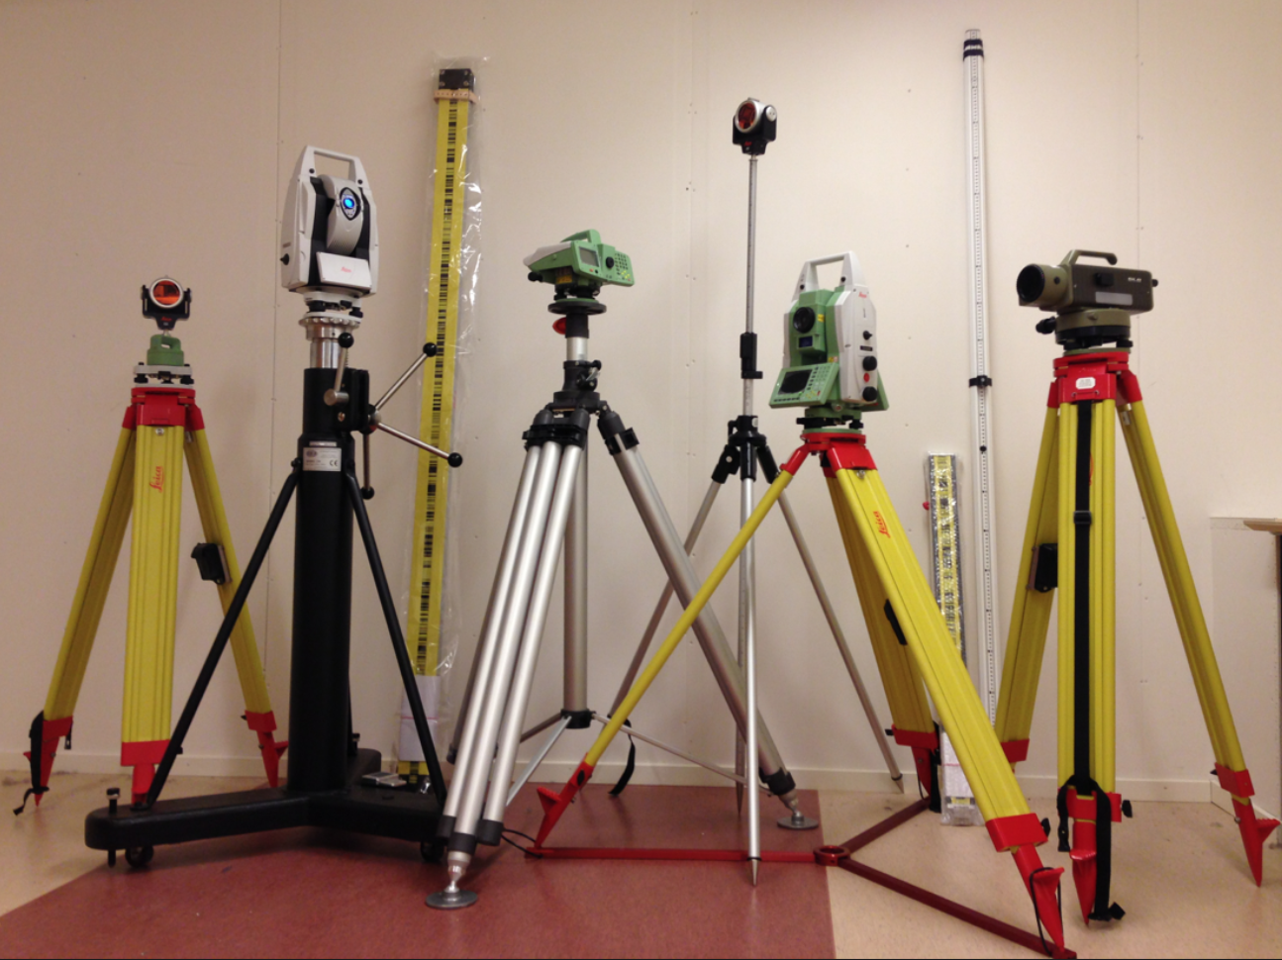
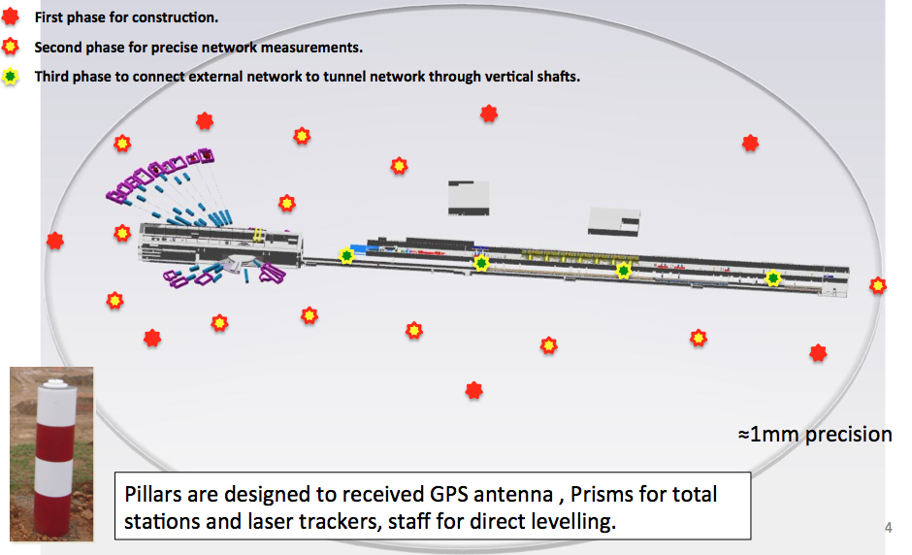
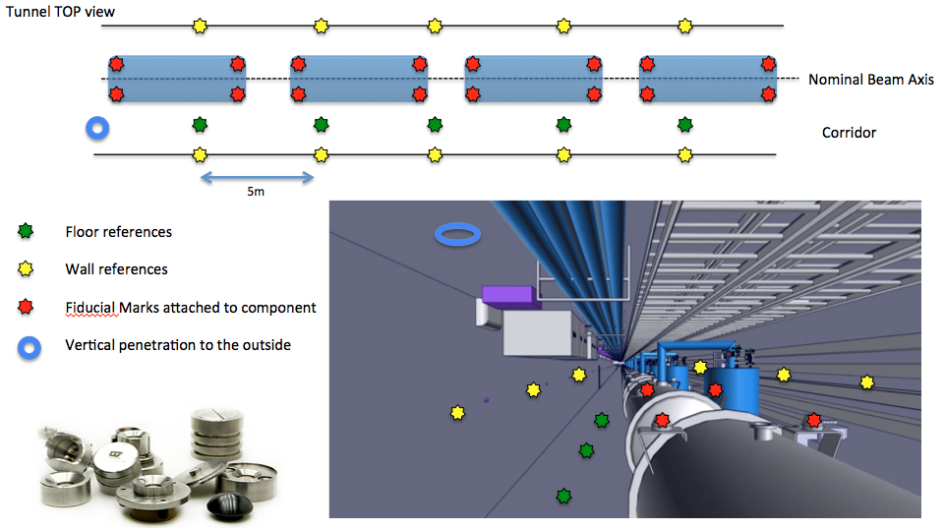
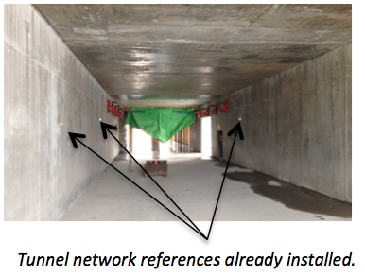
Survey & Alignment Strategy at ESS
Based on 3D free stationing technique with least squares adjustment calculus
Instrumentation: laser tracker, total station, digital and optical levels, 3D Arm, GPS, metrology software.
Two reference networks connected:
- One outside Geodetic Pillar Network (mm accuracy)
Measurements: GPS, Total Stations, Digital Levels.
- One internal reference network (0.1 mm accuracy)
Measurements: Laser Trackers , Total Stations, Digital Levels

Slide 3
Survey & Alignment Strategy at ESS
3D Free Stationing Technique
Tunnel
Nominal beam axis
No Forced Centering for instruments
We place the instruments where convenient

Slide 4
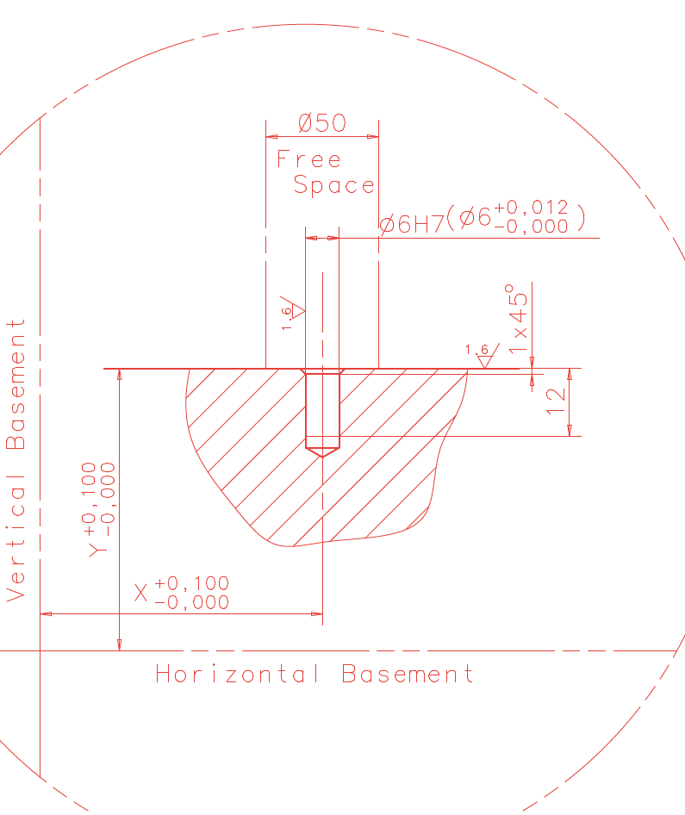
Fiducialization
Process
Fiducialization : report the sensitive part or axis of a component to external references used to align the component.
Fiducials to receive prism
Sensitive Axis: magnetic axis, accelerating axis…
Mechanical axis used for construction / assembly
Fiducialization Bench
Laser tracker
4

Slide 5
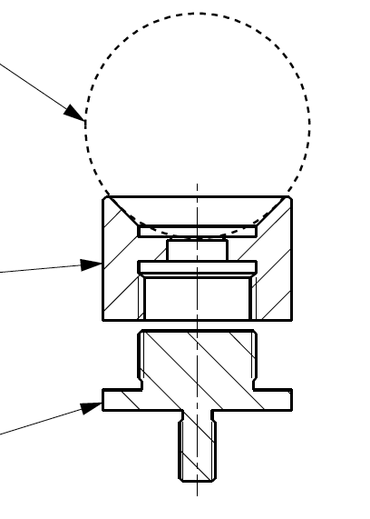
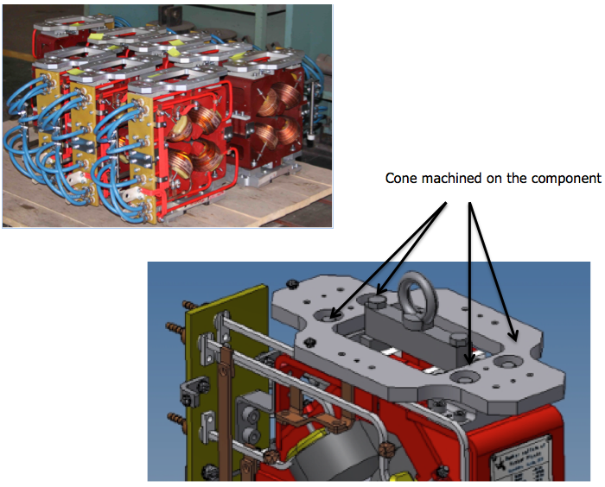
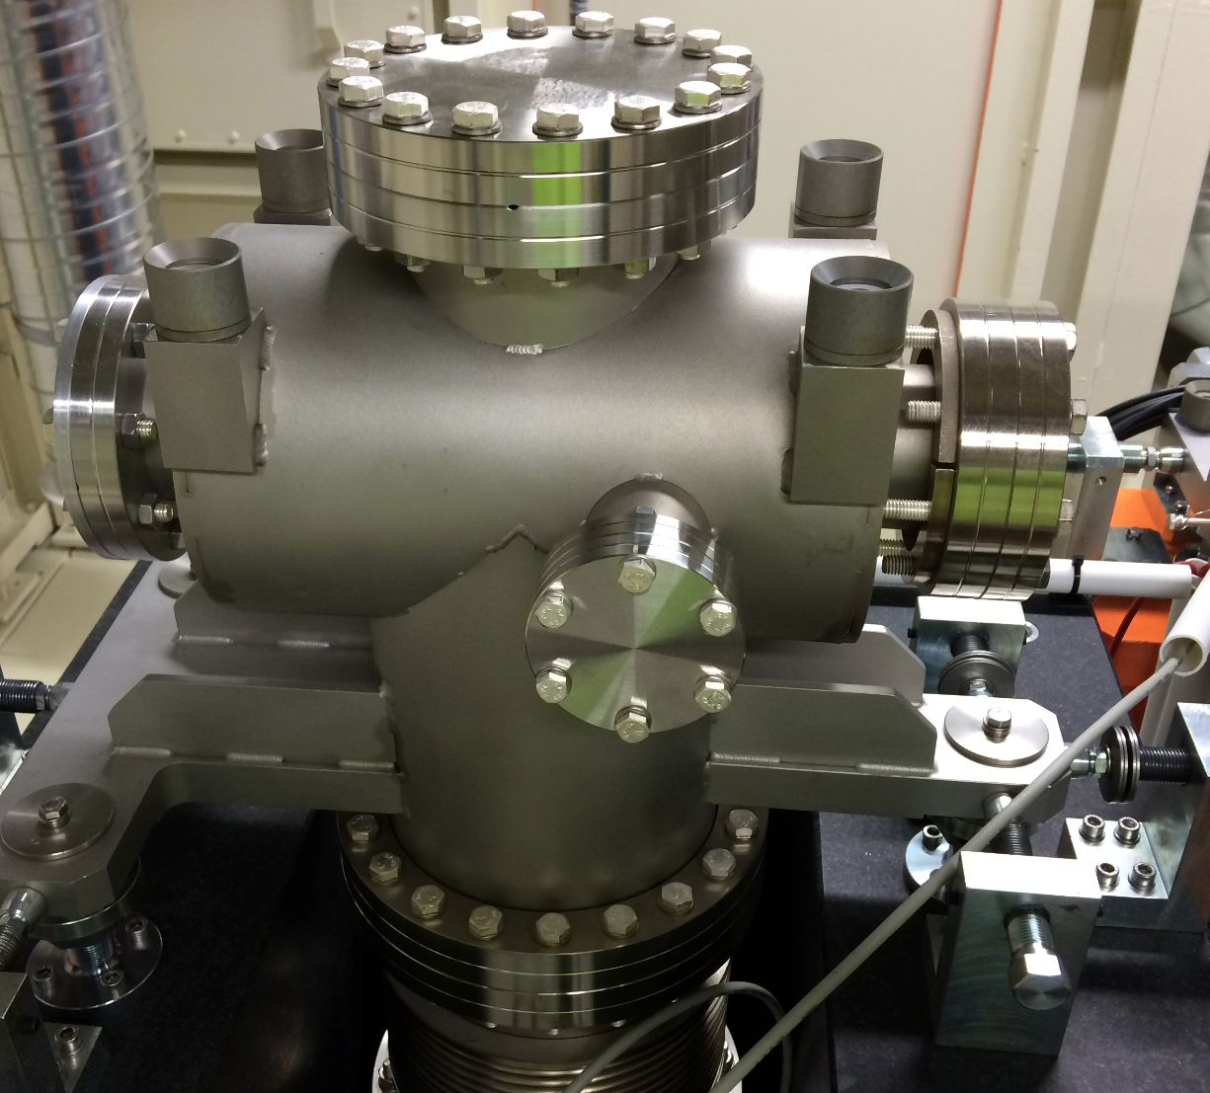
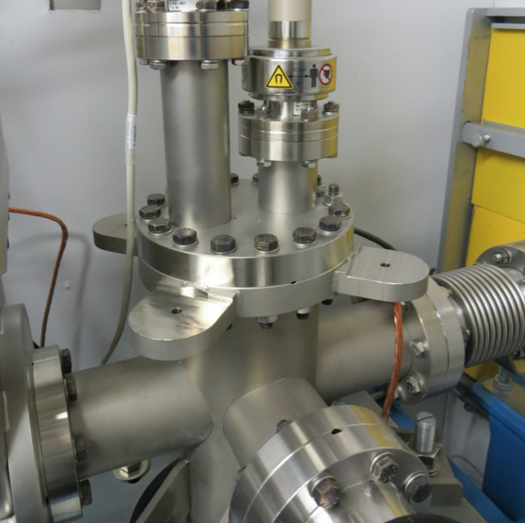
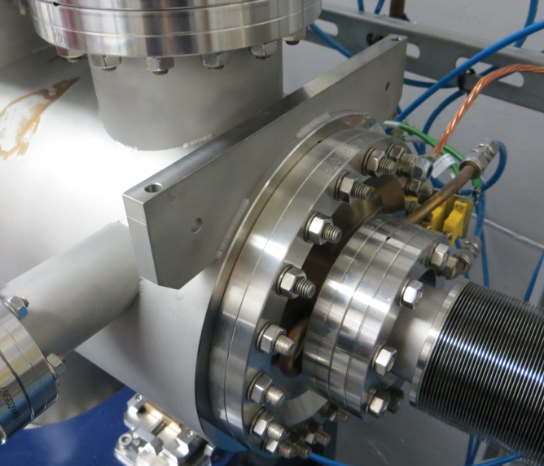
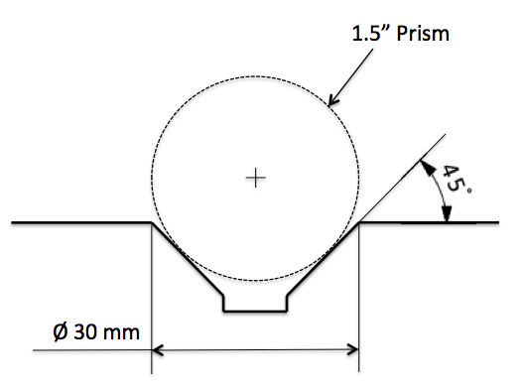
Fiducialization
Fiducials ESS-0012977
6H7 Machined Hole
Assembly glued with M6 Hole
Cone directly machined
on the component
1,5” Prism
Cone Part
M6 Part

Slide 6
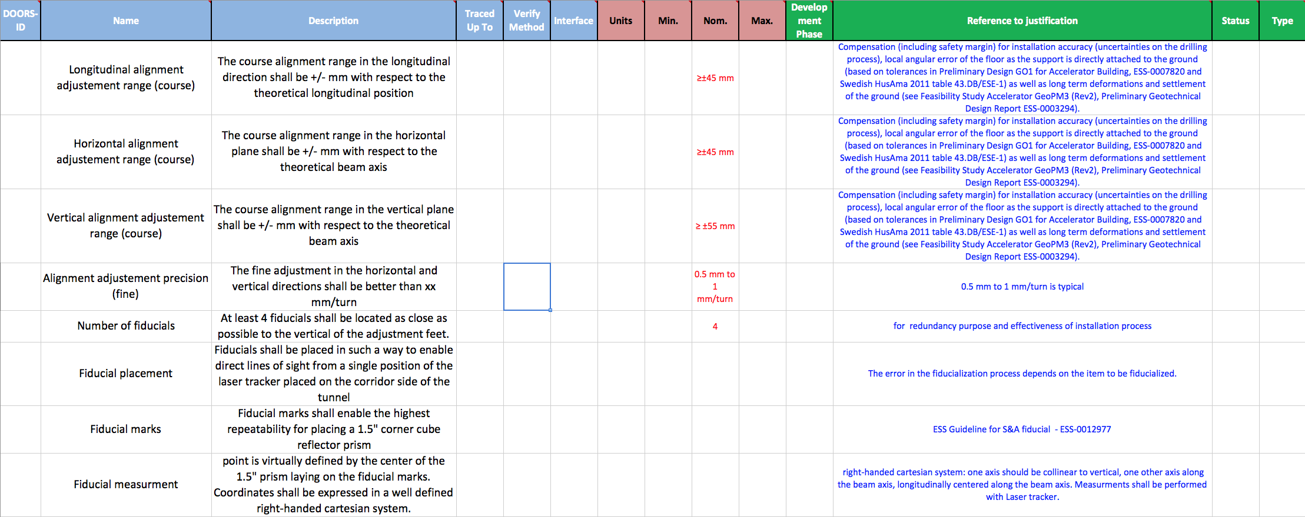
Requirements

Slide 7
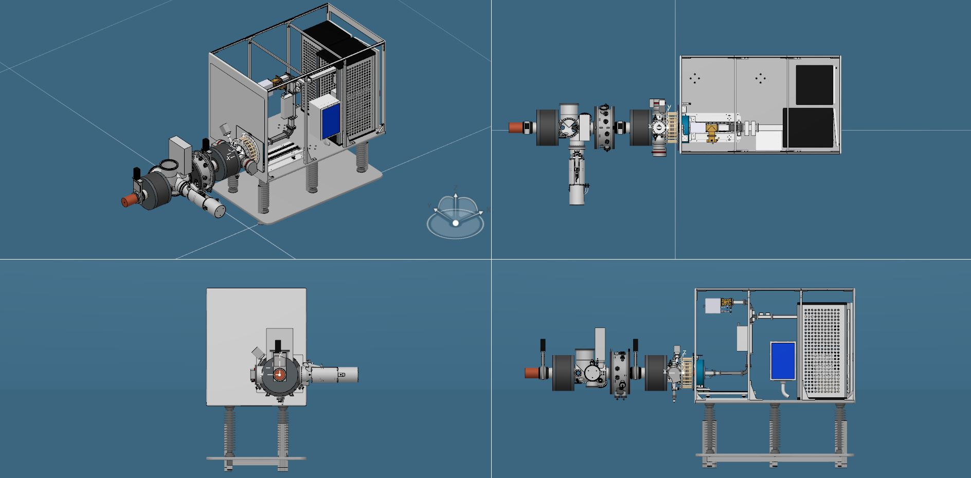
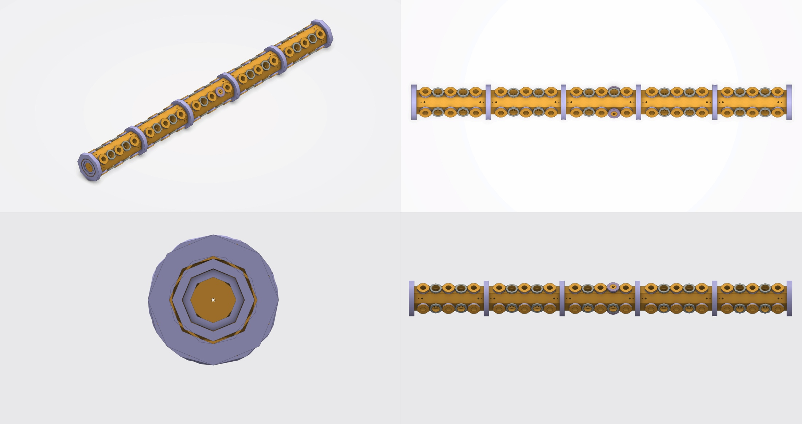
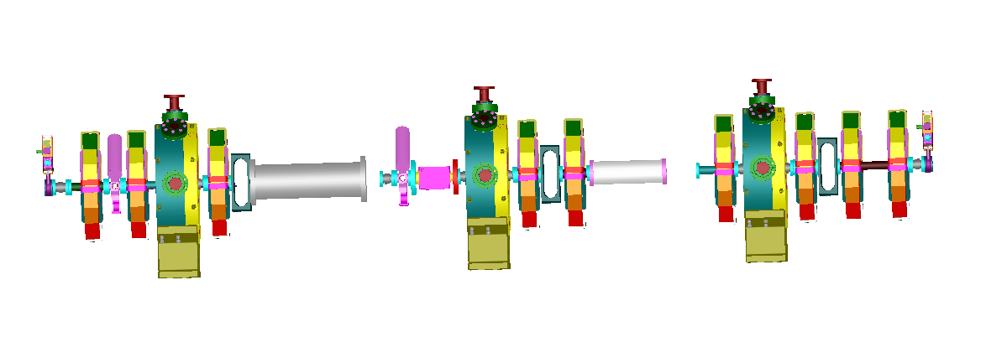
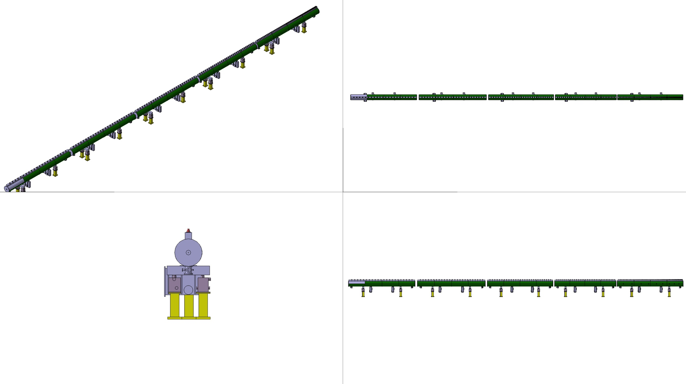
Status

Slide 8
Recommendations on Supports and Adjustment Systems
Some assumptions:
Beam high is 1500 mm from ground level.
Floor horizontality along 600m should be within ±15mm.
Grouting plates are excluded.
Supports shall be directly fixed into the floor.
Reinforcement bars very close to ground surface (3 to 5 cm).

Slide 9
Recommendations on Supports and Adjustment Systems
Supports directly attached to the floor.
No hole on the support leg.
Legs will be clamped on the side to have more flexibility in the drilling process

Slide 10
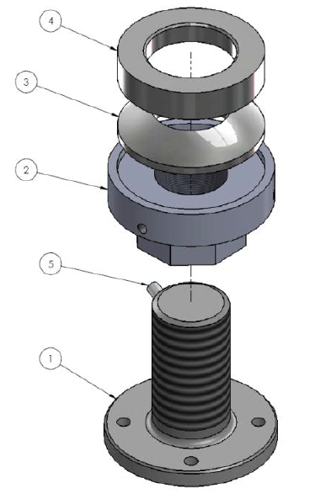
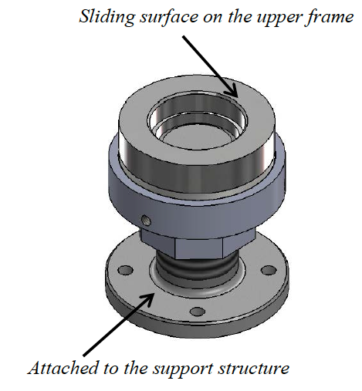
Recommendations on Supports and Adjustment Systems
3 vertical adjustments
2 x horizontal adjustments
3 vertical clamping/deformation control

Slide 11
Recommendations on Supports and Adjustment Systems

Slide 12
Recommendations on Supports and Adjustment Systems

Slide 13
Recommendations on Supports and Adjustment Systems

Slide 14
Recommendations on Supports and Adjustment Systems
4x fiducials

Slide 15
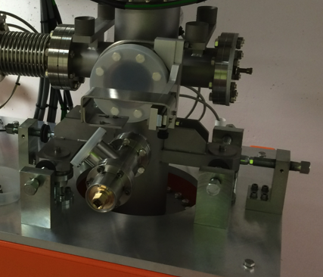
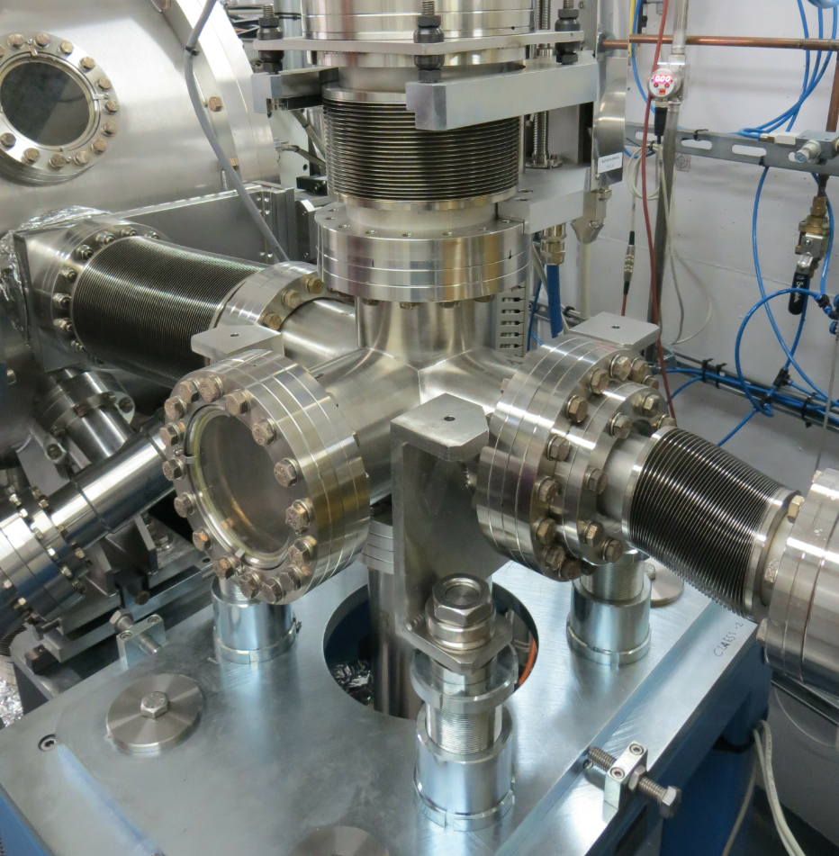
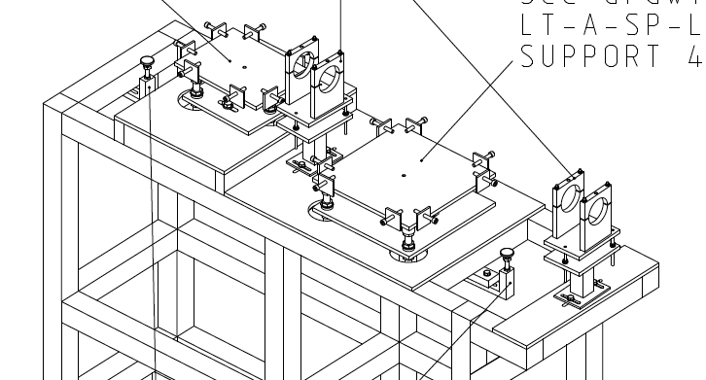
Recommendations on Supports and Adjustment Systems
On the top of this common support: you are free to select the most appropriate solution

Slide 16
Next Steps
Provide a 3D model of complete assembly:
We can then validate:
Position/ Type/ Number of fiducials
Adjustment System approach
Define and describe the fiducialization process for each component/assembly:
Type of instrument : Laser tracker, 3D arm, CMM, optical tools…
Where and how ?: on magnetic measurement bench, relying on mechanical tolerances….
Coordinates expressed in a well define coordinate system. (TBD)
Please use our support and expertise for this !!
We can provide you with instruments, definition of processes …
We can visit you when convenient
But all this need to be planned in advance!!

