Slide 1
Accelerator Integration Design Integration Group [DIG]
Nick.Gazis@esss.se
www.europeanspallationsource.se
Apr. 2015

Slide 2
Purpose
Design Integration Group (DIG) is part of the Physical Plant Working Group (PPWG)
DIG focuses on the integration of the related 3D-models in a Catia v6 master-assembly in ESS, either contributed by IKCs or designed in ESS
ESS needs to assimilate all the different design packages into one design
The ESS design is constituted out of released contributions:
A released contribution is defined as the currently agreed upon state of design between ESS & IKC
Without requiring in-kind partners to use a specific CAD software
ESS needs current status and rapid feedback on the progress of in-kind partner designs
Civil construction of the ESS facility is well underway
ESS needs to keep up with changes in designs as soon as they are available to assess impact on civil construction
To keep track of changes, ESS uses file versioning and released revisions.

Slide 3
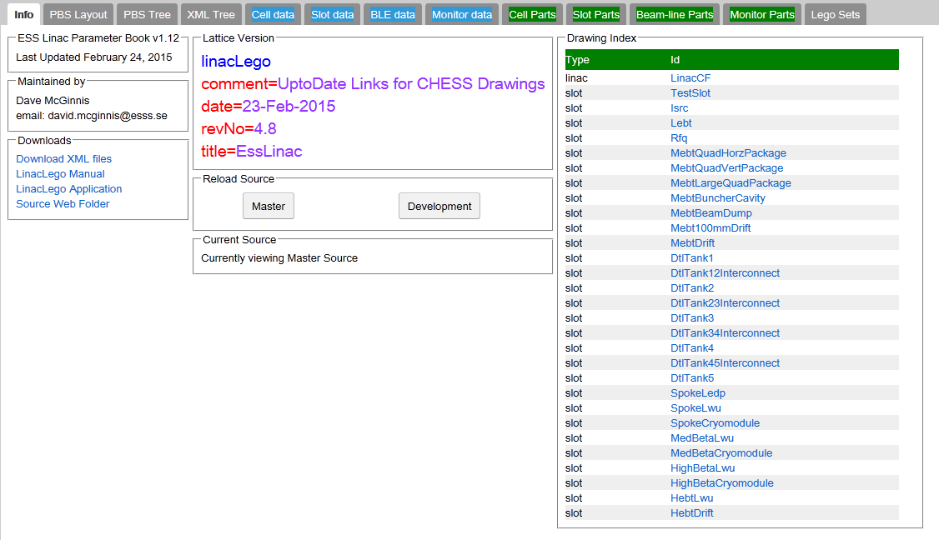
Contributing your designs to ESS
You can go to LinacLego and upload your designs, models, documents (for further information or CHESS account creation please contact Nick.Gazis@esss.se)

Slide 4
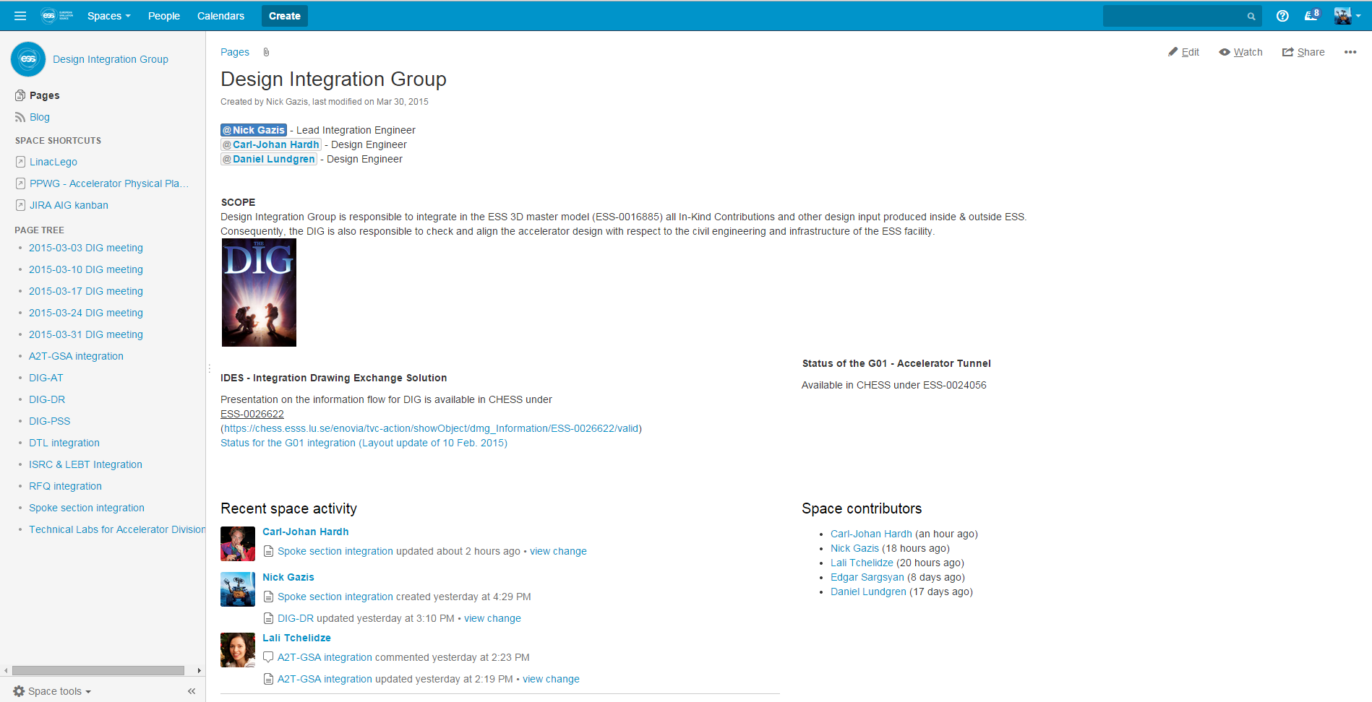
Monitoring the design integration of ESS
You can go to DIG home and check the latest status of the design integration (for further information or JIRA account creation please contact Nick.Gazis@esss.se)

Slide 5
End
Currently we have a preliminary integrated version of our linac in our master-assembly 3D-model
Still however we are missing several parts such as:
Supporting systems
Interfaces
Valves, flanges
etc.
We need IKC input so as to proceed to a detailed level of the integrated 3D-model of the ESS accelerator, so as to provide back to the IKCs with proposals for:
Assembly processes
Transportation processes
Installation processes
Commissioning processes

Slide 6
SPARE SLIDE – LinacLego Organization
LinacLego is used to describe the ESS lattice
It is the single-point-of-truth for tunnel components
Available on the Web
https://aig.esss.lu.se:8443/LinacLegoWebApp/
The lattice is described in the following hierarchy:
Section (ISRC, LEBT, RFQ, DTL, SPK, etc…)
Cell (SPK-01, SPK-02,… SPK-13)
Slot (SPK-02-LWU, SPK-02-CRM)
Beamline Element (SPK-02-LWU-QH01, SPK-02-LWU-QH02)
The ESS 3-D integration model will be based on slots
Slots are considered installation sub-assemblies
Definition of a Slot is flexible
There will be one CHESS document to contain the 3-D model of each Slot design

Slide 7
SPARE SLIDE – Lattice hierarchy in LinacLego
SECTION
ISRC
LEBT
RFQ
DTL
SPK
MBL
etc…
CELL
SPK-01
SPK-02
SPK-03
…
SPK-13
SLOT
SPK-02-LWU
BEAMLINE ELEMENTS SPK-02-LWU-QH01, SPK-02-LWU-QH02, …
Level of exchange for the CAD files between IKC-ESS
SPK-02-CM

