Slide 1
ESS LLRF System
2015-04-23
Anders J Johansson

Slide 2
LLRF at ESS
LLRF: Low-Level Radio Frequency
Controls the phase and amplitude of the field in the cavities to within x degree / y %.
Starts at cavity field pickup connector on cavity/cryomodule.
Ends at input to the pre-amplifier.
Commands the slow tuners.

Slide 3


LLRF system
Power Grid
PSU
(Modulator)
9
U
Pz Ctrl
10
I
Circulator
LLRF system
Pre
Amplifier
(Klystron, Tetrode)
:
-
Cavity
Motion control
Amp
3
4
5
6
7
M
Motor Ctrl
Slow Tuner
Load
1
2
LLRF system
:
PI
-
controller
1
…
10
Phase Reference Clk
352
.
21
MHz
8
Warning
/
LLRF system
Errors
:
Monitoring
Master Oscillator
&
Storing

Slide 4
Design concept
Digital implementation of fast control in FPGA
Modular design for simple maintenace
Modular design for large volume procurement
Redundant design for availability
Downconversion at 352 MHz

Slide 5
Control Architecture
1. Procedures
  such as tuning of a cavity, commissioning of a coupler
  Runs on any computer connected to EPICS
2. Algorithms
  such as updating the Feed-forward tables based on the measured error.
  Runs on CPU in crate
3. Functions
  such as PI-control and addition of FF-table.
  Runs in firmware on FPGA

Slide 6
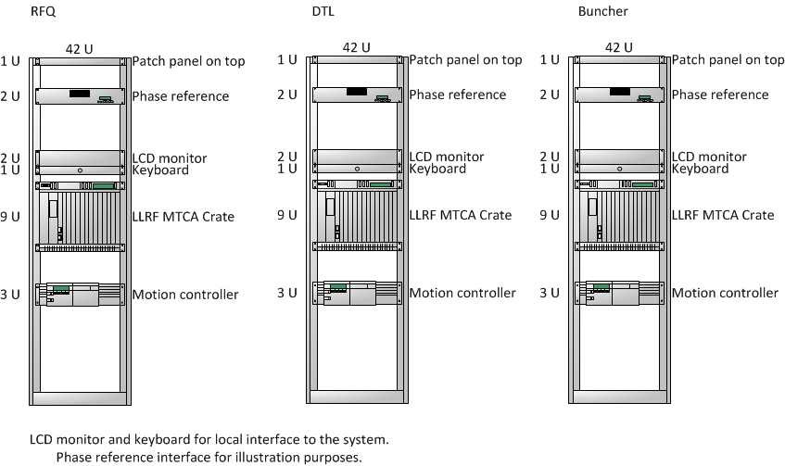
Warm Linac
Rack layout illustration

Slide 7
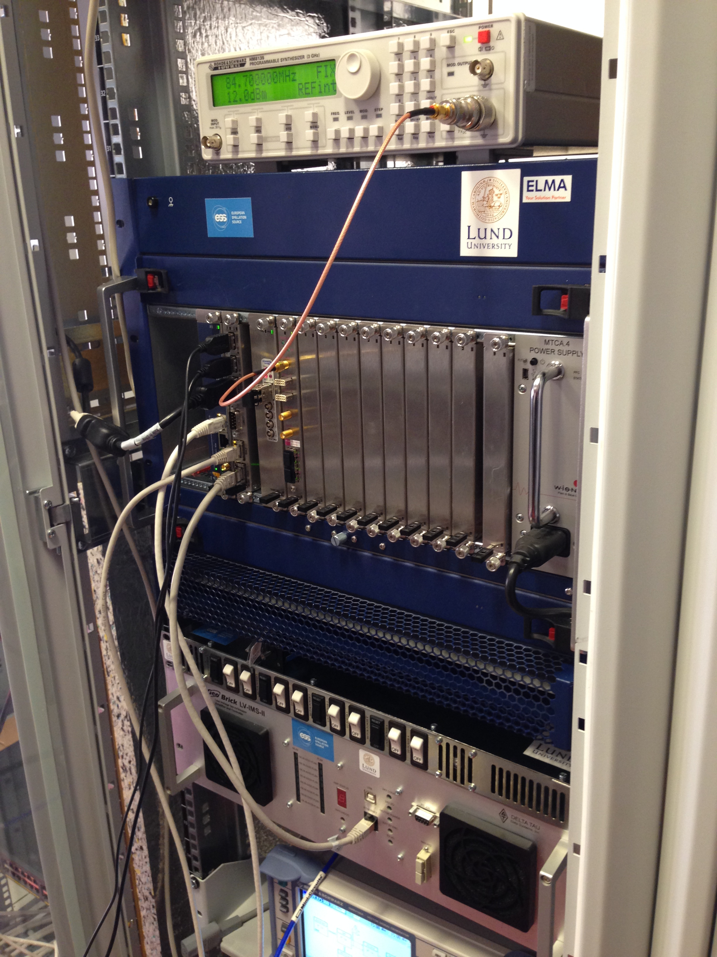

Slide 8
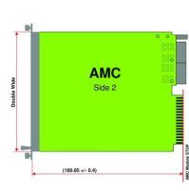
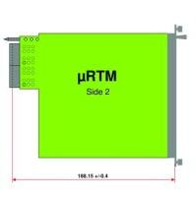
352.21 MHz MTCA.4 Warm Linac
CPU
CB control on backplane
Timing triggers
MCH supervision
External I/O
Ethernet on backplane
LO-generation
Phase referense
Cavity Pickup
VM out
PreAmp Out
PowerAmp out
PowerAmp Refl
Cavity In
Cavity Refl
Phase referense
Cavity Pickup
VM out
PreAmp Out
PowerAmp out
PowerAmp Refl
Cavity In
Cavity Refl
Timing
LO/REF
Timing (MRF)
FPGA/ADC
RF/VM
Interlock (to LPS)
Modulator V
Beam current
Vectormodulator out
FPGA/ADC
RF/(VM)
X
Y
Z
MCH
Fan Tray x 2
EPICS, Supervision
PSU x 2
230 V AC

Slide 9
LLRF RF inputs
Single coupler
Cavity pickup (Cavity)
LLRF out (LLRF Internal)
Pre-amp out (RFS)
Main Amplifier out (RFS)
Main Amplifier reflected (RFS)
Cavity forward (RFS)
Cavity reflected (RFS)
Phase reference in (Phase reference)

Slide 10
LLRF RF inputs
Two couplers
Cavity pickup (Cavity)
LLRF out (LLRF Internal)
Pre-amp out (RFS)
Main Amplifier out (RFS)
Main Amplifier reflected (RFS)
Splitter forward (RFS)
Splitter reflected (RFS)
Phase reference in (Phase reference)
Cavity forward 1 (RFS)
Cavity reflected 1 (RFS)
Cavity forward 2 (RFS)
Cavity reflected 2 (RFS)
Spare
Spare
Spare
Spare

Slide 11
LLRF inputs
Other
EPICS (ICS)
Ethernet for crate supervision (ICS)
Timing (ICS)
Beam current measurement (BI)
Modulator voltage (RFS)
Interlock (LPS in RFS)
230 V mains (?)

Slide 12
LLRF output
LLRF output (RFS)
EPICS (ICS)
Tuning command (tune x Hz up/down) over EPICS.

Slide 13
Motion Control
Baseline interface
Cavity WPs are responsible for protecting the cavities against harmful commands
LLRF calculates necessary tuning adjustments
Adjustments are sent over EPICS to be executed.

Slide 14
RFQ
Water skid
Motion Controller / PID temperature ctrl
TCP/IP
Cavity
Control Box
ICS
EPICS
RFS / LLRF

Slide 15
DTL
Limit switches / encoders
M
M
M
Connectors in tunnel
Motion Controller
TCP/IP
Cavity
ICS
Control Box
EPICS
RFS / LLRF

Slide 16
ICS
LLRF
Cavity WP

Slide 17
Motion control
LLRF comments
As the time constants are slow on the temperature tuning of RFQ and DTL, LLRF is helped by having detailed knowledge of the tuning process.
The LLRF architecture support extension to more RF-inputs if needed for tuning.
(Multiple sensors in RFQ/DTL?)
Stepper motor controller standardisation handled by E2H2C.

Slide 18
Components and Layout

Slide 19
Baseline Layout
Crate for 1 buncher cavity
MCH
CPU
Timing
LLRF
ADC
FPGA
+RTM
PSU
PSU
1 2 3 4 5 6 7 8 9 10 11 12

Slide 20
Baseline Layout
Crate for 1 352 MHz DTL cavity
MCH
CPU
Timing
LLRF
ADC
FPGA
+RTM
LLRF
ADC
FPGA
+RTM
PSU
PSU
1 2 3 4 5 6 7 8 9 10 11 12

Slide 21
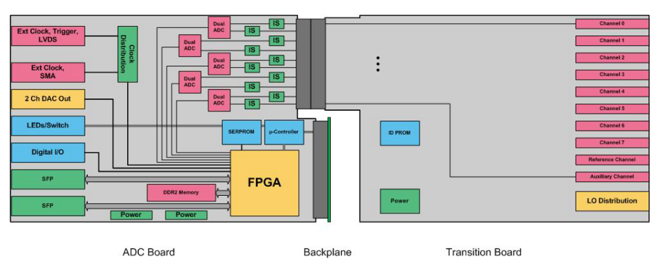
AMC for LLRF: Struck ADC
AMC: 10 Channel ADC + FPGA
AMC: Generic test interface

