Slide 2
SIL Assessment for ESS PSS SIFs
ESS PSS PDR
PRESENTED BY Fan YE and DENIS PAULIC

Slide 3
Agenda
1 Introduction to PSS SIL Assessment
2 Accelerator PSS Safety Instrumented Functions (SIFs)
3 Accelerator PSS SIL Assessment
4 Target Station PSS, Bunker PSS, DREAM PSS SIFs
5 Target Station PSS, Bunker PSS, DREAM PSS SIL assessment

Slide 4
1
Introduction to PSS SIL Assessment

Slide 5
PSS SIL Assessment
Risk Assessment
SIL Determination
  Inputs – Risk Assessments, ConOps
  Outputs – SIL targets for each SIF in terms of PFD/PFH and SIL
SIL Verification
  Inputs – SIL Determination, SIF configurations, Failure Data
  Method – Reliability Block Diagram (RBD), ProSET
  Outputs – SIL Verification results in terms of achieved PFD/PFH and SIL
SIL Determination
SRS
SIL Verification

Slide 6
SIL Determination and Verification
SIL Determination
  To determine the required SIL target (and reliability target PFD/PFH) for each SIF
  Layers of Protection Analysis (LOPA) used for SIL determination
  Guideline for SIL Assessment for Personnel Safety Systems (ESS-1408224)
SIL Verification
  To verify the proposed SIF design will meet the corresponding SIL (and PFD/PFH) target
  Reliability Block Diagram (RBD) used for SIL verification
  Event Tree Analysis (ETA) used to confirm frequency of individual hazardous scenarios meet the risk target
PFD = Probability of Failure on Demand
PFH = Average frequency of a dangerous failure per hour

Slide 7
2
ACC PSS Safety Instrumented Functions

Slide 8
ID Pattern for SIFs
System_SIFNumber
System
  ACCPSS, TSPSS, BunPSS, DREAMPSS, etc.
  Number
1 Emergency Switch-Off Button (ESOB) interlock
2 Main key interlock
3 Access Door interlock
4 Access Door lock
5 High radiation interlock
Notes:
There are several SIFs that are expected to be required in each PSS. These should always be numbered in the same order to facilitate cross-referencing between the systems, as shown below:

Slide 9
ACC PSS SIFs
ACCPSS_SIF1
If any Emergency Switch-off Button (ESOB) in the ACC PSS controlled area is detected pressed, de-energise the following EUC:
Proton Beam Actuators:
  ISrc HVPS,
  Grounding relay;
RF systems
  MEBT bunchers,
  RFQ/DTL1, DTL 2/3 and 4/5 modulators,
  Spokes RF Power Station (RFPS)
  MBL modulators,
  HBL modulators,
  Corresponding LLRF systems;
Actuators to block radiation from the target:
  Gamma blocker,
  Drive system of PBDR isolation valve.
7 ESOBs in NCL section
3 ESOBs Spokes section
4 ESOBs in MBL section
13 ESOBs in HBL section
11 ESOBs in HEBT-A2T section
Reset conditions:
ACC PSS shall be manually reset after a shutdown caused by pressing the ESOB, before allowing operation.
All ESOBs shall be unlatched to allow acknowledgment of ACCPSS_SIF1
PSS NCL PLC
PSS Spokes PLC
PSS MBL PLC
PSS HBL1 PLC
PSS HBL2 PLC
PSS HEBT-A2T PLC
2 contactors for ISrc HVPS
Grounding relay + contactor relay
3x2 contactors for MEBT bunchers
3x2 contactors for RFQ/DTL1, DTL2/3 and DTL4/5 modulators
26x2 contactors for Spokes RFPS
30x2 contactors for MBL and HBL modulators
155 output signals for LLRF systems, RF relays
2 contactors for gamma blocker's stepper motor
2 contactors for drive system of PBDR isolation valve.

Slide 10
ACC PSS SIFs
ACCPSS_SIF2
If the Permit for Proton Beam key is detected out of position ON in key exchange unit #1, de-energise the following EUC:
Proton Beam Actuators:
  ISrc HVPS,
  Grounding relay,
Actuators to block radiation from the target:
  Gamma blocker
  Drive system of PBDR isolation valve.
Non-isolated RF systems in whole ACC PSS controlled area:
  MEBT bunchers,
  RFQ/DTL1, DTL 2/3 and 4/5 modulators,
  Spokes RF Power Station (RFPS)
  MBL modulators,
  HBL modulators,
  Corresponding LLRF systems;
Reset conditions:
Prior to issuing the permit to energise the affected EUC, a manual reset shall be required if ACCPSS_SIF2 is tripped by returning the Permit for Proton Beam key back to position ON in slot 1, once the following is fulfilled:
the ACC PSS controlled area is searched and locked,
personnel counter shows 0,
all emergency exit doors properly closed and locked,
all safety tokens returned properly to respective units,
no unexpected key combination in the key exchange unit 1,
all ACC PSS SIFs that were triggered properly acknowledged.
Note: Permit for Proton Beam key will be locked in slot 2 until these conditions are fulfilled.
A manual confirmation of isolation is required once the RF system is properly isolated prior to issuing the permit to energise the isolated RF system when this SIF is tripped.

Slide 11
ACC PSS SIFs
ACCPSS_SIF2 – Option 2
If the Permit for Proton Beam key is detected out of position ON in key exchange unit #1, de-energise the following EUC:
Proton Beam Actuators:
  ISrc HVPS,
  Grounding relay,
Actuators to block radiation from the target:
  Gamma blocker
  Drive system of PBDR isolation valve.
  RF systems are excluded from the SIF (interfaced only by ACCSIF3).
  This option could impact a definition of Transition mode and triggering of blue lights – e.g., permit to energise RF systems could be issued before the Permit for Proton Beam key is in position ON.

Slide 12
ACC PSS SIFs
ACCPSS_SIF3
If any of the following doors is detected open:
  FEB PAS door 2,
  MAS door 2,
  HEBT PAS door 2,
  FEB90 E-Exit door, HEBT90 E-Exit door,
  E-Exit door 1, E-Exit door 2, E-Exit door 3, E-Exit door 4,
  A2T E-Exit door,
  Any Zone Gate,
de-energise the following EUC:
Proton Beam Actuators:
  ISrc HVPS,
  Grounding relay,
Actuators to block radiation from the target:
  Gamma blocker
  Drive system of PBDR isolation valve.
Non-isolated RF systems in whole ACC PSS controlled area:
  MEBT bunchers,
  RFQ/DTL1, DTL 2/3 and 4/5 modulators,
  Spokes RF Power Station (RFPS)
  MBL modulators,
  HBL modulators,
  Corresponding LLRF systems;
Reset conditions:
A manual reset from the ACC PSS HMI shall be required if ACCPSS_SIF3 is tripped:
once the RF system is properly isolated prior to issuing the permit to energise the isolated RF system.
once the whole ACC PSS controlled area is searched and locked, all emergency exit doors properly closed and locked, all zone gates closed and error free, and all safety tokens properly returned, prior to issuing the permit to energise EUC actuators tripped by this SIF, excluding already isolated RF systems.

Slide 13
ACC PSS SIFs
ACCPSS_SIF3 – Option 2
If SIL verification is not passed for Option 1.
  11 variations of SIF3 to cover only the hazardous area for the RF systems
    For each intrusion/access point AND
    For zone gates, based on the estimation of personnel moving from the point of intrusion/access
  Zone gates included in switching-off the RF systems
Potential issues: Common cause failures between shared elements.
Notes:
Add figures with number for comparison.

Slide 14
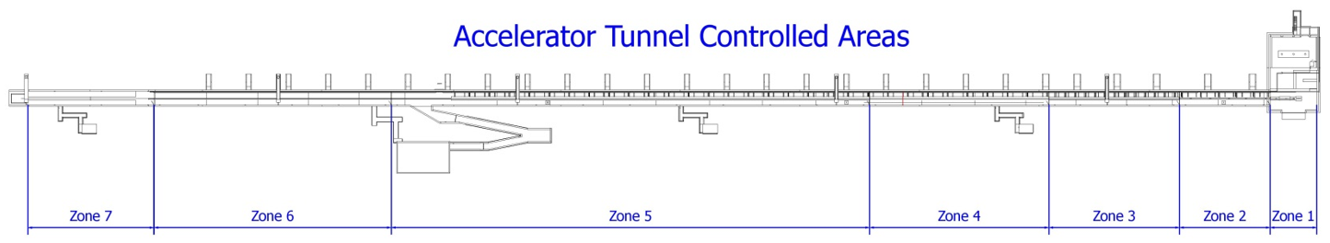
Option 1: ACCPSS_SIF3_1
Run slideshow on this slide
Access door interlock – FEB90
FEB PAS
FEB MAS
FEB90 E-Exit
Zone 8
A2T
Zone 7
HEBT
Zone 6
HBL2
Zone 5
HBL1
Zone 4
MBL
Zone 3
SPK
Zone 2
NCL
Zone 1
NCL

Slide 15
Option 2: ACCPSS_SIF3_1
Run slideshow on this slide
Access door interlock – FEB90
FEB PAS
FEB MAS
FEB90 E-Exit
ACCPSS_SIF3_8
Zone Gate 3
Zone Gate 4
Zone Gate 1
Zone 8
A2T
Zone 7
HEBT
Zone 6
HBL2
Zone 5
HBL1
Zone 4
MBL
Zone 3
SPK
Zone 2
NCL
Zone 1
NCL
ACCPSS_SIF3_9
ACCPSS_SIF3_7

Slide 16
ACC PSS SIFs
ACCPSS_SIF4
If any of the following is detected:
  Mode selection key (MODEK) is removed from all access allowing key slots in unit 1 OR
  Gamma blocker is detected open (not closed) OR
  PBDR isolation valve is detected open (not closed),
de-energise the lock (disable unlocking) for the following doors:
  FEB PAS D2
  MAS D2
  HEBT PAS D2
Reset conditions:
The ACC PSS shall prevent unlocking of the affected doors, until a manual reset is carried out by the operator by putting the MODEK in position ON in any of access allowing slots.

Slide 17
ACC PSS SIFs
ACCPSS_SIF5
If any radiation monitor connected to ACC PSS shows high radiation or has an error,
de-energise the following EUC:
Proton Beam Actuators:
  ISrc HVPS,
  Grounding relay;
Reset conditions:
A manual reset from the ACC PSS HMI shall be required if ACCPSS_SIF5 is tripped once the all radiation monitors are healthy and no high radiation is detected, prior to issuing the permit to energise the affected EUC.

Slide 18
ACC PSS SIFs
ACCPSS_SIF6
If the ACC PSS MODEK is detected in any of the slots to allow access with safety tokens:
  RP Survey slot,
  Restricted Access slot
  Search from FEB slot or
  Search from HEBT slot; AND
if any of the safety tokens in FEB PAS or HEBT PAS is detected taken out from the key exchange unit,
lock the MODEK in place by de-energising the solenoids for that slots, to prevent initiating proton beam operation.
Reset conditions:
The ACC PSS shall prevent unlocking of the MODEK, until all safety tokens are returned properly to respective key exchange units.

Slide 19
ACC PSS SIFs
ACCPSS_SIF7
If the Beam on Target (BoT) key is detected out of position ON in slot 1 of key exchange unit #1, de-energise the power of the bending magnets to ensure no beam is sent to the target.
This shall be activated 500ms after the key is detected out of position ON.
Reset conditions:
Prior to issuing the permit to energise the affected EUC, a manual reset shall be required if ACCPSS_SIF7 is tripped by returning the BoT key back to position ON, once the following is fulfilled:
All interfacing systems ready for BoT,
No feedback errors from bending magnets.
Note: BoT key will be locked in slot 2 until these conditions are fulfilled.

Slide 20
3
ACC PSS SIL Assessment

Slide 21
Zoned Approach to SIL Verification
Zone 1
  Proton Beam Actuators
  RFQ/DTL1 modulator and LLRF
  MEBT bunchers
Zone 2
  DTL2/DTL3, DTL4/DTL5 modulators and 4 LLRFs
Zone 3
  26 RF Power Stations for Spokes and LLRFs
Zone 4
  9 Medium Beta Linac modulators
  36 LLRFs
Zone 5
  10 High Beta Linac modulators
  40 LLRFs
Zone 6
  11 High Beta Linac modulators
  44 LLRFs
Zones 7 and 8 (HEBT and A2T)
  Gamma blocker
  PBDR valve
SIFs are linked to elements in different zones

Slide 22
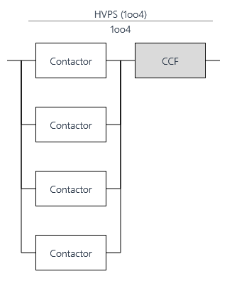
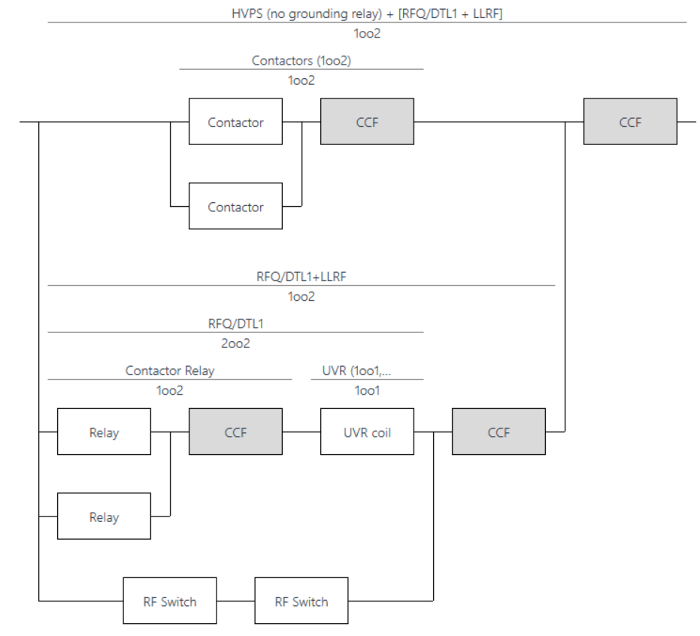
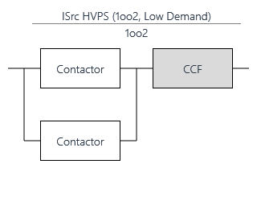
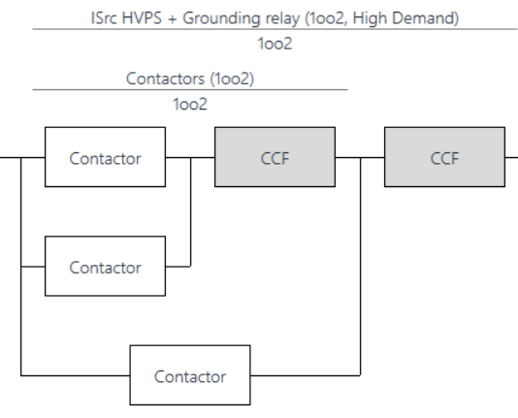
Options for Turning Off Proton Beam
Variation RBD: HVPS (no grounding relay) + RFQ as 1oo2
Variation RBD: Just HVPS (no grounding relay) - 1oo2 contactors vs 1oo4 contactors
PFH Achieved: 3.7E-10/hr
PFD Achieved: 4.5E-06
PFH Achieved: 4.0E-09/hr
PFD Achieved: 4.9E-05
Current RBD: ISrc HVPS + Grounding relay
PFH Achieved: 4.1E-10/yr
PFD Achieved: 5.0E-06

Slide 23
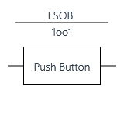
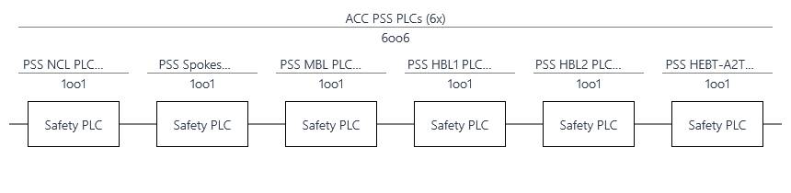
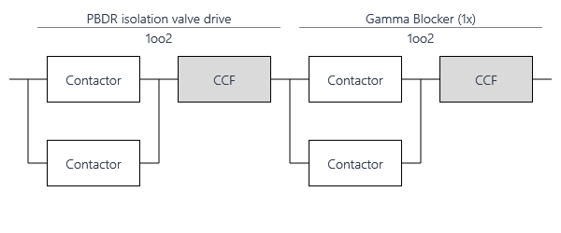
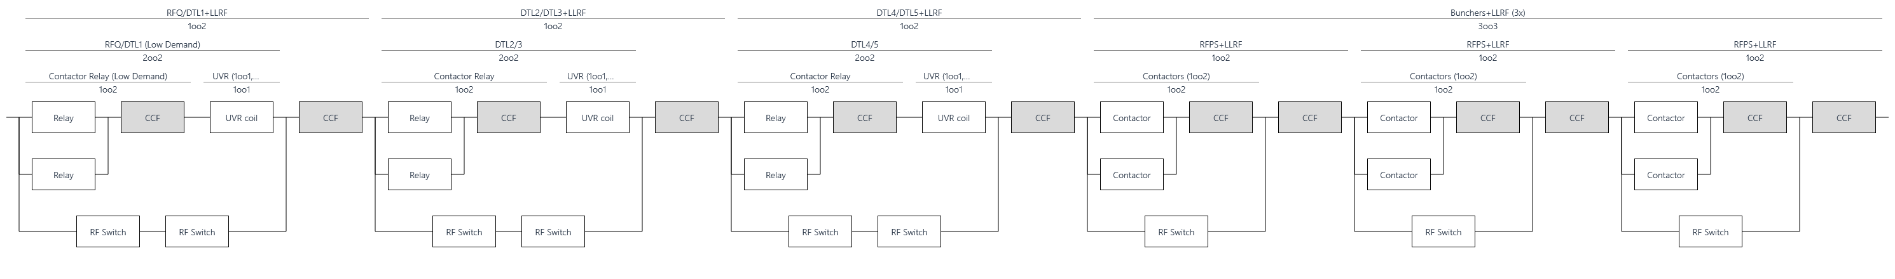
Example: RBD for ACCPSS_SIF1

Slide 24
ACCPSS_SIF2
ACC PSS main key proton beam interlock
PFH Target: 2.3E-7
SIL Target: SIL 2
ACCPSS_SIF2 without RF Systems
If the Permit for Proton Beam key is detected out of position ON, de-energise the Proton beam actuators and actuators to block radiation from the target.
Maximum achievable SIL: SIL 2
PFH Achieved: 3.4E-8/hr
ACCPSS_SIF2 including RF Systems
To also monitor all RF systems and cut the non-isolated ones.
Maximum achievable SIL: SIL 2
PFH Achieved: 4.6E-7/hr
Including the RF systems SIF 2 narrowly doesn’t meet the PFH target.
Notes:
Including the RF systems SIF 2 narrowly doesn’t meet the PFH target.

Slide 25
ACCPSS_SIF3
Option 1 vs Option 2
PFH Target: 1.1E-6
SIL Target: SIL 1
ACCPSS_SIF3 interfacing all RF Systems at once (option 1)
Maximum achievable SIL: SIL 2
PFH Achieved: 6.7E-7/hr
ACCPSS_SIF3 variations (option 2)
Maximum achievable SIL: SIL 2
PFH: 7.50E-07/hr (worst case, 4 SIFs)
Issue: Common cause failures between 4 SIFs (SIF3_1, SIF3_7, SIF3_8, SIF3_9) used for the whole area.

Slide 26
SIL Verification Results
ACC PSS Low Demand SIFs
SIF Tag | Selected PFD Target | PFD Achieved | Selected SIL Target | Max Allowable SIL (Architectural Constraints) | Result
ACCPSS_SIF1 – Emergency Switch Off Button Interlock | N/A | 3.5E-3 | SIL 1 | SIL 2 | Passed
ACCPSS_SIF5 – High Radiation Interlock | 1.0E-2 | 2.8E-4 | SIL 2 | SIL 2 | Passed

Slide 27
SIL Verification Results
ACC PSS High Demand SIFs
SIF Tag | Selected PFH Target | PFH Achieved (/hr) | Selected SIL Target | Max Allowable SIL (Architectural Constraints) | Result
ACCPSS_SIF2 – Main Key Interlock | 2.3E-7 | 3.4E-8 | SIL 2 | SIL 2 | Passed
ACCPSS_SIF2 (variation, monitor RFs) | 2.3E-7 | 4.6E-7 | SIL 2 | SIL 2 | Failed
ACCPSS_SIF3 (variation, all zones combined) | 1.1E-6 | 6.7E-7 | SIL 1 | SIL 2 | Passed
ACCPSS_SIF3_1 – Access Doors Interlock -FEB | 1.1E-6 | 1.3E-7 | SIL 1 | SIL 3 | Passed
ACCPSS_SIF3_2 – Access Doors Interlock – E-exit2 | 1.1E-6 | 4.5E-7 | SIL 1 | SIL 3 | Passed
ACCPSS_SIF3_3 – Access Doors Interlock– E-exit3 | 1.1E-6 | 5.5E-7 | SIL 1 | SIL 3 | Passed
ACCPSS_SIF3_4 – Access Doors Interlock - HEBT | 1.1E-6 | 3.9E-7 | SIL 1 | SIL 3 | Passed
ACCPSS_SIF3_5 – Access Doors Interlock– E-exit5 | 1.1E-6 | 2.1E-7 | SIL 1 | SIL 3 | Passed
ACCPSS_SIF3_6 – Access Doors Interlock– E-exit6,7 | 1.1E-6 | 1.5E-8 | SIL 1 | SIL 3 | Passed
ACCPSS_SIF3_7 – RF Interlock – Zone Gates 1 & 5 | 1.1E-6 | 1.7E-7 | SIL 1 | SIL 2 | Passed
ACCPSS_SIF3_8 – RF Interlock – Zone Gate 3 | 1.1E-6 | 2.0E-7 | SIL 1 | SIL 2 | Passed
ACCPSS_SIF3_9 – RF Interlock – Zone Gate 4 | 1.1E-6 | 3.0E-7 | SIL 1 | SIL 2 | Passed
ACCPSS_SIF3_10 – RF Interlock – Zone Gate 6 | 1.1E-6 | 1.8E-7 | SIL 1 | SIL 2 | Passed
ACCPSS_SIF3_11 – RF Interlock – Zone Gate 7 | 1.1E-6 | 2.0E-7 | SIL 1 | SIL 2 | Passed
ACCPSS_SIF4 – Access Door Lock | 1.1E-6 | 2.1E-7 | SIL 1 | SIL 2 | Passed
ACCPSS_SIF6 – Entry Keys Prevent Initiating Beam Operation | 1.1E-6 | 4.6E-7 | SIL 1 | SIL 2 | Passed
ACCPSS_SIF7 – BoT Key Bending Magnets Interlock | On-going* | 4.2E-8 | On-going* | SIL 2 | On-going*
*Note that the SIL target determination for ACCPSS_SIF7 is on-going. This SIF is valid for events when a person is working in the Target or bunker controlled area and the proton beam on target is allowed.

Slide 28
Event Tree Analysis (ETA)
ETA01 - Accelerator operation started in error, Electric shock hazard

Slide 29
Event Tree Analysis (ETA)
ETA02a - Accelerator operation started in error (access without key), Radiation hazard
ETA02b - Accelerator operation started in error (access with key), Radiation hazard
Notes:
EPD is always required.
0.1 for personnel counter.
Update definition of ETA02b initiating event (mechanical key exchange failure or similar)
We should probably go back to 0.01 in formalised search failure, not to be too optimistic here. ☺

Slide 30
Event Tree Analysis (ETA)
ETA03a - Intrusion (via PAS/MAS), Radiation hazard
ETA03b - Intrusion (via E-Exits), Radiation hazard

Slide 31
Event Tree Analysis (ETA)
ETA04 - Off-normal beam, Radiation hazard

Slide 32
Questions to the Committee
ACC PSS
Is the updated approach for Proton Beam actuators acceptable?
Are the options for ACCPSS_SIF2 and ACCPSS_SIF3, where all RF systems are interfaced, acceptable?
Is it ok to keep the monitoring of zone gates as part of ACCPSS_SIF3 if Option 1 is acceptable?
Is the probability of failure for the formalised search procedure (human error) acceptable?

Slide 33
4
TS PSS, Bunker PSS, DREAM PSS SIFs

Slide 34
TS PSS SIFs
TSPSS_SIF1
If any ESOB in Target PSS controlled area is detected pressed when bending magnets are energized (BoT allowed), de-energise the Proton Beam Actuators.
TSPSS_SIF3
If there is access to Target PSS controlled area (any access door or emergency exit door detected open) and bending magnets are detected energized (BoT allowed), de-energise the Proton Beam Actuators.
Access doors level 91 (2 doors, 2 switches per door)
Sliding concrete door level 103 (1 door, 2 switches)
Sliding concrete door level 115 (1 door, 2 switches)
Double-gated access door level 115 (2 leafs per door, 2 switches per leaf - 8 switches in total)
Emergency exit door level 90 (1 door, 2 switches)
Emergency exit door level 103 (1 door, 2 switches)
Feedback signals, bending magnet contactors (4 contactors’ feedback signals in total)
PSS NCL PLC
TS PSS PLC
Nexus PLC
2 contactors for ISrc HVPS
Grounding relay + contactor relay

Slide 35
TS PSS SIFs
This is done without a logic solver. PLC will monitor the safety circuits from the lock unit to ensure the door is locked.
TSPSS_SIF4
TSPSS_SIF4_1
Upon removal of the entry key to access door DIS602 from the door lock unit, lock the door DIS602 via solenoid.
TSPSS_SIF4_2
Upon removal of the entry key to access door DIS605 from the door lock unit, lock the door DIS605 via solenoid.
TSPSS_SIF4_3
Upon removal of the entry key to sliding concrete door to D02.103.4003 from the door lock unit, lock the sliding concrete door to D02.103.4003 via solenoid.
TSPSS_SIF4_4
Upon removal of the entry key to sliding concrete door to D02.115.4003 from the door lock unit, lock the sliding concrete door to D02.115.4003 via solenoid.
TSPSS_SIF4_5
Upon removal of the entry key to access door to D02.115.4001 (Connection Cell) from the door lock unit, lock the access door to D02.115.4001 (Connection Cell) via solenoid.

Slide 36
TS PSS SIFs / Bunker PSS SIFs
TSPSS_SIF6
If the Target Access key is detected out of position ON in Slot 3 of the key exchange unit 1, de-energise the following EUC:
  Light Shutter Systems (LSS) Actuators in D01.
  Light Shutter Systems (LSS) Actuators in D03.
BunPSS_SIF6_1
If the South Bunker Access key (SBAK) is detected removed from position ON in Slot 5 de-energize the following EUC:
  Light Shutter Systems (LSS) Actuators in D01
BunPSS_SIF6_2
If the North Bunker Access key (NBAK) is detected removed from position ON in Slot 4 de-energize the following EUC:
  Light Shutter Systems (LSS) Actuators in D03
These functions prevent people from being exposed to gamma radiation in Target basement area and Bunker PSS controlled area.
BunPSS_SIF8_1
If any of the LSS in D01 is detected open, lock the South Bunker Access key (SBAK) in position ON in slot 5 of Unit 1.
BunPSS_SIF8_2
If any of the LSS in D03 is detected open, lock the North Bunker Access key (NBAK) in position ON in slot 4 of Unit 1.

Slide 37
Bunker PSS SIFs
BunPSS_SIF7
If any safety token is detected removed from units 2 in North and South Bunkers and bending magnets are detected energized (BoT allowed), de-energise the following EUC:
  Proton Beam Actuators
  Light Shutter Systems (LSS) Actuators in D01.
  Light Shutter Systems (LSS) Actuators in D03.
Safety circuits from Bunker South key exchange unit 2 (2 safety circuits per unit)
Safety circuits from Bunker North key exchange unit 2 (2 safety circuits per unit)
Feedback signals, bending magnet contactors (4 contactors’ feedback signals in total)
Bunker North PSS PLC
Bunker South PSS PLC
Nexus PSS PLC
PSS NCL PLC
2 contactors for ISrc HVPS
Grounding relay + contactor relay
2 contactors for each LSS (16 in total)

Slide 38
DREAM PSS SIFs
Proton beam interlock if BoT allowed
DREAMPSS_SIF1
  If any ESOB in the DREAM PSS controlled area is pressed, de-energise the instrument shutter.
    Additionally, if the instrument shutter is detected open after the ESOB is detected pressed, and the bending magnets are detected energized (BoT allowed), de-energise the Proton Beam Actuators.
DREAMPSS_SIF3
If the access door to DREAM PSS controlled area is detected open, de-energise the instrument shutter.
    Additionally, if the instrument shutter is detected open 5 seconds after the door is detected open, and the bending magnets are detected energized (BoT allowed), de-energise the Proton Beam Actuators.
6 ESOBs
Feedback signals, bending magnet contactors (4 contactors’ feedback signals in total)
2 safety switches on the instrument shutter
DREAM PSS PLC
Nexus PSS PLC
PSS NCL PLC
Solenoid valve (PSS owned)
Pneumatic actuator for instrument shutter
2 contactors for ISrc HVPS
Grounding relay + contactor relay
2 contactors for each LSS (16 in total)

Slide 39
DREAM PSS SIFs
DREAMPSS_SIF2
      If the DREAM main key is detected out of position ON, de-energise the instrument shutter.
  DREAMPSS_SIF6
      If the DREAM instrument shutter is detected open, lock the DREAM main key in position ON.
DREAMPSS_SIF4
      If the entry key to open the access door to DREAM cave 1 is detected removed from position ON in the lock unit, de-energise the solenoid on the door's lock unit.
DREAMPSS_SIF5
      If the radiation monitor downstream the DREAM instrument shutter shows high radiation or has an error when the shutter is closed and DREAM access key to cave 1 is out of position ON, de-energise the Proton Beam Actuators.

Slide 40
5
TS PSS, Bunker PSS, DREAM PSS SIL Assessment

Slide 41
SIL verification Results
Low Demand SIFs
SIF Tag | Selected PFD Target | PFD Achieved | Selected SIL Target | Max Allowable SIL (Architectural Constraints) | Result
TSPSS_SIF1 – ESOB interlock from Target area | N/A | 4.6E-4 | SIL 1 | SIL 2 | Passed
DREAMPSS_SIF1 - ESOB interlock from DREAM PSS | N/A | 3.7E-2 | SIL 1 | SIL 1 | Passed
DREAMPSS_SIF5 - High radiation interlock in DREAM | 1.0E-2 | 4.2E-4 | SIL 1 | SIL 2 | Passed

Slide 42
SIL verification Results
High Demand
SIF Tag | Selected PFH Target | PFH Achieved (/hr) | Selected SIL Target | Max Allowable SIL (Architectural Constraints) | Result
TSPSS_SIF3 - Target Access Door Interlock | 1.1E-6 | 2.2E-8 | SIL 1 | SIL 3 | Passed
TSPSS_SIF4_1 – Target level 91 (Basement) access door DIS602 lock | 1.1E-6 | 1.1E-7 | SIL 1 | SIL 2 | Passed
TSPSS_SIF4_2 – Target level 91 (Basement) access door DIS605 lock | 1.1E-6 | 1.1E-7 | SIL 1 | SIL 2 | Passed
TSPSS_SIF4_3 – Target level 103 sliding concrete door lock | 1.1E-6 | 1.1E-7 | SIL 1 | SIL 2 | Passed
TSPSS_SIF4_4– Target level 115 sliding concrete door lock | 1.1E-6 | 1.1E-7 | SIL 1 | SIL 2 | Passed
TSPSS_SIF4_5– Target level 115 access door lock | 1.1E-6 | 1.1E-7 | SIL 1 | SIL 2 | Passed
TSPSS_SIF6 – Target access key LSS interlock | [HOLD] | 9.7E-8 | [HOLD] | SIL 2 | [HOLD]
BunPSS_SIF6_1– Bunker access key LSS interlock in Bunker South (D01) | [HOLD] | 4.3E-8 | [HOLD] | SIL 2 | [HOLD]
BunPSS_SIF6_2– Bunker access key LSS interlock in Bunker North (D03) | [HOLD] | 6.7E-8 | [HOLD] | SIL 2 | [HOLD]
BunPSS_SIF7– Safety tokens interlock | [HOLD] | 1.0E-7 | [HOLD] | SIL 3 | [HOLD]
BunPSS_SIF8_1– SBAK lock | [HOLD] | 9.6E-8 | [HOLD] | SIL 2 | [HOLD]
BunPSS_SIF8_2– NBAK lock | [HOLD] | 9.9E-8 | [HOLD] | SIL 2 | [HOLD]
DREAMPSS_SIF2– DREAM main key interlock | 2.3E-7 | 3.1E-6 | SIL 2 | SIL 1 | Failed
DREAMPSS_SIF3– Access door interlock in DREAM PSS | 1.1E-6 | 3.1E-6 | SIL 1 | SIL 1 | Failed
DREAMPSS_SIF4– DREAM cave access door lock | 1.1E-6 | 1.1E-7 | SIL 1 | SIL 2 | Passed
DREAMPSS_SIF6– DREAM main key lock | [HOLD] | 9.4E-8 | [HOLD] | SIL 2 | [HOLD]

Slide 43
Event Tree Analysis (ETA)
TBD

Slide 44
Questions to the Committee
TS PSS, Bunker PSS, DREAM PSS
Is the approach for the initiating event where a person is missed by search and operation initiated acceptable?
Are the presented set of identified Safety Instrumented Functions (SIFs) properly formulated, and do they fulfil the overall safety functions derived from the DREAM RA?
Do you have any recommendation/example for reliability data used for equipment similar to the DREAM instrument shutter?

Slide 45
Thank you for your attention!

Slide 46
Backup slides

Slide 47
ACCPSS_SIF3_2
Run slideshow on this slide
Access door interlock – E-Exit1
Zone 8
A2T
Zone 7
HEBT
Zone 6
HBL2
Zone 5
HBL1
Zone 4
MBL
Zone 3
SPK
Zone 2
NCL
Zone 1
NCL
E-Exit 1

Slide 48
ACCPSS_SIF3_3
Run slideshow on this slide
Access door interlock – E-Exit2
Zone 8
A2T
Zone 7
HEBT
Zone 6
HBL2
Zone 5
HBL1
Zone 4
MBL
Zone 3
SPK
Zone 2
NCL
Zone 1
NCL
E-Exit 2

Slide 49
ACCPSS_SIF3_4
Run slideshow on this slide
Access door interlock – HEBT90
Zone 8
A2T
Zone 7
HEBT
Zone 6
HBL2
Zone 5
HBL1
Zone 4
MBL
Zone 3
SPK
Zone 2
NCL
Zone 1
NCL
HEBT PAS

Slide 50
ACCPSS_SIF3_5
Run slideshow on this slide
Access door interlock – E-Exit 3
Zone 8
A2T
Zone 7
HEBT
Zone 6
HBL2
Zone 5
HBL1
Zone 4
MBL
Zone 3
SPK
Zone 2
NCL
Zone 1
NCL
E-Exit 3

Slide 51
ACCPSS_SIF3_6
Run slideshow on this slide
Access door interlock – E-Exit 4 & A2T E-Exit
A2T E-Exit
Zone 8
A2T
Zone 7
HEBT
Zone 6
HBL2
Zone 5
HBL1
Zone 4
MBL
Zone 3
SPK
Zone 2
NCL
Zone 1
NCL
E-Exit 4

Slide 52
Event Tree Analysis (ETA) – Not a Credible Scenario
ETA04a - RF systems not isolated prior to RF Testing (RFQ/DTL, with shutter switch)
ETA04b - RF systems not isolated prior to RF Testing (MEBT etc., no shutter switch)

