Slide 2
Installation and commissioning plan
ESS PSS PDR (2022-12-01)
PRESENTED BY Morteza Mansouri

Slide 3
Agenda
1 PSS development lifecyle
2 HW FAT
3 HW SAT
SW pre-FAT
SIT
FIT

Slide 4
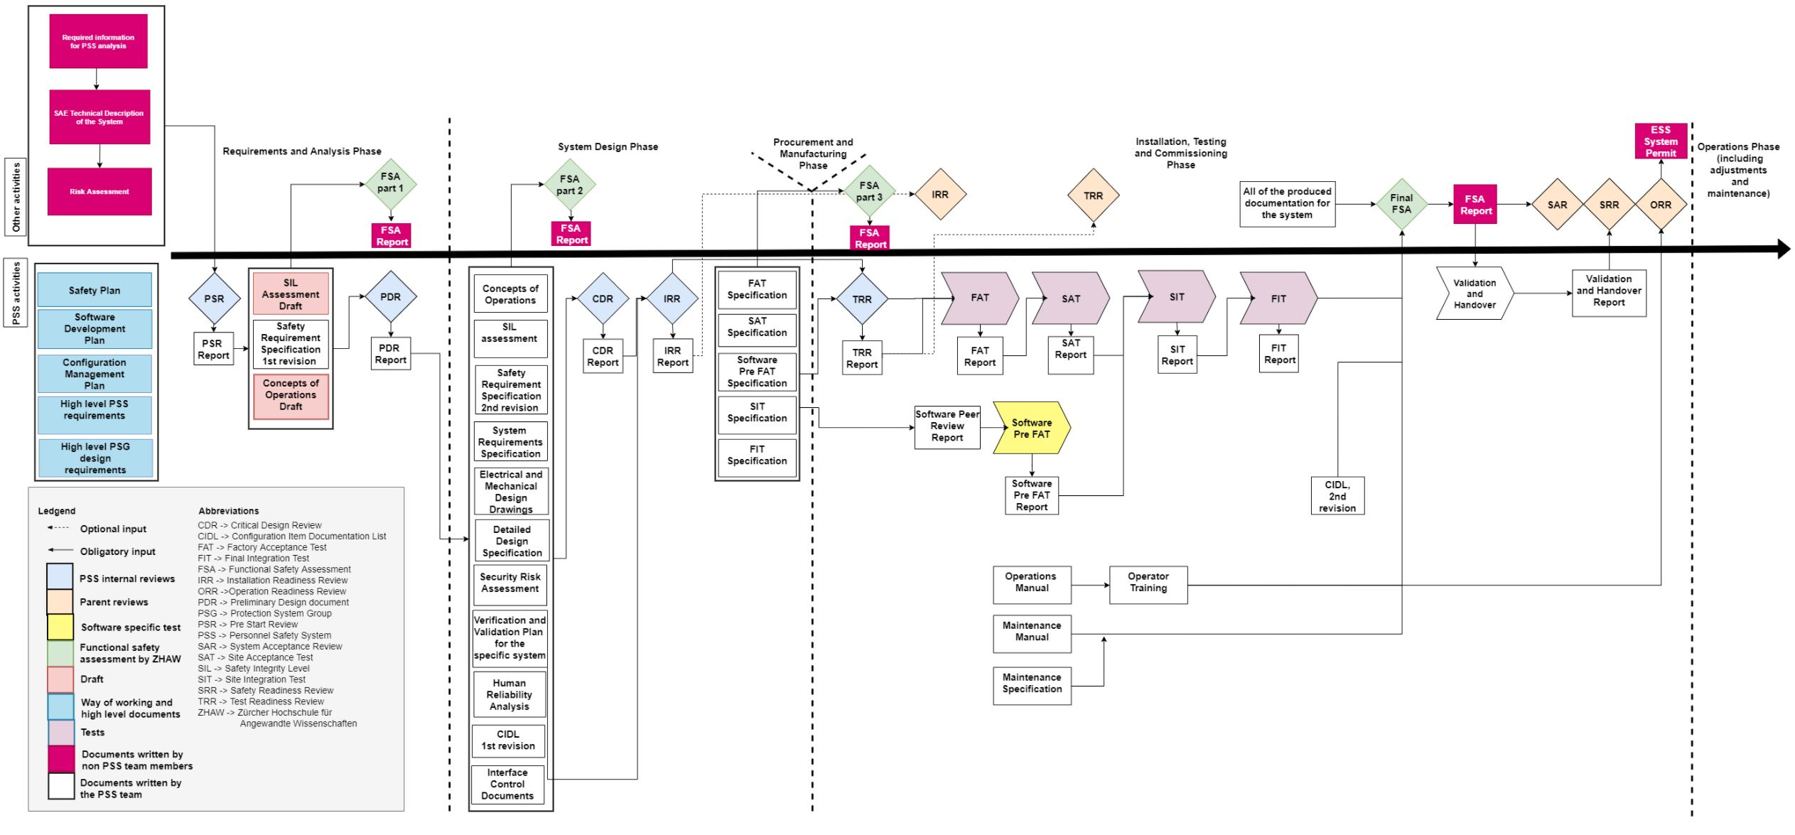
PSS development lifecycle

Slide 5
HW FAT
What does HW FAT for PSS mean?
The Hardware FAT for PSS hardware verifies that the as-built hardware system meets the specified design. The Hardware FAT includes component test. The Hardware FAT shall be performed by the vendor, but it should be designed and accepted by ESS.
What are the typical tests in a PSS HW FAT?
Ensure the manufactured enclosure/box is according to the specifications, e.g. the components labeling, color coding of wires, placement of components, locks, wires terminations, etc.
Protection against indirect contact
Insulation resistance
Test the correct operation of power supplies, selectivity modules, etc.
Check the correct operation of PLC I/O modules by simulating/forcing signals.
See further details in ESS-1418781.
Dependencies to other systems?
None identified so far.

Slide 6
HW SAT
What does HW SAT for PSS mean?
The Hardware SAT verifies that the hardware is installed as specified in its operational environment. It includes the same tests as the Hardware FAT and some additional field device tests and a loop check as well as required 230VAC tests such as continuity check, insulation resistance test and automatic disconnection of supply test, once the hardware is delivered to ESS. The Hardware SAT will be performed by ESS on site.
What are the typical tests in a PSS HW SAT?
Repeat HW FAT tests for the installed enclosures/boxes.
Ensure the field devices are installed according to the specifications, e.g. the components labeling, correct triggering of position monitoring switches, placement of components, door locks function as expected, cable/wires terminations, etc.
Perform loop check between PLC I/O modules and field devices.
See further details in ESS-3540556.
Note: HW Electrical Inspection must be performed by ESS Quality division before energizing the system.

Slide 7
HW SAT
Dependencies to other systems?
ACC PSS:
Modulators/RFPS installed in place (SPK and MB)
RF racks ready for PSS relays installation.
RFDS installed
Gamma blockers installed
PBDR isolation valve installed.
PS for bending magnets installed.
Target PSS:
Access doors, shielding doors, and hatches installed.
Electrical power for PSS cabinets and ICCs available at the point of supply.

Slide 8
HW SAT
Dependencies to other systems?
Bunker PSS:
Staircases and access doors installed.
Light shutters installed.
Raised floors for cabinets installed.
Electrical power for PSS cabinets available at the point of supply.
DREAM PSS:
DREAM instrument shutter installed.
The Bunker to cave area shielding and cave roof shielding installed.
Access door and zone gates installed.
Electrical power for PSS cabinets and ICCs available at the point of supply.

Slide 9
SW pre-FAT
What does SW pre-FAT for PSS mean?
Software Pre-FAT verifies the software functionality through simulations in test environment. It includes the software peer review (carried out by an independent software reviewer) to reveal potential software design defects and avoid systematic failures. The test will be documented in two documents: a software pre-FAT report document, and a software peer review document.
What are the typical tests in a PSS SW pre-FAT?
It’s a virtual commissioning of the system in which the system functions (safety instrumented functions, search procedures, key exchange procedures, etc.) are tested using SIMIT (simulation tool by Siemens).
In SW peer review, items such as code structure, modularity, etc. are checked by an independent SW developer. See further details in ESS-1941410.
Dependencies to other systems?
None identified so far.

Slide 10
SIT (Site Integration Test)
What does SIT for PSS mean?
The SIT verifies that installed hardware and software work together properly, ensuring that their combination is serving the purpose of PSS safety functions and procedures.
In case of ACC PSS, the SIT is performed while EUC (e.g. ISrc HVPS or modulators) are not connected to PSS.
In case of Target PSS, Bunker PSS and Instrument PSS, the SIT includes the local functional test of the system, i.e. the local EUC e.g. instrument shutter is connected to and tested with PSS during SIT.
What are the typical tests in a PSS SIT?
The system functions (safety instrumented functions, search procedures, key exchange procedures, etc.) which are local to specific PSS (i.e. excluding integrated testing with other necessary PSS) are tested and verified.

Slide 11
SIT (Site Integration Test)
Dependencies to other systems?
ACC PSS:
RF systems
RFDS certified
RFDS connected to cavities? (preferably not, but if connected, the PSS blanking plate to be installed)
Bending magnets: The Power supply is installed.
Gamma blockers: The gamma blockers are installed and control system is operational.
PBDR isolation valve: The PBDR isolation valve is installed and control system is operational.
REMS: Radiation monitors installed and operational. Interfaces with PSS already connected.
Physical Protection System: The card readers on both PAS FEB and PAS HEBT installed and operational
EPD system: The EPD system on both PAS FEB and PAS HEBT installed and operational (at least in the general mode)
Integration of ACC PSS to EPICS is completed, and ACC PSS OPI is developed.

Slide 12
SIT (Site Integration Test)
Dependencies to other systems?
Target PSS:
Access and shielding doors installed and operational.
Integration of TS PSS to EPICS is completed, and TS PSS OPI is developed.
Bunker PSS:
Light shutters energized and operational.
Integration of Bunker PSS to EPICS is completed, and Bunker PSS OPI is developed.
DREAM PSS:
Instrument shutter is operational (includes motion controls and instrument air), and connected to PSS.
Radiation monitors are operational and connected to PSS. (TBD)
Integration of DREAM PSS to EPICS is completed, and DREAM PSS OPI is developed.

Slide 13
FIT (Final Integration Test)
What does FIT for PSS mean?
The FIT is a repetition of the positive tests from SIT whilst designated systems and EUC are operational and connected to PSS.
In case of ACC PSS, the FIT is performed while EUC (e.g. ISrc HVPS or modulators) are connected to PSS.
In case of Target PSS, Bunker PSS and Instrument PSS, the FIT includes the integrated functional test of the system with Nexus and ACC PSS.
What are the typical tests in a PSS FIT?
Ensure the safety instrumented functions work together with the interfaced equipment/systems as expected.

Slide 14
FIT (Final Integration Test)
Dependencies to other systems?
ACC PSS:
The equipment/systems mentioned for the SIT are connected to PSS
Target PSS:
The equipment/systems mentioned for the SIT
Bunker PSS
Nexus PSS
ACC PSS

Slide 15
FIT (Final Integration Test)
Dependencies to other systems?
Bunker PSS:
The equipment/systems mentioned for the SIT
Target PSS
Nexus PSS
ACC PSS
DREAM PSS:
The equipment/systems mentioned for the SIT.
Accelerator PSS
Nexus PSS

Slide 16
ACC PSS
ACC PSS, TS PSS, Bunker PSS, Day-1 instrument PSS

Slide 17
Thank you!

