Slide 1
Progress on Remote Handling Systems
TAC 12
Magnus Göhran – WPM
www.europeanspallationsource.se
15th October 2015

Slide 2
Outline
Current Status
Current Developments on
Stainless Steel Liner and Anchor Plates
Electrical Conduits and Junction Boxes
Confinement Penetrations
Internal Casks
Next 3 months
Risks and Issues

Slide 3
Current Status
Currently there are 6 ESS staff, full time on the Active Cells WU and 2 Master Students
In-kind partner selected for the active cells – UKAEA/Culham – Ramping up effort
First major procurement of cast in items in progress
Internal Cask concept development in collaboration with development of monolith and shielding design

Slide 4
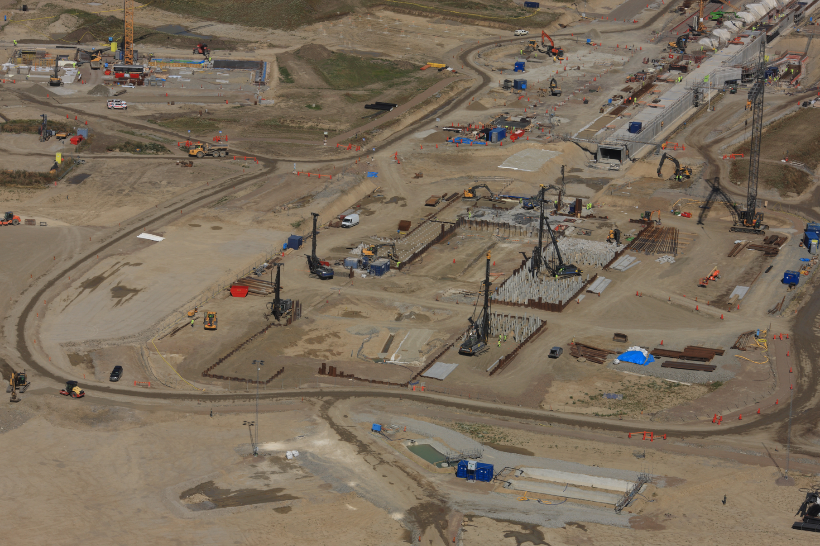
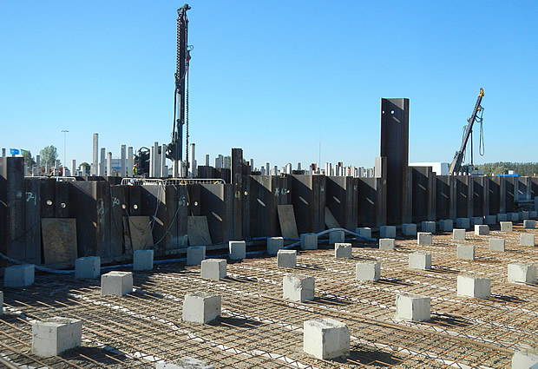
Current Status at Site

Slide 5
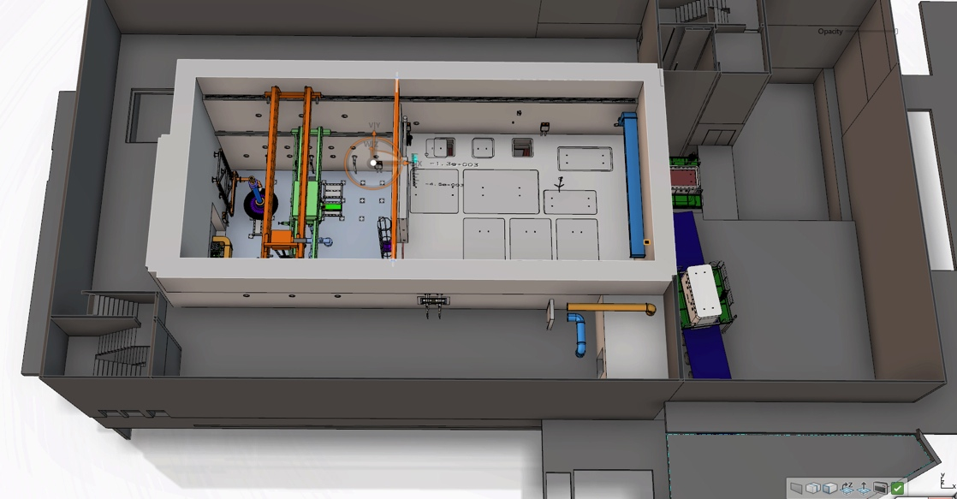
The Active Cells Layout
Process cell – Introduction of radiated components from the high bay, processing of components and preparation for interim storage and shipment as well as refurbishment in specific cases.
Maintenance cell – Maintenance of equipment and logistical hub for transfer inside the active cells.
Storage pits – Intermediate storage of vessels awaiting off-site shipment.
Technical galleries – Contains the remote handling interfaces for active cell operations, component storage, PIE activities, human logistics around the cells and air locks for entrance into the maintenance cells.
Transfer area – For off-site shipment of casks, control and decontamination of shipment cask surfaces.
Storage Pits
Transfer Area
Shipment
Technical Galleries
Process Cell
Maintenance Cell
Size:
Height 15 m
Length 30 m
Width 12 m

Slide 6
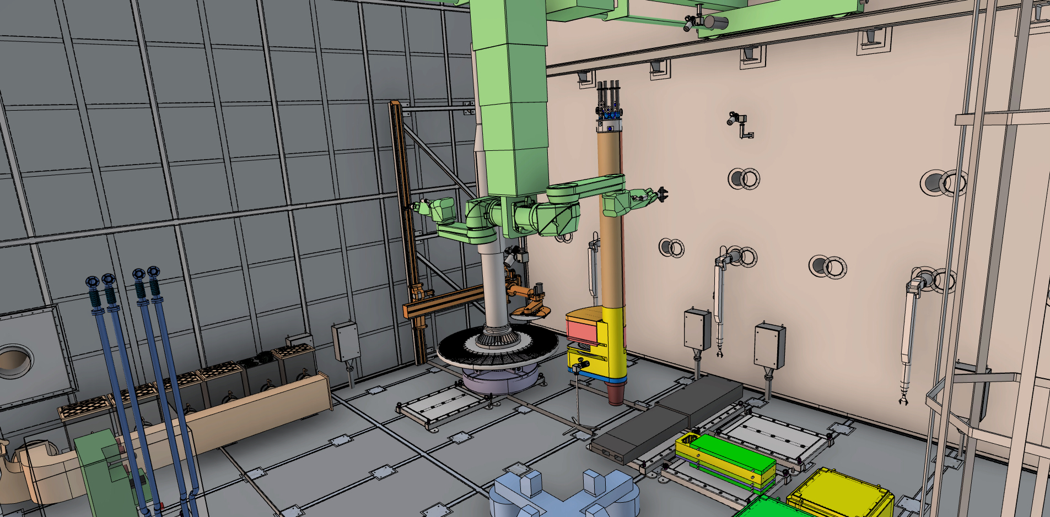
Process Cell details
HEPA Filters
Saw
Power Manipulator
Through Wall Manipulators
Cameras
El. and I&C
Anchor Plates
Liner Beams
Rotating Tables
Work Tables

Slide 7
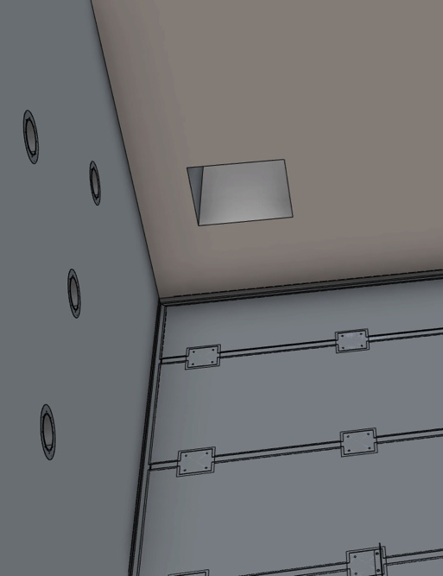
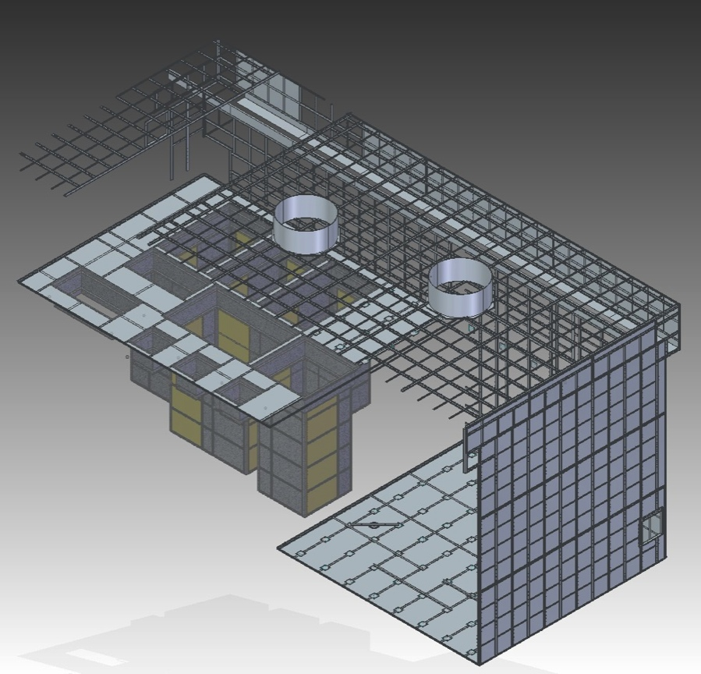
Stainless Steel Liner
Liner Beams 120x70
Plates 4 mm on floor 2 mm on wall and roof
Anchor plates combined with liner beams to ensure alignment
Storage pits – prefabricated
First Items on-site in March 2016 – Finished Sept 2017
Maintenance Cell Floor
Liner Beams
Storage Pits
Process Cell Floor
Anchor Plates in Floor

Slide 8
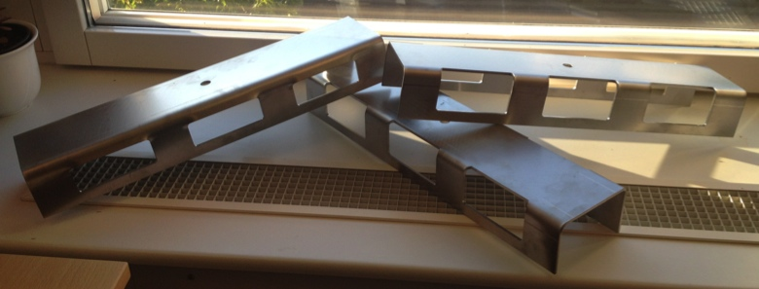
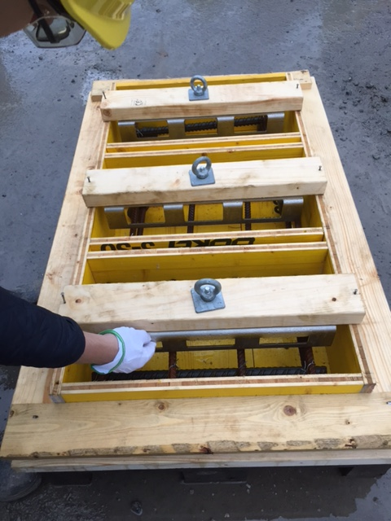
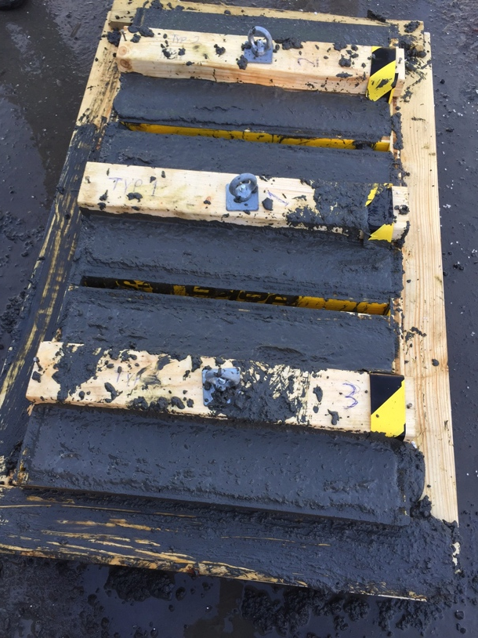
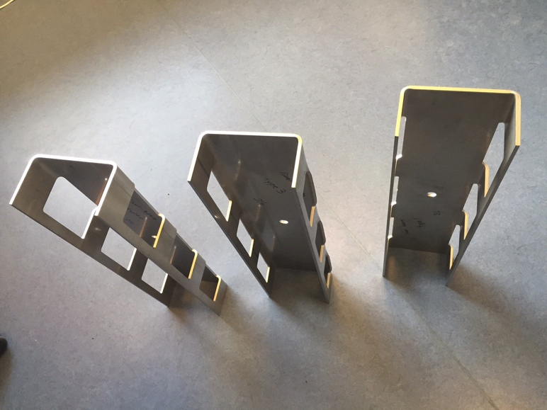
Liner Beam Prototypes
Testing folding accuracy
Filling degree of concrete underneath the beams – test casting with high density concrete
Will perform bending and pull out tests

Slide 9
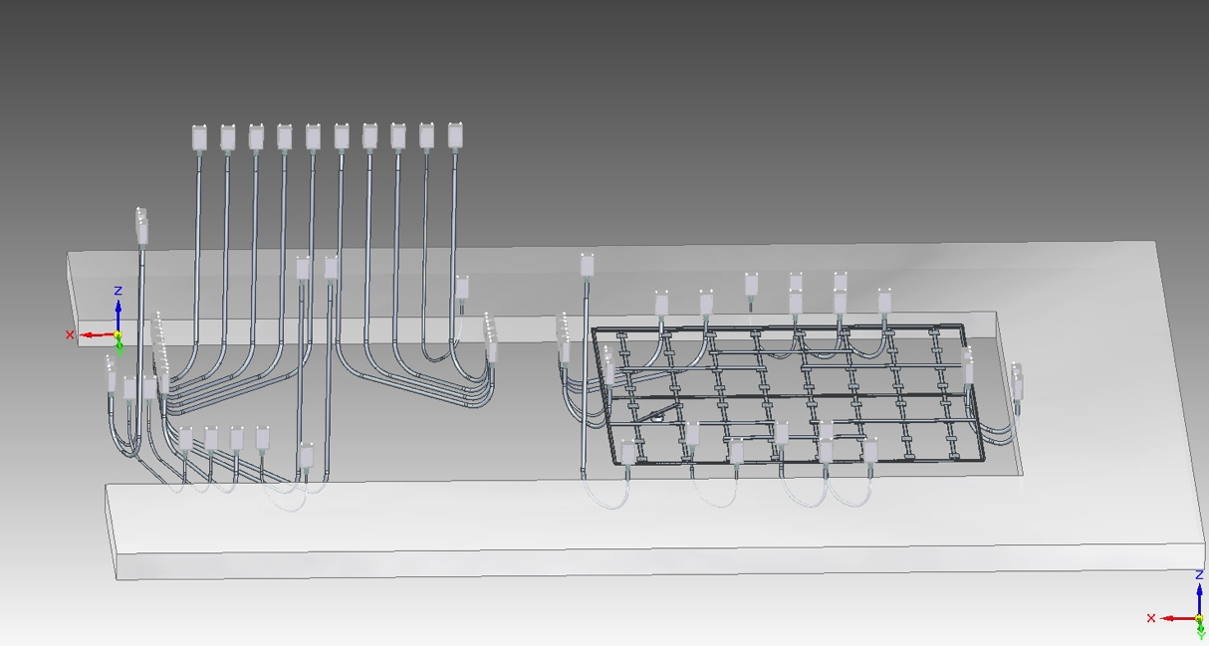
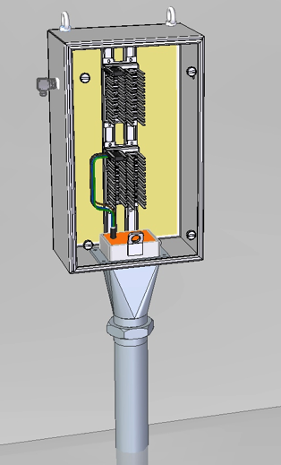
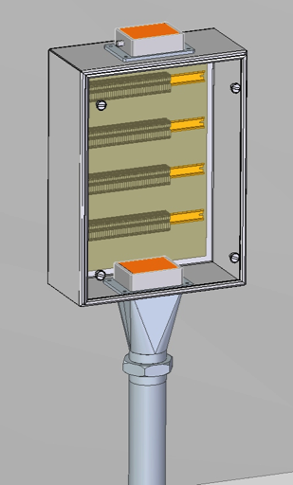
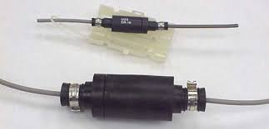
Electrical Conduits and Junction Boxes
Maintenance Cell
Cold side connection
Process Cell
Remote access
Hands-on
Grayboot Connector
Cold side connection
Transfer Area
Technical Galleries
Diameter 114 mm
Pipe routing from cold to hot side to avoid weak spots in the walls
1 meter bend radius

Slide 10
Confinement Penetrations - Layout

Slide 11
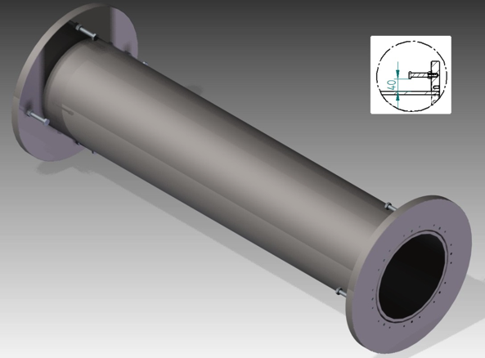
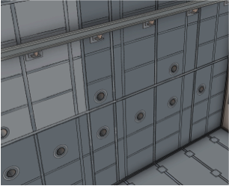
Confinement Penetrations
Stainless Steel
Straight pipe, without step
Oversized flanges
254 mm diameter
In total 40-50
Evenly distributed
One size – increase flexibility
Min. 2,7 meters from floor
Tight tolerances between tube and plug

Slide 12
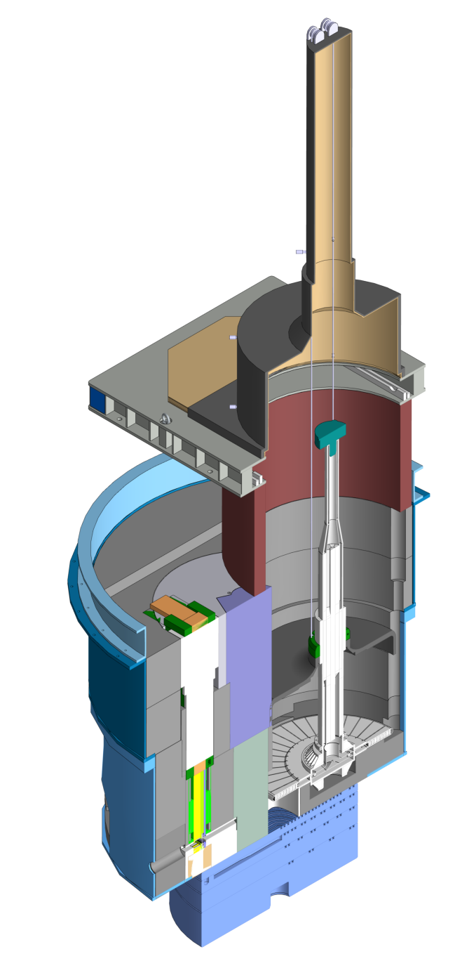
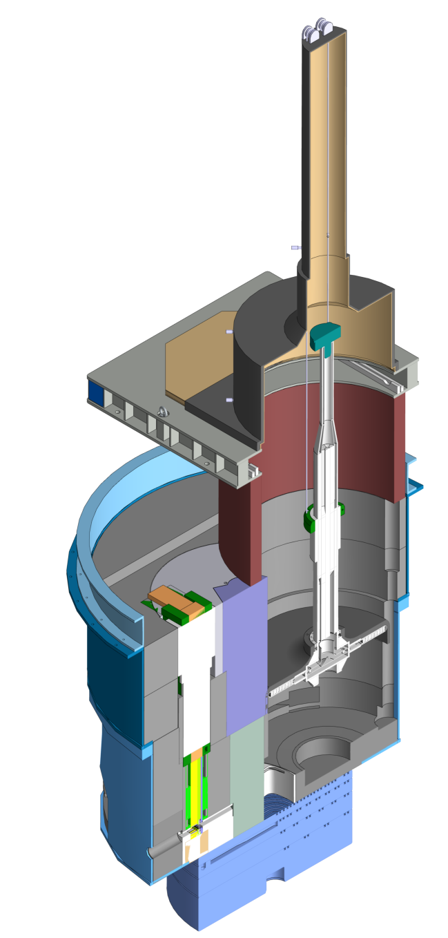
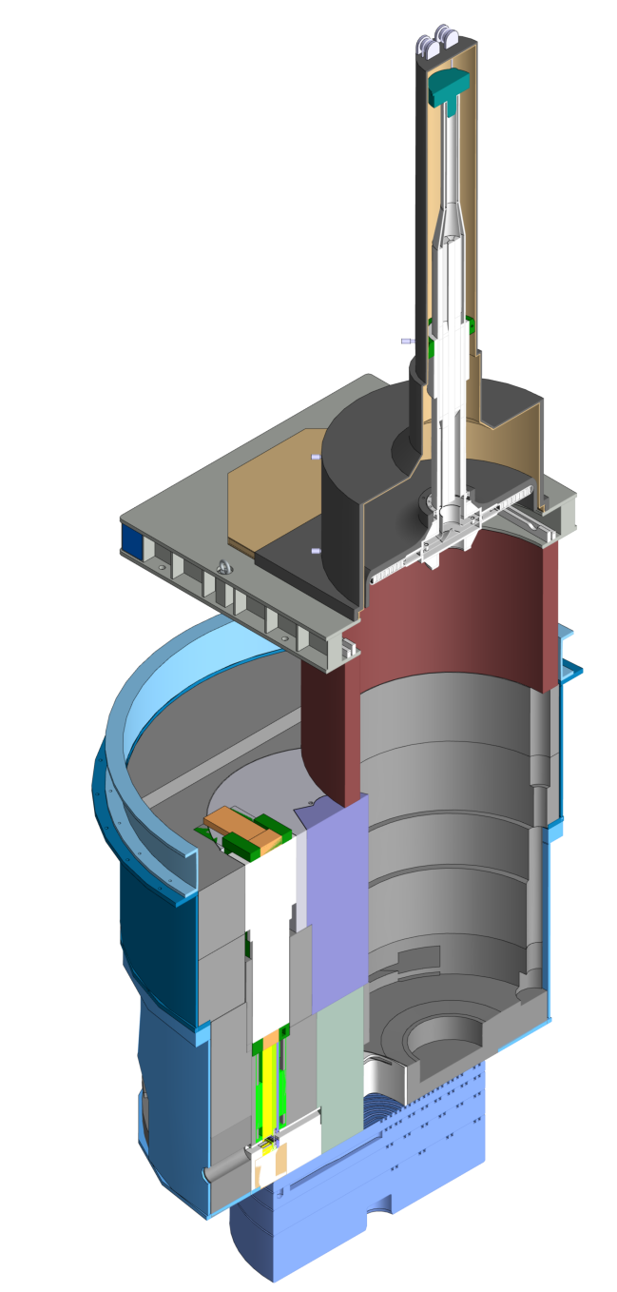
Target Wheel hoisting with shroud
Cask docking on top of Shielding ring
Pb shroud lowered
Lifting hoist connected to top of shaft
Wheel lifted
Shroud follows wheel up
5 cm Pb Shroud
Wheel with Shroud

Slide 13
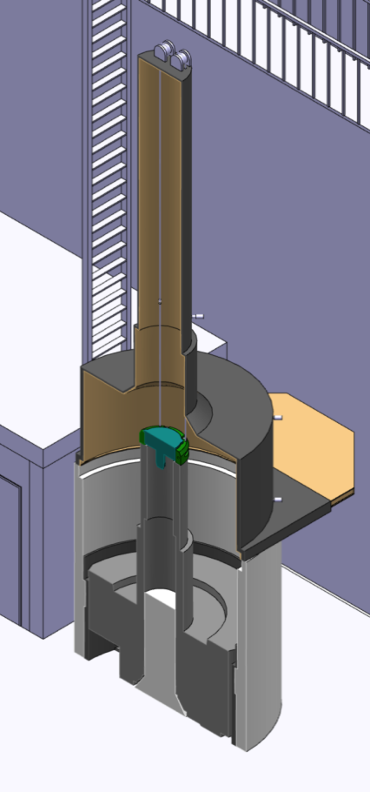
Target Wheel combined cask
The target wheel casks will be able to lift both the wheel and the centre shielding block
Target Wheel block in cask has a total weight of 85t
Shielding block storage in high bay
Shielding block in cask
Target Wheel in cask
Storage Cylinder in High Bay

Slide 14
Near Term Plans (next 3 months)
Part 1 Critical Design Review for Confinement Systems follow up
Perform Preliminary Design Review of Handling and Equipment Work Unit
Initiate procurement process for cast in items
Detailed Design of 2nd in line cast in items
Agree on installation interface of cast in items with Conventional Facilities/Sweco/Skanska
In-kind kick off meeting in December
Ramp up focus on monolith handling and cask operations

Slide 15
Risks and Mitigations
Procurement of cast in items take longer than expected and will delay construction project – Hold Critical Design Review (CDR) for first set of cast in items prior to full system CDR to ensure timely delivery
Cast in installation work takes longer than expected – active discussions with Conventional Facilities/Sweco/Skanska and inclusion of their experts in CDR review panel
Suitable fire suppression system hard to find – Seek advice from fire suppression and hot cell experts

Slide 16
Fire Suppression System
An active fire suppression system will be provided for defense in depth
Candidates:
Nitrogen gas
Hypoxic gas environment
Water mist*
Water mist mixed with Nitrogen gas
*) Currently preferred solution

Slide 17
Conclusions
Layout – concrete interface with CF is fixed
High focus on detailed design of cast in items
Start procurement of cast in items in near future
PDR of Handling and Equipment WU during autumn
Final CDR of confinement systems before Christmas

