Slide 1
Integrated Control System IT Infrastructure decisions, issues & progress TAC 12
Remy Mudingay
ESS/ICS
Date: 2015-10-15

Slide 2
Content
Scope of the Control System Infrastructure
Issues with the Temporary & Main Control room
Overview, decisions, issues & progress of the :
Control System Data Centre
Control System Network
Examples :
Neutron Instrument and the Control System Network
Strategy for the Accelerator installation
Lab Setup

Slide 3
Scope: Infrastructure WP 14.7
The scope of this work package is to design, develop and procure the IT infrastructure required for the Control System to operate.
It has the following work units:
Control Room 14.7.1
Design and implementation of the centralized ESS Control Room, which allows the Accelerator, Target, Neutron Instruments and Conventional Facilities to be controlled from the same room.
Data Centre 14.7.2
Provide servers and file storage infrastructure required for normal operation during development, commissioning and operations phase.
Control System Networks 14.7.3
Design and implementation of the networks between IO Controllers, Control Room(s) and Data Centre.
Cabling & Wiring 14.7.4
Covers the efforts and material required for connecting devices to the ICS through to the IO Controllers.
Notes:
Is the scope for the infrastructure work package appropriate and precise enough?

Slide 4
Issues with the Main Control Room(MCR) and Temporary Control Room (TCR)
MCR
Available Q2 2019
Target commissioning June 2019
Secondary ICS server room & network room
Redundancy
TCR
Available Q2 2017
Accelerator commissioning Q3 2017
Requirements gathering process has begun
Initial requirements from Beam Physicists
Issues with PSS
What should go in the TCR?
3-5 dedicated PSS racks
Issue – move to the MCR and re-commission, re-validate PSS (lots of effort)
Instead of using the TCR – PSS’ preferred option is a 10m x 10m area in Klystron gallery
Notes:
Need to go through this again.

Slide 5
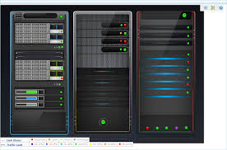
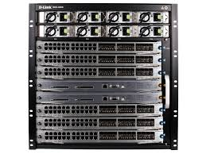
Control System Data Centre & Network
Capacity
Modular
Scalable
Openness
Open standards
Open Source
Robust
High availability
Secure
Authentication
System Monitoring
Integration
Simple
Logical
Models (Data Centre & Network)
Proven & Innovative technologies
Trends
Fulfill current & future needs
Service
High level of service
Anticipate needs
Data Centre
Core
2x 40Gb/s
2x 10Gb/s
Access

Slide 6
Network & Computing (data centre)
Internet
Stakeholders
DMSC
ICS
IT
Neutron Instrument Network (NIN)
General purpose Network
(GPN)
Technical Network (TN)
?
?
?
Data acquisition
Office & labs
EPICS control network
Data analysis
Internet access
Timing system

Slide 7
Network & Computing working groups
NSS, DMSC, ICS & IT
Progress
Shared infrastructure (DMSC & ICS)
Communications room (Experimental halls & Instrument stations & control room)
Fibre routes
Standards
IP addressing scheme
Cabling & Labelling
To do
Security policies
Scope of work
Responsibilities
Connectivity
Computing working group meeting
ESS Electronics Hardware Harmonization Committee (E2H2C)
Computing, signal processing, networking, fieldbuses Working Group
Computing
Networking

Slide 8
Control System Network fibre termination (decision)
Substation
Substation
Central utility
Server hall
Beam lines
Cryo
building
Klystron gallery
Target building
Control room
Dedicated COMMS room
Shared (NSS/IT)
Closed Cabinet
Open Rack

Slide 9
Communications room (COMMS room) Recommendations sent to CF (decision)
height 47U or 2200mm, nominal width of 600mm, maximum depth of 800mm
2 fiber enclosures and 3 copper patch panels, cable management accessories and network communication equipment. Access control
Max cabling distance 90m between the COMMs room and the Equipment Outlet (EO).
ISO/IEC 11801 for generic cabling for telecommunications for twisted pair copper interconnects.

Slide 10
Distances – COMMS room to core network (decision)
Termination point | Distance metres
GO2 to HO1 Route A | 700
GO4 to HO1 Route A | 240
GO4 to GO2 Route A | 240
HO5 to HO1 Route A | 2400
HO6 to HO1 Route A | 80
FO3 to HO1 Route A | 750
B01 to HO1 Route A | 1500
DO2 to HO1 Route A | 1000
DO4 to HO1 Route A | 1000
DO7 to HO1 Route A | 1000
DO8 to HO1 Route A | 1000
EO4 to HO1 Route A | 1000
GO2 to HO1 Route B | 2500
GO4 to HO1 Route B | 3000
GO4 to GO2 Route B | 800
HO5 to HO1 Route B | 800
HO6 to HO1 Route B | 3100
FO3 to HO1 Route B | 2500
B01 to HO1 Route B | 3000
DO2 to HO1 Route B | 2500
DO4 to HO1 Route B | 2000
DO7 to HO1 Route B | 2000
DO8 to HO1 Route B | 2000
EO4 to HO1 Route B | 1000
Single mode fibre(SMF) / Multi mode fibre(MMF)

Slide 11
Global fibre route, COMMS rooms & Core Network (decisions & uncertainties)
Substation
Substation
Central utility
Server hall
2017
Beam lines
Cryo
building
Klystron gallery
Target building
2019
Control room
Global route
Manhole every 50 - 120m
Microducts
Notes:
Review

Slide 12
Conceptual design of the Control System Network topology - option A (2nd SH in MCR)
x1
H05
Target Building - D02
x2
Access switch
x2
Fibre 10GbE to SH
Fibre 10GbE to MCR
x1
x2
Accelerator Building - G02
Main Control Room (MCR)
x1
Fibre 40GbE
x1
x8
x26
x26
Core switch
x26
x1
x4
Building
H06
Experimental zones - D and E buildings (excluding D02)
Cryo Plant
Server Hall (SH)
x1
x1
x4
x4

Slide 13
Conceptual design of the Control System Network topology - Option B (single SH)
H05
Target Building - D02
Access switch
x2
Fibre 10GbE to SH
x2
x2
Core switch
Accelerator Building - G02
Control Room - B01
x2
x52
x2
X4
Building
x26
x2
x2
x8
Server Hall (SH)
H06
Experimental zones - D and E buildings (excluding D02)
Cryo Plant
x4

Slide 14
Conceptual Control System Network Architecture
GPN|NIN
Proposed solution
Implications
Explore use cases
Security
Vulnerability assessment
Explore alternatives
Virtual
wireless
VPN/SSH gateway
Firewall/Router
Web services
EPICS V3/4 gateway
Server farm
Storage
TN
Diagnostics
Network (DN)
Isolated
Scope?
IO Controller
Motion controllers
PLC
Other
IO Controller
IO Controller
Notes:
Motion controllers
Other devices
Single network port, which network would they go into?
How would you both address the

Slide 15
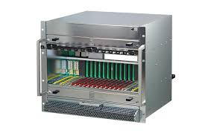
Neutron Instrument & Control System Network
Instrument control
workstation
Timing system
Neutron Instrument Network
IO Controller
Dedicated network switch
EPICS V3/4 gateway
Read access for all
Write access only on local instrument workstation
Technical Network
EPICS Gateway
EPICS Gateway
General Purpose Network

Slide 16
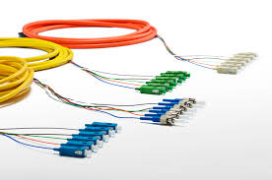
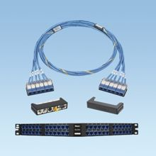
Klystron gallery CS Network installation strategy
Piecemeal installation
Modular cassettes (pre-terminated)
Copper
IO Controllers
Other devices
Fibre
Timing
Network switch
Network switch per rack row
Labelling standard TBD
Internal handbook based on ANSI/TIA 606-A
Naming convention

Slide 17
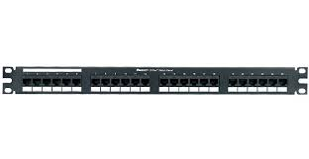
Klystron gallery: IO Controller – Core Network
Equipment Rack
x ?
Termination point
Core network
Termination point
ISO 11801 Cat 6A
Fibre trunk clockwise
8P8C/RJ45 modular
patch panel
Network Switch L2
Single logical network multi-layered switch
Fibre optic termination
Patch panel
Fibre trunk Counter- clockwise
IO Controller
Fibre optic termination Patch panel
Rack row
1GbE Cu
Core network
1/10GbE f/o
40GbE f/o

Slide 18
Exploring maintenance use cases for Klystron gallery & Accelerator tunnel
Wireless network
Available only during shutdown & maintenance
iPDU (intelligent power supply unit)
Security
Radius 802.1X
AAA
PEAP
LDAP (group + attributes)
Dynamic VLAN assignment
Based LDAP profile (groups/attributes)
Process Variable/Channel Access gateway

Slide 19
Lab infrastructure
Virtualisation
KVM(Kernel virtual machine hypervisor)
Images
staging
NFS central storage
ZFS
Mirror (8x 1TB + 4 hot spare disks)
Snapshots
Compression
Quotas
File-level checksum
Backup
Benchmarks
1.6GB/s local async & 900MB/s local sync
400MB/s NFS async* & 381MB/s NFS sync*
Archiver appliance testing
Performance
Per thread disk IO requirements
Configuration
Number of Archivers
Storage types
File-system
Bench
* Network limitation
IOC factory
CSentry
Boot server
ArchiverA
tftp
DHCP
Archiver
B
CCDB
DNS
Virtualisation
NFS
Distributed
Storage
Application
Data
VM
images
EEE
(ESS EPICS Environment)
Done
Current
To do
Network attached Storage

Slide 20
Control System Infrastructure
Thank you

