Slide 1
Slides for TAC meeting
Oct/2015
Marcelo juni Ferreira
Vacuum section leader
www.europeanspallationsource.se
October, 2015

Slide 2
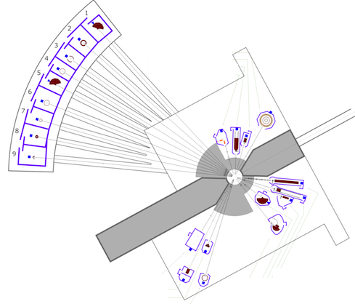
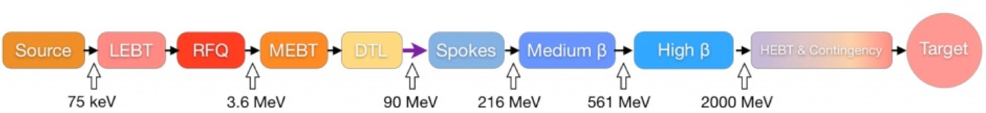
ESS Vacuum system
Target
Warm LINAC
Cold LINAC
The ESS organization charges the ESS Vacuum Group with the responsibility for all ESS “technical” vacuum systems of the Accelerator, Target and Neutron Instruments including neutron guides and choppers.
The main task of the group is to support the in-kind-contributions (IKC) of the vacuum systems provided by our ESS Partners to ensure an integrated vacuum system design throughout the ESS complex.
Neutron Instruments

Slide 3
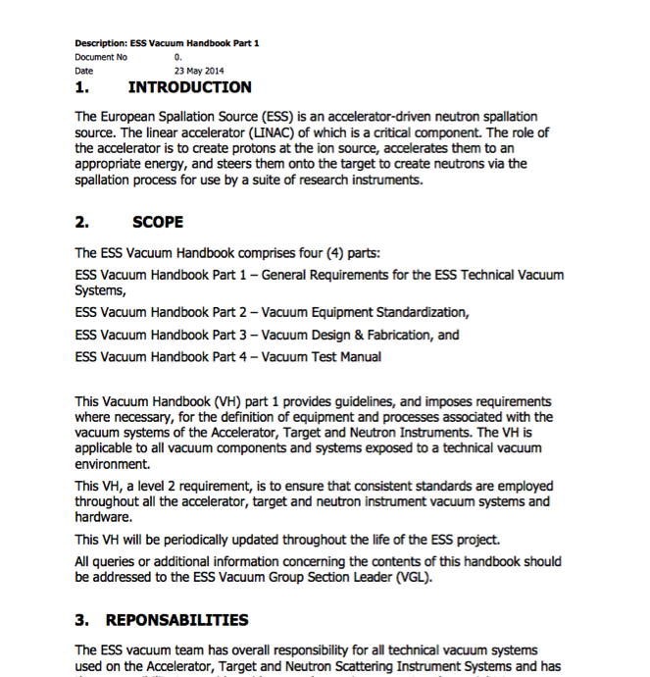
Vacuum Standardization, an Integrated Approach
Working closely with our partners across the project one of our primary goals was to promote the use of common vacuum equipment and standards. As a result a Vacuum Standardization meeting was held in February 2014 where equipment suitable for Standardization was agreed and reflected in the ESS Vacuum Handbook.
An important element of this Standardization is the Procurement Policy applied for the procurement of all “major” vacuum equipment. This policy is outlined in the ESS Vacuum Handbook.
The ESS Vacuum Handbook is primary a vacuum document that covers the requirements for the accelerator, target and instruments and is applicable to all ESS IKC Partners (ESS-0012894, 0012895, 0012896 and 0012897).
http://europeanspallationsource.se/accelerator-documents

Slide 4
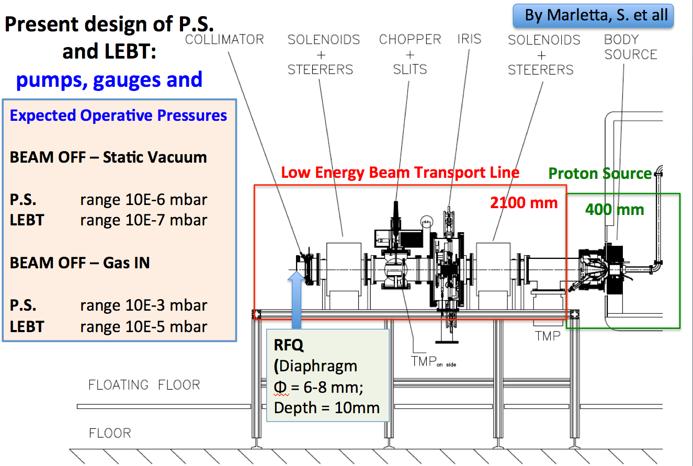

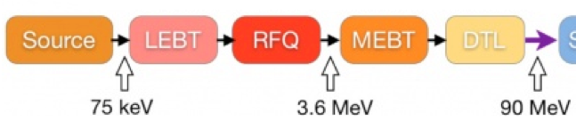
Example of Vacuum support: Warm LINAC
Proton Source (PS) and
Low Energy Beam Transport (LEBT)
Vacuum requirements agreed with the in kind for L2, L3 and L4 top-down and interfaces, including interface with other ESS groups, as ICS or Cryogenics.
4

Slide 5
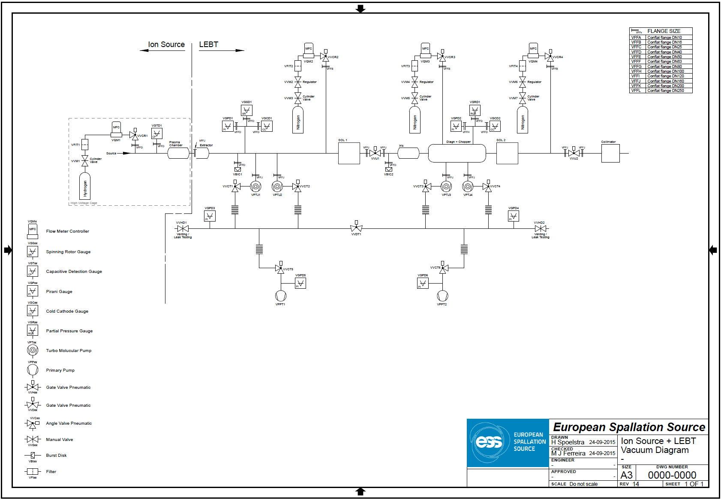
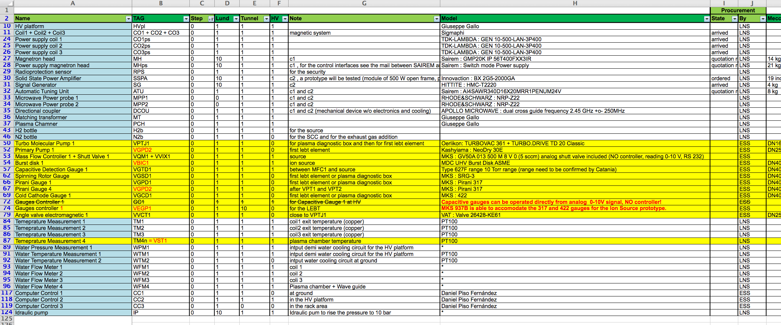
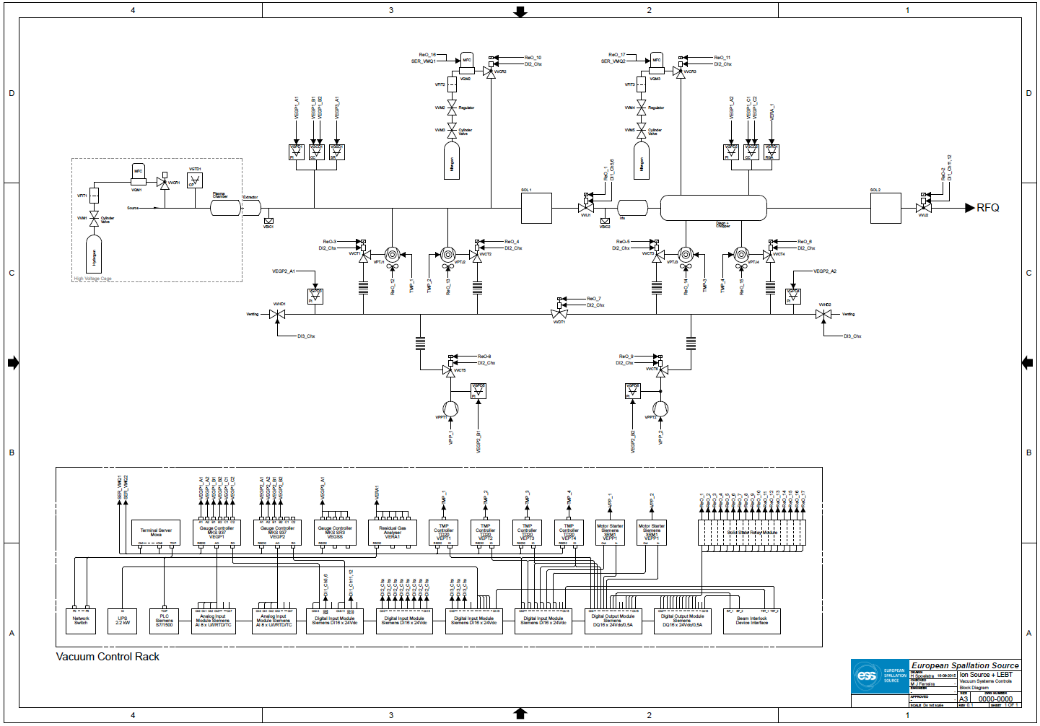
Standardization and vacuum integrated approach: PS + LEBT
Detailed list of components following the standardization model, including vacuum control signals
Vacuum diagram.
Vacuum control system wiring diagram, including interlock and signals.

Slide 6
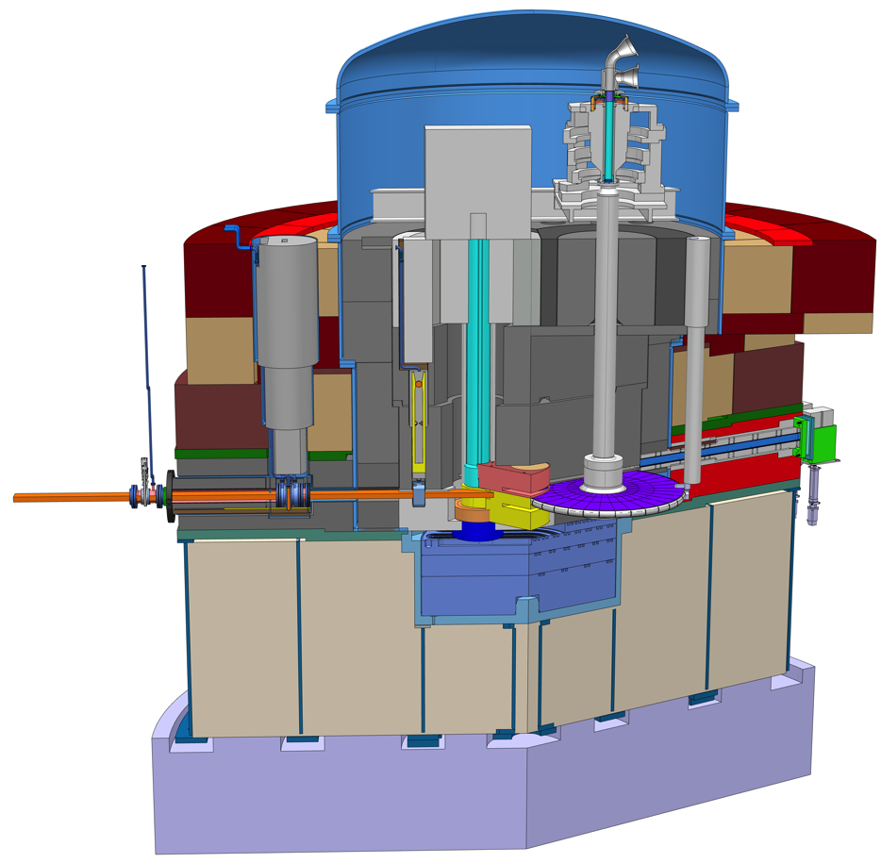
Example of Vacuum support: Discussion on the possibility to eliminate the Proton Beam Window
By Eric Pitcher
Dep Head Target Div.
Room above A2T
and upstream of
connections cell
Roots Blower
Roots and/or rotary vane pumps
Proton beam window
A Concept
Proton beam envelope
representation
Proton beam instrumentation plug

Slide 7
Beam expansion scheme adopted last year offers differential pumping opportunity
By Eric Pitcher
Dep Head Target Div.
connections
cell
helium
vessel
40mm diam x 2m long
beam pipe
~20 m
high-vacuum
throughput pump
moderators
neutron shield wall
target wheel
Monolith on HV (10⁻⁵mbar) following the ESS Vacuum Handbook guide lines.
New updates for the ESS VH to cover the target requirements.

Slide 8
Instruments for standardization:
Vacuum Catalog and blank orders
ESS will have a Vacuum Catalog pre-approved with some suppliers. They will have off shelf items used on daily bases by the ESS users, to decrease the cost of acquisition and fast delivery,
For major vacuum instruments such as turbo pumps, vacuum gauges, valves, residual gas analyzers or mass flow controller will follow a procurement-tendering process (pre-qualification documents, Statement of work and technical specification) to award suppliers on each item.

Slide 9
WP12 in kind = Daresbury/STFC
The ESS WP12 (Vacuum system) has a unique in kind for the cold LINAC: Daresbury Laboratory/STFC.

