Slide 1
Accelerator Project
TAC plenary October 2015
Mats Lindroos
Head of Accelerator
www.europeanspallationsource.se
October 13, 2015

Slide 2
Outline
Answers to TAC-11 submitted and available at JIRA board
  https://ess-ics.atlassian.net/secure/RapidBoard.jspa?rapidView=151
Accelerator overview
The re-organization of the accelerator division
Status of IK
High-lights from each WP
RF systems and integration test at ESS
Vacuum lab IK from UK
Progress on Spoke and elliptical cryomodules
Summary

Slide 3
Accelerator overview
The ESS accelerator project is making progress according to plan (5 MW, 14 Hz, 2.86 ms)
26 In-kind partners have started detailed contract negotiations for >50% of the project value.
  Head of Agreement permits work to start at IK partners while contract negotiations are being completed
  Remaining possible in-kind consist of commercial procurement of components for the accelerator
The accelerator division has 61 staff members. An additional 10 engineers and 40 technicians is to be hired up to 2019 (plus 15 operators)
  A new organisation has just been implemented
A major task today for the division is to coordinate, integrate and install the accelerator which to a large part will be delivered as in-kind or by industry
The division is also responsible for important technical development and procurements and will eventually have to assume full responsibility for the operation, maintenance and further development of the accelerator
352.21 MHz
704.42 MHz
2.4 m
4.6 m
3.8 m
39 m
56 m
77 m
179 m
Target
Source
LEBT
RFQ
MEBT
DTL
Spokes
Medium β
High β
HEBT & Contingency
75 keV
3.6 MeV
90 MeV
216 MeV
571 MeV
2000 MeV

Slide 4
Objectives of re-org
The annual review recommended a re-org to:
Further align line and project
Strengthen the safety organization
Strengthen the role of all WPs in the line organization
Furthermore, I also think it is essential:
To bring together lead engineers, liaison person and deputy WP leaders
Establish clear line authority for the accelerator systems and the Work Packages
Clarity regarding the responsibility for the development of interface requirements

Slide 5
Accelerator Project organization 2015
WP# | WP TITLE | WP LEADER | EXT. WP? | DEPUTY WP LEADERs FOR EXTERNAL WPs
WP01 | MANAGEMENT | J.G. WEISEND II | NO
WP02 | ACCELERATOR PHYSICS | M. ESHRAQI | NO
WP03 | NORMAL CONDUCTING FRONT END | S. GAMMINO | YES | W. WITTMER
WP04 | SPOKE CRYOMODULES | S. BOUSSON | YES | C. DARVE
WP05 | ELLIPTICAL CRYOMODULES | P. BOSLAND | YES | C. DARVE
WP06 | BEAM DELIVERY SYSTEMS | S. MØLLER | YES | I. ALONSO
WP07 | BEAM DIAGNOSTICS | A. JANSSON | NO
WP08 | RF SYSTEMS | A. SUNESSON | MIX | A. SUNESSON
WP99 | ACCEL INFRASTRUCTURE & INSTALLATION | D. MCGINNIS | NO
WP10 | TEST STANDS | W. HEES | MIX | W. HEES
WP11 | CRYOGENICS | P. ARNOLD | NO
WP12 | VACUUM | M. JUNI-FERRERA | NO
WP13 | SAFETY | L. TCHELIDZE | NO
WP14 | ACCELERATOR INTEGRATION | S. MOLLOY | NO
WP15 | ELECTRICAL SUPPORT | F. JENSEN | NO
WP16 | COOLING SUPPORT | A. LUNDMARK | NO
WP17 | POWER CONVERTERS | C. MARTINS | NO
Collaboration Board:
ESS Technical Director
Project leader
Representatives of all contracted institutes (one elected as chair)
Technical Board (quarterly):
Weekly ESS management team
All WP leaders and deputies
Representatives of all contracted institutes if not already a WP leader
Accelerator Project management team (weekly):
Mats Lindroos, Project leader
John Weisend, Deputy project leader and STS
David McGinnis, Senior Accelerator systems expert and engineering resources
Håkan Danared, In-kind manager and LINAC systems
Lali Tchelidze, Safety including radiation safety
Anders Sunesson, RF systems
Luisella Lari, Head planner
Andreas Jansson, Beams and operation
Matthew Conlon, QA/QC
Section leaders are part of the Project management and can be called to participate in the weekly meetings.

Slide 6
New AD – Groups, sections and WP
ACCELERATOR DIVISION
WP 1
Mats Lindroos
Beam Physics, Operation & Beam Diagnostics
WP 2,7
Andreas Jansson
Engineering Resources
WP 99
David McGinnis
LINAC
WP 3,4,5,6,14
Håkan Danared
Radio Frequency
WP 8,17
Anders Sunesson
Admin & QA
Safety
WP 13
Lali Tchelidze
Specialized Technical Services
WP 10,11,12,15,16
John Weisend
Beam Physics
WP 2
M. Eshraqi
Beam Diagnostics
WP 7
Vacant
Low Energy L.
WP 3
Vacant
High Energy L.
WP 4,5,6
S. Molloy
Power Converters
WP 17
C. Martins
RF Sources
WP 8
M. Jensen
Cryogenics
WP 11
P. Arnold
Vacuum
WP 12
M. Ferreira
Planning

Slide 7
New AD
ACCELERATOR DIVISION
Mats Lindroos
Beam Physics, Operation & Beam Diagnostics
A. Jansson – GL
Engineering Resources
D. McGinnis – GL
E. Tanke N. Gazis
LINAC
H. Danared – GL
Radio Frequency
A. Sunesson – GL
R. Montano R. Zeng
Admin & QA
C. Prabert S. Aas G. Jacobsson M. Conlon
Safety
L. Tchelidze – GL
D. Phan E. Bargalló
Spec. Technical Services
J. Weisend – GL
W. Hees A. Lundmark E. Vaena F. Jensen
Beam Physics
M. Eshraqi – SL
M. Munoz R. De Prisco
R. Miyamoto Y. Levinsen
Beam Diagnostics
Vacant – SL
B. Cheymol C. Thomas
H. Hassanzadegan H. Kocevar I. Kittelmann
M. Donna T. Shea V. Grishin
C. Roose (oPAC)
Low Energy L .
Vacant – SL
A. Ponton E. Sargsyan G. Hulla W. Wittmer
High Energy L.
S. Molloy – SL
C. Darve I. Alonso
Power Converters
C. Martins – SL
G. Göransson M. Kalafatic
RF Sources
M. Jensen – SL
B. Lagoguez C. Marrelli
R. Yogi
S. Ekström S. Calic
Cryogenics
P. Arnold – SL
J. Fydrych J. Jurns X. Wang X. Su
Vacuum
M. Ferreira - SL
P. Ladd Vacuum system Engineer, vacant H. Spoelstra S. Scolari
Planning
L. Lari L. Gunnarsson
61 staff

Slide 8
AD Staff 2015 (actuals Q1-3, forecast Q4)

Slide 9
Accelerator Division Staff per Category
Number of Accelerator Division employees and Operators at the end of each year (2014 actuals).

Slide 10
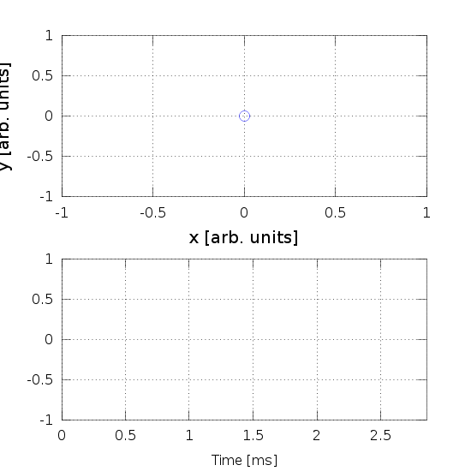
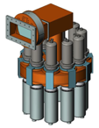
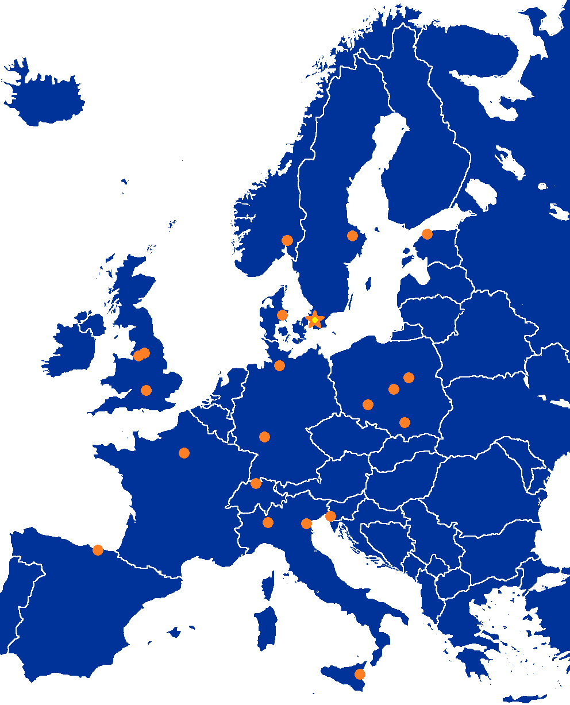
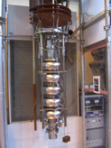
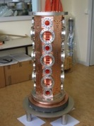

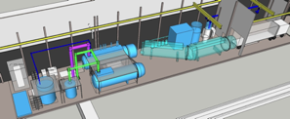

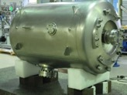
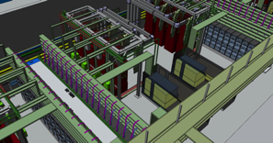
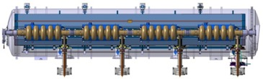
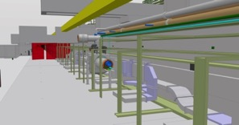


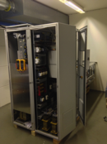
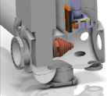


Accelerator Selected technologies
PARTNERS
ESS AD
Notes:
Explain in-kind and bilateral agreements for pre-construction phase which now are being transformed into in-kind contracts for construction

Slide 11


Partner Institutions
In-kind (main contributions)
Univ Agder (Ion source expert)
ATOMKI (RF-LPS)
CEA (RFQ, SRF, Diagn)
CNRS (SRF, Cryo)
Cockcroft Inst (Diagn)
Daresbury Lab (SRF, Vacuum)
Elettra (RF, Magn, PS, Diagn)
ESS-Bilbao (MEBT, RF)
GSI (Diagn, Vacuum, Cryo)
Huddersfield Univ (RF distrib)
IFJ PAN (Installations)
INFN Catania (Source, LEBT)
INFN Legnaro (DTL)
INFN Milan (SRF)
NCBJ (LLRF)
RAL (Diagn)
RHUL (Diagn)
Tallinn UT (RF)
TU Lodz (LLRF)
Univ Oslo (Diagn)
Warsaw UT (LLRF)
Wroclaw UT (Cryo)
Nothing signed
Contract
HoA
IKC
Not IKC, 32%
Planned IKC, 49%
Possible IKC, 16%
Paid contracts
Aarhus Univ (Beam del)
DESY (Diagn)
Lund Univ (LLRF, RF)
PSI (Diagn)
Uppsala Univ (Tests)
SE,DK, 3%

Slide 12
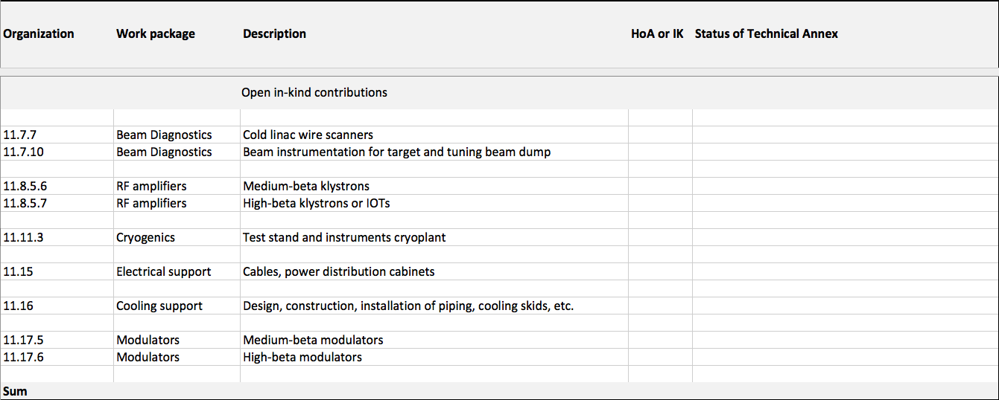
Open (Possible) In-Kind Contributions

Slide 13
High Level Master Schedule
There are many “close critical path” in the project, notably RFQ, DTL, Cryomodules and RF systems

Slide 14
Work Package Highlights
WP1 Management
  Held CDR for DTL and BD, PDR for CDS and PDR-1 for the ACCP
  Integration test under way
WP2 Beam Physics
  Baseline MEBT lattice released. This includes the updates and modifications as agreed by WP03
  Magnet Schedule has been prepared through collaboration with in-kind partner
WP3 Normal Conducting Front End
  Market survey (AAPC) for RFQ completed, analysis on-going.
  Production of Drift tube parts for prototyping on-going
WP4 Spoke Cavities & Cryomodules
  Significant performance improvement on “Romea” cavity after new BCP
  Detailed design of spoke cryomodule valve box near completion
WP5 Elliptical cavities & Cryomodules
  6 medium Beta cavities under construction at Zanon (IT)
  Space frame of M-ECCTD built and shipped to CEA

Slide 15
Work Package Highlights
WP6 Beam Delivery
  Beam Delivery CDR held October 8
WP7 Beam Instrumentation
  SLAC/ESS Prototype micro TCA rear transition module has been built & is under evaluation with LLRF
WP8 RF Systems
  Uppsala University has received first spoke RF power station. ESS was present for the first tests, (405 kW at 352.32 MHz)
  L3 IOT Design Review held. This went well and this prototype is expected to arrive 4 – 6 months early
WP99 Integration & installation
  Continues progress with CF on ventilation & fire suppression issues
WP10 Test stands
  First horizontal test of spoke cavity in HNOSS (Uppsala)
WP11 Cryogenics
  ACCP PDR-1 held & successful. Long lead items for cryoplant now being ordered

Slide 16
Work Package Highlights
WP12 Vacuum Systems
  STFC provided labs for material testing, gauge calibration, vacuum integration and a clean room to ESS Medicon Village
WP13 Safety & Reliability
  CFD modeling of tunnel ODH risks started
WP14 Engineering Services
  Continued IVDR review process (RFQ, DTL, BD, LWU)
WP15 Electrical System Support
  Optimization of electronics rack requirements & cooling approach for cost reduction
WP16 Cooling Water Support
  Started looking into more details regarding the FEB & Tunnel piping layout (including planning for installation)
WP17 Power Convertors
  330 kVA reduced scale prototype: Integrated test of Low Voltage power converter with High Voltage module #1, at LTH

Slide 17
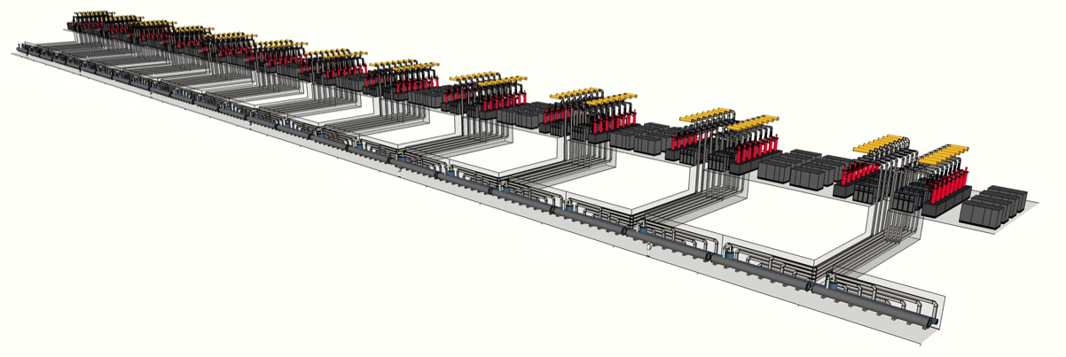
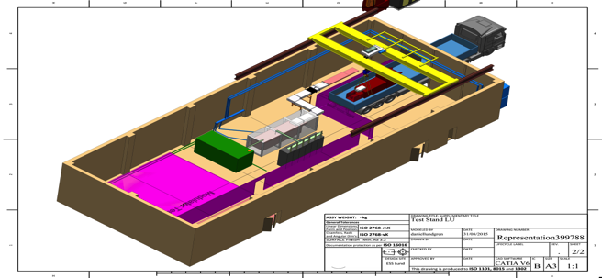
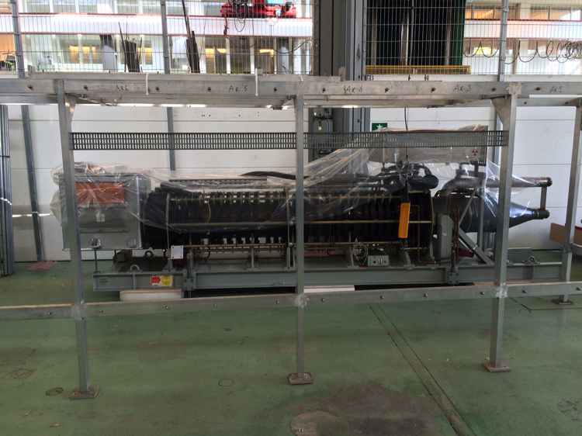
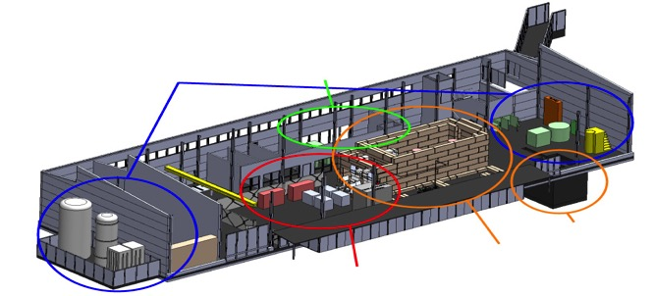
ESS Linac RF System
Integration test at LTH
In-kind RF:
Sweden, Uppsala University (FREIA) and Lund University
Polen, tri-uni
Italy, Elettre
Spain, ESS Bilbao
Hungary, Atomki
Estonia, TU Tallin
cryogenics
- liquid helium
- liquid nitrogen
control room
- equipment controls
- data acquisition
FREIA in Uppsala
Klystron arrived from CERN!
3 bunkers
with test stands
horizontal cryostat
vertical cryostat
RF power sources

Slide 18
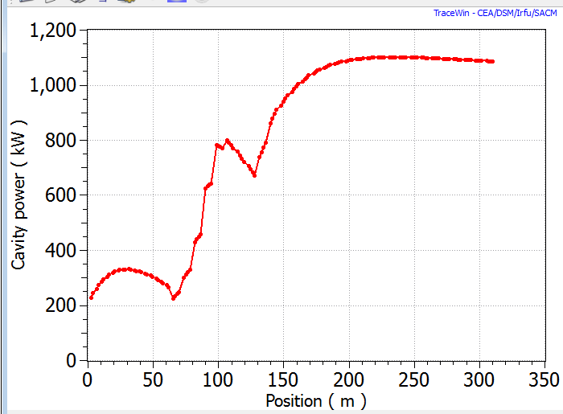
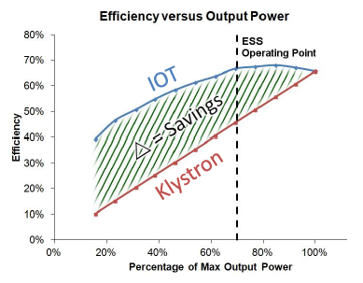


RF power sources: IOT progress
2 prototypes ordered
  Good progress with both vendors with L3 being 4-6 months ahead of schedule
Delivery in September 2016 to CERN test stand
84 tubes needed for high beta
Decision and tender early 2018 for 84 tubes - possible In-kind
18

Slide 19
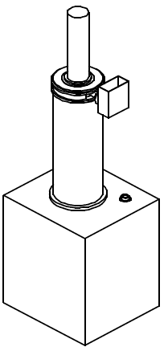
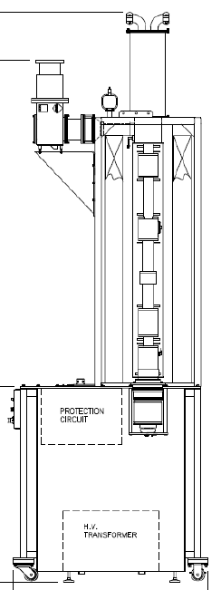
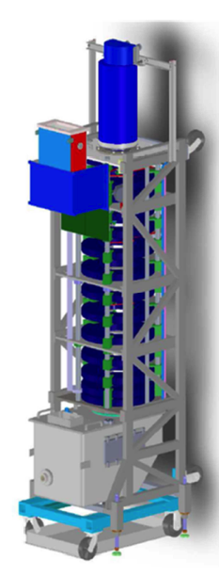
WP 8 Medium beta klystrons
3 prototypes ordered
Delivery Q2-Q3 2016
  To be tested at ESS
36 tubes needed for medium beta
Tender in the end of 2016 for 36 tubes - possible In-kind
Toshiba
E37504
CPI
Thales
TH 2180

Slide 20
WP17 Modulators medium beta
Two strategies
  A: SML – Stacked Multi-Level modulator topology 660 kVA
    This gives scalable, compact, and cost effective solutions
    New development by ESS
    Industrialization (build to print concept) tender for 9 units 2016
  B: Commercial topology 330 kVA
    Two contracts: Ampegon and DTI launched by ESS and CEA
    Ampegon modulator arrives in 2016 for tests in Uppsala
Baseline is strategy A with order of 9 units in fall 2016 – Possible IK

Slide 21
WP 17 Modulator decision chart (to medium β)
Strategy | Ready/Delivery | Validated | Decision point | Outcome
A - SML | Nov 2015 | Dec 2015 | If A: SML fully validated, Q1 2016 If B: Sept 2016 | Strategy A: Launch call for tender for nine 660 kVA units medium beta
B:1- Ampegon | Q2 2016 | Fall 2016
 |  |  |  | Strategy B: Launch call for tender for eighteen 330 kVA units for medium beta
B:2 - DTI | Q1 2016 | Mid 2016

Slide 22
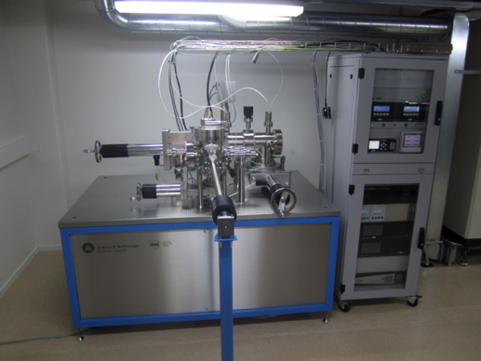
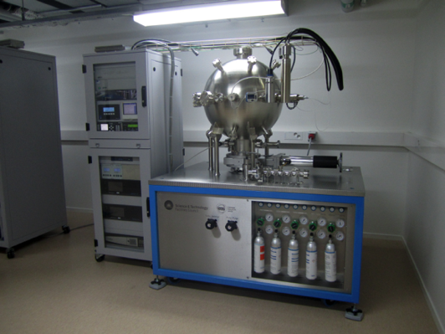
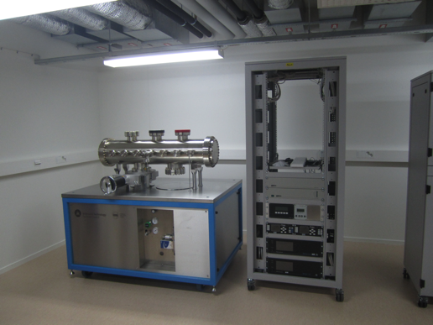
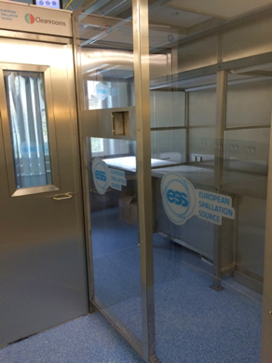
Vacuum lab at ESS, IK from UK-STFC-Daresbury
Material test facility
Calibration facility
Integration test facility
Clean room

Slide 23



ESS TAC
WP04

Slide 24
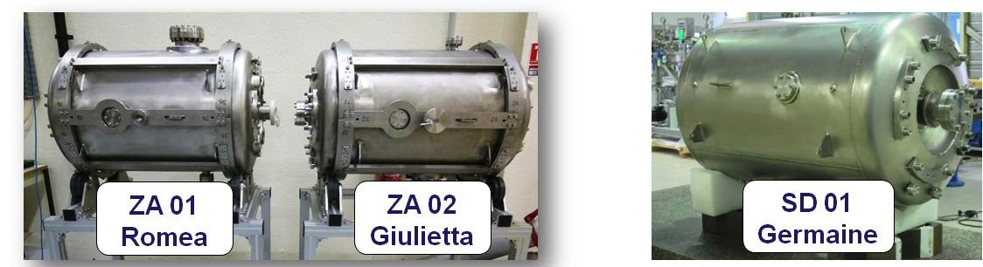
Spoke cavities: Summary of Vertical Test Results
First prototype (Romea) tested in January 2015
  Standard preparation (no baking, no heat treatment)
  Reached 11.4 MV/m, well above the 9 MV/m of the ESS Spec
  Qo also well within the spec (3.5 10⁹ at nominal gradient for a spec @ 1.5 10⁹)
Then Prototype #2 and #3 (Giulietta and Germaine) also tested (Feb - March 15)
  Results even better:
    better Qo achieved (7 10⁹ and 8 10⁹ at nominal gradient
    better max gradient reached: 12.5 and 15 MV/m)
  Improvement on Qo due to a change in the cavity chemical treatment procedure (lower T°, less trapped H).
Then Romea re-tested in June 2015 with improved chemical etching
  Best results reached so far: 15.5 MV/m max achieved gradient and Qo = 1 10¹⁰ at nominal gradient !!!

Slide 25
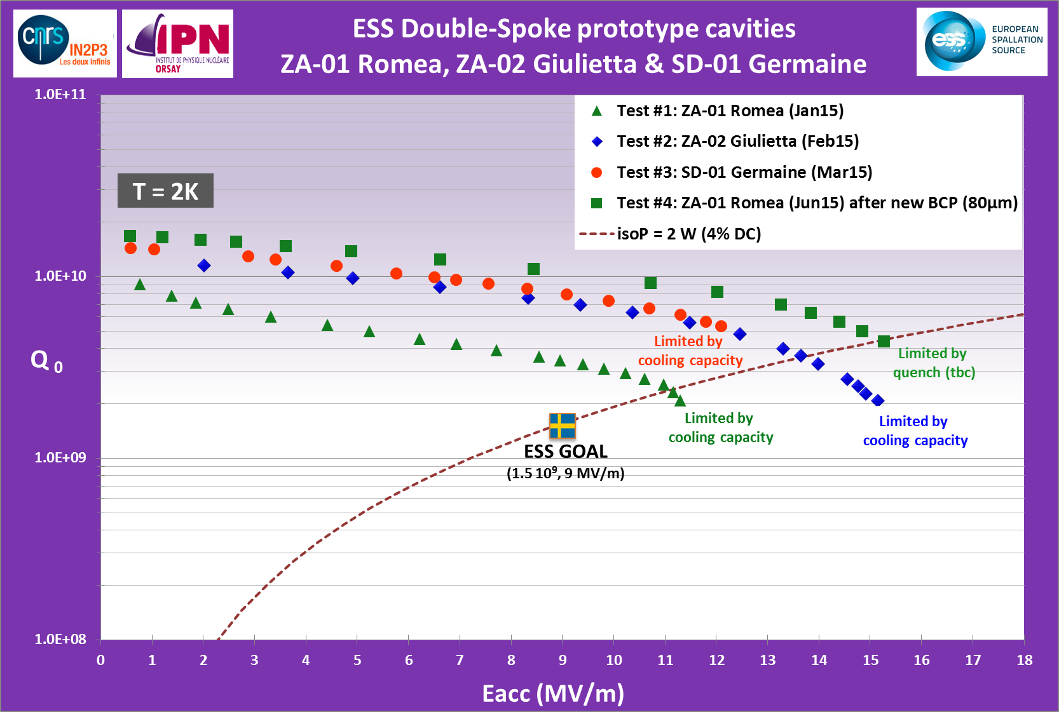
Vertical Test Results: summary
Qo improved by  T_{acid max}:
30°C (Test #1)
25°C (Tests #2 & #3)
18°C (Test #4)
All prototypes tested within the specs
NO BAKING
NO HEAT TREATMENT
Lacc=3/2*βλ=0.639 m

Slide 26
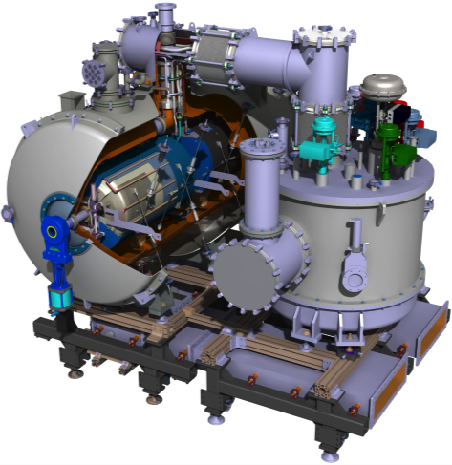
Spoke cryomodule status:
The design is fully achieved since several months
  95 % of the parts are already fabricated and delivered at IPNO
  The remaining parts are under fabrication (cryogenic circuits, thermal shield MLI, some instrumentation) and will be delivered to IPNO in end october)
  80% of the assembly tooling delivered to IPNO
  Already partial blank assembly done
Test of the spoke cryomodule prototype and planning to start series production
  A first cryogenic test is schedules at IPNO in January/february 2016
  Just after, the cryomodule will then be sent to Uppsala University for a complete test, at the nominal RF power. A test time of 3 months is planned
  We have then a 2 months-long buffer time (July-August 2016)
  A cryomodule Critical Design Review is scheduled in Sept. 16 to give the green light for series production
  The series cryomodule production procurement : Oct. 2016
  The first cryomodule of the series production is expected to be ready for test at UU in July 2017.
  Last cryomodule will be delivered to ESS after test in Jan. 2019
Lacc=3/2*βλ=0.639 m

Slide 27
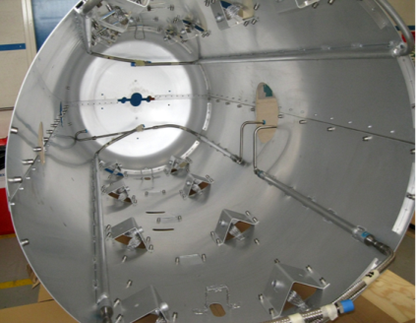
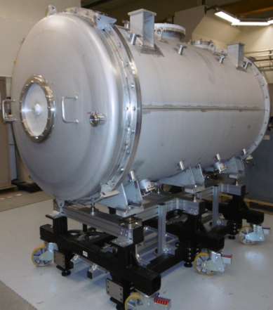
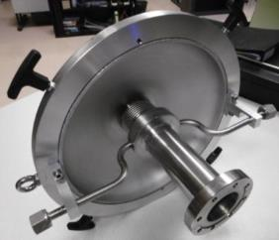
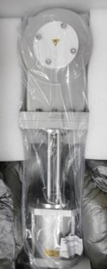
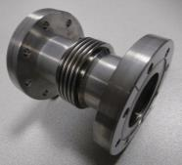
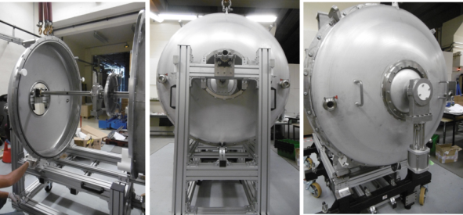
Spoke Cryomodule fabrication [1]
Most of the parts are fabricated and delivered
Vacuum vessel & Mechanical support
Thermal shield
Gate valves
Cold/warm transition
First blank assembly of some parts
Inter-cavity belows

Slide 28
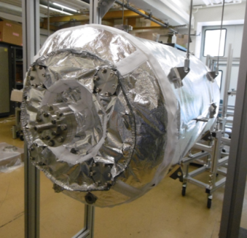
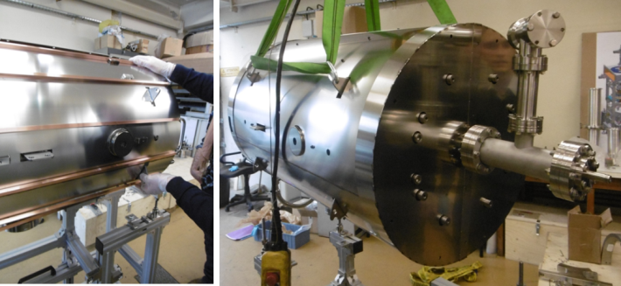
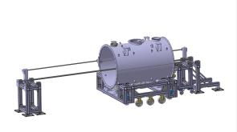
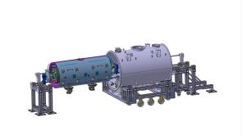
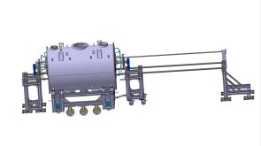
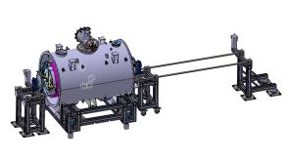
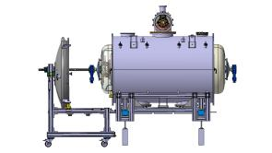
Spoke Cryomodule fabrication [2]
Magnetic shield
(2-layer Cryophy, actively cooled)
MLI for the cavity
Fabrications in progress
  Cryogenic circuits
  MLI for the thermal shield
  Valve box
Studies close to completion
  Detailed Tooling design and assembly procedures for the cavity string insertion

Slide 29
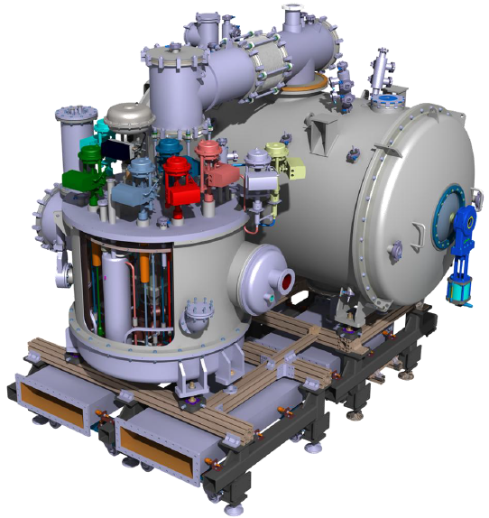
Spoke valve box
Design for the prototype completed (scale 1, but with additional constraints due to the required compatibility for test at Uppsala University).
Heat exchangers, cryovalves and instrumentation already received. Valve box under fabrication and is expected to be completed by end December 2015

Slide 30
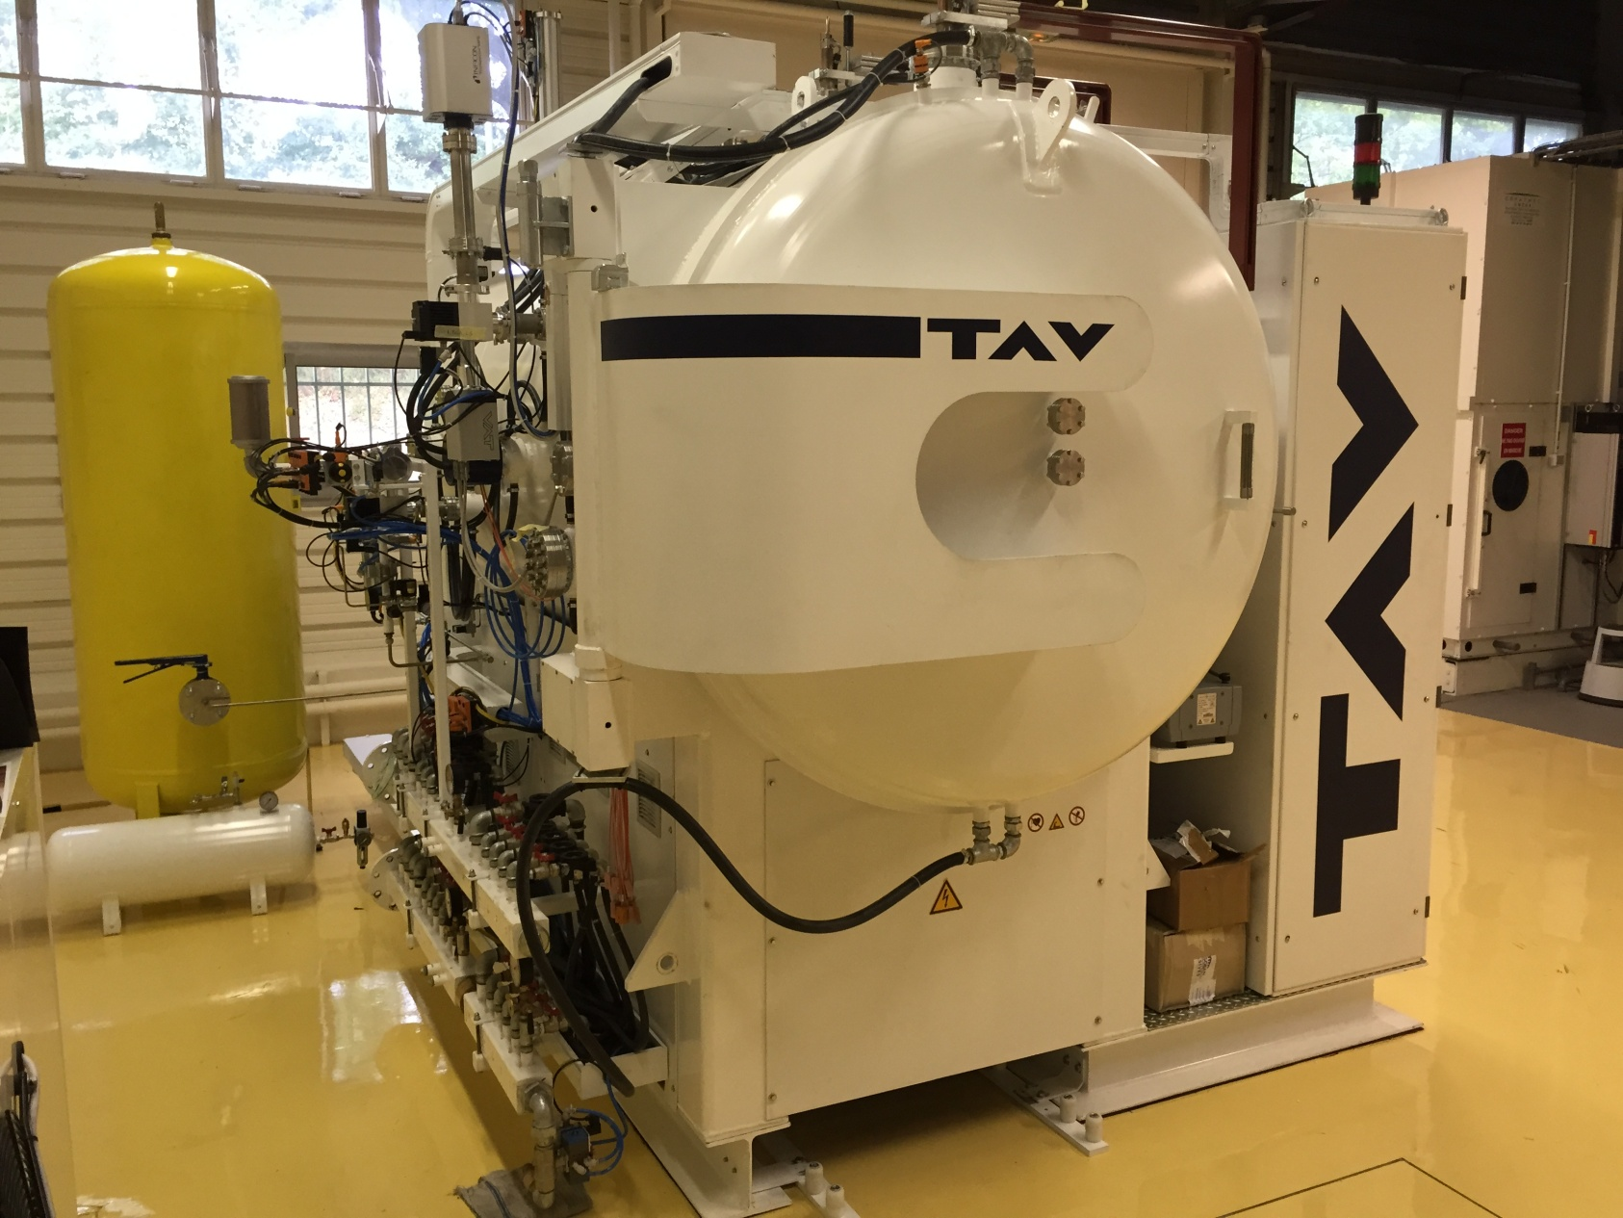
Vacuum Furnace for Cavity H degassing
Just received from TAV company. Installation and heat treatment procedure validation to be done within the next 2 months

Slide 31
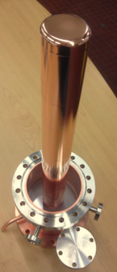
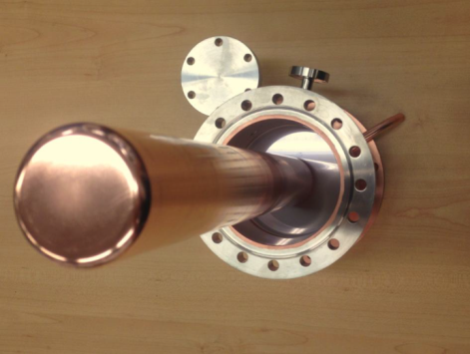
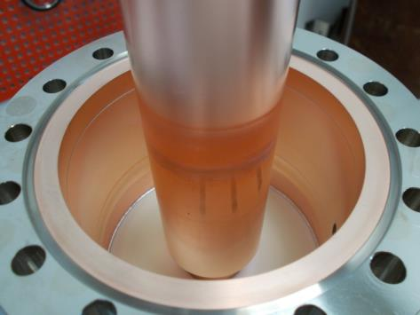
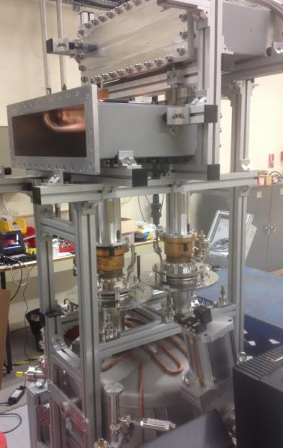
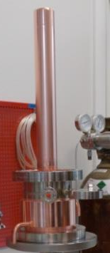
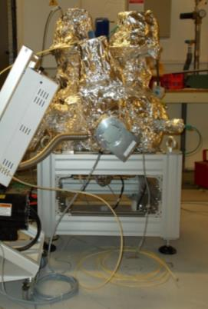
RF couplers
RF Power Couplers: 4 prototypes built by two french companies (SCT & PMB) and delivered
Electropolished
antenna
RF conditioning test bench:
1/2 height WR 2300
TiN coating
Doorknob
Power coupler window
Baking stand
Double-walled tube
Ramp-up to 155°C in 24 h
155°C is kept for 24h
10⁻⁹ mbar pressure level is reached
RF conditioning cavity
with water cooling loop
Tuning of the coupling cavity
Assembly in ISO4 clean room
Baking (24h@155°C)
Start of the 1st coupler pair RF conditionning at CEA Saclay premises in end October

Slide 32

Elliptical Cavities Cryomodules
WP5
Pierre BOSLAND, CEA Saclay
External WP5 leader
Christine Darve,
ESS deputy WP leader

Slide 33



Vertical Tests of two β0.86 prototype cavities
1) the performance degradation observed on SC elliptical cavities,
P01 - E. ZANON
P02 - RI
Both prototype cavities met the ESS requirements after the first test.
Slight degradation (pollution) of performances after 600°C heat treatment for hydrogen removing
Next cavities will not be heat treated in the same furnace:
Cavities for M-ECCTD and H-ECCTD will be heat treated in the new IPNO furnace
Cavities of the series will also be heat treated by our partners (LASA and STFC) in other furnaces. Procedures will be qualified by tests of the cavities in vertical cryostat before launching the production of the series .
Next test of P01 dressed with its LHe tank: 100µm BCP for removing pollution
P01 with LHe tank welded after heat treatment
The LHe tank welding of P01 done with no frequency shift and no field flatness modification

Slide 34





Cryomodule & main components
3) the finalization of cryomodule designs and their readiness for series production
6-cells medium beta (0,67) cavity
5 cells high beta (0,86) cavity
Cavities without HOM coupler
Design finalized (only minor details to be completed)
Similar to CEBAF/SNS cryomodule concept with 4 cavities per cryomodule
Common cryomodule design for medium and high beta cavities
 | Medium | High
Geometrical beta | 0.67 | 0.86
Frequency (MHz) | 704.42
Maximum surface field in operation (MV/m) | 45 | 45
Nominal Accelerating gradient (MV/m) | 16.7 | 19.9
Nominal Accelerating Voltage (MV) | 14,3 | 18,2
Q₀ at nominal gradient | > 5e9
Cavity dynamic heat load (W) | 4,9 | 6,5
Power Coupler
(HIPPI type coupler)
Cold Tuning System
(Saclay V5 type modified for ESS cavities)
Diameter 100 mm
1.1 MW peak power
Antenna & window water cooling
Outer conductor cooled with SHe
Doorknob transition equipped with a bias system
stepper motor + gear box at cold
Max tuner stroke: ± 3 mm
Max tuning range: ~ 600 kHz
Tuning resolution: ~1 Hz
2 piezo stacks

Slide 35



The production of the main components has been launched
Six beta0.67 prototype cavities (@ZANON)
All Dumbbells completed and frequency measurements performed
End groups completed by end of September
Helium tank prepared for welding
First cavity delivered to CEA by end of October
Once the 1st cavity is approved by CEA, Zanon can deliver one bare cavity every 2-3 weeks.

Slide 36


Slide 37






Medium β cryomodule fabrication
Production of the main components and the toolings has been launched
Vacuum vessel & space frame delivered
The detailed study of the assembling procedures is in progress.
XFEL cryomodules assembly lessons learned applied to ESS, QA process
(N₂)
…
Assembling of the cavity string with a N2 flow for protection against dust particles
Welding the titanium diphasic tubes
The cavity string is inserted in the spaceframe already equiped with the thermal shield
Closing the vacuum

Slide 38
Future work
Finalize and test the medium beta prototype cryomodule M-ECCTD
  cavities & couplers reception & test
  assembly with new toolings in a new clean room
  RF power test stand to complete at Saclay
Realize and test of a high beta prototype cryomodule H-ECCTD
Prepare the production of the 30 series cryomodules
  Production of the cavities
    INFN Milano: 36 medium beta cavities
    STFC Daresbury: 84 high beta cavities
  Production of the cryostat components
  Prepare the assembly infrastructure at Saclay after the XFEL cryomodules assembly
Two European factories with very high production capacity RI & ZANON
The Saclay infrastructure for the XFEL cryomodule assembly will be available
(last XFEL cryomodule assembly in April 2016)

Slide 39
Accelerator Summary
The accelerator is built by a collaboration
  CB and TB important tools
  IK contributions already represents 50% of the project volume
The accelerator project is in a phase of intense prototyping and reviewing and will soon see most major systems in construction
  Large part of prototyping and design done by in-kind partners
  Essential to get in-kind contracts agreed and signed in 2015 to permit construction of all systems to start in earnest
  Work on (parts of the) RF design, modulators, beam instrumentation and cryogenic design done in Lund
Coordination, integration and verification represent a major part of the work done today by the accelerator division at ESS in Lund
  A large number of Accelerator items will be installed in a very short time much faster than other similar projects – the integration test is very important to prepare for this
The goal is to build and train the accelerator division so that it can assume full responsibility for operation and maintenance of the accelerator systems in 2019
  The work at the Integration test in the M-building at LTH is an essential part of achieving this and was recommended by Annual Review

Slide 40
Extra slides

Slide 41
AD Staff 2015 – ( ) compared to ’Budget 2015’
(FTE) | Q1 2015 | Q2 2015 | Q3 2015 | Q4 2015
Employees | 56 (61) | 57 (67) | 61 (73) | 67 (75)
Seconded | 1 (1) | 1 (1) | 0 | 0
Contractors | 12 (12) | 17 (15) | 17 (14) | 19 (14)
Total | 69 (74) | 75 (83) | 78 (87) | 86 (89)

Slide 42
Control Change Boards (CCB) & control flow for ACCSYS
ESS governance
ESS Council
CCB-A
1-2/year
Collaboration board
CEO / ETB/ ESS CCB
CCB-B
Quarterly
ACCSYS TB
reports
ACCSYS Mngt Team
delegates, approves
CCB-C’
weekly
minutes, actions & ACCSYS Control Log

Slide 43




SRF developments
France, IRFU-CEA: 6 medium beta prototype cavities under fabrication at Zanon
  All 30 dumbbells have been e beam welded
  First complete bare cavity to CEA in October
France, IPN-CNRS: Experimental results obtained so far on the 3 prototype spoke cavities.
  Notice the recovery and even the gain on the performance of Romea after additional chemistry to recover from the “bad baking”.

