Slide 1
Target Project Progress and Plans
John Haines
Head of Target Division
www.europeanspallationsource.se
October 14, 2015

Slide 2
Outline
Organization
Update on all work packages
Project execution performance
Progress on Securing In-Kind Partners
Issues
Concluding remarks

Slide 3
Target Organization – Core team is in place and org is aligned with project deliverables
TARGET DIVISION
John Haines
Head of Division
Eric Pitcher
Deputy Head of Division
Carina Blixt
Team Assistant
Tobias Lexholm
Installation Coordinator
Target Controls Group Linda Coney (GL) Atefeh Adeghzadeh
Mikael Olsson (C)
Jan Espen Presteng (C)
Monolith & Handling Group
Rikard Linander (GL) Magnus Göhran Daniel Lyngh Ulf Odén
Naja de la Cour
Marc Kickulies
Kristoffer Sjögreen
John Jurns (M)
Markus Andersson (C)
Lennart Åström (C)
Reinhard Blum (C)
Paul Erterius (C)
Jens Harborn (C)
Rickard Holmberg (C)
Bengt Jönsson (C) Johan Kalmteg (C)
Jarich Koning (C)
Mikael Möller (C)
Eldin Mukovic (C) Anders Olsson (C) Mateusz Pucilowski (C)
Jesper Ringnér (C)
Mats Schmidt (C)
Aleksander Stankovic (C)
Srdjan Vareskic (C)
Mattias Wilborgsson (C)
Emil Boman (S)
Lukas Smisovsky (S)
Materials Group Yongjoong Lee (GL) Monika Hartl
Srinivasan Iyengar (C)
Jemilia Habainy (S)
Neutronics Group Luca Zanini (GL) Konstantin Batkov Alan Takibayev
Esben Klinkby (C)
Troels Schoenfeldt (C)
Zsofia Kokai (S)
Target Physics Group Günter Muhrer (GL) Riccardo Bevilacqua
Johannes Kazantzidis (C)
Fluid Systems Group Håkan Carlsson (GL) Per Nilsson Andrea Polato
Emil Lundh (M)
Klaudiusz Dybowski (C)
Leif Emås (C)
Björn Eriksson (C)
Alex Garcia (C)
Allan Lundgren (C)
Ingvar Olsson (C)
Olof Persson (C)
12.1 Management and Administration
12.7 Controls
Linda Coney (WPM)
12.8 Physics
Günter Muhrer (WPM)
12.5 Fluid Systems
Håkan Carlsson (WPM)
12.2 Target System
Ulf Odén (WPM)
(GL) Group Leader
(C) Contractor or Consultant
(M) Matrixed
(S) Student
12.3 Moderator & Reflector Systems
Daniel Lyngh (WPM)
12.4 Monolith Systems
Rikard Linander (WPM)
12.6 Remote Handling Systems
Magnus Göhran (WPM)

Slide 4
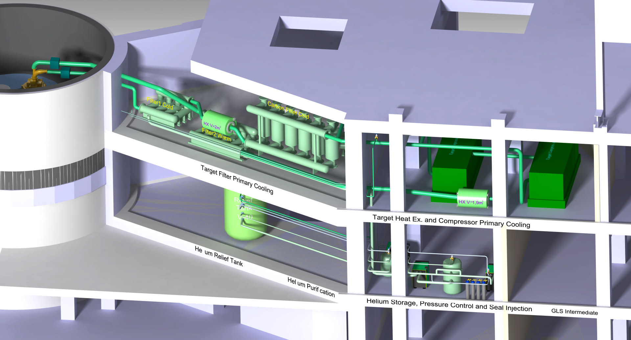
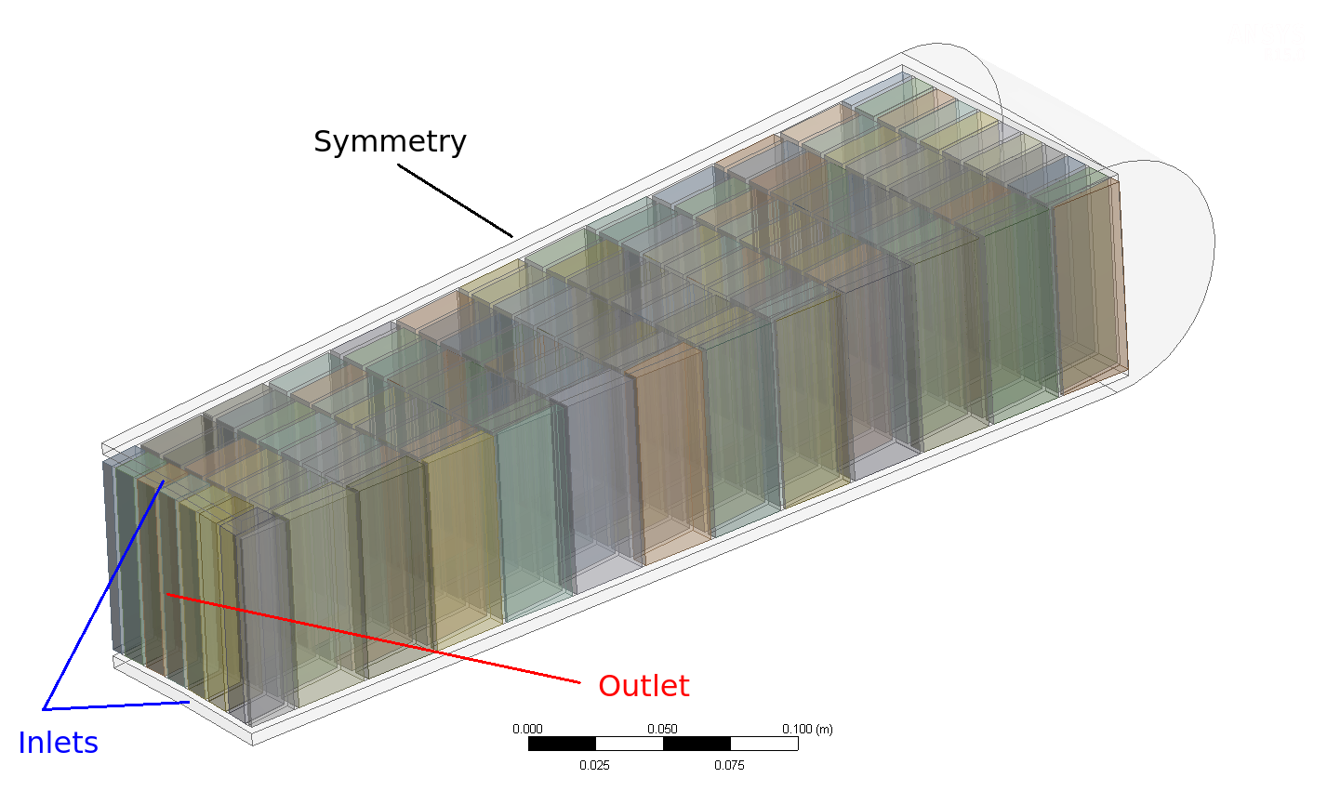
WP2: Target Systems
Target Wheel, Drive & Shaft
ESS-Bilbao team onboard, integrated with ESS-Lund team, and performing detailed design and prototyping
Review for new Target Wheel concept held earlier this week
Target Helium Cooling System
Equipment (blower, filters, etc.) configuration set
Nuclear Physics Institute of the Czech Academy of Sciences will be our partner for the Target Helium Cooling System
Hazard analysis complete and accident analyses underway
Array of W bricks in wheel sector
Target Helium Cooling System

Slide 5
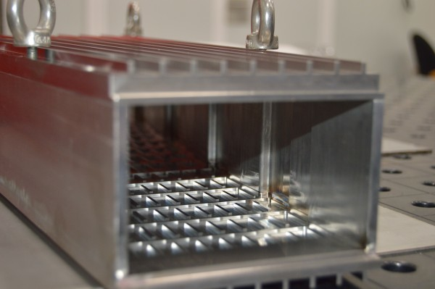
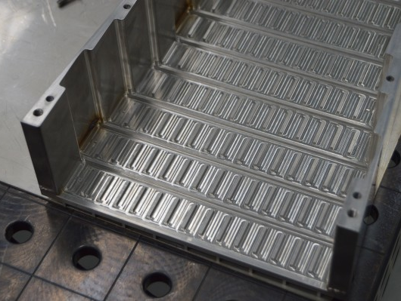
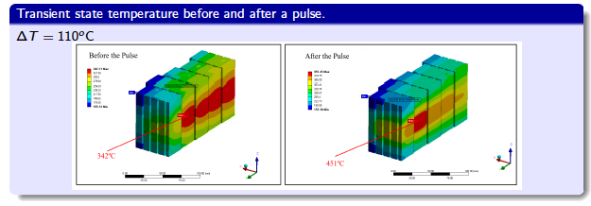
Target Systems Are Entering Detailed Design and Prototyping Phase
ESS-Bilbao Analyses and Prototypes
Manufacturing prototype for cassette structure that holds W target bricks
Beam power
reduction
Groove for filler
(AlSi12)

Slide 6
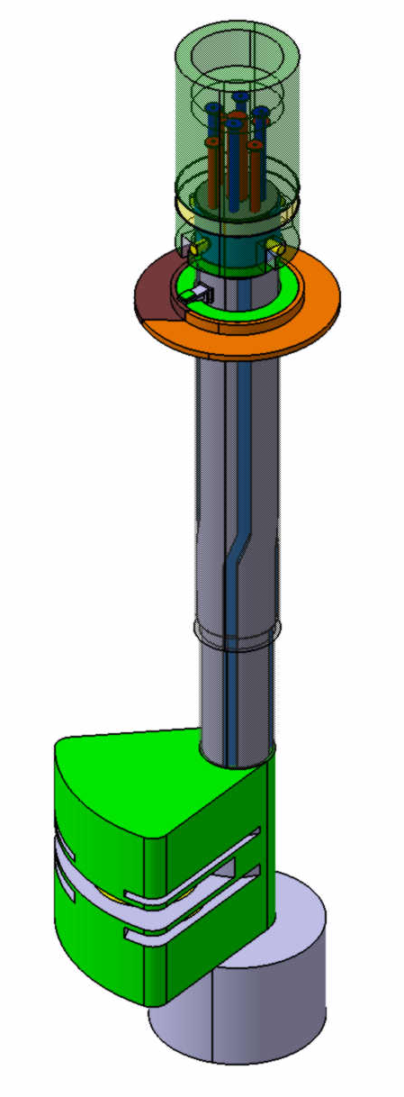
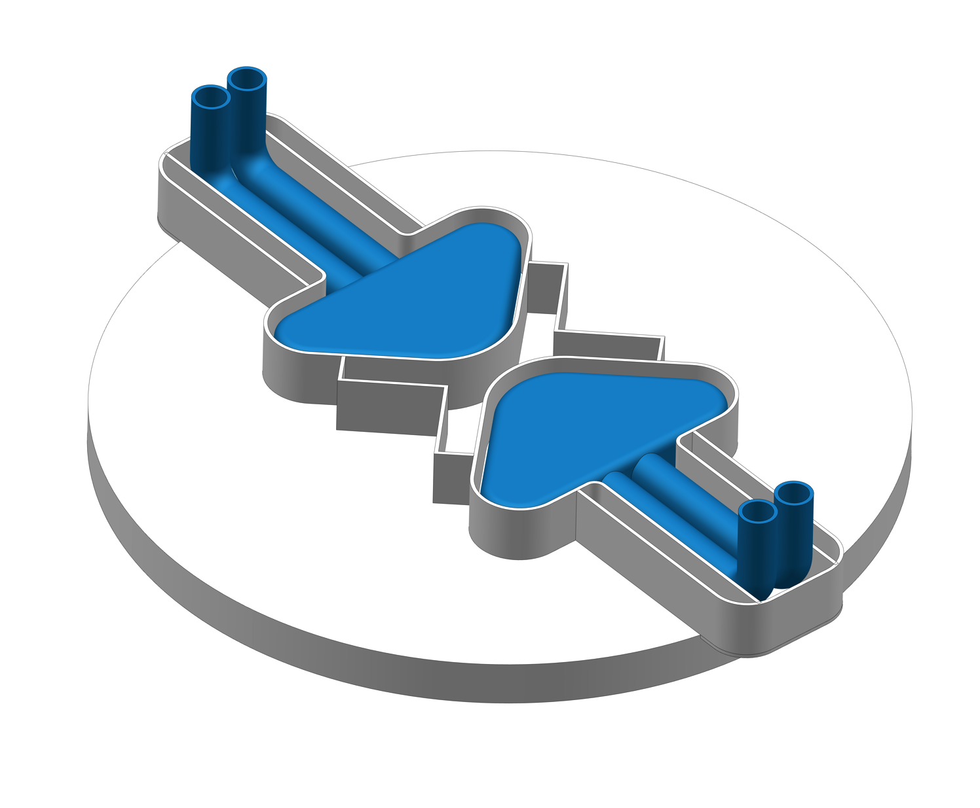
WP3: Moderator and Reflector Systems
Pleased to report that FZJ is our partner on this system
Design and prototyping work underway
Also, pleased to report that Moderator/Reflector concept is frozen
Preliminary Design Review for entire system held in June 2015
Moderator Reflector Plug
Liquid hydrogen system
He cryoplant
RFQ for procurement of He cryoplant released; expect to award contract at end of 2015/early 2016
Twister
Upper Cold (Butterfly) and Thermal Moderators

Slide 7
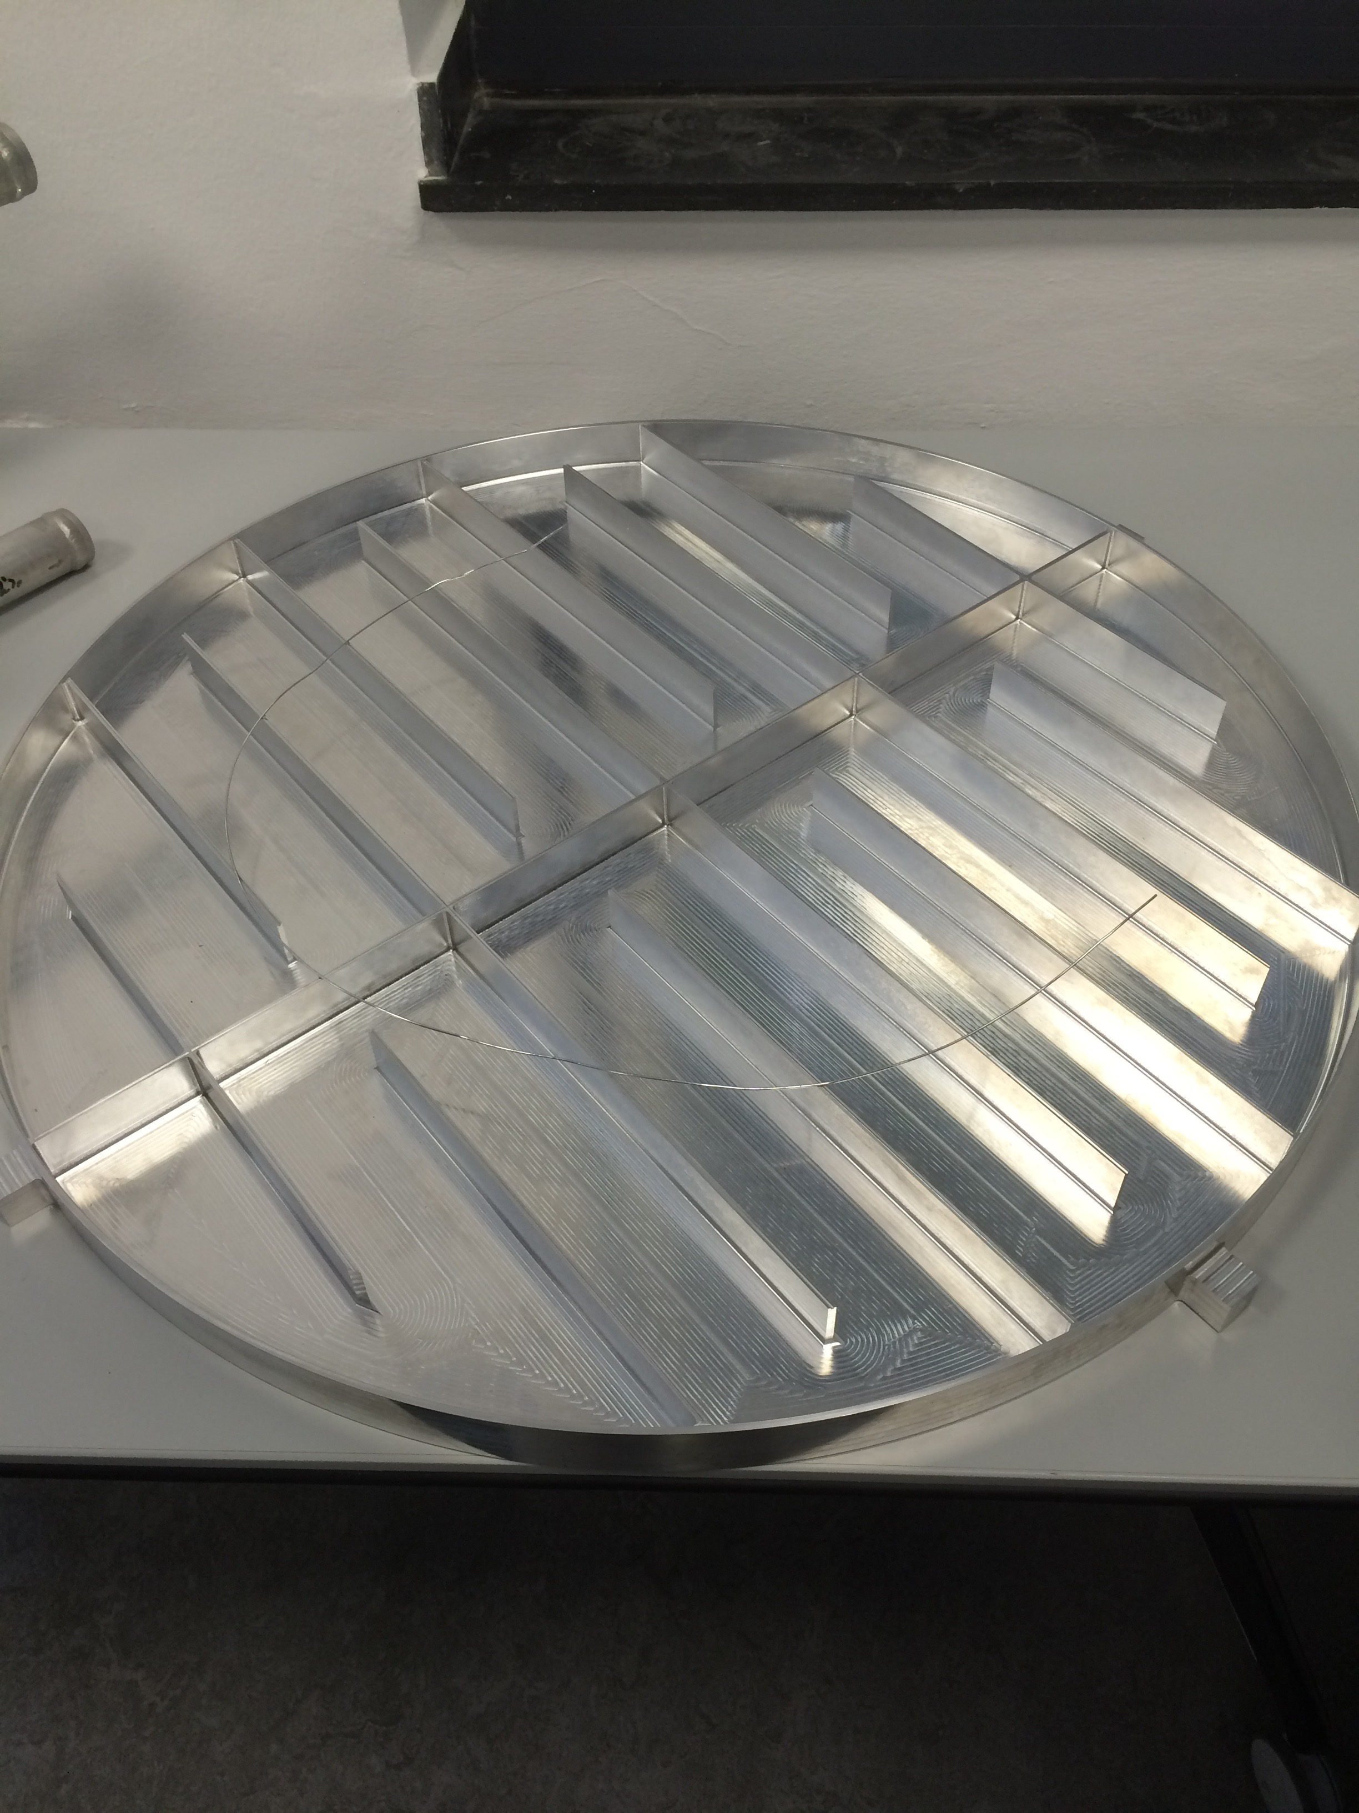
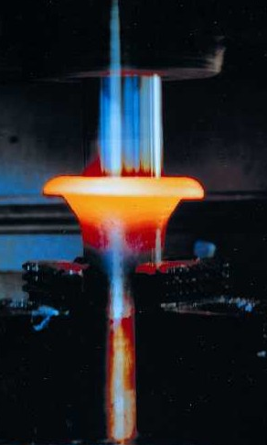
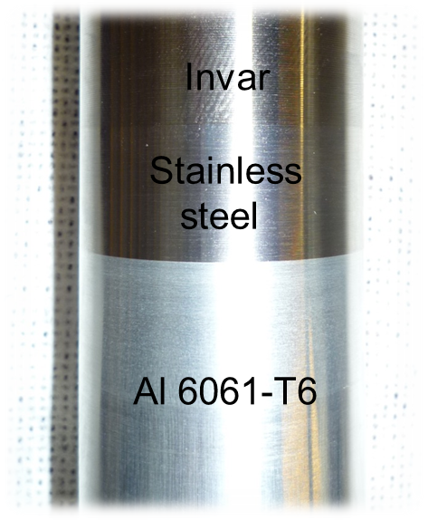
Moderator and Reflector Systems Are Also Entering Detailed Design and Prototyping Phase
FZJ Prototypes
Friction Welding Prototype
connection to cryo pipes
Prototype vessel for water pre-moderator
E-Beam Welding Tests
Beam power
reduction
Groove for filler
(AlSi12)
connection to moderator

Slide 8
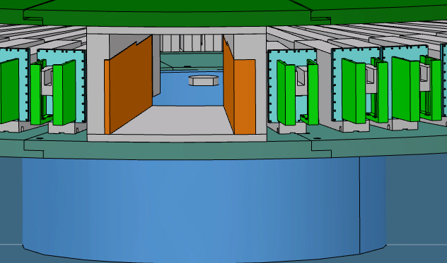
WP4: Monolith Systems
In-Kind Partnership Situation:
Secured partner for one more In-Kind Contribution
ESS-Bilbao has Neutron Beam Windows
ESS-Bilbao is also our partner for:
Monolith Vessel
Proton Beam Window
Tuning Beam Dump
Proton Beam Instrumentation Plug
CNR, Italy is our partner for the Irradiation Module
Seeking partners for Monolith Atmosphere and Shielding
Monolith Vessel
Kick-off meeting held at ESS-Bilbao in Sep
Preliminary Design Review next month
Change Request approved for incorporating features for non-scattering science opportunities
ECHIR
n-nbar

Slide 9
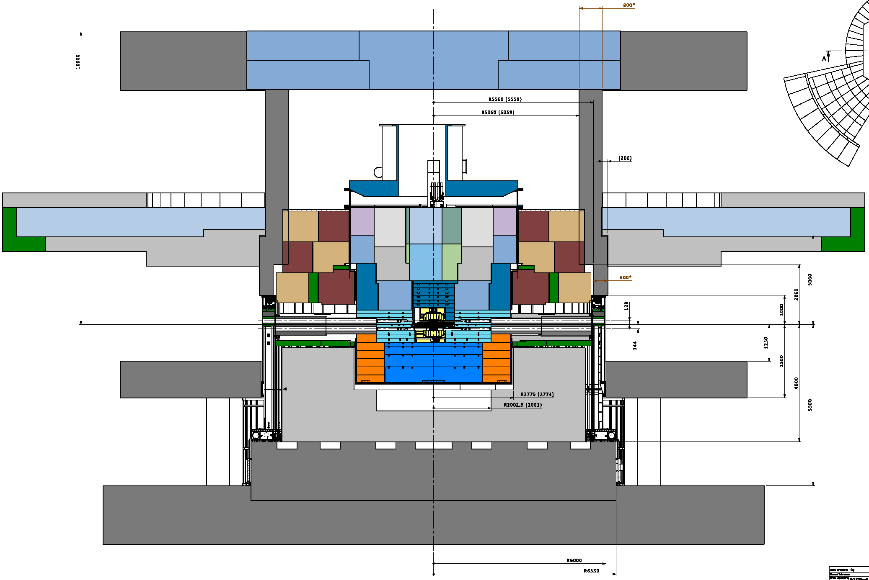
Interface with Conventional Facilities (CF) and neutron scattering instruments being addressed
New monolith base design lowers cost and impact on CF schedule
Established agreement with Neutron Science Systems (NSS) on beam extraction geometry
Details will be presented in t-TAC breakout

Slide 10
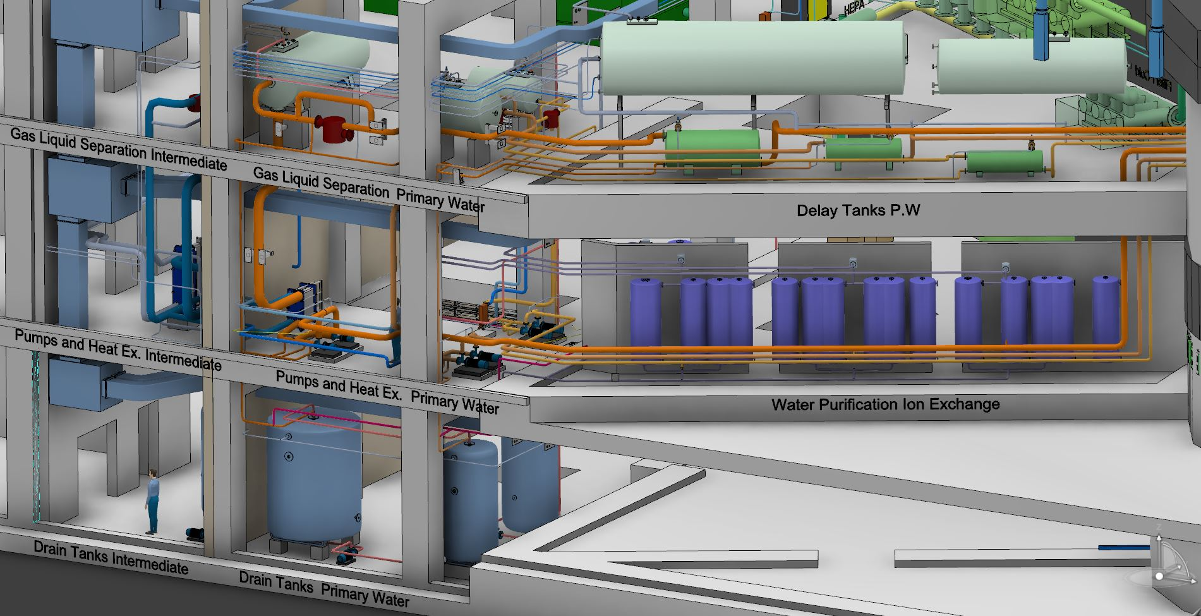
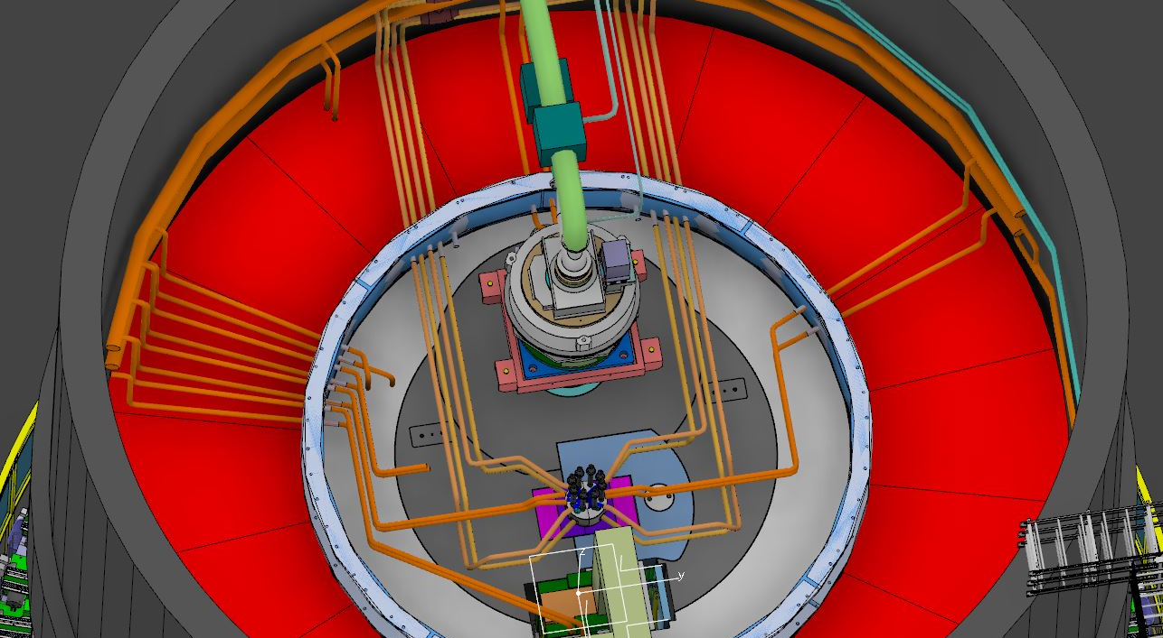
WP5: Fluid Systems
All PDRs complete
Primary Water Cooling Systems
Target Ventilation System
He Purification
Intermediate Cooling Systems
Going back to separate He purification systems for Target helium cooling loop and Monolith atmosphere
Off-the-shelf equipment; expect large cost savings relative to 2013 baseline estimate
Target Fluid Systems equipment located in Utilities Rooms within the Target Building
Interfaces between cooling systems and components within the monolith are outside the vessel boundary

Slide 11
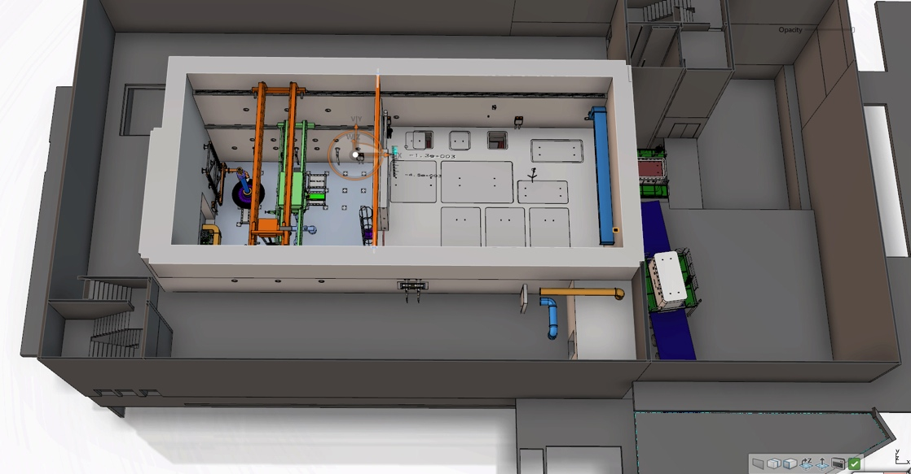
WP6: Remote Handling Systems
Storage Pits
Transfer Area
Shipment
STFC/UKAEA-Culham selected as IKC partner for Active Cells
Onboarding over the next few months
Near-term focus of ESS-Lund team is designing and procuring concrete embedments and other building interfaces to meet construction schedule demands
CDR for Active Cells Confinement (Part 1), which includes embedments and penetrations held last week
Technical Galleries
Process Cell
Maintenance Cell
Size:
Height 15 m
Length 30 m
Width 12 m

Slide 12
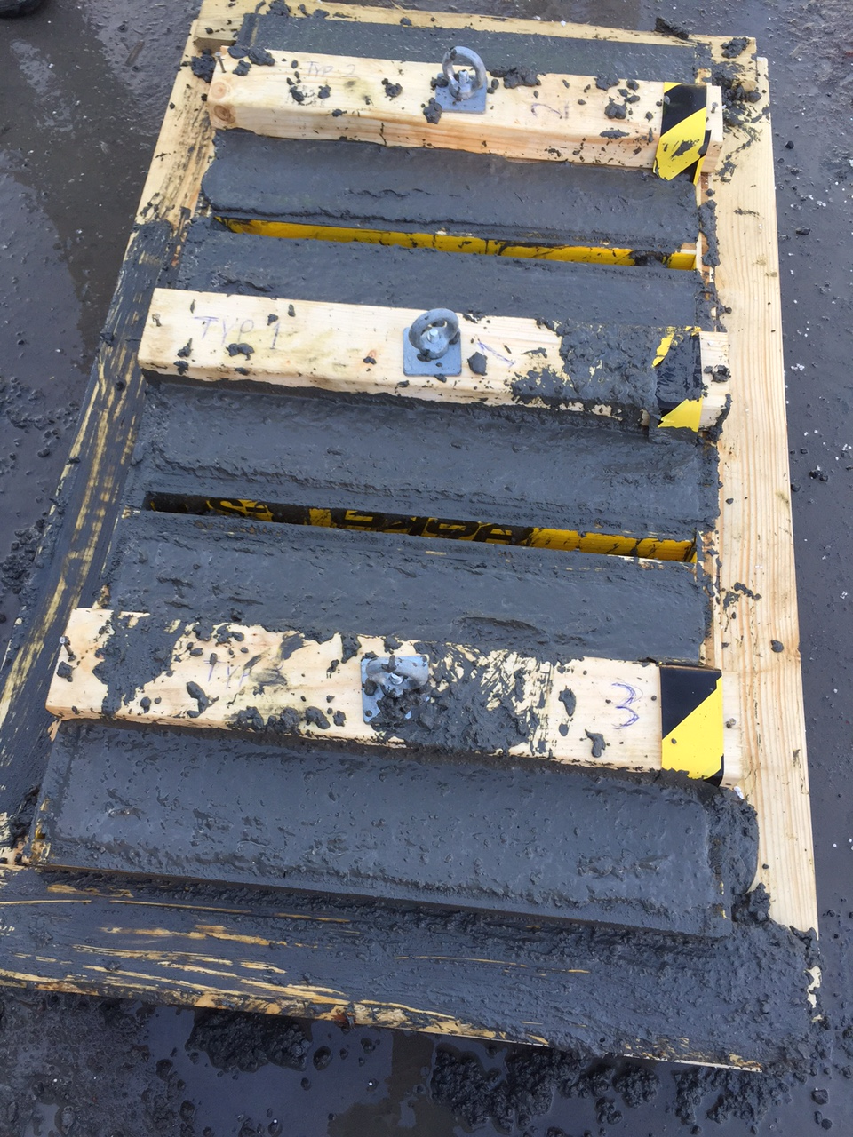
Concrete Embedments for Active Cells Will Be Installed in Early 2016
Prototyped and tested embedded supports for liner
Will proceed to procure parts now
Test casting with high density concrete performed to determine degree of filling of concrete underneath the beams
Will perform bending and pull out tests
Embedded support prototype for Active Cell liner

Slide 13
WP7: Controls
Good progress on nuclear safety evaluation
Qualitative hazards analyses for all systems complete
Bounding safety cases being identified and evaluated
Will identify systems with a safety-function and credited controls
Developing Target Safety System (TSS) design assuming safety-credited beam shutoff (i.e., no beam permit signal) for two event classes
Means to detect loss of wheel rotation and loss of cooling identified
Beam shutoff approach identified
Redundancy and diversity being addressed
Worked with CF to develop routing for dedicated cables
PDR for TSS planned for Dec 2015

Slide 14
WP8: Target Physics
Completed proof-of-principle tests for flat moderators in collaboration with J-PARC
Performing ortho-para hydrogen conversion measurements in collaboration with SNS
Materials handbook
Support for licensing efforts
14

Slide 15
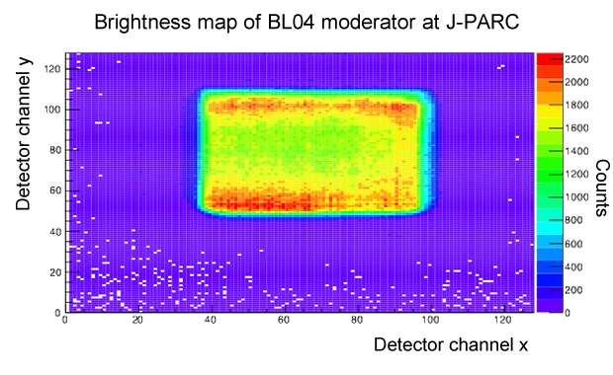
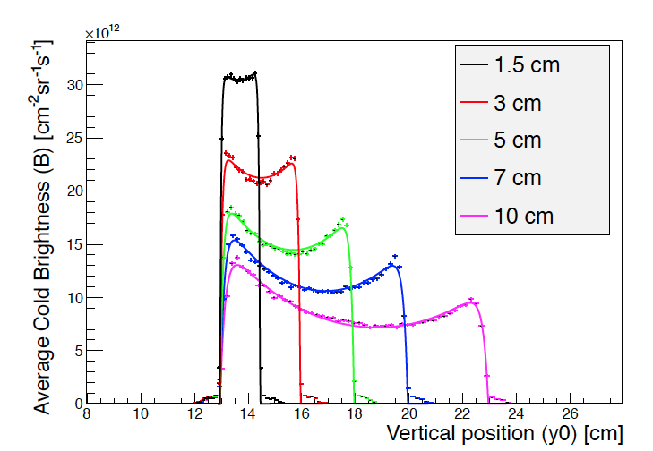
Measurements at J-PARC confirmed principle used for ESS moderator optimization
Note relative maxima at top and bottom of J-PARC moderator
MEASURED
CALCULATED

Slide 16
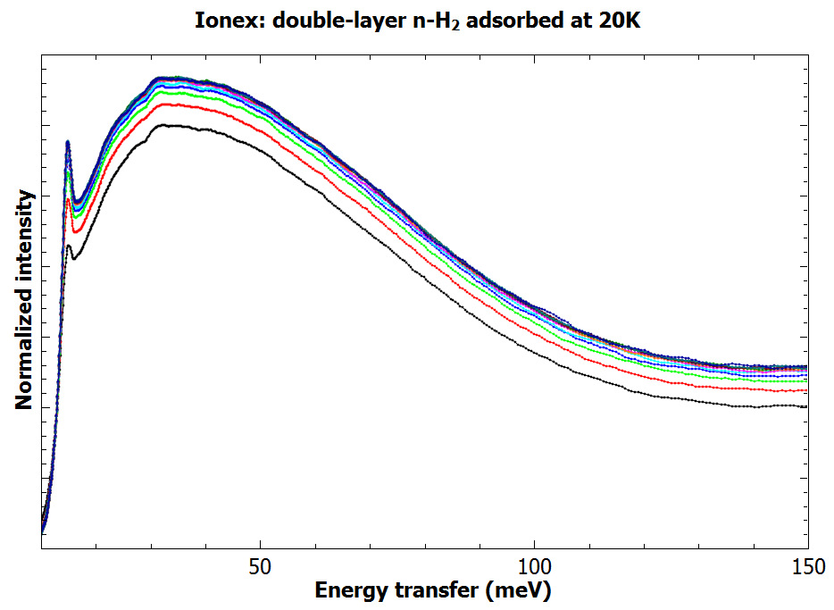
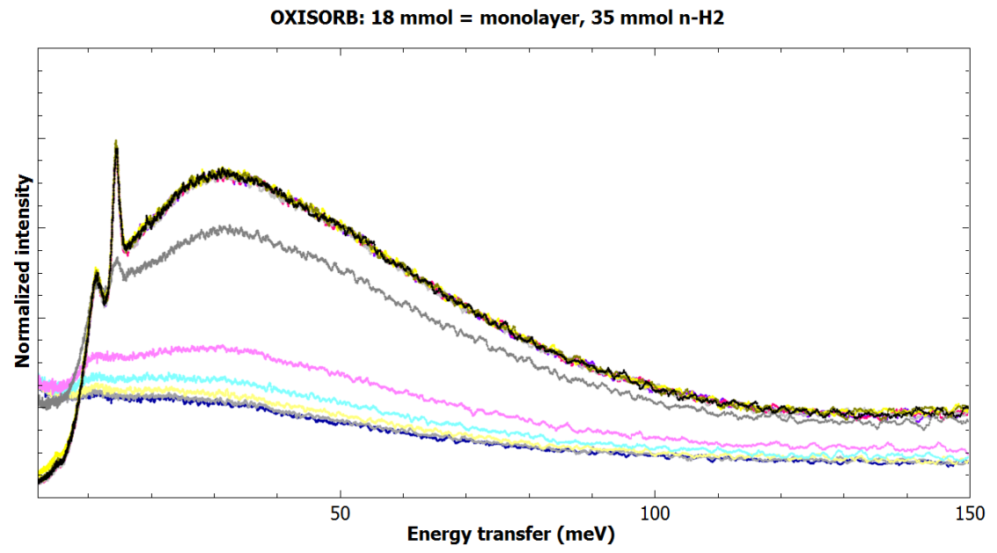
Ortho-para hydrogen tests at SNS confirm catalyst choice
Experimental program focused on:
Determining/verifying important rate constants for:
Orhto-para conversion rate in catalyst (Aug 2015) ✔
Para-ortho conversion rate by interaction with neutrons (Nov 2015)
Developing Raman spectroscopy system for para fraction measurements on ESS
Initial tests at SNS showed that OXISORB® is the preferred catalyst
Next: OXISORB® will be tested with flowing H₂ in Nov 2015 at VISION (SNS) using laser (Raman) and neutron scattering probes
Ortho-para H conversion energy – 14.7 meV
OXISORB® (Cr(II) on SiO₂)
1g catalyst : 44 mmol H₂
10-15 min conversion
Ionex® (Fe₂O₃):
1g catalyst : 4 mmol H₂
20-25 min conversion

Slide 17
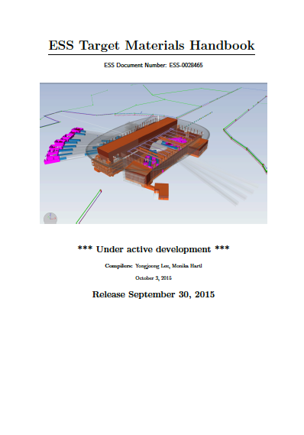
ESS Target Materials Handbook Issued
Provides uniform set of properties to be used by entire team, including in-kind partners
Updated and released monthly
Includes properties for:
Solids | Fluids
W | H2
SS-316LN | He
SS-316L | Water
Be
Al-6061 T-6

Slide 18
Target Physics Support for Licensing Process
Worked with System Engineering and NSS to develop a comprehensive set of rules for radiological zoning at ESS, based on
Dose limits
Temporary hotspots
Entrance and exit requirements
Monitoring
Work authorization
Compliance with Swedish legislation for normal operation and likely accidents
Led Target division efforts to deliver the following requirements to Conventional Facilities:
Surface treatments for all Target Building rooms (ESS-16344)
Leak tightness and pressure differential for rooms, doors, hatches and walls (ESS-11043)
Penetration requirements (ESS-38019)
Tungsten release factors experiment

Slide 19
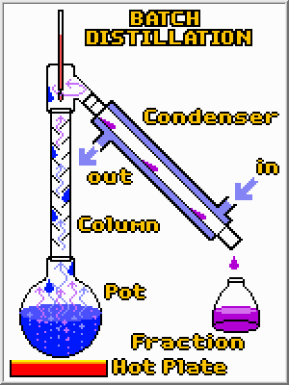
W Release Measurements Will Be Used to Support Safety Basis Accident Analyses
Experiments being conducted by IKC partner DTU - Denmark
irradiation
Dissolution to measure total I and Br
10 x 2 x 80
Heating to measure released I and Br
10 x 28 x 80
Dissolution to measure total I and Br

Slide 20
Detailed Installation, Testing, and Commissioning Plan Ready for Implementation
Added ~ 150 activities and milestones to schedule
Will be incorporated into baseline soon
Includes major component installation in a logical sequence and system and subsystem tests, as well as integrated system tests (cold commissioning)
June 2019 “Beam on Target” milestone maintained, but requires earlier than planned access to Target Building
Still needs to be integrated with others (CF, Accelerator, Instruments, I&C)
Especially concerned about CF interface
Defining early access dates and requirements
Just beginning to work with CF to integrate and finalize

Slide 21
EV Performance
Cum SV | -1.58 M€
Cum CV | -1.17 M€
Cum SPI | 0.89
Cum CPI | 0.92
Value (k€) | Dec-13 | Dec-14 | Jan-15 | Feb-15 | Mar-15 | Apr-15 | May-15 | Jun-15 | Jul-15 | Aug-15 | Sep-15 | Oct-15 | Nov-15 | Dec-15
Earned | 2,976 | 7,941 | 8,534 | 8,953 | 9,659 | 10,285 | 11,103 | 11,877 | 12,157 | 12,753
Actuals | 2,976 | 8,567 | 8,857 | 9,503 | 10,449 | 11,042 | 11,807 | 12,537 | 13,237 | 13,928
Scheduled | 2,976 | 8,518 | 9,063 | 9,691 | 10,532 | 11,215 | 11,939 | 12,927 | 13,633 | 14,333 | 15,848 | 17,464 | 19,394 | 20,855

Slide 22
Variances Primarily Caused By Extended Moderator Optimization Studies
Schedule:
Cumulative SV of -1.58 M€ (SPI = 0.89) is primarily due to:
Delays in finalizing moderator to gain significant enhancement in ESS performance; WP 3 has recovered, but WP4 is still in recovery
Many activities have slipped 2-5 months; focusing on recovering delays on critical activities --- still meet Jun 2019 “Beam on Target” milestone
Cost:
Cumulative Cost Variance of -1.17 M€ (CPI = 0.92) is primarily due to:
Breakage in monolith design work (-0.55 M€) caused by prolonged moderator optimization studies
Using higher cost and additional resources relative to plan in Fluid Systems (-0.31 M€)
Most of CV is unrecoverable; cost savings will be sought through value engineering efforts and expected reductions in He purification system to hold baseline budget

Slide 24
Status of Target Project IKCs
Target Project has 22 in-kind work elements
Partner selected for 13 work elements
Soliciting partners for 5 others (negotiating with potential partner for 3 packages)
Four IKC packages remain to be released
Last Call dates set for all remaining elements
“Last Call” - Announcement to stakeholders that we must have partner or we will use cash to self-perform

Slide 25
In-Kind Partners Are Onboard and Contributing to Key Areas of Target Project
In-Kind ID | WBS # | In-Kind Contribution | Cost Book Value (M€) | Partner
TIK.2.1 | 12.2.2-3 | Target Wheel | 8.4 | ESS Bilbao
TIK.2.2 | 12.2.4 | Target Helium Cooling System | 5.6 | UJF – Czech Rep.
TIK.3.1-3 | 12.3.2-4 | Moderator & Reflector Systems | 23.4 | FZJ - Germany
TIK.4.2 | 12.4.2.2 | Proton Beam Instrumentation Plug | 0.5 | ESS Bilbao
TIK.4.3 | 12.4.2.3 | Irradiation Module | 0.2 | CNR - Italy
TIK.4.4 | 12.4.3.1 | Proton Beam Window | 0.9 | ESS Bilbao
TIK.4.5 | 12.4.3.2 | Monolith Vessel | 4.6 | ESS Bilbao
TIK.4.6 | 12.4.3.3 | Neutron Beam Windows | 0.5 | ESS Bilbao
TIK.4.9 | 12.4.5 | Tuning Beam Dump | 2.5 | ESS Bilbao
TIK.6.1 | 12.6.2 | Active Cells | 21.5 | STFC/UKAEA
TIK.8.1 | 12.8.5.1 | Tungsten Release Factors | 0.2 | DTU - Denmark
Six partner institutes
Value of awarded packages = 68.4 M€

Slide 26
Progress in securing partners

Slide 27
Target Project Issues
Issue: Potential for schedule delays due to transitioning from ESS-Lund led Preliminary Design to IKC-partner led Final Design (for many systems)
Mitigation:
Clearly define scope and deliverables in Technical Annexes to IKC Agreement
Establish close collaboration and partnership and use agreed intermediate milestones to drive team focus
Continuous exchange of design information along with regular meetings and monthly reporting
Issue: Strong interface with Target Building design and construction could delay project completion
Mitigation:
Hired Target Project Installation Coordinator to further develop installation plans and integrate installation with other projects, especially CF
Established task force to ensure that design information/requirements are provided to CF “just in time” for detailed design of building
Developed detailed installation plan and beginning to work with CF team to integrate with detailed construction schedule
Plan to use CF contractor work force to execute some of the work, which simplifies construction management interface and provides opportunity to optimize work force efficiency

Slide 28
Concluding Remarks
Near term efforts focus on:
Transitioning from Preliminary to Final Design
Prototyping of key hardware elements is underway
Finalizing/confirming Target Building requirements in time to avoid delays
Integration of detailed installation plan with CF
Good progress on radiation hazard and accident analyses, identification of safety functions, and definition of safety-credited active controls (TSS)
Still on track for project completion in 2019
Plan relies on success of In-Kind Contribution partners
Partners for 13 of 22 work elements selected; Last Call dates for remaining nine work elements identified
Transitioning work to our six partners that are already in place
Lund team focusing on integration of partners’ work with the rest of ESS

