Slide 1
ESS Update
TAC Meeting
October 2015
James Yeck
Director General
www.europeanspallationsource.se

Slide 2
Construction investment
 | Already committed
 | Sweden (member) | 35.0 %
 | Denmark (member) * | 12.5 %
 | Germany (member) * | 11.0 %
 | United Kingdom (observer) | 10.0 %
 | France (member) | 8.0 %
 | Italy (member) | 6.0 %
 | Spain (observer) * | 5.0 %
 | Switzerland (member) | 3.5 %
 | Norway (member) | 2.5 %
 | Poland (member) | 2.0 %
 | Czech Republic (member) | 2.0 %
 | Hungary (member) | 0.95 %
 | Lithuania (future member) | 0.45 %
 | Estonia (member) | 0.25 %
 | Total | 99.15 %
 | Belgium (observer) | tbd
 | Netherlands (observer) | tbd
 | Greece (future observer) | tbd
 | Iceland | tbd
 | Latvia | tbd
 | Discussions: Portugal, Turkey, Finland
* Includes Pre-construction Costs
Notes:
Founding Members
Czech Republic
Denmark
Germany
Estonia
France
Italy
Hungary
Norway
Poland
Sweden
Switzerland
Founding observers
Belgium
Spain
Netherlands
United Kingdom
Ireland

Slide 3
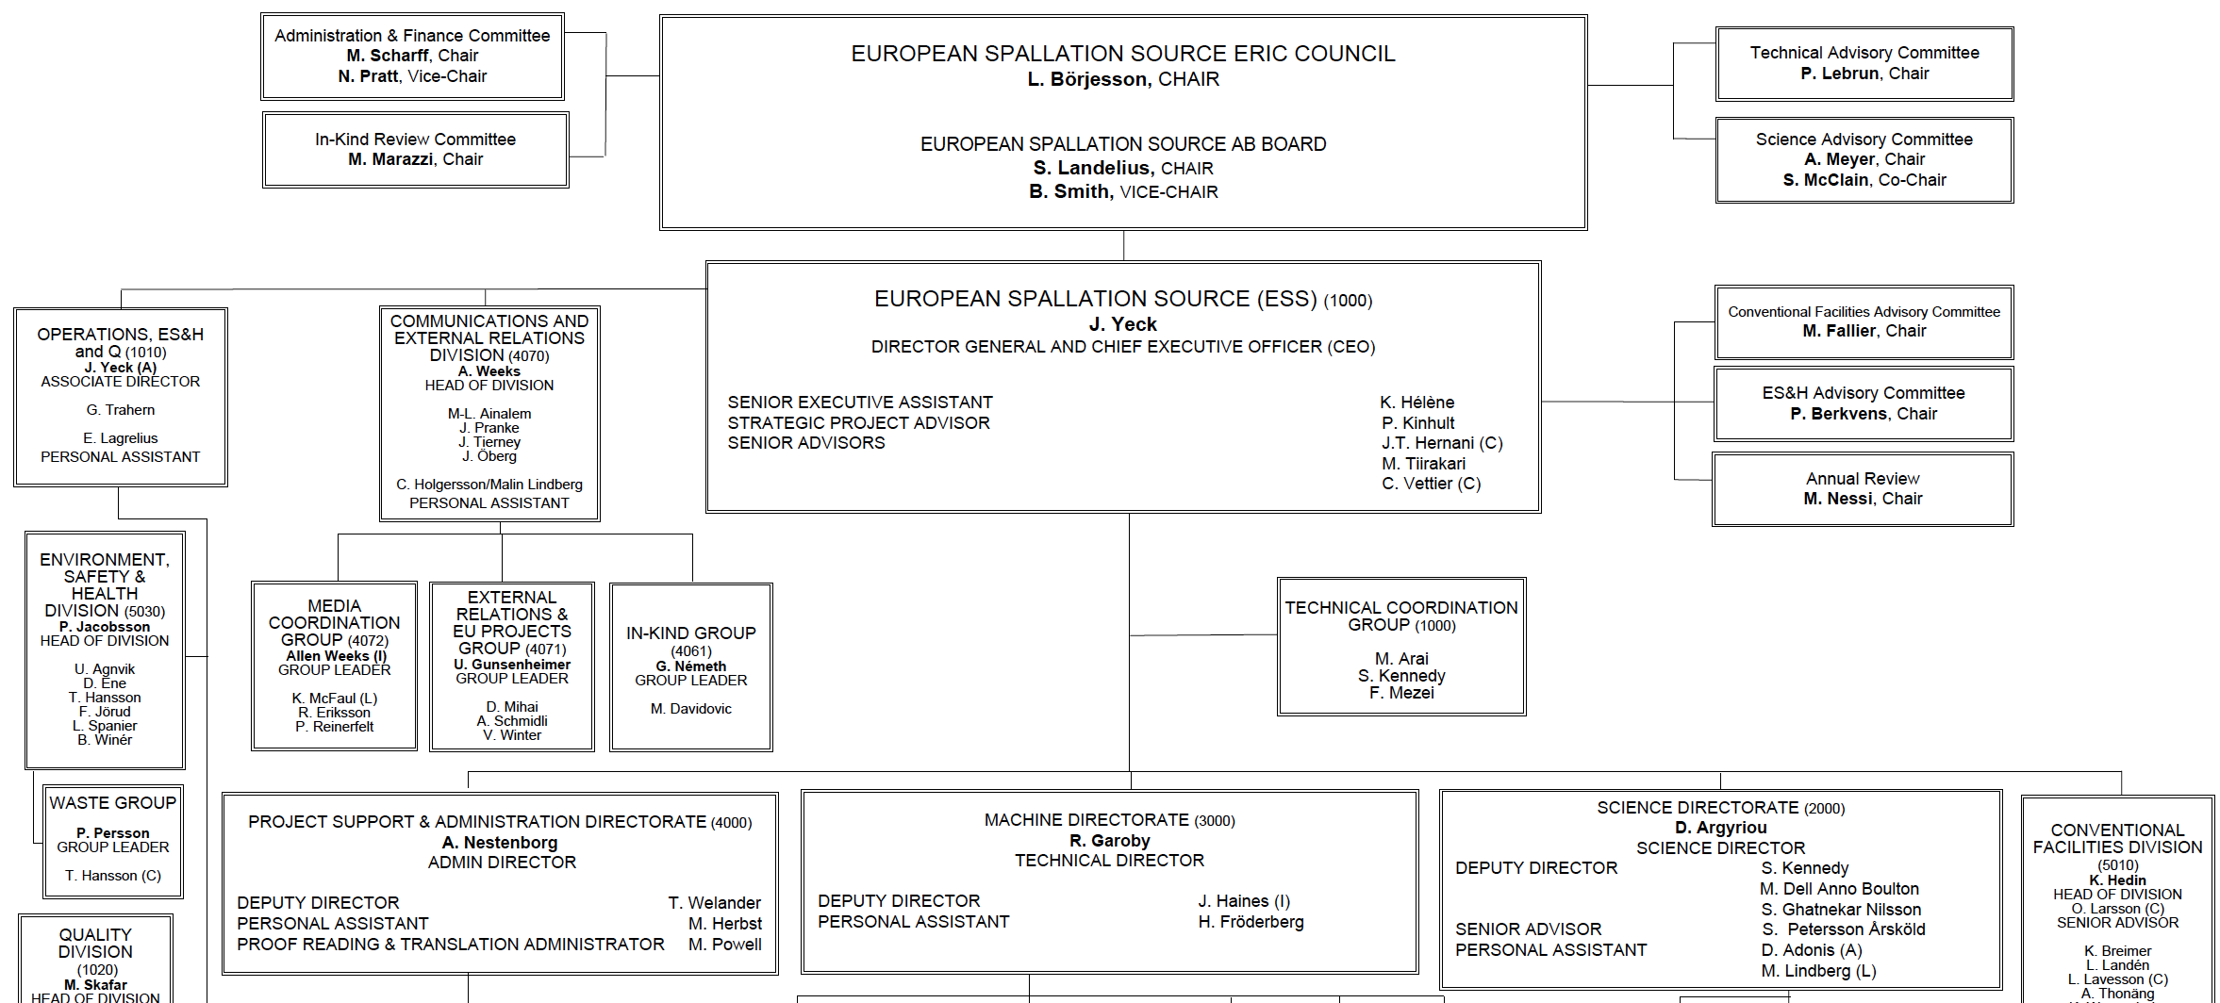
Organisation
~ 100
Partner Institutes
345
Employees
45
Nationalities

Slide 4
ESS AB transitioned into European Research Infrastructure Consortium (ERIC)
19 August 2015
The European Commission formally adopted its decision to establish the European Spallation Source (ESS) as a European Research Infrastructure Consortium, or ERIC.
28 August 2015
Decision entered into force
ERIC Founding Members
Czech Republic
Denmark
Germany
Estonia
France
Italy
Hungary
Norway
Poland
Sweden
Switzerland
ERIC Founding Observers
Belgium
Spain
Netherlands
United Kingdom
ERIC Potential Members
Greece
Turkey
Portugal
Finland

Slide 5
ESS transitioned into a European Research Infrastructure Consortium (ERIC) on 1 October
ESS AB
Swedish limited liability corporation
owned by the Swedish and Danish governments
ESS ERIC
European Research Infrastructure Consortium
Sole governing body: the European Spallation Source ERIC Council, comprised of representatives from the Member and Observer Countries
transfer of assets,
obligations and
personnel
on Oct 1, 2015

Slide 6
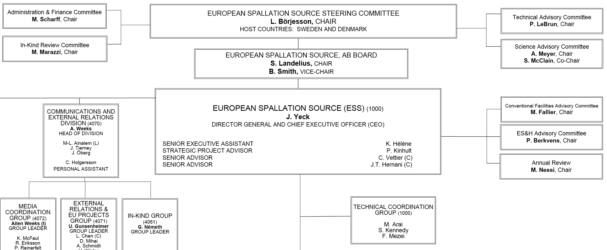
ESS AB transitioned into European Research Infrastructure Consortium (ERIC)
European Spallation Source
ERIC Council

Slide 7

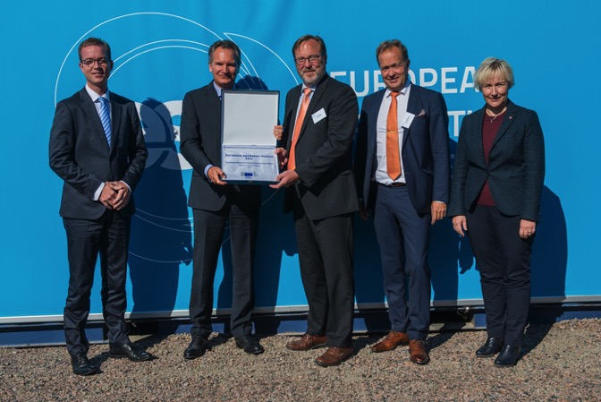
ERIC Plate Ceremony
Handing over of the ERIC Plate
8 September 2015 (60 guests) onsite
  Marks the transition from ESS AB to The European Spallation Source ERIC
Speakers:
  Robert-Jan Smits, Director-General for Research and Innovation, European Commission
  Helene Hellmark Knutsson, Swedish Minister for Higher Education and Research
  Dr. Esben Lunde Larsen, Danish Minister for Higher Education and Science

Slide 8
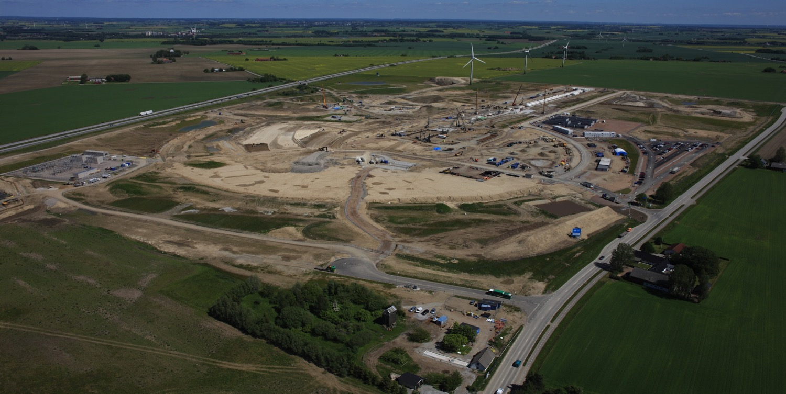

Progress on civil construction
June

Slide 9
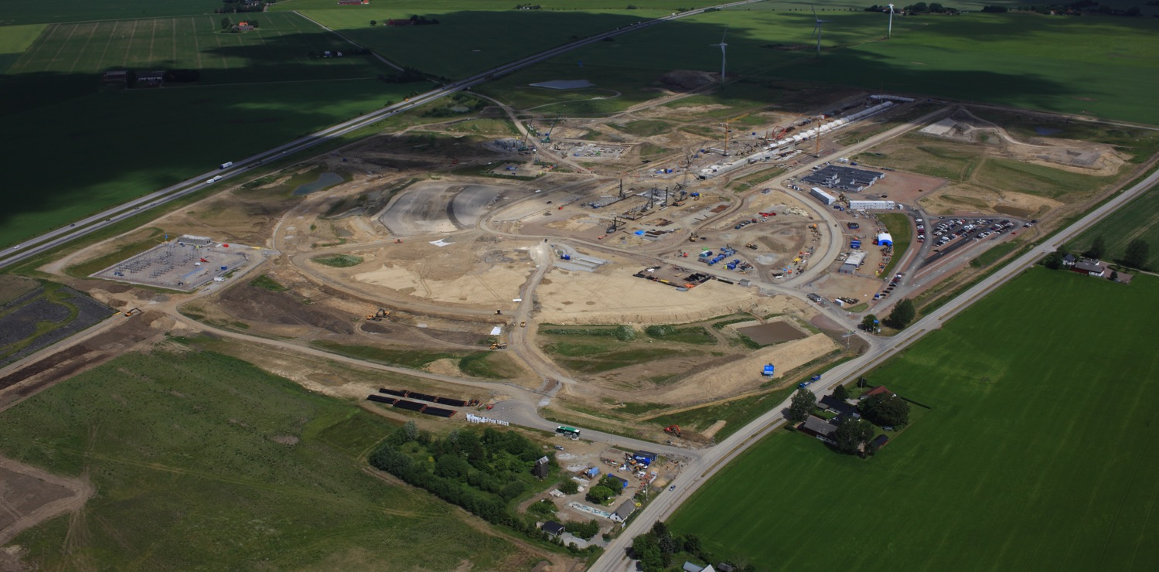
Progress on civil construction
July

Slide 10
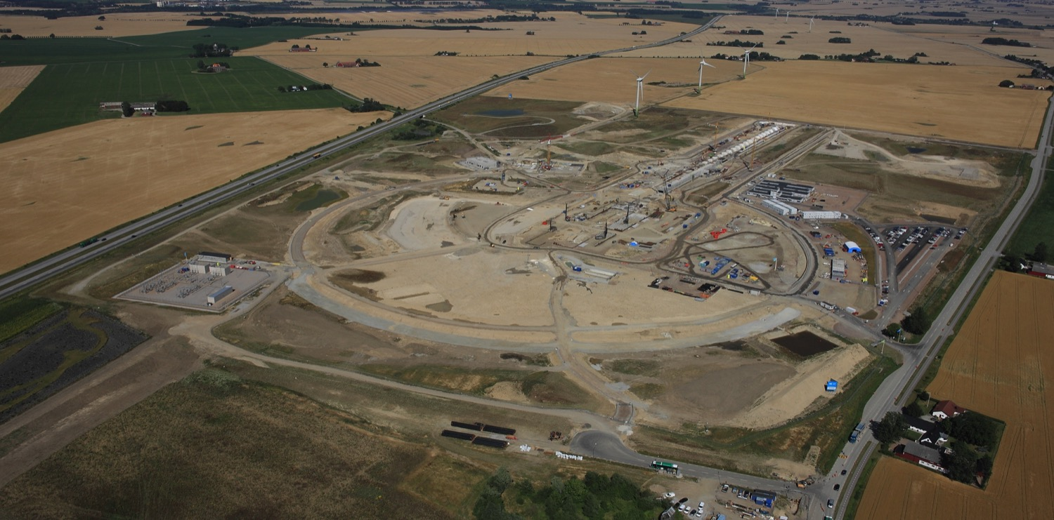
Progress on civil construction
August

Slide 11
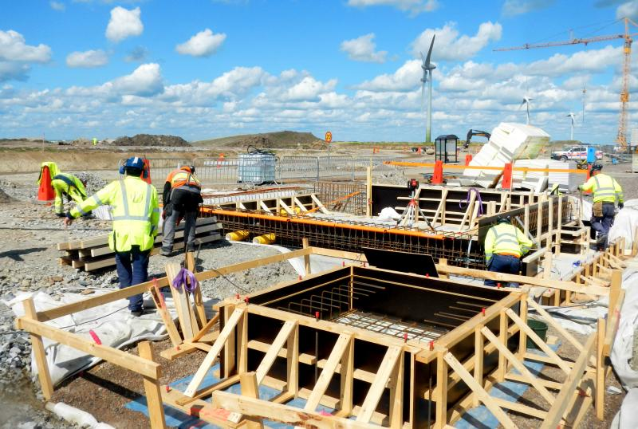
Progress on civil construction
Notes:
Target piling, Accelerator, vault E04a, G02 first substation, H01 reinforcement, H05 building, H06 precast walls installation.

Slide 12
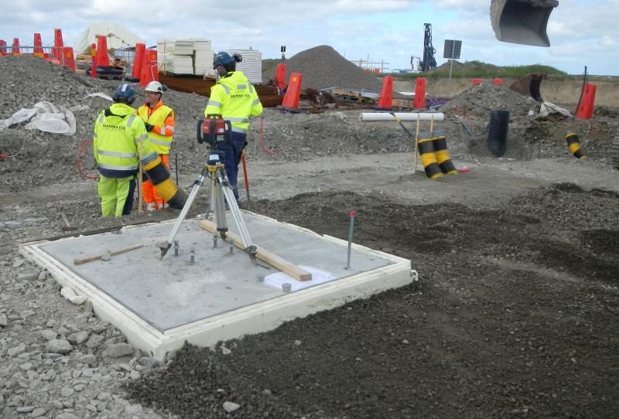
Progress on civil construction
Notes:
Backfill CTL & stubbs, first casting of HEBT bottom slab, G02 drilled foundations, G02 substation no1.
June 2015

Slide 13
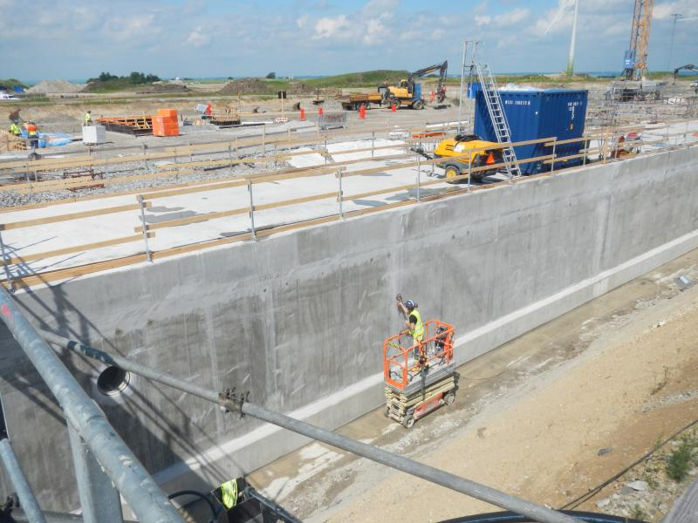
Progress on civil construction
Notes:
Tunnel and target

Slide 14
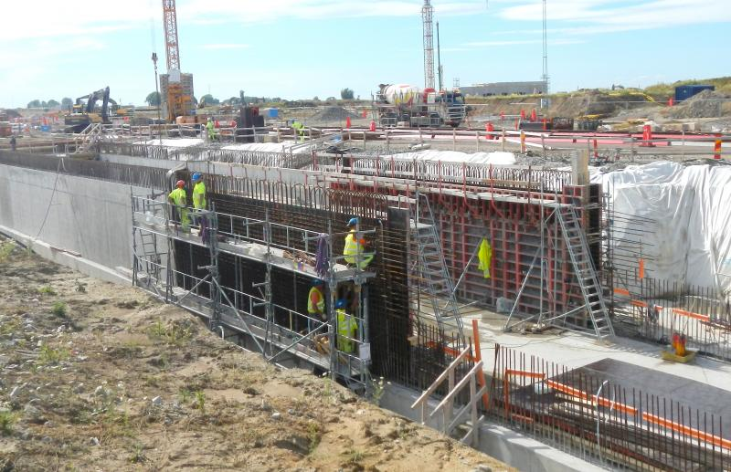
Progress on civil construction
Notes:
Target, G02, Retaining wall, CTL, H06, G01, FEB, HEBT
Aug 2015

Slide 15
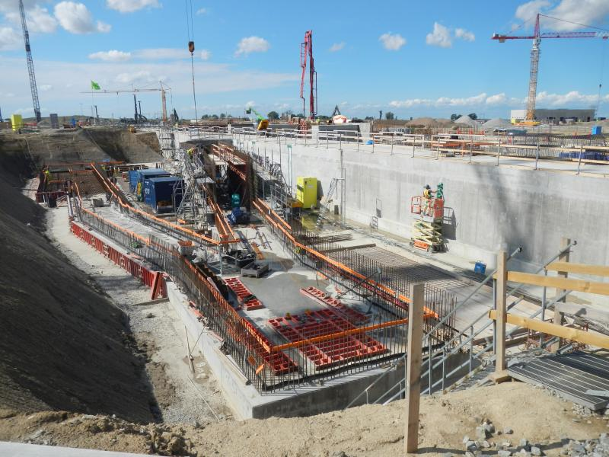
Progress on civil construction
Notes:
Target Tunnel Sep 2015

Slide 16
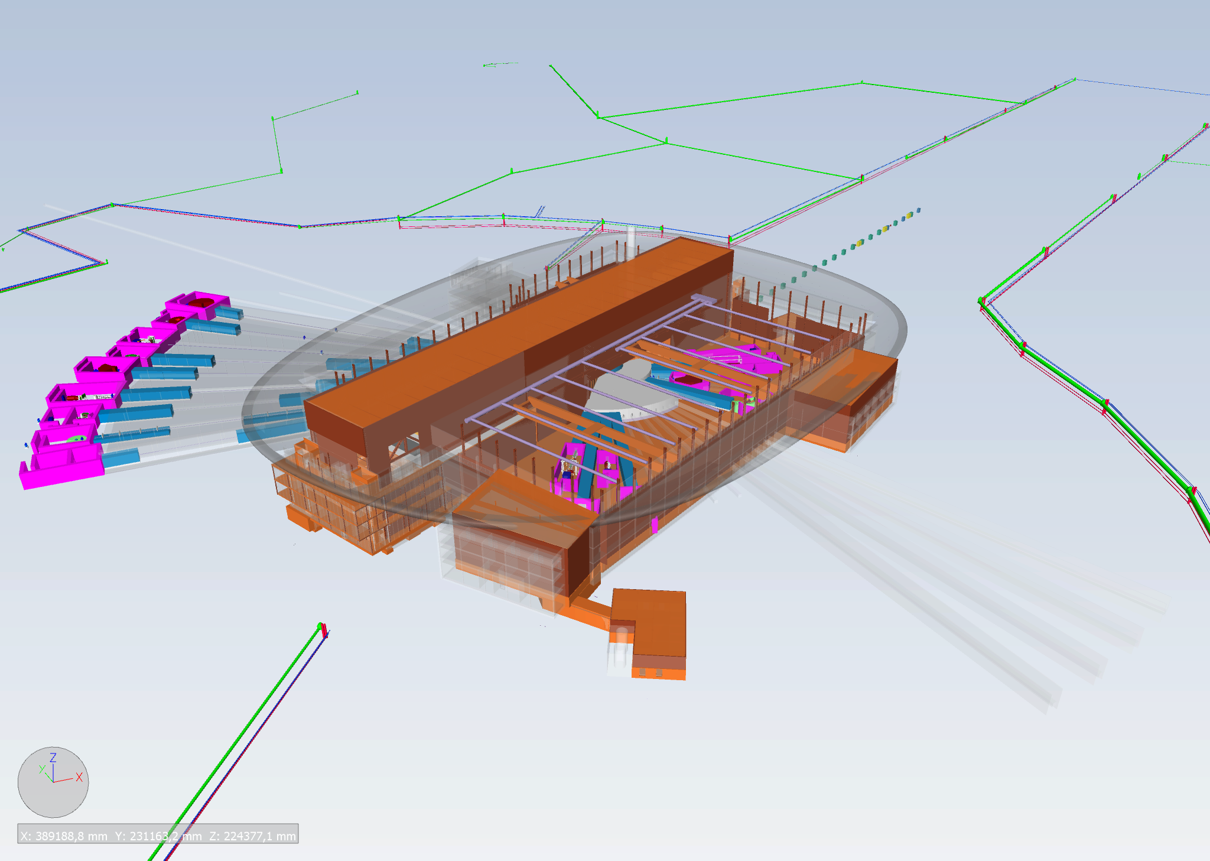










16 – instrument suite taking shape
CAMEA - Spectrometer
FREIA - Reflectometer
BEER - Diffractometer
LOKI - SANS
HEIMDAL - Diffractometer
VOR - Spectrometer
C-SPEC - Spectrometer
T-REX - Spectrometer
ESTIA - Reflectometer
MAGIC- Diffractometer
MIRACLES - Spectrometer
SKADI - SANS
NMX - Macro-Crystallography
ODIN - Imaging
VESPA - Spectrometer
2013 Round: Suggested 3 Instruments from 4 Proposals
2014 Round: Suggested 9 Instruments from 16 Proposals
2015 Round: Suggested 4 Instruments from 12 proposals
DREAM - Diffractometer
Leading Institutions

Slide 17
2015 Priorities
  Establish In-kind agreements
  Complete transition from ESS AB to the ERIC organisation
  Recruit directors for neutron scattering systems and administration
  Demonstrate that schedule drives decision-making (project culture)
  Complete 2nd Annual Project Review and implement action plans
  Implement technical coordination and resolve open design issues
  Secure solution for liquidity needs during peak construction years
  Preapre application for regulatory license required for installation
  Ensure appropriate employment conditions for staff and secondees

Slide 18
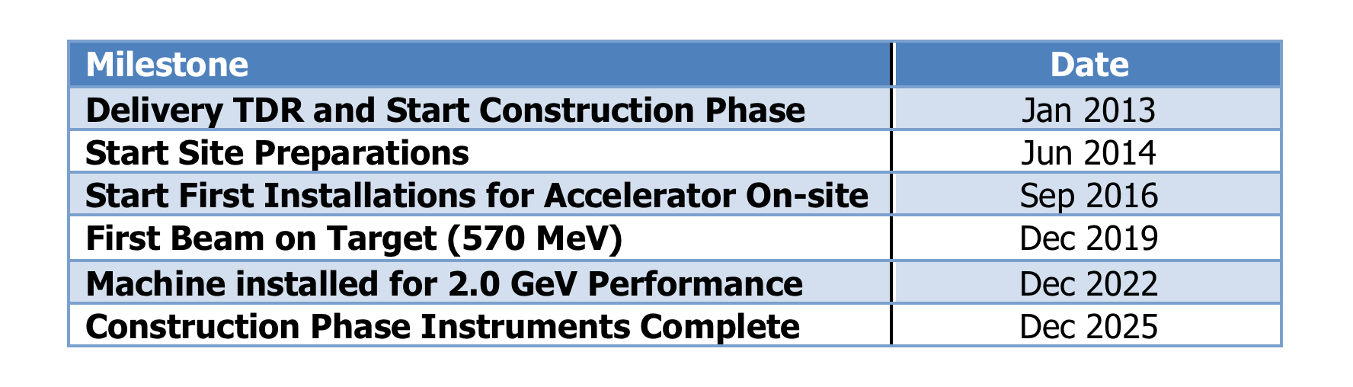
ESS Schedule baseline – external milestones
Ready for Beam on Target!

Slide 19
ESS construction cost baseline
(Jan 2013 pricing) | M EUR
Conventional Facilities | 531,9
CF scope supported by host countries | -93,0
Accelerator Systems | 510,2
Target Systems | 155,2
Integrated Control System | 73,0
Design & Engineering | 33,7
Neutron Scattering Systems | 350,0
Project Support & Administration and Licensing | 123,8
Contingency | 158,2
Total Construction Budget and ESS Cost Book Value | 1843,0

Slide 20
Construction project status

Slide 21
ESS In-kind Goals
Construction cost: € 1,840 Billion
In-kind: € 747 Million
€ 510 M
€ 350 M
€ 155 M
€ 73 M

Slide 22
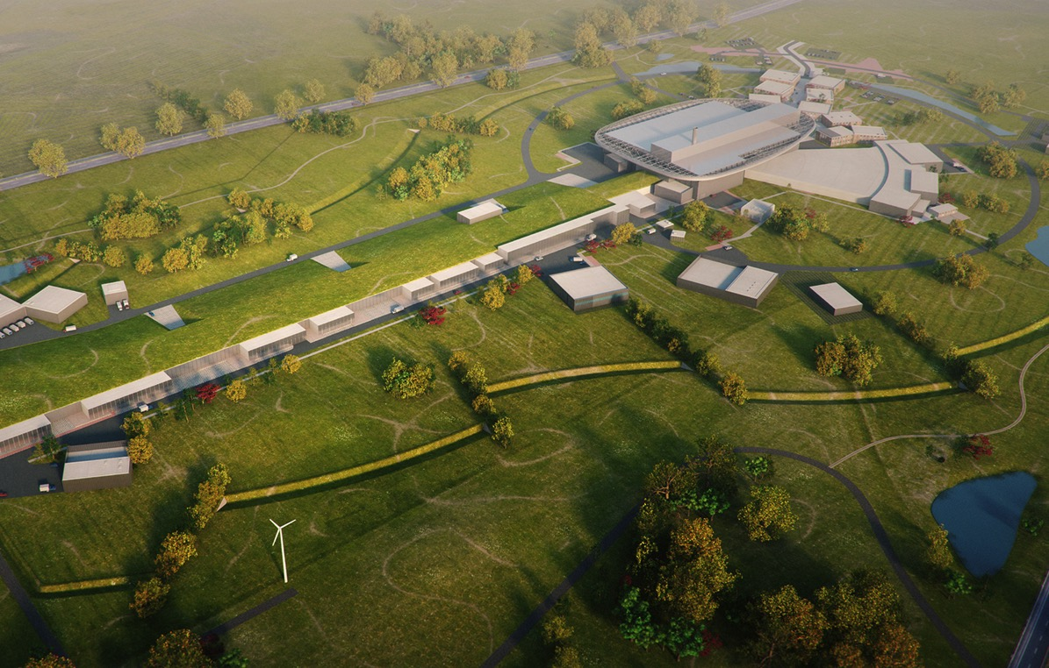
BrightnESS – critical support for transitioning to the operations phase
2025
ESS construction complete
2014
Construction work starts on the site
BrightnESS
2023
ESS starts
user program
2009
Decision: ESS will be built in Lund
2019
First neutrons on instruments
2012
ESS Design Update phase complete
2003
First European design effort of ESS completed

Slide 23
BrightnESS
BrightnESS serves as a risk mitigation tool in the delicate process of becoming fully operational.
Support In-kind
contribution
Enhance technical
performance
Increase
innovation impact

Slide 24
2nd Annual Project Review - April 2015
  Annual project reviews are comprehensive assessments of cost, schedule, technical, and management aspects of the ESS project.
  Charge for 2nd Annual Project Review was developed in consultation with our governance, stakeholders, and subcommittee chairs.
  1st review in November 2013 and progress assessment in May 2014 emphasized construction readiness – construction is now underway!
  2nd Annual Review assessed progress and plans:
    Advice on how to improve schedules and to reduce cost and schedule risks and uncertainties; and,
    Open approach led to accurate and constructive feedback and recommendations.

Slide 25
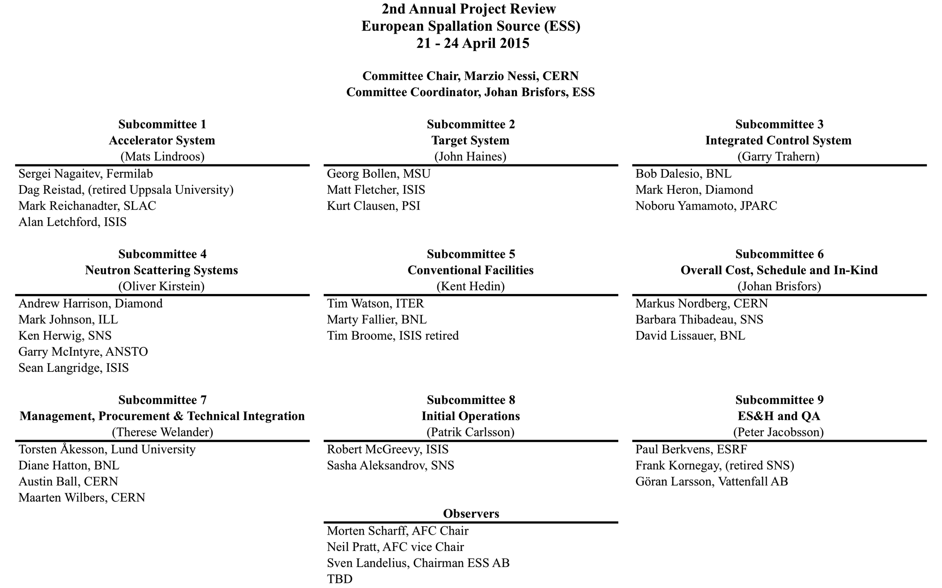
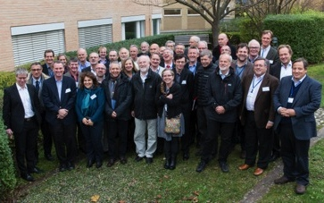
2nd Annual Project Review Committee

Slide 26
2nd Annual Review – general impression
Slide #1 from the 152 slide closeout
Very positive, impressive progress since 2014. We have now a real project with a right atmosphere.
ESS is now a rolling machine which will reach its target.
ESS is defining also for future projects how to deal with in-kind. A very impressive progress in this area.
Schedule is very tight, but not impossible.
More than 100 people have joined ESS in the last 12 months.
Technical problems are finding solutions
We are seeing an increasing in the amount of details to deal with (this is very positive!!).
Operation begins to be an integral part of the overall project.

Slide 27
Top 10 Actions
Schedule : identify milestones with better visibility: i.e. Module-0, Production Readiness Review, anchor them clearer to the installation,…
In due time review the schedule for operation from Dec 2019, with the goal of optimising scientific success from the start of user operation in 2023.
Increase external engagement to ensure a timely transfer to ERIC. Increase engagement with authorities and unions on contract duration, taxation and social insurance of staff to support ESS’s capability to deliver. Also solve these issues for the presence of in-kind manpower at ESS during installation and commissioning.
Further re-inforce the central technical oversight, including follow-up of in-kind projects (regular visits, intermediate reviews)

Slide 28
Top 10 Actions
Prioritisation of instruments within budget must ensure that the first tranche of instruments (8) is ready to deliver world-class science at the start of user operations (2023).
Improve safety culture and define a structure for implementing the culture across the organization. Be more precise on the risks definition, recording and mitigation. Hire the Radiation Control Officer.
An improvement in the way CF requirements are identifed, recorded and verified is mandatory. Define beneficial occupancy and readiness of buildings as a clear input to the overall schedule.
Clarify budget planning and risk management assumptions used (use of cost escalation, contingency, EAC/BAC, liquidity gap, risk impact etc)

Slide 29
Top 10 Actions
Expedite as much as possible the formal design review process across ACCSYS: both the horizontal WP reviews and the vertical integrated system reviews. In addition, consider adding a safety and QA rep to the design review committee and tracking all actions post-review until completion. Ultimately, the goal is to get all requirements for IK contributions established and TAs signed before the end of this year.
The ESS/AD should start establishing some technical credibility and developing the technical workforce by getting their hands on relevant hardware systems as soon as possible. We endorse the so-called "Blinky Light Test", the rf test stand and the opportunity of early integration of the ion source, its control system and the beam diagnostics. Also, the Uppsala test stand should be used as an opportunity to train staff.

Slide 30
Summary
  Excellent progress launching the ESS construction project
  Major emphasis on defining in-kind deliverables from our member countries, developed and executed in a collaborative framework
  Anchoring commitments by current member countries and engaging new members
  Emphasis on schedule performance
  Self assessment of progress since Annual Review on Nov 25th
  Governance transitioning into EU treaty organization (ERIC) which uses the established governance and advisory committees
  Using the commitment to the schedule to drive decision making

Slide 31
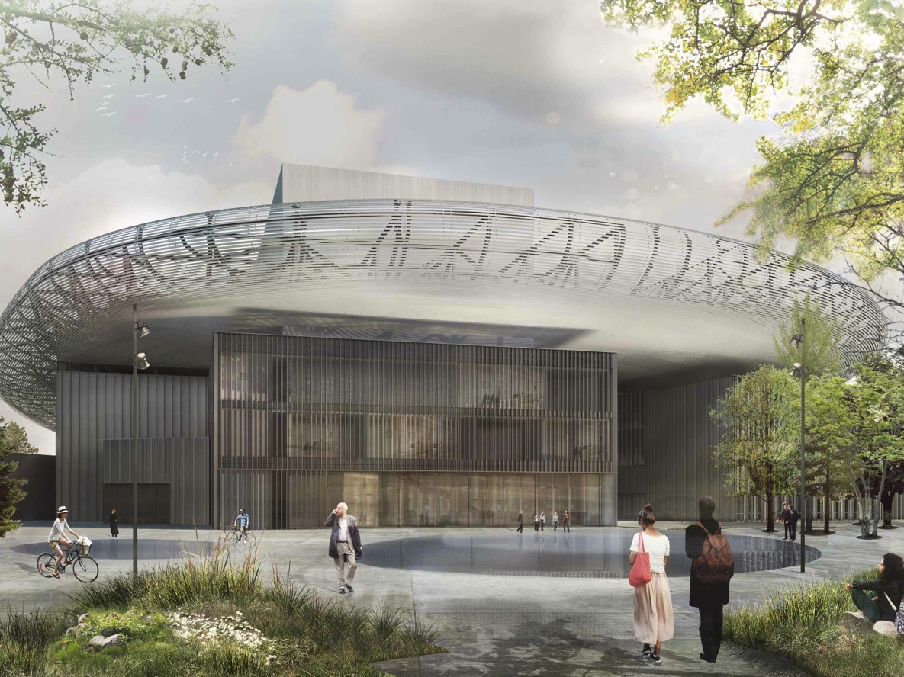
Thank you!

