Slide 1
Introduction and Charge
for the 12th TAC meeting
14-16 October 2015, Lund
Roland Garoby
https://indico.esss.lu.se/indico/event/315/

Slide 2
Progress since TAC#11
Since April 2015:
The 2nd Annual Review scrutinized organization, status and plans of ESS and provided recommendations.
ESS changed statute and became the “European Spallation Source ERIC”.
Construction on site has significantly progressed and design has been refined.
Configuration Control (mode of operation of CCB), Technical Management and Technical Coordination (ETB and Technical Coordinators) have been improved.
Major changes have been made to the Accelerator and ICS divisions.
Main in-kind agreements have been prepared in view of signatures in 2015 and additional in-kind contributions have been negotiated.
Design and prototyping has advanced at the in-kind partners and in Lund.
Work has started for the “Installation Permit” to be submitted in Spring 2016 (2nd step of licensing).

Slide 3
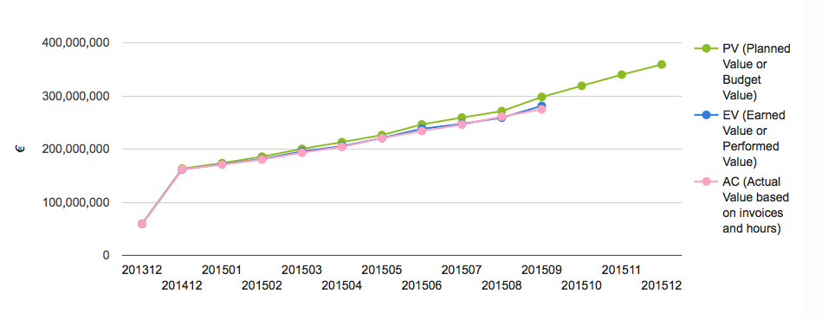
Progress in Earned Value…
Scheduled: 297.9 MEURO
Earned: 281.1 MEURO
Actuals: 274.7 MEURO
Completed of total project* : 15.2 %

Slide 4
Questions to the TAC for its 12th meeting
Accelerator
a1) Does the TAC find the proposed ESS beam instrumentation suite from ion source up to the target imaging system adequate for commissioning and operation of ESS?
a2) Does the TAC have recommendations regarding the outlined implementation of this beam instrumentation?
a3) The on-going test program for a reduced scale modulator prototype, the integration test, the future elliptical cryomodule test stand at site and the FREIA facility which are now launched will address the long standing recommendation from TAC is to for AD to “get the hands dirty”:
Does this plan properly address ESS needs? Can it be further improved?
Are there additional issues to consider for ensuring success with the planned test activities?
The plans for site acceptance test of equipment except for cryomodules have NOT been presented here as this is "work in progress". Does the TAC have specific recommendations regarding this work?
a4) All Vacuum work for ESS is centralized and under the responsibility of the Vacuum group in the Accelerator division:
Does the TAC support the high level plans for vacuum work at ESS?
TAC views and recommendations on the in-kind contributions for vacuum work at ESS are welcome.

Slide 5
Questions to the TAC for its 12th meeting
Target
t1) Are the design approaches for the Target Wheel, Moderator and Reflector Systems, and Remote Handling Systems sensible and likely to meet system requirements, and do they represent a reasonable balance between performance and other parameters, e.g. manufacturability, operability, maintainability, cost, and schedule?
t2) Are the initial accident analyses cases presented at the meeting being properly evaluated and are reasonable and appropriate safety mitigation measures being properly identified?
t3) Is the design approach for the safety-credited active control system (TSS) likely to lead to a highly reliable system for protecting workers and the public during the postulated reference events (stopped wheel and loss of cooling)?
t4) Is the interface between Target and Instruments related to neutron beam extraction well defined and does the proposed design solution represent a reasonable balance between performance, maintainability, cost, and schedule?

Slide 6
Questions to the TAC for its 12th meeting
ICS
c1) Is the strategy for standardization of hard- and software appropriate (standard digital platform, PLC, Epics…)?
c2) Is the strategy for outsourcing sensible and reasonably balanced? How could in-kind contributions be increased?
c3) Is the scope of the infrastructure work package appropriate and precise enough? Are the proposed technologies appropriate (blown fiber, single mode, modular cabling etc.)?
c4) Is the current concept of temporary control room feasible/useful/problematic?
c5) Is the proposed usage of beam instrumentation sufficient to cover machine protection needs?

Slide 7
Additional considerations
General questions
Have the recommendations and concerns of the previous TAC meeting been properly addressed?
The TAC#12 meeting is spread over 3 days instead of 2, in an attempt to give to the Committee more time to discuss. Should it be continued?
Additional suggestions/comments and recommendations?
Planning
A preliminary version of the Committee report is expected on Friday 16, October.
The final report is expected two weeks later.
The Chairman will orally present the TAC#12 report to the Council on October 21-22.

Slide 8
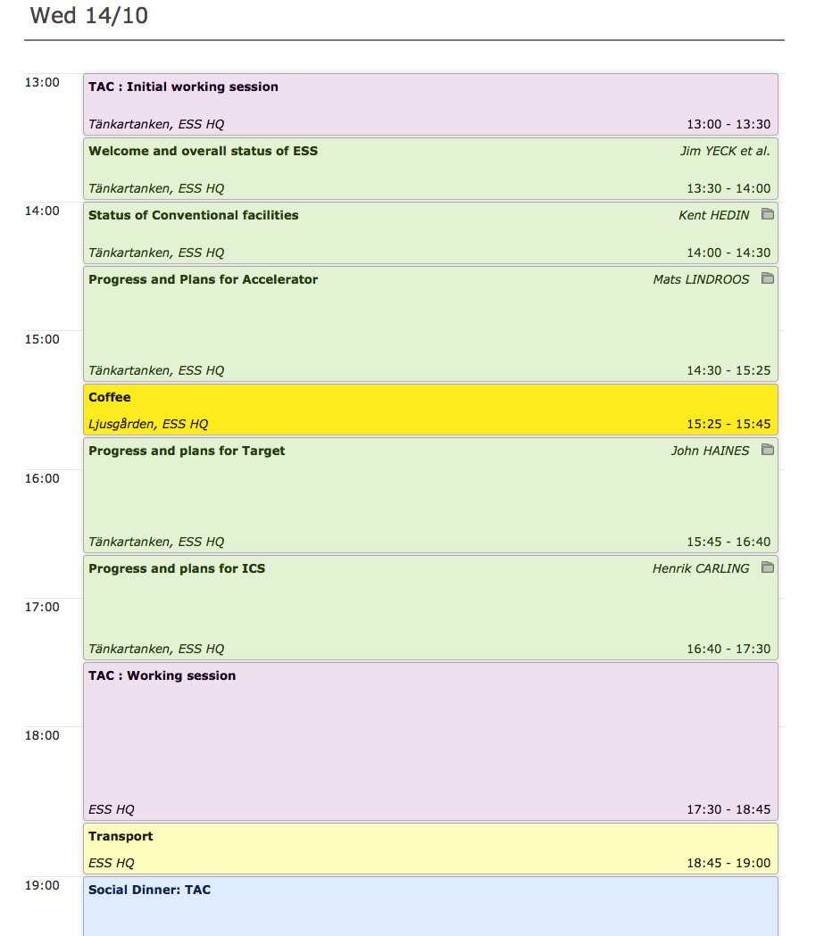
Agenda TAC#12: Wednesday 14 Oct. 2015
Site visit replaced by extensive report from K. Hedin
Dinner in Lund
(Hypoteket)

Slide 9
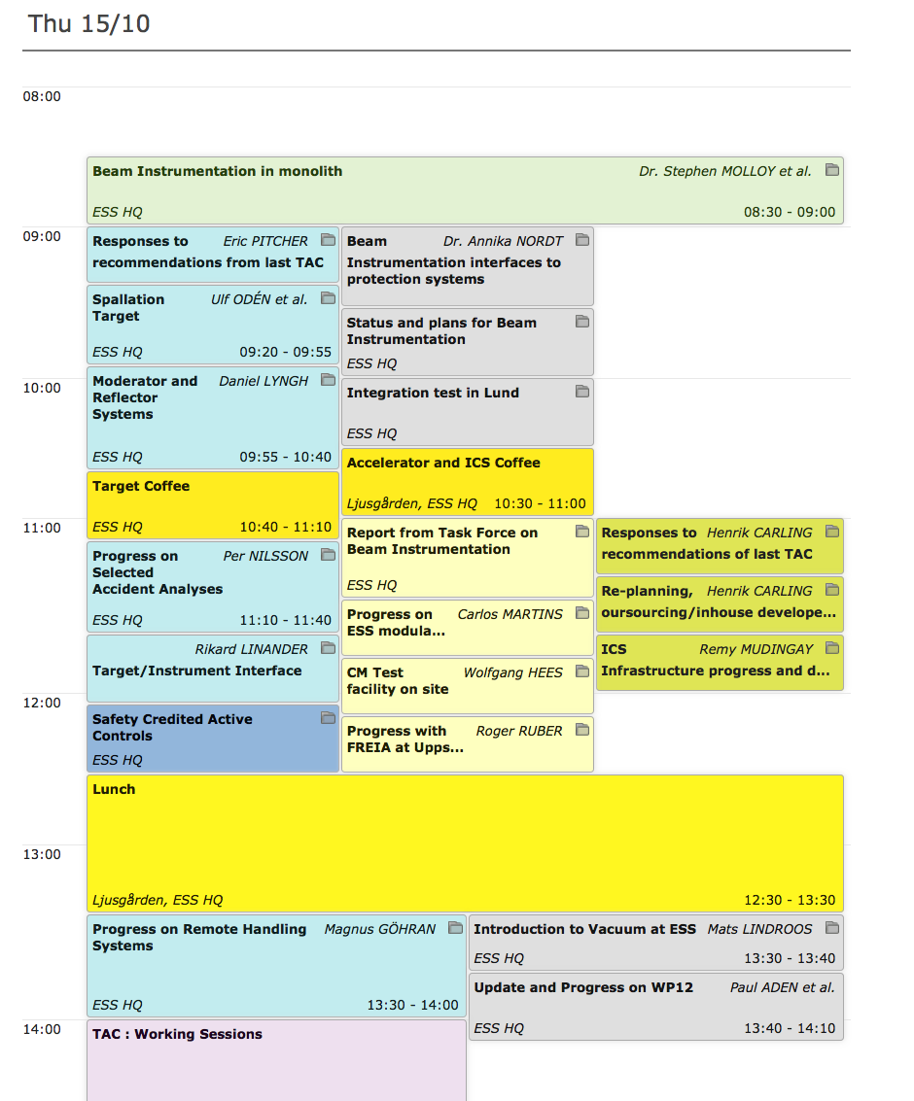
Agenda TAC#12: Thursday 15 Oct. 2015
Combination of common and separate sessions
Dedicated ICS session
4.5 hours TAC session
19:00 - Dinner in Lund
(Klostergatans vin och delikatess)

Slide 10
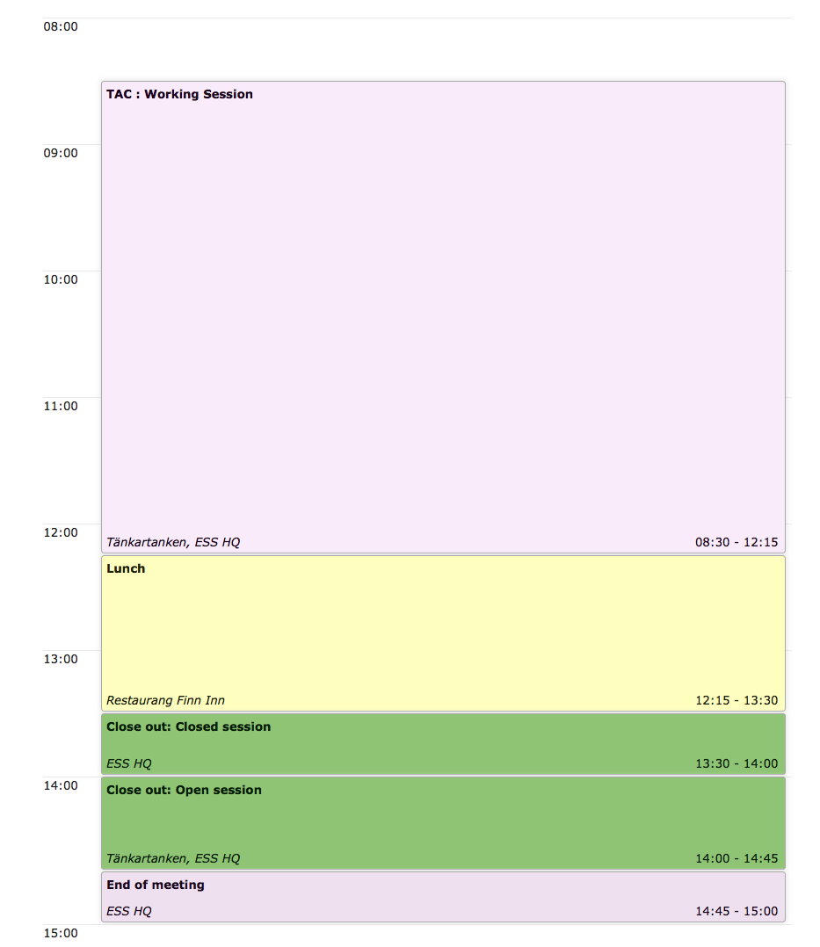
Agenda TAC#12: Friday 16 Oct. 2015
3.5 hours TAC session: additional Q&As and presentations are possible
Optional private close out to the ESS management

Slide 11
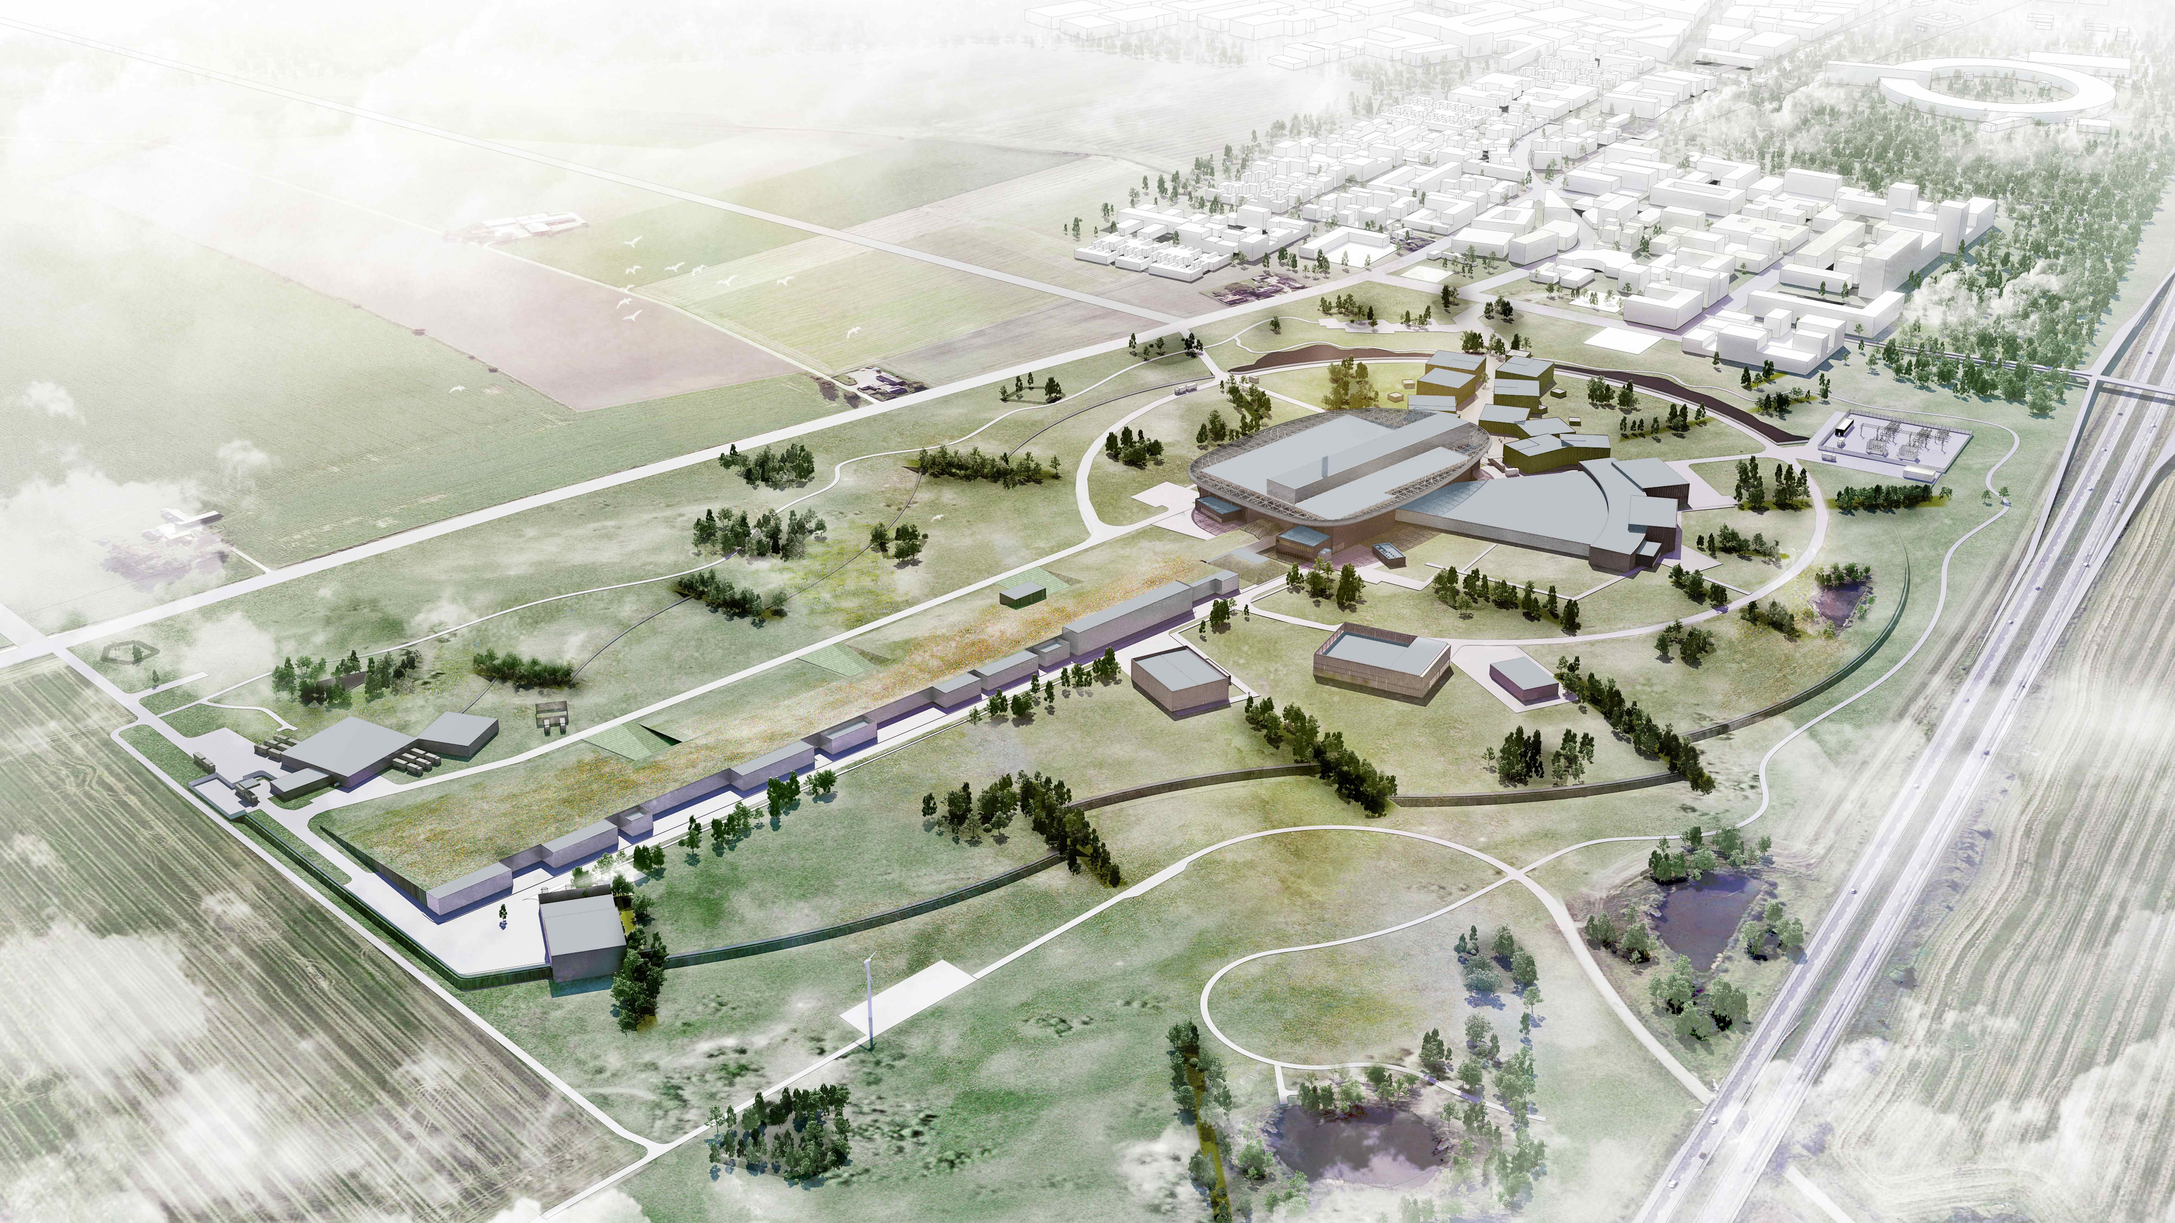
Thank you for being here.
We need your advices!

