Slide 1
ESS Construction Project
Kent Hedin
Head of Conventional Facilities
www.europeanspallationsource.se
8 October 2015

Slide 2
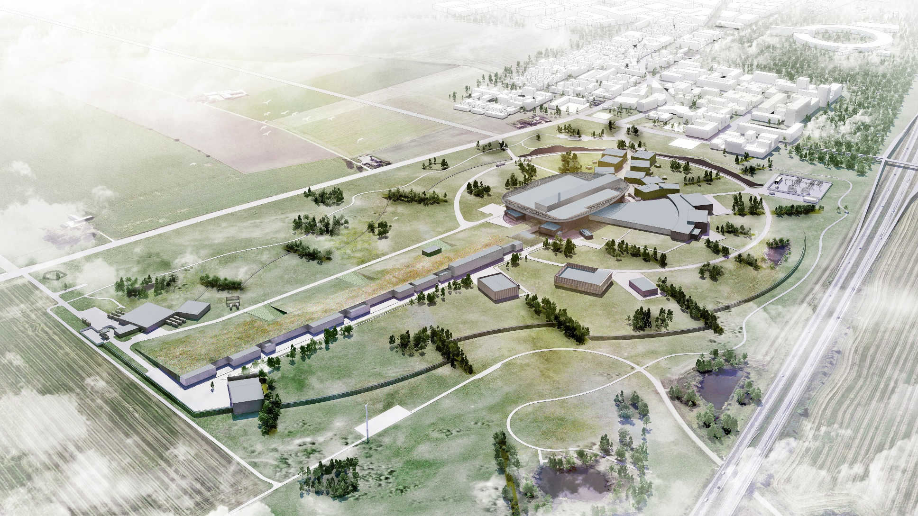
CF Scope
CF in numbers
72 hectares
26 buildings, approx. 100 000 m²
50 000 m³ concrete
6 000 tons reinforcement
40 km pipes
Campus Area with Office & Labs – 17 560 m²
Notes:
Quote from TDR “Technical design Report”
The term “conventional facilities” refers to
The spaces required to house the ESS research equipment, machines and instruments and to accommodate the human beings who will either make use of the facility directly, or who will support its operation and maintenance, be they ESS staff, guest researchers or visitors. CF is also responsible for the mechanical and electrical services necessary for the proper functioning of the facility.

Slide 3
CF Overview
Necessary permits obtained in 2014
Contract for construction signed with SKANSKA Feb 2014
Milestone for Ground Break achieved and site works have proceeded according to plan during 2014-2015
Construction works of Accelerator tunnel started ahead of schedule
Construction of Substations and Target building has commenced during 2015
Most critical work this year; piling of Target & Experimental Halls
Campus Area in preliminary design. Contract will be procured beginning 2016
Budget wise still in ramp up. 2016 the most work intense year to come.
Staff level steady and sufficient

Slide 4
CF Organization

Slide 5
CF BASELINE PROGRAMME (INCL. ESS RAD SAFETY ANALYSIS)
2015 | 2016
MONTH | SEP | OCT | NOV | DEC | JAN | FEB | MAR | APR | MAY | JUN
W | 36 |  | 38 |  | 40 |  | 42 |  | 44 |  | 46 |  | 48 |  | 50 |  | 52 |  | 1 |  | 3 |  | 5 |  | 7 |  | 9 |  | 11 |  | 13 |  | 15 |  | 17 |  | 19 |  | 21 |  | 23
G01, G02,
G04
Accelerator
1
2
3
4
D02
Target
1
2
3
4
F03, Shipping
E01, E03, E04, E05
Exp. Halls
1
2
3
4
D04, 05, 06, 07
TARGET BUILDINGS
H09 SPRINKLER
1
2
3
4
D01, 03, 08, E02
TARGET BUILDINGS
H10 Waste building
1
2
3
4
1. BUILDINGS INVENTORY | 2. RADIATION CALCULATIONS/ ASSESSMENTS | 3. HAZARD ANALYSIS, FINALIZE REQUIREMENT DOCS | 4. APPROVAL OF REQUIREMENT DOCS
SSM Requirements Fixed

Slide 6
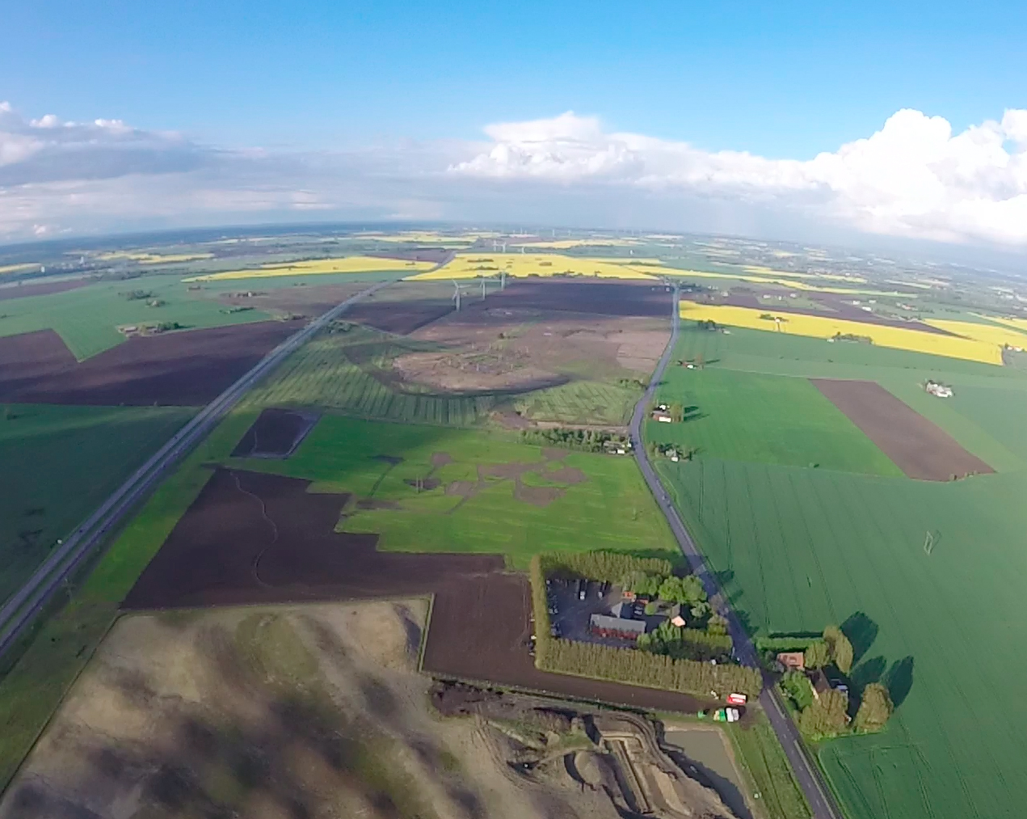
Once upon a time… there was a big green field.
8 May 2014

Slide 7
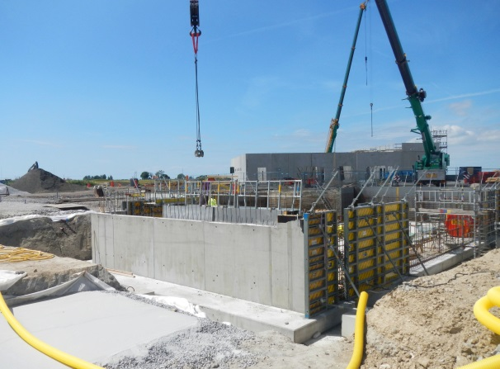
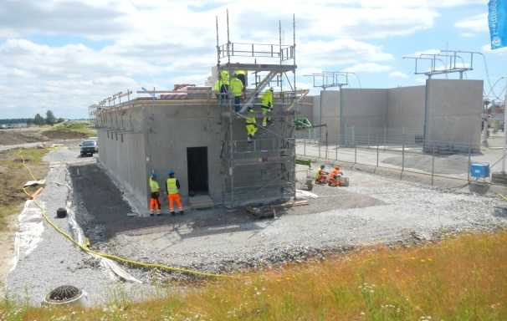
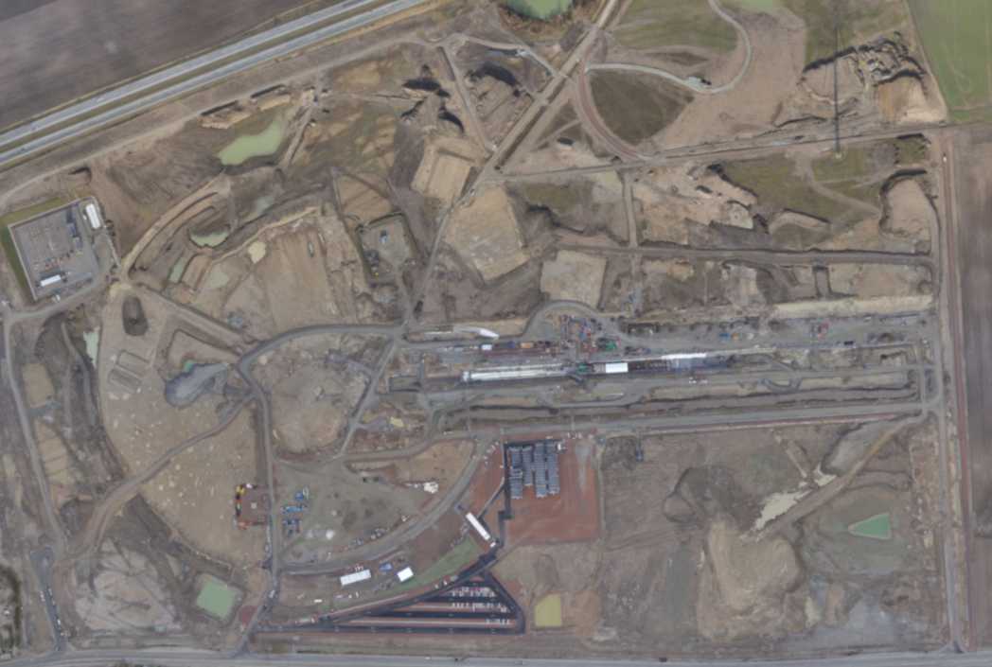
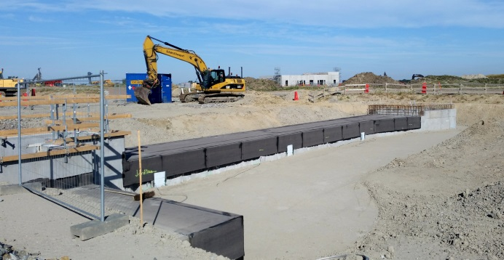
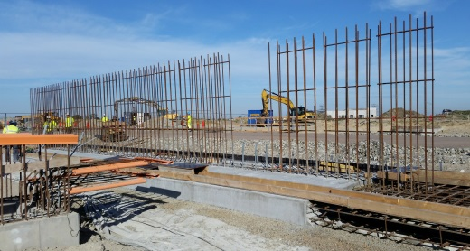
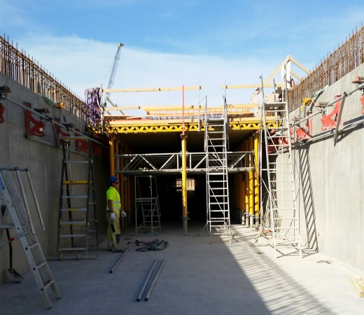
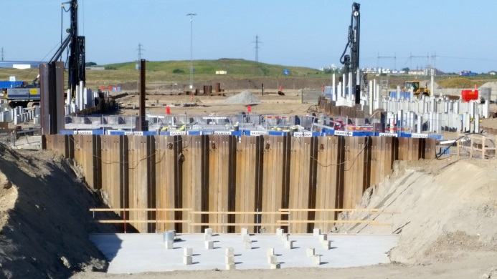
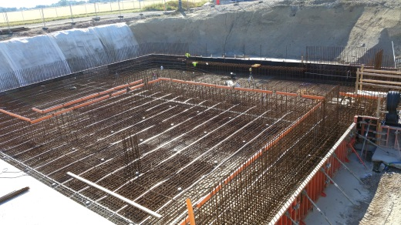
Ongoing works
H06
H05
H01
G04
G02
D02
G01
Site Offices

Slide 8
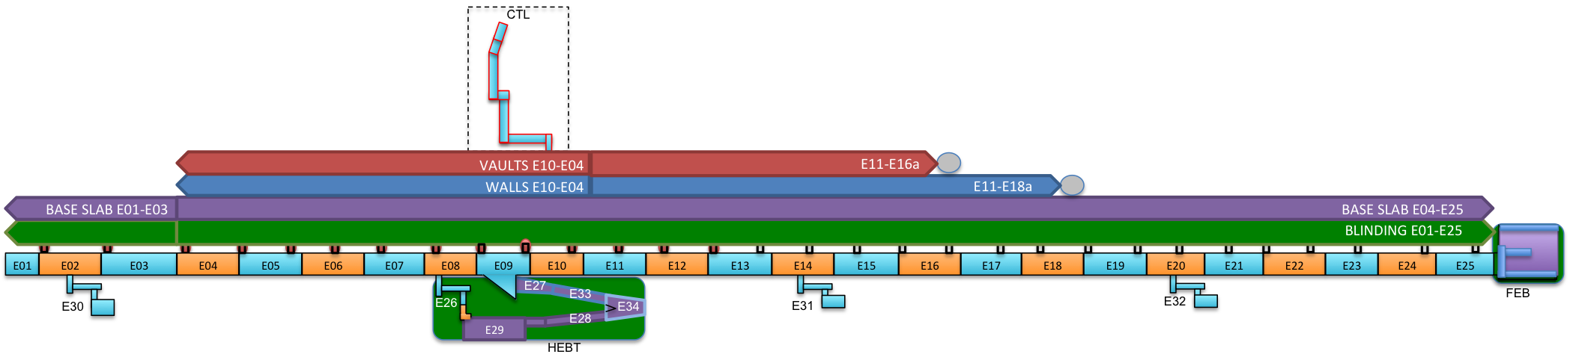
Accelerator
Progress 2015-10-09
G01
Blinding 537 m (100%)
Base slab 537 m (100%)
Walls 316,5 m (59%)
Vaults/top slab 271 m (50%)
CTL tunnel Completed – inc. Fill
HEBT Base slabs completed, walls in progress
FEB Base slabs completed, walls in progress

Slide 9
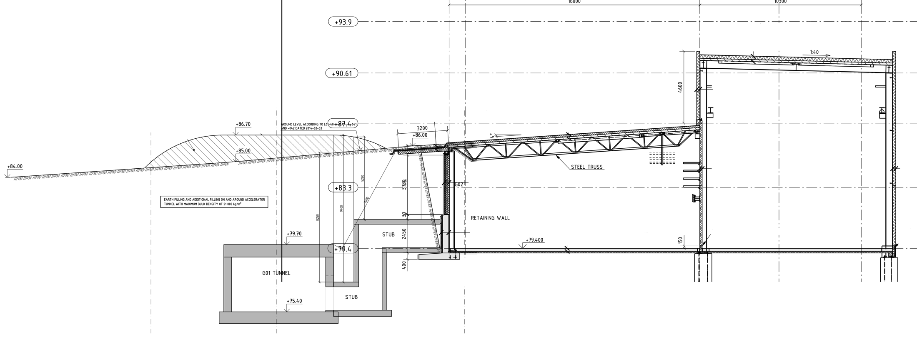
Intersection G01 – G02
4-11 m
5,5 m
6 m
10 m
15,5 m
3,5 m

Slide 10
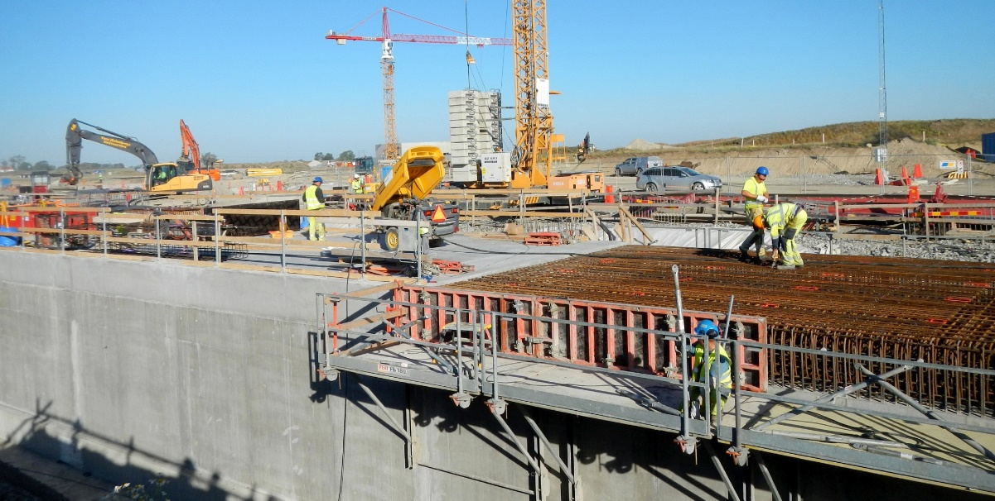
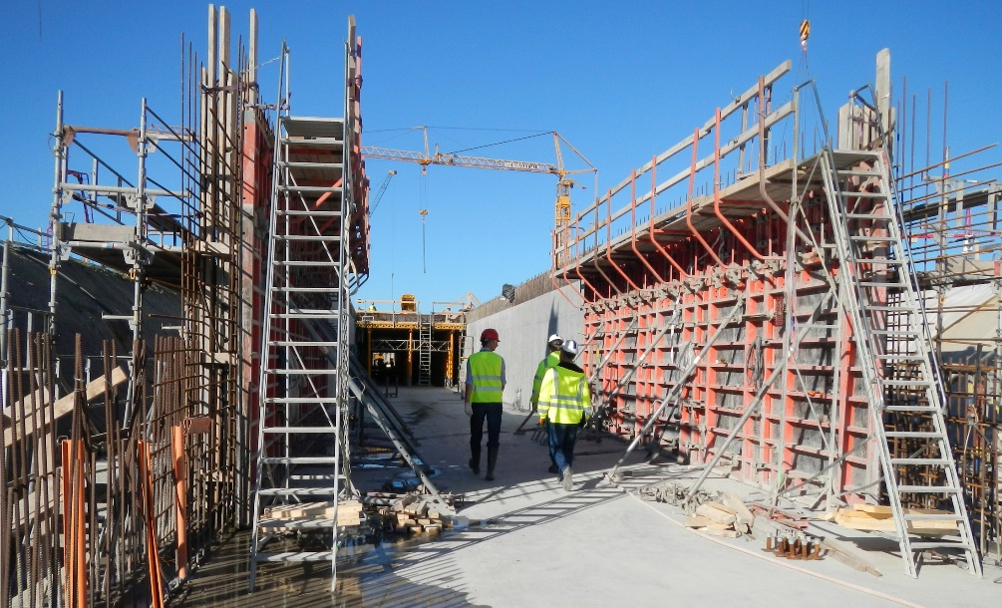
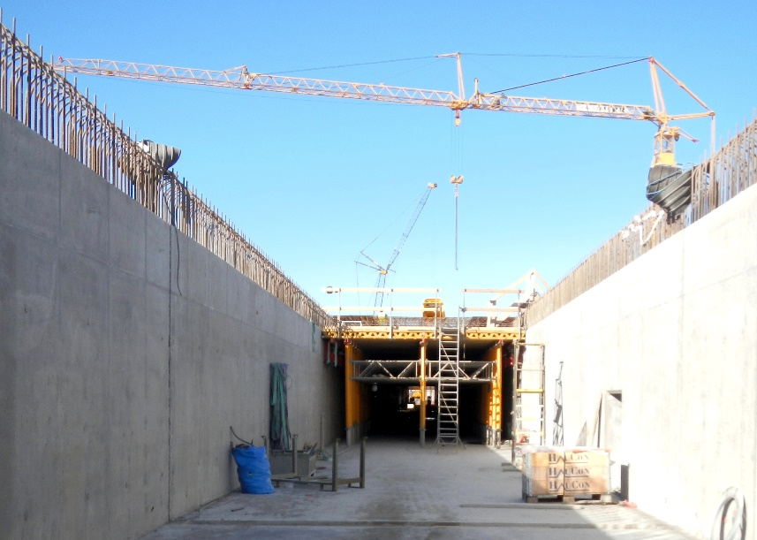
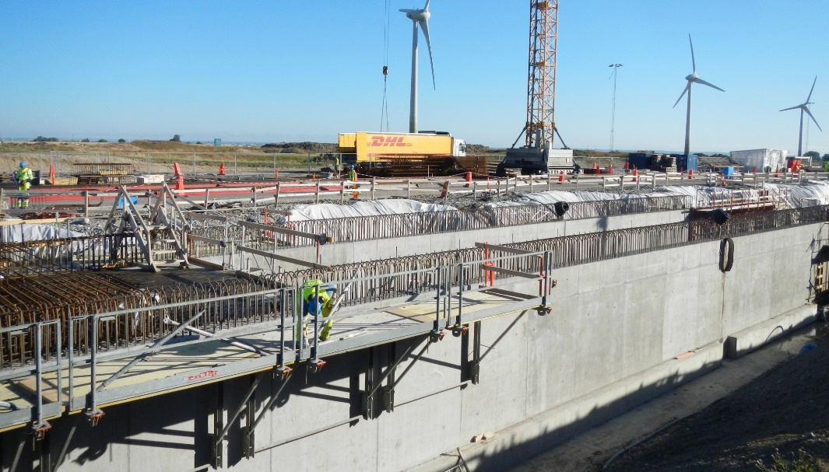
Recent tunnel pics
Top slab reinforcement
Formwork for walls
19 August 2015

Slide 11
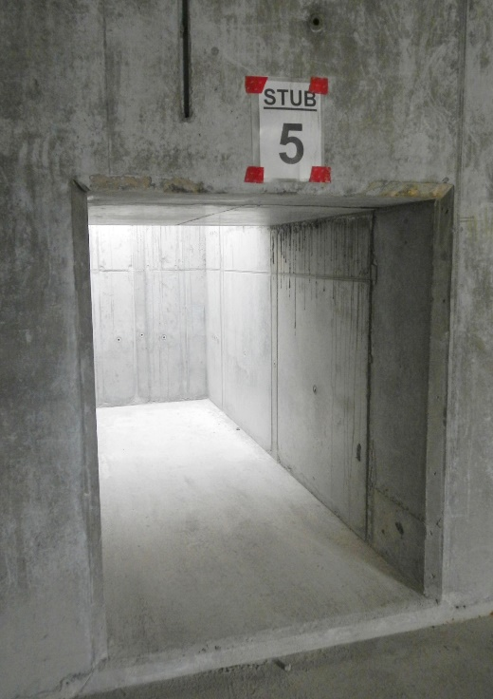
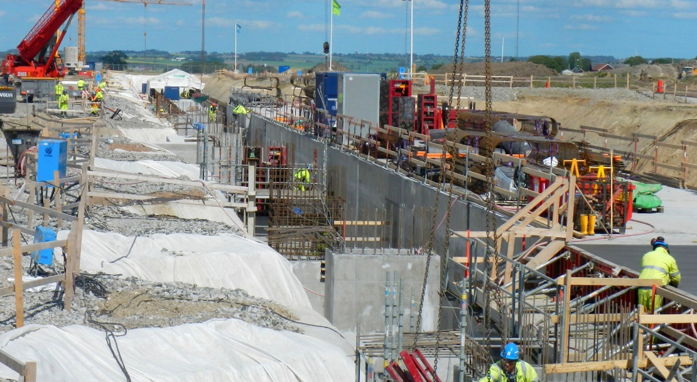
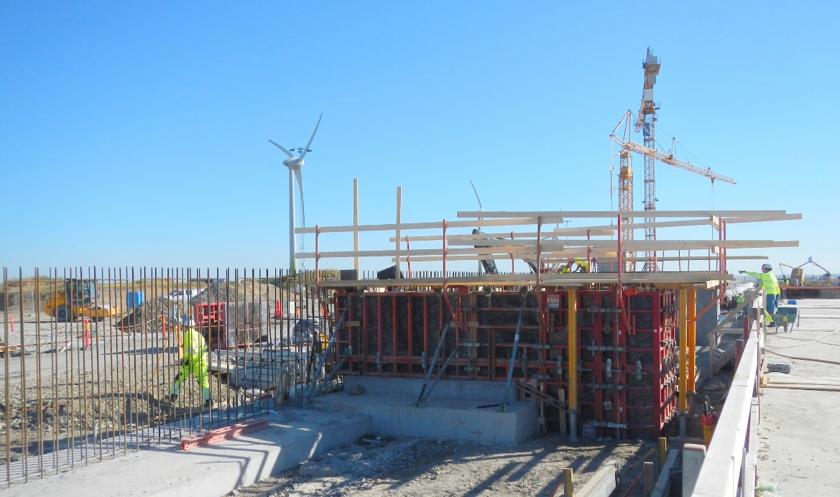
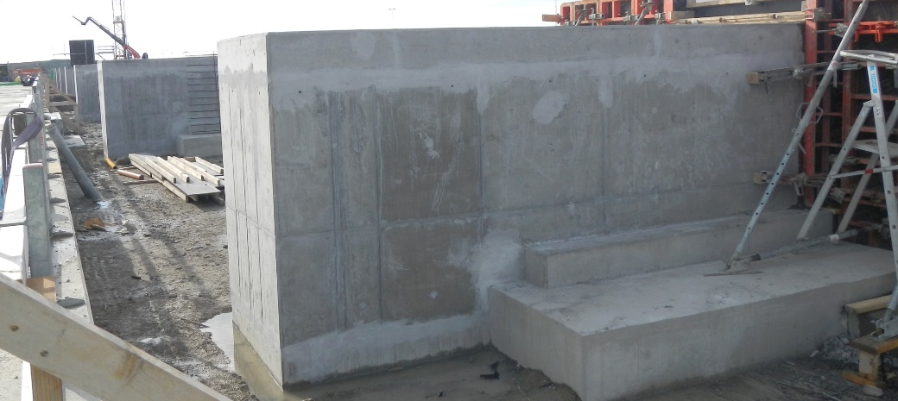
Stubs
28 May 2015
4 June 2015
19 August 2015
23 September 2015

Slide 12
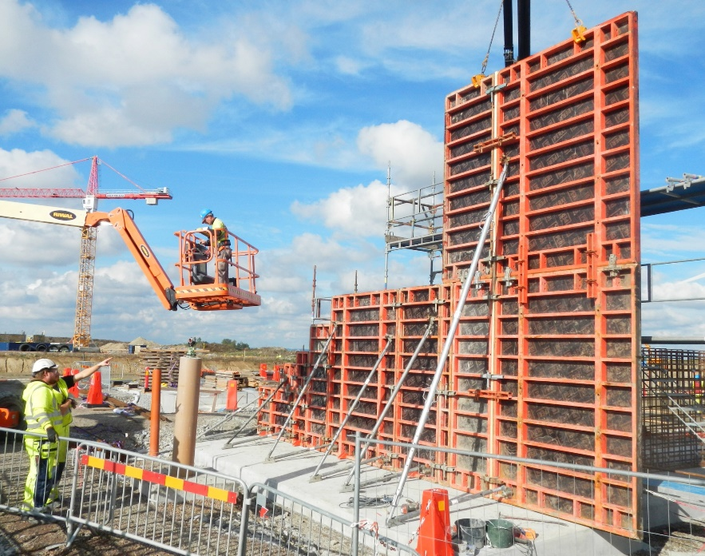
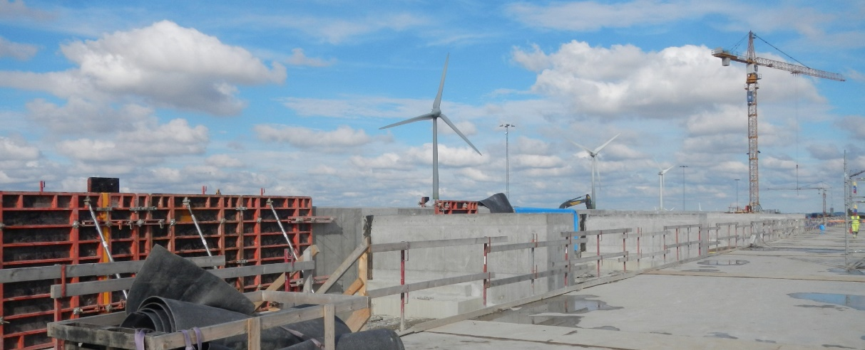
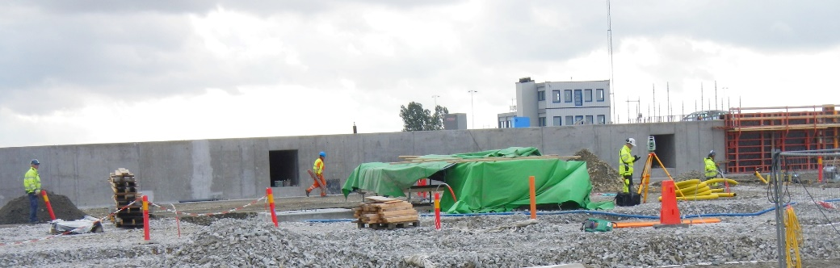
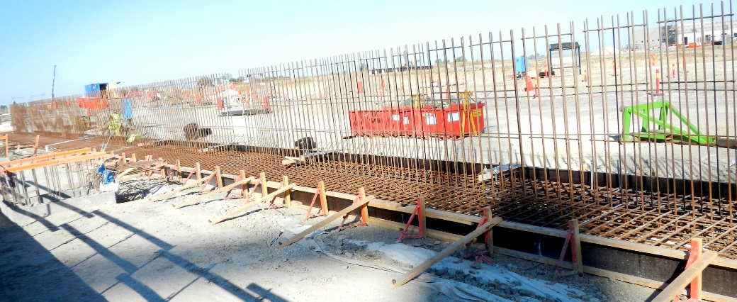
Retaining wall
Gable wall
23 September 2015
18 September 2015
Formwork 19 August 2015

Slide 13
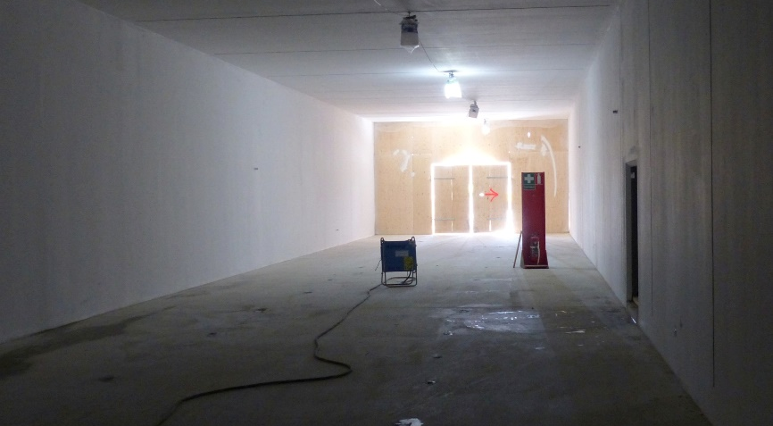
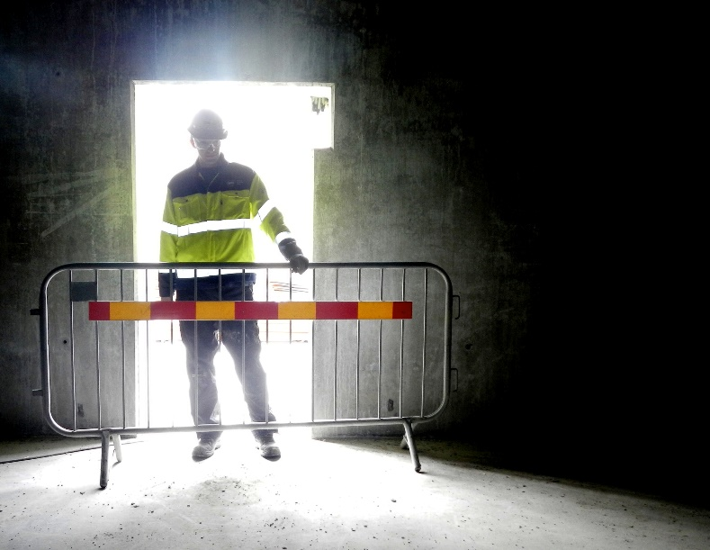
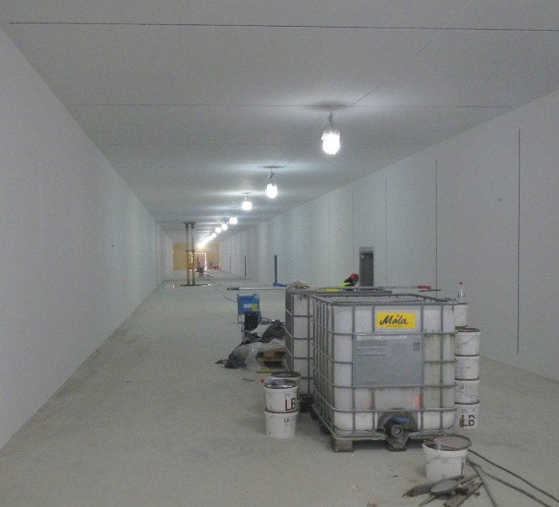
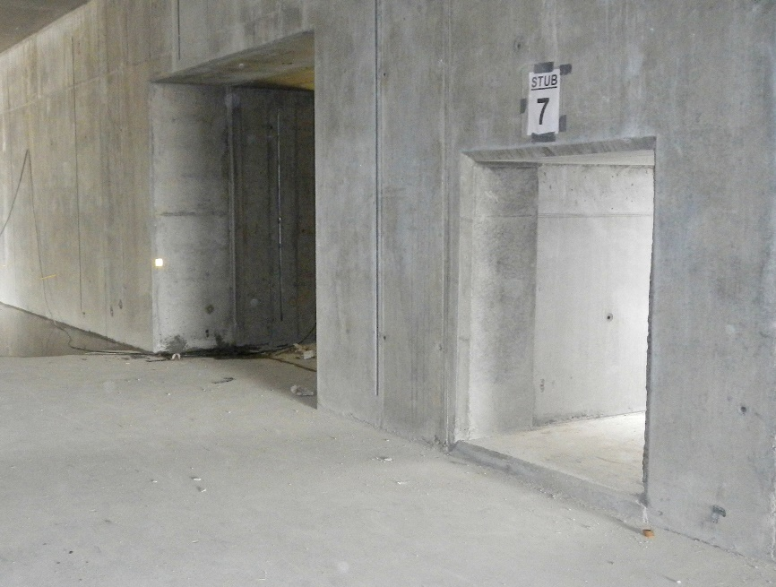
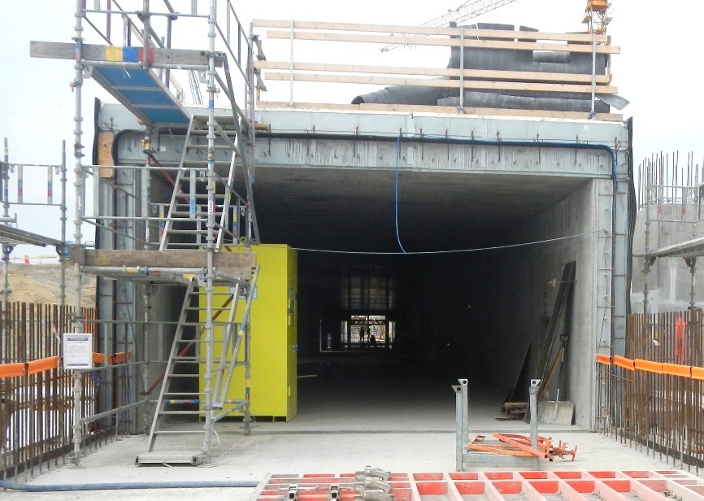
Tunnel vision

Slide 14
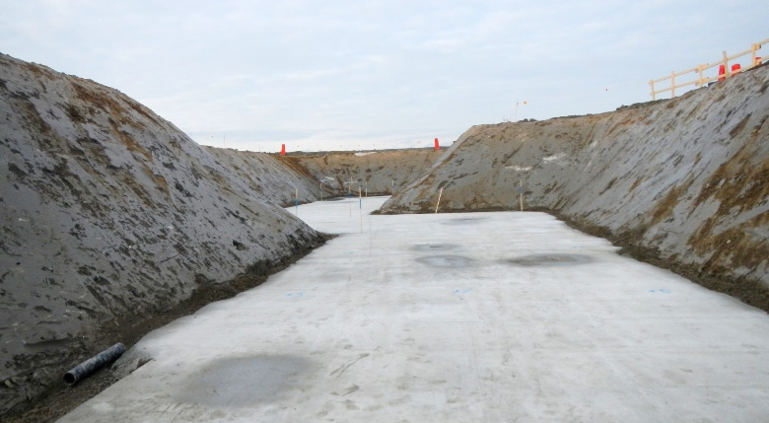
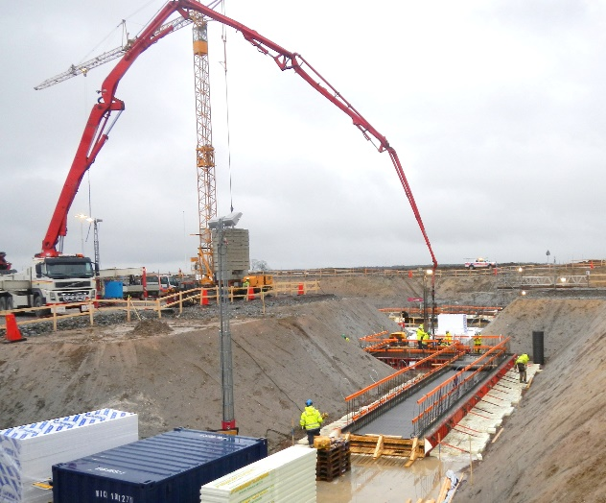
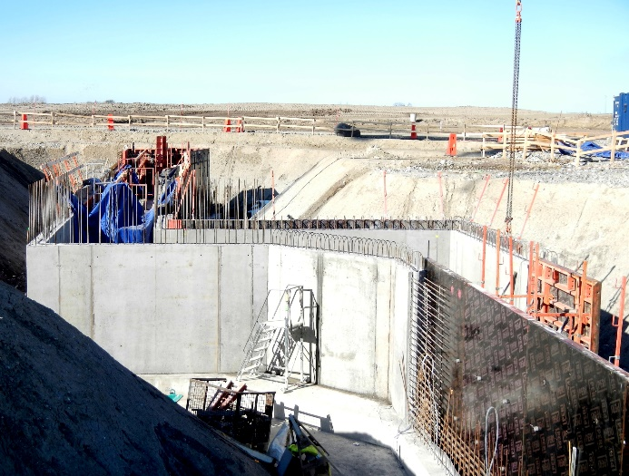
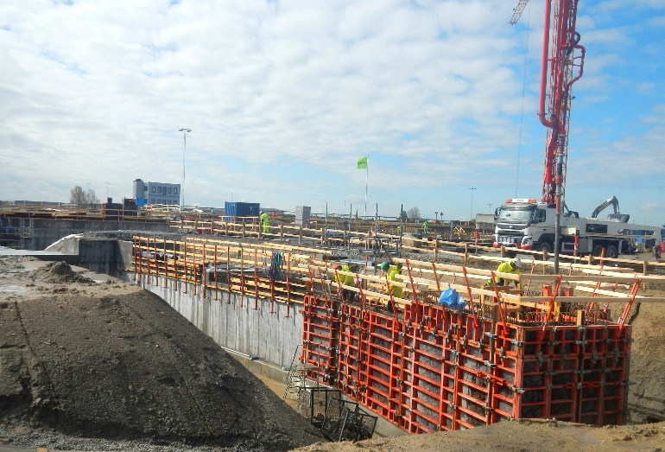
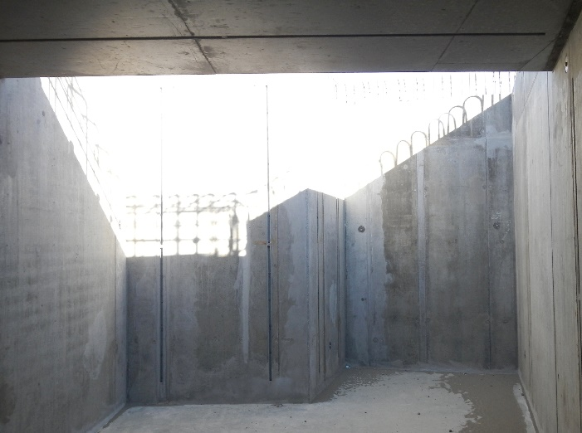

CTL
Blinding – 21 November 2014
Bottom slab –
19 December 2014
19 May 2015
12 March 2015
Inside CTL –
19 August 2015
Refill CTL –
4 August 2015

Slide 15
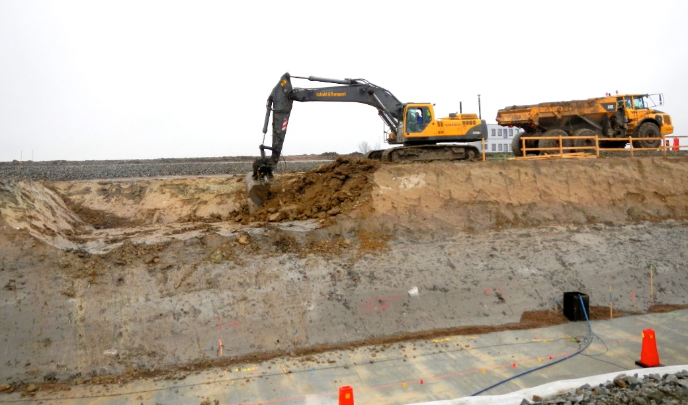
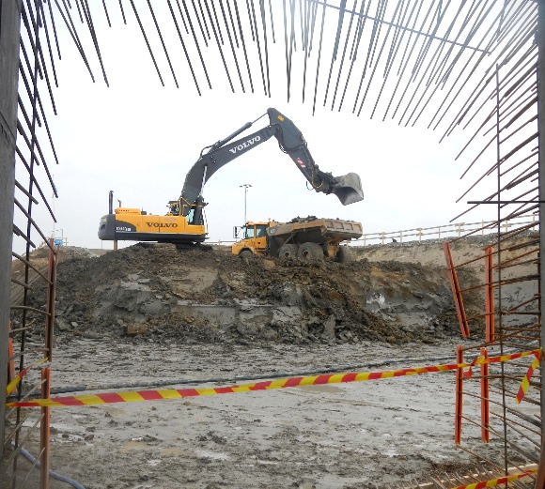
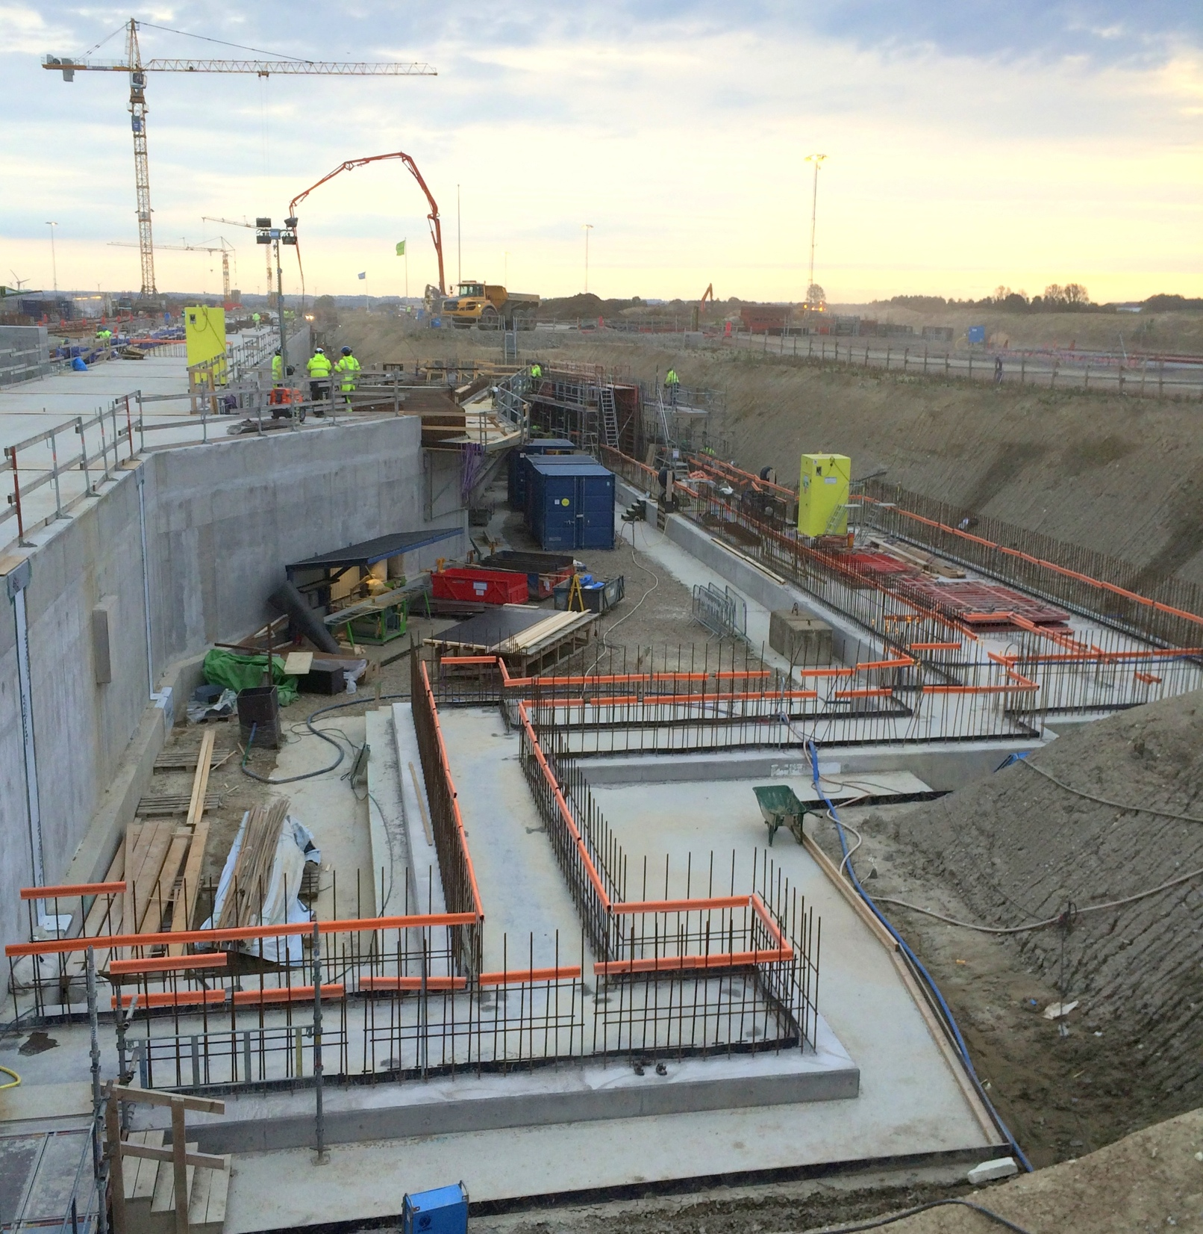
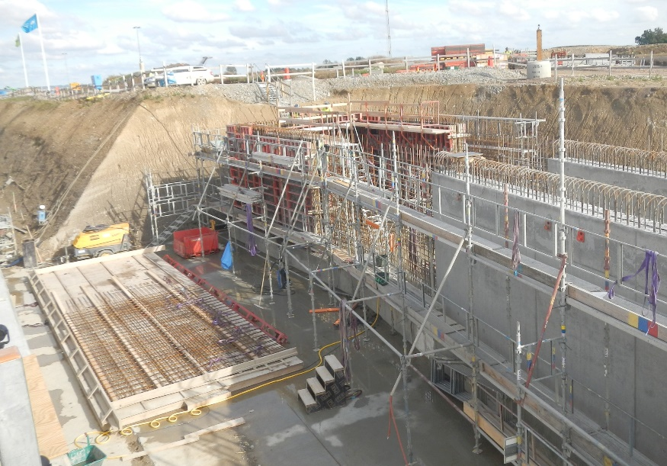
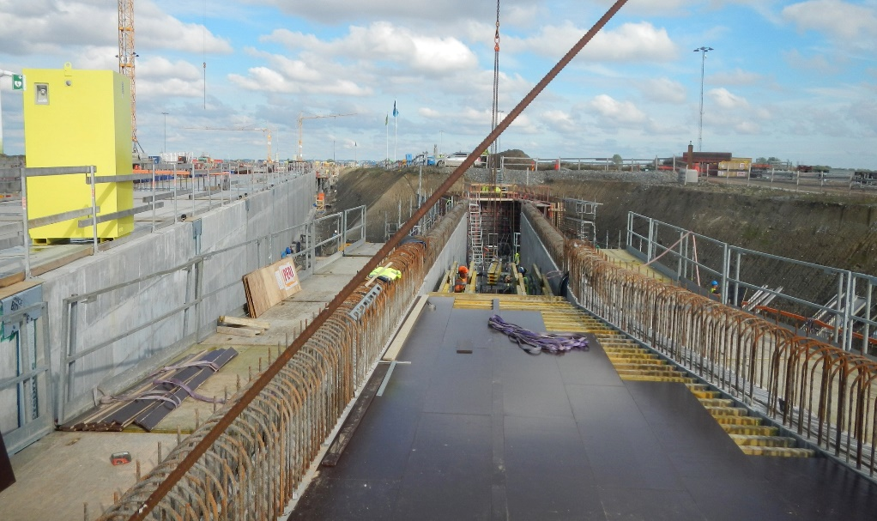
HEBT
6 November 2014
8 October 2015
15 April 2015
23 September 2015
23 September 2015

Slide 16
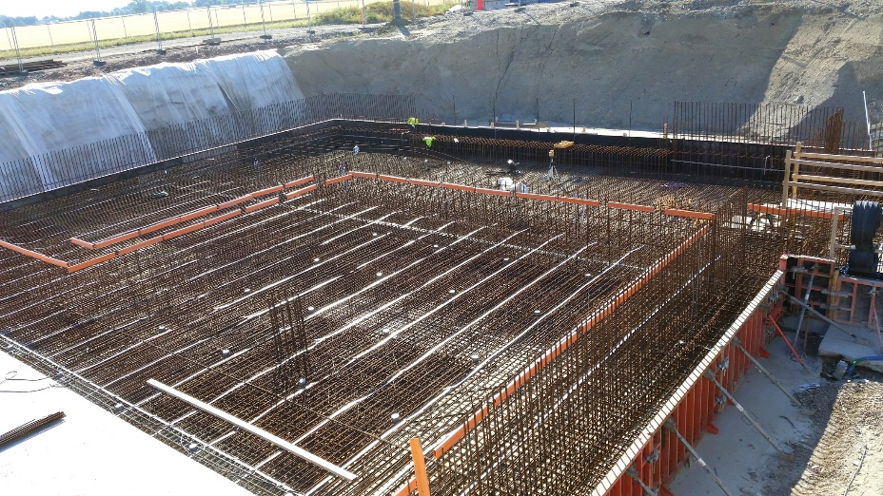
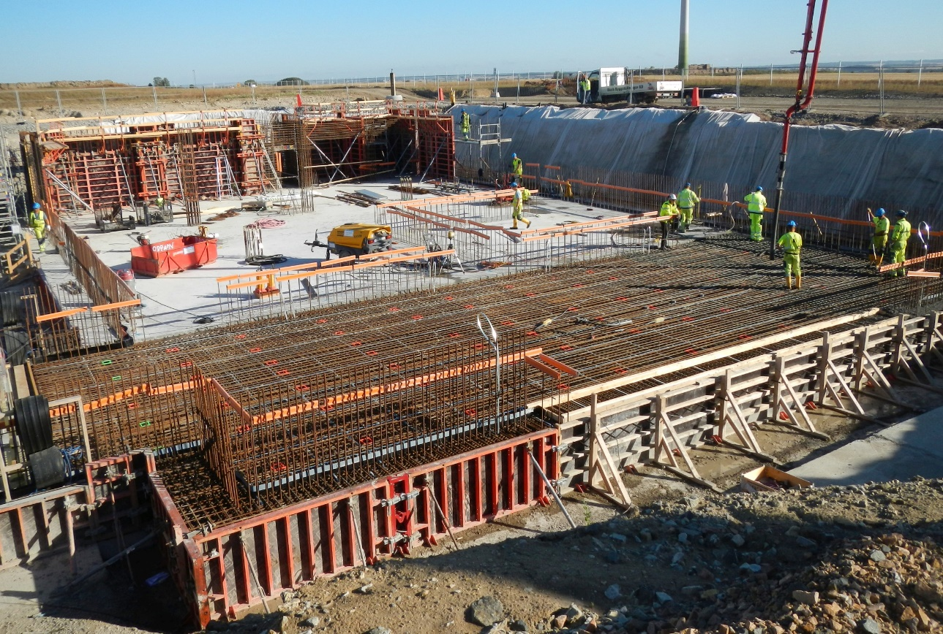
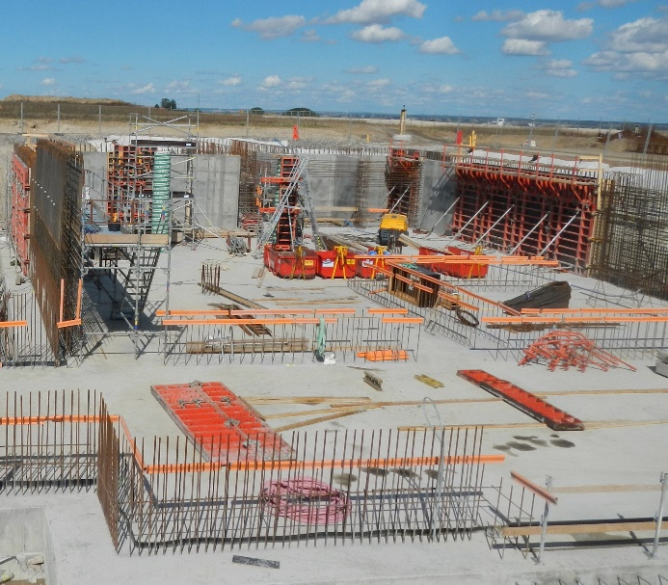
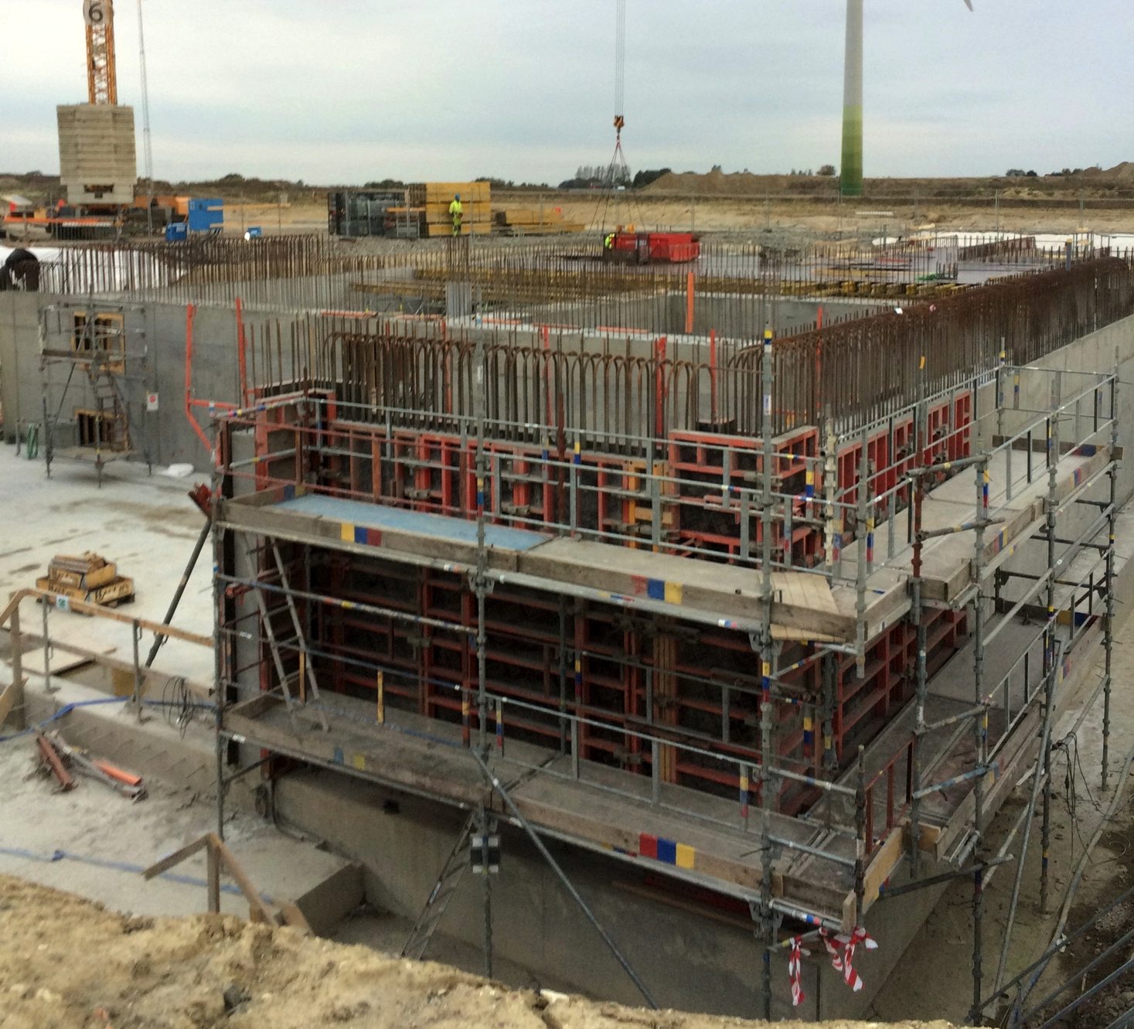
Front End Building
19 August 2015
3 August 2015
3 September 2015
8 October 2015

Slide 17
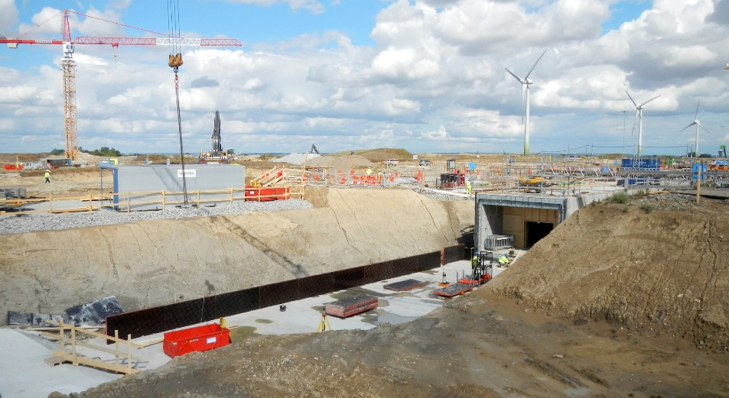
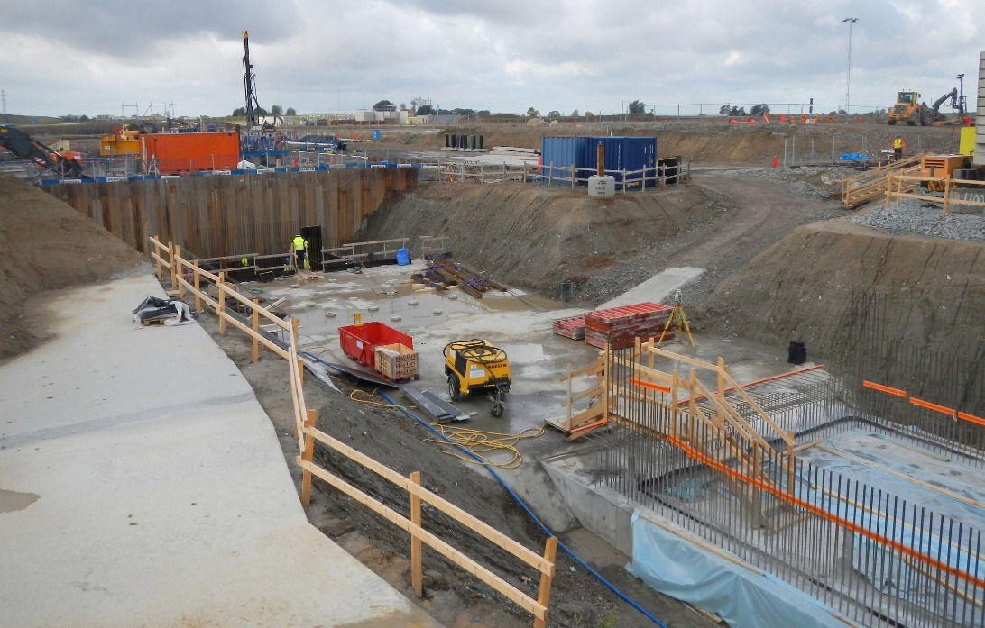
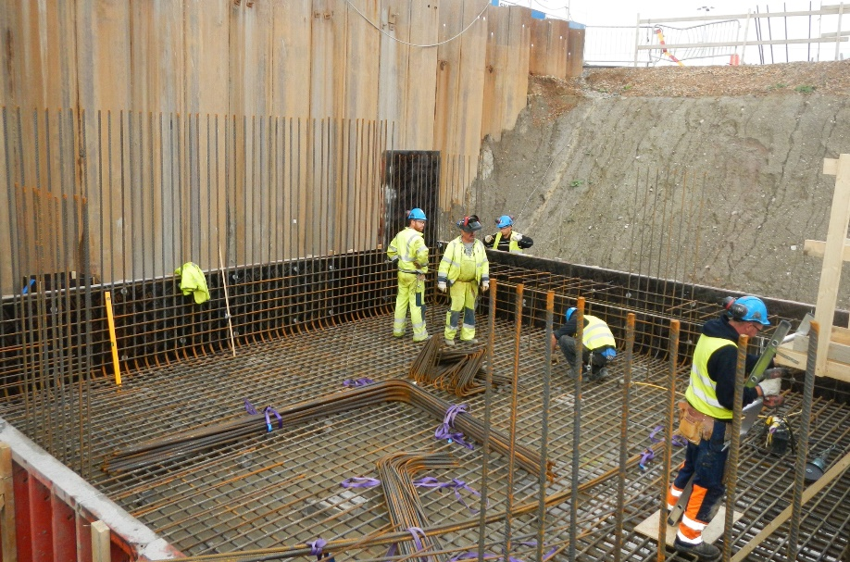
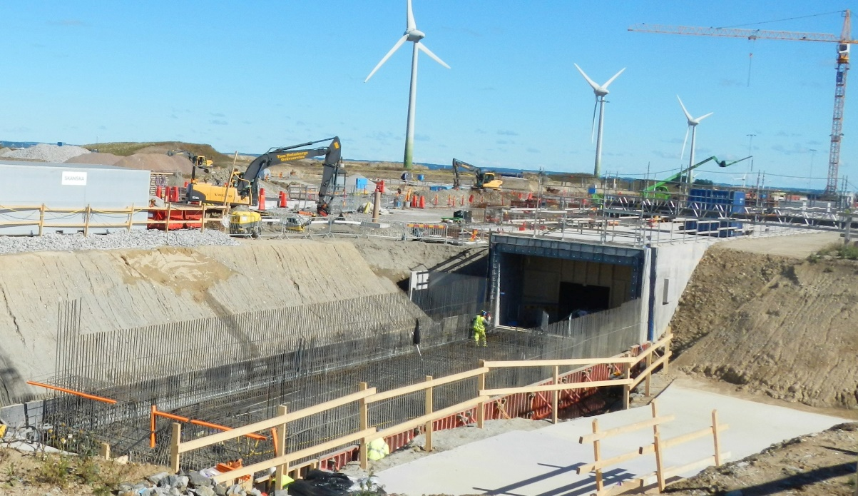
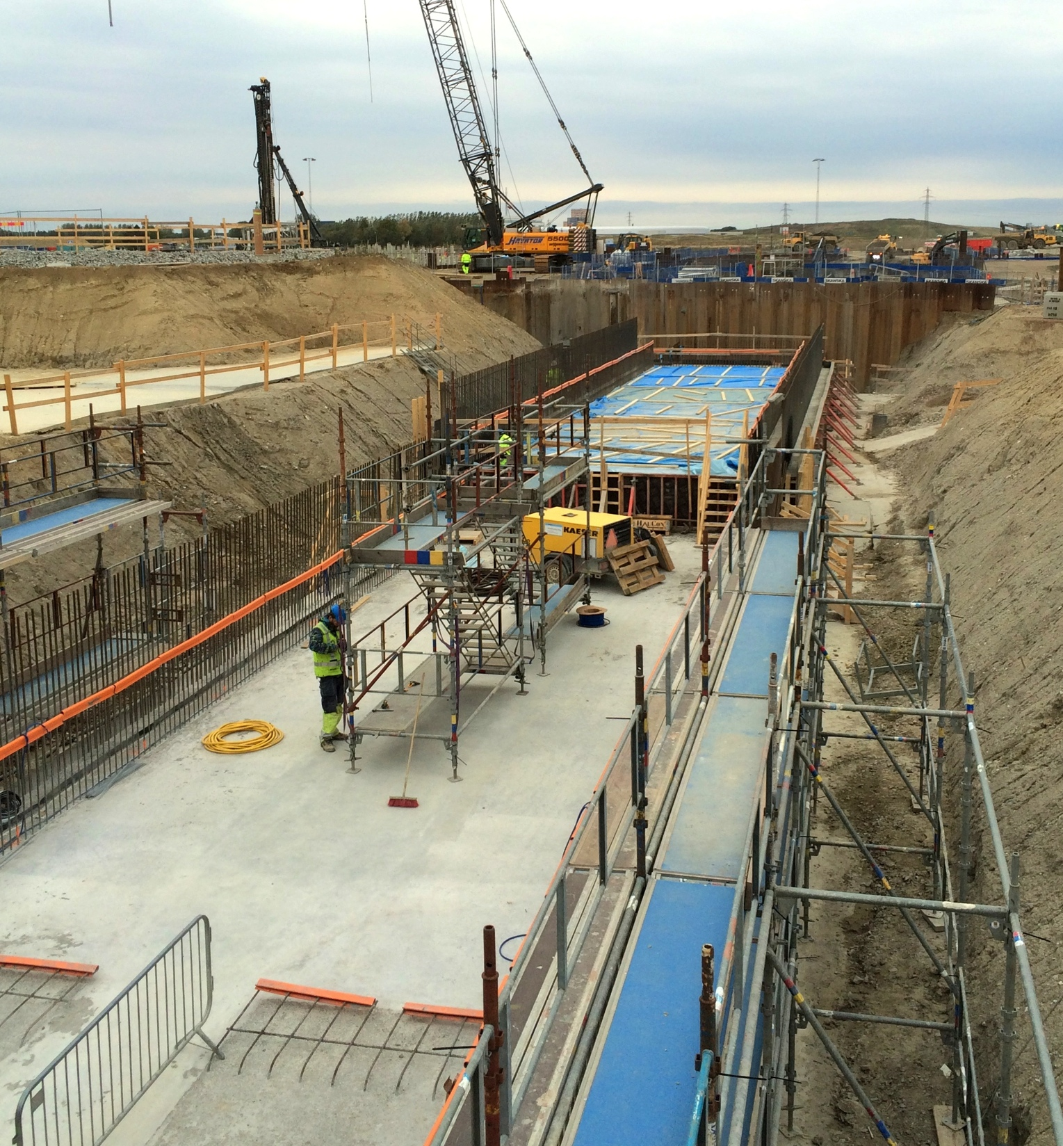
Dog Leg
28 August 2015
18 September 2015
8 September 2015
8 October 2015

Slide 18
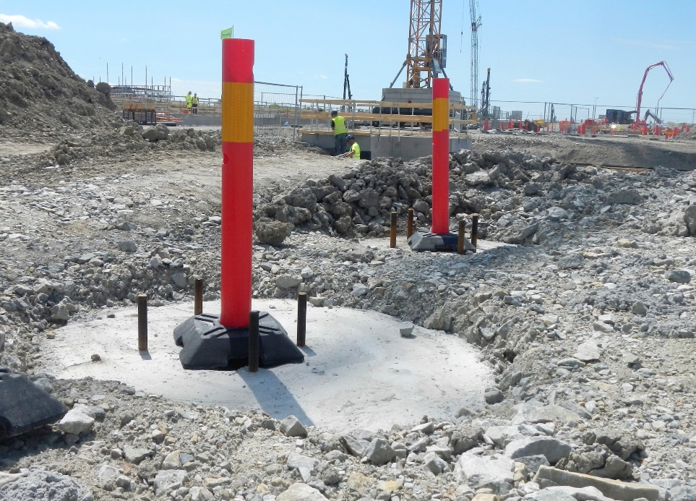
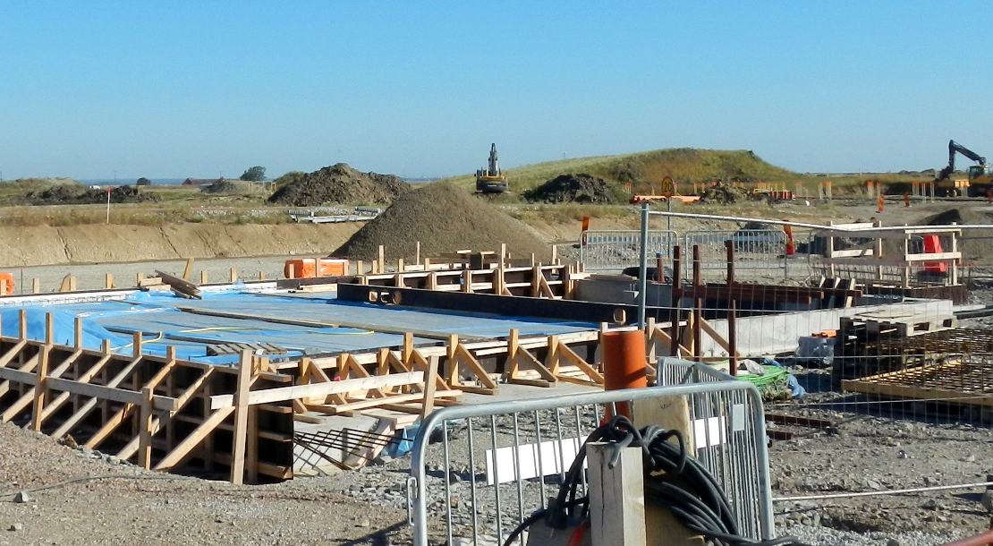



Gallery
Substation 1
19 August 2015
Drilled foundations
7 July 2015
Gallery steel structure 8 October 2015

Slide 19





G04 cryo
18 September 2015
8 October 2015

Slide 20




Target
12 March 2015
26 February 2015
22 April 2015
Sheet piling –
25 March 2015

Slide 21



Target
D01/D02/D03
Sheet Piles
Steel core Piles
Concrete Piles
Large diameter bored Piles (Monolith)
Progress, Target, 1st of September 2015
1101 /3958 concrete piles (28%),
^{84 /364 steel core piles}

Slide 22

Monolith area

Slide 23





Target - piling
4 June 2015
19 August 2015
30 September 2015

Slide 24










H05 aux
26 February 2015
25 March 2015
21 May 2015
4 June 2015
20 August 2015
8 October 2015

Slide 25




H06 aux
7 July 2015
18 September 2015
19 August 2015
Roof top
8 October
2015

Slide 26




H01 - CUB
8 October 2015
12 June 2015
19 August 2015

Slide 27



Campus Area
Circular Road Sheet Piling
8 October 2015

Slide 28

Aerial View

Slide 29

Skanska ESS Construction
- Building the future together

