Slide 1
Report from Task Force on Beam Instrumentation
Stephen Molloy

Slide 2
Contents
Mandate of the taskforce
  Authorities
  Deliverables
Assumptions
Tasks
Status
Preliminary conclusions

Slide 3
Mandate
Deliverables
A written report with:
A definition of the ACC:TGT interface. This will allow the task force to concentrate on accelerator diagnostics, and leave aside those that are purely for TGT purposes.
The beam parameters that AD need to measure, and the lattice locations in which AD need to measure them.
The baseline technology for the core PBI devices (that includes e.g. the BCMs, BLMs, BPMs).
The priority in time for the additional PBI proposed in the existing plan from the BD group for PBI at ESS

Slide 4
Structure
Online documentation:
  https://ess-ics.atlassian.net/wiki/display/PBITF/PBI+Taskforce+Home
Roles:
  Stephen Molloy, Chair, Secretary
  Andreas Jansson, Group Leader for Beam Instrumentation
  Mamad Eshraqi, WP Leader for Beam Physics
  Others called in as necessary
    Many thanks to the Beam Instrumentation, Beam Physics, & Aarhus University teams for their enthusiastic cooperation with this process
Meetings:
  Ad-hoc and based on linac sections
  Typically proceed as follows
    Meeting #1: Discuss the various needs of the section, decide on tasks
    Meeting #2: Present strawman proposal, & review
    Meeting #3: Determine pseudo-final proposal
    Meeting #4: Address remaining issues

Slide 5
Assumptions
The region of interest extends from the interface between the ion source and LEBT all the way to the Target, including the Tuning Beam Dump.
The purpose of commissioning is to achieve the L3 requirements.
  This must take into account the staged construction of the linac
    E.g., devices only required for >1 MW operation have less time-pressure than others
The purpose of PBI is:
  Beam measurements required for set-up of component to design values.
    For example, cavity phase scans making use of beam phase monitors.
  Debugging of off-normal beam conditions.
    Specifically those conditions not otherwise communicated to the control system
  Demonstrate achievement of the L3 requirements, including interface requirements, and the ACC:TGT interface requirements.
    Only those requirements related to the beam
    Including subsequent monitoring of those parameters
  Machine optimisation and development.

Slide 6
Tasks
Split the work amongst four tasks based on the assumptions
Task #1: Nominal operations
Assume that ACCSYS L3 requirements have been achieved, and that the machine is operating as designed.
What PBI is needed to maintain nominal operations?
  This should include debugging of off-normal beam conditions.
Task #2: Demonstration of successful commissioning/restart
Assume the existence of the PBI suite detailed in the response to task #1.
What additional PBI is needed to demonstrate the successful achievement of the L3 beam requirements?
Task #3: Commissioning/restart
Assume the existence of the PBI detailed in the responses to tasks #1 & #2.
Assume that all accelerator systems and components have achieved (or can achieve) their requirements.
What additional PBI is needed to allow set-up of component parameters to their design values?
Of these, which are needed only during commissioning, and which need to be permanently installed?
Task #4: Optimisation & development
Assume the existence of the PBI detailed in the responses to the previous three tasks.
What additional PBI is needed for machine optimisation and development?

Slide 7
LEBT Proposal
Doppler Measurement for species fraction. For commissioning, possibly relocated to test-stand during operations. Not yet decided.
Allison Scanner
Transverse x & y position & profile. Gated to suppress signal from chopped beam.

Slide 8
MEBT Proposal
DC remainder from RFQ takes ~3 quads to be cleaned out, so an additional measurement here is necessary
3 WS’s, 2 NPM’s, & a BSM give a very complete suite of measurements of the 6-D phase-space
Chopper & Dump
Fast current monitor (~1 GHz BW) to measure chopping efficiency
“Slit & grid” 4-D transverse phase space measurement

Slide 9
DTL Proposal
Faraday Cups for beam commissioning/startup. Note that the transmission of tank #1 depends strongly on RF phase/amplitude, which can therefore be coarsely tuned based on the BCM. Transmission is very good for remaining tanks, even if powered off.
Unequal number of BPM’s in each tank to assist with trajectory correction. Proposed distribution is 6,4,3,2,2
No WS’s. Incoming mismatches are not visible after tank #1, so must be corrected in the MEBT. DTL quads are PMQ’s, so no transverse optics to correct.

Slide 10
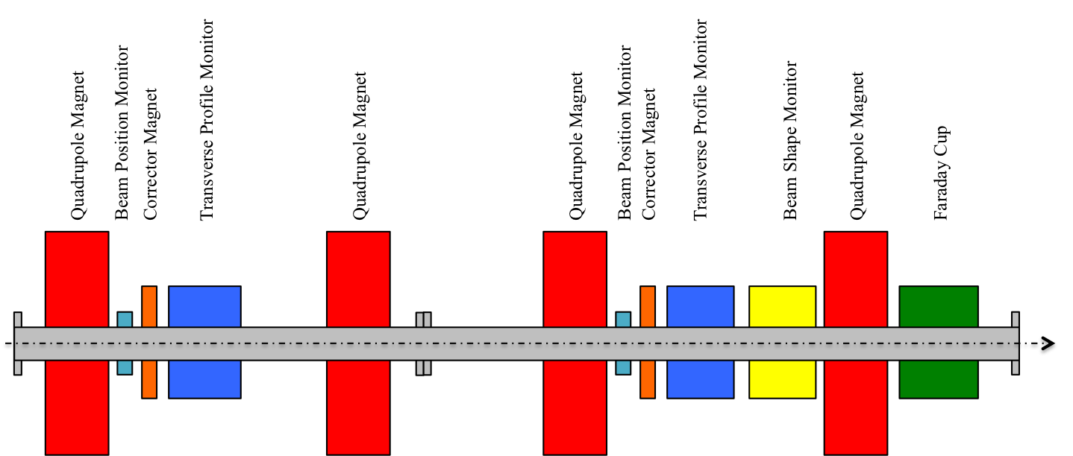
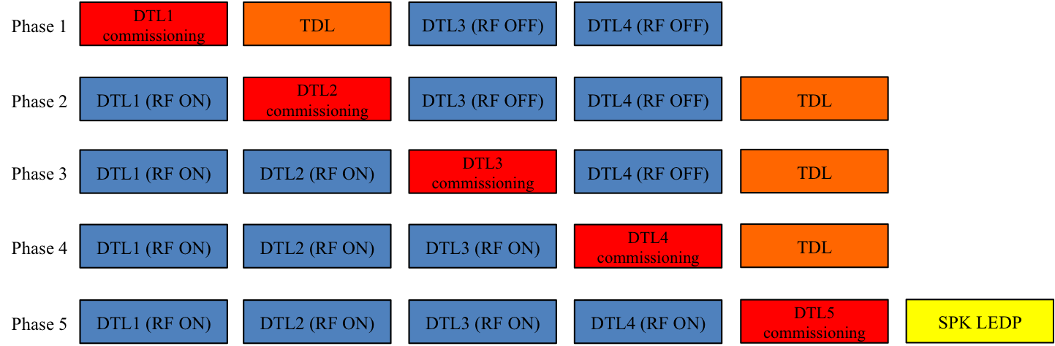
DTL: Commissioning Proposal
Temporary Diagnostics Line for DTL commissioning
One possible configuration shown here
Note that this proposal is consistent with the proposed installation sequence

Slide 11
Cold linac + HEBT + Dogleg
These sections are broadly similar
  Doublet lattice separated by acceleration (or drift) slots
Overarching decisions
  Wire-scanners installed as triplets, not singlets
    Reduces the aging of individual scanners
  One BPM per LWU
  Non-invasive profile monitors
      i.e., residual gas ionisation or beam induced fluorescence
    Not critical for commissioning, and so re-prioritised to a subsequent phase
      Operations/power-ramp up

Slide 12
Spoke Proposal
Three WS to measure DTL output transverse phase-space
NPB co-located with WS
Faraday Cup acting as a low-power beam stop. For commissioning DTL Tank#5
Faraday Cup acting as a low-power beam stop for machine start-up
Single BPM in each LWU

Slide 13
Medium-Beta Proposal
Three WS to measure transverse phase-space after the frequency jump (352 MHz acceleration → 704 MHz)
Faraday Cup for machine start-up

Slide 14
High-Beta Proposal
A placeholder for a transverse measurement in case the performance of the Medium-Beta linac requires it.

Slide 15
HEBT & Dogleg Proposal
WS triplet near the end of the HEBT. Slow phase advance leads to a large separation

Slide 16
A2T Proposal
Post-raster BPMs verify correct triggering of the raster magnets. Measured amplitude of beam position and B-dot loops in the raster magnets can be correlated with the beam spot on the luminescent coatings in the Target.
Steerers located symmetrically around the raster action point to allow for verification of the downstream optics and probing of
Raster system
Raster system
Cross-over point in the Neutron Shield Wall. Position measured here should not be affected by deflections close to the raster action point. This BPM will therefore allow verification of the lattice values.
Action point of raster system. 180deg out of phase (both planes) from the cross-over point in the Neutron Shield Wall. WS will therefore measure the same beam as at the cross-over.

Slide 17
Target Instrumentation
Instrumentation to be installed in the Target Monolith was also discussed
  This was presented earlier today
Conclusions
  Luminescent coatings applied to the PBW and BEW
  Halo monitors on the PBW and PBI Plug
  Consider backup options
    Specifically the use of a wire-grid system in the PBI Plug

Slide 18
Summary
Multiple recommendations made throughout the linac and target
The difference from the previous baseline is significant but not drastic
Achievements:
  A better integration with Target Systems
  Closer ties between Beam Physics and Beam Instrumentation
  Defined a core suite of systems to take ESS through commissioning to operations

Slide 19
Spare slides…

Slide 20
Working assumptions (initial)
The region of interest extends from the interface between the ion source and LEBT to the interface between accelerator and target.
  The tuning dump interface is also included in the ACC:TGT definition.
  The mechanical and beam interfaces between the accelerator and target are coincident at the upstream face of the neutron shield wall.
    Note that this implies that target PBI is not part of ACCSYS scope.
The purpose of commissioning is to achieve the L3 requirements.
The purpose of PBI is:
  Measurement of the beam to allow the set-up of component parameters to design values.
    For example, cavity phase scans making use of beam phase monitors.
  Debugging of off-normal beam conditions.
    Specifically those conditions not otherwise communicated to the control system
  Demonstrate achievement of the L3 requirements, including interface requirements, and the ACC:TGT interface requirements.
    Only those requirements related to the beam
    Including subsequent monitoring of those parameters
  Machine optimisation and development.

Slide 21
ACC:TGT interface negotiations
Target Division didn’t agree to the proposed change in the ACC:TGT interface definition
They’re happy to have TGT beam diagnostics taken into the scope of this taskforce
Thus:
  Proton beam diagnostics within the TGT monolith are now part of this taskforce

