Slide 1
Update on Work Package 12 Beam Transport Modules (LWUs) - UK-A-6
Dr Paul Aden STFC Daresbury Laboratory
ESS TAC, Lund, 15th October 2015

Slide 2
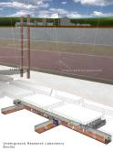
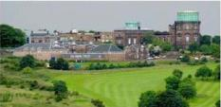
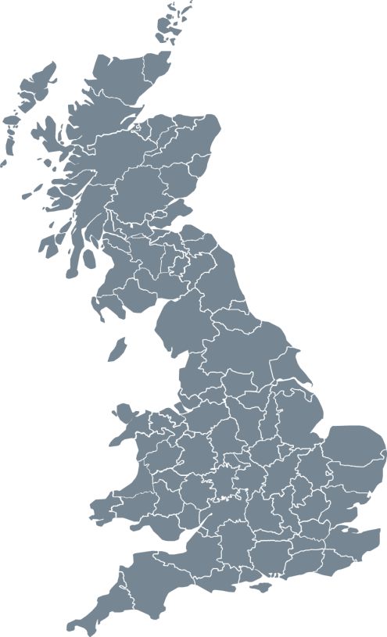
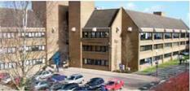
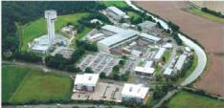
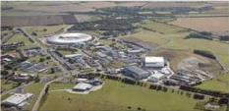
STFC
UK Astronomy Technology Centre
Edinburgh, Scotland
Boulby Underground Laboratory
North Yorkshire
Polaris House
Swindon, Wiltshire
Daresbury Laboratory
Sci-Tech Daresbury Warrington, Cheshire
Chilbolton Observatory
Stockbridge, Hampshire
Rutherford Appleton Laboratory
Harwell Didcot, Oxfordshire

Slide 3
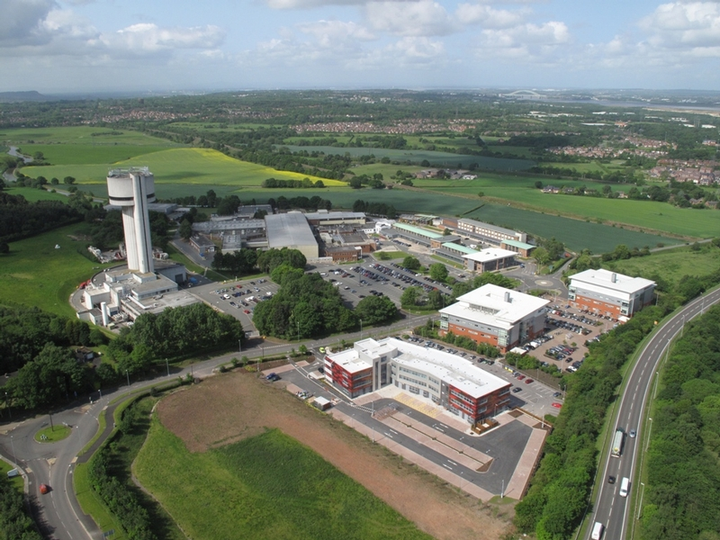
STFC, Daresbury Laboratory

Slide 4
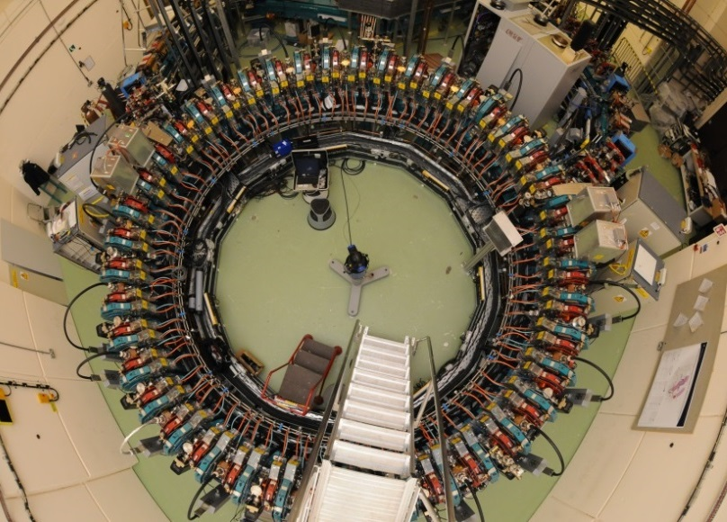
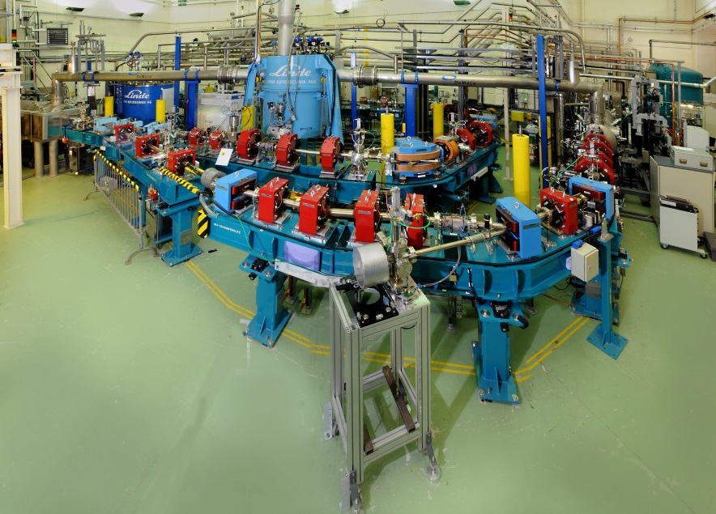
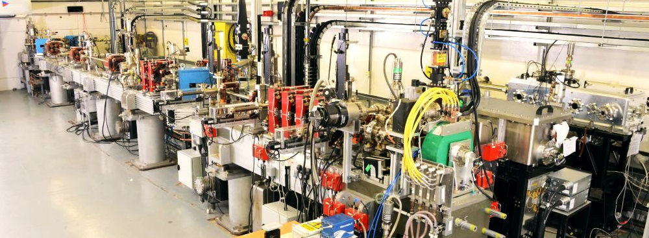
3 Onsite Accelerators
EMMA
ALICE
VELA

Slide 5
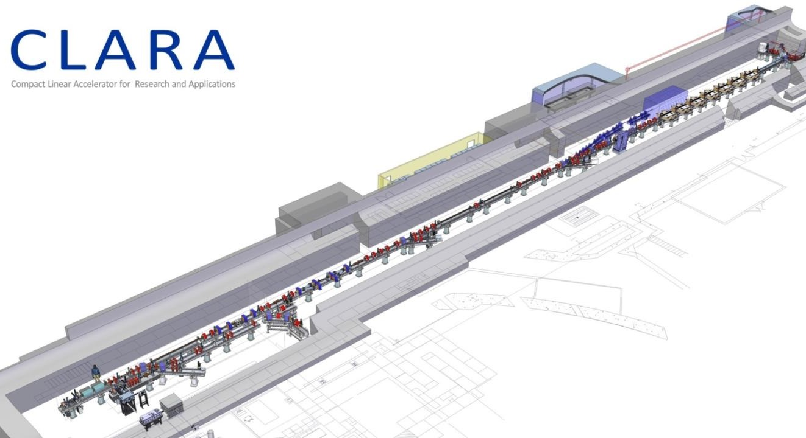
CLARA - under construction

Slide 6
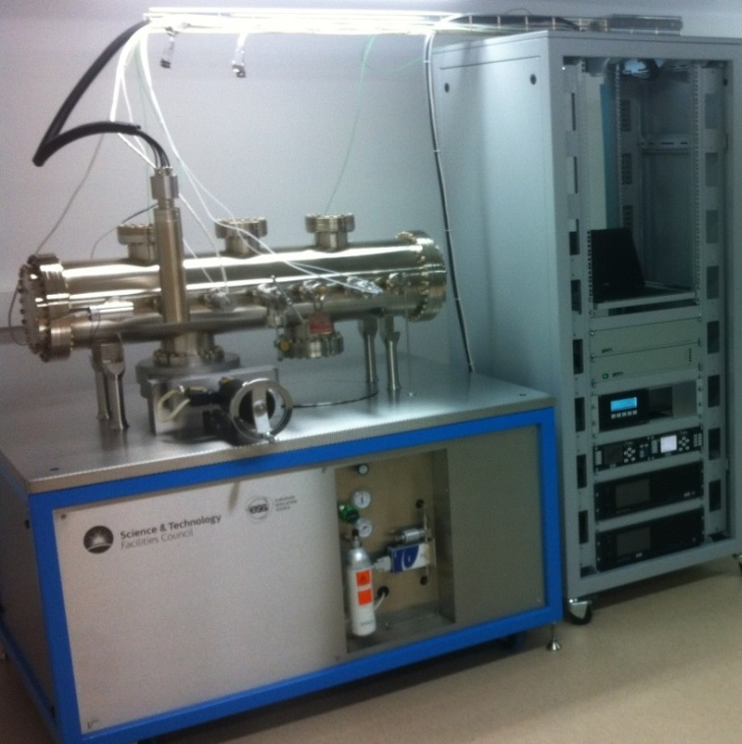
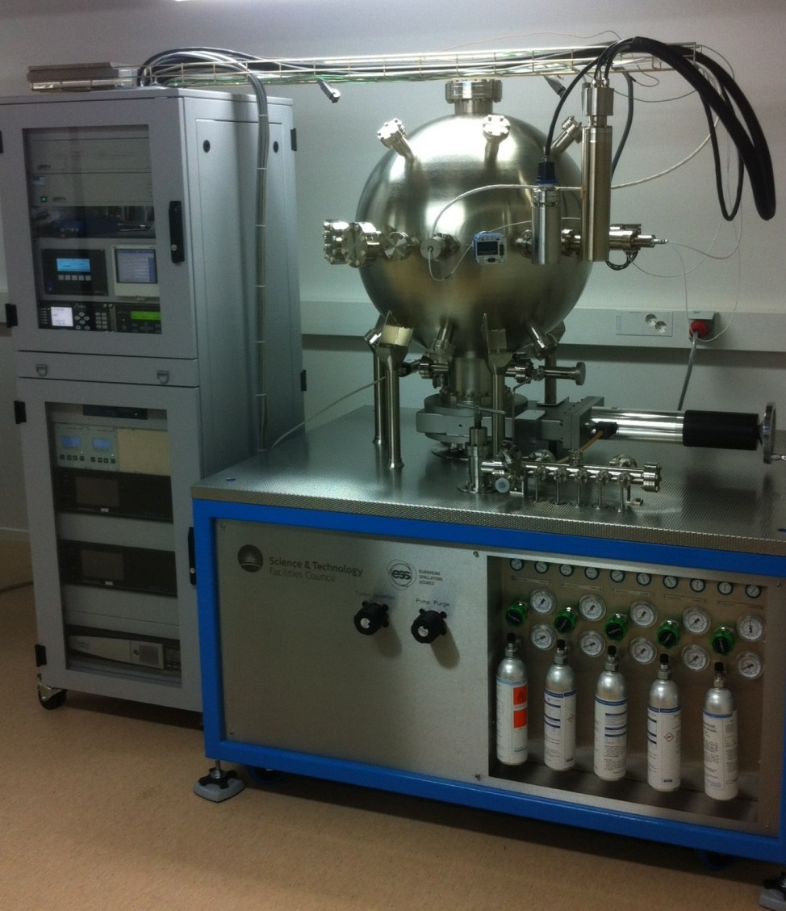
Vacuum Test Facilities
Delivered to ESS July 2015

Slide 7
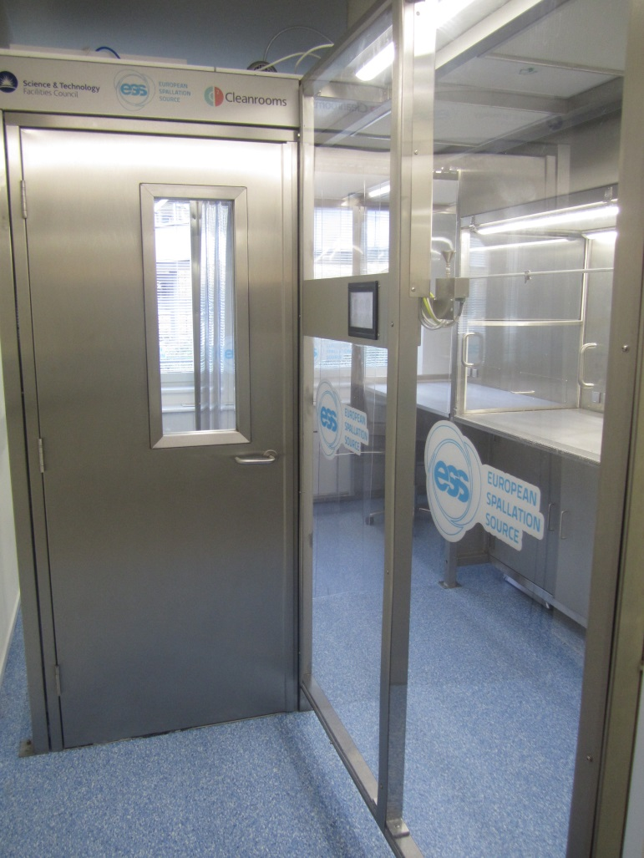
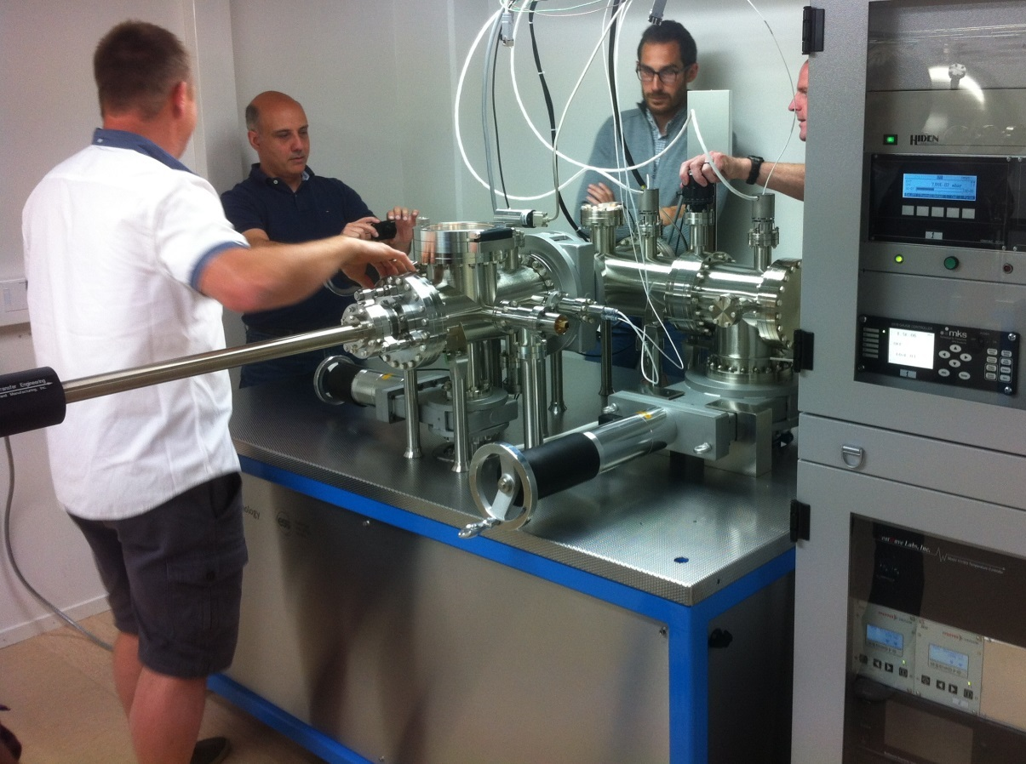
Vacuum Test Facilities
Delivered to ESS July 2015
Notes:
Particle test facility to ESS will be a ‘particle free’ accelerator and this.
Outgassing system to provide in vacuum material characterisation

Slide 8
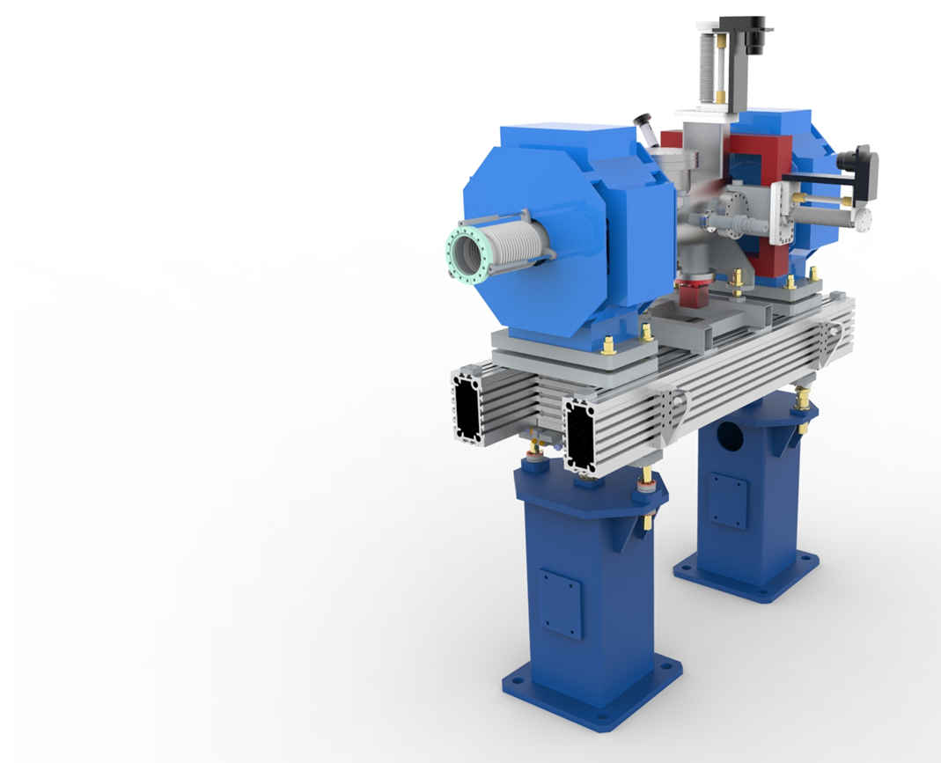
BTM WP Scope
To design, procurement and assemble;
2 Prototypes
3 Test Chambers
75 LWUs
52 Beam pipe modules
2 Differential pumping systems
2 mobile installation cleanrooms
Notes:
Over the next four years we have been asked to delivery …

Slide 9
Scope of work update
Particle control only on 52/75 LWUs
BPM work package
Only electrical centre measurement
It has been requested that BPMs are supplied on contract loan from DESY
Scope of work has been passed to ESS BI & Vacuum groups for final verification.
Awaiting feedback from BI – BPM design decisions
Notes:
Upto hebt

Slide 10
Overview In/Out
In
Girder design & procurement
Chamber design (within given parameters) & procurement
Vacuum design & procurement
Survey & Alignment
Particulate Control
Out
BPM Procurement & Design
BCM Design
Bolt in diagnostics
Magnet Design & Procurement
Installation & Onsite testing
Full excluded / included list in stfc document tdl-1224-meng-spec-0005

Slide 11
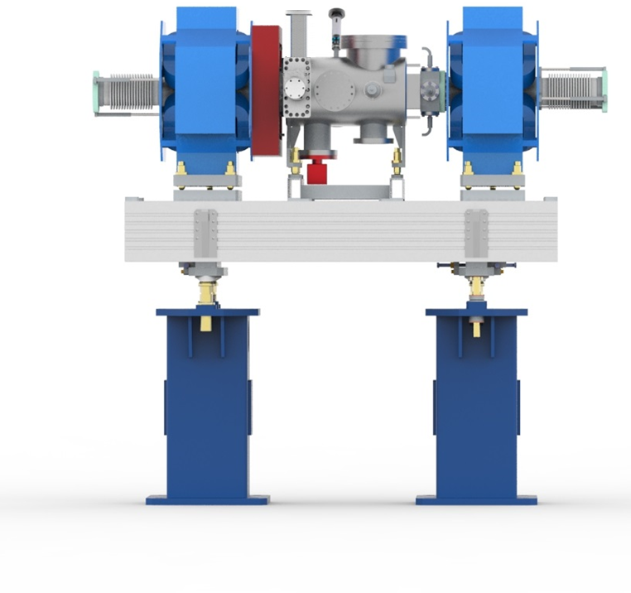
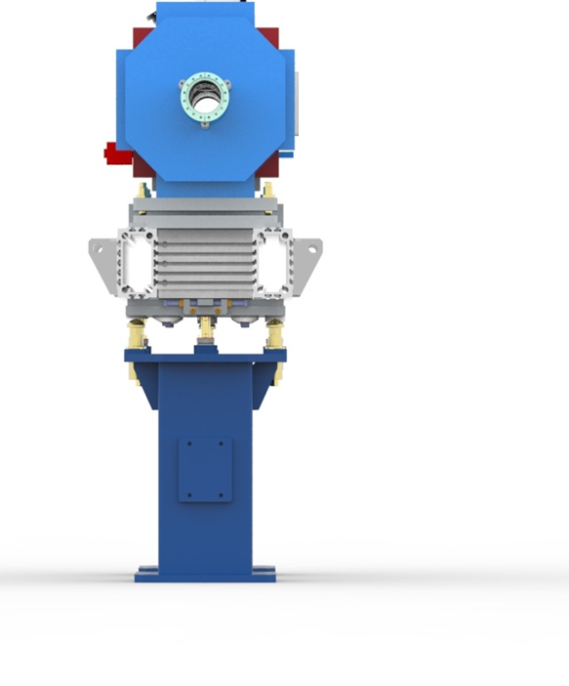
Warm Linac Units
STFC CAD Model for Elliptical LWU Prototype

Slide 12
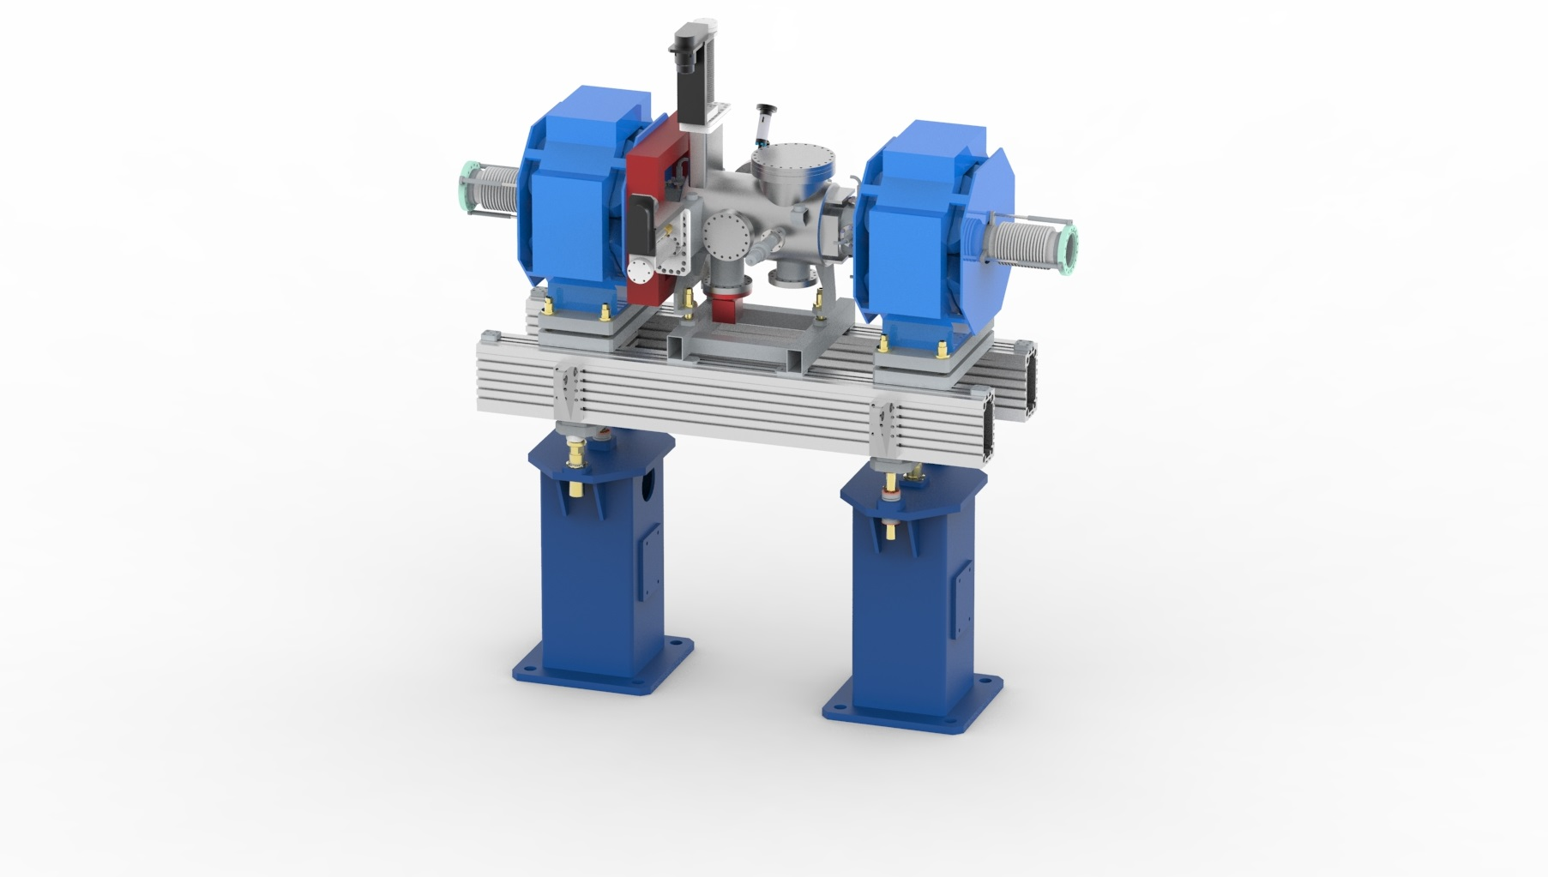
Warm Linac Units
Quadrupole Magnets
BPM on entrance & exit
‘Particle Free’ Chamber
- ISO 5 or better
Aluminium slotted girder
Fiducials, laser tracker alignment
-50µm Accuracy
Semi–kinematic
girder adjustment
Built in lifting points
Pedestals

Slide 13
Design
Based on many years experience developing accelerator modules
Slotted girders allows for versatility
Optimised for ground vibrations
Fiducial mounts for survey and alignment
±50µm alignment to local girder network
Girder adjustment ±25mm
Magnet/Chamber adjustment ±25mm
Large space between pedestals for access/egress

Slide 14
Design
Vacuum Requirements:
1 x 10⁻⁹ mbar
UHV Cleanliness
Particle free to ISO 5 or better
Vacuum requirements within STFC Vacuum Specs & inc.
Cleaning
Baking
RGA Scanning
Particle counting
STFC Vacuum Specs: ASTEC-VAC-QCD-SPC001-008
Notes:
Well defined UHV specs

Slide 15
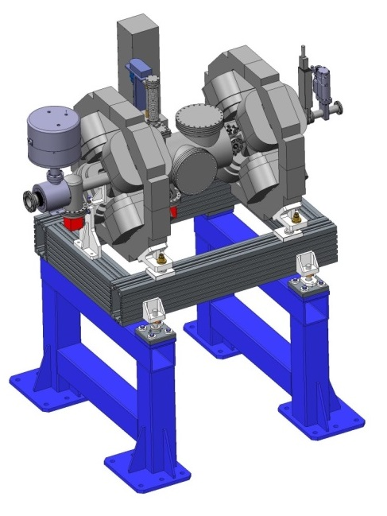
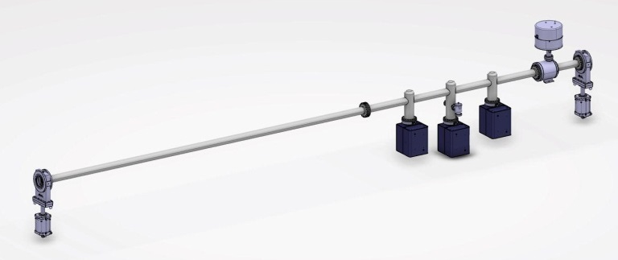
Differential Pumping Sections
Design work not yet started on LEDP & HEDP
Pumping ratio to be 100:1 (1 x 10⁻⁹ mbar on cryo side)
Early concepts;
Notes:
Similar to previous work at stfc

Slide 16
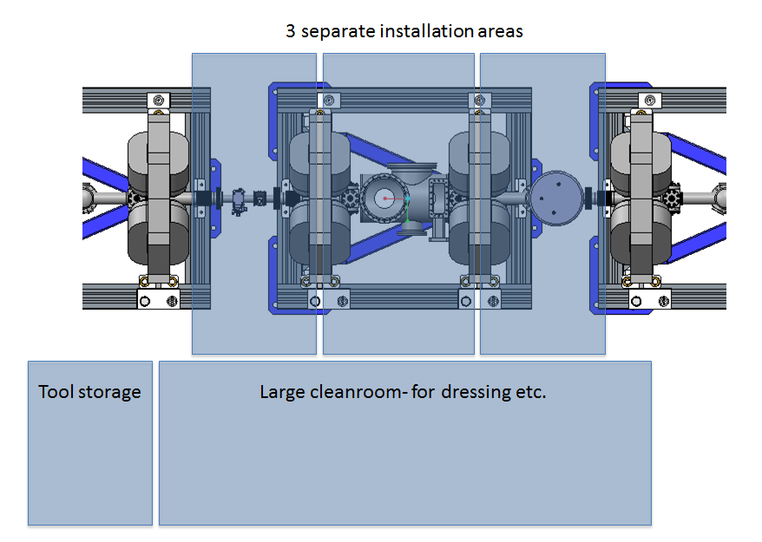
Mobile Installation Cleanrooms

Slide 17
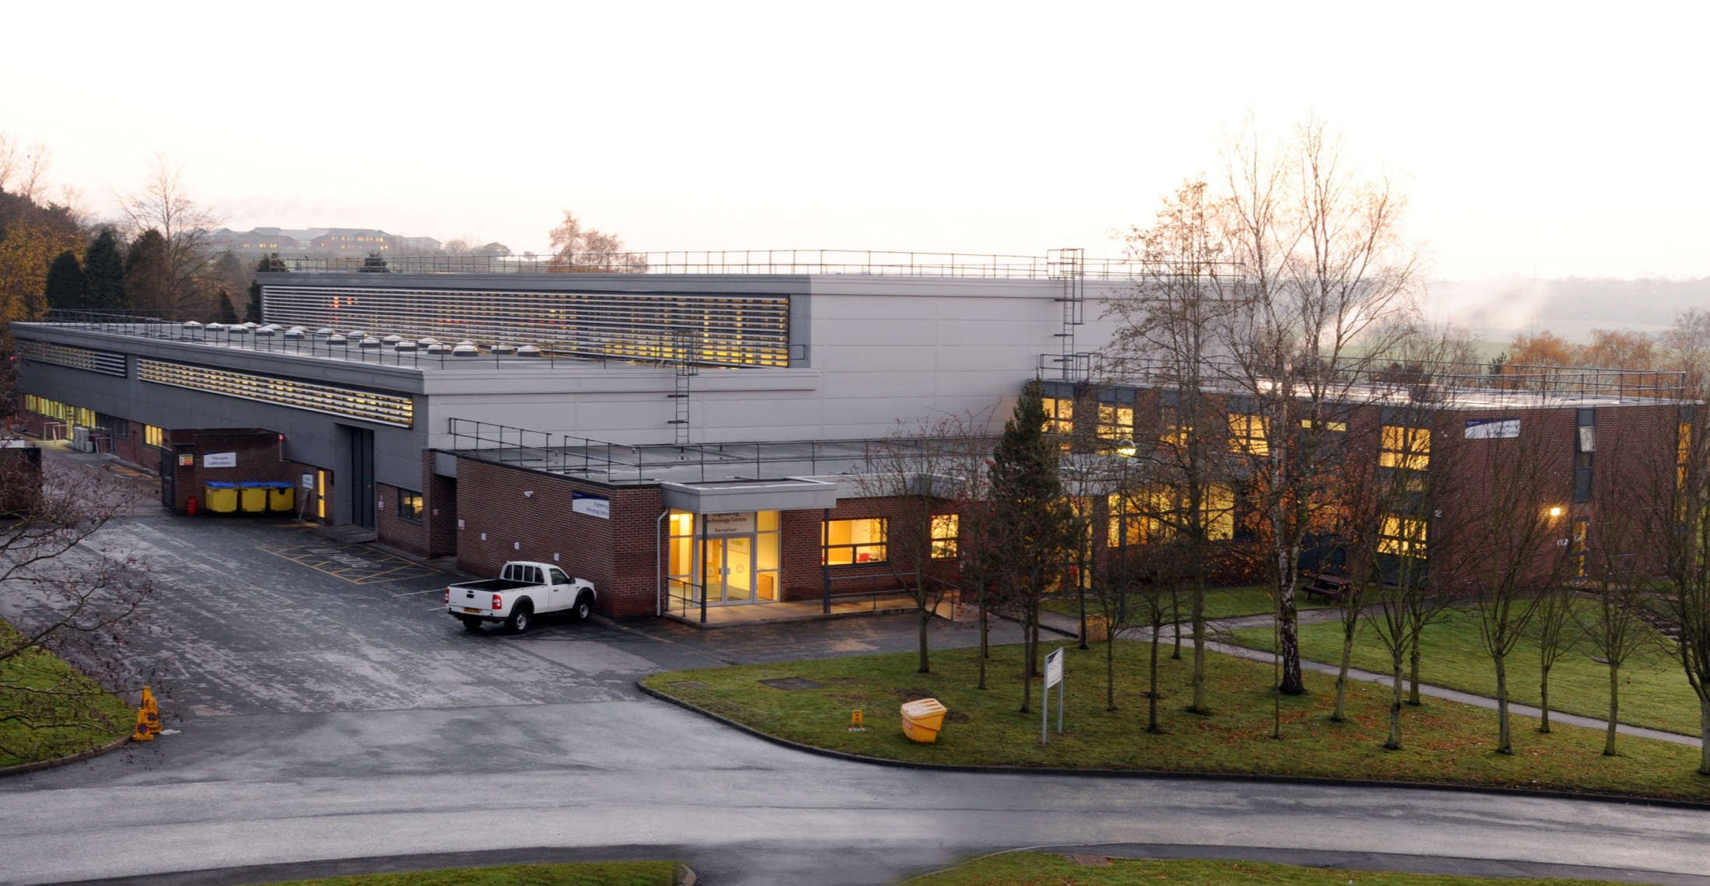
Assembly locations & Facilities
Engineering technology centre
Notes:
Engineering technology centre

Slide 18
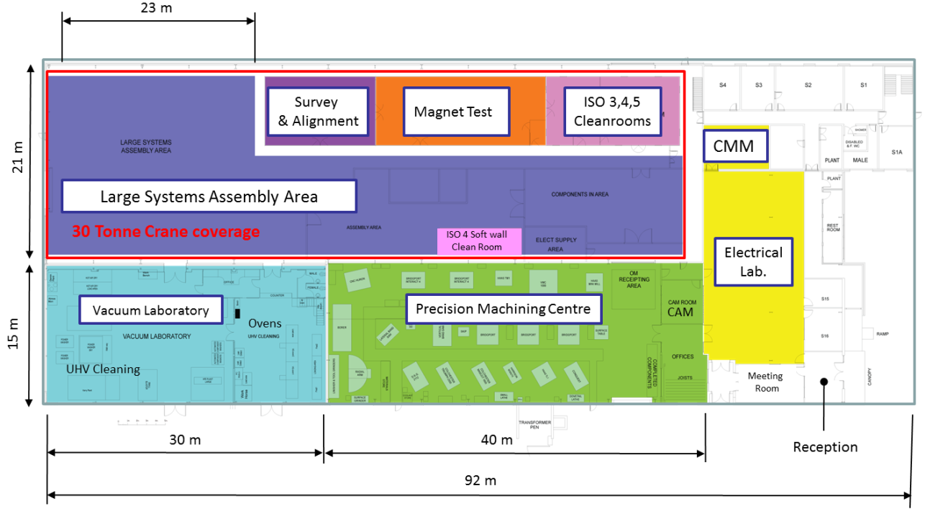
ETC Build Area
Soft wall cleanrooms
& Assembly Area
Notes:
Large Volume Assembly area with overhead crane, softwall cleanroooms, ISO 4 Cleanrooms, large vacuum laboratory,

Slide 19
Vacuum Laboratory
Cleaning vacuum components to UHV standards with aqueous and solvent base systems
Pre clean with Auto Wash (industrial dish washer)
Solvent cleaning with HFE 72 DE capability 0.3 m cube, 3 m long chambers possible.
A demin water plant > 2 x Auto washers,
Alkali degrease bath, Power wash bay.
3 x Solvent cleaning HFE72DE Slurry blaster,
Drying cabinet, Cranes.

Slide 20
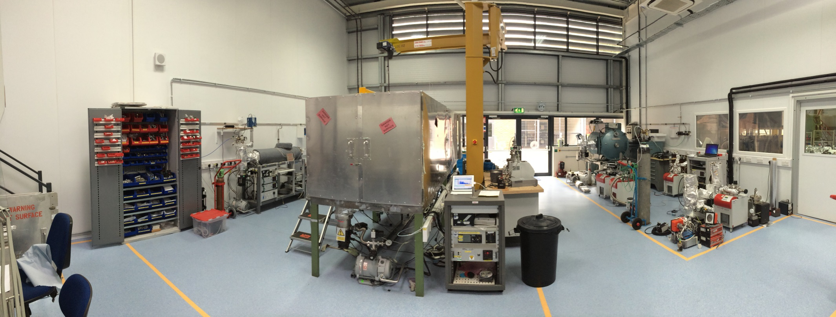
Vacuum Laboratory
4 x ovens to 250ºC
vacuum furnace to 1100ºC
Air oven to 150ºC
Leak detection & test facilities.

Slide 21
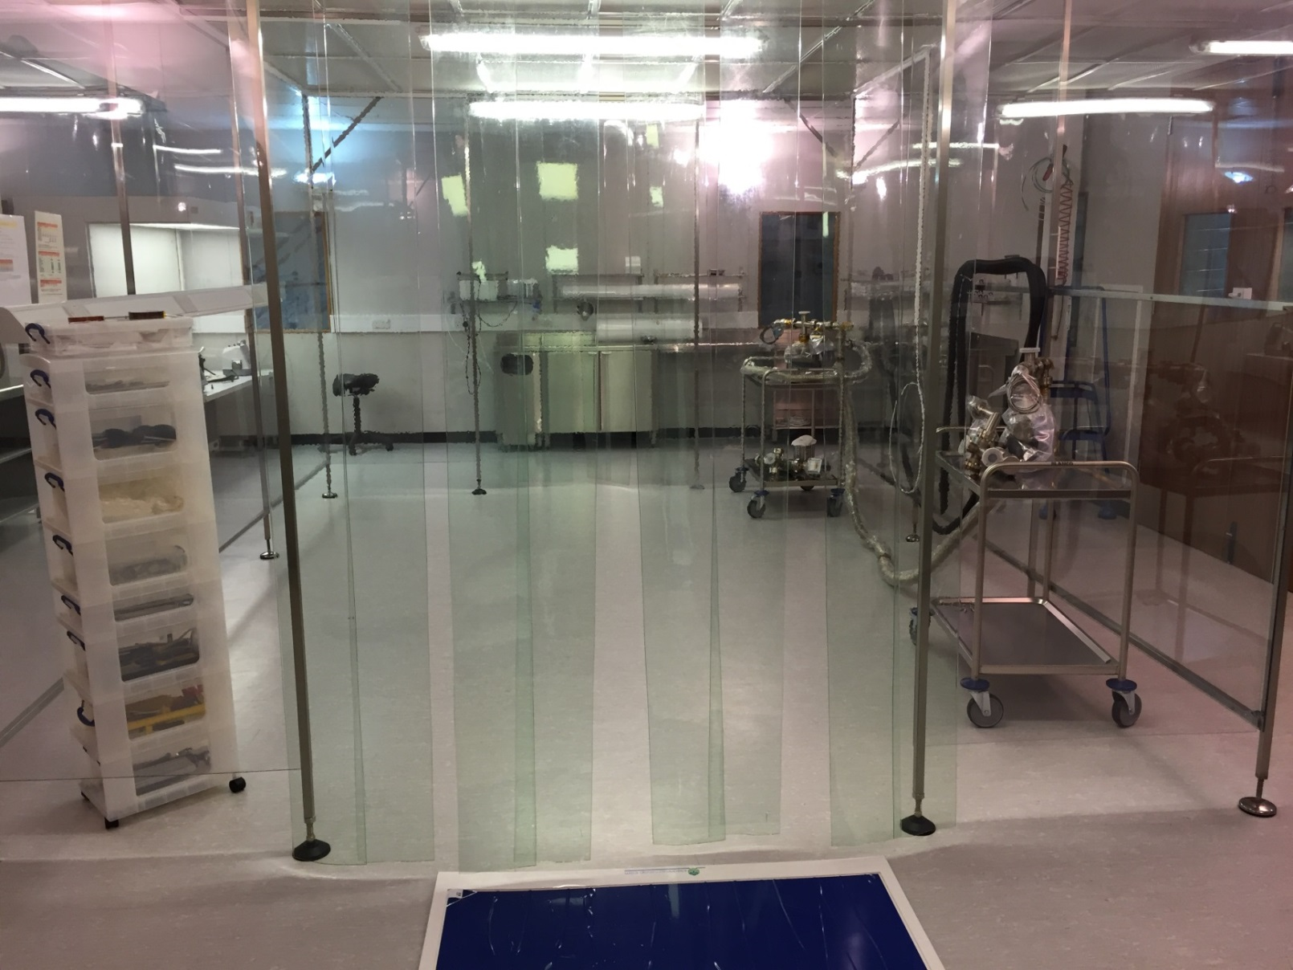
Cleanrooms
Change area
6m² - ISO 7
Outer area
80m² - ISO 6
Inner area
12m² - ISO 3
(at rest)

Slide 22
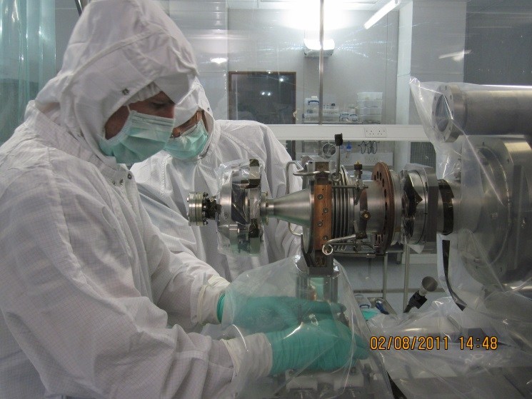
Low particulate experience on ALICE
ALICE Cathode in
ISO 4 Cleanroom

Slide 23
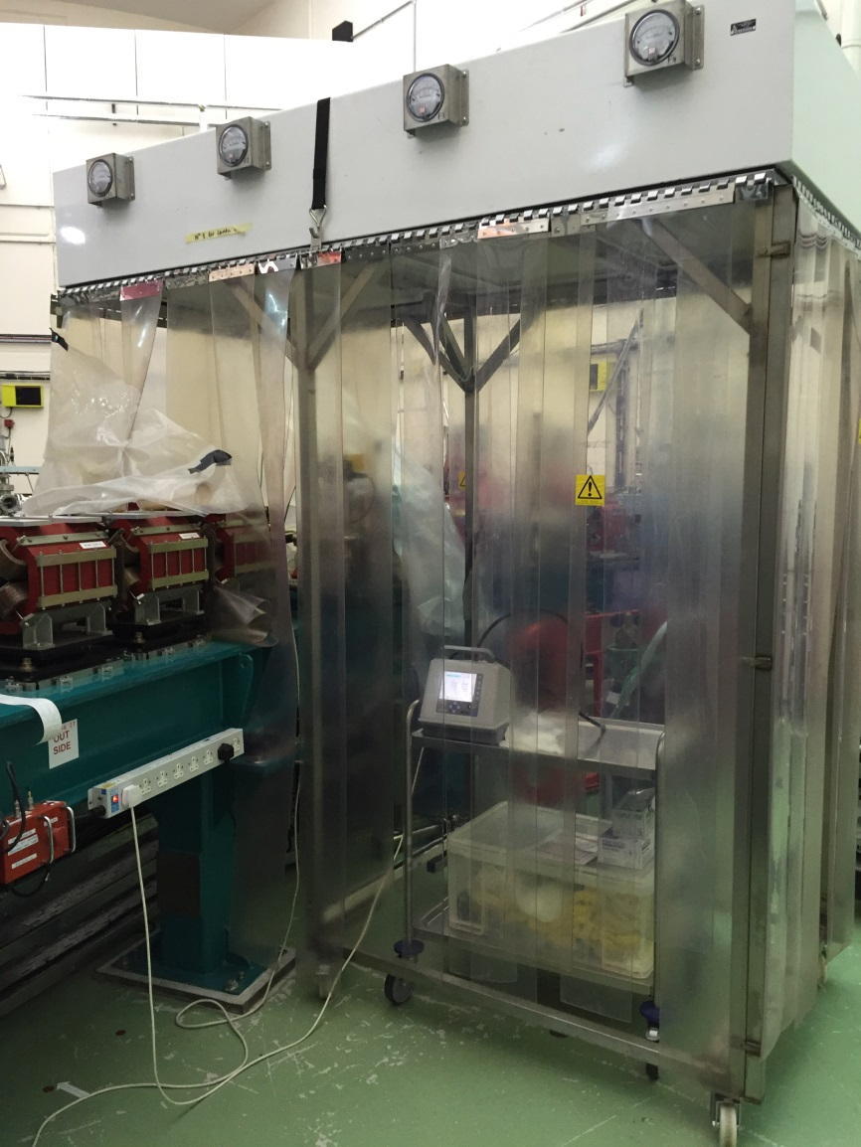
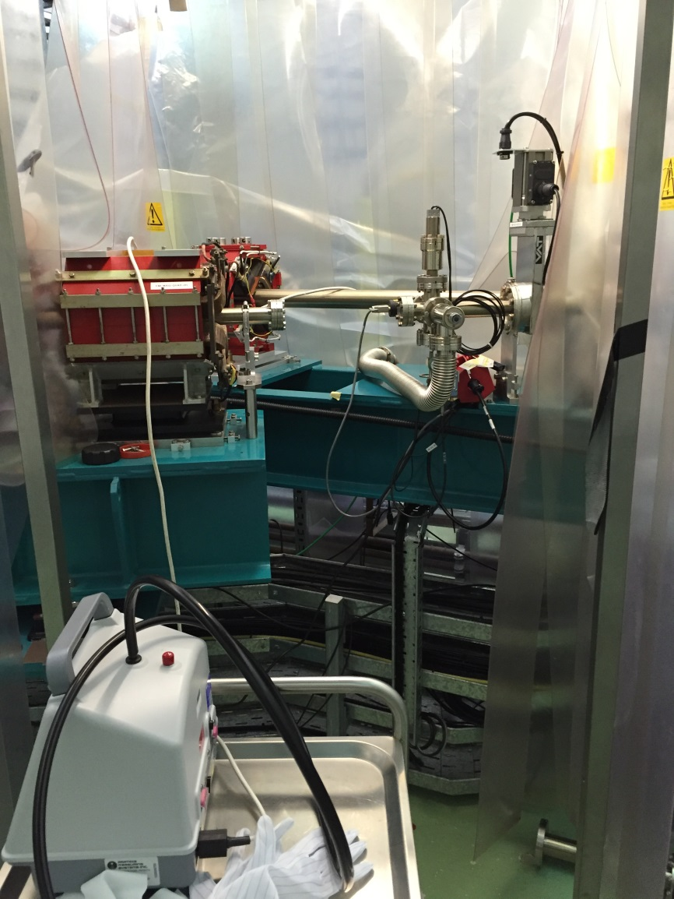
ALICE Softwall Mobile Cleanrooms
Notes:
Very similar to those required for ESS

Slide 24
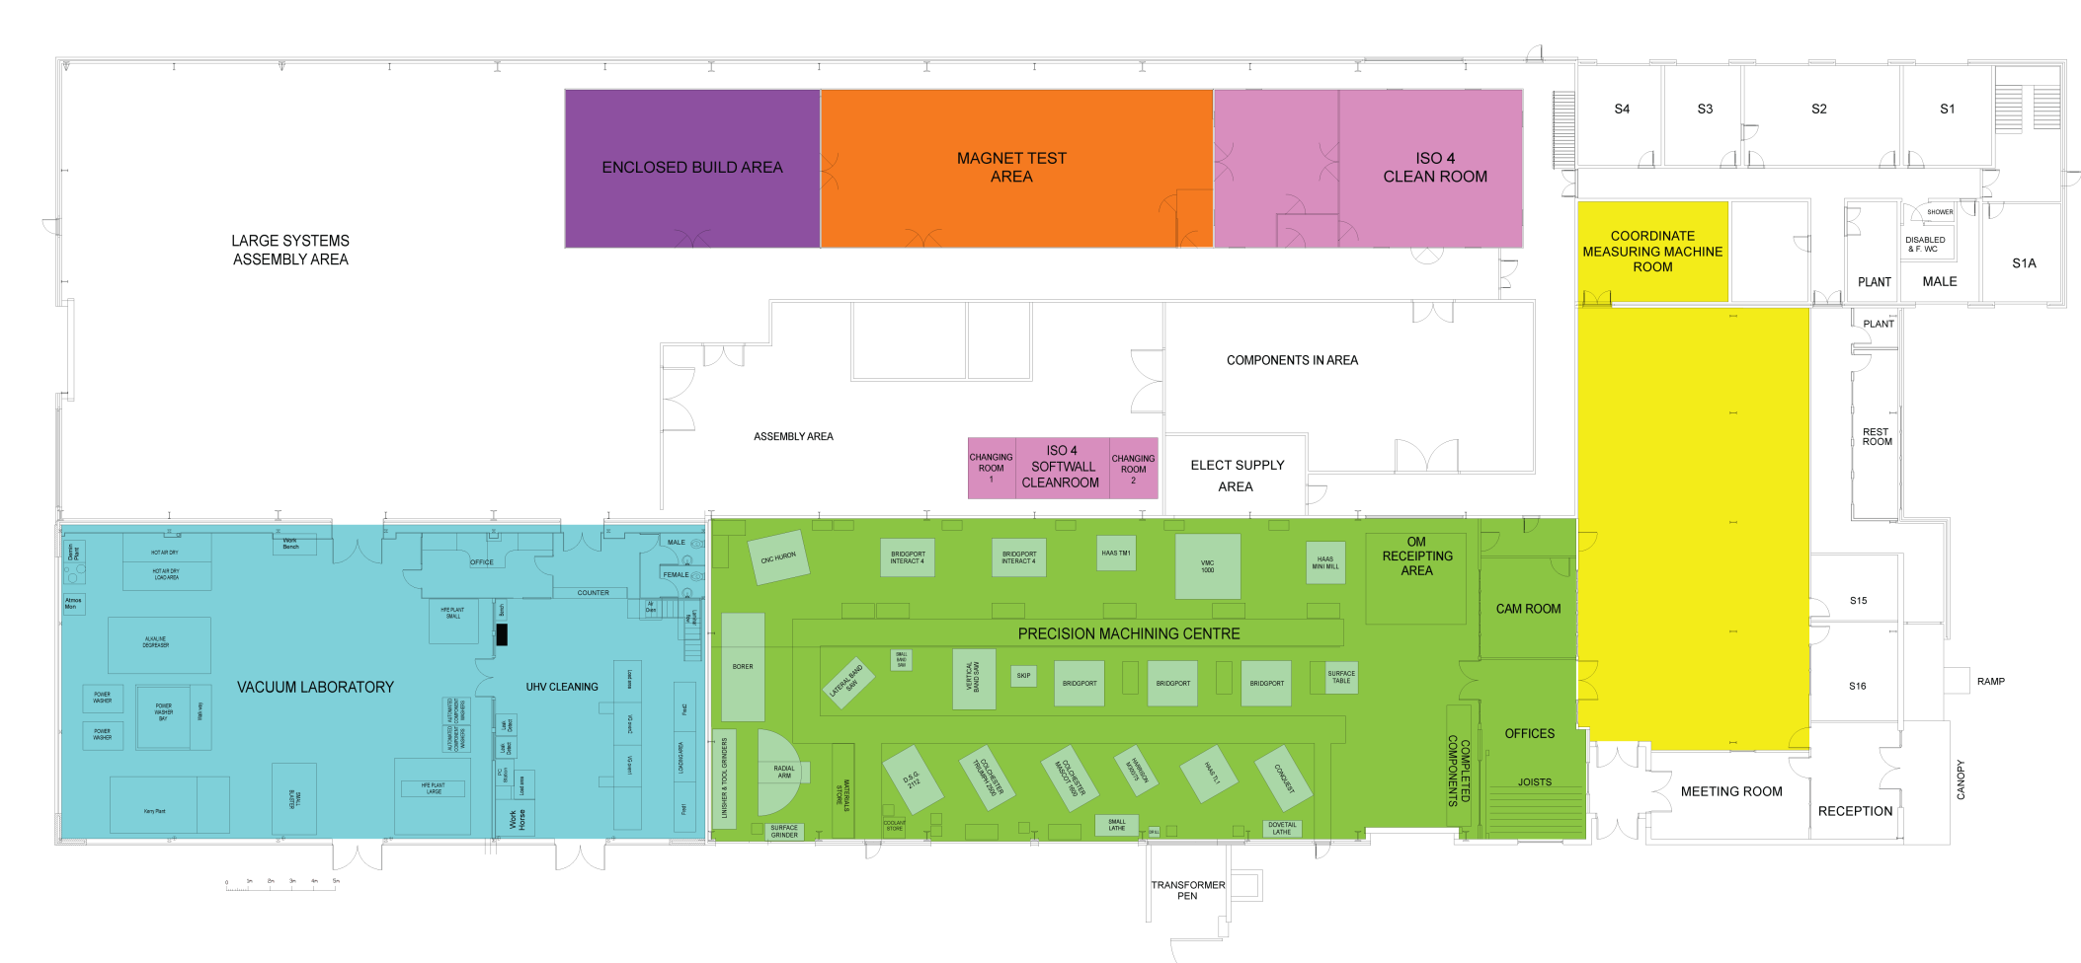
ETC Floor Plan
23 m
Survey
& Alignment
Magnet Test
ISO 3,4,5
Cleanrooms
21 m
CMM
Large Systems Assembly Area
30 Tonne Crane coverage
ISO 4 Soft wall
Clean Room
Electrical
Lab.
Vacuum Laboratory
Precision Machining Centre
CAM
15 m
Ovens
UHV Cleaning
Meeting
Room
30 m
40 m
Reception
92 m

Slide 25
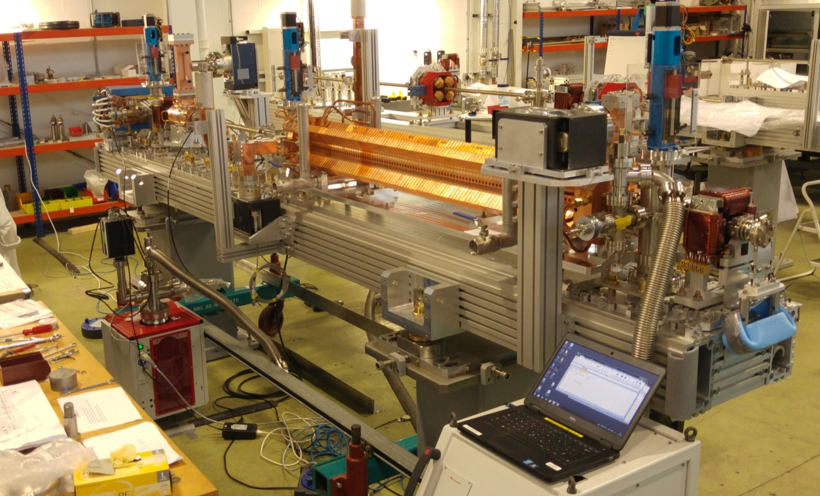
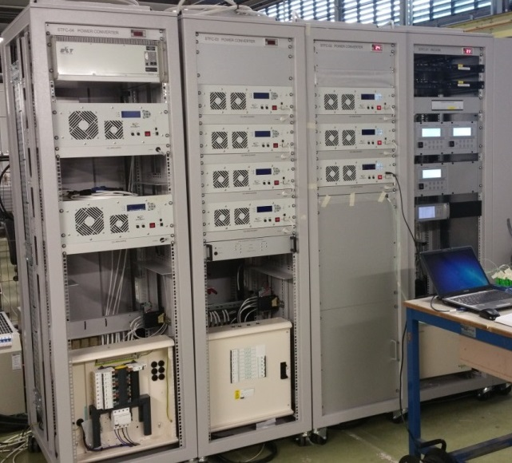
On-going Similar builds at Daresbury
Extreme Light Infrastructure – Nuclear Physics Facility
Delivery to Romania – over 18months period from 04/16
21 Modules
21 Racks
ELI - NP
Notes:
And Also 4 CLARA modules,
PSUs, Vacuum equipment, No Diagnostics, No RF.,
Racks include - PSUs, control, instrumentation, with EPICs,
Everything can be operated without overall control system

Slide 26
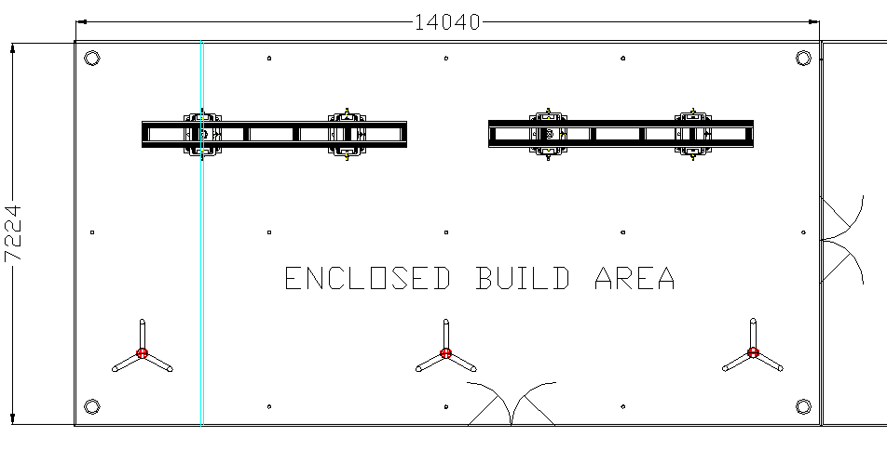
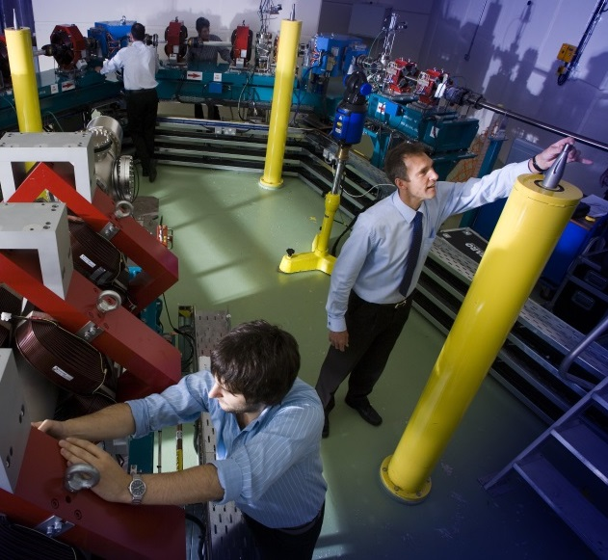
New Temperature Controlled Survey Alignment Room
Temperature Range 20 - 26°C
Stability ± 1°C over the full area of the room
A fixed 3D survey network
Capacity to align 6 BTM modules in the room
11 x Floor mounted nests
4 x Steel Survey Pillars
Filled with Sand
Survey & Alignment Room
ALICE @ Daresbury
Notes:
rj

Slide 27
Challenges & Risks
Time Scales
Particulate Control
Production bottle necks
Mechanical Design
Interfacing with various in kind contributors
Delivering to DL
Magnet deliveries
BPM deliveries
External deliveries
Design for reliability
Reduce possibility for leaks

Slide 28
Solutions
Time Scales
Careful Planning
Scheduling regular design reviews
Change control documentation
Monitoring and controlling progress against milestones and deliverables
Risk management
Particulate Control
Previous Experience, ALICE, DICC etc.
Agrees Procedures
Develop Quality Assurance
BSI 9001:2008 Quality Control

Slide 29
Solutions
Mechanical Design
Prototype essential
Draw on previous experience
Production bottle necks
Increased Staffing
Thorough project planning & management
Interfacing with various in kind contributors (IKC)
STFC to be included in ESS / IKC design reviews
Close contact with IKC
BSI 9001:2008 Quality Control

Slide 30
Schedule
2015 | 2016 | 2017 | 2018 | 2019 | 2020
Prototypes
BTM Assembly
BP Assembly
LWU Assembly
Installation Cleanrooms
Differential Pumping System 1
Differential Pumping System 2

Slide 31
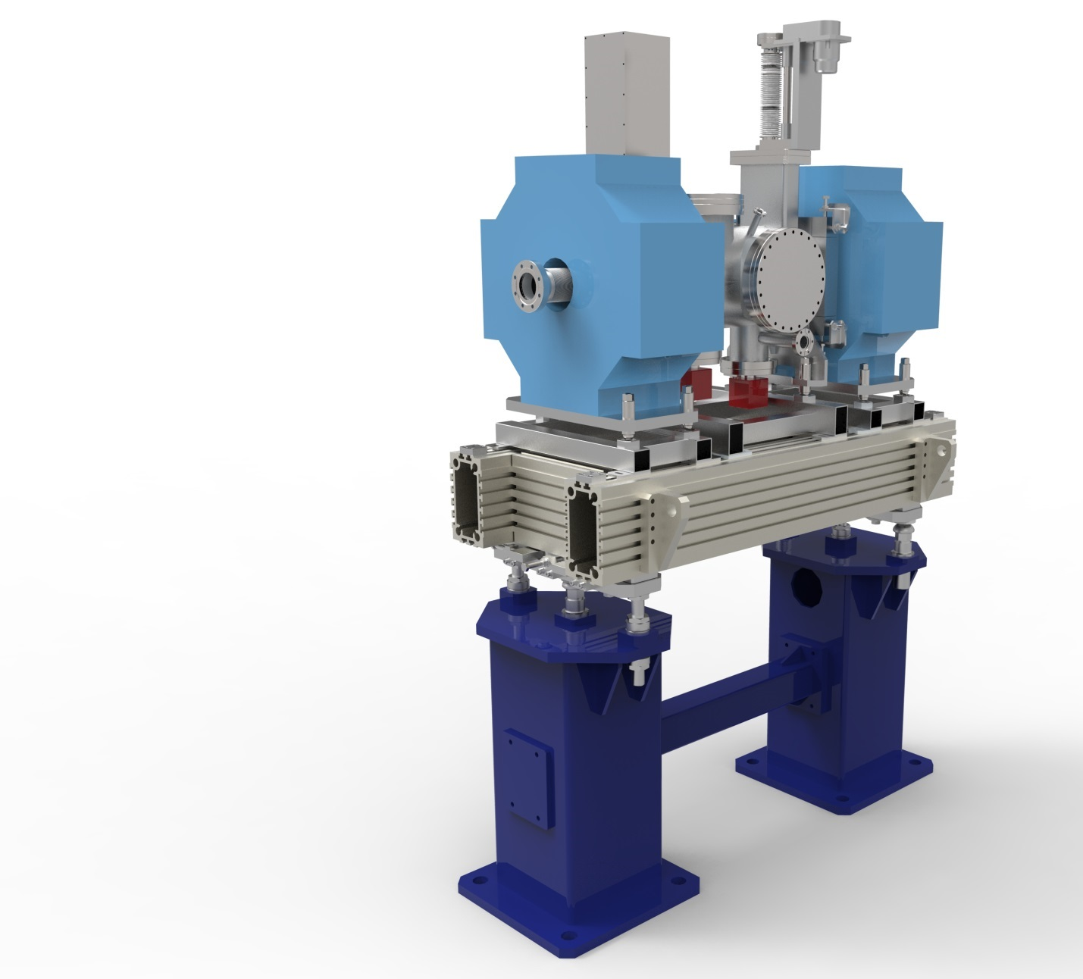
Schedule
Prototype
FDR 10/11/15
Procurement to start 12/11/15
Build to start 10/2/16
Production Units
PDR 10/11/15
Procurement to start 12/11/15
Beam pipe build to start 8/8/16
LWU Build to Start 1/2/17
Notes:
Prototype 2 - FDR 14/7/16

Slide 32
Schedule
10th PDR November 2015 – Production Units
BPM Type / Delivery Dates
BPM design?
Welded or flanged
Prototype must have flanged design
Both types will fit in the space envelope
For most but not all LWUs
Welded is the only option for 5 spoke units.
Final Magnet Design not until December 15
Problem for prototype

Slide 33
Schedule
Beam Pipe Production to start August 16
LWU production to start January 17
Dictated by first magnet shipment (Feb 17)
Important that Magnet deadlines don’t slip
Important that timescales can be given for BPMs

Slide 34
Conclusions
Experienced staff
Unique facilities and assembly areas
Proven track record
International delivery
STFC Management Framework
BSI 9001:2008 Quality Control
Agreed vacuum processing procedures with ESS
Currently evaluating measures to reduce time scales
Notes:
Vac processing – UHV cleaning, particle control

Slide 35
Thank You
ESS TAC, Dr Paul Aden, 14-10-15

