Slide 1
Beam Instrumentation in Monolith
Stephen Molloy
PBI Taskforce Leader

Slide 2
Talk Outline
Beam Instrumentation Taskforce
  Who, what, why
Beam-on-Target requirements
Beam Delivery systems
  Accelerator-to-Target – A2T
Target implications
Concerns
Conclusions

Slide 3
Beam Instrumentation Taskforce
Commenced on 1st June
  Original deadline: 31st July
  Extended to Oct TAC
    Due to Summer Vacation, and a scope increase
Purpose: “Set a baseline for PBI at ACCSYS”
  Conceived as a “focus group” for Beam Instrumentation and Beam Physics
  Allowed requests from Beam Instrumentation to have a higher priority for the Beam Physics team

Slide 4
Beam Instrumentation Taskforce
Initial scope
  From the Ion Source to the Neutron Shield Wall
  Implication – Target diagnostics were not considered
Scope extension (mid August)
  All the way to the Target face
  Agreed by Target & Accelerator Management
  Implication – Target diags must be discussed

Slide 5
Beam on Target requirements
Primary questions for the Taskforce:
  What is the minimal PBI suite that is sufficient for commissioning?
  What backup options should be considered in case of technological challenges?
Answers should be guided by the agreed Beam on Target specifications
    “Beam on Target Requirements”, ESS-0003310 – Released on 3rd July, 2015
Parameter | Value at Beam Entrance Window (BEW) | Value at Proton Beam Window (PBW)
Maximum beam footprint enclosing 99% beam fraction (mm²) | 160 H × 60 V | 140 H × 52 V
Maximum beam footprint enclosing 99.9% beam fraction (mm²) | 180 H × 64 V | 160 H × 56 V
Nominal time-averaged peak current density (µA/cm²) | 56 | 89
Maximum time-averaged peak current density (µA/cm²) | 71 | 112
Maximum displacement of footprint from nominal position (mm) | ±5 (horizontal) ±3 (vertical) | ±4 (horizontal) ±3 (vertical)
Minimum σ_{x}σ_{y} for rastered Gaussian beam (mm²) | 50 | -
Minimum horizontal raster frequency (kHz) | 35 | -

Slide 6
Some applicable findings
https://ess-ics.atlassian.net/wiki/display/PBITF/Target+Diagnostics
ESS-0003310 is the sole source of appropriate specifications
Necessary beam conditions are only specified at two locations – PBW & BEW
Limits are placed on the 1% and 0.1% populations of the transverse tails
There are no magnetic optics downstream of the Neutron Shield Wall (NSW)
The A2T optics are such that there is an optical waist in both planes at the NSW, and that this is coincident with a cross-over point in the rastered trajectory
The maxima of the rastered trajectory is linearly related to the extent of the time-averaged beam size at the PBW & BEW
The raster magnets will include B-dot loops to probe their field

Slide 7
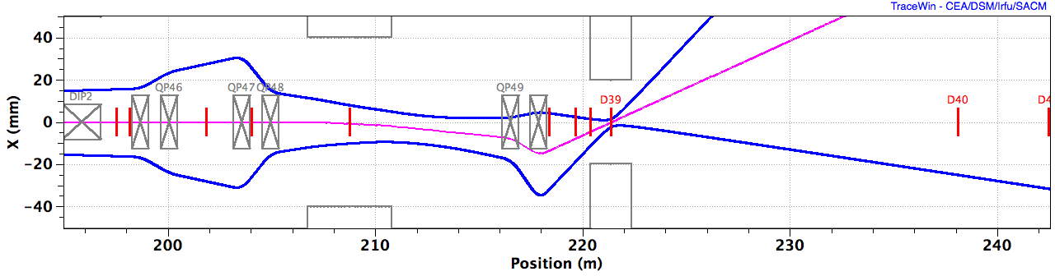
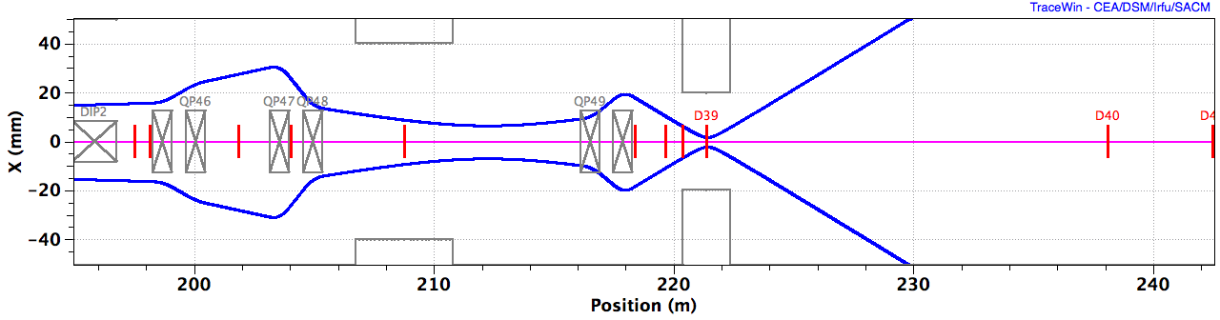
Beam diagnostics in A2T
AP
CO
AP
CO

Slide 8
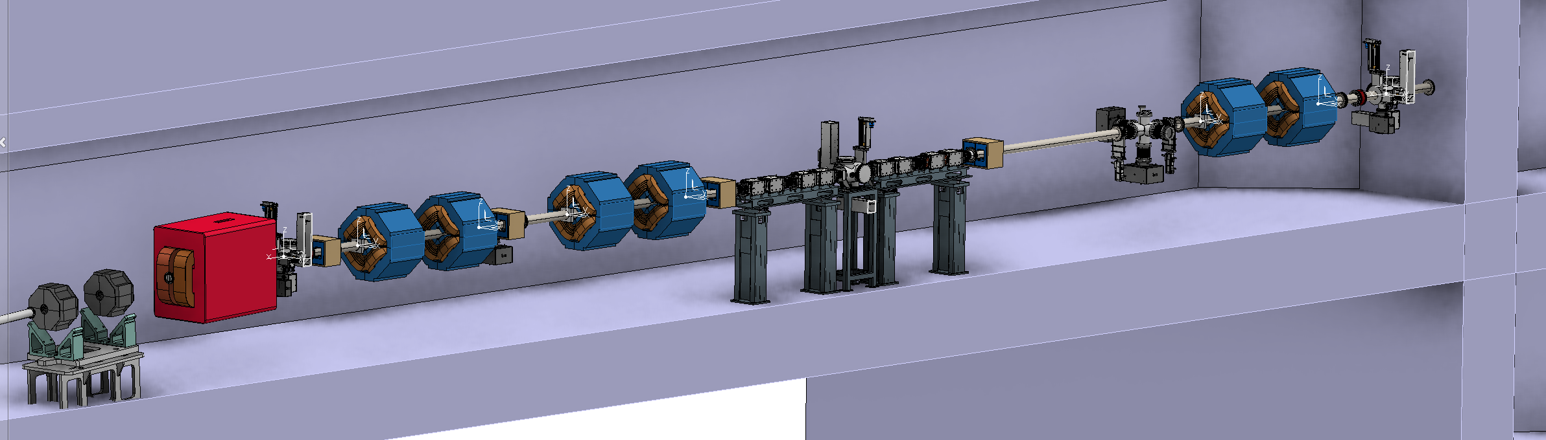
Beam diagnostics in A2T
Note: The 3D model has not yet been updated to reflect the Taskforce recommendations
AP
CO

Slide 9
Implications for Target diagnostics
What info can be gleaned from A2T diags?
  The correct operation of the raster system (frequency and approximate amplitude) can be verified via B-dot loops
  The correct triggering of the raster system can be verified via 3 A2T BPMs
  Centroid and raster amplitude at PBW & BEW can be approximated from the BPMs
What info is missing?
  Verification of the precise location of beam impact on PBW & BEW
  Verification of the population of the transverse tails

Slide 10
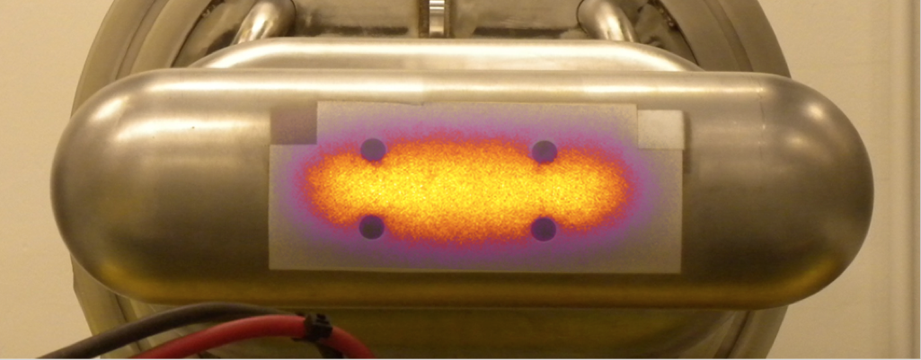
“Seeing is believing”
– Eric Pitcher, 28th Sept 2015
Proc. of SPIE Vol. 8142 81420N-1
A fiducialised luminescent coating applied to the objects of interest gives a direct measurement of the necessary parameters
Therefore,
  Apply such a coating to the PBW & the BEW
  Install light guides, sensors, etc., as appropriate to extract the signal from the Target Monolith
    In the “PBI Plug” currently included in the monolith design

Slide 11
Transverse tails
Dynamic range of luminescent coatings will not be capable of verifying the 1% & 0.1% specifications
Need an additional diagnostic to measure this
Solution,
  Include halo measurements at PBW & BEW
    Perhaps based on thermocouples or SEY
Problem,
  Rotating target makes such a measurement at the BEW very difficult
Solution,
  Move the BEW halo measurement to the plug that supports the profile measurement light guides

Slide 12
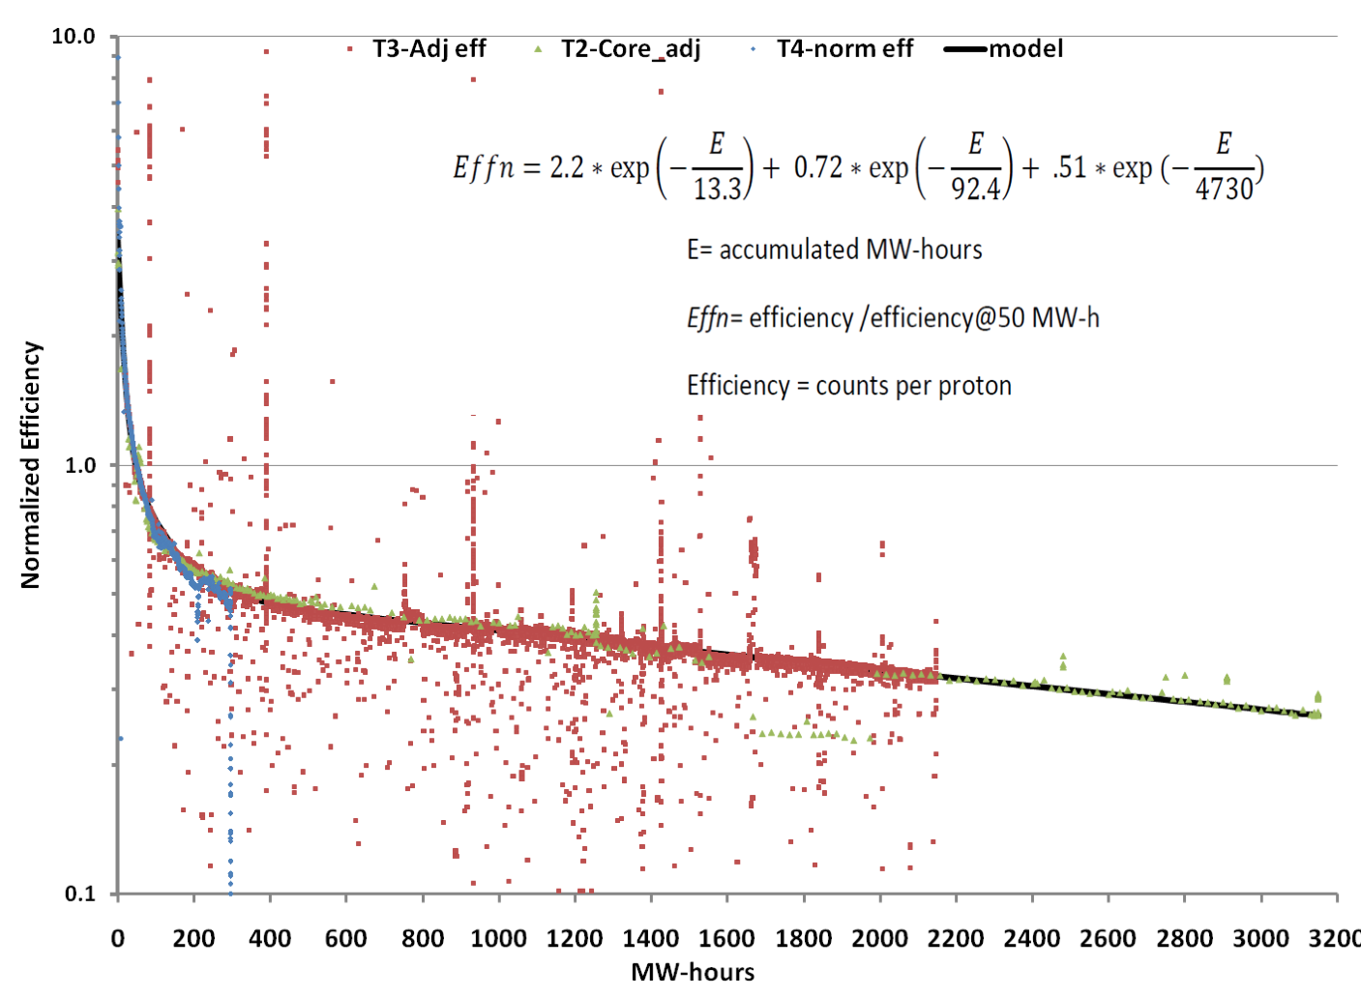
Summary thus far
Beam on Target specs can be verified via:
  Wire-scanner at raster action-point in A2T
  Appropriately placed BPMs in A2T
  B-dot loops in the raster magnets
  Luminescent coatings applied to the PBW and BEW
  Halo monitors
Concerns
  Luminescence degradation
    Observed at SNS
Spallation Neutron Source Target Imaging System Operation, McManamy, et al., 2011

Slide 13
Luminescence Decay,
Spallation Neutron Source Target Imaging System Operation, McManamy, et al., 2011
Environment of PBW and BEW
  Higher operation temperature & neutron flux at BEW, therefore
    More uniform degradation
    Higher levels of degradation (subjected to larger neutron flux than PBW)
  Higher proton flux at PBW, therefore
    Non-uniform degradation concentrated at the beam spot
  Material choice
    Trading brightness for uniform degradation is advised
ESS:
  BEW – 5 yrs x 5000 hrs/yr x 5MW / 36 sectors
    = 3500 MWhrs → ~7% relative efficiency
  PBW – 0.5 yrs x 5000 hrs/yr x 5 MW
    = 12500 MWhrs → ~1% relative efficiency
  (Take care with these efficiency numbers. Calculation is very simplified.)

Slide 14
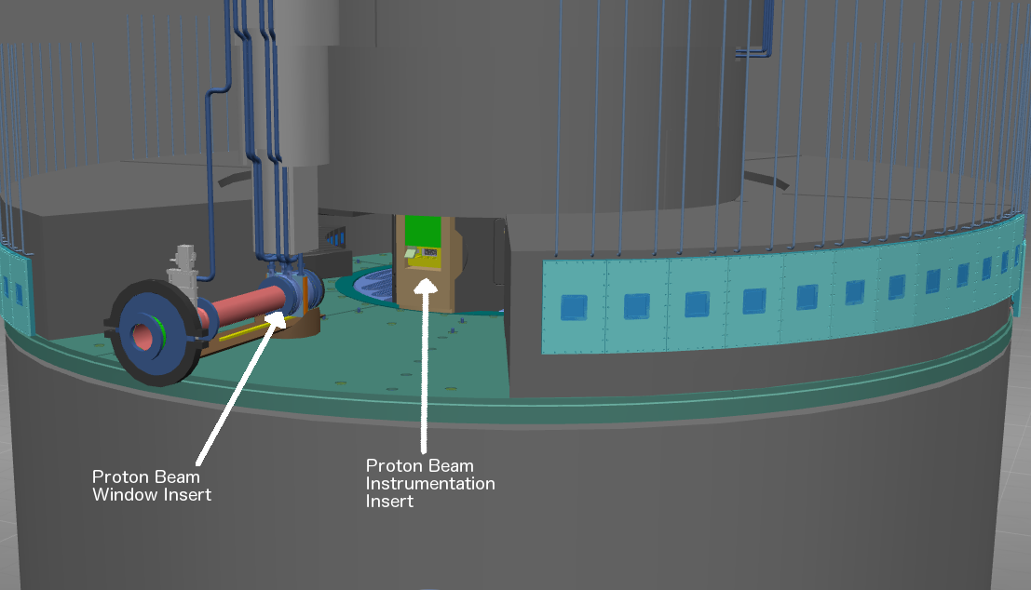
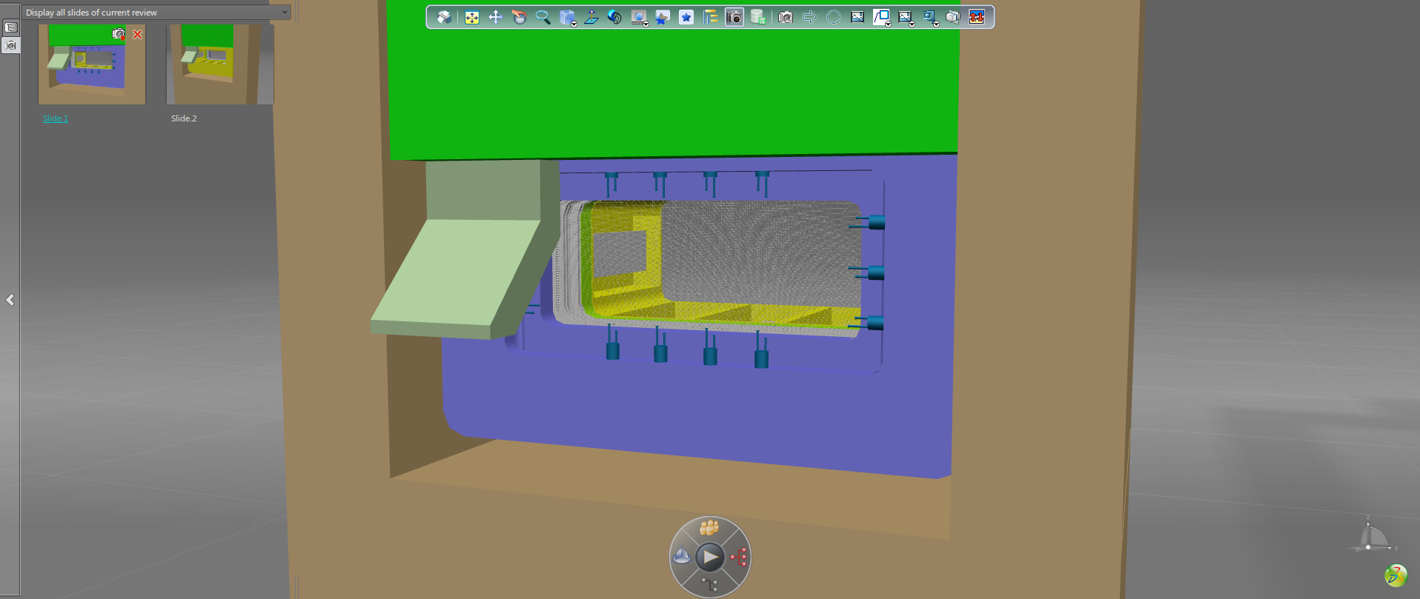
Back-up option
No perfectly equivalent option has been identified
  i.e., no option that directly measures the flux at the PBW & BEW
An alternative is a wire-grid system in the PBI plug
  The proton current density may make this risky
    Environment issues also increase risks

Slide 15
Summary
Taskforce recommendation:
  Wire-scanner at raster action-point in A2T
  Appropriately placed BPMs in A2T
  B-dot loops in the raster magnets
  Luminescent coatings applied to the PBW and BEW
  Halo monitors on the PBW and PBI Plug
  Consider backup options
    Specifically the use of a wire-grid system in the PBI Plug

