Slide 1
Preliminary Design of Safety Credited Active Controls
Mikael Olsson
Control engineer – Target control
www.europeanspallationsource.se
15-10-15

Slide 2
Agenda
Purpose
Pilot TSS: events
Pilot TSS: system inputs and output
Pilot TSS: functions
Pilot TSS: architecture
Planned next steps

Slide 3
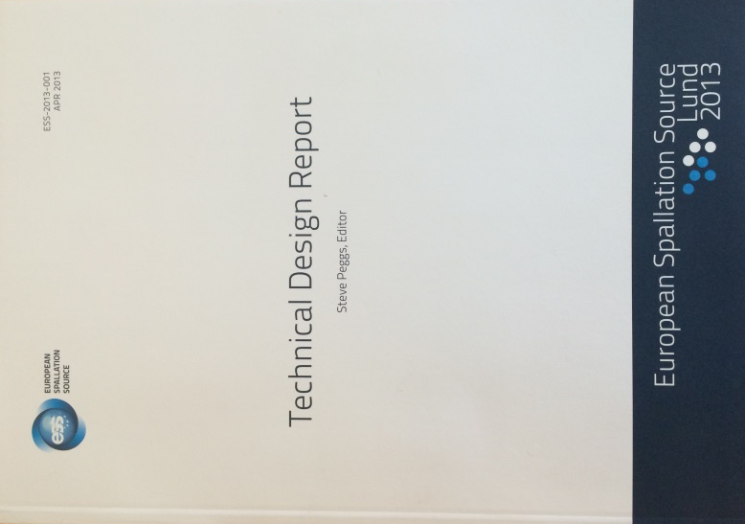
Purpose of Target Safety System (TSS)
TSS is the ESS safety credited active monitoring and control system that shall:
”…protecting workers and the public from exposure to unsafe levels of radiation, and preventing the release of radioactive material beyond permissible limits”
”…bring the target station into a safe state in case of an abnormal event from nuclear safety point of view…”

Slide 4
Pilot TSS
Scenario analysis ongoing (quantitative)
The hazard analysis (qualitative) indicates a set of likely events for TSS => Pilot TSS
TSS
Selected events
Target Wheel stop during beam on Target
Loss of Target wheel cooling during beam on Target
Includes loss of flow, loss of cooling function and the He bypass scenarios
Leakage from Target Cooling circuit into monolith, Depressurization of Pcool
Pilot TSS

Slide 5
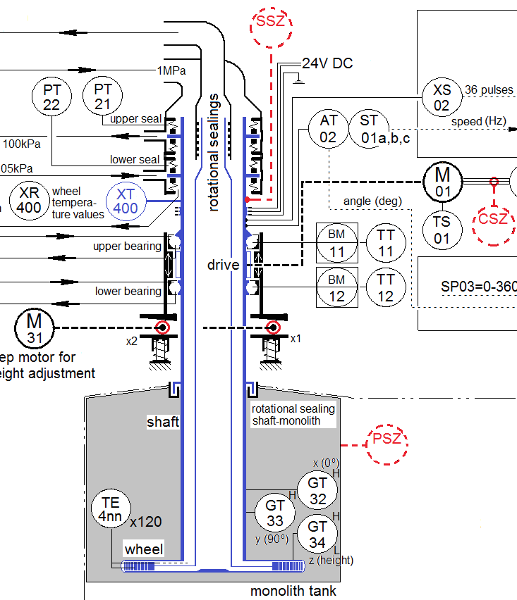
Pilot TSS: system inputs
Process variable Event | Outlet velocity | Outlet pressure | Inlet temperature | Target shaft rotational speed | Wheel motor power consumption
Loss of He cooling flow (blower fail), #3 | X
Loss of He cooling pressure (leakage), #4 |  | X
Loss of He cooling heat exchange, #3 |  |  | X
Decrease of wheel rotational speed, #1 |  |  |  | X | X
PSZ
SSZ
TSZ

Slide 6
Pilot TSS: system output
Purpose = achieve safe state
Safe state = no beam on target
Ion source
Contactors stop allowing power to the Ion source
Closed if Target variables ok – allow power
Open if any out of range – no power on 400 V electrical power supply to the ion source
Contactors dedicated to TSS
RFQ as a remaining potential redundant solution
High voltage electrical power generation
(75 kV)
Conventional electrical power (400 V )
High voltage isolation
Ion source high voltage area
Control
Coils
Magnetron
TSS control

Slide 7
Pilot TSS: safety functions
Function | Normal operation
TSS shall achieve safe state if…
… target He cooling outlet velocity < 40 m/s | 60 m/s
… target He cooling outlet pressure < 7 bar | 10 bar
… target He cooling inlet temperature > 80 °C | 40 °C
… target shaft rotational speed < 11.6 rpm | 23.3 rpm
… target wheel motor power consumption < TBD W | TBD W

Slide 8
Pilot TSS: safety functions - principal
Read
Evaluate
Act
Target wheel He cooling outlet velocity
< 40 m/s
Target wheel He cooling outlet pressure
< 7 bar
Target wheel He cooling inlet temperature
> 80 °C
If inside all limits
Close contactors at the ion source
Target wheel shaft rotational speed
< 11.6 rpm
If any limit exceeded
Open contactors at the ion source SAFE STATE
Target wheel motor power consumption
< TBD W
If sensor connection lost
Diagnostic
If communication lost
Fail safe
If control HW failure
If power lost

Slide 9
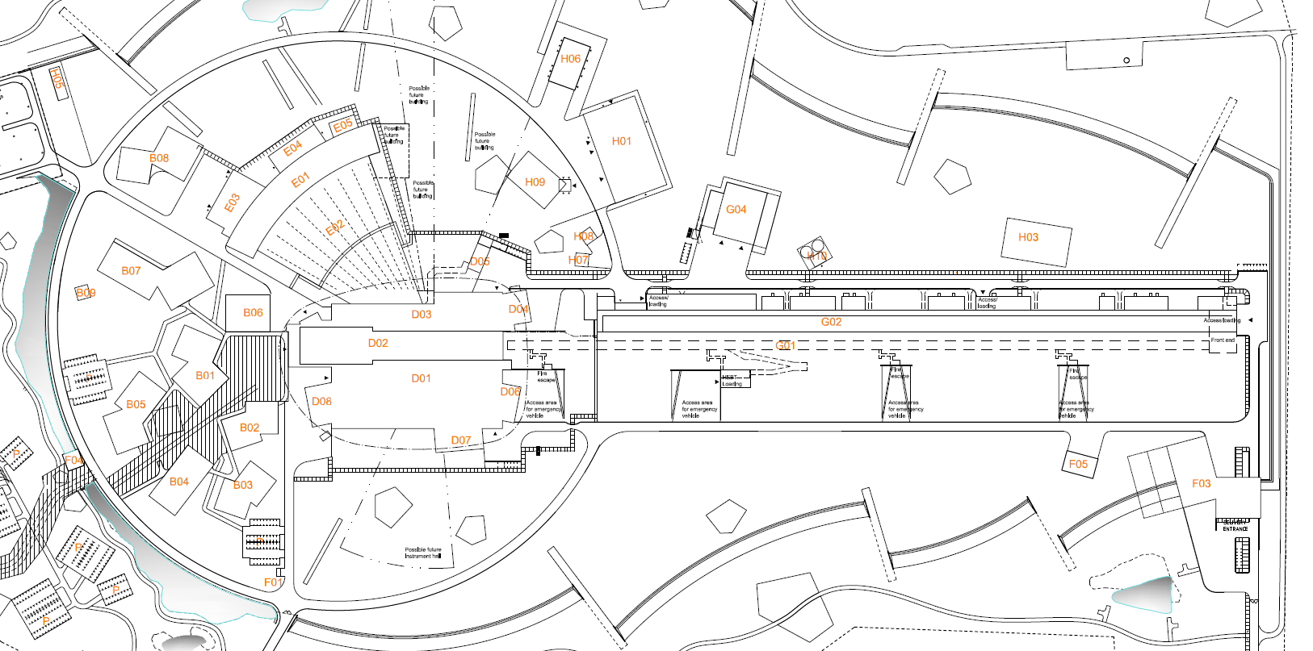
Pilot TSS: architecture – ESS layout
150 m
600 m
Target building
Two TSS rooms
Control equipment
Process measurements
Front end building
Beam shut off equipment

Slide 10
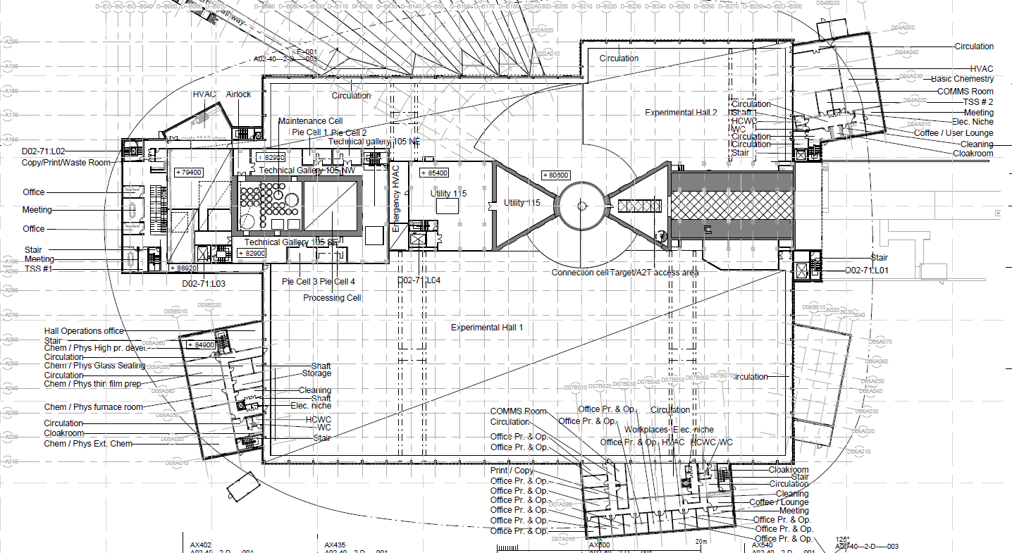
Pilot TSS: architecture – Target building
TSS room 1
Control equipment
CPU
Utility room
Process measurements
Distributed I/O
TSS room 2
Control equipment
CPU

Slide 11
Pilot TSS: architecture – system layout
Utility room
TSS room 1
Front end building
x3
DI
PLC
DO
x3
x3
PSZ
SSZ
Ion source
2oo3
2oo3
2oo3
2oo3
2oo3
x3
1oo5
TSZ
x3
TSS room 2
400 V
DI
PLC
DO
2oo3
2oo3
2oo3
2oo3
2oo3
1oo5

Slide 12
ESS safety function classification - Public
Severity (mSv) Probability | 0.01-0.1 | 0.1-1 | 1-20 | 20-100 | >100
H1 Normal
H2 Expected frequency ≥ 10⁻² |  | C3 | C2 | C1 | C1
H3 Unexpected 10⁻⁴ ≥ frequency < 10⁻² |  |  | C2 | C1 | C1
H4 Unlikely 10⁻⁶ ≥ frequency < 10⁻⁴ |  |  |  | C1 | C1
H5 Very unlikely frequency < 10⁻⁶ |  |  |  |  | C1
Classification | Severity | Meaning
C3 | Low | Verification + qualification
C2 | Medium | C3 + independant, physically separated redundant trains
C1 | High | C2 + diversity
Unacceptable
Risk reduction recommended
Tolerable

Slide 13
Next in design development
Bending magnet control/measurement
Meet requirement for Operations from Accelerator to allow ion source warm-up and/or beam in accelerator while Target Station not ready for beam
Safety assessment
Evaluate Pilot TSS design coverage of requirements
Start electrical design
New electrical engineer working on Target started this month
TSS in main control room
Determine details of signals to EPICS and to Machine Protection relevant system
Determine requirements for TSS hardware in MCR
Pilot TSS PDR in December

Slide 14
End
Thank you

Slide 15
Pilot TSS events
Events related to
Target wheel cooling
Target wheel rotation
Examples from qualitative hazard analysis
4
1 and 3

Slide 16
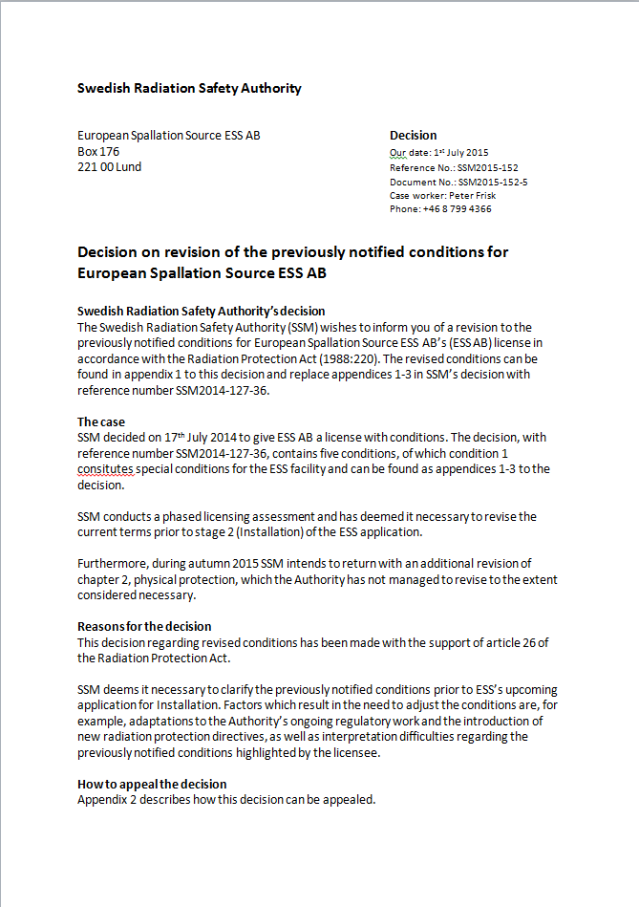
Stakeholders
SSM
Radiological consequences
Safety classes
Event classes
Design principles
ESS
Safe, reliable, high availability

Slide 17
Pilot TSS: logical blocks – one train
Read
Evaluate
Act
System
P
C
P
CCF
DI
CPU
DO
CCF
Subsystem
C
P
Diagnostic
Diagn
v
v
CCF
v
Diagnostic
T
T
CCF
T
Diagnostic
r
r
CCF
r
Diagnostic
P
P
CCF
P
Diagnostic

