Slide 1
Target/Instrument Interface tTAC-12
Rikard Linander
WP Manager – 12.4 Monolith Systems
www.europeanspallationsource.se
14 October 2015

Slide 2
Outline
Definition of agreed interface responsibilities
Agreed beam extraction parameters
Proposed approach for beam insert alignment and positioning
Beam insert installation and removal concept
Interface between monolith, shutter, and bunker atmospheres
Monolith shielding adequacy

Slide 3
Section cut of the monolith and instrument bunker area

Slide 4
Project Responsibilities
CF
NSS
Neutron optics inside
inserts and light shutters
Bunker roof support columns
TD
CF

Slide 5
Interface drawing MR/NSS

Slide 6
Interface drawing MR/NSS
Horizontal focal point coordinates

Slide 7
Interface drawing MR/NSS
Vertical focal point coordinates

Slide 8
Neutron beam port positions
Nominal beam port position defined by
Focal point coordinates
Angular position

Slide 9
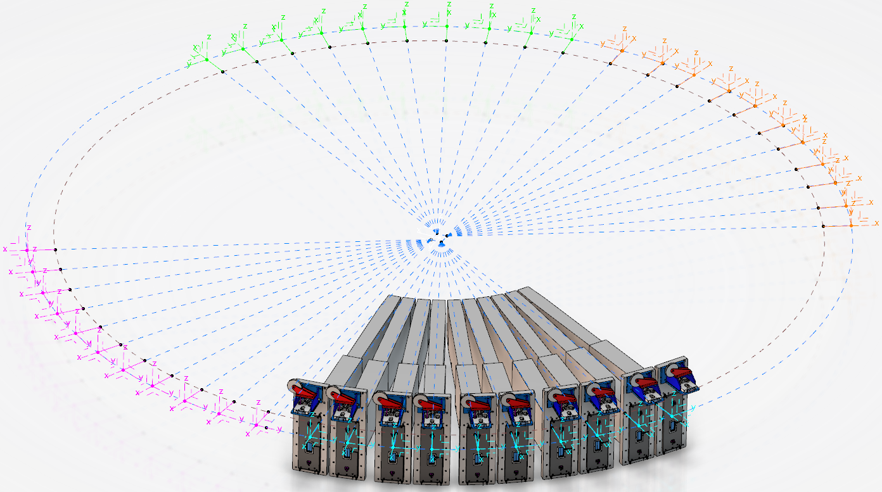
Reference coordinate systems
Catia 3D assembly setup
Issue: We need to be able to easily position and move components in relation to TCS and moderator focal points.
Solution: Master modelling technique. We create a 3D sketch with all important dimensions and place CSYS at point where we want to attach the components. This 3D sketch is then placed first in assemblies where needed.

Slide 10
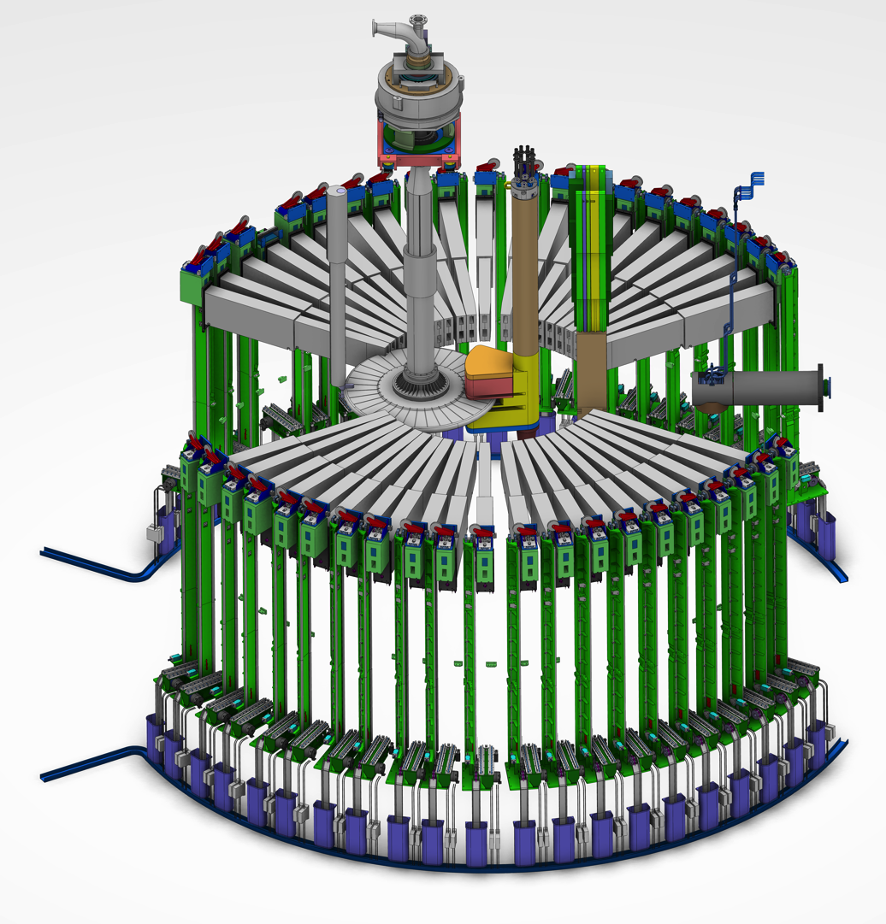
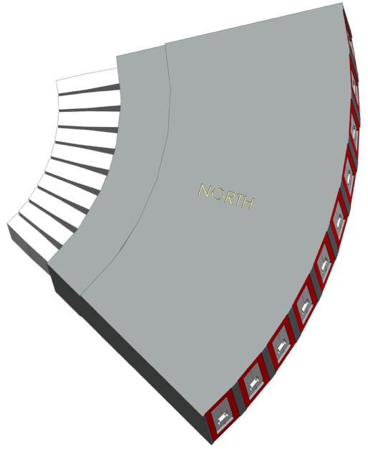
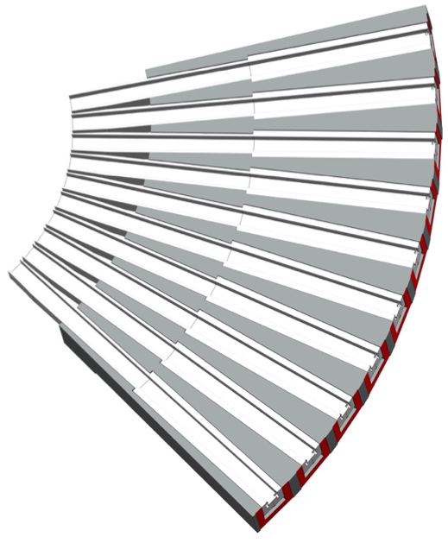
Neutron beam port blocks
The geometry of the 42 neutron beam ports are defined by four port blocks
Outer surfaces (red) are envisaged as the reference plane for each individual beam line
The port blocks are part of the monolith atmosphere boundary
Port block
Port block (sectioned)

Slide 11
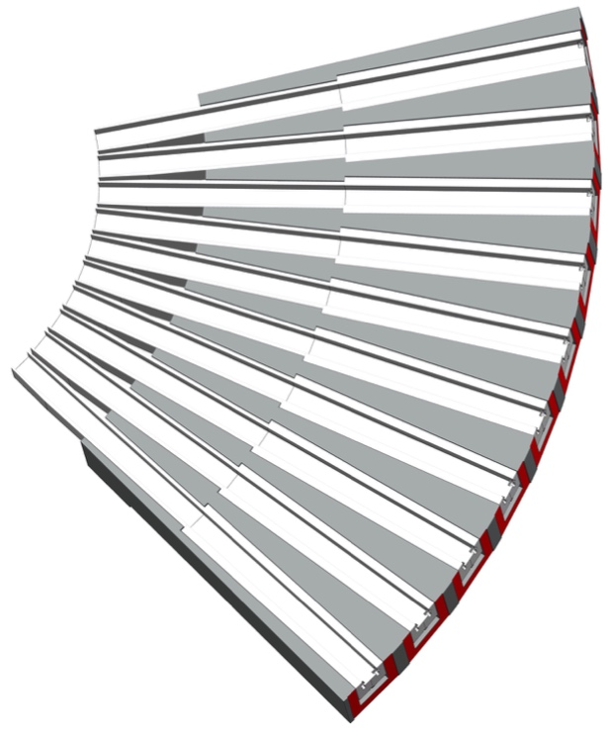
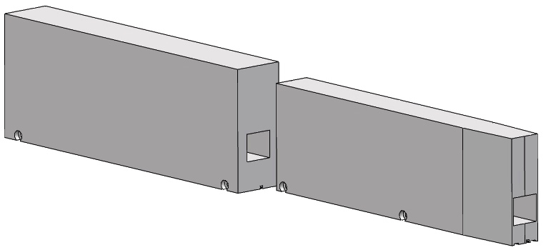
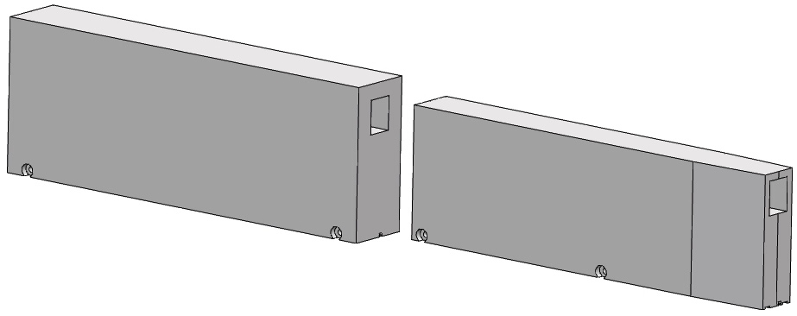
Neutron beam port inserts
Double decker inserts
  Shield plug inserts will be used for not yet commissioned beam ports
  Active inserts can be equipped with neutron optics for viewing either of the upper or the lower moderators (or both)
  On-going assessment of the alternatives to use one-piece or two-piece inserts
    Weight constraints due to monolith crane capacity (20 tons)
    Space restrictions depending on final instrument bunker design
    Disposal and waste considerations
  Inner half 660 mm high, 200 mm wide with tapered front tip
  Outer half 740 mm high, 270 mm wide
  Total length 3.5 m
  Maximum total mass ca. 4.5 tons
Port block (sectioned)
Inserts inside
port block

Slide 12
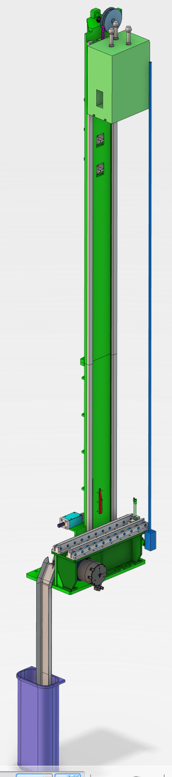
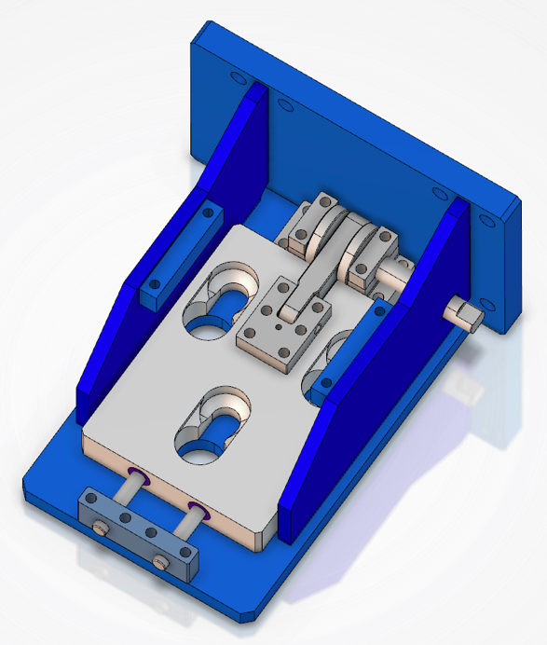
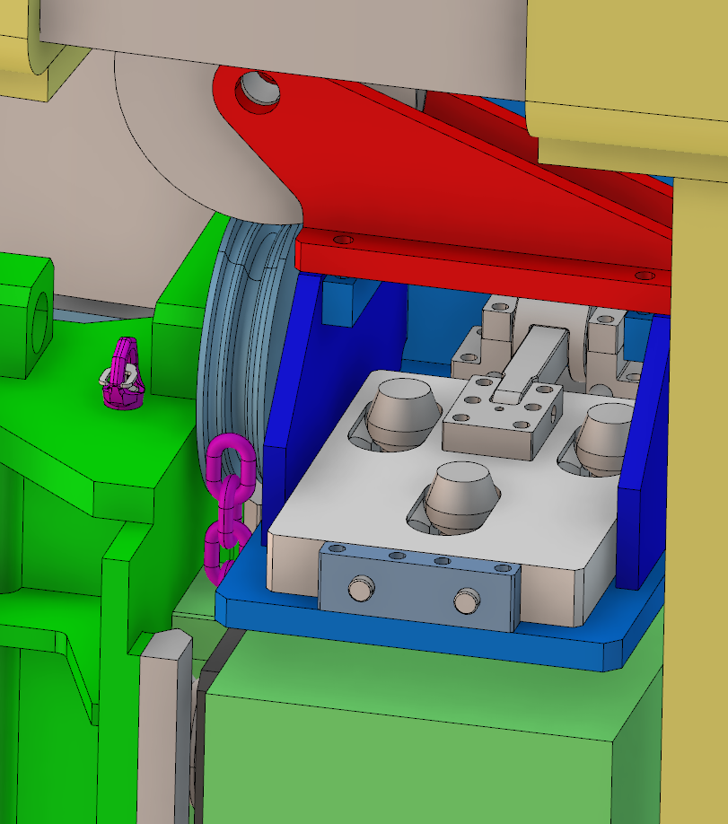
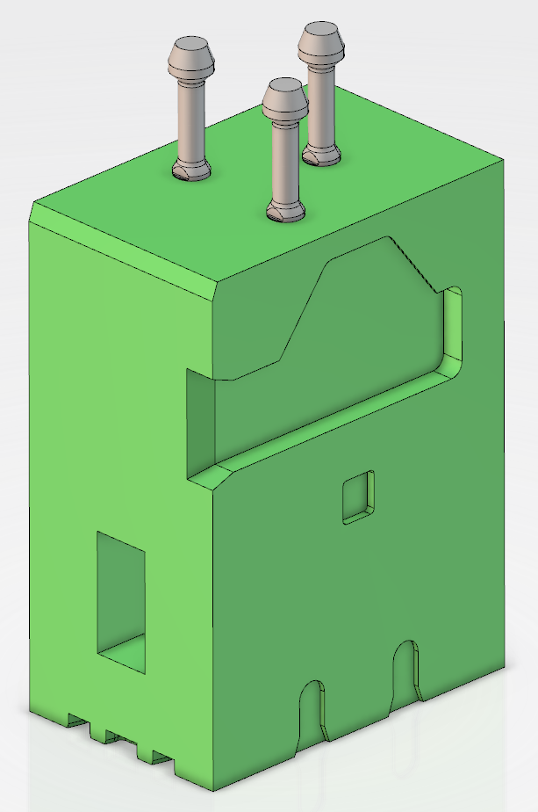
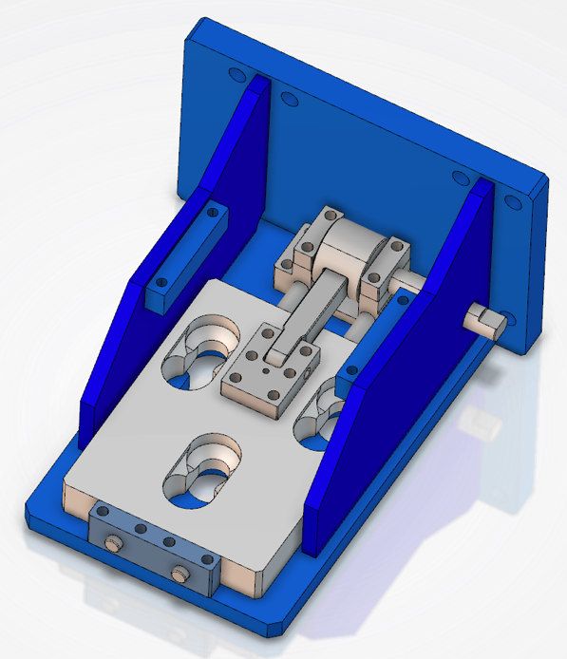
Light shutter technical solution
In open position the top bracket lock plate allows the light shutter studs to penetrate the three holes from below.
In closed position the shutter stud cones will rest in the seat pockets thus creating a tripod hanging support for the shutter.
The 3 seat pocket can be machined to compensate for inaccuracy in bracket placement in relation to nominal neutron beam.

Slide 13
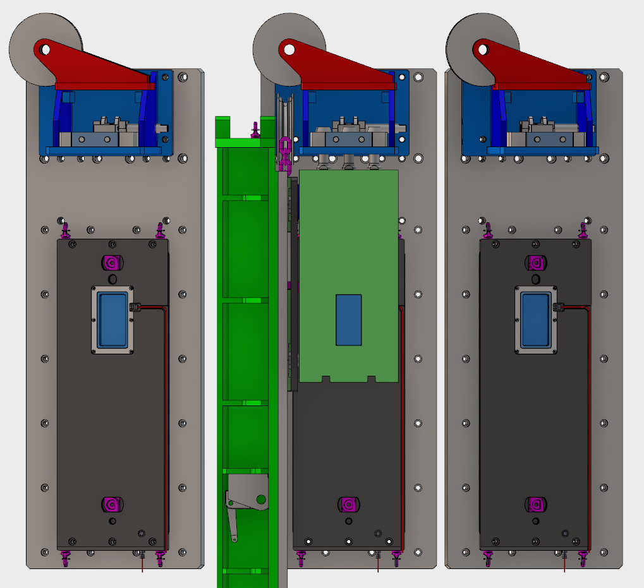
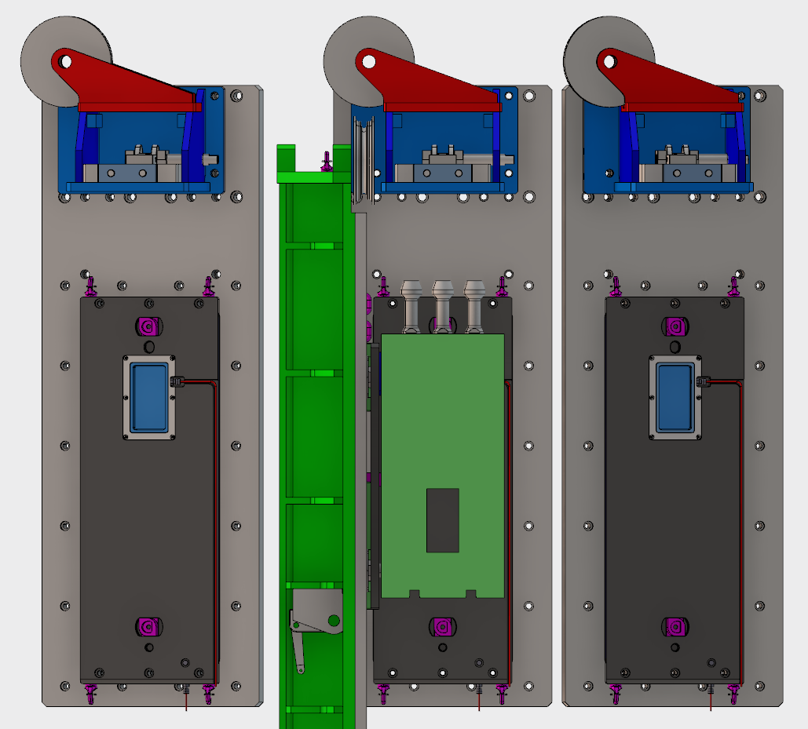
Light shutters
Operation locations
On top the light shutter can be located in the open or closed position.
In the open position it hangs in the 3 studs.
In the closed position it rests on the lower lock.

Slide 14
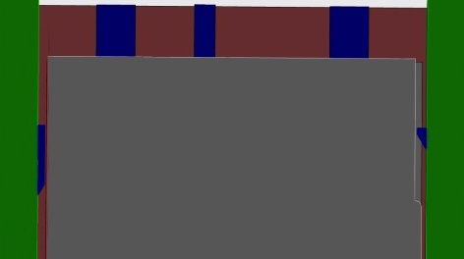
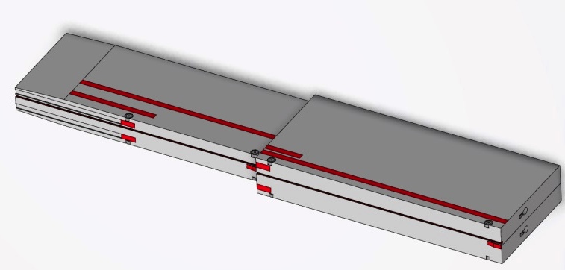
Proposed positioning and alignment concept for neutron beam port inserts
The current proposal is to use a robust 3-2-1 positioning and alignment system
With reference to the local coordinate system of each beam port:
  Three horizontal resting plates (Z-direction)
  Two lateral guide plates (Y-direction)
  One axial stop (X-direction)
Alignment precision for insert remains
to be decided and agreed with NSS
  E.g. anchoring and alignment of guides inside insert
Process for re-aligning activated guides within inserts
or inserts within monolith remains to be addressed
Y
X
Z
Z
Z
Z
Z
Z

Slide 15
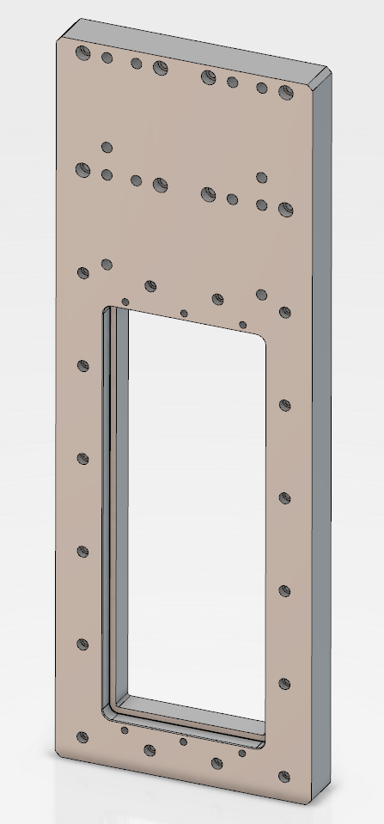
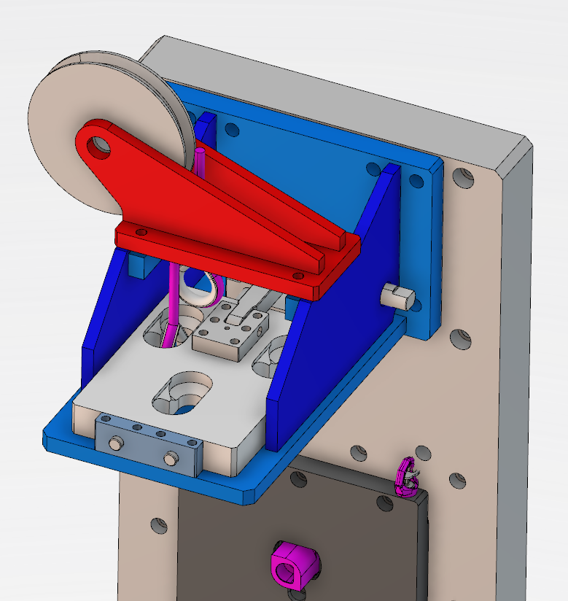
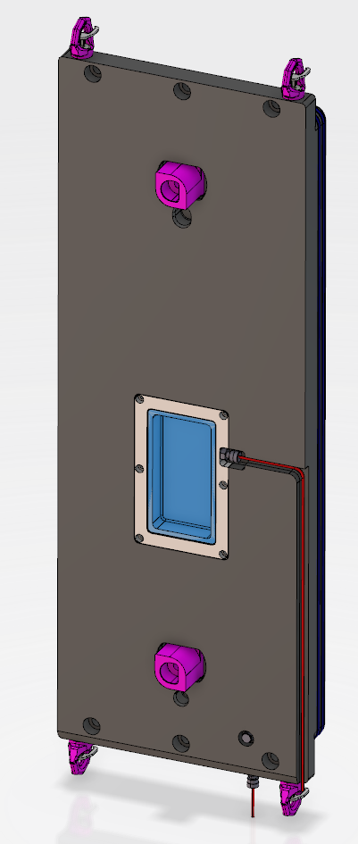
Neutron beam port reference surface
The outer surface of the neutron beam port blocks will be the reference plane defining the nominal neutron beam port position and direction
  The interior of the neutron beam port will be precisely measured relative the reference plane after installation of all monolith structures
  Positioning plates will be custom made for each individual insert
  for achieving desired alignment precision of the insert to the
  reference plate
  Light shutter attachment bracket fastened on the reference plane
  surface for sufficiently precise alignment of the shutter, i.e. its internal
  guide section, in its open position
  Also the continued installation,
  positioning and alignment of
  the beam line should refer
  to the reference surface

Slide 16
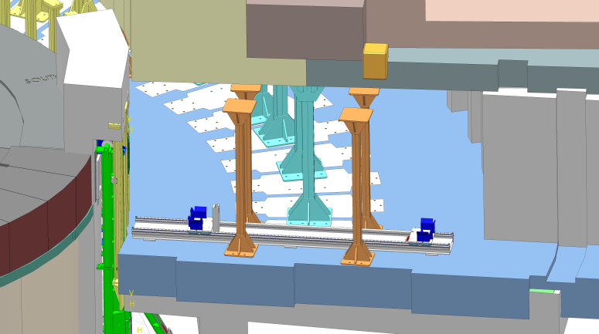
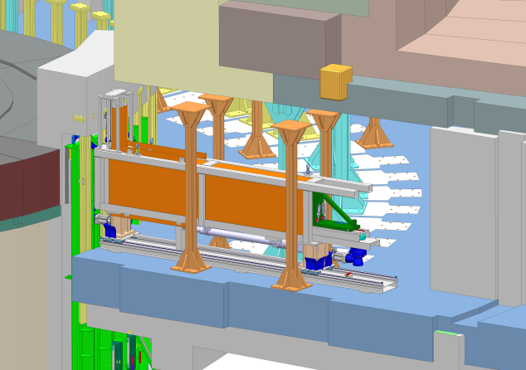
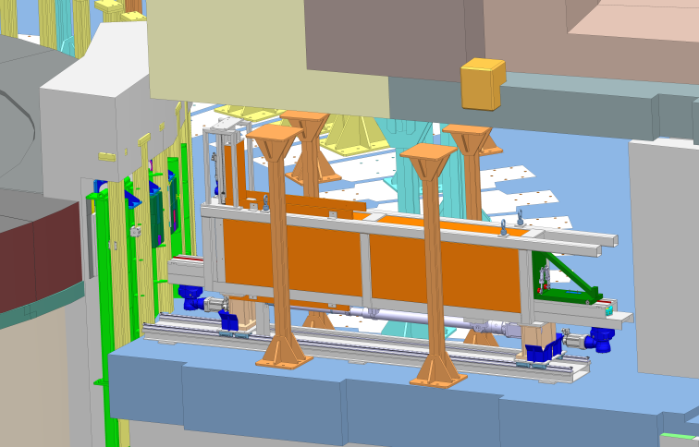
Conceptual insert exchange sequence
Preparing instrument bunker for monolith insert exchange
Positioning handling tool wagon on floor plates
Placing insert exchange tool onto wagon
Moving insert exchange tool towards towards monolith and docking it to the port

Slide 17
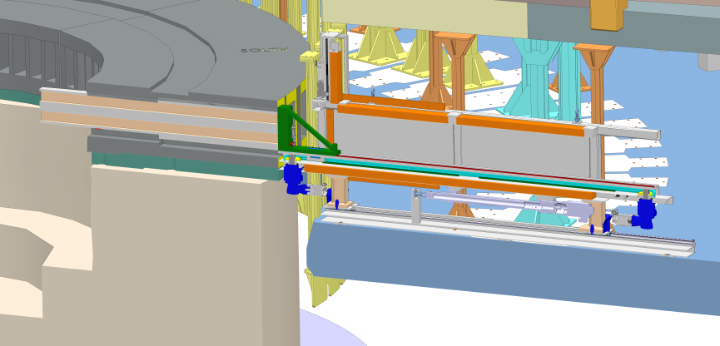
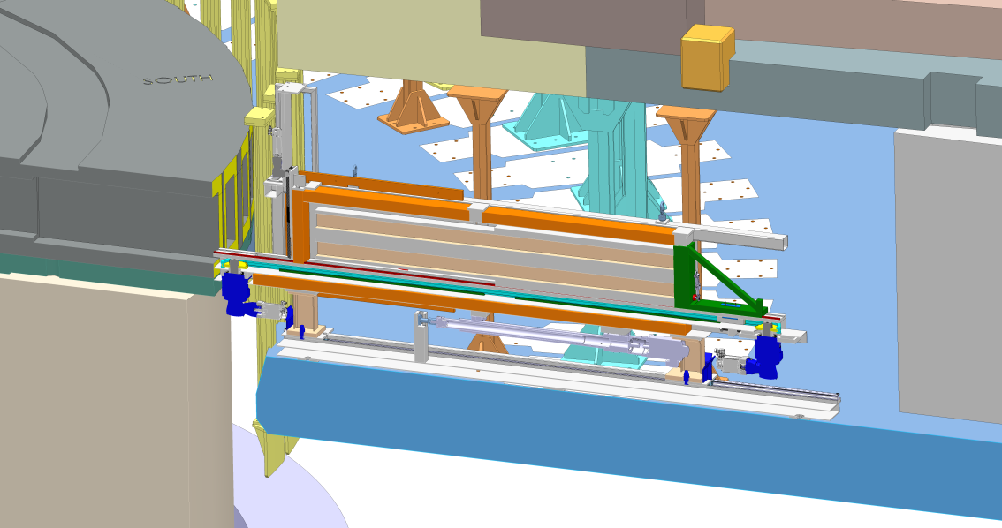
Conceptual insert exchange sequence
Connecting carrier to the insert
Pulling insert by chain drive onto tool
Closing front end lead cover for complete shielding
Releasing and lifting of the exchange tool including extracted insert
Reversing the extraction sequence for installation of new insert

Slide 18
Radioactivity level of a light shutter
Main function of the light shutter is to shield the gamma radiation from the monolith internals during maintenance in the bunker
Potential requirements (previously discussed) to close a light shutter during neutron production
  There is no identified need from any target station system to close a light shutter during neutron production modes
  Analysis and measurement of background
  Cool down of neutron optics equipment located downstream
The radioactive inventory and radiation dose level will depend on how it is used during neutron production
  Open position; activation mainly through neutron transport losses in and surrounding its guide section
  Closed position; irradiation and activation of the radiation shield material, assumed to be tungsten

Slide 19
Shutter activation and dose estimates
Shutter in open position
  Assumption of five years of irradiation and one day of decay time
  Estimated contact dose is in the order of 1 mSv/h, upstream face as well as downstream face
Shutter in closed position
  Assumption of 30 days of irradiation and seven days of decay time
  Activation of a tungsten blocker material
    ~0.57 GBq W-181 (very soft gammas, T1/2 = 121.2 days)
    ~15 GBq W-185 (soft gammas, T1/2 = 75.1 days)
    ~11 GBq W-187 (~33% 0.6 MeV gammas, ~27% 0.5 MeV gammas, T1/2 = 23.9h)
  Estimated contact dose is in the order of 1 Sv/h upstream face, and on the order of 1 mSv/h downstream face

Slide 20
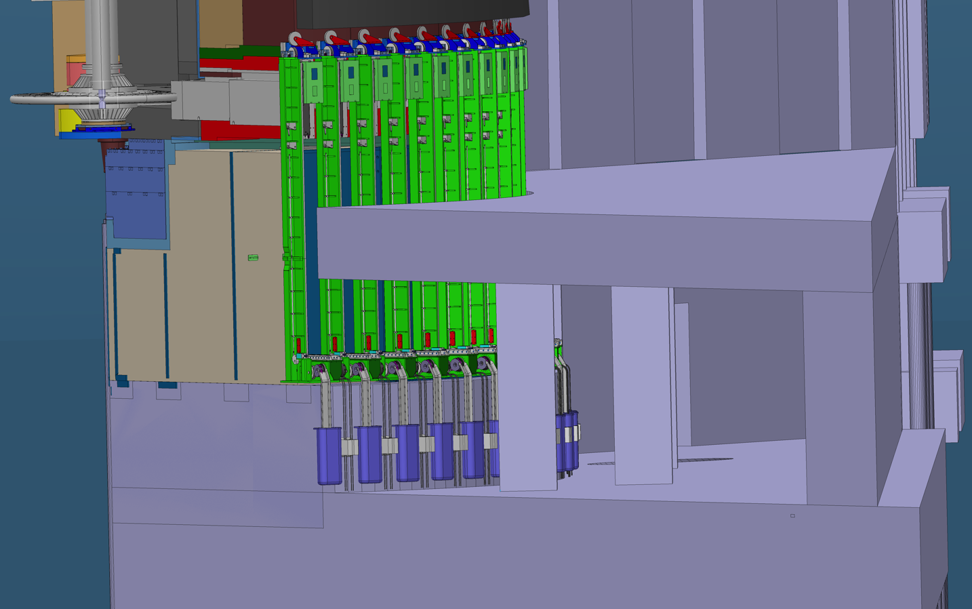
Light shutter access from target station basement

Slide 21
Separation of different atmospheres and gas volumes
TS
HVAC
Monolith Atmosphere
Instrument
Bunker Air
Handling
TS
HVAC

Slide 22
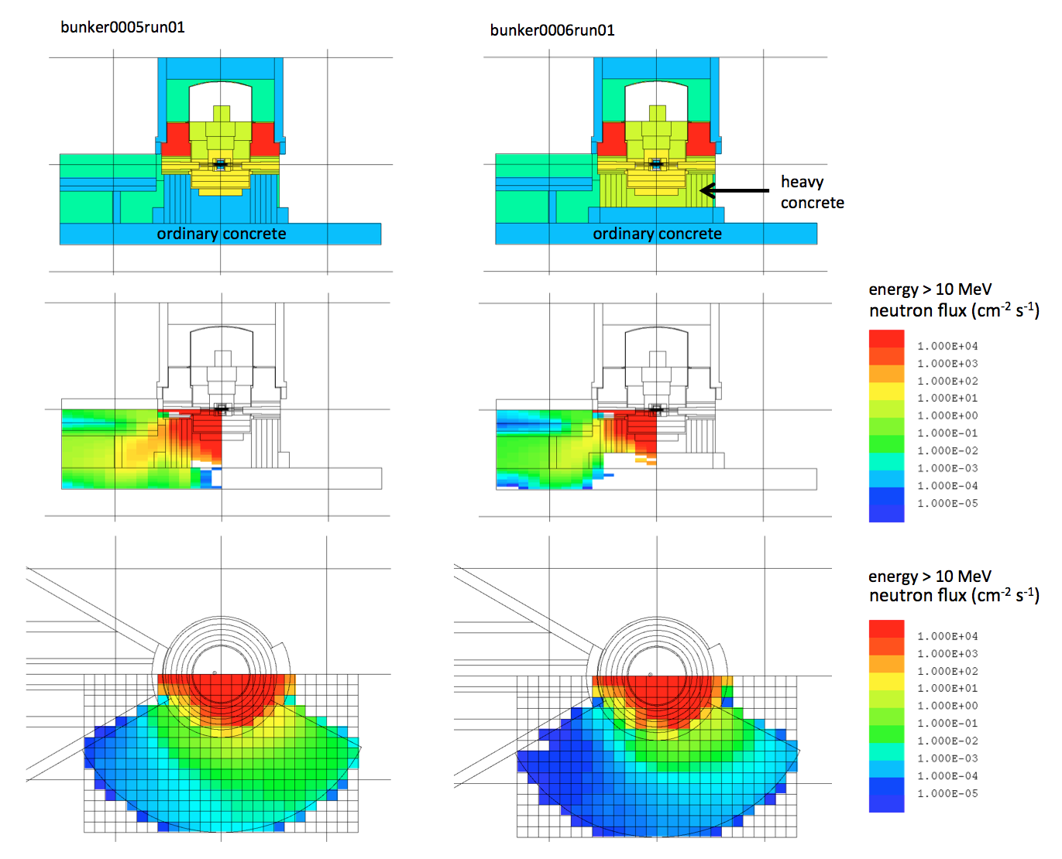
Shielding adequacy – instrument background
Transport of neutrons > 10 MeV through the lower part of the monolith shows that contribution from the ground-shine is negligible in comparison to the contribution from the direct neutron beams
  Ground-shine flux is
  in the range of 10⁻⁴ to 10¹ n/(cm²s)
  Flux via direct neutron beams
  greater than 10⁸ n/(cm²s)

Slide 23
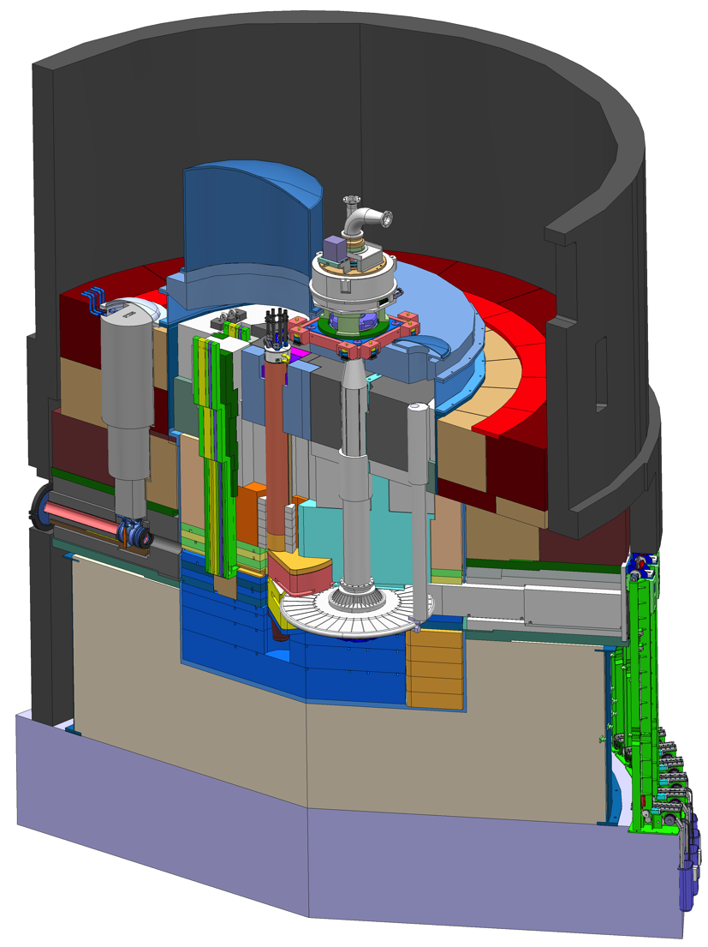
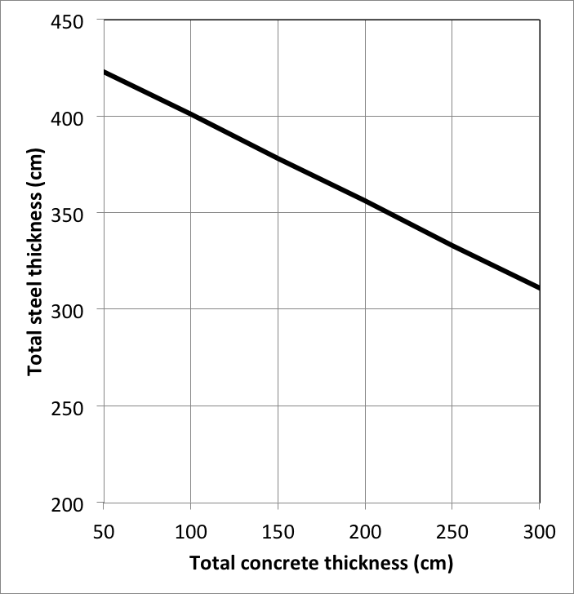
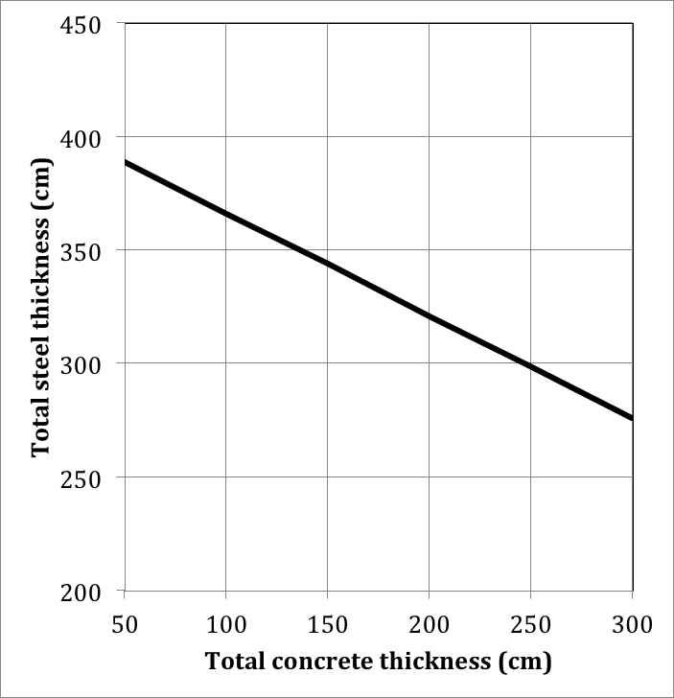
Monolith provides adequate bulk shielding to satisfy personnel protection design requirements
Adequate
shielding
Adequate
shielding
Supervised zone (<3 μSv/h)
Unrestricted controlled zone (<25 μSv/h)
Total steel thickness as function of the total concrete thickness, to ensure that the areas adjacent the lower part of the monolith could be classified to different zones during operation (in respect to the prompt dose).
Position in experimental hall above bunker roof and close to monolith shield wall
Position in target basement room beneath the bunker floor

Slide 24
Concluding remarks
The interface between Target and Neutron Scattering Systems is intricate
Also Conventional Facilities is a very important stakeholder
Important aspects
  Coordination of and access for installation and maintenance
  A holistic view of shielding performance is essential
  Component activation depends on both functional requirements and design solutions
    For example, specifications on usage of light shutters
    Monolith design
    Instrument bunker design
  Separation of atmospheres
  Alignment of beam guide components and structures, outside as well as inside the monolith
The solution is to keep up the continuous dialogue, close cooperation and mutual involvement

