Slide 1
Progress on
Selected Accident Analyses
Per Nilsson, CFD Specialist
and
Jan Espen Presteng, Safety Engineer
www.europeanspallationsource.se
October, 2015

Slide 2
Outline
Background
Hazard analyses
First 5 scenarios
Plans

Slide 3
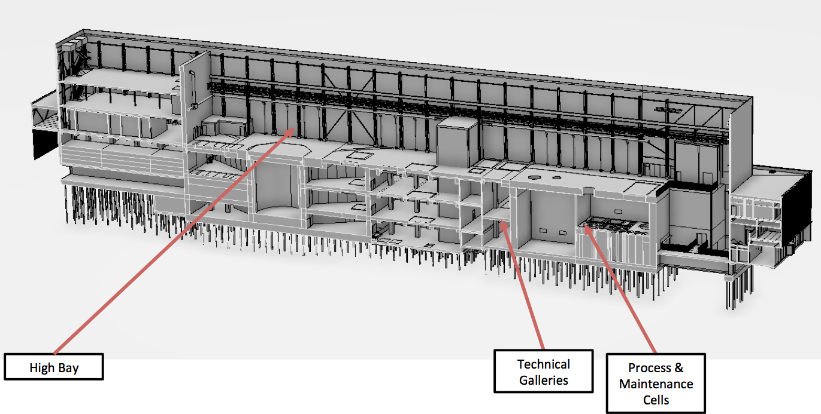
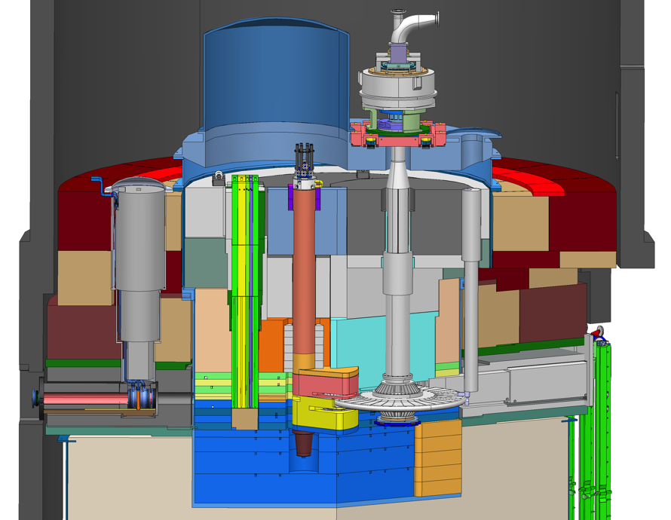
Background
SSM;
Nuclear Authority
Design Facility
Hazard Analysis
Scenario Analyses
Safety Functions
Classification
Systems
Buildings
Operation
Events
(Severity
& Probability)
PIEs and Top
Enveloping
Unmitigated
Mitigated
Disciplines:
- Mechanical
- Ventilation
- Electrical
…
Physical evolution
Release Factors
Leaks, diffusion
Internal spread
External spread
Severity Probability | 0.01 -0.1 | 0.1 -1 | 1 -20 | 20 -100 | >100 mSv
H1 Normal
H2 Expected
H3 Unexpected
H4 Unlikely
H5 Very unlikely
Radiological impact
Inventory
Dose Factors

Slide 4
Selected events
Enveloping events (to cover all events in hazard analysis)
Unmitigated
The first set shall include diversity of locations and types
Results:
Dose to workers and reference person
Feedback to system design
- Classification
- Target Safety System TSS
- Redesign

Slide 5
Selected events
Target Wheel stop during beam on target
Beam Event: Focused and non-rastered beam on target
Loss of Target wheel cooling during beam on Target
Leakage from Target Cooling circuit into monolith, depressurisation of PCool
Clogged W channels, local overheating
Loss of He purification function
Water leakage from Intermediate Water System into Target He
Loss of confinement in Target He system – release into Utility rooms
LH2 leakage with explosion/LH2 leakage with local fire
Water leakage in monolith (highest contamination level)
Water leakage into connection cell and utility rooms
NBG/Chopper - missile effect on monolith system
Beam dump – high power beam when target in maintenance mode
Earthquake scenario Target/monolith
Active Cells: Operator inside maint. cell when sliding door unintentionally opens
Active Cells: Operator inside confinement (process cell) next to worst case inventory
Active Cells: Operator inside confinement (maintenance cell) next to worst case inventory
Active Cells: Loss of dynamic confinement (loss of HVAC)
Active Cells: Loss of confinement process/maintenance – open doors
Active Cells: Fire in Maintenance or Process cell
Active Cells: Earthquake scenario

Slide 6
18. Ventilation HA
Event
Extraction fan stops
Postulated Initiating Events
External event: electricity supply interruption
External event: earthquake
External event: fire in the fan room or fire in the ducts
Component Failure
Wrong working procedure (collision on the component or wrong installation of the component )
Environment parameters exceed (T, humidity) machine specifications
Process automation failure
P (per year)
6,37E-02
1,00E-06
2,79E-02
1,00E-02
1,00E-04
1,00E-02
Top Events | Unmitigated Consequences
Loss of dynamic confinement Decreased air flow | L: contamination leaks to High Bay and Technical galleries L: leaks in Technical Galleries and Highbay vented outside (reduced filtering)
C to operators | C to Public
>100 mSv Only this considered for HA | < 0.05 mSv
Postulated Initiating Events
 | RR
External event: electricity supply interruption
External event: earthquake
External event: fire in the fan room or fire in the ducts
Component Failure
Wrong working procedure (collision on the component or wrong installation of the component )
Environment parameters exceed (T, humidity) machine specifications
Process automation failure
Severity Public Probability | 0.01-0.1 | 0.1-1 | 1-20 | 20-100 | >100 mSv
H1
H2
H3
H4
H5
6
6

Slide 7
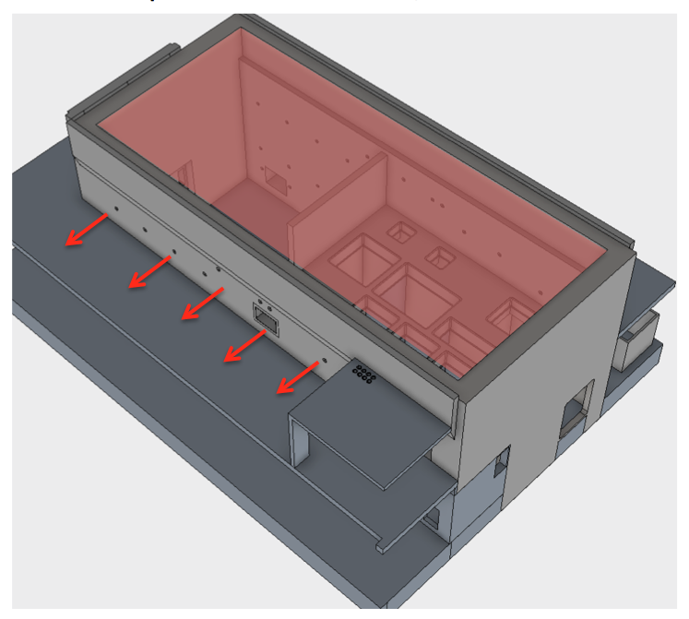
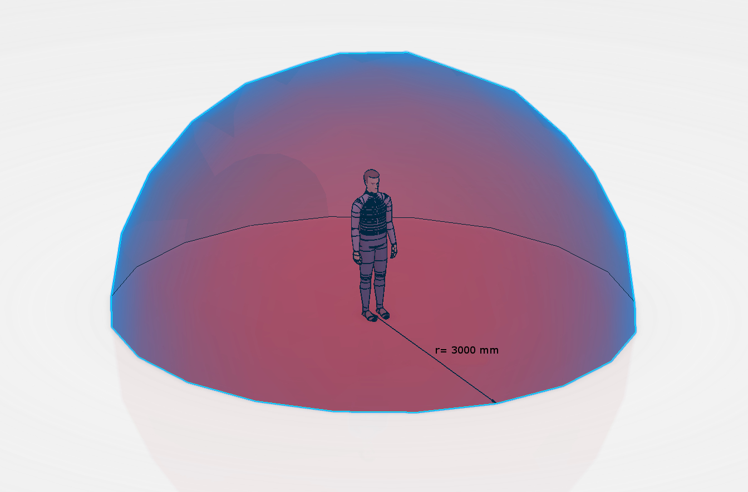
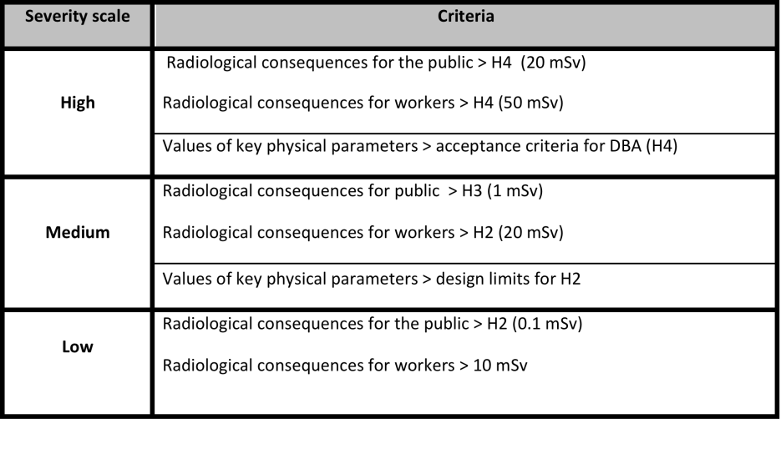
18. Loss of Dynamic Confinement in AC
Physical case investigated based on half sphere, r = 3m
Radiological first estimate to workers in 4h
190 mSv in High Bay
130 mSv in Galleries
Safety Functions:
Severity > 20 mSv
Other mitigations! E.g. PSS
7
7

Slide 8
15. AC Prompt Radiation To Worker
Physical case investigated
Doses (obvious?)
workers: severe
public: no impact
Mitigations, highest class
Control systems
Procedures

Slide 9
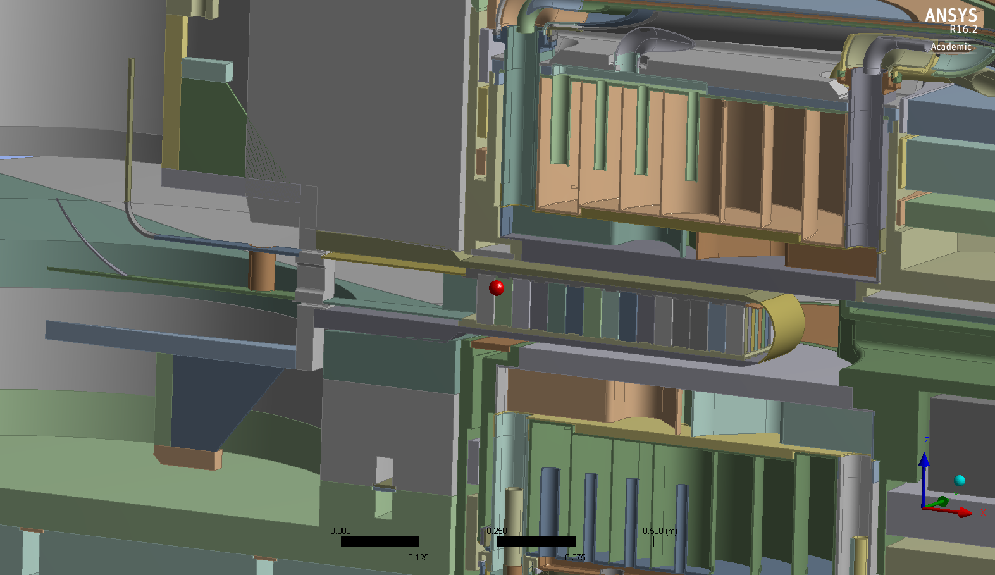

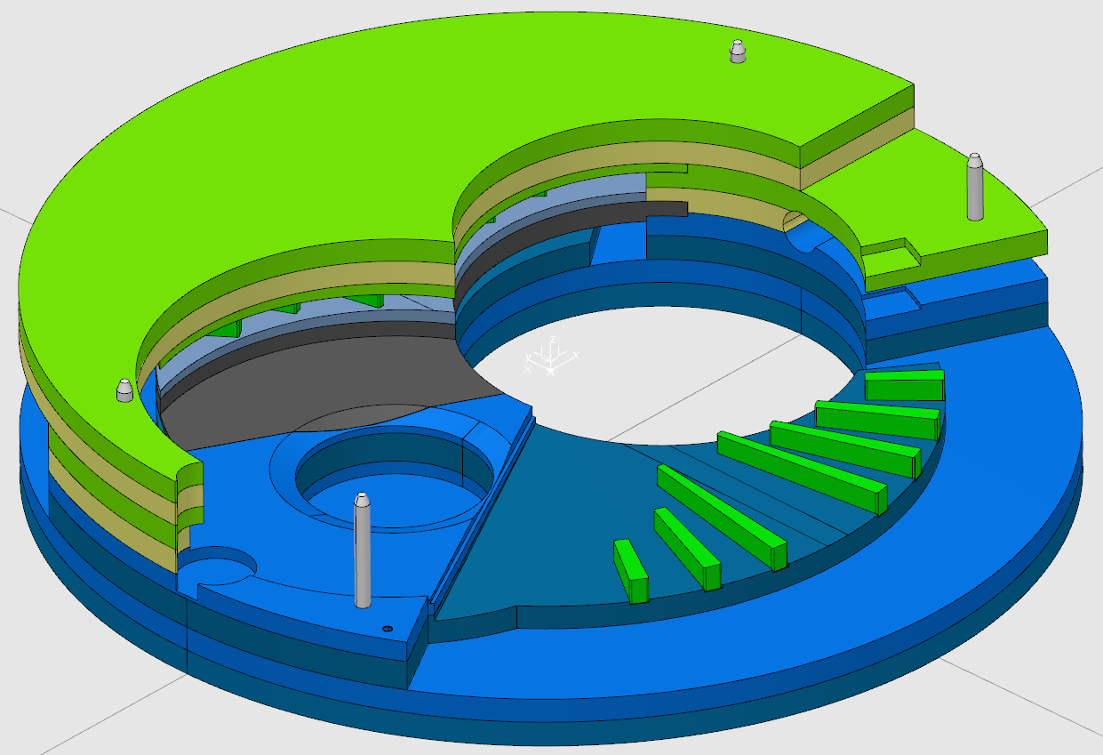
9. Hydrogen combustion, 2 cases
a. Explosive
- External physical case investigated
(severe but not radiological)
- Releases to be calculated
WSP
b. Slow combustion
- Internal physical case being investigated
(first rough estimate 0.5 kg Tungsten oxidised)
- Releases to be calculated

Slide 10
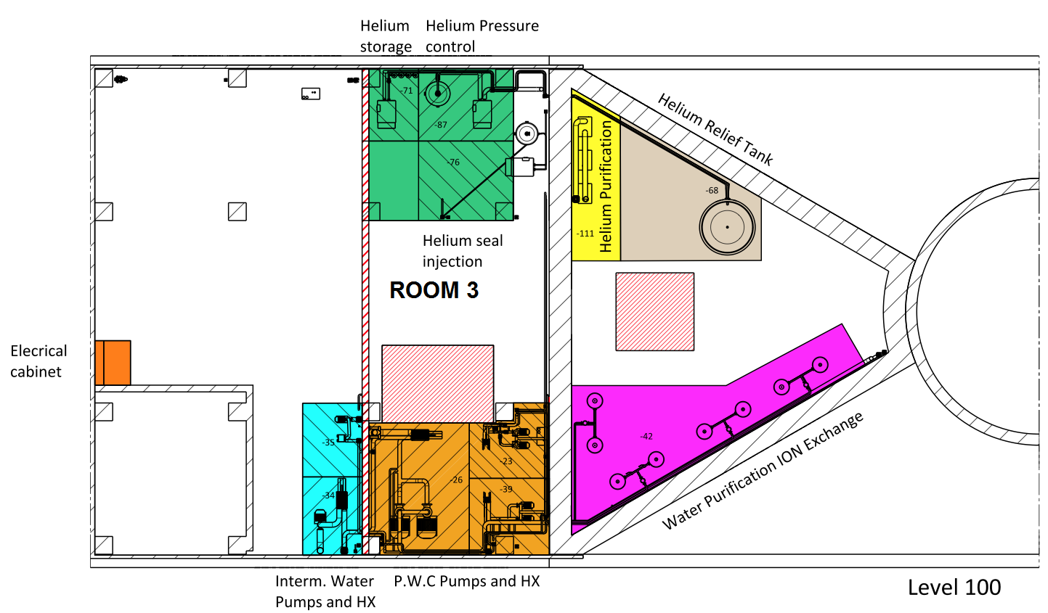
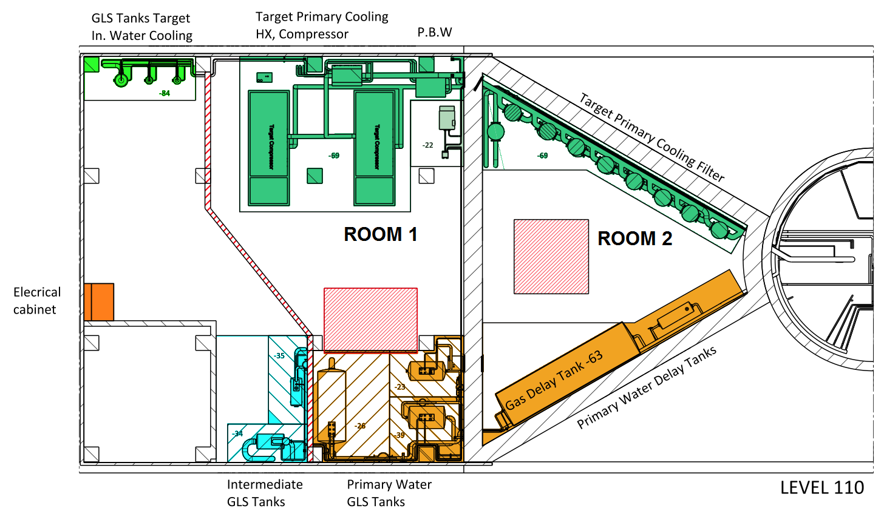
8. Large Leak From Target Helium
Physical case investigated
Filter backflow and wheel effect separate, for now
(ODH immediate problem for workers)
Doses being calculated,
current estimates:
workers: even <100 g/s severe
public: full rupture < low severity

Slide 11
1. Wheel Stop With Beam
Physical case investigated up to event, i.e. mitigated
Result: Maximum 4 pulses ( ~ 0.28 s)
Unmitigated to be analysed
Releases to be calculated

Slide 12
Plans
First 5 accident scenarios by Dec 2015
  Scenario development (evolution, impact), 20th Oct
  Dose rate calculation
  Approval completed, 14th Dec
All scenarios ready by May 2016

