Slide 1
ESS Beam Diagnostics
Andreas Jansson
ACCSYS WP7 Leader
www.europeanspallationsource.se
14 October 2015

Slide 2
Outline
General Scope of WP7
High level overview of PBI task force conclusions/recommendations (details in Steve’s talk)
Current status of in-kind plans and agreement
Current status of design of BI systems
Machine protect functionality
Summary

Slide 3
BI scope
Beam instrumentation group responsible for all proton beam diagnostics in ESS linac up to and including the target
~13 different systems
~40 (major/minor) variants of beam line components
~21 variants of readout systems
~500 device instances in all
Lots of inter-dependencies, and possible synergies.
Always planned to do this in collaboration with other labs.
Later in the process, focus on outright in-kind contributions from member country institutions. This has been a major focus recently.

Slide 4
Beam Diagnostics Section
Name | Role
A. Jansson | Acting section leader (position to be advertised)
R. Baron | Electronics engineer
B. Cheymol | FC, WS & EMU system lead
M. Donna | FPGA Development
T. Grandsaert (DO) | Mechanical Design support
H. Hassanzadegan | BPM & BCM system lead
I. Kittelmann | BLM system lead, Longitudinal profile system lead
H. Kocevar | BI software, EPICs integration
T. Shea | Target diagnostics system lead
C. Thomas | NPM system lead, WP planning support
V. Grishin | CERN BLM project coordinator (project position)
J. Norin | Project Documentation Support (consultant)
C. Roose (oPAC) | Non-invasive profile (oPAC Fellow)

Slide 5
BI device counts
Numbers derived from task force recommendations (with exception for dump line)
 | BLM | BCM | BPM | EMU | Slit | Grid | FC | WS | NPM | Img | Aperture | BSM
LEBT | 0 | 1 | 0 | 1 | 0 | 0 | 1 | 0 | 2 | 0 | 0 | 0
MEBT | 0 | 3 | 11 | 0 | 1 | 1 | 1 | 3 | 2 | 0 | 0 | 1
DTL | 15 | 5 | 17 | 0 | 0 | 0 | 2 | 0 | 0 | 0 | 0 | 0
Spk | 52 | 0 | 14 | 0 | 0 | 0 | 2 | 3 | 1 | 0 | 0 | 1
MB | 36 | 1 | 9 | 0 | 0 | 0 | 1 | 3 | 3 | 0 | 0 | 1
HB | 84 | 1 | 21 | 0 | 0 | 0 | 0 | 1 | 1 | 0 | 0 | 0
UHB | 45 | 2 | 15 | 0 | 0 | 0 | 0 | 3 | 0 | 0 | 0 | 1
DgLg | 23 | 1 | 7 | 0 | 0 | 0 | 0 | 0 | 0 | 0 | 0 | 0
A2T | 15 | 2 | 7 | 0 | 0 | 1 | 0 | 1 | 1 | 2 | 3 | 0
DmpL | 6 | 2 | 3 | 0 | 0 | 0 | 0 | 0 | 0 | 1 | 1 | 0
TOTAL | 276 | 18 | 104 | 1 | 1 | 2 | 7 | 14 | 11 | 3 | 4 | 4
Notes:
Make new layout with one less halo monitor *after MSW)

Slide 6
Task force recommendations
LEBT&MEBT:
  no changes in number of BI devices
DTL:
  additional FC (also moved one FC)
  additional 2 BPMs
  profile device after tank 1 (WS/NPM combo, maintained intertank slot)
LEDP/Spokes:
  2 WS
  FC/dump after WS (TBC),
  uninstrumented BPM pick-ups.
Elliptical, HEBT & Dogleg:
  uninstrumented BPM pick-ups.
A2T&Target:
  2 profile devices (TBC),
  in-monolith BPM
Compared to previous layout
Not so many deltas
Both plus and minus
Notes:
Reasons for uninstrumented pick-ups:
- reduced the number of LWU variants (like both Qf and Qd BPMs for steering, also quad bpm measurements)
- Short baseline for TOF (addressed by upstream/downstream BPMs, also on-line rough energy measurement)
- Quad pick-ups later (also Qf/Qd needed)
- Online spares/Possibility to change layout later

Slide 7
The BI In-kind Challenge
How to do diagnostics as in-kind without ending up with multiple technical solutions to the same problem (e.g. different BPM electronics in different parts of the linac) and still make in-kind packages interesting for partners?

Slide 8
In kind strategy
Development of common readout system in a separate work unit (which could be in-kind, partially or fully)
  May also include production of custom electronics boards (typically analog front end boards).
  Custom boards can also be licensed and commercialized through an industrial partner (DESY/Helmholtz model)
Vertical system (e.g. MEBT BPMs) include the delivery of the readout system, based on a central design (can be in-kind, partially or fully)
  Beam line device mechanical design
  Procurement of commercial components
  Non COTS hardware may be provided by central design in-kind partner (TBC)
  Integration and testing
Bundle vertical systems with same or similar beam line devices (sensor-detector)
Allocate oversight/coordination/integration effort in Lund corresponding to the complexity of the integration task (expected need of support from Lund)
NB. Scheme is similar to that for ESS LLRF
Similar split used for SNS (with all-DOE partners)

Slide 9
In-kind status (approximate)
 | central design |  | LEBT | MEBT | DTL | Spoke | MBE | HBE | HEBT/Dogleg | A2T/Target
BLM (IC) |  | BLD |  |  | ESS (CERN)
 | ESS | DAQ |  |  | ESS (CERN?)
BCM |  | BLD | Catania | Bilbao | Legnaro | Daresbury | Daresbury |  |  | Daresbury
 | ESS/DESY/Poland | DAQ | ESS* | Bilbao* | ESS* | Daresbury* |  | Daresbury* |  | Daresbury*
BPM |  | BLD |  | Bilbao | Legnaro | Daresbury | Daresbury |  | Daresbury | Daresbury
 | ESS (SLAC) | DAQ |  | Bilbao* | ESS* | Daresbury* | Daresbury* |  |  | Daresbury*
FC/Stop |  | BLD | ESS | Bilbao | Bilbao? | TBD | Bilbao
 | Bilbao | DAQ | Bilbao | Bilbao | Bilbao?
EMIT |  | BLD | Saclay | Bilbao
 | Saclay/Bilbao | DAQ | Saclay | Bilbao
WS/Halo |  | BLD |  | Bilbao |  |  |  |  | ESS (CERN)
 | Trieste | DAQ |  | Bilbao/Trieste |  | Trieste | Trieste |  | Trieste | Trieste
IPM |  | BLD |  |  |  | Saclay
 | Saclay | DAQ |  |  |  | Sacay
Lumi/BIF |  | BLD | ESS | Bilbao |  |  |  |  |  | ESS?
 | ESS | DAQ | ESS | Bilbao |  |  |  |  |  | ESS?
BSM |  | BLD |  | Bilbao | Bilbao? |  | ESS? |  | ESS?
 | Bilbao**/ESS | DAQ |  | Bilbao | Bilbao? |  | ESS? |  | ESS?
Imaging |  | BLD |  |  |  |  |  |  |  | Olso/Cockcroft
 | Olso/Cockcroft | DAQ |  |  |  |  |  |  |  | Olso/Cockcroft
SEM |  | BLD
 |  | DAQ
Aperture |  | BLD |  |  |  |  |  |  |  | Oslo
 |  | DAQ |  |  |  |  |  |  |  | Oslo
 |  |  |  | * some components supplied by/from Poland |  |  | ** integration of MEBT/DTL BSM
Actively looking for partner
Detailed discussions ongoing with identified partners

Slide 10
In kind and project documentation
Significant effort spend in the recent past on in-kind discussions and documentation.
This includes providing the technical information, formatting it appropriately, and getting it into the appropriate documentation system (CHESS/DOORS)
System leads responsible for providing tech details, in addition hired short term consultant to help with formatting and documentation system entry/organization (includes giving IK partners access to files, which needs to be done explicitly for each file in CHESS)
  Will also focus on getting draft interface requirements ready for DOORS
Also, some documentation will need to be updated to reflect PBI task force recommendations

Slide 11
BI system overviews

Slide 12
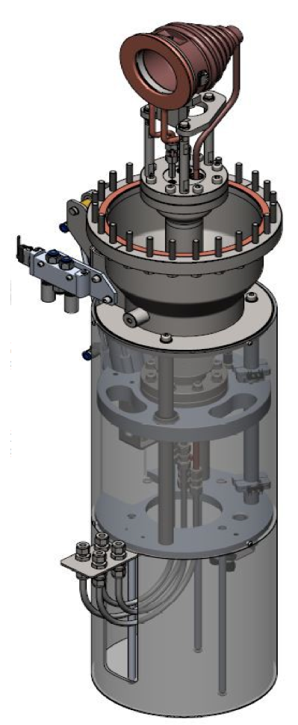
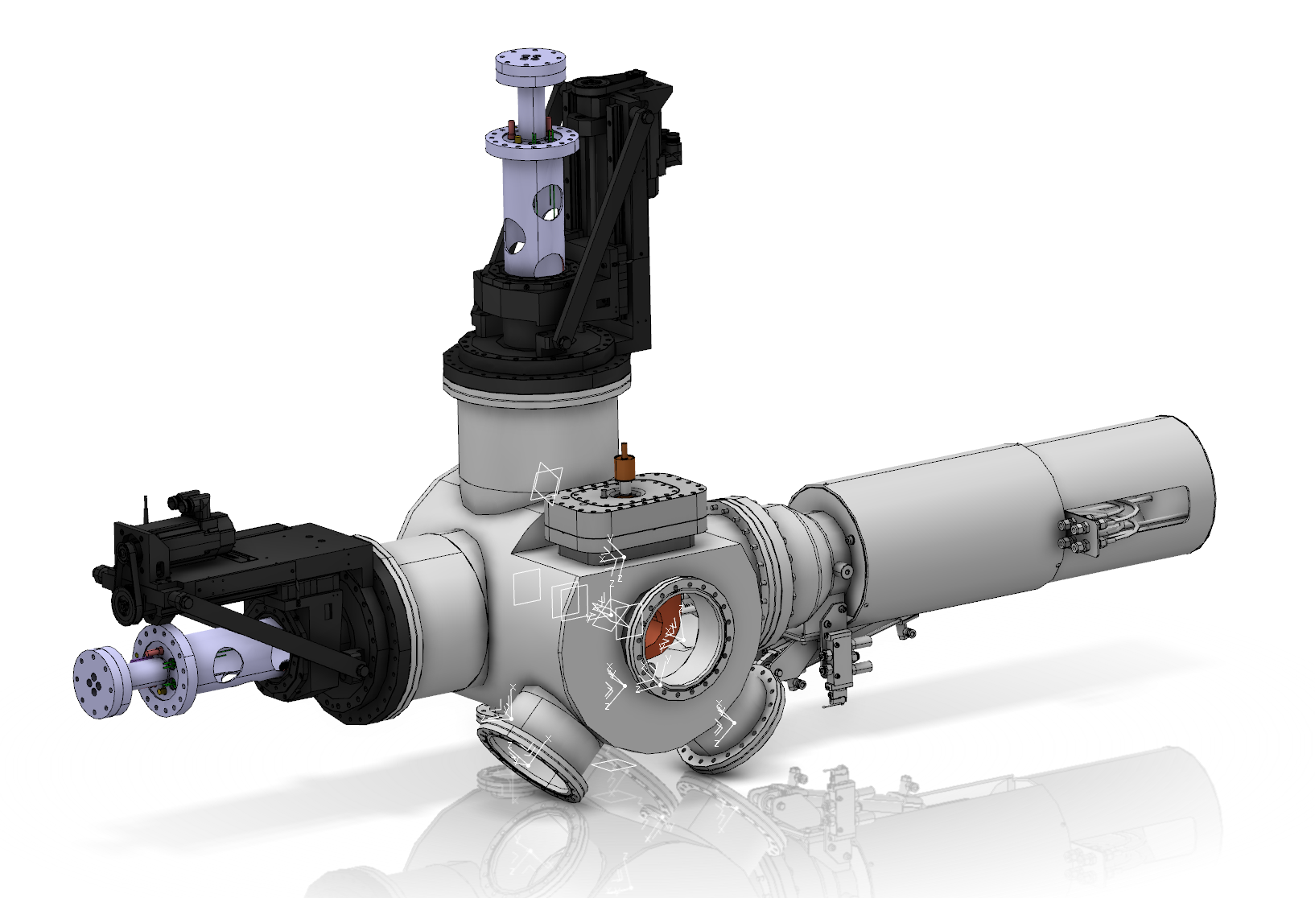
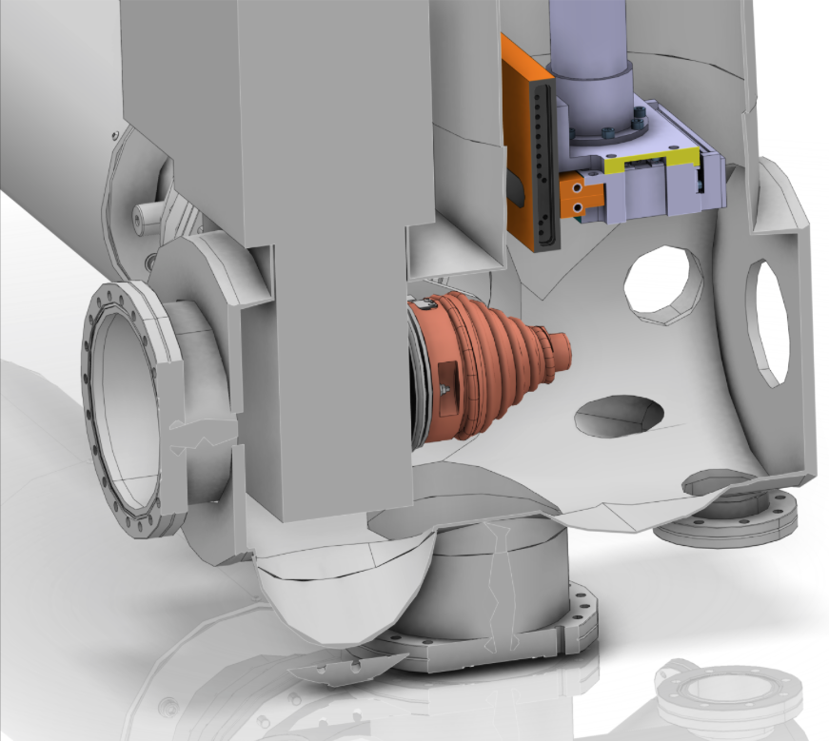
Faraday Cups
https://ess-ics.atlassian.net/wiki/display/BIG/FC+-+Faraday+Cup
LEBT FC Designed for full power (6 ms, 100 mA, 14 Hz)
Procured and delivered to ESS
Emittance meter
Chopper
Inside view
FC
Conceptual design of LEBT chopper/BI chamber
LEBT FC (Pantechnik)
MEBT FC done by Bilbao
DTL FC and Cold linac insertable stop under discussion with Bilbao (one new by PBI TF)
New Spoke stop in task force recommendation
CHESS documents:
ESS LEBT instrumentation: ESS-0015175
MEBT FC specification: ESS-0036676

Slide 13
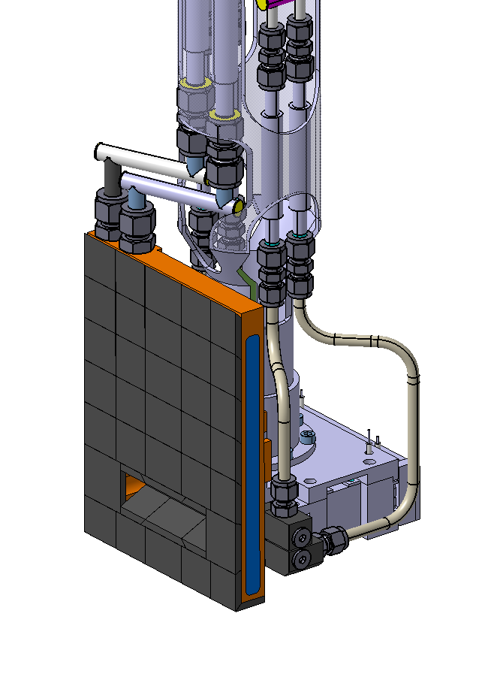
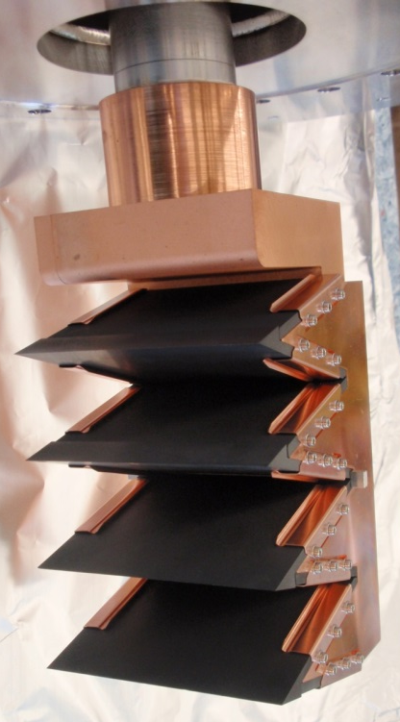
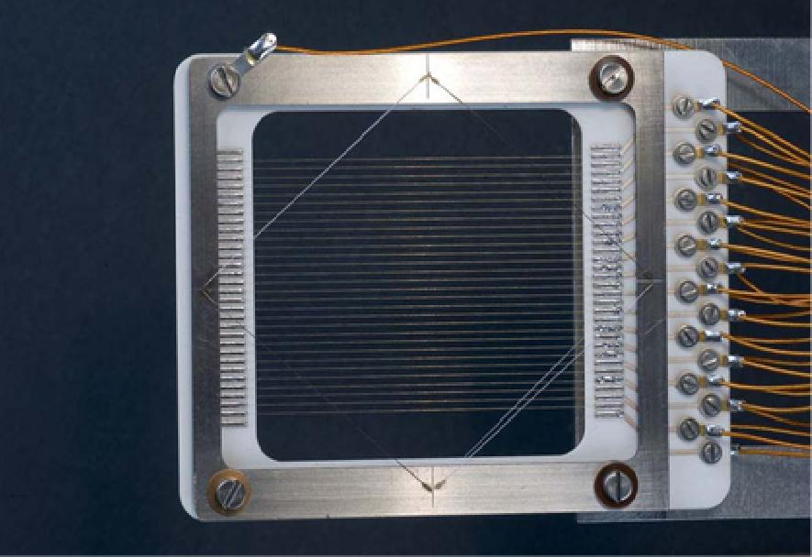
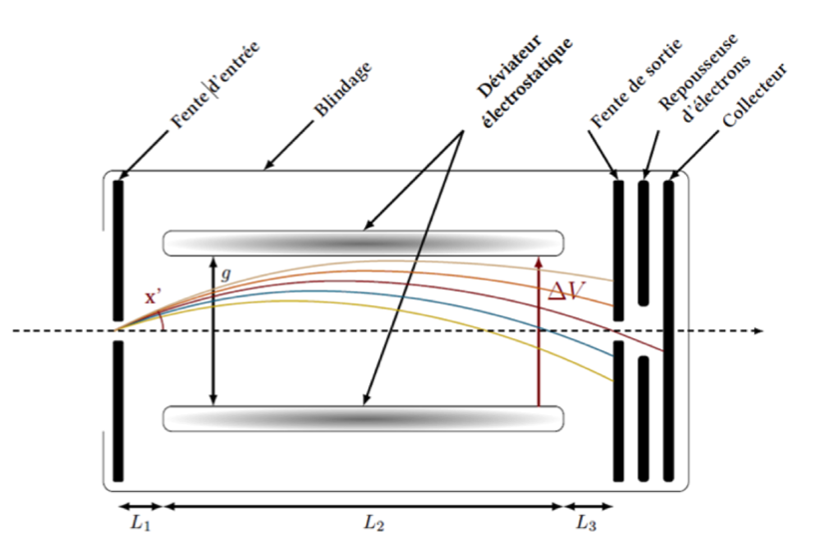
Emittance measurement (LEBT and MEBT)
https://ess-ics.atlassian.net/wiki/display/BIG/EMU+-+Emittance+Measurement+Unit
Related CHESS documents:
MEBT EMU: ESS-0020535
LEBT EMU thermomechanical simulations: ESS-0036400
LEBT EMU specifications: ESS-0028985
LEBT PDR Report: ESS-0041340
Optional use studies:
High power/high duty cycle EMU: ESS-0038060
Potential beam diagnostics for a movable test bench: ESS-0020683
IFMIF like Allison scanner developed at CEA for the ESS LEBT. Full power capable.
LINAC4 emittance meter slit and grid
ESS Slit and grid will be Bilbao in-kind, based on ESS preliminary design
Schematic view of an Allison scanner (CEA/IRFU)

Slide 14
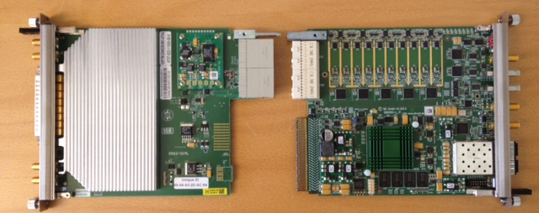
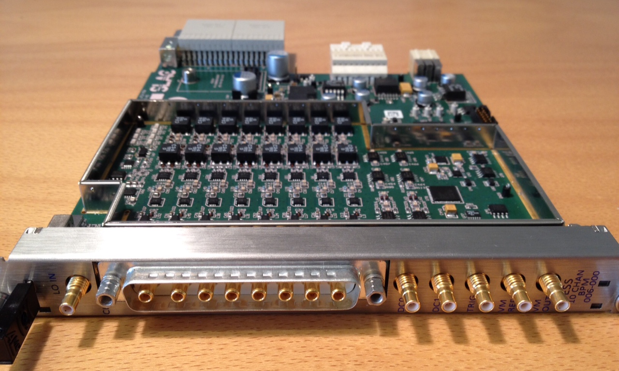
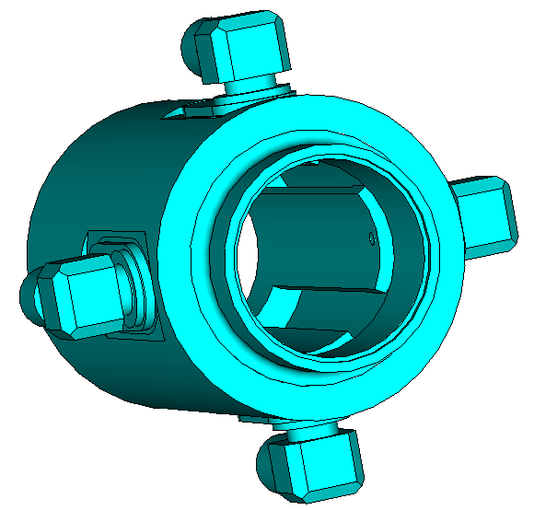
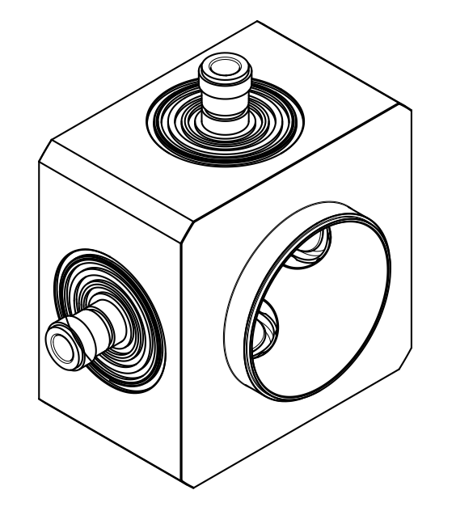
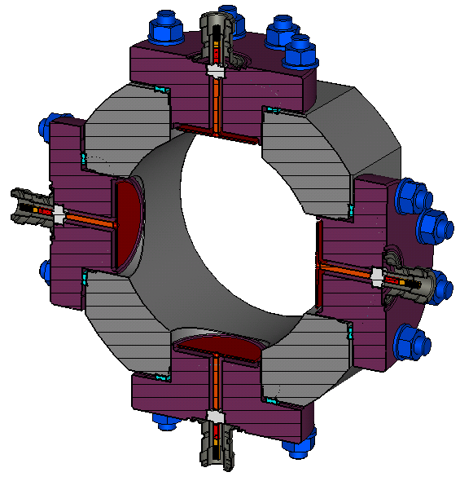
Beam Position Monitor
https://ess-ics.atlassian.net/wiki/display/BIG/BPM+-+Beam+Position+Monitor
Struck ADC and DESY 700MHz downmixer
Prototype SLAC/ESS 352MHz
downmixer RTM (w. VM)
Bilbao MEBT BPM
design proposal
Legnaro DTL
BPM design
DESY cold linac
design variants
CHESS documents:
MEBT BPM specification: ESS-0037394
DTL BPM specification: ESS-0039816
BPM system design doc: ESS-0041439

Slide 15
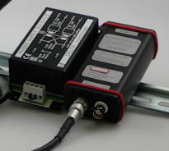
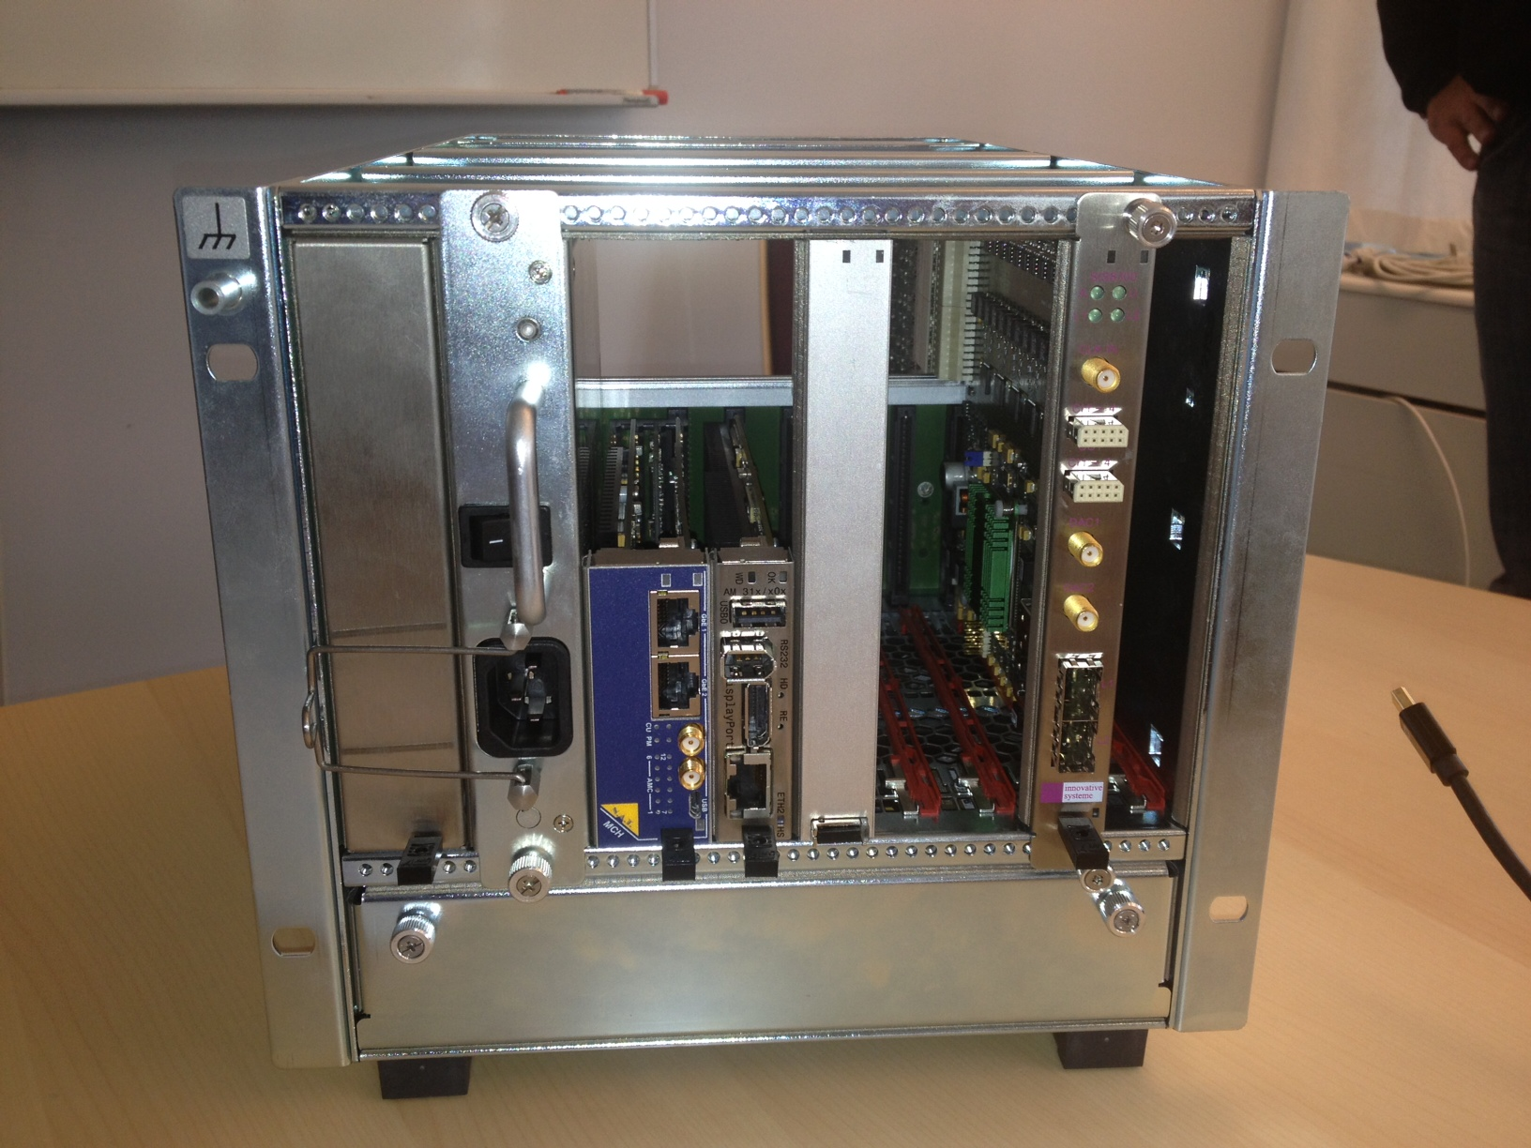
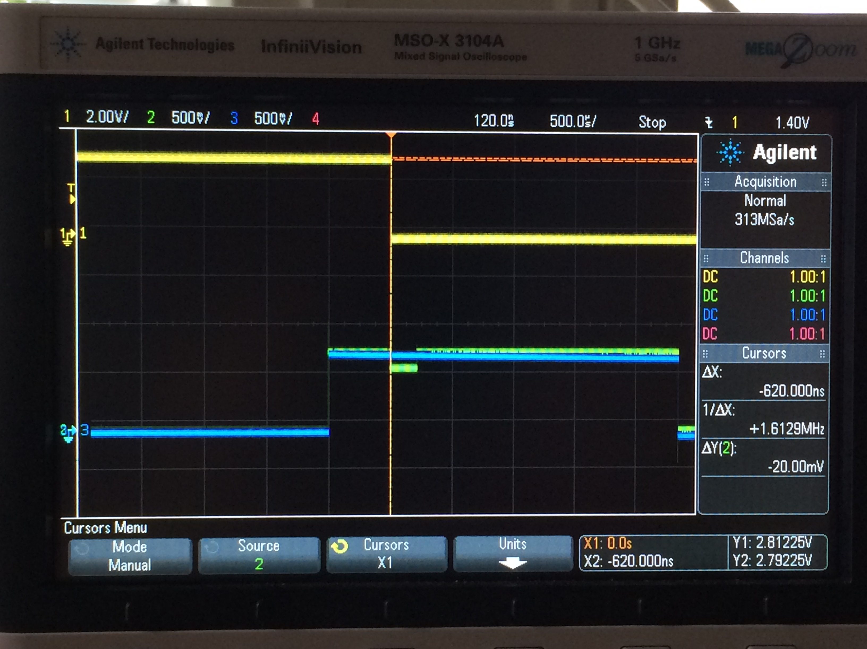
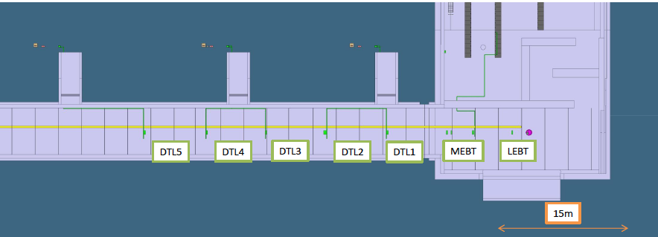
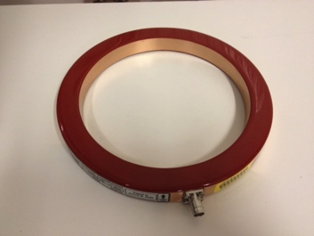
Beam Current Monitor
https://ess-ics.atlassian.net/wiki/display/BIG/BCM+-+Beam+Current+Monitor
FE electronics and
Diff driver at stub exit
Diff receiver, ADC and
Processing in crate
Cable lengths from tunnel to gallery longer than recommended (25-35m in warm linac),
but seems manageable with custom modification
CHESS documents:
LEBT BCM specification: ESS-00407092
RFQ BCM specification: ESS-0040786
MEBT BCM specification: ESS-0037395
DTL BCM specification: ESS-0039814
IBIC13 BCM paper: ESS-0040764
BCM system design: ESS-0041438
ACCT coil on
beam line

Slide 16
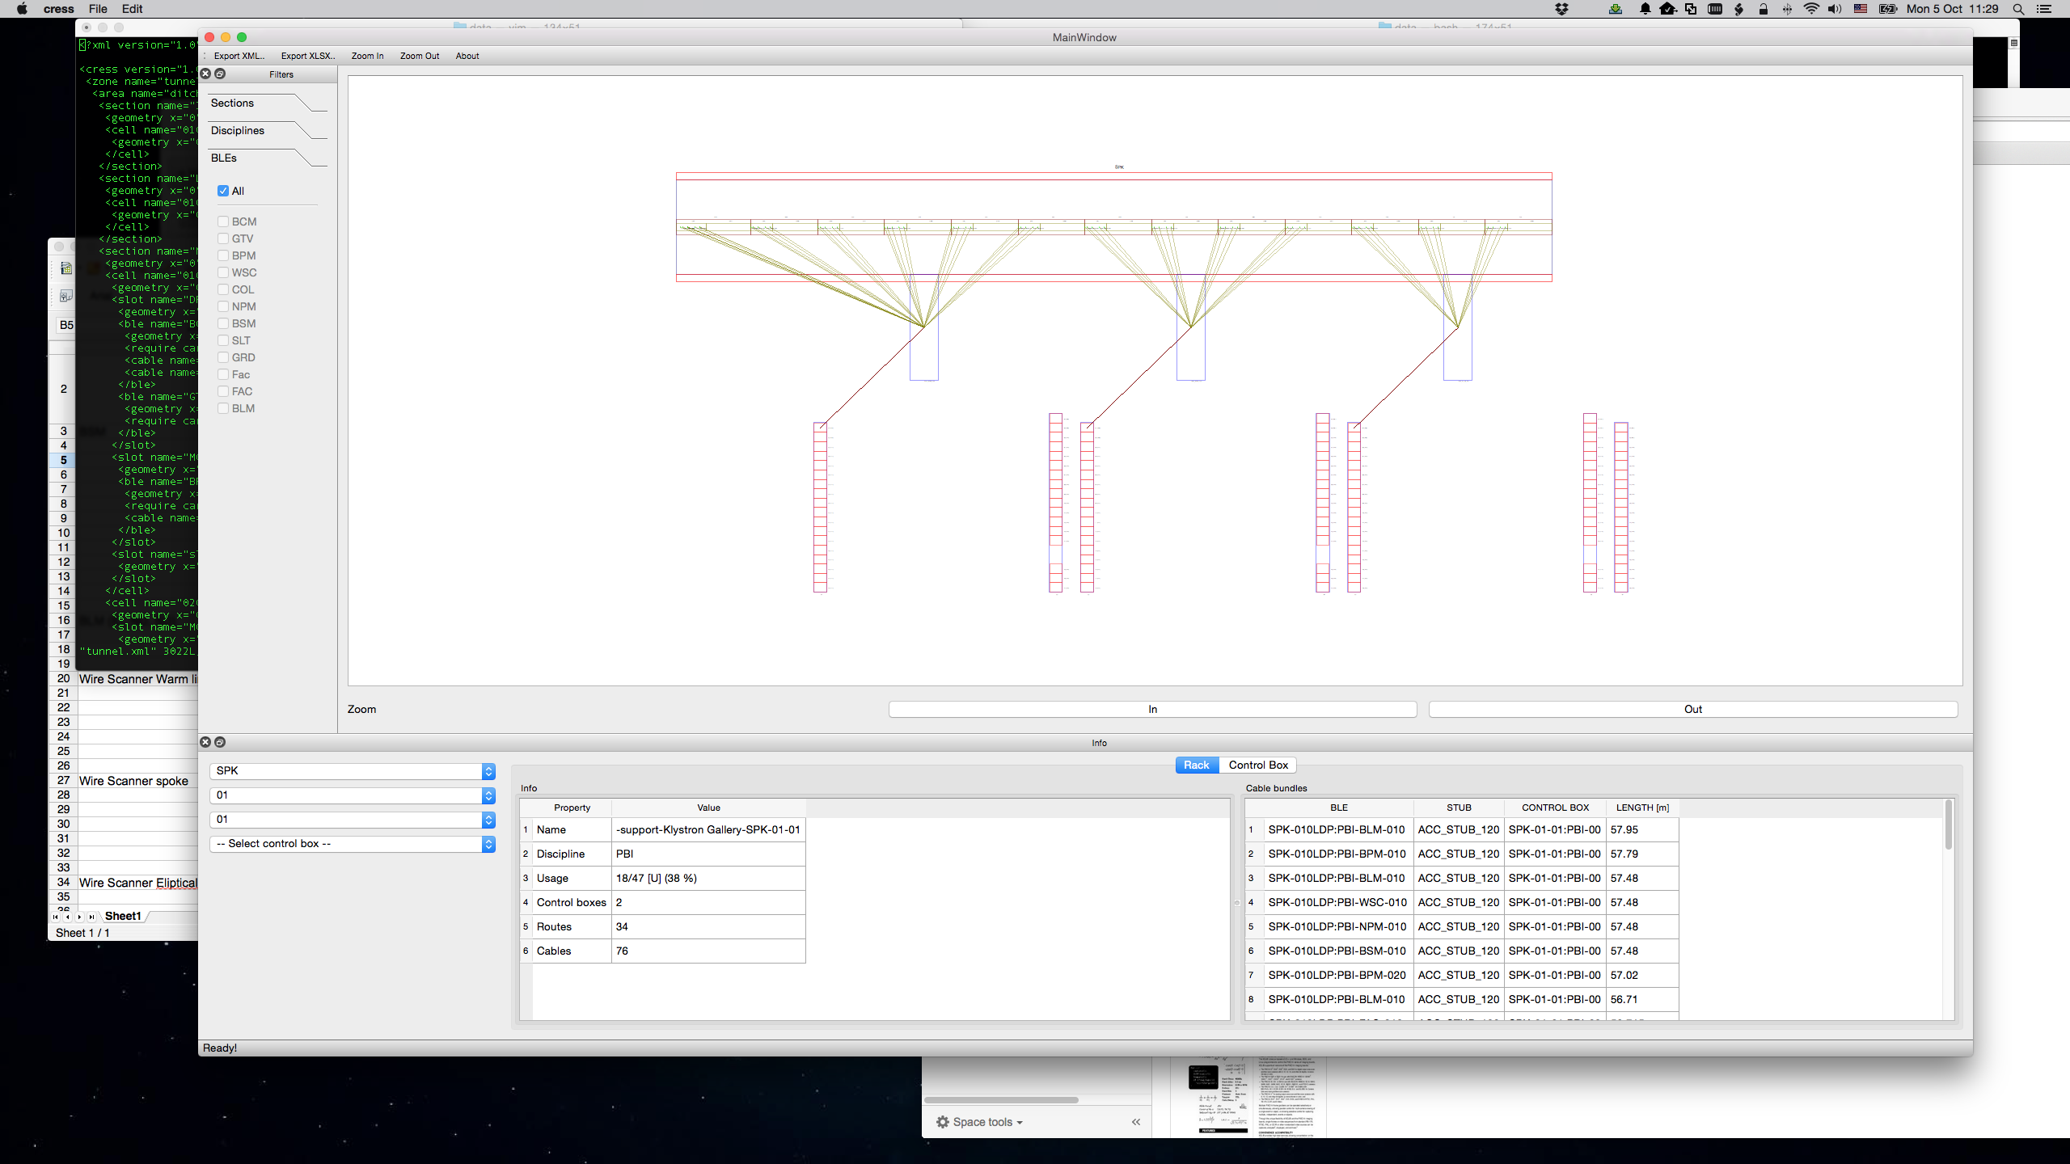
Cabling visualization tool

Slide 17
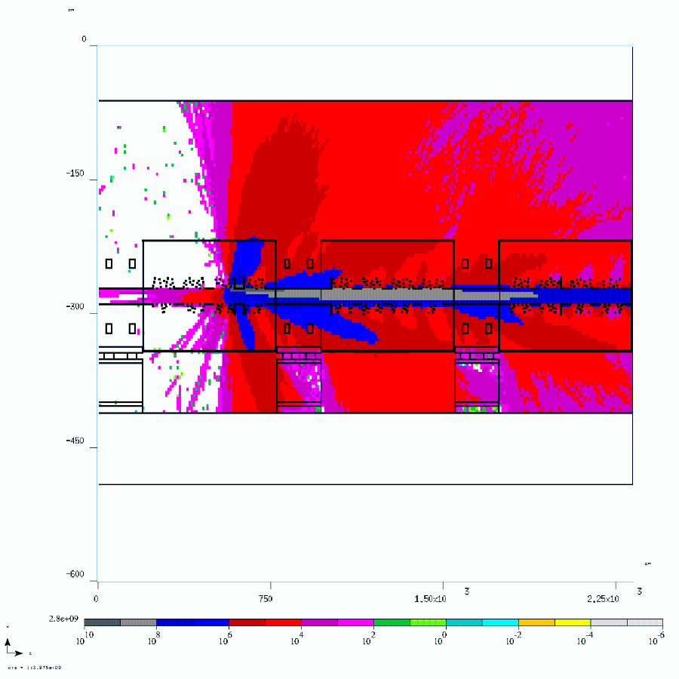
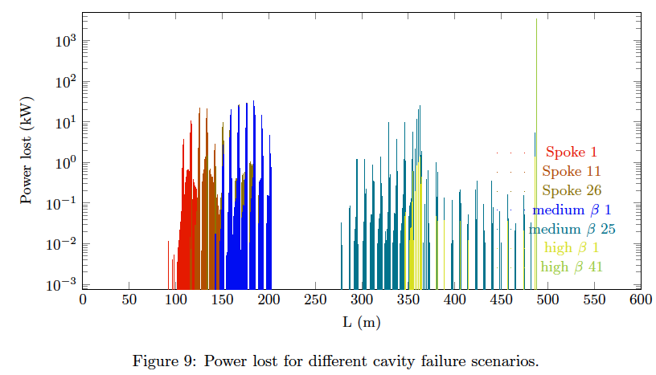
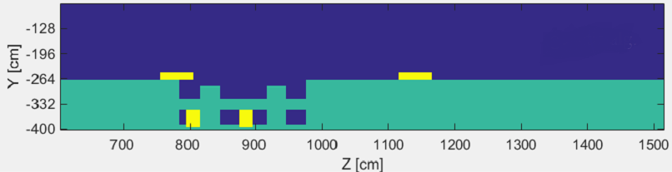
BLM – simulations and detectors
https://ess-ics.atlassian.net/wiki/display/BIG/BLM+-+Beam+Loss+Monitor
M. Eshraqi et. All, ESS-0031413
M. Jarosz, IPAC15, Richmond, US
M. Jarosz et al, oPAC conference, Seville, 2015
Loss locations from failure
studies
Optimized BLM locations
(preliminary)
Showers from point losses
Optimized BLM locations based on all possible loss points to avoid blind spots
Verification and performance analysis will be done based on a set of failure
scenarios simulated by Beam Physics Group (now sections in common group).
LHC style ion chambers being built in collaboration with CERN (& GSI)
In addition, investigating Micromegas detectors with CEA Micromegas team
(insensitive to thermal neutrons and gammas). Plan to install a few such advanced detectors.

Slide 18
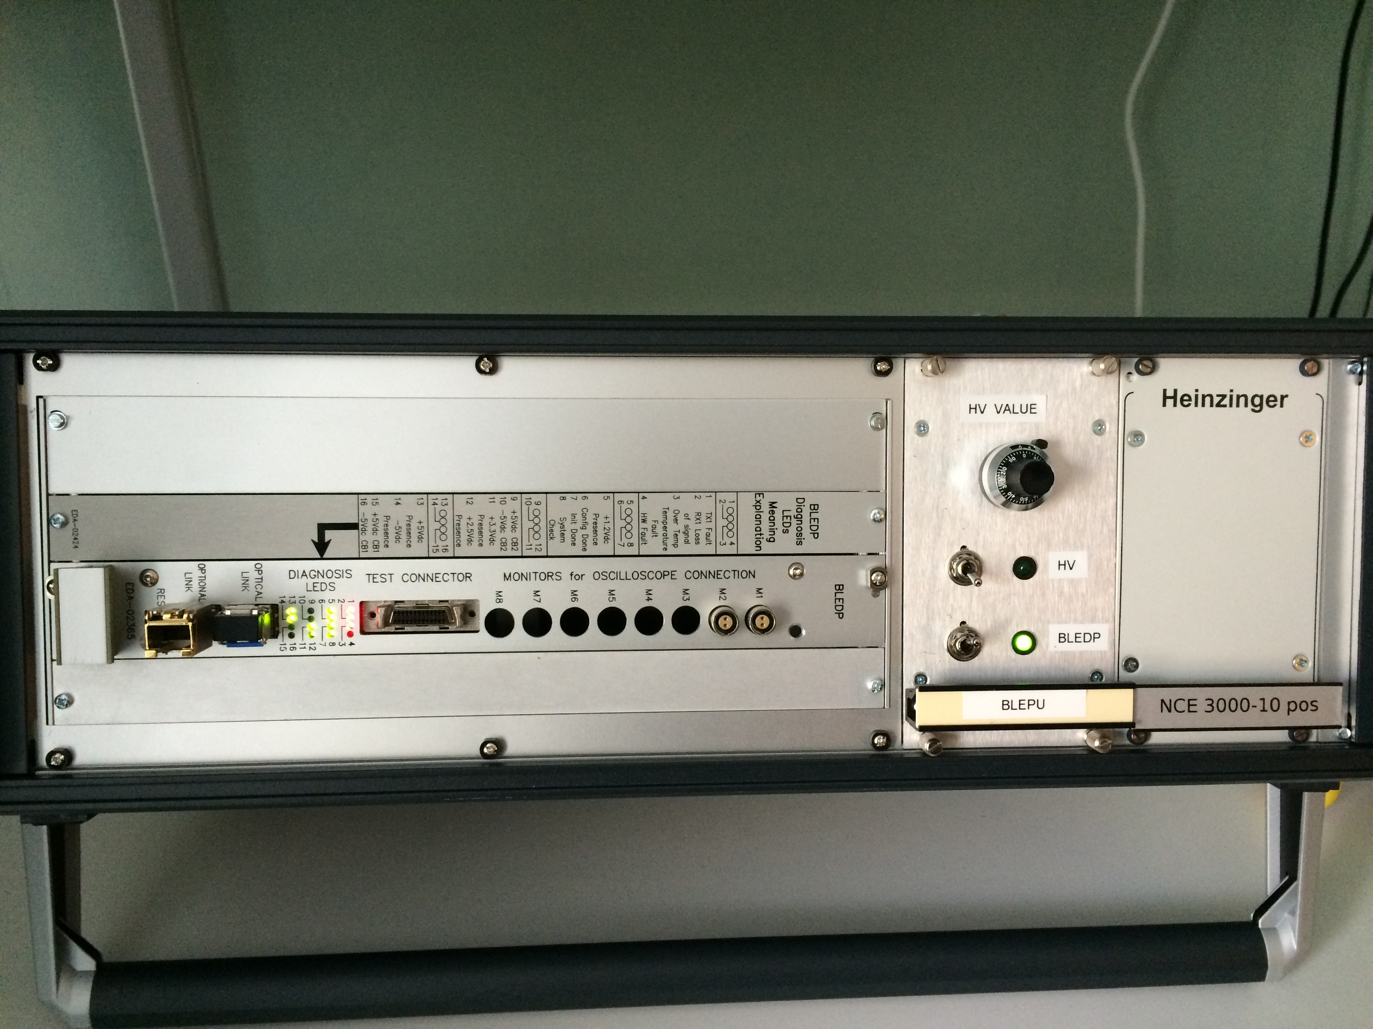
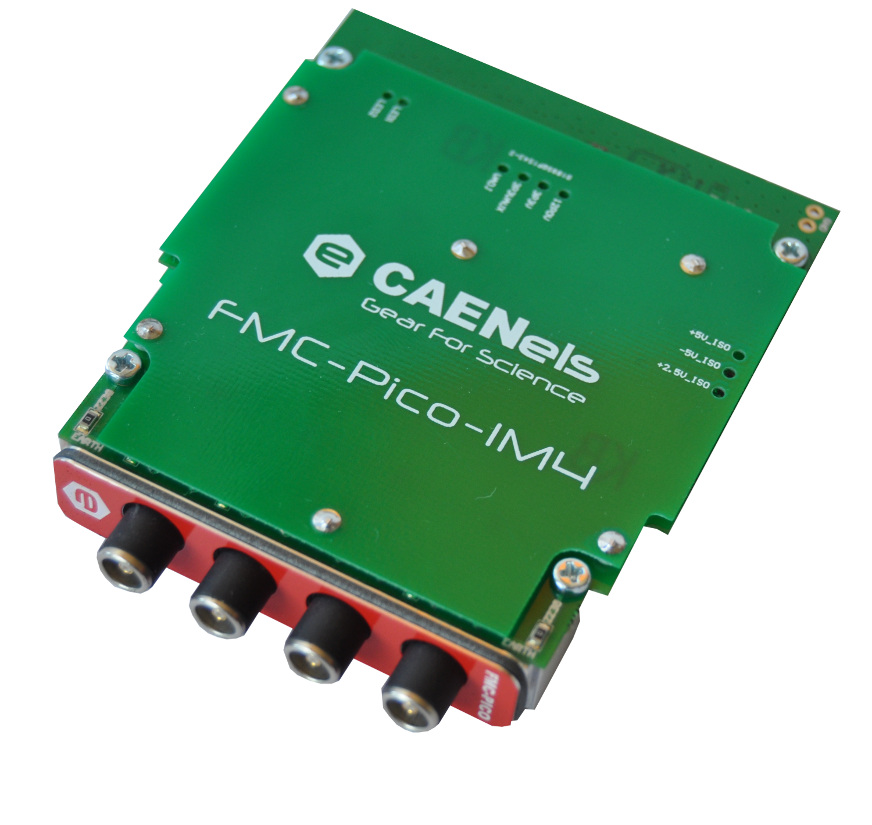
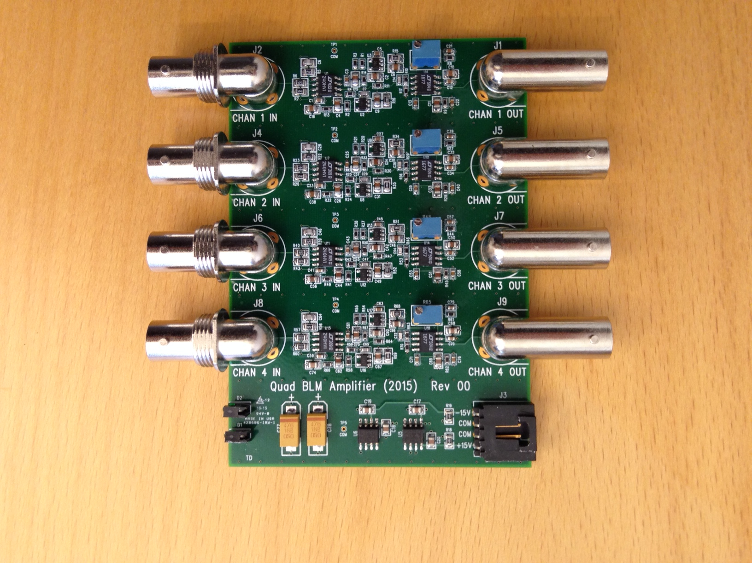
BLM – FE electronics and processing
Options under consideration:
CERN FE (baseline option)
Available on loan at ESS
Can be read out with ICS
proposed IOxOS board
Commercial pA board
(modified for bandwidth)
Will receive unmodified
Version on loan soon
Can be hosted on ICS
proposed IOxOS board
New SNS front end
(very simple)
Available on loan at ESS
Need suitable ADC, which
could potentially be hosted
on IOxOS board if an FMC
(More on BLM later in MPS discussion)

Slide 19
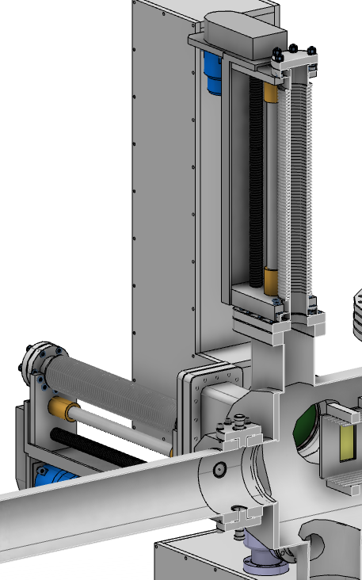
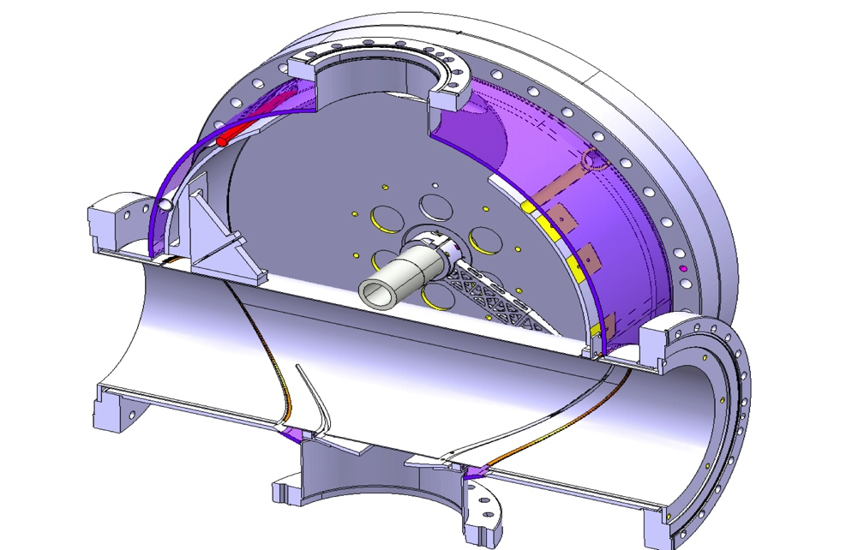
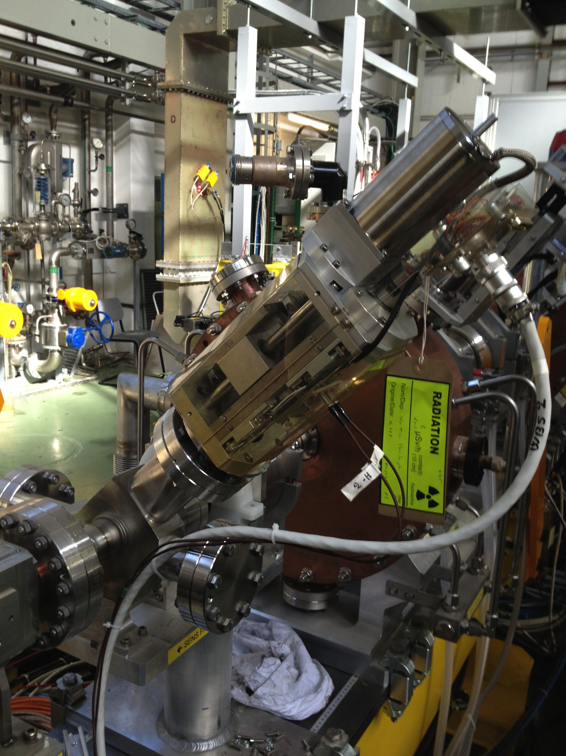
Wire Scanners
https://ess-ics.atlassian.net/wiki/display/BIG/WS+-+Wire+Scanner
45 degree dual scanner in MEBT
Carbon wire
Bilbao in-kind
(photo from Linac4)
Separate H/V scanners
in cold linac
Hydroformed bellows
Tungsten wire
Fast wires in HEBT
(CERN design)
Carbon wire
Full power capable
Common readout electronics by Trieste
CHESS documents:
WS conceptual design: ESS-0020237
Readout prototype proposal: ESS-0033505
Thermal model of wire: ESS-0037080
Mech. Design spec (warm): ESS-0036675
Mech. Design spec (cold): ESS-0036590
Acquisition scope and spec: ESS-0036783

Slide 20
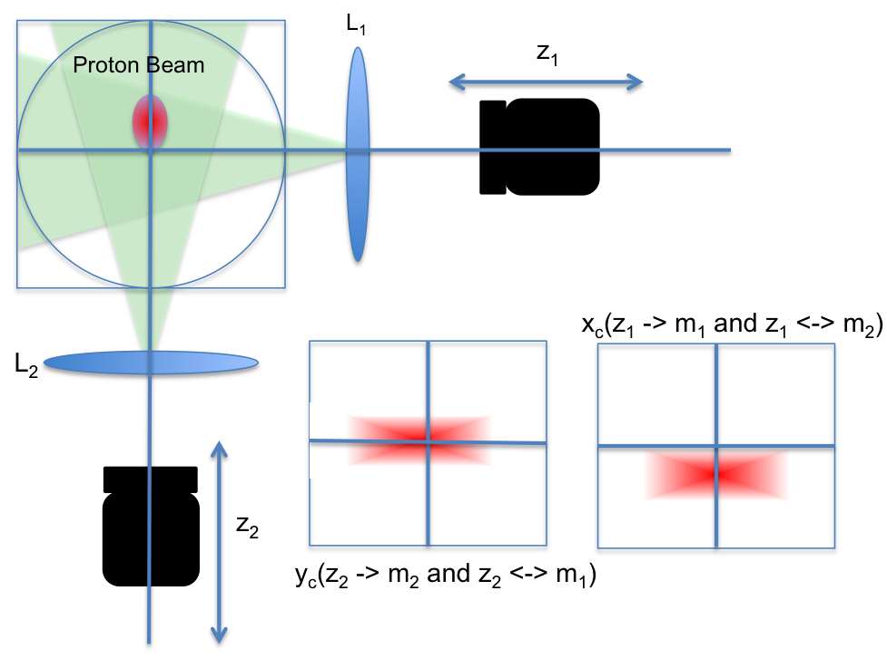
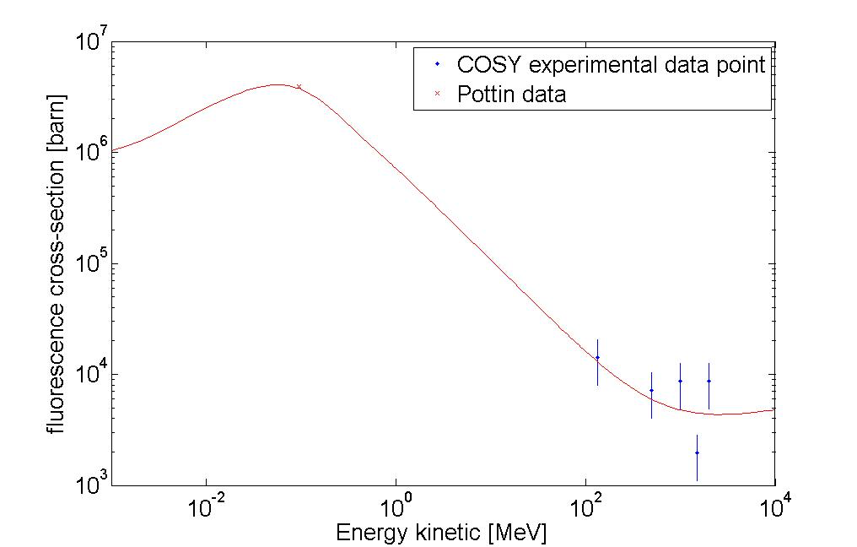
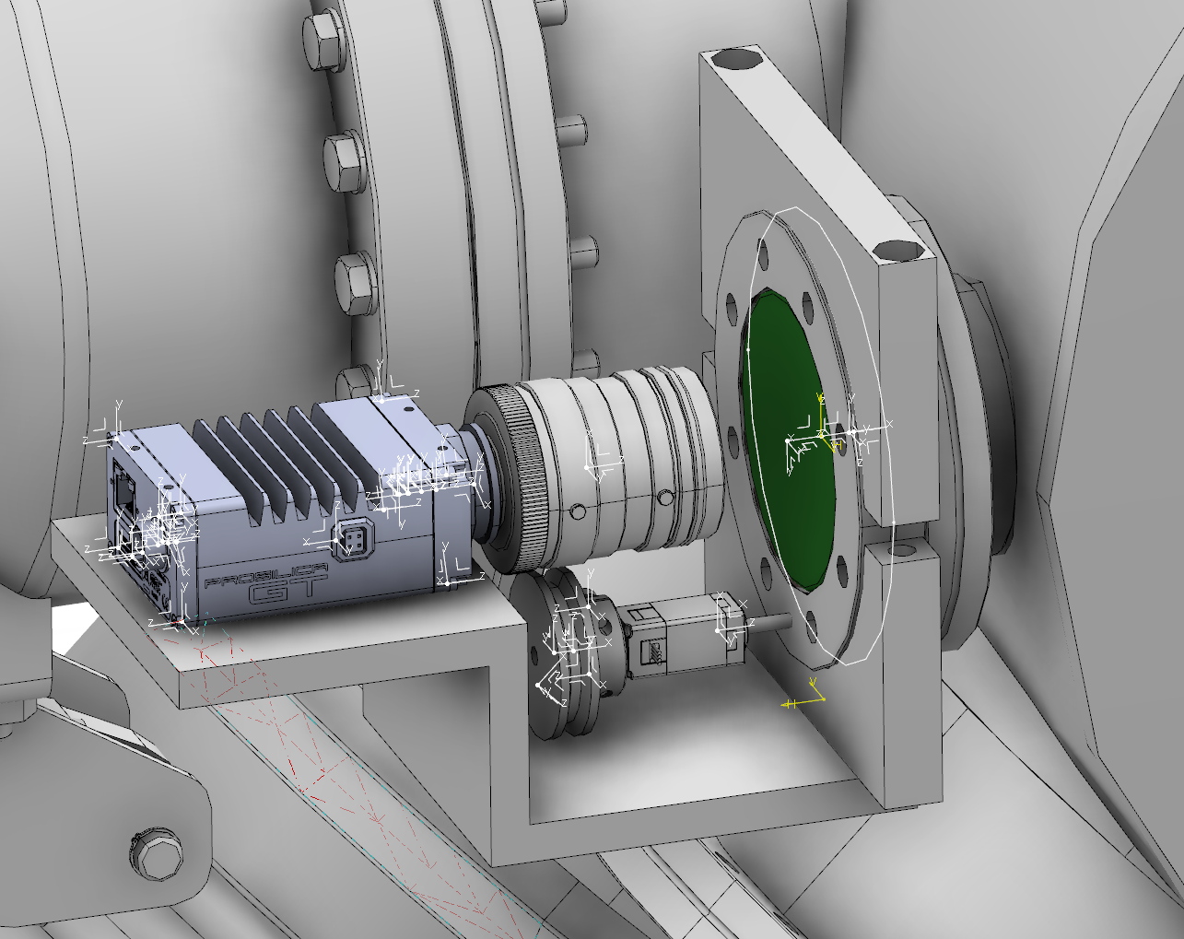
Non-invasive Profile Monitors
https://ess-ics.atlassian.net/wiki/display/BIG/Non+Invasive+Profile+Monitor
LEBT Luminescence monitor
H2 Luminescence cross section
Measurements at Juelich
C. Roose, oPAC conference, Seville
Cross-sections measured by Pottin at 95 keV in red. In blue are the experimental cross sections from the COSY experiments. The solid lines is the Bethe-Bloch stopping power scaled to pass though the experimental data.
CHESS documents:
LEBT NPM conceptual design: ESS-0037613
LEBT NPM PDR report: ESS-0038182
MEBT NPM specification: ESS-0036710
DTL NPM specification: ESS-0039553
Cold linac NPM (IPM) expected
to be done as Saclay in-kind

Slide 21
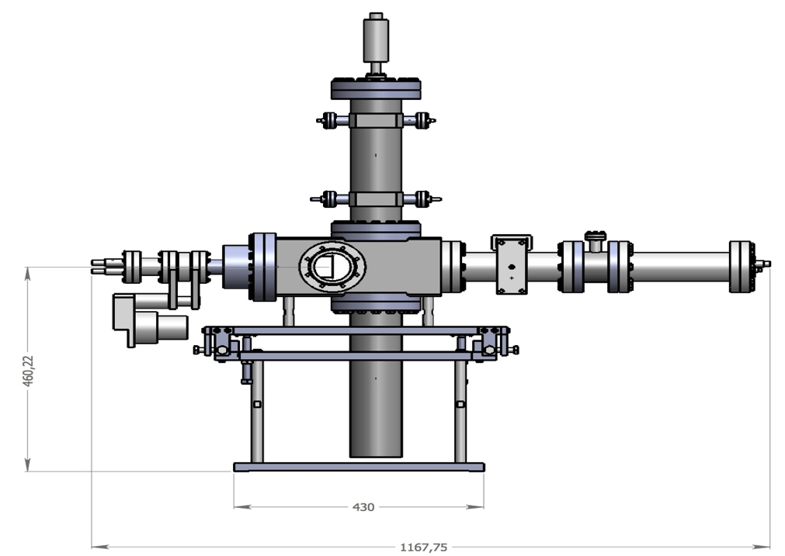
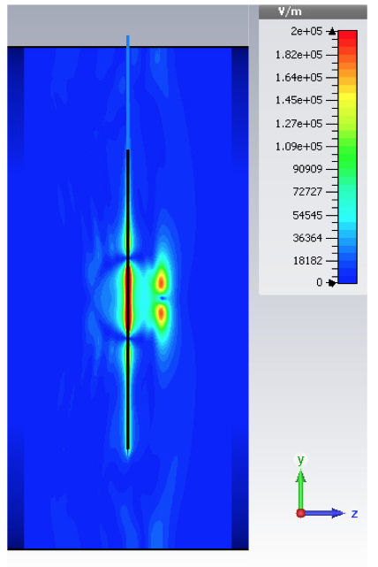
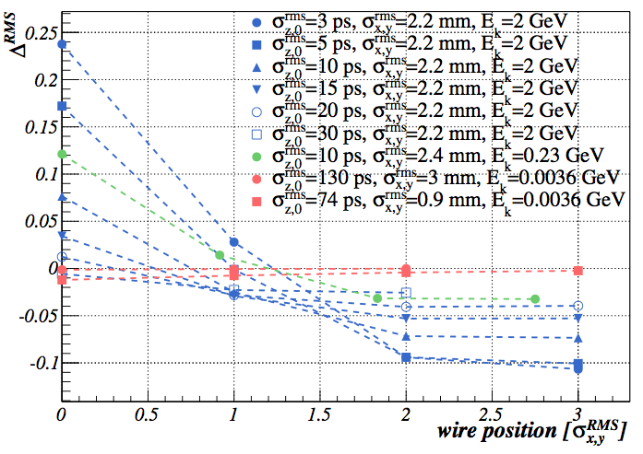
Longitudinal profile
https://ess-ics.atlassian.net/wiki/display/BIG/BSM+-+Bunch+Shape+Monitor
Expected normalized difference in RMS of the SE time distributions at the beam pipe boundary as a function of wire position in units of one-sided RMS beam transverse size σ R M S
NEW BSM concept for ESS (courtesy of INR)
Calculated bunch electric field for conditions expected at 2 GeV.
Feschenko BSM used in the MEBT and at the transition between the warm linac and the superconducting linac
well established method (LINAC4, JPARC)
  1° phase resolution (i.e. 10 ps @352.2 MHz)
  With new RF deflector (dual λ/2) 0.5° phase resolution expected, i.e time resolution better than 5 ps
Intrinsic limitations to resolution due to:
  Space charge
    Simulations performed at ESS indicate that the effect is negligible
  Time dispersion of secondary electron emission (SEE)
Improved Feshenko BSM may work at frequency jump (TBC), where bunches are 6-12ps rms
Not expected to work at high beta, when bunches are 3-6 ps.
  New method needed, e.g. based on Cherenkov or OTR
  Design concepts exists and will be investigated
CHESS Documents:
Longitudinal profile design status: ESS-0041166
Low energy BSM specification: ESS-0037520
LINAC’14 longitudinal profile paper: ESS-0041167

Slide 22
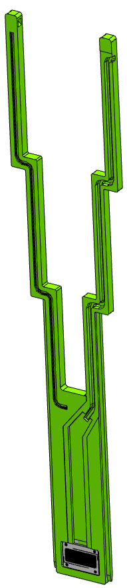
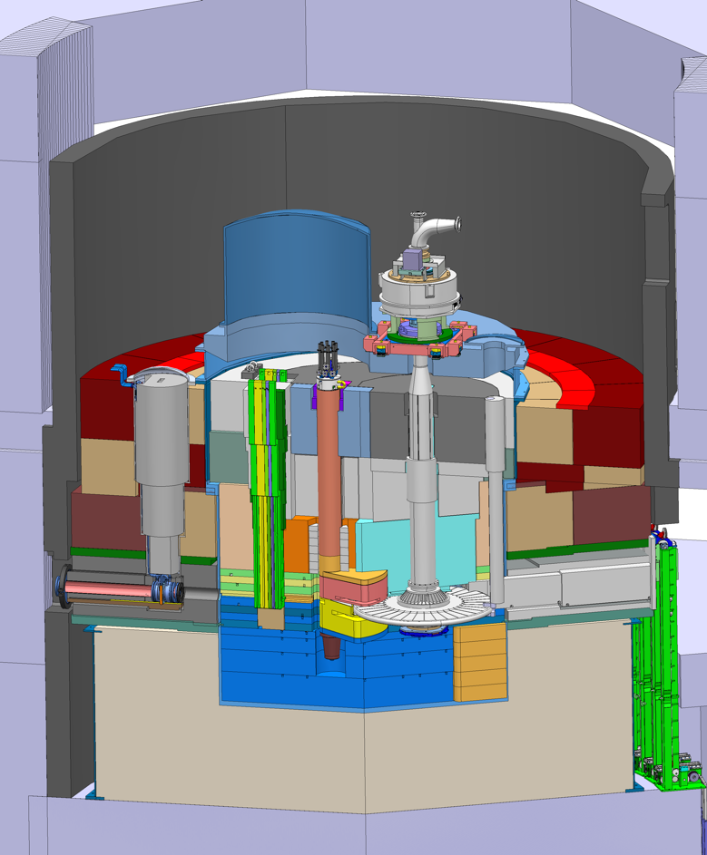
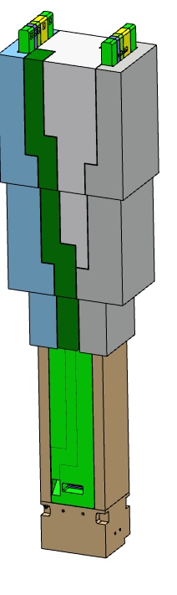
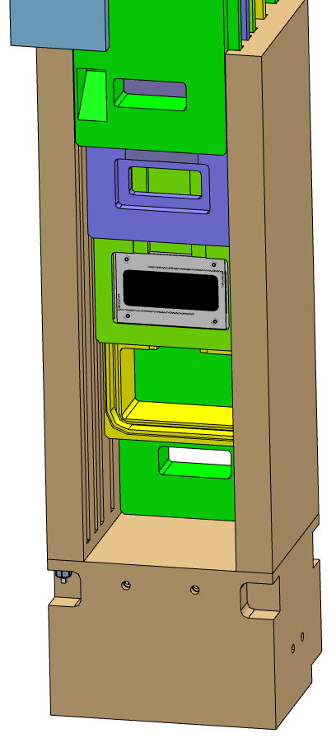
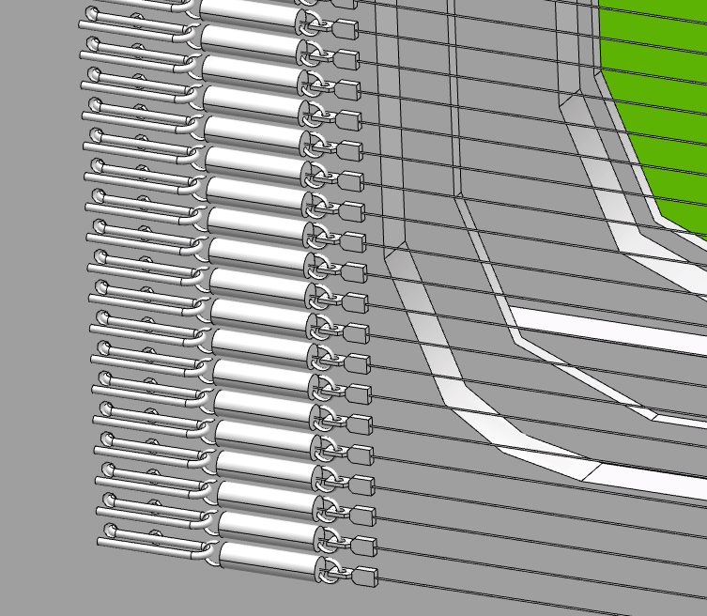
Instrumentation in the Monolith collaboration with target division
https://ess-ics.atlassian.net/wiki/display/BIG/Imaging+Systems
https://ess-ics.atlassian.net/wiki/display/BIG/Aperture+Monitor
https://ess-ics.atlassian.net/wiki/display/BIG/Grid
PBW: lumi coating, aperture mon.
PBIP: Grid, optics, aperture monitors
Target: luminescent coating
Design for shielding, cooling and remote handling
Slice concept for independent replacement
Water cooling supply and return
Signal path
Hook and spring design
(LANL / ORNL)
CHESS docs: Target diagnostics IK work unit descriptions: ESS-0034203
Interface control documents: ESS-0032631, ESS-0022919

Slide 23
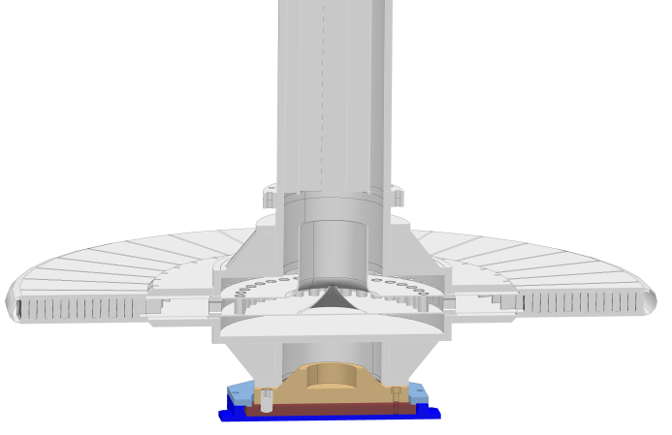

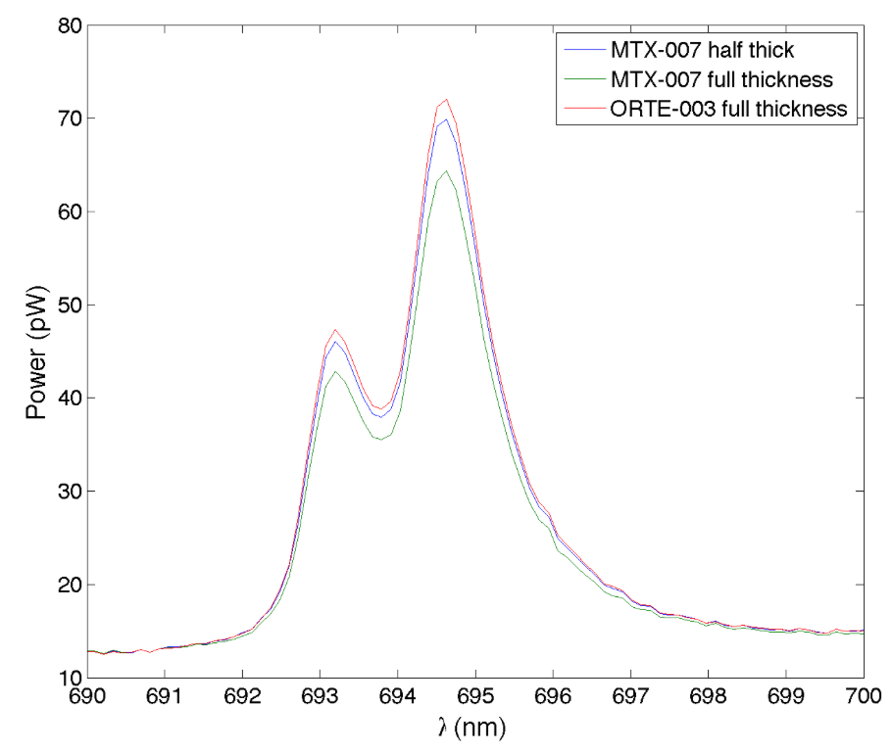
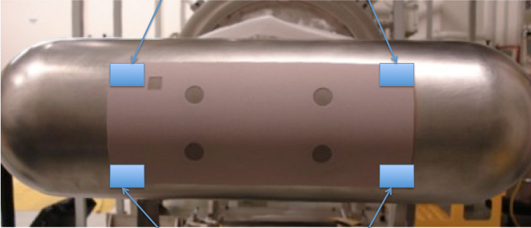
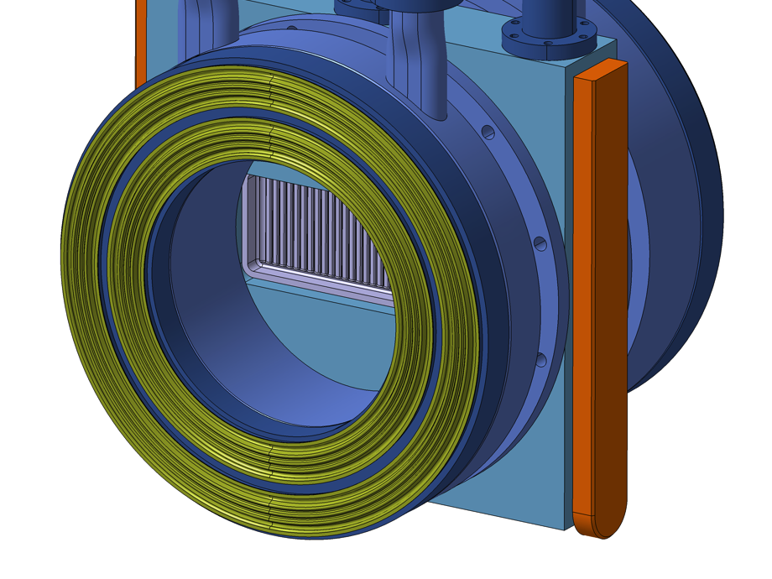
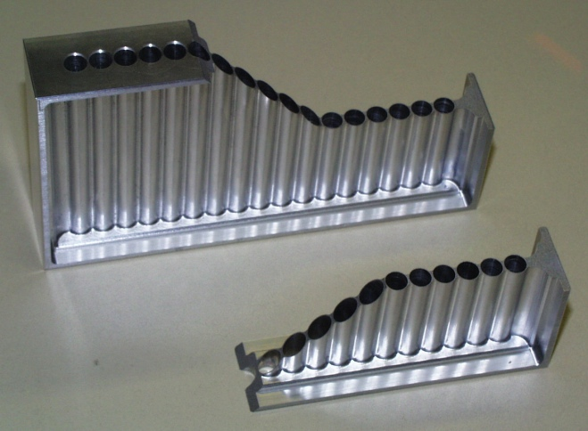
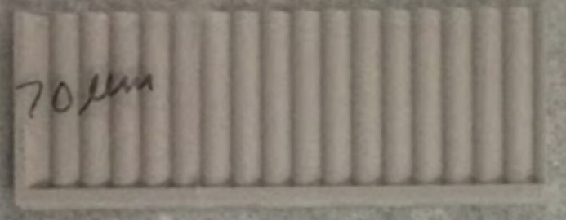
Imaging – Luminescent Coating
https://ess-ics.atlassian.net/wiki/display/BIG/Luminescent+Coating+Development
Target
Coated steel samples
Emission spectrum of coated steel sample measured in ESS optics lab
Sample space on SNS target
PBW
Pan pipe design
Coated Aluminum surface samples (Jülich, Stony Brook).
4 different thicknesses
Similar sample to be tested at BLIP

Slide 24
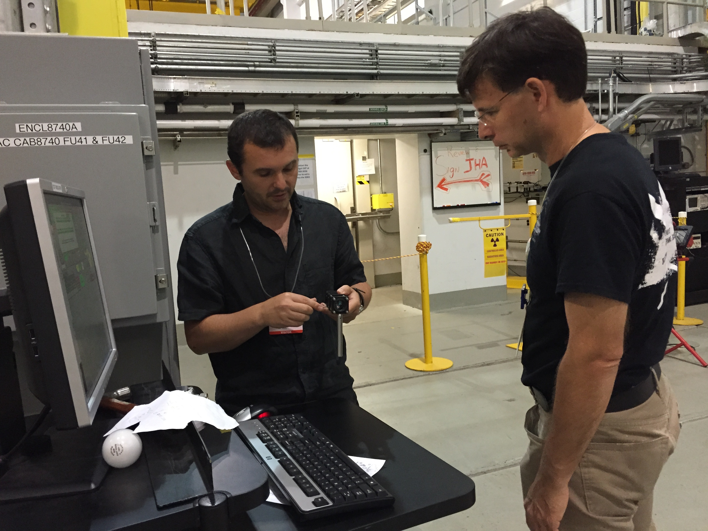
Hot news: SNS target coating spectra
Data from August: end of life target/coating (Normalised to 471nm He line)
Data from October: New target/coating (Normalised to 471nm He line)
O lines are present in both Oct and Aug spectra: should be understood!
Photo-luminescence and protons on fresh coating shows same ruby line spectrum

Slide 25
BI Machine Protect Functionality

Slide 26
Current BI inputs to BIS
All BLMs
All BCMs
  Differential current measurement (loss detection)
  Verify proper beam destination at switch magnet
  Detect beam when not expected (un-triggered acquisition)
Some BPMs
  Monitor trajectory after bending magnets
  Monitor raster scanning
  Possibly use as backup in warm linac
Possibly target beam density and aperture monitors (TBC)
Dedicated limit switches on all movable devices for configuration control.

Slide 27
Logical separation of protection functions
Protection function primary,
measurement function
secondary
EPICs interface
(register map)
‘Secure’ EPICs
interface
Diagnostics
processing
Timing interface
Analog FE
ADC
Modular FPGA designs for
maintainability
Lock physical implementation of
protection functions on FPGA.
Protection
processing, self test and threshold compare
Protection
interface
Thresholds
Note that separate diagnostics
processing feature allows
full scale testing of upgraded
MPS processing.
Notes:
Split digitital signal, separate processing in different logical blocks inside same FPGA

Slide 28
Redundancy
BLMs detector layout designed to created redundant detection of failures
  More detectors than absolute minimum
  Several detectors will see any given failure event
  Single board failure impact reduced by system connection layout to avoid creating blind spots.
Differential BCMs may similarly be designed for redundant detection.
  More than one differential pair measurement observing the same loss point.
More in the next slides…

Slide 29
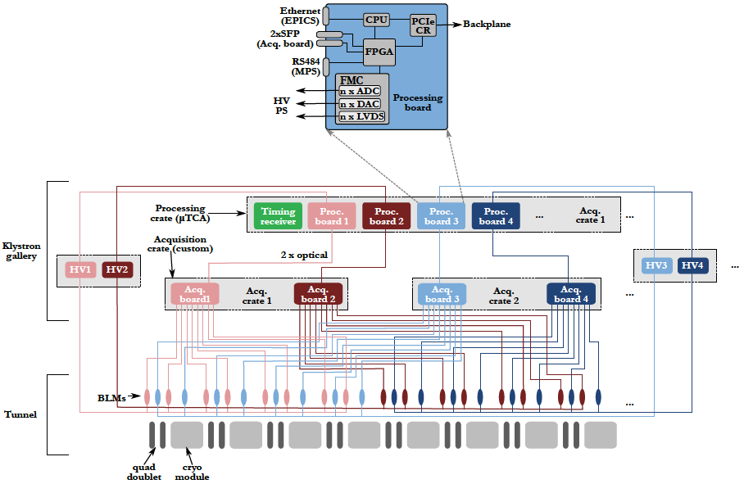
Preliminary BLM system layout

Slide 30
BCM redundancy possibilities
beg. A2T
end. A2T
Differential BCM is main loss
detector in warm linac
beg. DGLG
beg. MB
beg. HB
beg. HEBT
end. HEBT
beg. DMPL
end DMPL
LEBT
MEBT
DTL
Configuration destination dependent
v
NB. Configuration to be refined by analysis. Also need to handle
Intermediate Faraday cups/ beam stops (presumably by masks)
This particular layout could potentially be handled by 2 independent 8ch boards

Slide 31
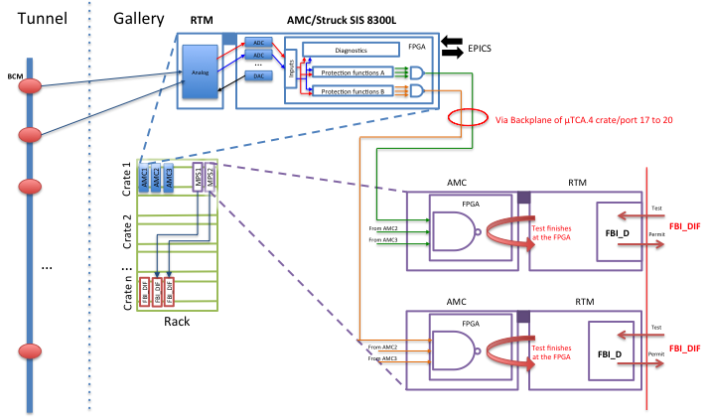
MPS physical interface
Studying options where BIS interface hosted on separate card, allowing use of cards that does not have space for BIS connectors (e.g. Struck), as well aggregation of interlock signals from multiple cards in a crate.
Reliability/Availability performance will be assessed as part of proposed task force on core MPS devices.

Slide 32
Summary
A lot of effort recently spent on in-kind discussions, drafting agreement annexes and producing related documentation
Also, PBI task force work over last few months just concluded (see Steve’s talk)
In addition, some technical progress on BI systems (highlighted in the talk)
Next step: adjust to task force recommendations, wrap up in-kind agreements and go full steam ahead for beam in 2019.
A main focus in the next 6 months will be reliability/availability analysis of MPS functions (see Annika’s talk)

Slide 33
The end
NB
For TAC members: if CHESS access is not available, please contact Johan
Norin (johan.norin@esss.se) to obtain copies of references.
A JIRA/Confluence account has been created for TAC members to access
Information in WIKI links.

