Slide 1
Beam Instrumentation and
Machine Protection
TAC12
Annika Nordt et al.
ICS/Protection Systems
www.europeanspallationsource.se
15 October 2015

Slide 2
Overview
Overview on Machine Protection and Beam Instrumentation
Requirements
Status
Next steps
Backup Slides: Thresholds for Beam Losses

Slide 3
Scope of Machine Protection @ ESS
Machine Protection needs to reliably do the following:
protect the “machine” from damage, be it beam-induced or resulting from any other source,
protect the “machine” from unnecessary beam-induced activation.
Machine protection will be implemented in a way to:
minimize unnecessary down-time due to spurious trips,
provide optimal support for failure localization,
support all operational modes of the facility,
support operation in degraded mode
Notes:
Text according to slide

Slide 4
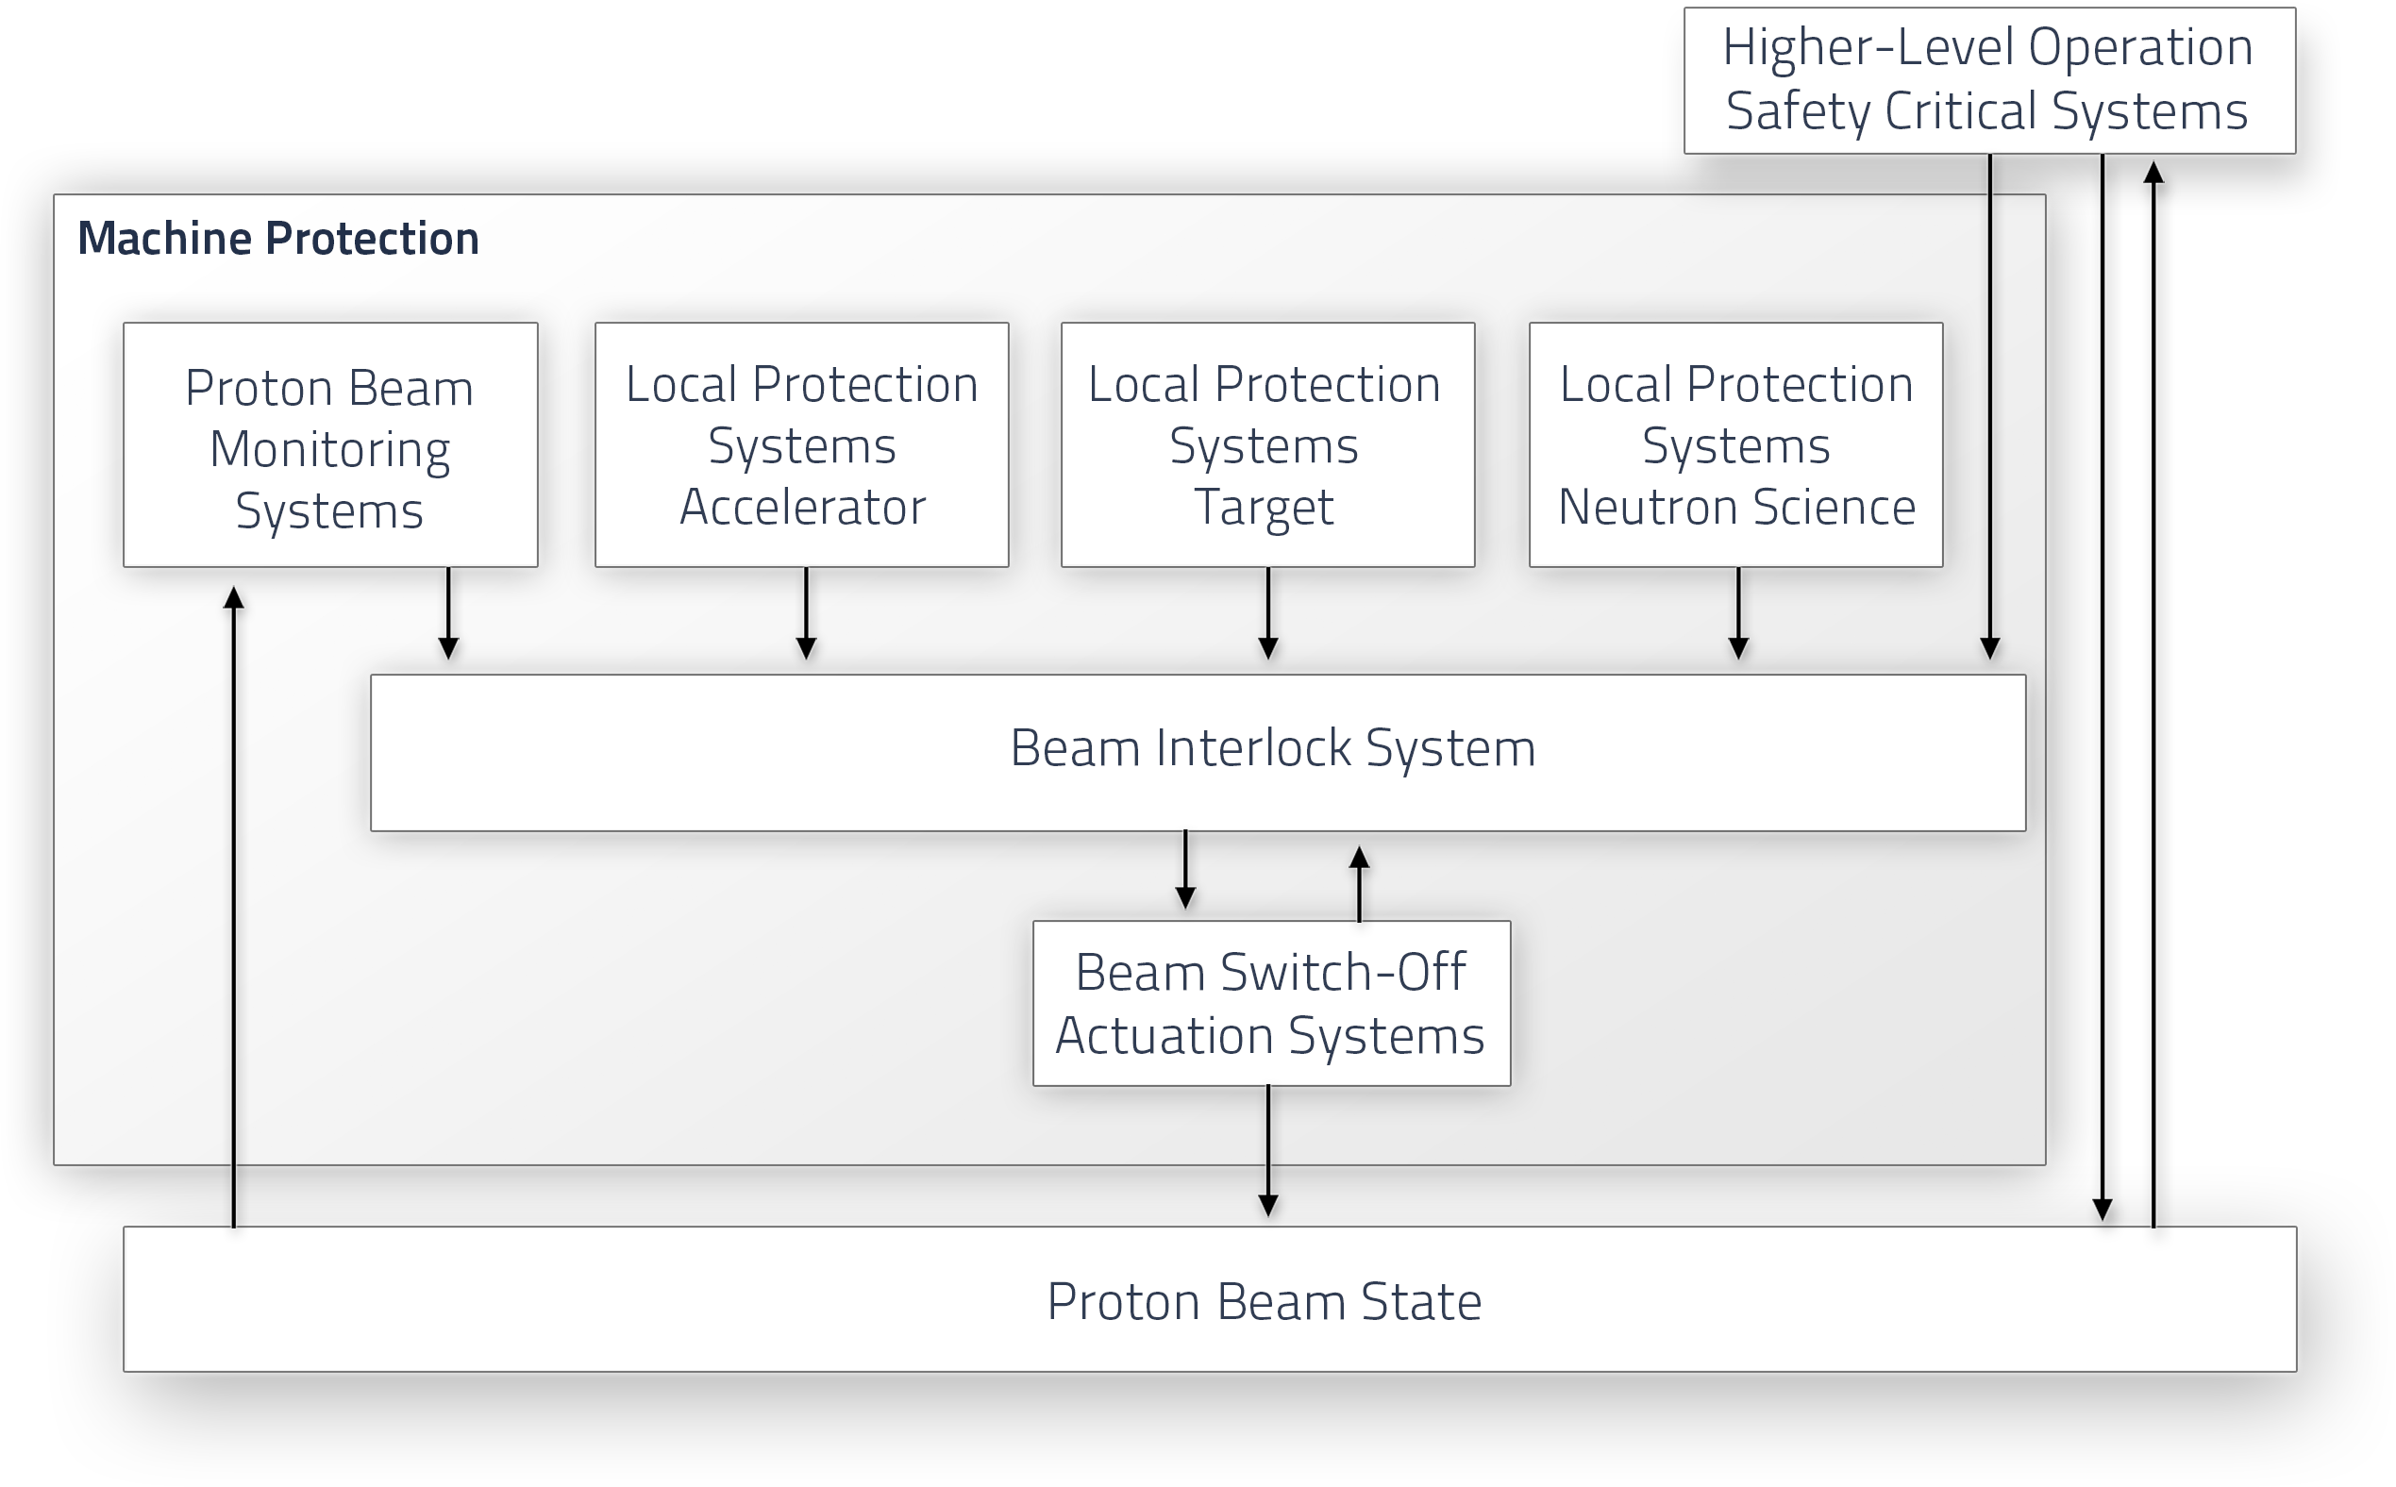
Functional Architecture Concept
Notes:
In addition to all the systems associated with protection and beam permit at the lower “machine” level, there are Higher-Level Operation Critical Systems.
The diagrams represent the system in terms of a hierarchical control structure. Horizontal layers indicate layers of hierarchy.
The Higher-Level Operation Critical Systems (e.g. PSS, TSS) are those additional systems that are essential for operation and that need to work properly. If not, there should be no permission to produce beam.
Some of those Higher-Level Operation Critical Systems might have a direct impact on the beam and some of them might need to know the beam state.
Local Protection and Beam Permit Systems are in charge of
monitoring a specific segment of the “machine” and detecting non-nominal states that could lead to damage,
taking any necessary actions for preventing damage to equipment in that segment in such a case,
confirming that everything in their segment is ready for beam production.
Turning beam on, knowing that something is wrong, needs to be avoided. This would unnecessarily increase the demand rate for Proton Beam Monitoring or other protection related systems.
Note that Local Protection and Beam Permit Systems do not monitor beam parameters themselves to protect their segment from beam-induced damage. Doing that is the job of Proton Beam Monitoring.
Local Systems do focus on local equipment of their segment and protect from locally detectable threats.

Slide 5
Beam Monitoring Systems
Proton Beam:
potential source of damage
source for activation
Machine protection:
has to make sure that the beam parameters are as they should be
Reaching the required availability and protection levels will however only be achievable if some degree of standardization in implementation and documentation is achieved.
Notes:
Text according to slide

Slide 6
MP Categorization of BI Systems
Categories of Beam Instrumentation systems (from Machine Protection perspective):
BI systems providing active protection (backbone of MP) | BI systems in need of protection | Other purposes (destination of beam)
Beam Loss Monitors [250] | Wirescanners [15] | Faraday Cup in the LEBT
Beam Current Monitors [21] | Emittance Measurement Units (Allison scanner, Slits &Grids) [2]
Some very few Beam Position Monitors (eg in dogleg, A2T line) | Faraday Cups (except LEBT FC) [3+1]
 | BSMs, Iris
 | In general: all devices which can intercept the beam pipe will be connected to the Beam Interlock system
Notes:
Text according to slide

Slide 7
Protection for Insertable Devices
We will interlock the position of insertable devices by using position switches (dedicated for Machine Protection).
The position switches are connected to a PLC based interlock system (ICS/WP5 is in charge of the PLC based interlock system).
The PLC based interlock system will generate a beam permit signal depending on the beam mode and other criteria.
The operational concept assuring that insertable devices are operated only when beam parameters allow for it, is currently being worked on.
Notes:
Text according to slide

Slide 8
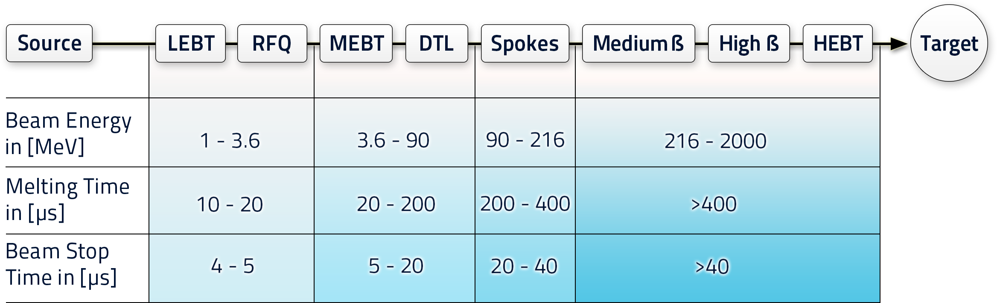
Damage Potential and Timescales LINAC
Σ21 Beam Current Monitors
Σ250 Beam Loss Monitors

Slide 9
Thoughts and Comments
Most severe damage potential in the warm LINAC (first 50m)!
But there we have only 1 layer of protection: 8 Beam Current Monitors (BCMs)
Beam Loss Monitors (BLMs/IC/LHC type) are sensitive >80MeV (ie cold linac)!
We should consider to add Beam Position Monitors, neutron detectors or redundant BCMs, however currently we consider 8 BCMs (warm LINAC) only.
BCMs need to be fast AND reliable in order to achieve the required overall response time of a few μs and a protection integrity level PIL2!
Notes:
Text according to slide

Slide 10
Allocation of Response Time (LINAC)
FBIS Driver (implemented on sensor system)
Sensor Interface Module
Master
Module
Actuator Interface Module
Sensor Systems
(BLM, BCM etc.)
Actuators
(Choppers, PS)
4 modules of the Fast Beam Interlock System (FBIS)
Module | BCM (measure, compare to threshold, trigger BIS) | Sensor Interface Module | Master Module | Actuator Interface Module | LEBT Chopper rise time | Total (in theory) | ToF (600m/2GeV)
Reaction Time | 1μs | 500ns | 250ns | 100ns | 300ns | 2.15μs | 4.1μs
First prototype testing shows that 4μs could be achieved. However overall response needs to be measured (BCM connected to BIS, cable delay, BIS triggering the LEBT chopper,etc).

Slide 11
Allocation of Protection Integrity Level (PIL)
PIL2 (for full protection function) for BIS, BLMs, BCMs is resulting from previous risk analysis
PIL allocation (proposal) | Sensors (BLMs, BCMs): 35% of Total PIL | Beam Interlock System (BIS): 15% of Total PIL |  |  |  | Actuators: 50% of Total PIL | Total: PIL2
What does this allocation mean?
PIL (regarding blind failures/SIL from IEC61508) | PFH (Probability of blind failures per hour)
1 | 10⁻⁵ - 10⁻⁶
2 | 10⁻⁶ - 10⁻⁷
3 | 10⁻⁷ - 10⁻⁸
4 | 10⁻⁸ - 10⁻⁹
PIL Allocation | PFH (Probability of blind failures per hour)
Sensors (BLMs, BCMs) | 3.5•10⁻⁷ – 3.5•10⁻⁸
BIS | 1.5•10⁻⁷ – 1.5•10⁻⁸
Actuators | 5.0•10⁻⁷ – 5.0•10⁻⁸

Slide 12
Requirements BCMs, BLMs: Summarised
Requirement | BCMs | BLMs | BIS | Actuators
Response time | 1μs | 10μs | 2μs | <1μs
Failure rate | 3.5•10⁻⁷ – 3.5•10⁻⁸/h | 3.5•10⁻⁷ – 3.5•10⁻⁸/h | 1.5•10⁻⁷ – 1.5•10⁻⁸/h | 5•10⁻⁷ – 5•10⁻⁸/h
Interface | Redundant to BIS | Redundant to BIS |  | Redundant to BIS
But where are we currently???/what PIL has been achieved so far with first prototypes?
To understand that, we did an FMEDA based on a first preliminary design of the BIS
(FMEDA=Failure Modes, Effects and Diagnostics Analysis)
Notes:
Text according to slide

Slide 13
Initial Results from FMEDA of the BIS
Courtesy of R. Andersson & A. Monera
15% of PIL2

Slide 14
Testing/A Proposal
FBI: Fast Beam Interlock System
FBI_D: Driver
FBI_DIF: Device Interface Module
FBI_M: Master
BI Board
FBI_D
FBI_DIF
FBI_DIF
FBI_M
4% duty cycle machine: use 68ms in between pulses
Test links between master and interface module (takes less than 20μs), and between interface module and BI systems
FPGA (protection functions)
FBI_D
FBI_DIF
We want to loopback the test signal inside the FPGA that contains the protection functions (ie not just testing links, but FPGA/protection functions/flip the beam permit)
Safe testing is possible if links are redundant (ie never be blind)

Slide 15
More Comments
Requirement: Provide redundant connections between BLMs, BCMs and the BIS
Advantages:
  Opportunity to safely test the system and never be blind during test times (1 link at a time)
Disadvantages:
  More space on BI board level is required (space for 2 drivers, 2 connectors):
    this can be accommodated on the board provided by ICS (ESS- PSI-IOxOS collaboration),
    however it is a restriction for the Struck board (currently used for BCMs, BPMs)→ solution here could be that BI develops an additional board (see next slide)
Notes:
Text according to slide

Slide 16
BI-BCM Design
Currently under Investigation
Tunnel
Gallery
RTM
AMC/Struck SIS 8300L
ADC
FPGA
EPICS
Analog
ADC
Diagnostics
…
BCM
DAC
Inputs
Protection functions A
Protection functions B
Via Backplane of μTCA crate
AMC1
AMC2
AMC3
MPS1
MPS2
Crate 1
AMC
RTM
FPGA
Test
Crate 2
From AMC2
Test finishes at the FPGA
FBI_D
FBI_DIF
From AMC3
Permit
…
…
FBI_DIF
FBI_DIF
FBI_DIF
Crate n
AMC
RTM
Rack
FPGA
Test
From AMC2
Test finishes at the FPGA
FBI_D
Permit
FBI_DIF
From AMC3
Notes:
Text according to slide

Slide 17
Next Steps I
Several design concept proposals for the BIS, BCM, BLM systems have been made so far.
A few prototypes have been built (BIS, BCM) and are tested.
However, we need to finalise this phase and conclude on a final design concept.
ICS/MP prefers standardization where possible!
proposal is the ESS-PSI-IOxOS board with redundant links to the BIS for all fast systems connected to the BIS (BCMs, BLMs, BPMs, RF local interlock system)
Notes:
Text according to slide

Slide 18
Next Steps II
We (AD and ICS) agreed to create a working group which
Shall analyse and evaluate current design proposals (BCMs, BLMs, actuators, BIS, RF local interlock system) as well as come up with new/improved design proposals of these systems.
The working group will consist of: A. Jansson (BI), A. Nordt (BIS), E. Bargallo (RAMI), expert on mitigation devices (AD/WP3), R. Andersson (FMEDA), R. Montano (RF local interlock system) [list is preliminary].
The results from these analyses shall be used as input for the final designs.
Results shall be delivered by the next TAC as well as the proposal for the final designs.
Internal review on BCM design planned for Nov 2015.
MP functional review and BIS PDR planned for Dec 2015 (external review).
The final design proposals need to be approved by the Machine Protection Committee.
Notes:
Text according to slide

Slide 19
Summary
Presented scope and concept for ESS machine protection and how to use Beam Instrumentation systems for achieving the required protection integrity level.
First designs of hw components done (to be optimized).
Prototyping started.
Working group has to be established.
First audit with external experts by the end of this year for machine protection architecture and the Beam Interlock System.
MPC must approve final designs for all systems relevant for Machine Protection.

Slide 20
BackUp Slides

Slide 21
Tasks and Responsibilities
Simulate relevant beam loss scenarios [Beam Physics, BI teams]
Categorize the different loss types [BI, MP, Beam Physics teams]:
  For different time scales,
  Particle spectra,
  According to number of lost protons leading to damage in [p/m/s],
  According to requirements for hands on maintenance times, etc.
Define damage levels of critical equipment (in number of max lost protons/deposited energy/timescales) [system stakeholders with the help of the beam physics team?]
The results then can be used to define [BI, MP and beam physics teams]:
  beam loss thresholds for BCMs and BLMs [approval by MPC],
  integration times for BCMs and BLMs [approval by MPC],
  dynamic range and response times for the BCM, BLM electronics [approval by MPC], etc.
Define beam and machine modes [operations, BI, MP and beam physics teams, approval by MPC]
Notes:
Text according to slide

Slide 22
Thresholds for Beam Losses
Overview:
BLMs and BCMs are used to protect the machine from un-necessary and/or dangerous beam losses leading to equipment damage and/or activation
If measured losses exceed pre-defined loss thresholds, then the beam operation will be stopped (removal of beam permit towards the BIS)
Strategy:
BLMs and BCMs should initiate a beam stop before beam losses lead to damage
Thresholds should be set to 1/10th of the damage level [rule of thumb]
Thresholds should be set to 1/3rd of the cavity quench level [rule of thumb]
Allow for some minor adjustments by operators (applied thresholds)
Allow changes of “master” thresholds only by expert team
Thresholds_{BLMs} (E_{beam}, Δt)=MeasLoss_{BLMs} (E_{beam}) x N_{p} (E_{beam}, Δt)
Allow for masking of certain integration times
Allow for masking of certain BLMs, BCMs
Notes:
Text according to slide

Slide 23
Thresholds for Beam Losses
Procedures for changing/setting thresholds and/or masking:
Proposed beam loss thresholds and/or changes of existing beam loss thresholds have to be:
  Approved by the Machine Protection Committee
  Documented and versioned in a dedicated repository (svn, mercurial, etc)
  Tested (specific criteria such as: functional shape regarding different integration times, settings in DB compared to settings in electronics, comparison between “old” and “new” settings, etc)
Application of changes is allowed only:
  After approval by MPC (CHESS document)
  During no-beam times
  By expert (RBAC)
  Via expert application (GUI) / running consistency checks automatically
Notes:
Text according to slide

Slide 24
Thresholds for Beam Losses
Important to have:
Failure catalogue and loss levels (who is in charge/timelines?)
Knowledge about damage level for specific equipment
Knowledge about quench level for cavities (possible?)
Robust DB (with automatic consistency checks)/not existing yet
Procedures
Template for documentation
Tests with beam
Logging of status information, loss thresholds (log on change)
Notes:
Text according to slide

