Slide 1

Cryomodule Test Facility on Site
Test Stand 2
TAC12
Wolfgang Hees, WP leader Test Stands
www.europeanspallationsource.se
2015-10-15

Slide 2
Contents
mandate
requirements
layout
parts and interfaces
manpower
organisation / IKC
schedule

Slide 3
Mandate
The mandate of WP10 is to “test the cryomodules”
For the spokes see FREIA talk.
For the elliptical cavity cryomodules “testing” means:
reception in Lund & preparation for test stand
coupler conditioning at warm
cooldown, coupler conditioning at cold
RF tests up to full power
warm up (& potentially prepping for installation)

Slide 4
Requirements
high-level requirements from WP5
requirements for interfaces between WP10 and others are being written (e.g. vacuum, cryo, water…)
requirements from WP10 to CF for the buildings and utilities are in DOORS and are being followed up
a lot of work remains to be done !

Slide 5
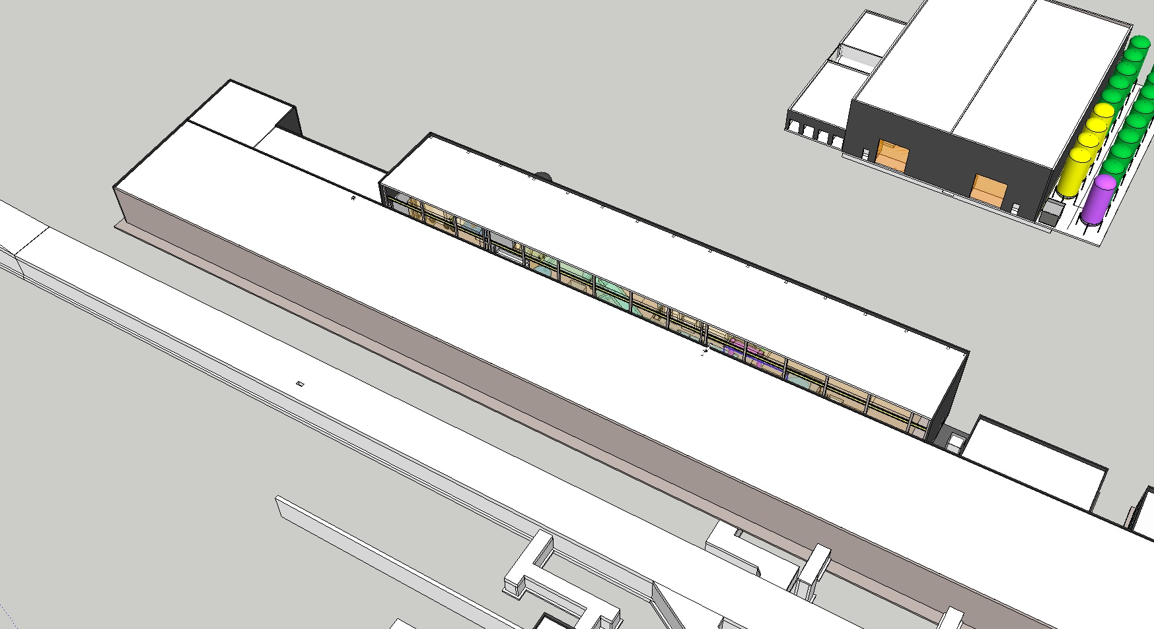
Layout 1
Test Stand 2 will occupy 50 m in the high energy end of the klystron gallery, in the contingency space.

Slide 6
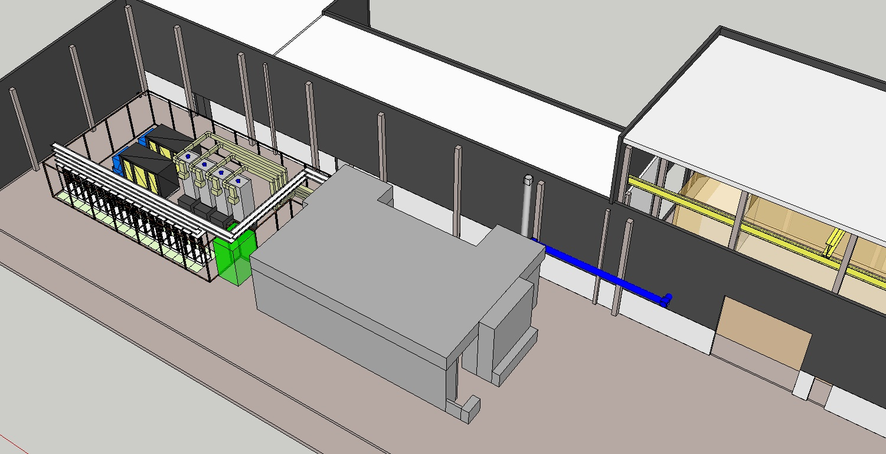
Layout 2
It consists of a bunker, a prep area, an area for RF equipment and a control room.

Slide 7
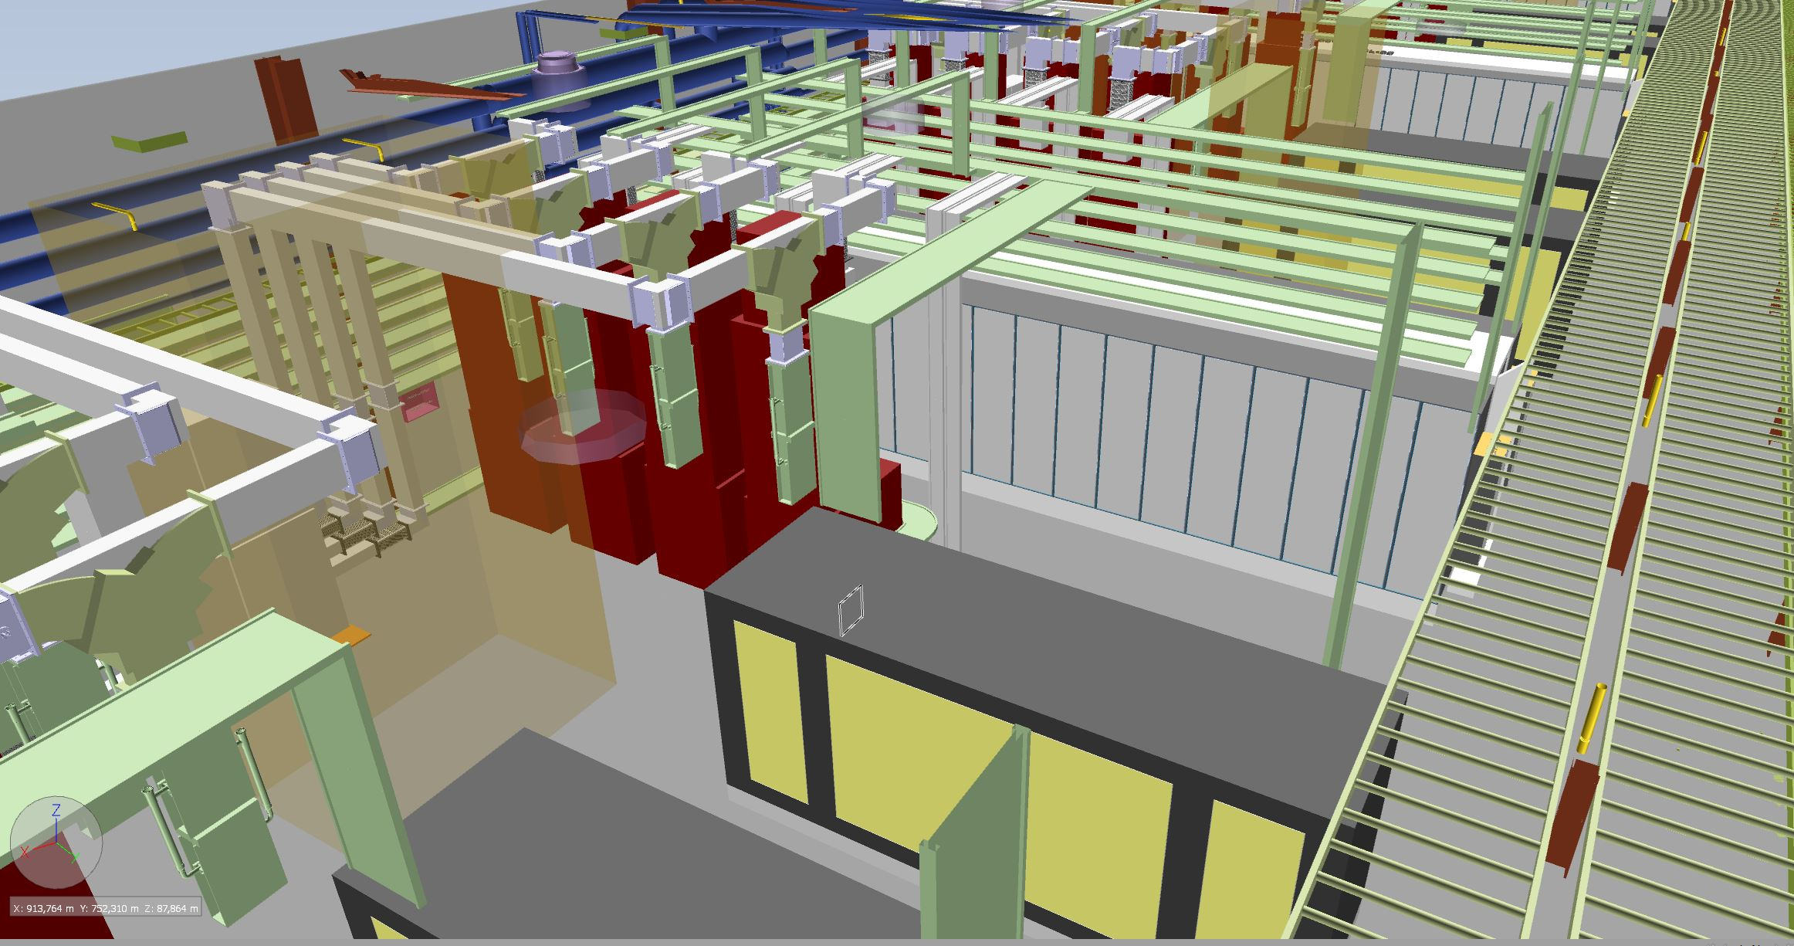
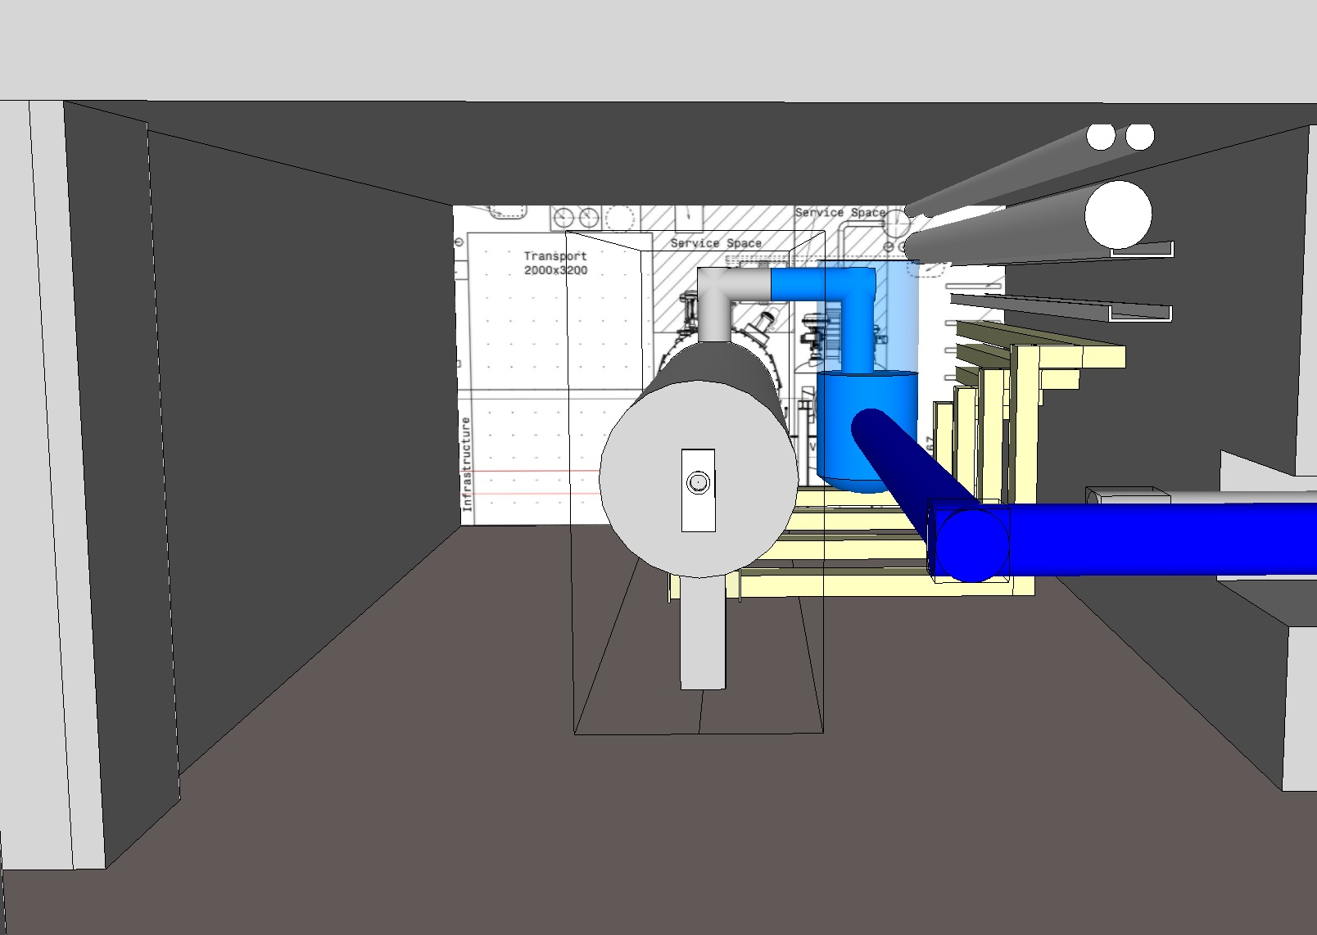
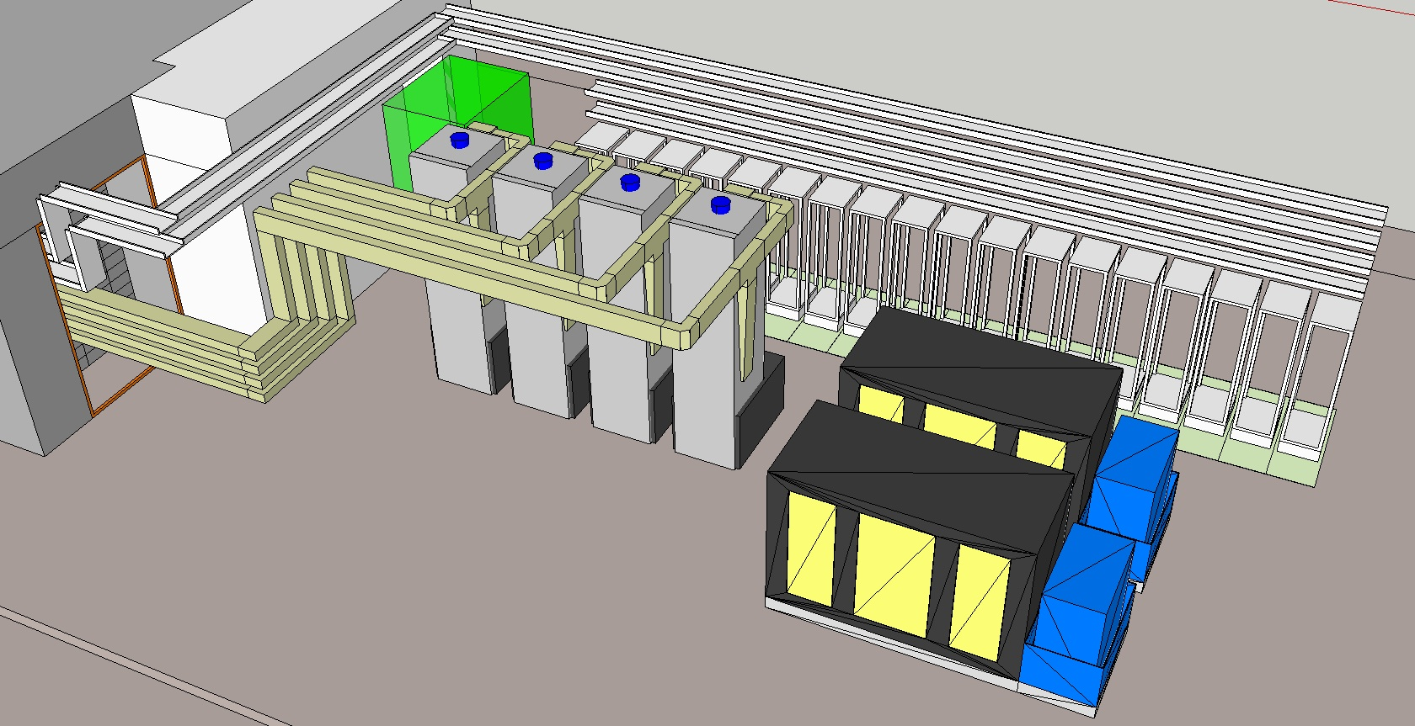
Layout 3
The RF area is almost identical to the corresponding area in the KG. The bunker has the same dimensions as a slice of the tunnel.

Slide 8
?

Slide 9
Interface requirements
Interface name | discipline A | discipline B | requirement ID | req. nbr | requirement description | requirement text
WP10-CF - 1 | WP10 | CF | WP10-CF - 1 - R001 | 1 | floor load | CF shall provide WP10 with a floor in the bunker area that accepts a total load of 1200 t and a point load of 30 t/m2
WP10-CF - 1 | WP10 | CF | WP10-CF - 1 - R002 | 2 | free height | CF shall provide WP10 with a building that offers a free height under the roof of at least 5.5 m
WP10-CF - 1 | WP10 | CF | WP10-CF - 1 - R003 | 3 | building width | CF shall provide WP10 with a building that offers a free width of at least 15.6 m
WP10-CF - 1 | WP10 | CF | WP10-CF - 1 - R004 | 4 | removable panel | CF shall provide WP10 with a removable wall panel in the gable wall of at least 3 m wide and 3 m high, near the north west corner
WP10-CF - 1 | WP10 | CF | WP10-CF - 1 - R005 | 5 | level floor | CF shall provide WP10 with a level building floor without thresholds in the klystron hall and the unloading area
WP10-CF - 1 | WP10 | CF | WP10-CF - 1 - R006 | 6 | equipment access door | CF shall provide WP10 with an access door between the klystron hall and the unloading area of at least 5 m wide and 5m high
WP10-CF - 1 | WP10 | CF | WP10-CF - 1 - R007 | 7 | truck access | CF shall provide WP10 with an access from the road to the unloading area that allows a standard truck (16 m length) to drive into the unloading area
WP10-CF - 1 | WP10 | CF | WP10-CF - 1 - R008 | 8 | overhead crane | CF shall provide WP10 with an overhead crane in the unloading area that has a free height under hook of at least 9 m, a capacity of at least 15 t and a slow gear
WP10-CF - 1 | WP10 | CF | WP10-CF - 1 - R009 | 9 | electrical outlets | CF shall provide WP10 with standard electrical outlets in the test stand area that supply both 230 VAC and 400 VAC 3-phase at X A
WP10-CF - 1 | WP10 | CF | WP10-CF - 1 - R010 | 10 | compressed air | CF shall provide WP10 with a compressed air supply in the test stand area
WP10-CF - 1 | WP10 | CF | WP10-CF - 1 - R011 | 11 | instrument air | CF shall provide WP10 with an instrument air supply in the test stand area
WP10-CF - 2 | WP10 | CF | WP10-CF - 2 - R001 | 1 | ventilation | CF shall provide WP10 with an adequately ventilated (aerated) building
WP10-CF - 2 | WP10 | CF | WP10-CF - 2 - R002 | 2 | temperature | CF shall provide WP10 with controlled temperature in the test stand area, the temperature shall be X°C +/- Y°C

Slide 10
Organisation / IKC
TS2 is installed, commissioned and operated in responsibility of WP10
WP11 (cryo) is providing cryoplant operation
WP8 (RF) is responsible for RF tests
In-Kind partner IFJ PAN (Krakow, Poland) provides specialists for CM handling, preparation, connection, testing (experience from XFEL)
WP12 (vacuum) provides some support (clean room)
WP5 IKC partners (cea, France) are providing advice and support

Slide 11
Manpower
ESS staff:
1 WP leader
1 test stand engineer
2 RF engineers
½ cryo operator
IKC staff from IFJ PAN (Poland):
according to HoA: 53 FTEs spread over 7 years
(intermittent work on TS2, some personnel can be used for tunnel installation)

Slide 12
Schedule
2015
2016
2017
2018
2019
2020
2021
2022
design
procurements
access
inst
commissioning
MB prototype transport and test
CM production
MB testing
HB testing 1
HB testing 2

