Slide 1
TAC 12, Oct 15, 2015
WP3 Cryogenic Cooling System
J.Ringnér, J.Jurns, M.Klaus, H.Quack

Slide 2

Cryogenic Cooling System Overview
TMCP & CMS
Overall simplified schematic
Cryogenic Cooling System:
TMCP – Target Moderator Cryoplant
CTL – Cryogenic Transfer Lines
CMS – Cryogenic Moderator System

Slide 3
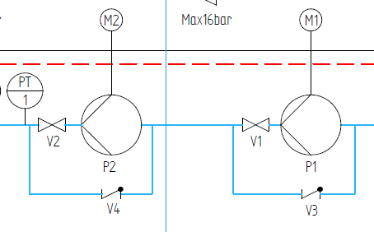
Cryogenic Cooling System Overview
Hydrogen pump set up
Pumps in serial configuration, benefits compared to parallel configuration:
Both pumps are running with full flow during operation
The system pressure drop is shared 50/50
If one pump fail it’s easy to bypass and continue operation with one pump.
Higher efficiency
Setup is agreed and supported by pump vendor
Proposed full scale hydrogen test of the pumps prior delivery to ESS.

Slide 4
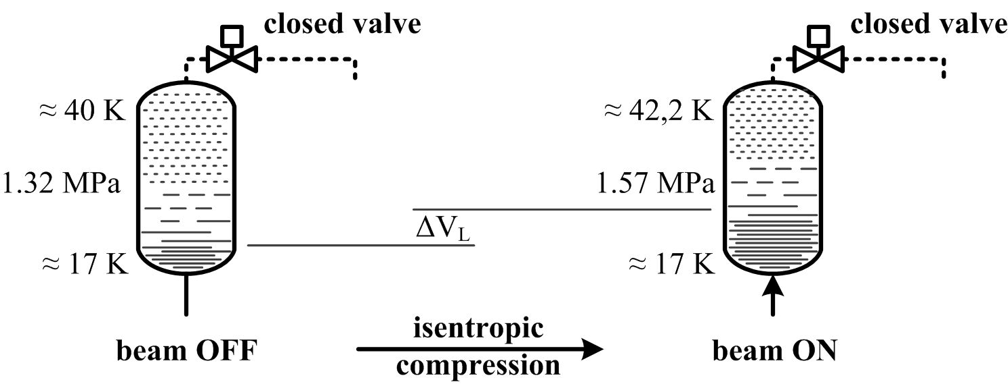
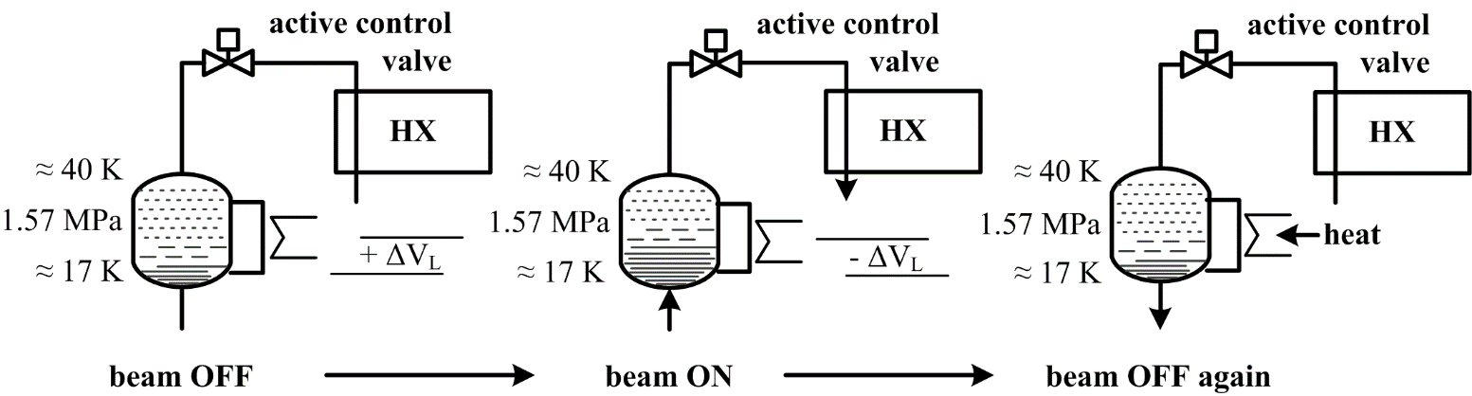
Cryogenic Cooling System Overview
Pressure Control System
The passive buffer
beam on – liquid is pushed in the vessel – compression
beam off – liquid will flow in the loop – expansion
The actively controlled buffer
Passive version + controlled release of 40 K vapor to loop = less pressure increase during inflow (beam on)
Pressure buildup/recovery via internal thermosiphon (beam off)

Slide 5
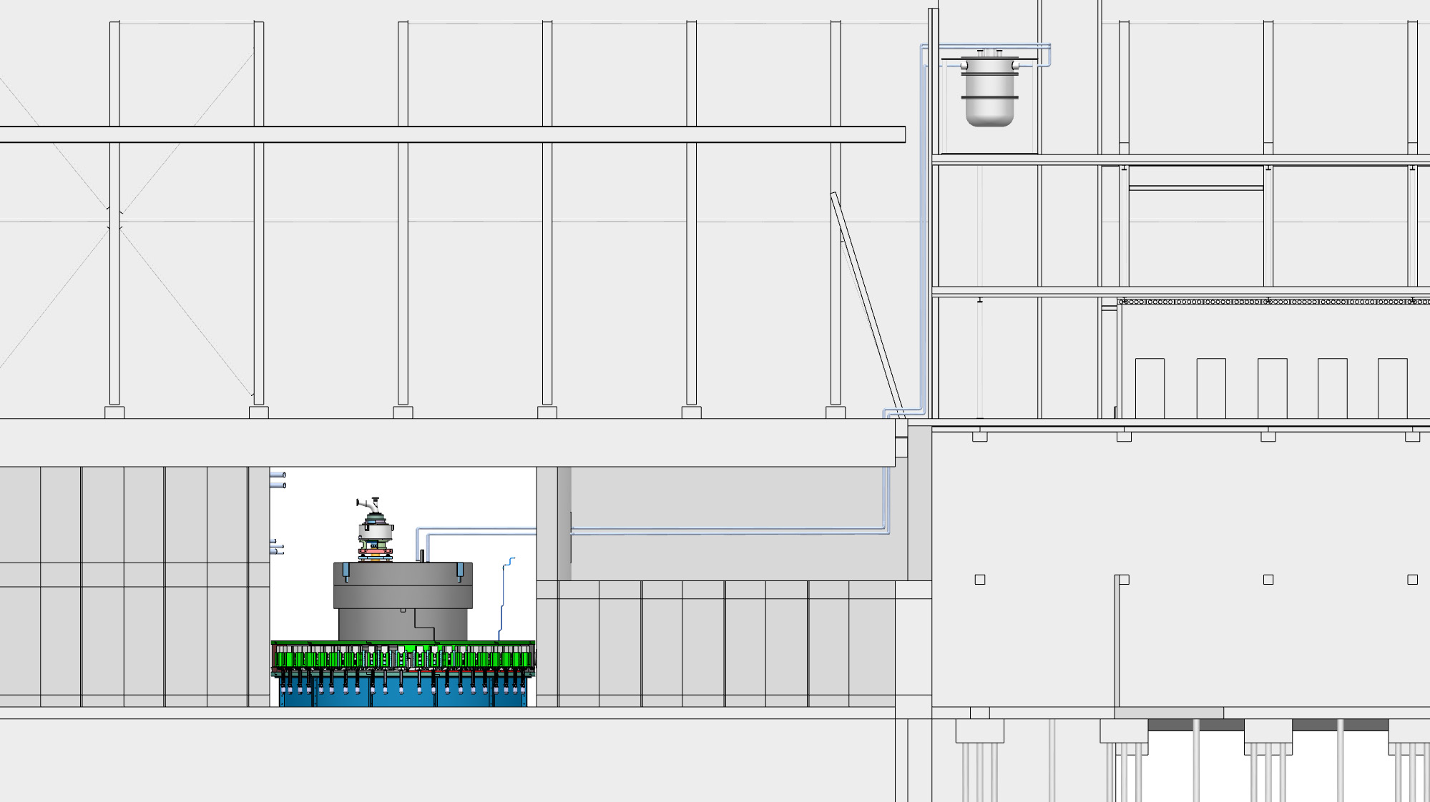
Cryogenic Cooling System Overview
Physical location of the hydrogen room
  H2 cold box room
  High Bay
  Target,
  Moderator plug
  Transfer lines ~40m

Slide 6
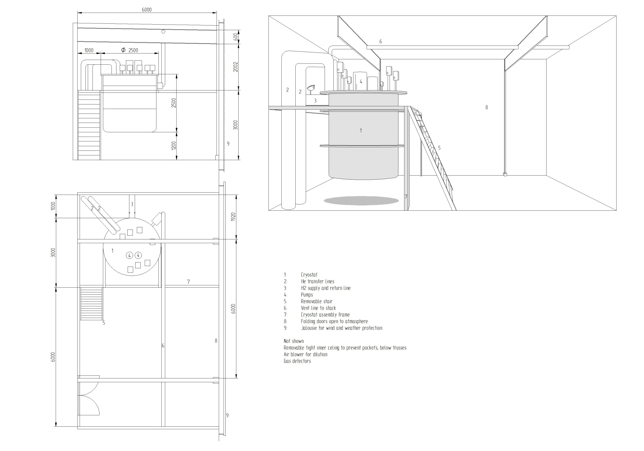
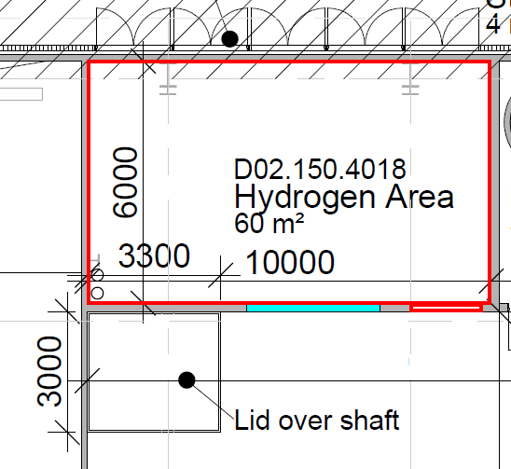
Cryogenic Cooling System Overview
Physical location of the hydrogen room

Slide 7
Cryogenic Cooling System Overview
Cryostat and maintenance
There is a cylindrical “shirt” welded to the top plate. This shirt carries e.g. inlet/outlet for He, hydrogen, Vacuum etc..
The cylindrical shell of the box is divided into two sections, each with a height of 1 m. This to be able to disassemble the cryostat while it is mounted in the frame work.
The box hangs in a structure, so that the top plate is at a height of 3,7 m above the floor level. Thus there is a free space of 1,3 m below the closed box. To open the box, first the lower section is lowered to the floor and moved to the side. Then the upper section is lowered and also moved to the side.

Slide 8
Cryogenic Cooling System Overview
Characteristics CMS
Operational parameters
Heat load – 3.5-28.8 kW
Operating pressure – 15 bar
Hydrogen mass flow – 1000 g/s
Hydrogen temperature (supply/return) – 17-20 K
OP converter >99.5% Parahydrogen
Characteristics TMCP
Operational parameters
Heat load – 3.5-30.3 kW
Operating pressure – 20 bar
Helium mass flow – 130-970 g/s
Helium temperature (supply/return) – 15-20 K

Slide 9
Cryogenic Cooling System Overview
Project status
CMS
Preliminary design review June 15, 2015. WP transferred to in-kind FZ Juelich:
CMS scope includes:
  Final design of the system
  Manufacturing of CMS
  Installation of all CMS, including interconnecting piping & cabling
  Controls
  Acceptance testing, training, documentation

Slide 10
Cryogenic Cooling System Overview
Project status
TMCP
Open Call for Tender issued early September 2015 to procure a 30 kW, 15 K cryoplant:
TMCP scope includes:
  30.3 kW, 15 K cryoplant complete
  33 kW H₂/He heat exchanger for CMS
  Vacuum jacketed CTL jumper spool for performance tests
  Installation of all TMCP, including interconnecting piping & cabling
  Controls
  Acceptance testing, commissioning, training, documentation
TMCP proposals due to ESS December 1, 2015
CTL
Drafted a request for budgetary estimate to procure, install, and checkout two 335 m, DN100 vacuum jacketed pipe assemblies (one supply, one return):
Received replies from five VJ piping fabricators. Average estimated cost 1,500 €/m
Finalize CTL routing, draft specification, and release OCT by 2Q2016

Slide 11
Thank you!

Slide 12
Cryogenic Moderator Systems
Process Parameters Overview
Heat load, Safety factor & operational margin development

Slide 13
Cryogenic Cooling System Overview
Physical location of the hydrogen room
Changed from inside High-bay to the top target floor.
Main reason safety.
New location has opening to outside atmosphere.
+
Explosion safety requirements and ATEX regualtions
-
Longer distance to moderator -> larger H2 inventory

Slide 14
Cryogenic Cooling System Overview
Characteristics
Operational parameters
Heat load – 3.5-30.3 kW
Operating pressure – 5-20 bar
Helium mass flow – 130-970 g/s
Helium temperature (supply/return) – 15-20 K
Configuration
Turbo-expander based helium refrigeration system
Cold box co-located with other ESS cold boxes in klystron gallery building
Warm compressor station co-located with other ESS warm compressor systems in separate compressor building
Warm helium gas storage in tank farm adjacent to compressor building
Utilities
  3.5 MW, 6.6 kV el power WCS; 60 kW, 400 V el power cold box & controls
  3 MW cooling water at 27 C

Slide 15
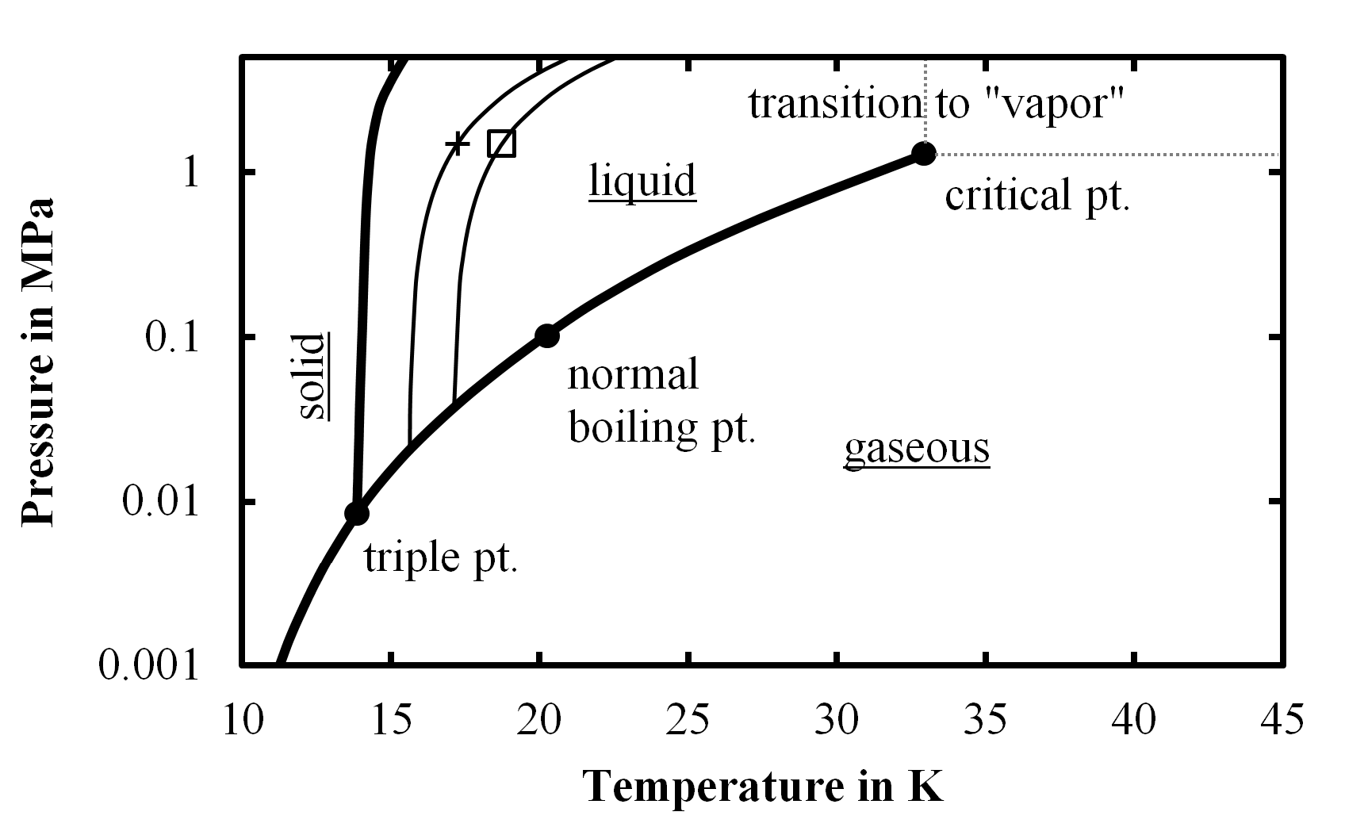
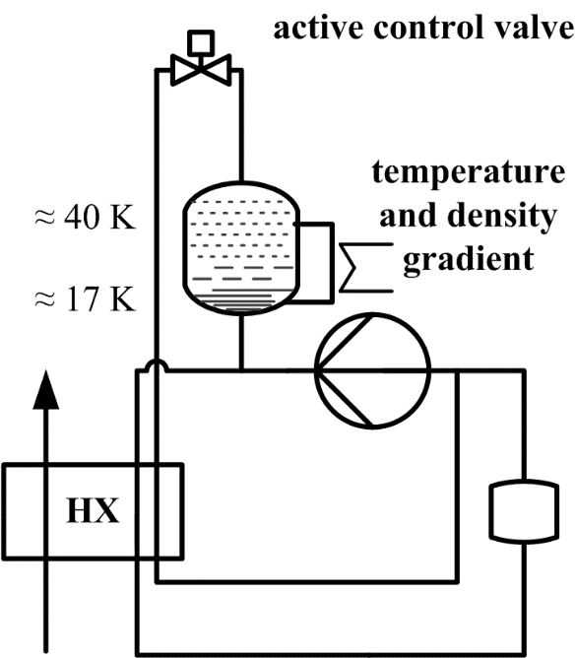
Cryogenic Cooling System Overview
Pressure Control System
Pressure Control System – Buffer Vessel
A vertical buffer vessel with an axial temperature and density gradient will store/release hydrogen mass of the main loop in case of beam increase/decrease.
Small mean temperature variations can cause severe pressure fluctuations
H₂ at < 20 K almost incompressible
H₂ at > 35 K becomes compressible
-> buffer mitigates pressure variations

Slide 16
TMCP & CMS Overview
Summary
The cryogenic heat load to the CMS and subsequently to the TMCP are characterized by a wide range of heat load, narrow range of operating conditions, and expected fast changes in heat load that the systems must respond to safely and efficiently
The unique operating requirements of the CMS and TMCP will require continuing efforts to coordinate the design of hardware and development of the operating scheme
The proposed configuration of the TMCP and CTL effectively addresses these challenges by providing a system that can:
  Operate efficiently over the entire range of operating conditions
  Respond quickly to changes in heat loads

Slide 17
TMCP & CMS Overview
Summary
The cryogenic heat load to the CMS and subsequently to the TMCP are characterized by a wide range of heat load, narrow range of operating conditions, and expected fast changes in heat load that the systems must respond to safely and efficiently
The unique operating requirements of the CMS and TMCP will require continuing efforts to coordinate the design of hardware and development of the operating scheme
The proposed configuration of the TMCP and CTL effectively addresses these challenges by providing a system that can:
  Operate efficiently over the entire range of operating conditions
  Respond quickly to changes in heat loads

Slide 18
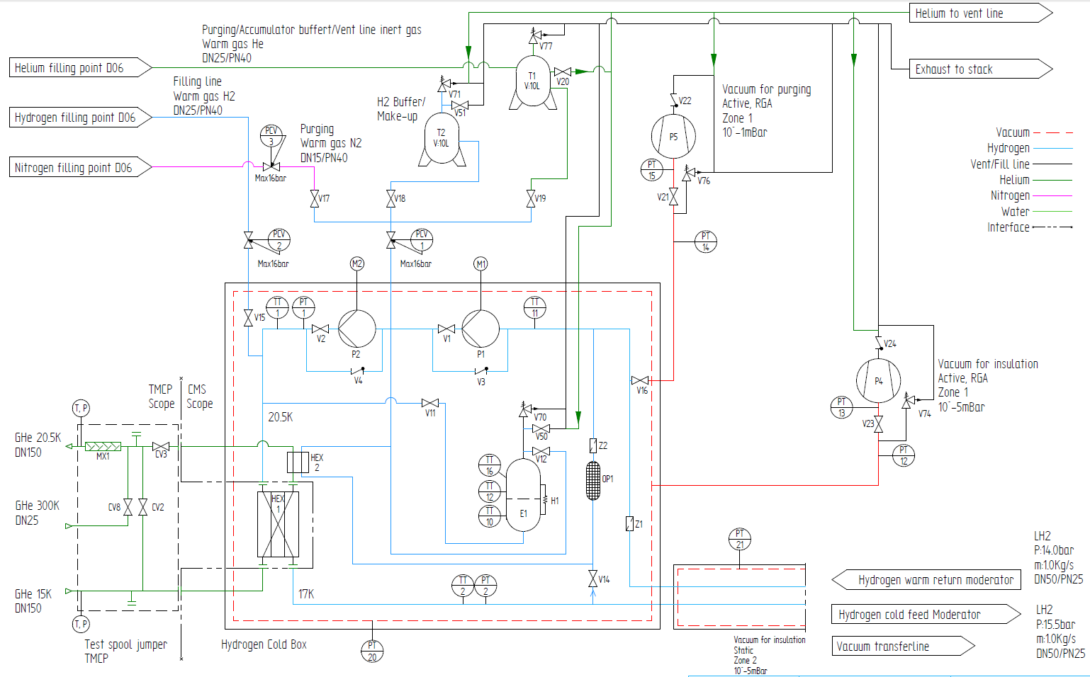
Cryogenic Cooling System Overview
P&ID

Slide 19
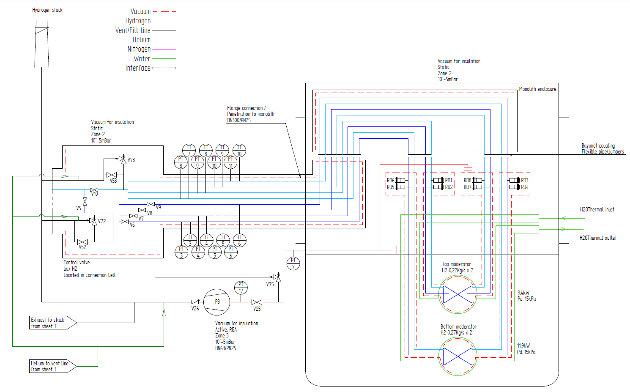
Cryogenic Cooling System Overview
P&ID

Slide 20
TMCP Process Design Description
TMCP
CTL
CMS
ESS

Slide 21
Cryogenic Cooling System Overview
Scope
The Target Moderator Cryoplant (TMCP) will provide the cooling for the CMS. The heat deposited into the H₂ is removed via a heat exchanger in the CMS cold box that transfers the heat from the H₂ circuit to a cold gas He circuit operating at approximately 15 K and 1.9 MPa, which is connected to the TMCP cold box.
Function
  Primary Functions
Remove heat from CMS hydrogen circuit
  Operational Functions
Circulate cold helium through Cryogenic Transfer Line (CTL)
Operate between maximum and minimum heat loads
Function efficiently under defined operational modes
Manage TMCP helium inventory

Slide 22
Requirements – TMCP capacity
TMCP capacity range
Start of operations (2019) to nominal capacity (2025)

Slide 23
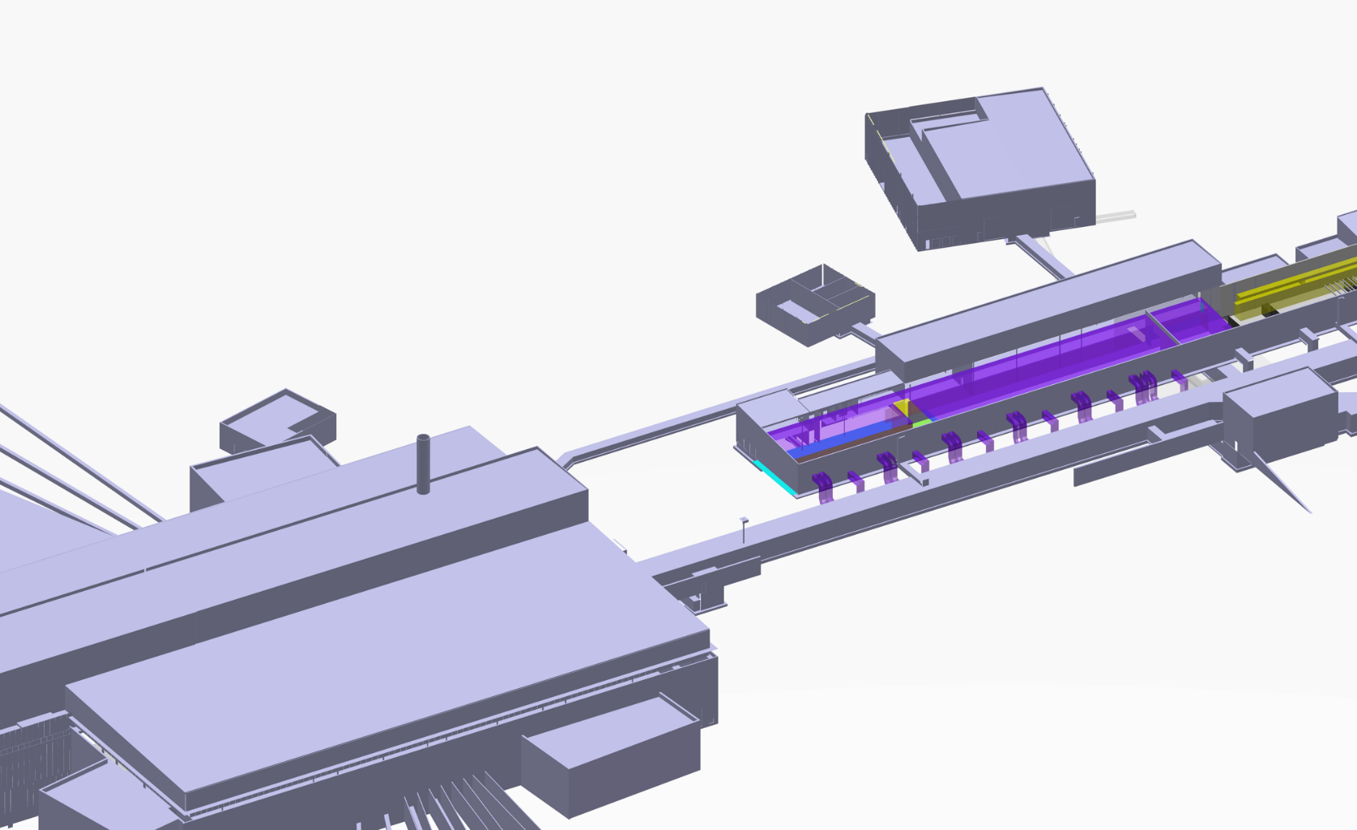
Cryogenic systems location overview
TMCP System Layout
Compressor building
Cryo transfer line tunnel
Connection to H₂ cold box in Target building
He cold box building

