Slide 1
WP 2 Target System
Ulf Odén
WPM Target System
www.europeanspallationsource.se
October 15, 2015

Slide 2
Outline
Highlights
Risks and issues
Concluding remarks

Slide 3
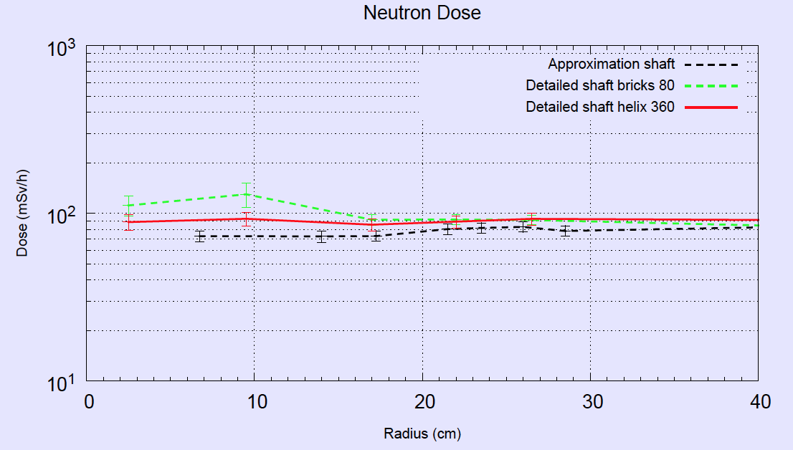
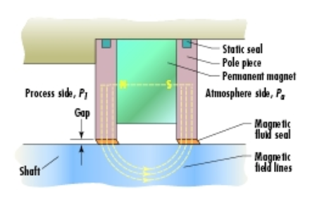
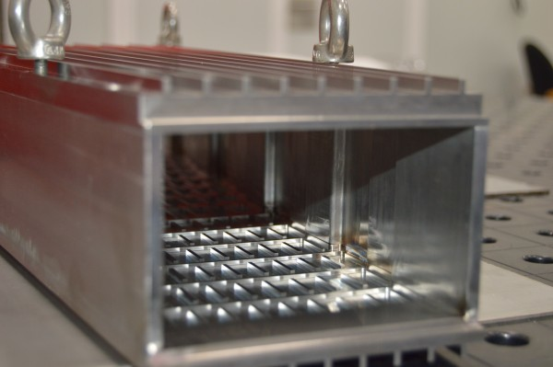
Highlights Target Wheel Drive & Shaft
New Design Requirements
- Vacuum
Ferrofluidic Seal
10² mSv/h
Shaft and Wheel Design
- Streaming paths
- Radiation levels
- Optimize pressure drop
- Distance to moderator
Brightness -4 to -5 %/cm
Moderator
Target
Moderator
Manufacturing tests
ICD
- Moderator tolerances
- Monolith - Target Wheel Suspension
- Active cells - spent wheel handling
Notes:
P+beam 5.2 MW -10% horizontal and vertical
Radiation level in connection cell ??
Pressure drop 0.9 -> 0.6 bar

Slide 4
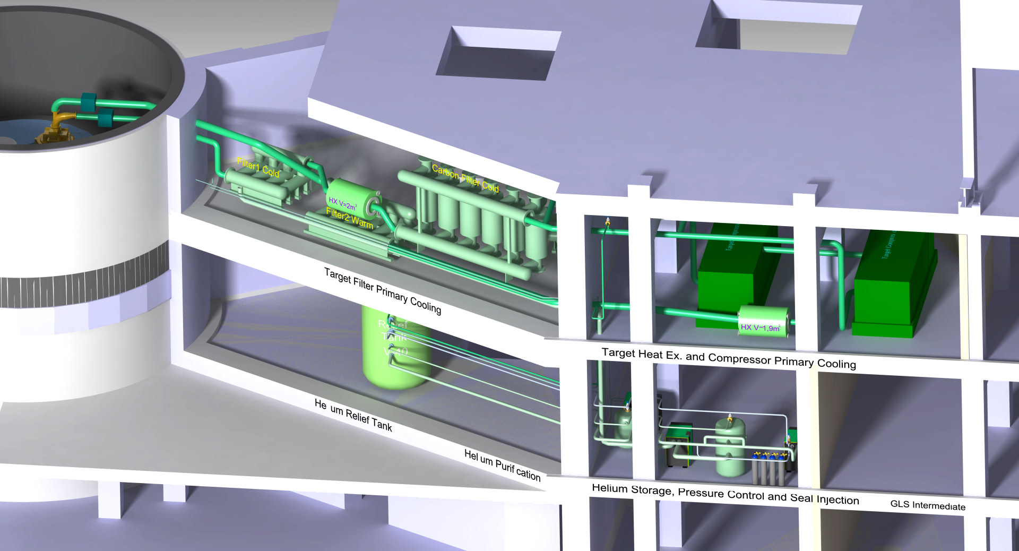
Highlights Target Helium Cooling System
Close to finalize:
Helium inventory calculation and Hazard analysis
Blower configuration
Filter configuration
In-Kind Partner

Slide 5
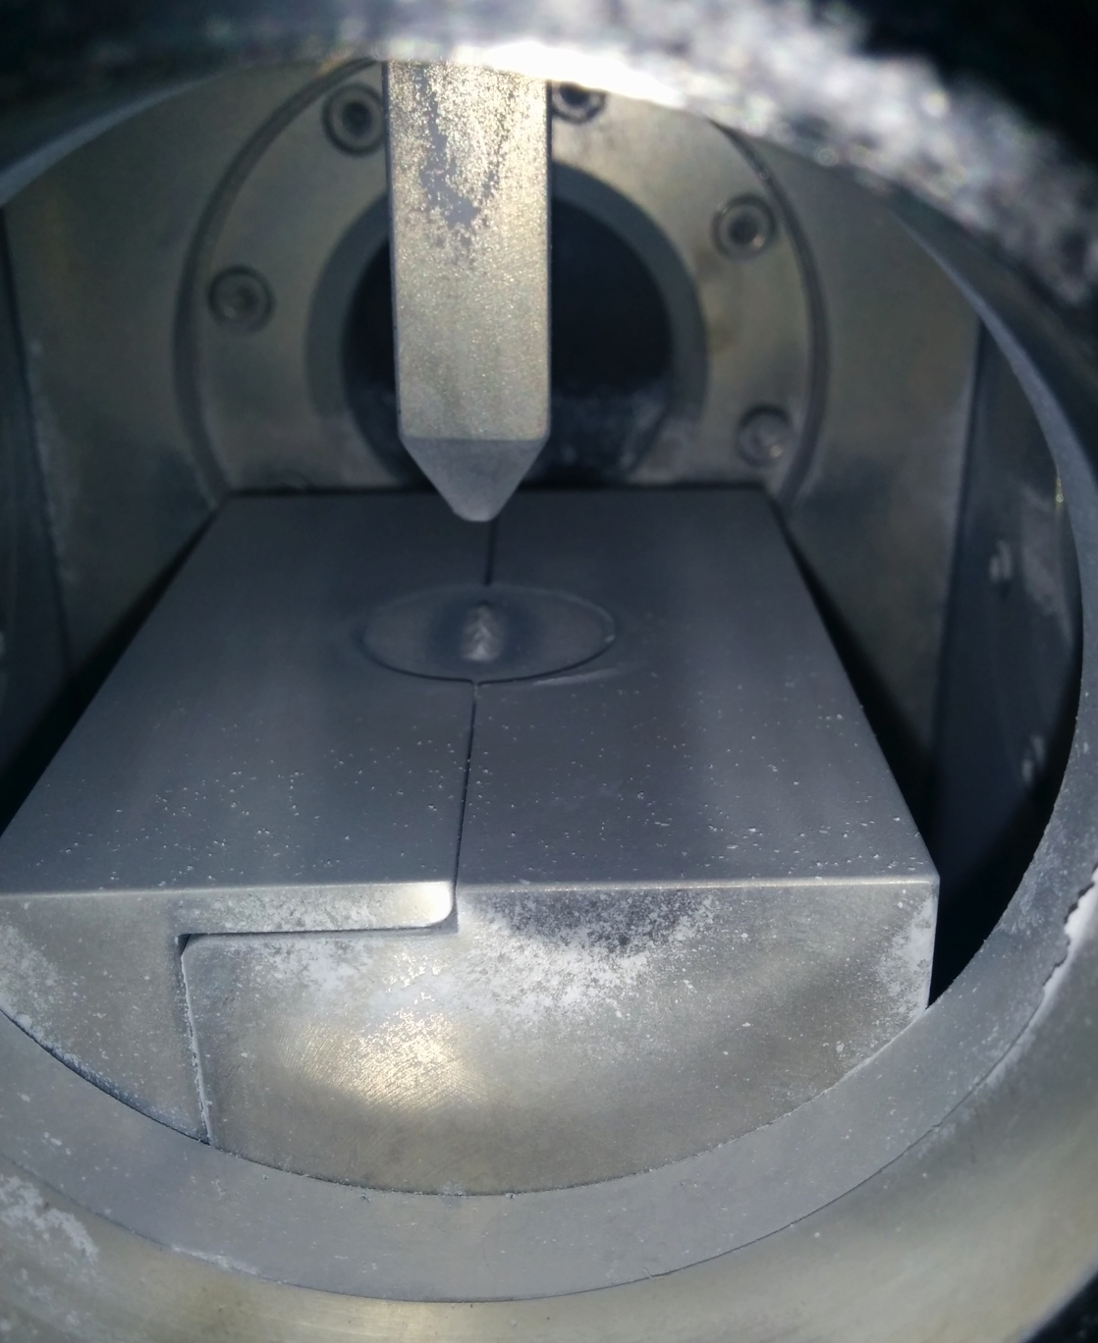
ETHEL
Assumption in the TDR:
“An ablation rate of 10 μm/y of all surfaces is a reasonable upper limit for target deterioration. This amounts to 0.07% of the target mass becoming dust per year, or roughly 3 kg/y to 4 kg/y.”
Is it possible to verify/change this assumption?
Preliminary results indicates that the erosion is much less. The results needs to be quantified.

Slide 6
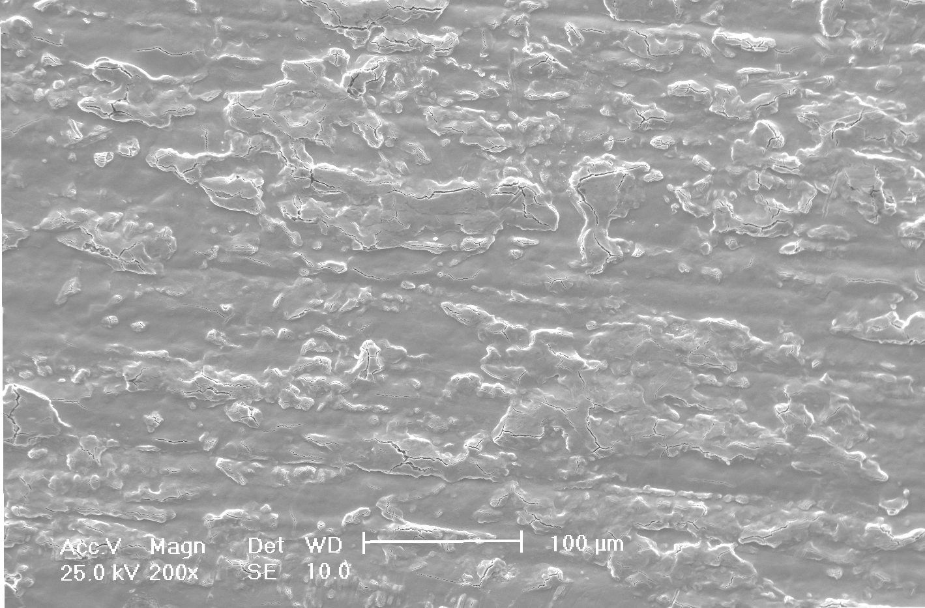
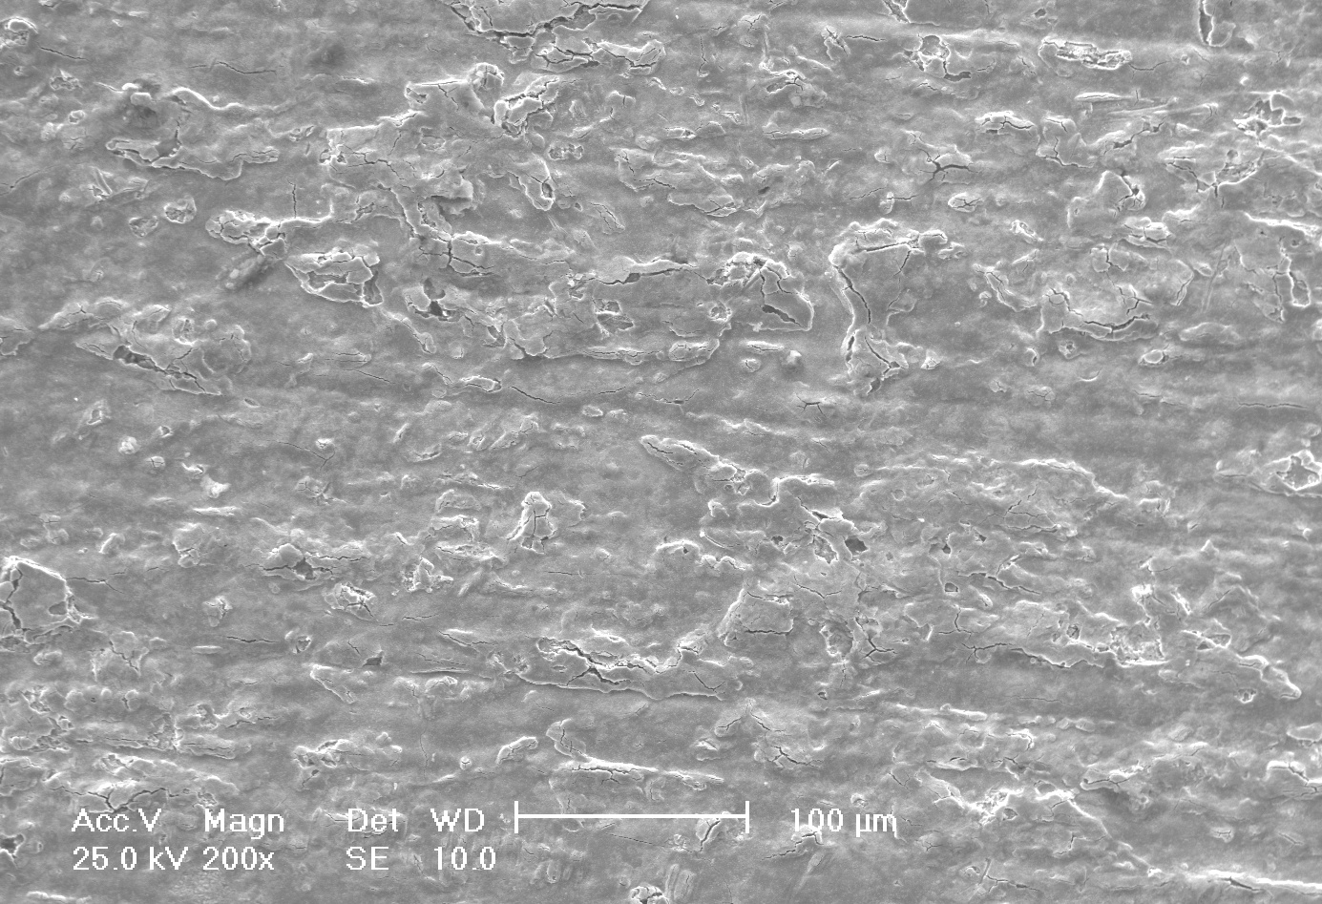
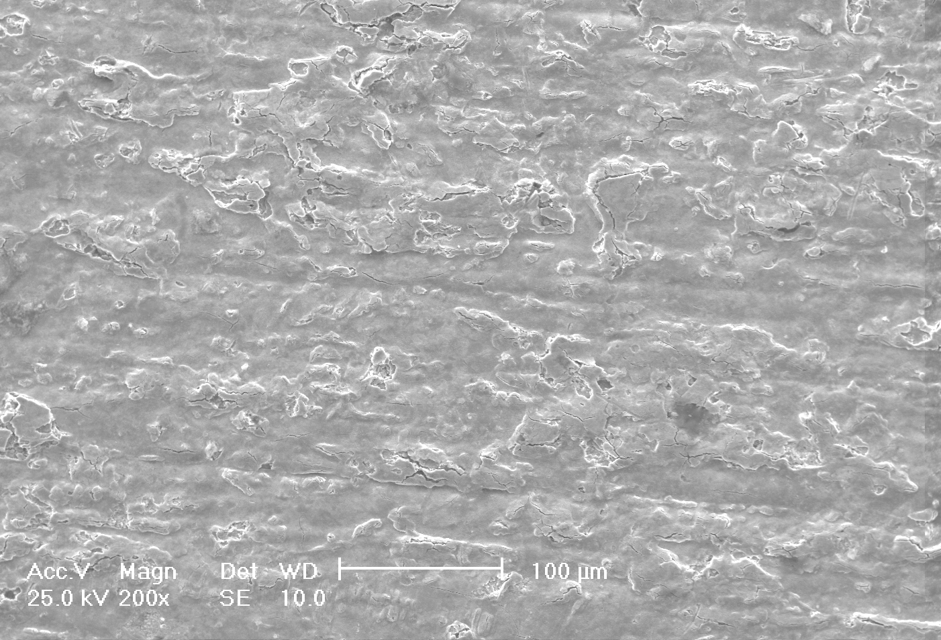
ETHEL test shows some oxide erosion in the first five hours, much less in next five hours
5h
10h

Slide 7
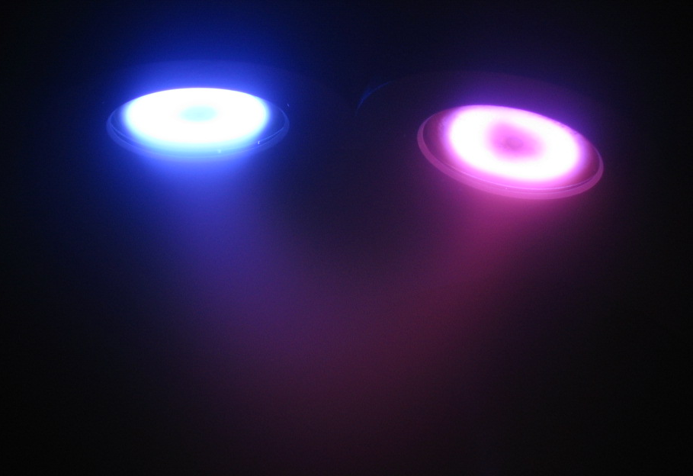
Coating of Tungsten
Coating possibilities is not critical to the current target design
Coating experiments on going
Prevent oxidation
High temperature damage to the coating layer
Results ready and analyzed at the end of this year
Al-Ti-N Oxidation Resistance Coatings

Slide 8
Risks and Issues Target Wheel Drive & Shaft
Manufacturing demonstrates shortcomings in design – Integrate supplier experience in design – Manufacturing tests
The Concept evolves during Final Design (He -> vacuum) - Close collaboration with In-Kind Partner
Safety Functions are not finally defined - Strongly emphasize to complete the inventory calculation and the accident analysis

Slide 9
Risks and Issues Target Helium Cooling System
Late In-Kind Partner to the project - Pre procurement activities started up
Blower concept fails (pressure drop too high, oil in helium can´t be handled) - Accurate calculations and confirmations from suppliers

Slide 10
Concluding Remarks
Evolved concept design (vacuum, radiation levels, manufacturable)
ETHEL experiment indicates a low level of erosion
W-coating decision by the end of this year
Beam on Target System in June 2019 -> possible

